Slide 1

Managing Differences &
6 Degrees of Integration
Equality & Diversity Introduction

Slide 2

Aims: Managing Differences & Six Degrees of Integration
Students should be able to:
Consider how we create and use stereotypes,
Be able to discuss how stereotypes negatively impact our social interactions,
Argue the case for how limited we are by social division while inspiring us to make a change.

Slide 3
Activity
What does diversity mean to you?

Slide 4
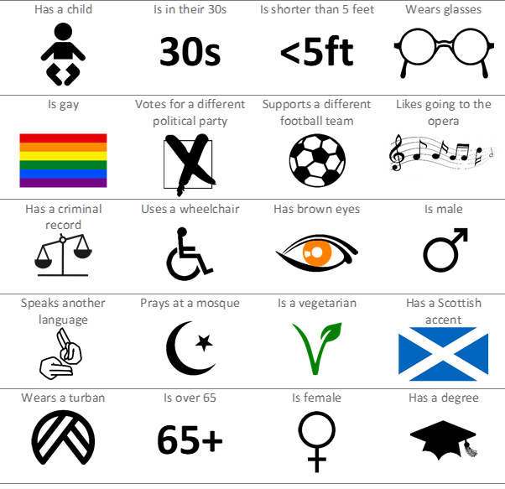
Do you know someone who:

Slide 5
What is Diversity and Equality?
There is no single agreed definition of Diversity or Equality
Equality = treating people fairly and equally.
Diversity = refers to recognising the differences between people and taking this into account when we relate to them.
Diversity is ‘otherness’ - (University of Maryland, 1995)
Diversity and Equality is about challenging responses:
  INSIDE the police organisation and….
  OUTSIDE in terms of service delivery to the public
Notes:
People with the same needs should be treated equally, regardless of their appearance, beliefs, age, background or lifestyle.

Slide 6
Other – ISM’s
Otherising happens by our brains making incredibly quick judgments and assessments of people and situations without us realising. Our ISMs are influenced by our background, culture and personal experiences.
(Oxford English Dictionary 2018)
Other
(Noun)
A person of a marginalised or excluded group or demographic within society.
Otherism
(Noun)
A conscious or unconscious bias that is formed through ignorance or conditioning that results in beliefs or actions that exclude individuals or groups deemed different or ‘other’.
Otherise
(Verb)
To exclude or facilitate the exclusion of an individual or group through action or inaction.

Slide 7
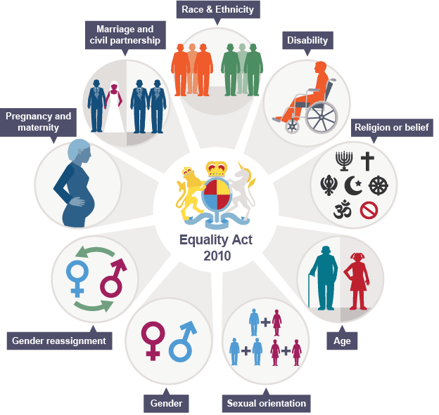

Slide 8
Stereotyping
NOUN
A widely held but fixed and oversimplified image or idea of a particular type of person or thing.
‘the stereotype of the woman as the carer’
‘sexual and racial stereotypes’
  A person or thing that conforms to a widely held but oversimplified image of the class or type to which they belong.
  ‘don't treat anyone as a stereotype’
  Oxford English Dictionary (2018)

Slide 9
Stereotyping continued.
We’re all individual but can be put into groups such as:
  White,
  Black,
  Students,
  Teachers,
  Old,
  Young etc.
This is not stereotyping.
When we start to apply traits and characteristics to these groups and then assume that everyone within these groups are the same, then we begin to stereotype people.
Notes:
This is done everyday and is powerful
Sometimes the stereotypes are based on some truths which are twisted and changed, sometimes they are even fabrications.
Our minds associate objects and appearances with a stereotype that can be used to judge someone by appearance.

Slide 10
The pain of positive stereotypes
In social psychology, a positive stereotype refers to a subjectively favourable belief held about a social group.
Common examples of positive stereotypes are Asians with better math ability, Black people with greater athletic ability, and women with being more warm and communal.

Slide 11
Stereotypes of all kinds lump an individual into a group. When you find a stereotype applied to you, it removes some of your individuality. That happens whether the stereotype used was positive or negative.
It is frustrating to realize that someone views you just as a member of a group and not as an individual. And in many situations, that leads you to dislike the person who made the comment.
Siy and Cheryan (2012)
Finally, it is suspected that there is an additional factor at play in these studies. When someone uses a positive stereotype to judge you, it is reasonable to assume that it is only a matter of time until they apply negative stereotypes as well.

Slide 12
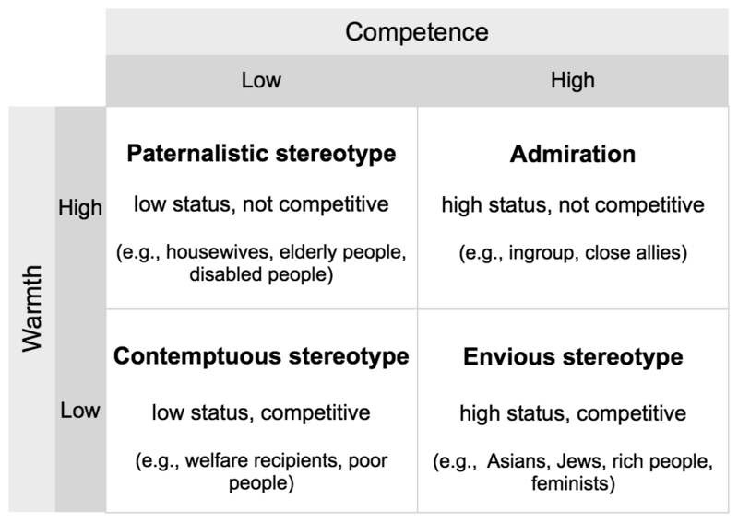
Fiske et al. (2002)
Notes:
Stereotype Content Model

Slide 13
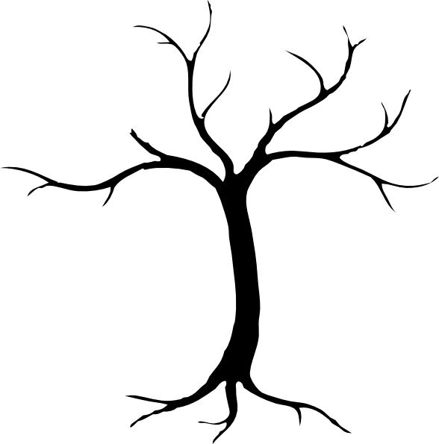
Attitude & Behaviour
Beliefs
Prejudice
Values
Leaves
Discrimination
Branches
Conscious decisions based upon values
Trunk
Family, Peers, Geography, Religion, Media etc.
Roots

Slide 14
Massey Theory: Imprint Period
0-7 yrs
Most Crucial Period
Phobias Formed
Absorb Info
West (2015)

Slide 15
Becoming Principled: Imprint Period
Pre-moral In the pre-moral state, we have no real values (we are thus 'amoral'). Young children are premoral. So also are psychopaths. Our basic nature tells us to be Machiavellian, doing whatever it takes to achieve our goals, even if it means hurting other people.
West (2015)

Slide 16
Massey Theory: Modelling Period
8-13 yrs
Behaviour of Friends
Emulate Heroes
Environment
West (2015)

Slide 17
Becoming Principled: Modelling Period
Conventional Most people have conventional values, as learned from their parents, teachers and peers. These basically say 'here are the rules to live in reasonable harmony with other people.' The bottom line of this state is that we will follow them just so long as we think we need to. We will break our values occasionally, and especially if our needs are threatened or we are pretty sure we can get away with breaking values with nobody else knowing about it.
West (2015)

Slide 18
Massey Theory: Socialization Period
14-21 yrs
Rebel Against Things
Social Values
Absorb Info
Develop Relationships
West (2015)

Slide 19
Becoming Principled: Socialization Period
Principled When we are truly principled, we believe in our values to the point where they are an integral and subconscious part of our person. Right and wrong are absolute things beyond the person, for example as defined by a religion. The test of a principled person is that they will stick to their values through thick and thin, and even will sacrifice themselves rather than break their principles. Many great leaders were principled (Martin Luther King, Gandhi, etc).
West (2015)
Notes:
If you can understand how people's values develop, then you can guide the process. This is well understood by dictators and religious sects around the world. Dictators regularly take over the education system and brainwash the children in their ideals. An old Jesuit saying is not that far off: 'Give me the child and I will give you the man.'
Being principled is a very powerful method of influence. But beware: this is a one way street -- it also means there are many things you cannot do.

Slide 20
Attitude & Behaviour
Beliefs
Prejudice
Values
Leaves
Discrimination
Branches
Conscious decisions based upon values
Trunk
Family, Peers, Geography, Religion, Media etc.
Roots

Slide 21
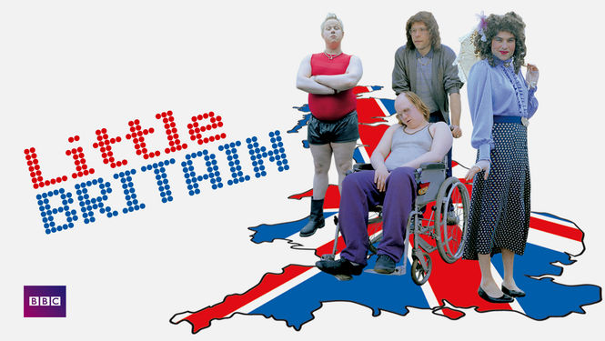
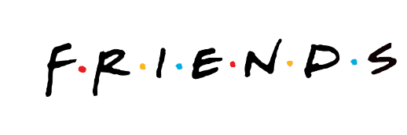
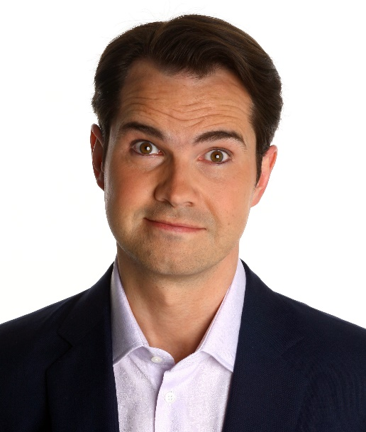


Pop Culture & Media influence

Slide 22


Notes:
A Thought provoking video…
How Would you feel if those headlines were about you?
I would classify those comments as hate speech and possibly a hate incident, due to then targeting particular people due to a specific part of their personal being

Slide 23
Paradigm of Prejudice and Discrimination
INTENTIONAL
Prejudiced Discriminator
Non-Prejudiced Discriminator
Prejudiced Non-Discriminator
Non-Prejudiced Non-Discriminator
UNINTENTIONAL

Slide 24
Activity
What influences our values and beliefs in the police service?

Slide 25
The nature of the job!?
Shift work – restricts social relations outside of the organisation- encourages enhanced solidarity and insularity (Cain, 1973).
Probationer training – until recently, prolonged period of training away from the wider community
Uncertainty of the everyday – officers become loyal to their group
Pressures to be loyal creates an atmosphere that makes it difficult to challenge behaviour
Nature of the job- fosters suspicion and cynicism, reinforcing stereotypes

Slide 26
Betaris Box
My Attitude
My Behaviour
Your Attitude
Your Behaviour
Affects
Affects
Affects
Affects

Slide 27
Break?

Slide 28
ISM Calculator
We are not all perfect, to end ISMs, we need to be conscious of it.
Challenge your ISMs!
Take the test:
https://ismcalculator.typeform.com/to/jaCahU

Slide 29
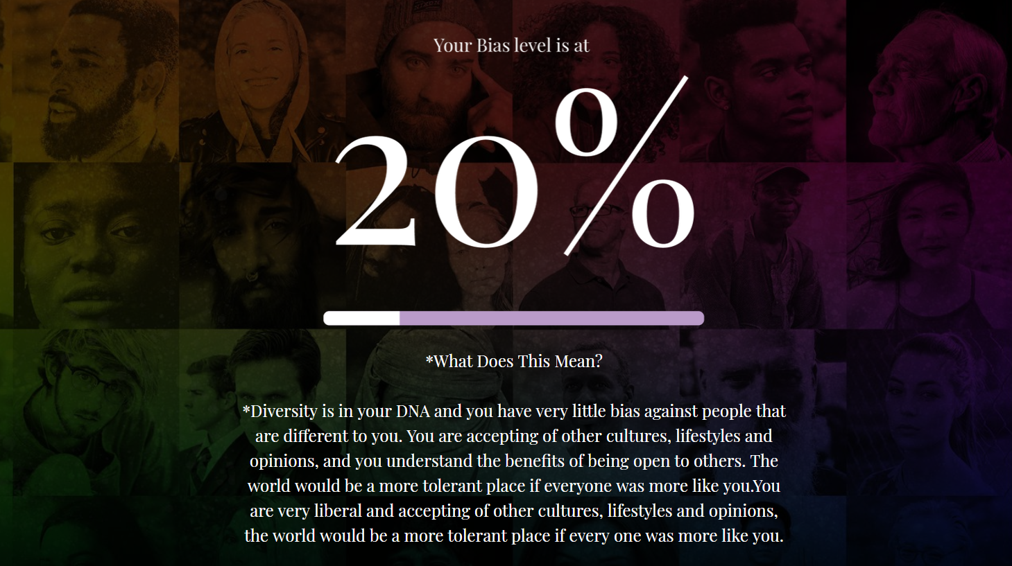

Slide 30
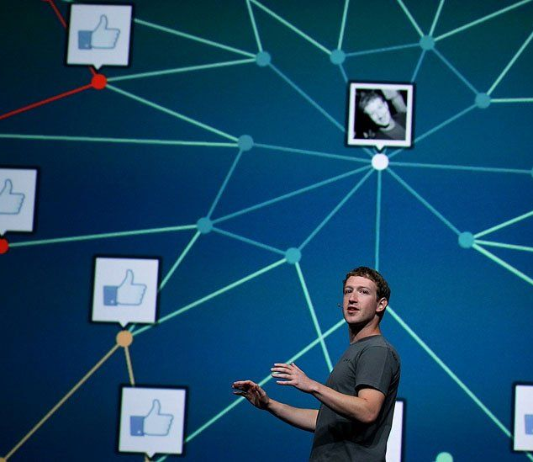
6 Degrees of Separation
“I read somewhere that everybody on this planet is separated by only six other people.
Six degrees of separation. Between us and everybody else on this planet. The president of the United States. A gondolier in Venice. Fill in the names. . .
How every person is a new door, opening up into other worlds. Six degrees of separation between me and everyone else on this planet. But to find the right six people . . .”
Guare (1990)
Notes:
You've heard of six degrees of separation? It's the theory that you and pretty much any random stranger can be linked through a chain of up to six social connections. Well, Facebook looked into this and claims that the number's a bit lower.
On average, people on Facebook are separated by 3.57 degrees, according to researchers at the social network. This means you could be connected to even the most distant stranger, hunched over a computer in some far corner of the world, by fewer than four people.
FB calculate that this is possibly more like 3.57 degrees of separation – we are all connected through 3 and a half people statistically.
One caveat about this research, though: It applies only to the 1.59 billion people who are active on Facebook. Given that there are more than 7 billion people on the planet, and that over four billion still lack regular access to the Internet, it's unlikely that the new theory holds for humans at large.

Slide 31
Separation vs Integration
Famously it is said that there are just ‘six degrees of separation’ between any two individuals on the planet – from a newborn child in the most isolated tribe of the Amazon to Queen Elizabeth II. Sadly misunderstanding and strife dominate our world and its politics, and there is now an urgent need for understanding and connection.
From Separation, to Connection, to Integration
The Six Degrees of Integration: are six steps or degree shifts in our behaviour patterns that will bring us closer to having a more diverse and integrated social circle. We need to transcend the six degrees of separation together and move us towards lives connected by six degrees of integration.
…Because the world is separate enough.

Slide 32
The 6 Degrees of Integration
2°
3°
4°
5°
6°
1 °
Check
Create
Change
Celebrate
Champion
Challenge
Sarpong (2017)
Notes:
Get a piece of paper and write two column headings:
Challenge & Check

Slide 33
CHALLENGE your Ism?
2°
3°
4°
5°
6°
1 °
We all have so many “isms” that keep us apart, isms that are buried so deeply within us, that we are unaware of them and their ramifications on ourselves and others:
  Racism, sexism, ageism, elitism, (the list is endless).
It may be uncomfortable but create an honest inventory of your limiting beliefs, you don’t need to show it to anyone but being truthful with yourself is the first step to change.

Slide 34
CHECK your Circle
2°
3°
4°
5°
6°
1 °
If you really want to know what your beliefs are, have a look at your close social circle and whom you choose to:
  Befriend, hire and even love.
That will tell you everything that you need to know, especially if you live in a location that would allow for more diversity in your life.

Slide 35
CREATE a new connection
2°
3°
4°
5°
6°
1 °
Reach out and connect with someone you ordinarily wouldn’t connect with, examine the views you have about this new connection, are you comfortable? Do you feel superior or inferior?

Slide 36
CHANGE your mind
2°
3°
4°
5°
6°
1 °
Actively change whatever beliefs prevent you from seeing yourself in the “other” and your fellow human being as an equal.

Slide 37
CELEBRATE Similarity & Difference
2°
3°
4°
5°
6°
1 °
Do not only get comfortable with diversity but celebrate difference, whilst also remembering what unites us and all that we have in common.

Slide 38
CHAMPION the cause
2°
3°
4°
5°
6°
1 °
In the words of TED “ideas worth spreading”, pass the message on, collective change begins with other individuals influencing other individuals.

Slide 39
Rawls on Justice
What if we had to design our own society without factoring in our own perspectives based on gender, race, ethnicity, intelligence, interests etc … How would you approach this design challenge?
Would you try to favour some over others? (Remember we know nothing about our own personal circumstances and therefore would have no idea about where we would sit in this society)

Slide 40
References
Crown Copyright (2010), Equality Act, The Stationery Office (Her Majesty’s Stationery Office); London.
Fiske S T, Cuddy A J C, Glick P, and Xu J (2002), A model of (often mixed) stereotype content: Competence and warmth respectively follow from perceived status and competition, Journal of Personality and Social Psychology, Volume 82 Issue 6, Pages 878–902
Govt. Equalities Office (2011) Equality Act 2010: Public Sector Equality Duty. What Do I Need To Know? A quick Start Guide For Public Sector Organisation (Online) Available at www.gov.uk/government/uploads/system/uploads/attachment_data/file/85041/equality-duty.pdf Accessed on 20/8/18
Guare, J (2010), Six Degrees of Separation, A & C Black Publishers; London.
HQ Stories (2017), June Sarpong - Diversify: Six Degrees Of Integration (Online) Available at https://www.youtube.com/watch?v=A4g7WUATtiE Accessed 18th September 2018.
Loftus, B. (2010) ‘Police occupational culture: classic themes, altered times’, Policing and Society, Volume 20, Pages 1-20.
Manning, P. (1989), 'Occupational Culture'. In: Bailey, W.G. (ed.) ‘The Encyclopaedia of Police Science’, Garland; London.
Oxford English Dictionary (2018), Oxford English Dictionary, Oxford University Press; Oxford.
Sarpong, J (2017), Diversify, Harper Collins; London.
Siy and Cheryan (2012), When Compliments Fail to Flatter: American Individualism and Responses to Positive Stereotypes, Journal of Personality and Social Psychology, Volume 104 Issue 1, Pages 87–102.
West L (2015), Coaching with Values; How to put values at the heart of your coaching to make a lasting difference, Author House; Indiana, USA.
Williams, C (2016), Facebook just smashed ‘six degrees of separation’ to bits (Online) Available at https://www.huffingtonpost.co.uk/entry/facebook-six-degrees-of-separation_us_56b36408e4b01d80b2453a72 Accessed 20th September 2018.

Slide 41

Any Questions?
C.Newton-Evans@UWTSD.ac.uk

