Slide 1
Explainable AI in Healthcare Diagnostic Systems
Module: Research Methods and Professional Development
Module code: ACFA7004
Lecturer: Mohamed Ben Farah
Assignment Title: Presentation
Presentation by;
Student name: Sravanthi Sangam
Student ID number: 2536458

Slide 2
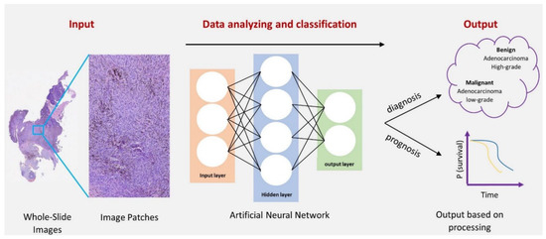
Research Context and Background
Deep Neural Networks are rapidly integrating into clinical diagnostic environments to automate complex analytical tasks [1].
In radiology these systems actively assist in analyzing chest X-rays, CT images and MRI scans.
AI networks are used in pathology for streamlining the classification of digital whole-slide tissue biopsies.
Emerging diagnostic systems also leverage multi-modal data for precision cardiotoxicity forecasting [2].
Primary clinical goal of utilizing deep neural networks is to accelerate emergency patient triage loops and minimize diagnostic turnaround times.
These tools reduce clinician cognitive fatigue by serving as an objective and reliable double-check.
Fig 1: Application of Deep learning in medicine

Slide 3
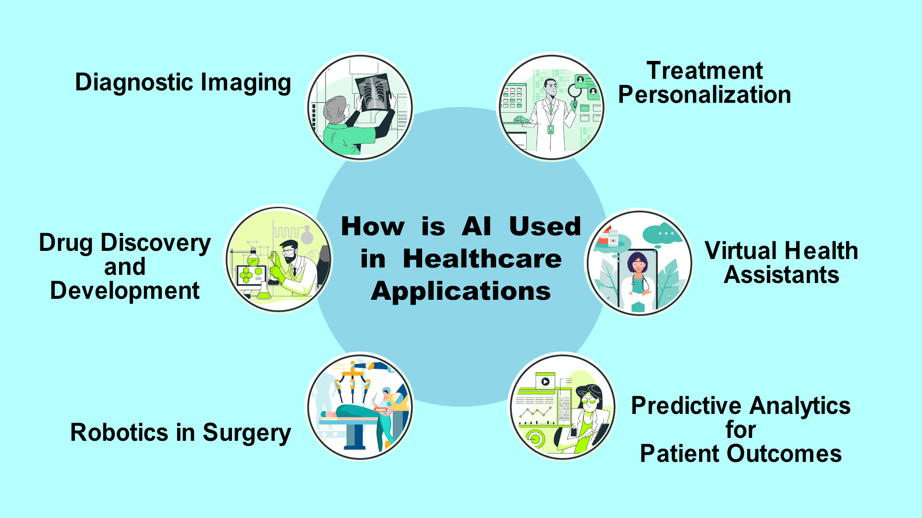
Literature Review
Clinical AI has entered a phase of rapid evolution, moving away from rigid and manually encoded expert diagnostic systems [3].
Contemporary healthcare deployments favor highly fluid and deep learning diagnostic architectures.
A stark trade-off persists in literature between high-accuracy "black-box" models and simpler, lower-accuracy linear structures [4].
Deep architectures achieve superior pattern recognition but naturally limit a user's ability to trace internal reasoning paths [1].
International bodies are counteracting this opacity by building strict and protective regulatory standards.
The WHO Ethical Guidance frameworks mandate keeping fundamental human rights at the absolute center of digital health.
Joint FDA transparency principles demand clear communication regarding data inputs, performance limits and device logic.
Effective clinical implementation now relies directly on equipping users to critically assess algorithmic outputs at the point of care.
Fig 2: Clinical AI applications

Slide 4
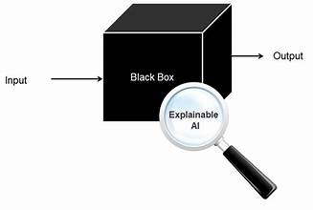
The Identified Literature Gap & Research Problem
  The Research Problem: The opaque "Black Box" nature of high-performing models creates severe clinical accountability, liability and safety risks.
  The Literature Gap: Current XAI methods prioritize mathematical neatness or visual plausibility over real-world clinical utility and workflow fit.
The current critical research gap
Algorithmic Metrics | Clinical Utility Metrics
- Spatial/Pixel Heatmaps | - Actual Clinician Trust
- Mathematical Neatness | - Cognitive Load Changes
- Plausible Output | - Error Verification Fit
Fig 3: Blackbox models illustration with XAI integration

Slide 5
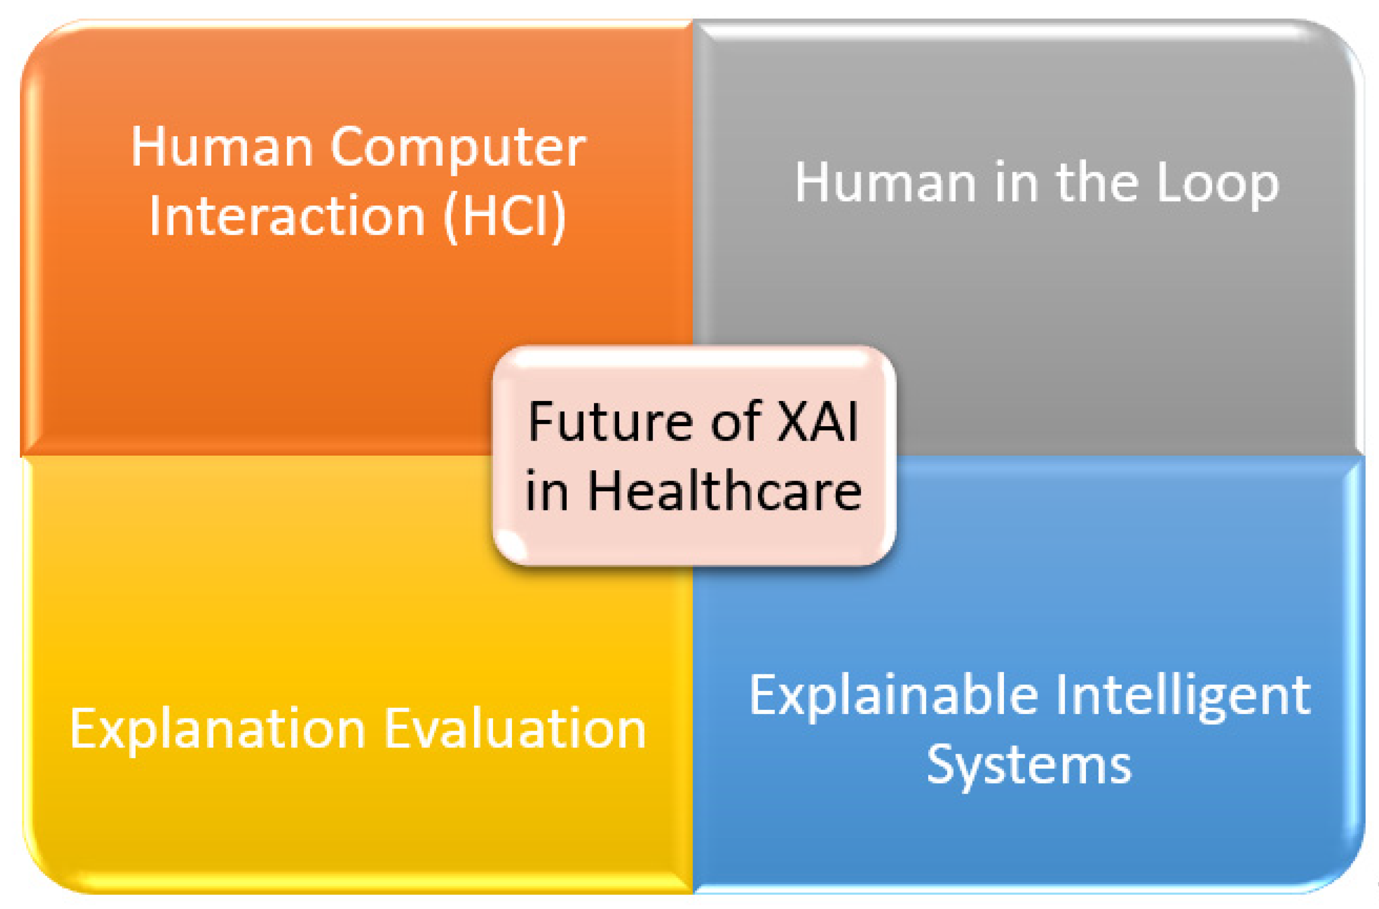
Research Aim and Objectives
Research Aim: To develop and comprehensively evaluate an explainable and human-centered diagnostic framework that balances algorithmic accuracy with interpretable features to support safe clinical decision-making.
Smart Research Objectives
To clean and preprocess multi-institutional chest radiography data arrays by month 2.
To train an ensemble convolutional architecture for pulmonary anomaly detection by month 5.
To integrate post-hoc feature attribution layers (Grad-CAM and SHAP) onto the network by month 7.
To quantify cognitive fit and clinician validation performance using standardized human-centered metrics by month 10.
Fig 4: Future of XAI in healthcare

Slide 6
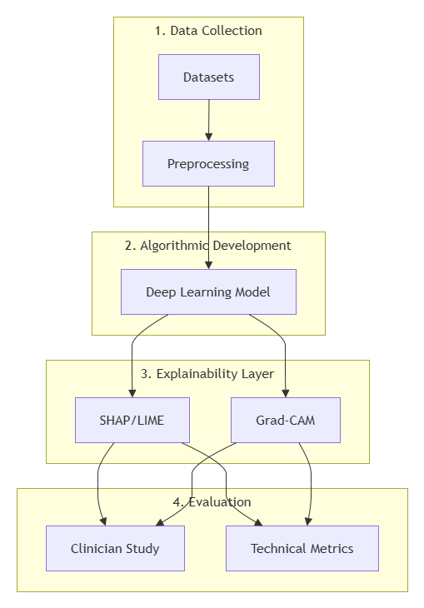
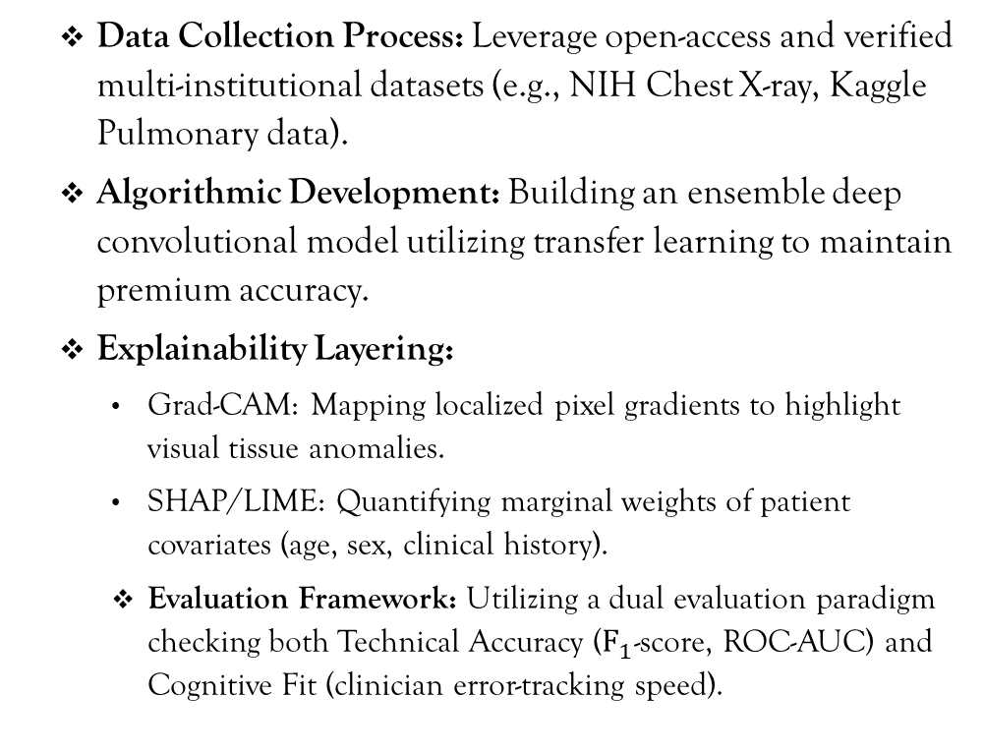
Research Methodology
  Data Collection Process: Leverage open-access and verified multi-institutional datasets (e.g., NIH Chest X-ray, Kaggle Pulmonary data).
  Algorithmic Development: Building an ensemble deep convolutional model utilizing transfer learning to maintain premium accuracy.
  Explainability Layering:
    Grad-CAM: Mapping localized pixel gradients to highlight visual tissue anomalies.
    SHAP/LIME: Quantifying marginal weights of patient covariates (age, sex, clinical history).
    Evaluation Framework: Utilizing a dual evaluation paradigm checking both Technical Accuracy ($F_{1}$-score, ROC-AUC) and Cognitive Fit (clinician error-tracking speed).
Fig 5: Methodology Workflow

Slide 7
Project Planning and Resources
Phase Task | Timeline | Crucial Resources Required
P1: Data Ingestion & Preprocessing | Weeks 1–3 | Multi-source open radiography databases, Python
P2: Model Training & Ensemble Build | Weeks 4–6 | High-Compute GPU Cloud (AWS EC2 / local cluster)
P3: XAI Layering & Interface Build | Weeks 7–8 | Grad-CAM, SHAP, and Streamlit dashboard libraries
P4: Live System Demonstration & Audit | Weeks 9–10 | Interactive Web UI Prototype, Simulated Patient Scan logs

Slide 8
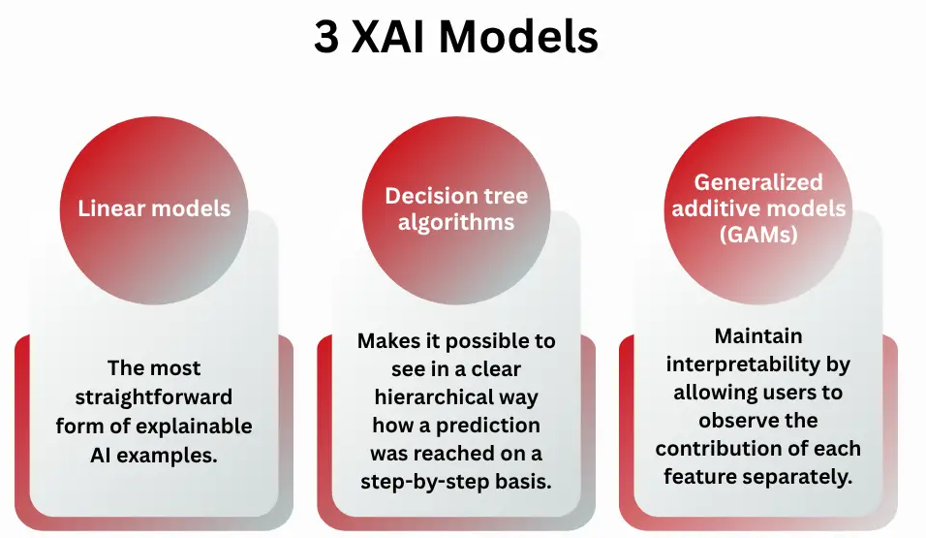
Project Impact and Limitations
Potential Project Impacts
Proposed framework directly aligns advanced diagnostic software with emerging regulatory guidelines like the EU AI Act.
Visual and tabular explanations significantly lower institutional risk under modern clinical governance standards.
Exposing structural model blind spots helps eliminate diagnostic errors driven by dangerous shortcut learning.
Providing clear and actionable rationale inherently cultivates stronger clinician confidence in digital assistants.
Transparent diagnostic processing models ultimately improve patient safety outcomes at the point of care.
Project Limitations
Real-time extraction of ensemble feature attributions demands exceptionally high computational resource allocations.
Generated explanations remain local to individual cases and lack universal baseline transferability.
Post-hoc visualization outputs exhibit sensitive variability when exposed to noisy and uncurated real-world clinical data.
Fig 6: Types of XAI Models

Slide 9
Conclusion
Advanced machine learning provides remarkable power to improve clinical diagnostics but remains bottlenecked by black-box opacity.
Explainable AI bridges the identified critical operational gap by transforming uninterpretable models into transparent systems.
This research proposal will address a clear literature gap by focusing directly on human factors and real-world clinical utility.
Proposed dual-evaluation framework will ensure that algorithmic accuracy balances safely with human cognitive fit.
Developing verifiable and interactive dashboards will empower medical professionals to audit automated diagnostic outcomes confidently.
True progress in healthcare computing relies on building deep and accountable collaboration between human expertise and machine intelligence.

Slide 10
References
[1] Md. A. B. Shiddik, “Explainable Artificial Intelligence in Healthcare: Current Landscape, Challenges, and Future Directions,” Health Science Reports, vol. 9, no. 3, Mar. 2026, doi: https://doi.org/10.1002/hsr2.72172.
[2] S. Wu et al., “CardioAI: A Multimodal AI-based System to Support Symptom Monitoring and Risk Prediction of Cancer Treatment-Induced Cardiotoxicity,” PubMed, pp. 1–22, Apr. 2025, doi: https://doi.org/10.1145/3706598.3714272.
[3] [1]U. Nations, “Marine litter, an analytical overview,” Unep.org, vol. 2, no. 1, 2022, doi: https://doi.org/N/A.
[4] A. Nicosia, N. Cancilla, J. D. Martín Guerrero, I. Tinnirello, and A. Cipollina, “Artificial Intelligence in Nephrology: From Early Detection to Clinical Management of Kidney Diseases,” Bioengineering, vol. 12, no. 10, p. 1069, Oct. 2025, doi: https://doi.org/10.3390/bioengineering12101069.
[5] WHO, “ETHICS AND GOVERNANCE OF ARTIFICIAL INTELLIGENCE FOR HEALTH ETHICS AND GOVERNANCE OF ARTIFICIAL INTELLIGENCE FOR HEALTH,” 2021. Available: https://iris.who.int/bitstream/handle/10665/341996/9789240029200-eng.pdf

Slide 11
Thank You!

