Slide 1
Introduction
This presentation will review the risks and success of Ironman wales 2017 on social media, this will also include examples and images of that ironman included on the social media during the event.
Notes:
This presentation will review the risks and success of Ironman wales 2017 on social media. And will also include examples and images of the different type of promotional media that the Ironman use for the event.

Slide 2
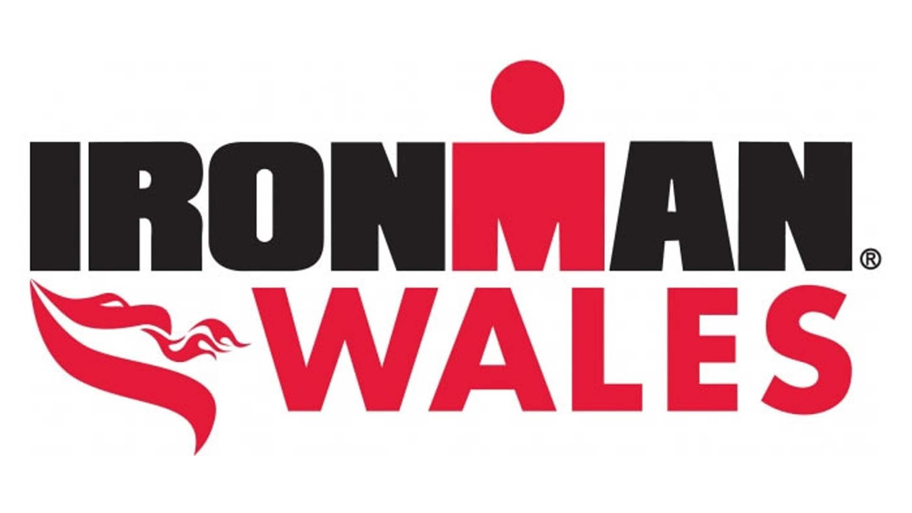
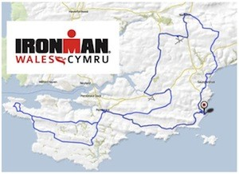
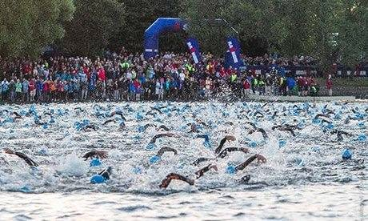
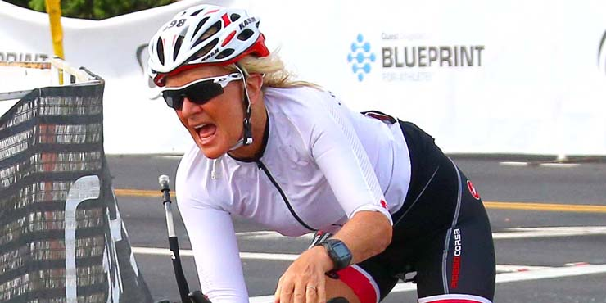
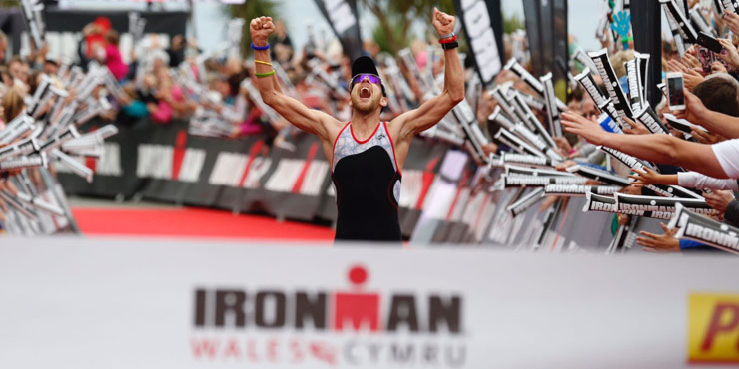
About Ironman Wales
Swim 2.4 mile
Bike 112 mile
Run 26.2 mile
Notes:
According to (Wales Online, 2017) Ironman wales takes place in the seaside resort of Tenby in Pembrokeshire the event gets bigger and better every year in 2017 nearly 2,000 athletes from 45 countries have been taking part. The sport event start with a 2.4 mile swim that takes about 50 minutes, and then following by 112 mile bike ride around the city finally they have the marathon to run for 26.2 miles that end in the seaside town.

Slide 3
Social media
Notes:
Social media is a website that allows social interaction and it is growing rapidly throughout the world. According to (George Veletsianos, 2016) social media and social networking sites have become so much more than just a way to connect friends, they serve to connect people to ideas, journalists to breaking news, businesses to customers, politician to citizens, employers to jobs, consumers to advertisers, students to teachers and the global to the local. It is because of the far reaching and increasingly expanding influence of social media.

Slide 4
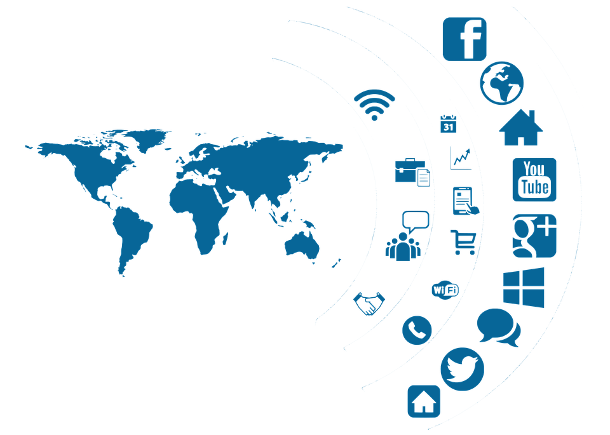
Social media coverage
22 TV channel coverage
BBC news
Channel 4
BBC Radio
Sport news
Wales online
TRI247
Ironman wales page
Notes:
Sport event are becoming increasingly globalised and commercialised and attracting greater media attention than ever. According to (Ironman, 2017) On 9 September 2017 around 10,000 spectators attend to the Ironman Wales event in Tenby, and millions of people has been engaged through digital and social media. The ironman wales event use social media to update people because social media is the best way to engage with supporters because it links in with television, radio and written press, these can all be accessed through the internet which is what makes it better way to engaged with the ironman supporters and it is other way to get more supporters for the event.
Ironman wales has got 22 TV channel coverage for example BBC news, channel 4, BBC radio, sport news, wales online, TRI247. And they have multi million viewers from UK and Worldwide. Reputation of the ironman wales event grows very fast the event has got huge followers all over social media brand on Facebook t 21, 276k followers, on Instagram 336.6k, on YouTube 21k subscribers, on twitter 7118k followers.

Slide 5
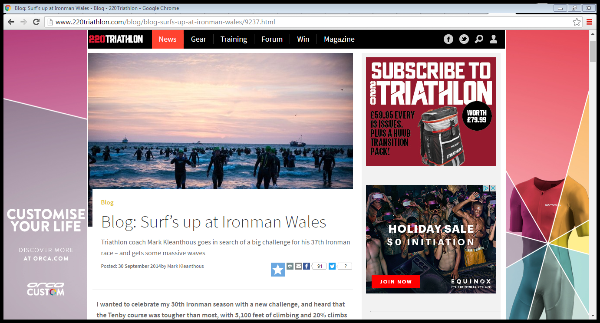
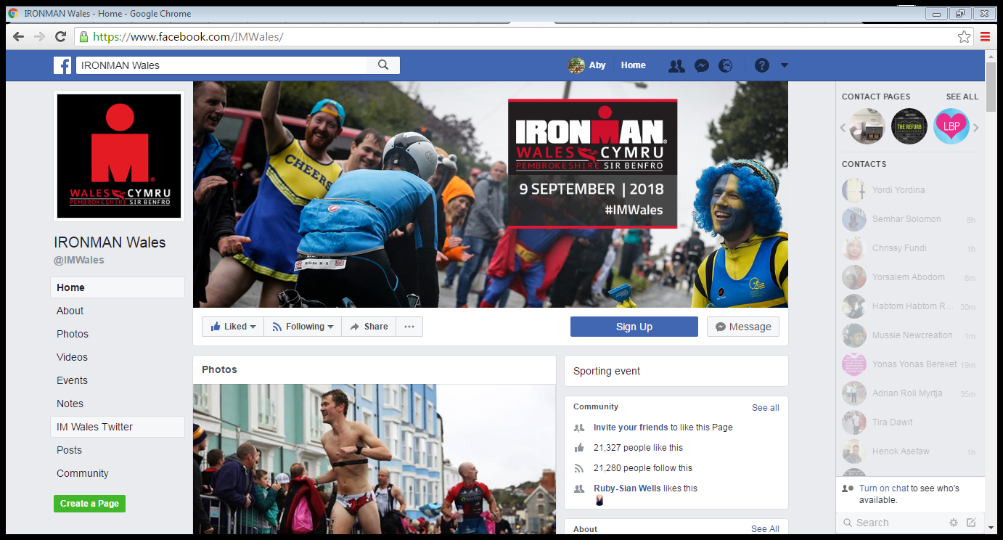
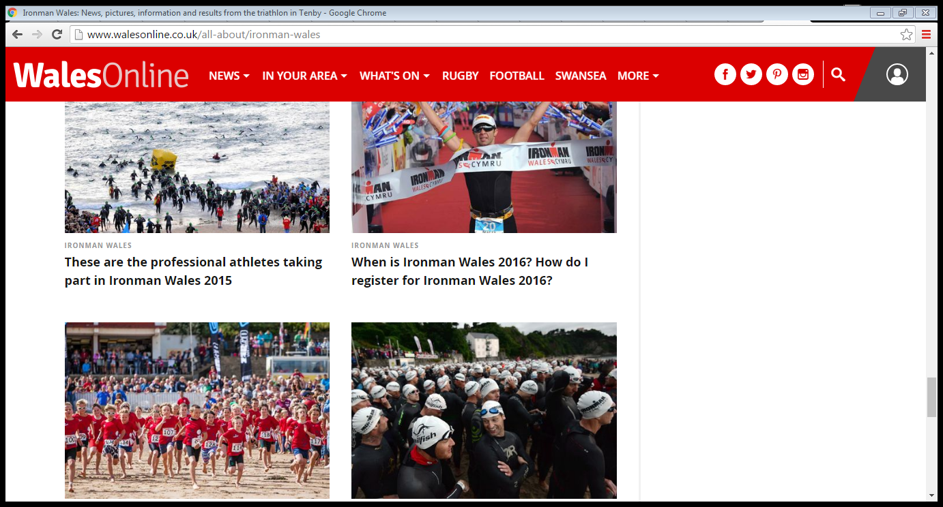
Blog
Notes:
Ironman wales event use social media to engage with public and the event has been advertising all over social media this clearly portrays both positive and negative impact on the event. The positive impact are,

Slide 6
Social media followers

Slide 7
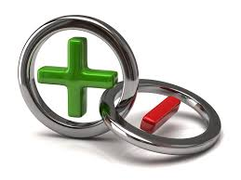
Risk and success of social media for ironman wales event

Slide 8
success
Risk
Information
Advertising
Marketing
Feedback
Stay connected and updated
Motivation
Promoting
Communication
Fane engagement
Terrorism
Easy access
Negative comments
Overcrowded
Facility ran out
Notes:
Social networking has already completely change the way people interact in the world, but also it is advancing more to make it easier to access. Now social networking is becoming mobile and can be accessed through the use of call phone. It is thought to be a great idea and would increase the use of social networking since a lot of carry cell phone with them at all time.
Social media makes events to stand out in order to reach potential attendees. The event has attracted many of the world’s best athletes and celebrities in recent year they taking part on the marathon which would inspire more people to join I the ironman event and have more views as the is very well known face participating. Celebrities such as Gordon Ramsey, Jan Frodeno, Faris AL-Sultan, Leanda Cave, Sebastian Kienle and Andreas Raelert.
Social media is the perfect way to spread information in a very short time, it helps to engage with the people who like to attend the ironman wales event. As the supporters use social media site such as Facebook, LinkedIn, and Twitter they will most likely talk about the event in advance, during the event and after the event on these social sites.
Ironman use social media to market the event. Social media helps to makes the event to stand out in order to Show people what the event is all about, it helps to increase the event visibility and brand recognition and it is much cheaper and easier than using the traditional marketing such as TV, radio, newsletters, flyers and newsletters print as it requires payment
As part of its marketing strategy, visit wales added ironman event in their website to boost international visitors in to the city. As it turns out the ironman wales event grew the Pembrokeshire’s economy by £3.7 million. This major event proved to be beneficial for Pembrokeshire.
The ironman wales team are always looking to improve the event each season. To do this they use social media to get feedback from fans and volunteers. And the ironman team send feedback forms to the volunteer to get their opinion and experience whether it is about the race, the event or any other thing that can help to improve the event. The attendees are in empowered to review the event by easily publish their feedback for the world to see this forces to the event planner to take the event experience to the next level.
By promoting ironman event on social media has huge advantage to drive attendance. The event organiser can estimate how many people might be interesting to attend the event by the number of follower on social media.
Ironman races are very high profile events, which create a lot of interest from both the local and national media. Both volunteers and participants are encouraged to engage their Ironman experience online whenever possible to gain more attention and recognition among users. Any event organizers would love the users to post content of their event on blogs, microblogging sites, internet forums etc. However negative content in related to the event would be an upsetting nature. Therefore, it is advisable for the organizers to come up with tools that allow any negative comments to be communicated directly to organizers as opposed to sharing these online to avoid unnecessary shame and promote further improvements in future project.
Social media is useful for ironman event planer by connecting with fans to find out what topics they are interested in, what the fans care about and what they are expecting in the event. They do this by joining discussion groups on LinkedIn, becoming fans of pages and brands on Facebook, tweeting about specific topics, and sharing content they find interesting. Understanding and identifying this information is a great way for planners to target the ideal attendees based on their interests rather than just traditional criteria.
Through social media the event can build loyal customers and supporters. Every new follower the event gain each individual person could potentially share about it to their friend and family that helps to grow the audience. And by posting the event on social media to show the people who wasn’t able to come to the event will motivated them for the next event.
Social media is a great way to get and give information, Ironman wales social media page include all the essential information about the event. Such as, date, time, place of the event, ticket price, result of the event, and information about the athletes who are they where they come from how many times they have been in ironman event. And social media also helps to give all the information that the supporters and athletes need through Social media and the Pembrokeshire council and the ironman event organiser inform the people who live in Tenby, the people who has business and the guests about any road closures and any other changes due to the event. Social media also helps to advertise about the recruitment for volunteering and give them essential information through social media.
Online forums such as LinkedIn groups and Facebook allow attendees to communicate and collaborate before and after the event. This can change the dynamic of the event in a positive way, as more meaningful dialogue and participation can occur if attendees have a higher common knowledge point at the start of the event.
By making social media sites easily accessible during the live event, this not only increase social participation of the live audience, but can allow all the people on web who weren’t able to attend the event in person can follow the live updates and engage.
Social media can shape the reputation of the ironman event. The event are successful over time because of their good reputation with sponsors and attendees. In that regard social media represents a huge opportunity to improve the reputation and success. That can be as simple as hearing feedback from attendees and making changes based on that feedback.

Slide 9




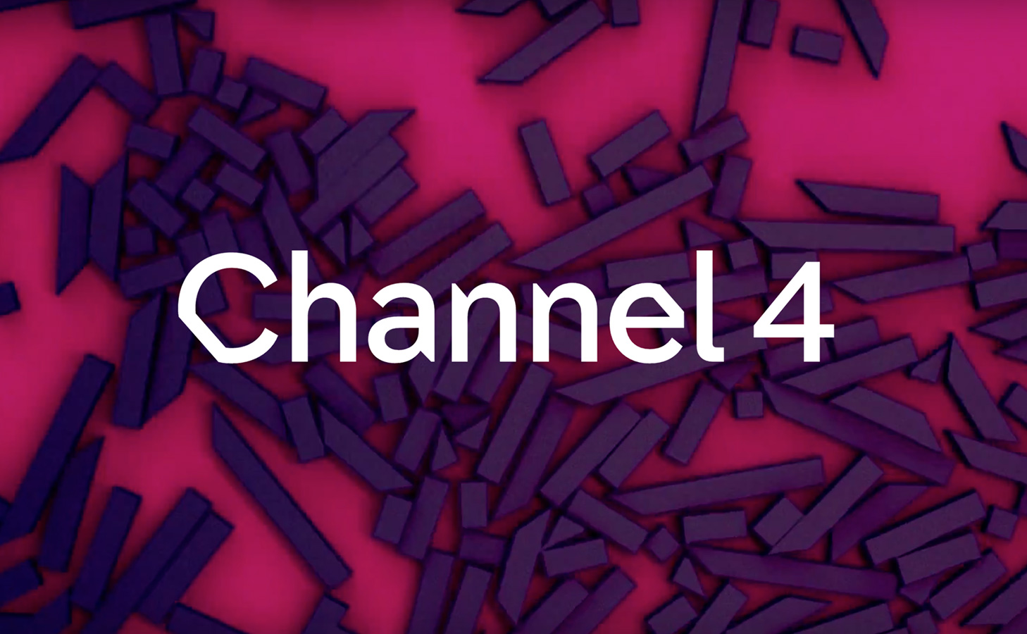
Social media

Slide 10
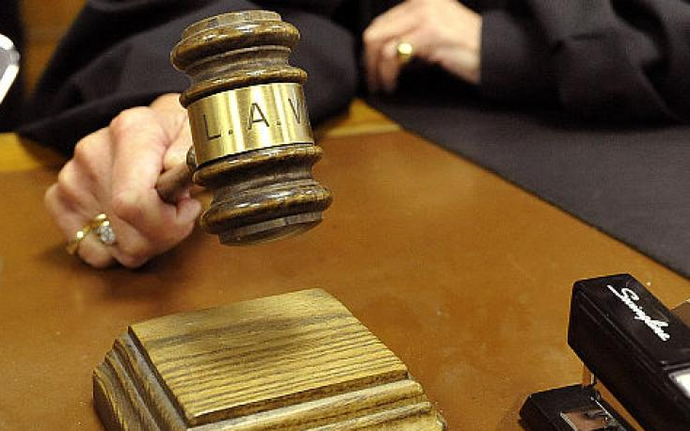

conclusion
Recommendation
Notes:
In conclusion, we have seen Social media has positive and negative pointe for the event bout it doesn’t explain that social media is good or bad thing it stands in between. Social media plays a massive role to keep the fans in touch with what is going on with the event
In conclusion, it is evident that social media has huge impact on ironman event. On the positive note, it can reach out to a broader audience, it helps to engage with their customers and it will inform the customers with new information regarding the event. However, the downside is it that any negative reviews about ironman are on public view. If utilized properly, ironman can review this bad comments and use it as reference to improve for their next event at Pembrokeshire.
It is recommended that event organisers to prioritize social media as method of promotion in future as opposed to other traditional methods due to its cost efficiency and the expected growth of users within the next few years.

Slide 11

Reference
Hana s Noor Al Deen, J. A. (2012). social media usage and impact .
raghav bali dipanjan sarka, t. s. (2017). social media analytics.
https://twitter.com/IRONMAN_Wales?ref_src=twsrc%5Egoogle%7Ctwcamp%5Eserp%7Ctwgr%5Eauthor
http://eu.ironman.com/triathlon/events/emea/ironman/wales.aspx#axzz50QgOgnqW
http://www.bbc.co.uk/news/uk-wales-south-west-wales-41198859
http://www.walesonline.co.uk/whats-on/whats-on-news/incredible-pictures-ironman-tenby-2017-13598993
https://en-gb.facebook.com/IMWales/
http://eu.ironman.com/triathlon/events/emea/ironman/wales/athletes/faqs.aspx#axzz50YxndAr5

