Slide 1
ALN
Mental Health

Slide 2
Learning Objectives
1. Consider and explore the prevalence of mental health conditions for children and young people in mainstream education in Wales.
2. Evaluate the provision in place that supports pupils with this specific ALN.

Slide 3
Mental health
It is estimated that three children in every average size classroom will have a mental health issue.
By the age of 14, half of all mental health problems will have begun.
To stem the flow, we need a change. We need to equip our children with the skills, confidence and tools to be emotionally resilient.
We need to intervene much earlier, addressing the seeds of distress before they take root.
National Assembly for Wales (2018)

Slide 4
Mental health conditions affecting children
Anxiety disorders
Attention-deficit/hyperactivity disorder (ADHD)
Autism spectrum disorder (ASD)
Eating disorders
Mood disorders
Schizophrenia
Task
Research one of these mental health conditions and consider the impact it would have on a child’s home/school daily life?

Slide 5
What about the kids? Kids talk mental health
https://www.youtube.com/watch?v=tJ5AT0_2N0s

Slide 6
Well-being of Future Generations Wales Act (2015)
Wales is one of the first countries to introduce a law like this. The Act says that 44 public bodies, such as Local Authorities, the NHS, Fire and Rescue and others, must work together towards seven well-being goals.

Slide 7
The seven well-being goals:
A prosperous Wales – where everyone has jobs and there is no poverty.
A resilient Wales – where we’re prepared for things like floods.
A healthier Wales – where everyone is healthier and are able to see the doctor when they need to.

Slide 8
Continued…
A more equal Wales – where everyone has an equal chance whatever their background.
A Wales of cohesive Communities – where Communities can live happily together.
A Wales of vibrant culture and thriving Welsh language – where we have lots of opportunities to do different things and where lots of people can speak Welsh.
A globally responsible Wales – where we look after the environment and think about other people around the World.
Future Generations Commissioner for Wales (2018)

Slide 9
Donaldson-Successful Futures (2015)

Slide 10
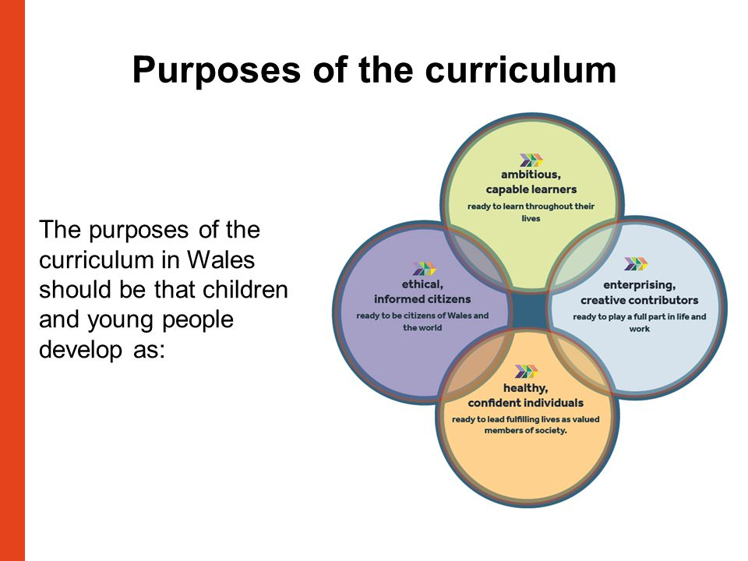
One of the four purposes of the new curriculum
healthy, confident individuals who:
› have secure values and are establishing
their spiritual and ethical beliefs
› are building their mental and emotional well-being
by developing confidence, resilience and empathy
› apply knowledge about the impact of diet and exercise
on physical and mental health in their daily lives
› know how to find the information and support to
keep safe and well
› take part in physical activity
› take measured decisions about lifestyle and
manage risk
› have the confidence to participate in performance
› form positive relationships based upon trust and
mutual respect
› face and overcome challenge
› have the skills and knowledge to manage everyday
life as independently as they can
and are ready to lead fulfilling lives as
valued members of society.

Slide 11
The six Areas of Learning and Experience recommended by the Donaldson Review are:
Expressive Arts
Health and Well-being
Humanities
Languages, Literacy and Communication
Mathematics and Numeracy
Science and Technology

Slide 12
The Welsh Government (2018, p.16) states:
“The whole approach to developing young people aged 3 to 16 will change. The new curriculum will have more emphasis on equipping young people for life. It will build their ability to learn new skills and apply their subject knowledge more positively and creatively. As the world changes, they will be more able to adapt positively.”
National Assembly for Wales (2018)

Slide 13
In groups choose one of the following news articles to review and discuss
£1.4m mental health project to help school pupils
https://www.bbc.co.uk/news/uk-wales-41361491
Child mental health 'must be national priority' in Wales
https://www.bbc.co.uk/news/uk-wales-43894892
Children as young as six self-harming in Wales schools
https://www.bbc.co.uk/news/uk-wales-41267915
South Wales Police want mental health lessons for young people
https://www.bbc.co.uk/news/uk-wales-42622297
Instagram 'worst for young mental health'
https://www.bbc.co.uk/news/health-39955295

Slide 14
The Child Death Review pilot for Wales analysed deaths occurring from suicide and apparent suicide in children and young people in Wales under 18 years that occurred between October 2006 and September 2009. It highlighted the specific issues of:
● Bullying (mostly school related)
● Misuse of drugs and alcohol
● Physical, emotional and sexual abuse
● Self harm
● Deprivation
● Social connections
NHS Wales (2014)

Slide 15
Risk factors for children and young people identified by NHS Wales review
Depression
Attention Deficit Hyperactivity Disorder (ADHD)
anxiety disorder
Asperger syndrome
Conduct disorder
Alcohol and drugs
NHS Wales (2014)

Slide 16
Continued…
Physical or sexual abuse
Parental separation/divorce
Being bullied
Impulsivity
Restricted educational achievement
Low socio-economic status
Adverse childhood experiences
NHS Wales (2014)

Slide 17
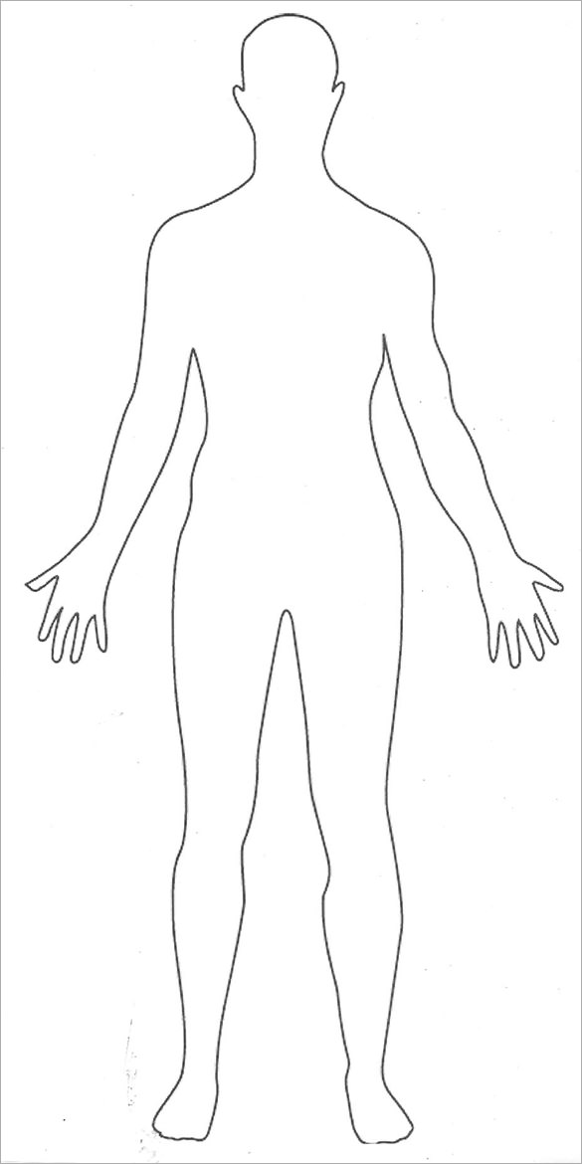
Task
Consider the possible visible signs of the risk factors mentioned. Use the outline of the human body provided to record your ideas

Slide 18
Task
Research one of these services available to children/young people and adults in Wales. Consider the target age, support offered and impact to date.
*Hafal
*Camhs
*Together For Children and Young People Programme (T4CYP)
*Cruse Bereavement
*Gofal

Slide 19
Bullying in childhood: cause or consequence of mental health problems?

Slide 20
Every learner in every school has the right to learn, free from the fear of bullying, whatever form that bullying may take.
Everyone involved in a learner’s education needs to work together to ensure that this is the case.
Schools need to take an active approach to tackle all forms of bullying, and should be taking action to prevent bullying behaviour as well as responding to incidents when they occur.

Slide 21
It is essential to develop a strong inclusive ethos where bullying and prejudice is not tolerated.
Human rights are guarantees that
protect individuals and groups from actions that affect their freedom and human dignity.
This rights-based and inclusive ethos is the
foundation upon which all bullying can be effectively addressed.
Welsh Government (2011)

Slide 22
How do schools support pupils?
Anti-bullying policies
Anti-bullying week
Restorative practice
Playground buddies
Worry trees
Rights respecting group (UNCRC)
PSE
School counselors
School council

Slide 23
Task
1. Research and evaluate a school/college or university policy regarding bullying or choose one from below.
2. Discuss your findings with your group and provide feedback to the rest of the class.
Oakleigh House school. (2018) Prevention of bullying policy.
https://www.oakleighhouseschool.co.uk/wp-content/uploads/sites/25/2018/11/Prevention-of-Bullying-Policy-Sep-2018.pdf(Accessed: 20 November 2018).
UWTSD. (2016) Student Harassment and Bullying Policy.
https://www.uwtsd.ac.uk/media/uwtsd-website/content-assets/documents/strategies-policies/2.0-Student-Harassment-and-Bullying-Policy-FINAL---7.11.2016.pdf(Accessed: 20 November 2018).

Slide 24
BBC News. (2018) Bullying: Children point finger at adults.
https://www.bbc.co.uk/news/education-46140135(Accessed: 20 November 2018)

Slide 25
Learning Objectives
1. Consider and explore the prevalence of mental health conditions for children and young people in mainstream education in Wales.
2. Evaluate the provision in place that supports pupils with this specific ALN.

Slide 26
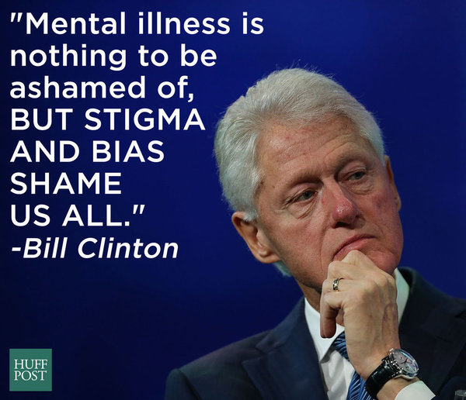
U.S. President 1993-2001 (42nd)

Slide 27
Reference List
Future Generations Commissioner for Wales (2018) Well-being of Future Generations (Wales) Act 2015. https://futuregenerations.wales/about-us/future-generations-act/ (Accessed: 20 November 2018).
National Assembly for Wales. (2018) Mind over matter. https://www.assembly.wales/laid%20documents/cr-ld11522/cr-ld11522-e.pdf (Accessed: 15 November 2018).
NHS Wales. (2014) Thematic review of deaths of children and young people through probable suicide, 2006-2012. http://www2.nphs.wales.nhs.uk:8080/ChildDeathReviewDocs.nsf/5633c1d141208e8880256f2a004937d1/ce6956a584dd1f6b80257c9f003c3fa1/$FILE/PHW%20probable%20suicide%20web.pdf (Accessed: 20 November 2018).
Welsh Government. (2011) Respecting others: Anti-bullying overview. https://beta.gov.wales/sites/default/files/publications/2018-03/respecting-others-anti-bullying-overview.pdf (Accessed: 20 November 2018).

