Slide 1

DIGITAL BUSINESS IN 2021
Nia Lewis

Slide 2



Introduction
Airbnb was founded in 2008 by Brian Chesky.
The sharing Economy is estimated to grow from $15 billion in 2014 to $335 billion in 2025.
Airbnb currently has 5.6 million listings in over 100,00 cities in 220 countries.
Notes:
Airbnb was founded in 2008 by Brian Chesky, the worldwide organisation is recognised for being a community marketplace for people to list, discover and book unique accommodation around the world. By facilitating bookings and financial transactions, Airbnb makes the process of listings or bookings a space, effortless and efficient through a peer to peer platform (Forbes, 2020).
The sharing Economy is estimated to grow from $15 billion in 2014 to $335 billion in 2025, which reflects how quicker than ever we are shifting to the world of a shared economy (Tabcum, 2019).
Airbnb currently has 5.6 million listings in over 100,000 cities in 220 countries, Airbnb offers a variety of unique spaces for everyone, at an affordable price around the globe (Airbnb, 2021).

Slide 3
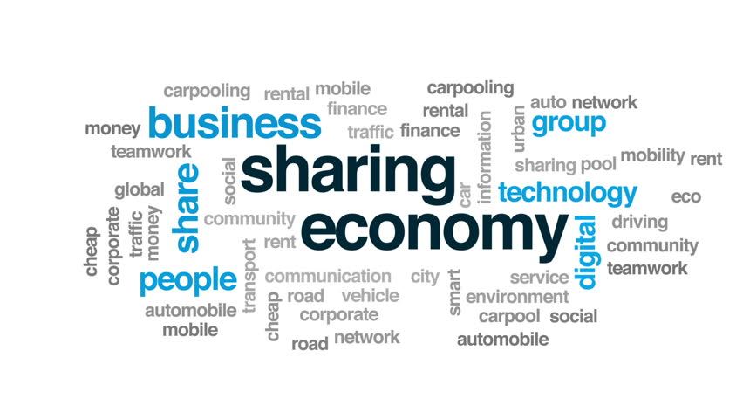
The Sharing Economy
Chapter 2
Peer-to-peer accommodation has emerged as a new socioeconomic system.
There is a significant positive impact peer-to-peer accommodation in the sharing economy is having on travel trends and patterns.
The sharing economy has evidently helped Airbnb achieve success through the collaborative commerce.
Notes:
This chapter within the book explores multiple elements within the sharing economy. The concentration of the chapter focuses on peer-to-peer accommodation which has emerged as a new socioeconomic system, which leverages information technology to empower users to share and make use of underutilized goods (Capra, 2016). The use of these proliferation of sharing economy platforms have many benefits to businesses such as Airbnb as the sustainable initiative is valued and supported by customers who are serious about environmental stewardship (Matzler, 2015).
(Dolnicar,2018) suggests that sharing resources that are truly underutilized have the potential to be more appealing for new tourists, develop more communities through social interactions, and generate economic value for local businesses. Although, she also indicates that the sharing economy is detrimental to the regulator, losing tax income that is essential to maintain shared tourism resources and infrastructure (Jung, 2019) Has similar views to this element of Chapter 2 by outlining the detrimental effects of the sharing economy including transactional and social risks which includes the risk of information asymmetry and weak trust in platforms. In comparison (Pesonen,2015) states there is a significant positive impact peer-to-peer accommodation in the sharing economy is having on travel trends and patterns. The availability of Airbnb enables an extensive range of destinations for tourists, increases their duration of stay and their frequency of travel. The sharing economy has evidently helped Airbnb achieve success through the collaborative commerce.

Slide 4
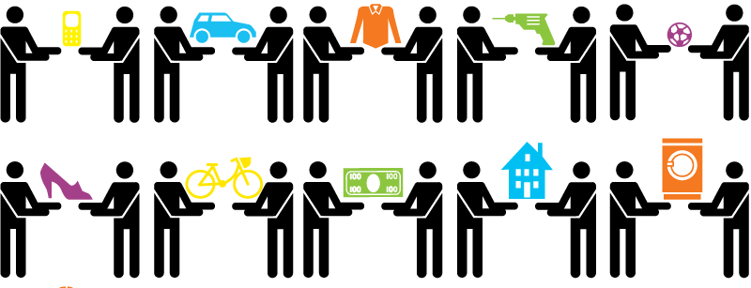
Collaborative Consumption
Chapter 2
Collaborative consumption which highlights the approach towards a resource-saving consumption culture resulting in customers seeing less value on ownership in favour of renting.
Airbnb’s practises intend to produce a seamless platform connecting supply and demand in the hospitality sector.
Notes:
Chapter three concentrates on collaborative consumption which highlights the approach towards a resource-saving consumption culture resulting in customers seeing less value on ownership in favour of renting (Leismann, Schmitt, & Baedeker, 2013). The sharing economy has been growing within the travel industry (Pesonen,2015) states that collaborative consumption stands as a valued addition to multiple developments in the marketplace, that have significantly transformed the behaviour of travellers and disrupted the travel industry.
The power of social networks has a significant effect on the peer-to-peer business model adapted by Airbnb, as social technologies has enabled this form of consumption to develop on a wider scale. This reflects Airbnb’s practises in producing a ‘’seamless platform connecting supply and demand in the hospitality sector’’ (Cusumano, Michael, 2015).
Collaborative consumption is located in the sharing economy as a technological phenomenon, this element offers economic benefits such as saving money, enabling access to resources and lowers the cost of economy coordination within communities. The benefits constitute more individualistic reasons for participating in the peer-to-peer business model (Hamari, 2016).

Slide 5

E-commerce.
Chapter 2
The competitive nature of the business environment compels businesses to adapt strategies that reflect their core objectives
E-commerce can be identified as a business model that allows firms and individuals to buy and sell goods, products or services over the internet
Consumers can also benefit from E-commerce as it easily and conveniently delivers information and services around the clock
The use of E-commerce allows Airbnb to operate as a consumer to consumer platform. Although it can also be identified that the use of business to consumers falls under the ecommerce definition of providing technologies to enable transactions
Notes:
The competitive nature of the business environment compels businesses to adapt strategies that reflect their core objectives. The information technology focused environment used in today’s business world, enables companies to strive and achieve sustainable competitive advantage, by implementing technological capabilities into their strategic initiatives as it is suggested a key element for organisational growth (Hight, 2019).
E-commerce can be identified as a business model that allows firms and individuals to buy and sell goods, products or services over the internet (Vulkan, 2020). Chapter 2 The Sharing Economy states that capturing and identifying the critical mass of sellers using digital platforms is very important to Airbnb as the use of online platforms enables clear communication and flexibility between both parties whilst exchanging underutilized resources (Kathan & Maltzer, 2016).
The use of e-commerce allows businesses to maintain a database of consumer preferences and also target precise customer segments, the use of e-commerce capabilities can develop customer loyalty and drive repeat customers (Hua, 2015). (Thakkar, 2017) also suggests that Airbnb is a part of the new infrastructure of consumerism, which offers convenience and supplying demand.
E-commerce benefits organisations such as Airbnb by making national and international markets more accessible and reducing the cost of processing and collating information. Consumers can also benefit from E-commerce as it easily and conveniently delivers information and services around the clock (Rainer, 2009). Although, in recent years the increased risk of cybercrime serves as a barrier as a preventative measure for fraudulent transactions and for future technology. Negative perceptions reduce consumers ability and willingness for business online transactions from the on-going fraudulent online activities (Apau, 2019). Airbnb have addressed this concern by partnering with safety experts ‘Get Safe Online’ to raise awareness and provide helpful guides for hosts and guests to ensure they stay safe whilst online (Airbnb,2018).
The use of E-commerce allows Airbnb to operate as a consumer-to-consumer platform. Although it can also be identified that the use of business to consumers falls under the ecommerce definition of providing technologies to enable transactions. C2C focuses on information transfers as B2C homes in on the transactions through buying and selling. Although Ecommerce is supported by both B2C and C2C activities as B2C has a C2C categorisation, the platform used as the technology is the peer- to-peer.

Slide 6

Value
Chapter 2
The use of detailed and trusted profiles and reviews creates value for guests as they can develop a promising expectation of what they are contemplating to book through Airbnb.
Chapter 2 illustrates the importance of value creation and the importance of digital technology that enables buyer-seller interaction at a scale of high speed and flexibility.
The detail of Airbnb’s search algorithms is a main contribution for its competitive advantage.
Notes:
Chapter 2 also explores the value creation of peer-to-peer accommodation networks, it discusses the contributions that are expected from buyers, sellers and the facilitator. In relation to Airbnb, there is a high influence expected from the network members, this is due to having to introduce themselves through their online profile and occasionally conduct reviews about hosts and guests. The use of detailed and trusted profiles and reviews creates value for guests as they are able to develop a promising expectation of what they are contemplating to book (Dolnicar,2018). A study by (Fareri & Delgado, 2014) suggests social value has an influence on future guests intention to book through Airbnb, social value is also driven by positive and negative social interactions which reflects how reviews creates value and demand.
Chapter 2 illustrates the importance of value creation and the importance of digital technology that enables buyer-seller interaction at a scale of high speed and flexibility; technology platforms is the core to facilitate value creation (Dolnicar,2018). There are multiple activities that Airbnb use to create value for hosts, guests within their organisation, they optimize searches to match guests and hosts with the use of algorithms that consider more than fifty different factors to match guest and host preferences in conducting outcomes. Some of the factors include availability of instant booking, price, type of space, amenities and multiple others. The detail of Airbnb’s search algorithms is a main contribution for its competitive advantage and creates value for hosts as Airbnb suggest that listing information is the key factor most easily applied by hosts to feature high in search listings (Ifrach, 2017).

Slide 7
Business Model – Multi Sided Platform
Chapter 2
Multi-sided platform business models which consists of the buyer-seller interaction that exists from both buyers and sellers connected by a platform.
Sellers
Buyers
Direct Interactions
Affiliation
Affiliation
Multi-sided platform
Notes:
Chapter 2 also highlights the success of multi-sided platform business models which consists of the buyer-seller interaction that are connected through a platform. The platform facilitates the transaction between the two parties (Dolnicar,2018). Multi sided platforms are also argued to be the most efficient and powerful business model in the digital economy due to their adaptability and ability to handle complexity, rapid-scale and value capture (Roth, 2019). Airbnb is recognised for being an online marketplace that operates a successful multi sided platform, they have been successful at attracting and attaining large numbers of hosts and guests which reflects why they are the market leader for commercial peer-to-peer accommodation networks (Dolnicar,2018).

Slide 8
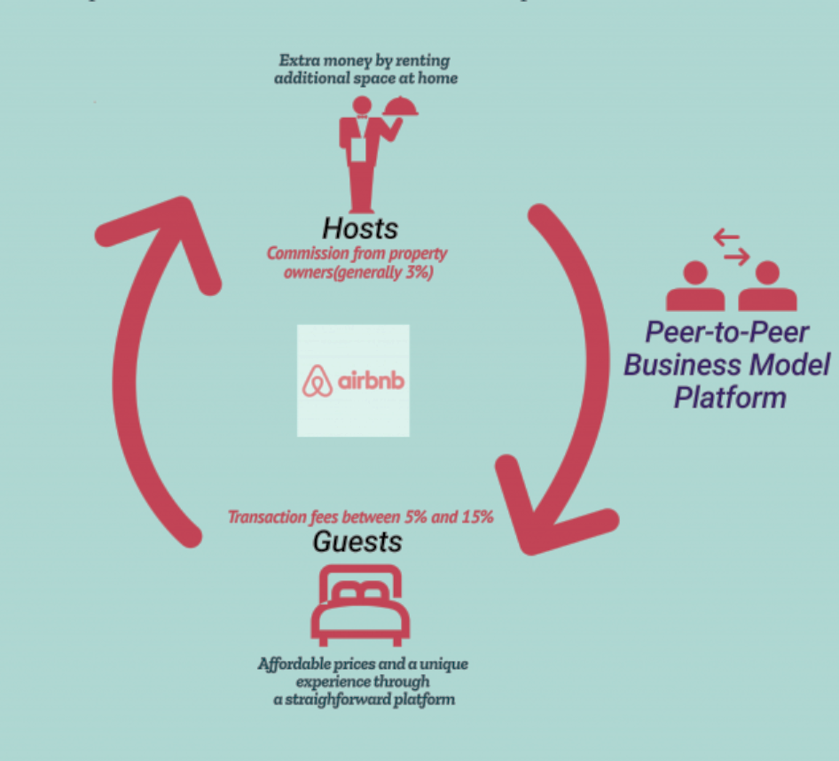
Business Model – Peer to Peer
Chapter 2
(Cuafano,2018)
Notes:
Marketplace is an active element of the function of Airbnb, the use of this peer-to peer marketplace is different from traditional hierarchical one-sided business models. Marketplace facilitates Airbnb with a digital platform that connects previously unmatched demand-side and supply-side participants through innovative methods of value creation (Tauscher, 2016).
In practise, the concept of a peer-to-peer business model offers an added advantage: while every organisation has a business model, not every organisation has its future mapped out in a strategy that focuses on creating value (Casadesus-Masanell, 2010). In addition to this statement (Chanda, 2018) agrees that peer-to-peer selling platforms offer significant opportunities for social relations such as new adapted methods of production and allocation, a scalable technological infrastructure and a sustainability focused economy.
These business platforms and models are an active part of the function of Airbnb’s business which allows them to engage with customers and capture all methods online to bring revenue into the business.

Slide 9
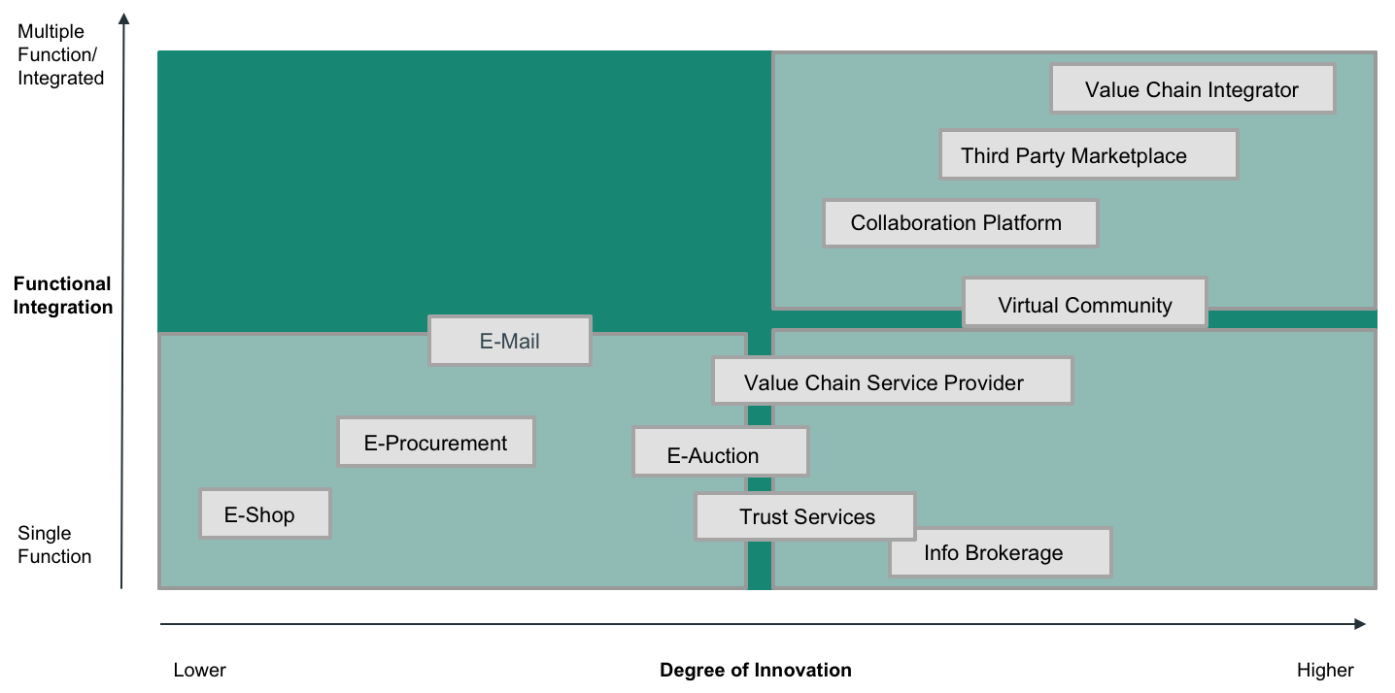
Digital Disruption
Notes:
Chapter 2 highlights the digital disruption that occurred when Airbnb became a high demand digital platform, the chapter outlines the positive impact of digital disruption and the negative impacts including the increased competition for hotels without creating any extra value to the community and the local economy (Dolnicar, 2018). Digital disruption is the transformation that is produced using emerging digital technologies and business models. The innovative new technologies and models has an influence on the value of existing products and services accessible within that industry (Oxford, 2019). Despite Airbnb being recognised for digital disruption and as a down-marketing offering that expanded the market, (Amit, 2020) argues that Airbnb is not a digital disruption and that it is an example of a blue ocean strategy, which is referred to a market for a product where there is no competition. A blue ocean strategy guides organisation to create new market space through reconstructing industry boundaries (Mi, 2015).
The business model by Timmers in 1998 has two dimensions, the degree of innovation and the extent of functional integration. The degree of innovation varies from a weak level which is reflected in traditional trading to a high level through new innovative applications such as value chain integration. Over the last decade technologies have developed which has enabled businesses to integrate more business functions which opens opportunities for businesses to be more innovative. Businesses are innovative by using technologies, but this often means they increase the levels of functionality of their system as well (Kamoun, 2008). When relating this diagram to Airbnb they would be placed at the top of the value chain integrator as they operate with high levels of innovation and high levels of functionality. The use of Airbnb adapting innovation in services and operations allows them to stay competitive against their competitors. (Sako, 2012) suggests that the ability to discover and satisfy customers unmet needs, is the most important driver of business model innovation.

Slide 10

Perspective
Chapter 8
The chapter studies whether peer-to-peer accommodation networks are emerging into one stop travel shops. The chapter indicates that there is no identified trend of peer-to-peer accommodation networks expanding beyond offering accommodation and associated services.
Airbnb have also expanded its offering through partnerships with popular airlines such as KLM, they have recently worked with KLM enabling and encouraging passengers to book Airbnb accommodation through the airline’s website.
While the tourism industry and policy makers are still developing a suitable response to the high demand of peer-to-peer accommodation trading, network facilitators such as Airbnb are emerging into a new areas to create value and meet the needs of customers.
Notes:
Chapter 8 covers the theme of perspective. The chapter studies whether peer-to-peer accommodation networks are emerging into one stop travel shops. The chapter indicates that there is no identified trend of peer-to-peer accommodation networks expanding beyond offering accommodation and associated services (Dolnicar,2018). It is only a matter of time until tourists are able to book everything from the same online service.
Airbnb have also expanded its offering through partnerships with popular airlines such as KLM, they have recently worked with KLM enabling and encouraging passengers to book Airbnb accommodation through the airline’s website (Dolnicar ,2018)
(Rokou, 2018) also states that shaping the customer journey to be as streamlined as possible, removing as much friction as possible from the booking process. The key to meeting the needs of customers through a simple and convenient booking process is by adopting a one-stop shop for all services related to a customer’s trip. While the tourism industry and policy makers are still developing a suitable response to the high demand of peer-to-peer accommodation trading, network facilitators such as Airbnb are emerging into a new area to create value and meet the needs of customers (Dolnicar,2018).

Slide 11

Sustainability.
Chapter 24
Statistics state that accommodation providers are recognised for having the largest consumptions of water internationally with the direct average water use per guest per night amounts to 350 litres.
environmental damage is influenced from the economic and social challenges faced by the increasing demand for destination-based travel.
the future of the world’s most important and popular tourism destinations should be considered and monitored through the lens of sustainable tourism.
Notes:
Chapter 24 highlights the impact that the tourism industry is having on the environment. The chapter explores whether accommodation through peer-to-peer network places is having a major effect on the environment or whether it is reducing the impact (Dolnicar,2018). The chapter explores the different elements of the environment including water, land, air and climate change. Statistics state that accommodation providers are recognised for having the largest consumptions of water internationally with the direct average water use per guest per night amounting to 350 litres (Gossling, 2015). Airbnb are contributing to be more sustainable as 79 percent of Airbnb hosts in Europe report that they provide energy efficient appliances, the chapter concluded that the comparative environmental damage is caused by different tourist accommodations, higher quality accommodation such as hotels comes at a higher environmental cost of land, water and air (Dolnicar,2018).
It is also suggested that the environmental damage is influenced from the economic and social challenges faced by the increasing demand for destination-based travel, the future of the world’s most important and popular tourism destinations should be considered and monitored through the lens of sustainable tourism (McClimon, 2019).
Another focus of Chapter 24 is the peer-to-peer accommodation services. It highlights that the service level of accommodations listed on peer-to-peer network such as Airbnb is lower when compared to hotels. Bedlinen and towels are not replaced, and a deep clean only occurs before each guest arrives, fewer than 2 percent of Airbnb hosts are reporting washing bed sheets and towels daily (Dolnicar,2018). Which stands in direct contrast of hotels daily room-cleaning service routines (Grun,2017). Although, it must be considered that spaces listed on peer-to-peer accommodation networks usually contained kitchens that are fully equipped, which results in an increase of domestic utility supply for cooking.
Overall, the spaces listed on Airbnb are not likely to have an environmental impact in comparison to hotel services that are being offered, statistics reflect that peer-to-peer accommodation networks may be a contributing solution to decreasing the environmental burden of tourist accommodation. As the increasing awareness of the environmental damage from tourism, Airbnb can maintain their growth in this environment and the chapter also highlights the importance of sustainability through the circular economy, which is associated with a previous theme discussed, collaborative consumption.

Slide 12

Concluding the 7 themes.
Collaborative Consumption
The Sharing Economy
Sustainability
Digital Disruption
Ecommerce
Value
Perspective
Notes:
In conclusion, this PowerPoint has highlighted key themes that have all been explored within the three chapters of the Peer to Peer Accommodation Book by Sara Dolnicar. The seven themes explored were critiqued by looking at their relation and importance to Airbnb. It is evident that all themes interlinked and had similarities, but each had their own contribution to digital business. This PowerPoint reflects the success of Airbnb and their innovative strategy to a more sustainable sharing economy.

Slide 13
THANK YOU FOR LISTENING.

Slide 14
Bibliography
Airbnb. (2018). Tackling Fraud, Airbnb Partners with Get Safe Online. Retrieved from Airbnb: https://news.airbnb.com/en-uk/tackling-fraud-airbnb -partners-with-get-safe-online/
Airbnb. (2021). Retrieved from https://news.airbnb.com/about-us/
Amit, S. (2020). Leading in the Digital World. MIT PRESS.
Apau, R. (2019). CYBER-CRIME AND ITS EFFECTS ON E-COMMERCE TECHNOLOGIES. Journal of Information, 44-50.
Capra, L. (2016). Who Benefits from the “Sharing” Economy of Airbnb. International World Wide Web Conferences Steering Committee,, 1-2.
Casadesus- Masanell, R. (2010). From Strategy to Business Models and onto Tactics. LRP Long Range Planning.
Chanda, V. (2018). Peer-to-peer selling in online platforms: A salient business model for virtual entrepreneurship. Journal of Business Research, 1-4.
Cusumano, Michael. (2015). How Traditional Firms Must Compete in the Sharing Economy. Journal of Communications of the ACM, 32-34.
Dolnicar, S. (2018). In Peer-to-Peer accomodation networks (pp. 15-20). Goodfellow.
Dolnicar, S. (2018). Environmental Sustainability. Goodfellows Publishers.
Dolnicar, S. (2018). Peer to Peer accommodation networks. Goodfellows Publishers.
Dolnicar, S. (2018). Peer-to-peer accommodation networks. Goodfellows Publisher.
Dolnicar, S. (2018). Peer-to-peer accommodation networks. Goodfellows.
Dolnicar, S. (2018). Peer-to-peer accommodation networks. Goodfellows.
Dolnicar, S. (2018). Peer-to-peer accommodation networks. goodfellows.
Dolnicar, S. (2018). Peer-to-Peer accommodation networks. Goodfellows.
Dolnicar, S. (2018). Peer-to-peer accomodation networks. Goodfellow.
Dolnicar, S. (2018). Peer-to-Peer accomodation networks. Goodfellows Publishers.
Dolnicar, S. (2018). Peer-To-Peer accomodation networks. Goodfellows.
Full list of 46 references in notes.
Notes:
Airbnb. (2018). Tackling Fraud, Airbnb Partners with Get Safe Online. Retrieved from Airbnb: https://news.airbnb.com/en-uk/tackling-fraud-airbnb-partners-with-get-safe-online/
Airbnb. (2021). Retrieved from https://news.airbnb.com/about-us/
Amit, S. (2020). Leading in the Digital World. MIT PRESS.
Apau, R. (2019). CYBER-CRIME AND ITS EFFECTS ON E-COMMERCE TECHNOLOGIES. Journal of Information, 44-50.
Capra, L. (2016). Who Benefits from the “Sharing” Economy of Airbnb. International World Wide Web Conferences Steering Committee,, 1-2.
Casadesus-Masanell, R. (2010). From Strategy to Business Models and onto Tactics. LRP Long Range Planning.
Chanda, V. (2018). Peer-to-peer selling in online platforms: A salient business model for virtual entrepreneurship. Journal of Business Research, 1-4.
Cusumano, Michael. (2015). How Traditional Firms Must Compete in the Sharing Economy. Journal of Communications of the ACM, 32-34.
Cuafono,G (2018) https://fourweekmba.com/airbnb-business-model/.
Dolnicar, S. (2018). In Peer-to-Peer accomodation networks (pp. 15-20). Goodfellow.
Dolnicar, S. (2018). Environmental Sustainability. Goodfellows Publishers.
Dolnicar, S. (2018). Peer to Peer accommodation networks. Goodfellows Publishers.
Dolnicar, S. (2018). Peer-to-peer accommodation networks. Goodfellows Publisher.
Dolnicar, S. (2018). Peer-to-peer accommodation networks. Goodfellows.
Dolnicar, S. (2018). Peer-to-peer accommodation networks. Goodfellows.
Dolnicar, S. (2018). Peer-to-peer accommodation networks. goodfellows.
Dolnicar, S. (2018). Peer-to-Peer accommodation networks. Goodfellows.
Dolnicar, S. (2018). Peer-to-peer accomodation networks. Goodfellow.
Dolnicar, S. (2018). Peer-to-Peer accomodation networks. Goodfellows Publishers.
Dolnicar, S. (2018). Peer-To-Peer accomodation networks. Goodfellows.
Fareri, D., & Delgado, S. (2014). Social rewards and social networks in the human brain,” The Neuroscientist,. The Neuroscientist, 380-410.
Forbes. (2020, November 23). Retrieved from https://www.forbes.com/companies/airbnb/?sh=791dbba3676e
Gossling, S. (2015). Assessing tourism’s global environmental impact 1900–2050,. Journal of Sustainable Tourism, 639–659.
Grun,B, & Dolnicar, D. (2017). A sharing-based approach to enticing tourists to behave more environmentally friendly. Journal of Travel Research.
Hamari, J. (2016). The Sharing Economy: Why People Participate inCollaborative Consumption. Journal of the Association for Information Science and Technology, 2050-2052.
Hight, S. (2019). The power of e-commerce Does e-commerce enhance the impact of loyalty programs on hotel operating performance? International Journal of Contemporary Hospitality Management, 1-5.
Hua, N. (2015). “The other side of technology adoption: examining the relationships between e-commerce expenses and hotel performance. International Journal of Hospitality Management, 110-120.
Ifrach, B. (2017). How Airbnb uses machine learning to detect host preferences. Retrieved from https://medium.com/ airbnb-engineering/how-airbnb-uses-machine-learning-to-detect-hostpreferences–18ce07150fa3. Karlsson, L., Kemperman, A., and
Jung, K. (2019). KDI Journal of Economic Policy, 15-41.
Kamoun, F. (2008). "Rethinking the Business Model with RFID. " Communications of the Association for Information Systems, 645-650.
Kathan, W., & Maltzer, K. (2016). The sharing economy: Your business model’s friend or foe? Business Horizons,.
Leismann, K. M., Schmitt, H., & Baedeker, C. (2013). Collaborative Consumption: Towards a Resource-Saving Consumption Culture. 184–203.
Matzler, K. (2015). Adapting to the Sharing Economy. MITS Management Review.
McClimon, T. J. (2019). Forbes. Retrieved from Forbes: https://www.forbes.com/sites/timothyjmcclimon/2019/12/09/the-future-of-preservation-is-sustainable-tourism/?sh=24d6c9676ea5
Mi, J. (2015). Blue Ocean Strategy. In Wiley Encyclopedia of Management (eds C.L. Cooper, J. McGee and T. Sammut‐Bonnici). 1-4.
Oxford, C. o. (2019). Retrieved from Digital Disruption: What Is It and How Does It Impact Businesses?: https://blog.oxfordcollegeofmarketing.com/2016/02/22/what-is-digital-disruption/
Pesonen, J. (2015). Impacts of Peer-to-Peer Accommodation Use on Travel Patterns. Journal of Travel Research, 2-8.
Pesonen, J. (2015). Impacts of Peer-to-Peer Accommodation Use on Travel Patterns. Journal of Travel Research, 1-4.
Rainer, K. (2009). Introduction to Information Systems. Wiley.
Rokou, T. (2018). Travel industry committed to creating one-stop-shop for customers. Retrieved from Travel Daily News: https://www.traveldailynews.com/post/travel-industry-committed-to-creating-one-stop-shop-for-customers
Roth, A. (2019). Multi-sided platforms. Electronic Markets, 1-6.
Sako, M. (2012). Technology Strategy and Management Business Models for Strategy and Innovation. communications of the acm, 20-25.
Tabcum, S. (2019, March 4th). Forbes. Retrieved from https://www.forbes.com/sites/forbeslacouncil/2019/03/04/the-sharing-economy-is-still-growing-and-businesses-should-take-note/?sh=3a76aa664c33
Tauscher, K. (2016). Understanding platform business models: A mixed methods study of marketplaces. European Management Journal, 1-5.
Thakkar, P. (2017). E-Commerce Impacts Consumers, Entrepreneurs. International Journal of Research in all Subjects in Multi Languages, 1-3.
Vulkan, N. (2020). The Economics of E-commerce. In A Strategic Guide to Understanding and Designing the Online Marketplace (pp. 1-10).

