Slide 1
Operations Management
Event Planning, Logistics, Exhibitions, Events and Operational Set Up
WEEK 7

Slide 2

Operations management TASK
In your groups
Consider a risk assessment on this event
Think of inherent risks / residual risks, risk scoring factors
Critical dependencies
Emergency procedures
Risk based audit
Operational risk / financial risk/
Internal / external / environmental risks

Slide 3

Launched in 1980 at Olympia
focused on showcasing how the industry has evolved and reshaped itself over the last few years to meet the demands of the new consumer market
market leading international travel event unlocking business opportunities for inbound and outbound tourism professionals
Trade Show – Business to Business (B2B)
Reed Exhibitions
NTO’s and international travel providers to do business with world-class travel buyers, as well as to showcase their services to the international press.
https://www.wtm.com/london/en-gb.html

Slide 4
Sustainability commitment
increasing amount of EU and national legislation with regards to material waste and its disposal at events.
For events, this legislation puts increasing responsibilities on the venue and organisers to ensure that waste is now separated before it leaves the exhibition site and that the maximum amount of material goes to be recycled rather than going to landfill.
https://www.wtm.com/london/en-gb/about/sustainability.html

Slide 5
Facts and Figures
2.5b Industry contract generated
50k Senior Travel industry Professionals Attend
Government Ministers
3K Media Attendees
100 New Stories
International Press
8 Regions

Slide 6
Developments at WTM
1982 Launch – 350 Exhibitors, 7,753 trade attended
1992 Moved to Earls Court, used Boat Show Pool and WTM Meridian Club Launched - 7K exhibitors
1994 Environmental Awareness Day Launched
1998 Water Aid Launched Raised £1m Supported 900k people in 28 countries
2001 Programme rewritten post 9/11 – 2 mins silence - Aimed to re build confidence and explore impacts
2002 Moved to Excel
2004 Environmental Awareness Day renamed World Responsible Tourism Day
2007 Hosted 1st UNWTO Ministers summit on Tourism and Climate - Bali Summit
2008 11K exhibitors
2010 Speed Networking Introduced
2013 Meridian Club renamed WTM Buyers Club
2020 Virtual WTM
2022 in Excel London

Slide 7

The WTM considers HR issues in the industry
Research revealed that half (49%) of respondents aged 16-24 are interested in a career in the sector.
They cited the discounts and offers they can benefit from (34%),
the exciting, fun and sociable environment (33%),
and the obvious opportunity to travel the world (29%).
Most young people are most interested in pursuing jobs as flight attendants (20%), travel agents (16%), and travel writers (15%).
What’s holding back the rest are the long hours (26%) rude customers (23%) and time away from family and friends (21%) with a third (32%) adding a career in the sector would be more desirable if it came with a higher salary.
The struggle to replace manpower lost during the pandemic is a global one, and the solution lies in facing up to pay and conditions that caused so many to pursue new careers outside the industry post covid.
https://rxglobal.com/unleashing-new-generation-travel-talent

Slide 8

Recruitment
a series of talks on the Insight Stage focused on ‘Driving Recruitment and Developing Talent’.
With the industry struggling to recruit, a panel discussion on ‘Keeping your Team Happy and Motivated’ will focus on retention issues such as
employee wellbeing,
hybrid working, and
what makes employees love their employers

Slide 9
Planning trade shows & exhibitions
Event plan
B2B / B2C
Business Plan
Define the budget
Planning
Aims & Objectives = Game plan
Procedures
Expectations
Staff planning
Logistics & transport

Slide 10
Pre event planning - is a crucial phase in organizing a successful event.
Sales & Marketing planning
Target audience / VIP’s / invites / attraction
Publicity
Appointments / programme / events
Free products / give aways
Retail merchandising
Managing visitors
Booking appointments
Staffing, roles, responsibilities, training & Dress codes
presentation

Slide 11
1. Define Objectives and Goals:
Clearly outline the purpose of the event. Establish specific goals and objectives.
2. Budgeting:
Determine the budget for the entire event.Allocate funds to different aspects like venue, catering, decorations, etc.
Plan for unforeseen expenses.
3. Create an Event Planning Team:
Assemble a team with specific responsibilities. Assign tasks and deadlines to team members.
4. Choose a Date and Time:
Consider the target audience and their availability. Check for conflicting events.
5. Select a Venue:
Choose a venue that suits the event type and size. Confirm the availability of necessary facilities (parking, audio-visual equipment, etc.).
6. Vendor Selection:
Research and select vendors for catering, audio-visual services, decorations, etc. Obtain quotes and negotiate contracts.
7. Event Marketing and Promotion:
Develop a marketing strategy to promote the event. Use various channels such as social media, email, and traditional advertising.
8. Registration Process:
Set up an efficient registration system. Consider online registration to streamline the process.

Slide 12
9. Accommodations and Transportation:
If applicable, arrange accommodations for attendees. Plan transportation options if needed.
10. Create a Timeline:
Develop a detailed timeline for the event day. Include setup, registration, speakers, breaks, and cleanup.
11. Speakers and Program:
Confirm speakers and their requirements. Develop a program schedule.
12. Logistics and Operations:
Coordinate logistics such as seating arrangements, signage, and on-site support. Plan for emergencies and have a contingency plan.
13. Technology and Audio-Visual:
Ensure all necessary technology is in place. Test audio-visual equipment in advance.
14. Sponsorship:
If applicable, secure sponsors and fulfill any sponsorship commitments.
15. Prepare Materials:
Create event materials such as programs, name badges, and handouts.
16. Final Check:
Conduct a final walkthrough of the venue. Confirm all arrangements with vendors and suppliers.
17. Communication Plan:
Establish a communication plan for the event day. Provide contact information for key team members.
18. Evaluate and Learn:
After the event, conduct a debriefing session to evaluate what went well and identify areas for improvement.
Gather feedback from attendees.

Slide 13
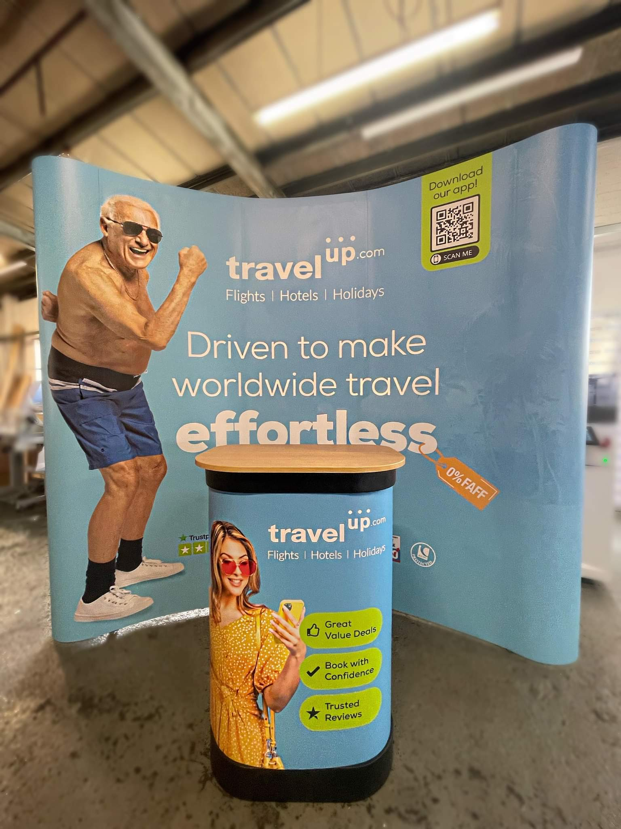
Trade Stand management
Signage & Branding
Theming
1st impressions
Entertainment
Promote
Team
roles
Meet & Greet
Use of games, lucky draws, contests, discounts to attract
Networking
Catering

Slide 14
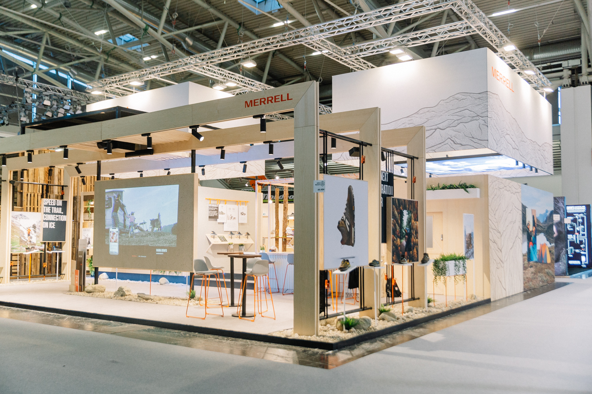
Guide to trade stand management
Pre-Event Planning:
Define Objectives:
  Clearly outline the goals of your trade stand (e.g., lead generation, brand awareness, product promotion).
Design Your Stand:
  Create an eye-catching and functional booth design.
  Ensure it aligns with your brand and effectively communicates your message.
Prepare Marketing Materials:
  Design and print promotional materials (brochures, business cards, banners).
  Consider interactive displays or demos to engage attendees.
Staffing:
  Select and train booth staff.
  Ensure staff is knowledgeable about products/services and trained in effective communication.
Lead Capture System:
  Implement a lead capture system (e.g., mobile apps, scanners) to collect attendee information for follow-up.

Slide 15
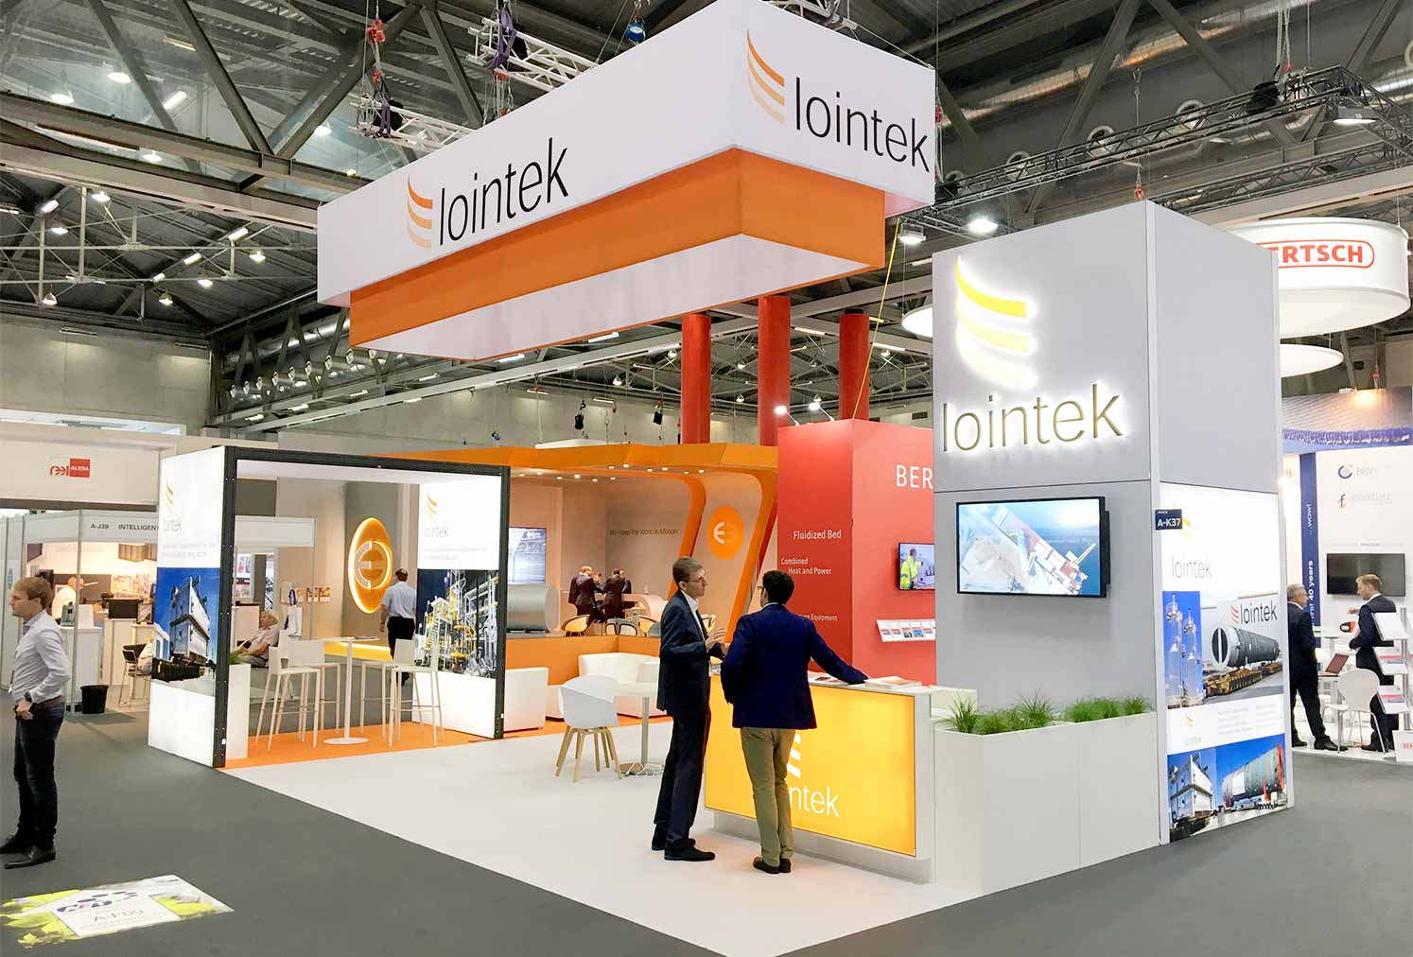
On-Site Management:
Set Up Early:
  Arrive early to set up your booth professionally.
  Test all equipment and displays.
Engage Attendees:
  Train staff to be approachable and engage with attendees.
  Consider interactive activities or demonstrations to attract attention.
Promotional Giveaways:
  Prepare promotional items to attract visitors.
  Ensure the giveaways align with your brand and are useful to your target audience.
Networking:
  Encourage your team to network with other exhibitors.
  Attend relevant sessions or events to build connections.
Monitor Competitors:
  Keep an eye on your competitors' booths.
  Analyze their strategies and adjust yours accordingly.

Slide 16
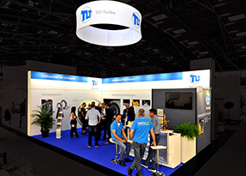
Communication and Branding:
Branding:
  Ensure consistent branding across all materials and displays.
  Use clear and concise messaging.
Social Media Engagement:
  Promote your presence on social media before, during, and after the event.
  Encourage attendees to share their experiences at your booth.
Public Relations:
  Consider reaching out to event organizers for potential media coverage.
  Prepare a press kit if relevant.

Slide 17
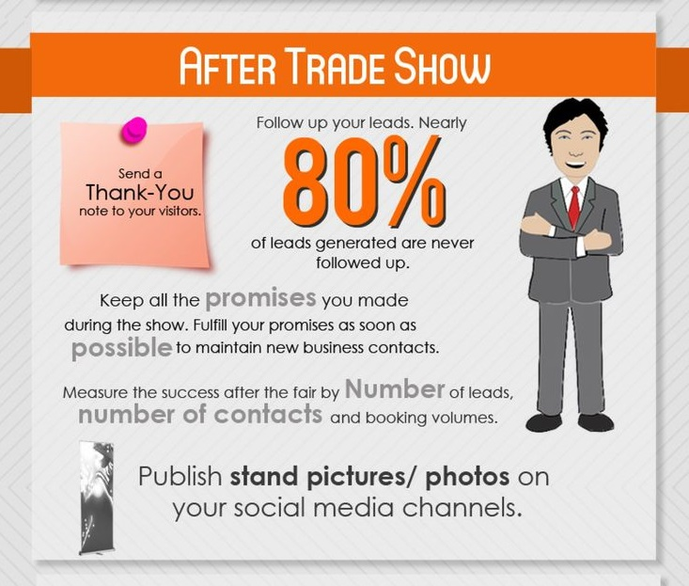
Post event
Follow up
Analyse leads
reconnect
Analysis & Evaluation
Review budget – costs v profits
ROI
Future planning

Slide 18

Forbes Seven Steps for organising a Successful Trade Show event
Plan far in advance
Prepare sales & Exec team
Schedule pre booth meetings
Be active on social media
Provide give aways / prizes / competitions
Scan, scan scan! This will help your team with post-show follow-up. (badge scanners )
Debrief & follow up (Kelleher,2018)
https://www.forbes.com/sites/forbescommunicationscouncil/2018/05/30/seven-steps-for-a-successful-trade-show/

Slide 19

Purple guide
Health & Safety Legislation
Planning, Management & Risk Assessments
Venue & Site design
Policies & Procedures
Attractions & Entertainment
Contingency & Emergency planning
Medical
Communications
Transport /traffic management
At Venue
Fireworks & Special Effects
Crime & Disorder
Insurance
Accessibility

Slide 20
Emergency Procedures
Raising the Alarm
Inform Public
Onsite emergency Response
Summon Emergency Services
Crowd Management – Evacuation / Control
Evacuate People with Disabilities
Traffic Management – Emergency Vehicles
Provide 1st Aid and Medical Assistance
Organisation – Specific Responsibilities
Control Centre = Hub

Slide 21
Evacuation
Plan Escape Routes
Signage
Emergency Lighting
Evacuation Routes
Safety Points
Assistance
Immediate Access to Routes

Slide 22

In groups for 30 minutes:
Discuss a trade stand that you would like to bring to the next WTM in London
Discuss the running of the stand – logistics / HR
Design of the stand / size
Concept / theme
Give aways etc #
What sort of issues would you be considering?
Make sure that you have some entertainment on the trade stand

Slide 23
Guidance on running events safely
https://www.hse.gov.uk/event-safety/
https://www.thepurpleguide.co.uk/index.php/the-purple-guide
https://theatregreenbook.com/news-events/
https://www.greeneventbook.com/

