Slide 1
Entrepreneurship –Assignment 2
LCMB7004
Fund Raising for Startups –
Challenges and Opportunities
Presented by
Abel (2130529)
Agna (2130537)
Ganga (2130065)

Slide 2
Entrepreneurship is viewed as one of the key drivers of development and the generation of jobs.
Objectives
Consider the traits of successful startups.
Study the various steps involved in startup fundraising
Study the numerous financing steps for startups.
Consider the difficulties in obtaining capital for startups.
Give appropriate advice for overcoming typical fundraising obstacles.

Slide 3
Steps In The Process Of Raising Money
Frame your financial goals. : Both in the business strategy and the investor pitch deck, the financial objectives and targets must be stated.
Making a budget : Building an accurate budget for early-stage start-ups with past records is one of the most challenging tasks to accomplish. (Cassar, G).
Research Investors : In this phase, finding suitable startup investors is crucial. You can find out who they are by asking for references from people who are connected to industry (Cassar, G) executives, colleagues, advisors, etc.
Getting the Pitch right : To demonstrate to financiers why the company is a great investment, assemble all necessary documentation, including the marketing plan and shareholder pitch deck.

Slide 4
Possibilities for Funding Startups
According to a recent survey, a lack of capital is one of the prime causes why many new firms fail in their first year of operation. Based on the kind and nature of the business, start-up funding may change.
Bootstrapping : Another name for this efficient method of startup finance is self-funding. The founders can choose to spend their own cash or raise funds from friends and family (Cassar, G). Due to the few procedures and compliances, cheap of raising, and variable interest rates, it is very simple to raise money.
Public funding : It is accepting bookings, mortgages, donations, and investments from numerous persons. In this scenario, the company owner publishes a comprehensive explanation of their venture on a webpage for crowd funding (Fayolle, A). It outlines the goals of a company, revenue projections, sources of financing, and explanations for each. Due to the interest it generates, it assists in both financing and promoting the goods.

Slide 5
Angel Investment : They are the ones that have extra money to invest and are eager to do so in up-and-coming startups. They operate in groups of networks to evaluate various proposals before investing. Along with funding, they provide mentorship services (Fayolle, A). Angel investors have aided well-known businesses like Alibaba, Google, and Yahoo.
Venture Capital : Professional money managers, venture capitalists invest in businesses with enormous potential. They make investments in companies using equity and exit the company through IPOs or other purchases.
Incubators and Accelerators: They can be located in all the major cities and assist hundreds of new enterprises each year (Fayolle, A). Incubators support local businesses by giving them a home, resources for training, a network, and shelter. Accelerators encourage, support, and help businesses move forward and make significant strides.
Fundraising through competition victory : Competitions that involve creating a business plan or creating a product inspire businessmen with company ideas to launch their own companies.

Slide 6
Bank loans are used to raise money : Each company that needs to finance their organization approaches financing from banks. Capital investment loans and other sources of funding are financed by them.
Loans from NBFCs or microfinance institutions : Companies give folks without access to traditional banking institutions financial services.
Additional short - term business funding methods: There are other methods as well, like as selling assets, using bank cards, pre-selling products, etc., to raise money for a firm.

Slide 7
Fundraising Challenges for Startups
Inability to commit to creating a proper balance sheet : Entrepreneurs should develop a financial statement that illustrates the expansion of the company through time.
Lack of a thorough business plan : Most business owners operate their enterprises based solely on personal experience and fail to record the operational information. They have difficulties whenever they seek bankers for financing.
Failure to accurately estimate finance requirements : Most companies build annual financial projections but forget to factor in the need for working capital to support company cyclicality. Due to a lack of capital investment, companies suffer (Fayolle, A).

Slide 8
Lack of ability to describe or support outstanding debts : Several aspiring business owners are unable to consider things from the lender's perspective. Due to a lack of preparation, they are having problems presenting the facts and data to lenders in order to finish the mortgage procedure. Another obstacle to meeting the financial criteria is the language barrier. (Fayolle . A)

Slide 9


Slide 10
Case Study : Dazo, a food-tech business based in Bangalore
A start-up situated in Bangalore. Under a year following its establishment, Dazo chose to cease operations.
The company was the most recent in 2015 among food technology start-ups to leave the industry or scale back operations as funding became more difficult.
“We were scaling up and were looking to get into more cities, but were short on capital. At some point we felt we were lagging behind other players and decided to quit,” said Shashaank Singhal, chief executive of Dazo (linkedin.com).
In April, Dazo received an unknown amount of money from Rajan Anandan, the head of Google India, Amit Agarwal, the regional director for Amazon, Sumit Jain, Aprameya Radhakrishna, the creator of TaxiForSure, and Alok Goel, the former CEO of FreeCharge (linkedin.com).

Slide 11
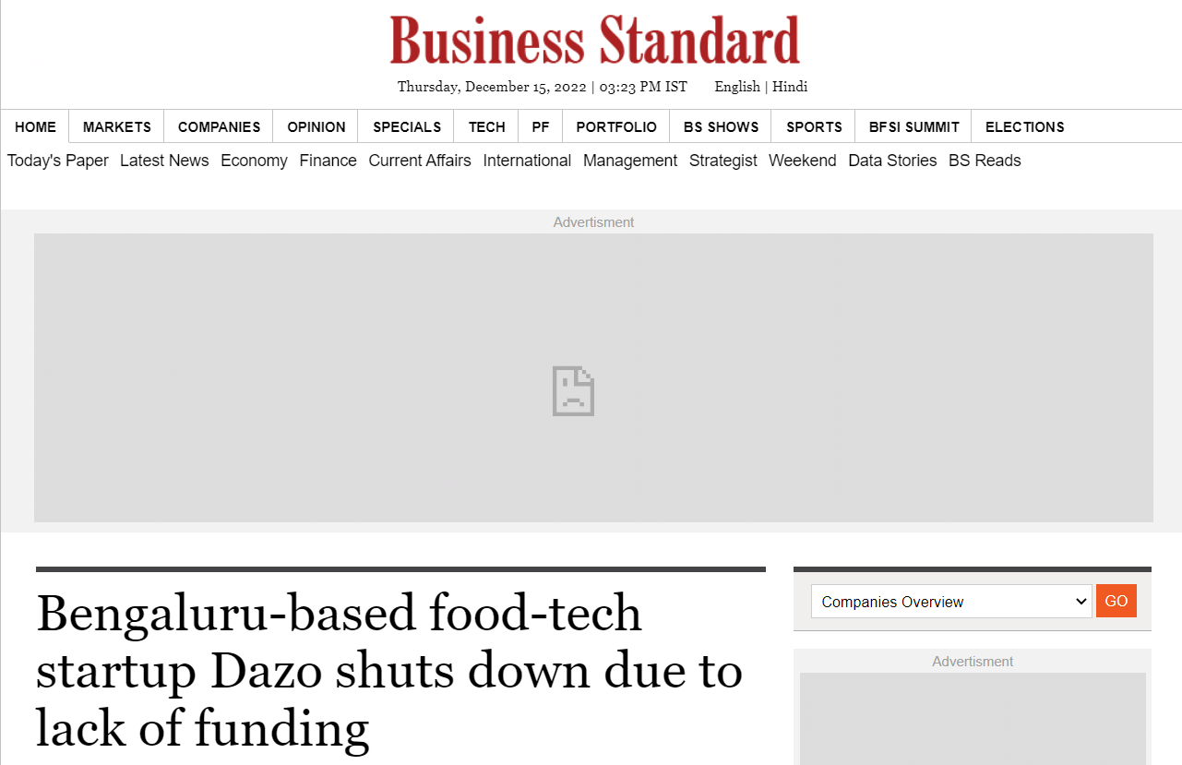
The business began as an online eatery or virtual kitchen before changing its direction to become an aggregator of well chosen restaurants (failory.com).
Strong competition and a capital shortage were two of the primary factors in the decision to close the business.

Slide 12

Reasons of failure
Financial irresponsibility :
They were misallocating their funds, in the opinion of experts and seasoned employees of their own businesses.
Massive payments to those who have little expertise or no skills and even less knowledge (Garg, T)
Inadequate experience :
Due to the startup's young crew, there aren't many seasoned professionals available to serve as mentors when needed.

Slide 13
Insufficient talent :
One of the employees of Dazo had said, “They did hire really experienced people and they deserved to lead the team and eventually most of them left.
The organisation has traditionally struggled to retain talented employees. Inability to retain experienced personnel may be one of the main causes of Dazo's demise (Garg, T).

Slide 14
Approaches for avoiding typical financial obstacles
Identifying the ideal investor : The most important phase for entrepreneurs is the requirement to conduct research, choose the kind of venture capitalist or angel investor, and choose how information will be delivered.
Networking: The financing of startups revolves around it. The key to expanding the organization is socializing with other businesses and business contacts.
Have a backup plan : Developing an escape route will help to increase the financing opportunities. By establishing defined objectives and ideas, one may take into account prospective funding alternatives.
The conclusion : Getting money is not hard if you work hard and are dedicated. Acquiring a business's finances before it absolutely needs them, by six months, is always advantageous.

Slide 15
References
Cassar, G. (2004). The financing of business startups. Journal of Business Venturing, 19(2), 261–283
Fayolle, A. (2002). The field of entrepreneurship in the study of the entrepreneurial process: some ideas and avenues of research. Proceedings from 6th international conf
Garg, T. (2017). Challenges Faced By Food Tech Startups. [online] Entrepreneur. Available at: https://www.entrepreneur.com/en-in/growth-strategies/challenges-faced-by-food-tech-startups/288391.
www.failory.com. (n.d.). What Happened to Dazo, the Curated Meal Marketplace? [online] Available at: https://www.failory.com/cemetery/dazo.
www.linkedin.com. (n.d.). FIVE REASONS WHY FOODTECH STARTUPS ARE FAILING. [online] Available at: https://www.linkedin.com/pulse/five-reasons-why-foodtech-startups-failing-som-singh [Accessed 15 Dec. 2022].
‌
‌

Slide 16
Thank You

