Slide 1
Critique the social, pedagogical and recreational tasks required of Youth and Community Workers.

Slide 2

Structure
Aim
Exploring the importance of social skills
  'It's getting out of hand': Backlash grows against 'distracting' Me Too campaign
  Brigitte Bardot Brands #MeToo Campaigners 'Hypocritical And Ridiculous'
Starting off, where are social skills necessary
Definitions
Origins of social education in Youth Work
Tasks of the social educator

Slide 3
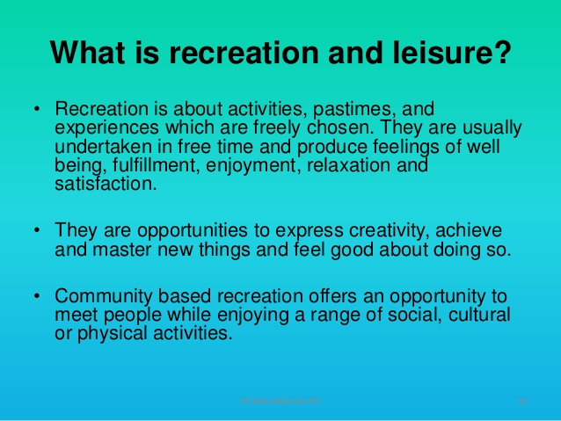

Slide 4
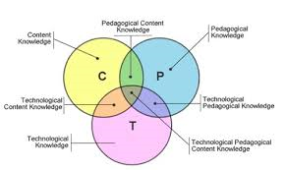
Tasks of the Professional Youth and Community Worker
Critique the social, pedagogical and recreational tasks required of Youth and Community Workers.

Slide 5
How best to learn social skills?
https://youtu.be/WmIC6BGWWWI
https://youtu.be/M6GyCJXj_KM
Quality work with young people : developing social skills and diversion from risk.
John. Huskins
Revised edition. s.l. : UK Youth 2002
Available at Carmarthen Library Extra Large (362.7 HUS )

Slide 6

NOS
Enable young people to develop holistically, working with them to facilitate their personal, social and educational development, to enable them to develop their voice, influence and place in society and to reach their full potential
LSIS, 2012.

Slide 7
NOS Continued
This statement refers to the holistic development of young people, recognising that personal, social and educational development can also include, for example, physical, political and spiritual development.
LSIS, 2012.

Slide 8

How can you foster social skills development?
Where and in which contexts are social skills needed?

Slide 9

In practice
In your experience how can youth work enhance the social skills of young people?

Slide 10

What is social education?
The origins of the notion of 'social education' are very far from clear,
the Albemarle Report referred to it, though, it would seem, in a very unspecific way: '..... it is the task of the (Youth) Service to offer, in its own different environment, social education of the kind that has long been valued in the corporate life of those pursuing formal education in schools, technical colleges and universities.'

Slide 11
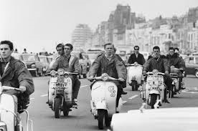
By 1969 youth work was stating categorically:
'The primary goal of youth work is the social education of young people'

Slide 12

What is Social Education in youth Work?
... any young person's meetings with others, with his capacity in these meetings to accept others and be accepted by them, and (with) the common interests around which these meetings may revolve. Social education is thus concerned with the ideas, thoughts and opinions, the motives and the emotions inherent in such meetings and interests. It is about the interaction of human beings, about their friendships and enmities, about the way these are deepened and extended, and about their consequences. Its product therefore is any individual's increased consciousness of himself— of his values, aptitudes and untapped resources, and of the relevance of these to others. It enhances the individual's understanding of how to form mutually satisfying relationships, and so involves a search by the adult for ways of helping the young person to discover how to contribute to as well as take from his association with others.
Davies and Gibson, 1967: pg 12.

Slide 13

How can social education be learned?
'It would seem appropriate to state the objective of social education in terms of the young learning to understand themselves, the kind of person they are, the nature of the beliefs they hold, the roles they play and anticipate playing, as well as learning about their way of seeing the social and physical environment which they inhabit. These two general levels of objectives have been called 'the establishment of self-esteem' and 'the clarification of experience.‘
Taylor, 1967: pg 5

Slide 14
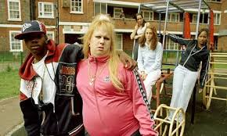
Social Education
Youth work's social education tradition — despite all the pressures to get young people to conform, to adjust, to become merely 'socially acceptable' and so on — has thus consistently given attention to the meanings attached to their experience by young people themselves.
Smith (no date)

Slide 15
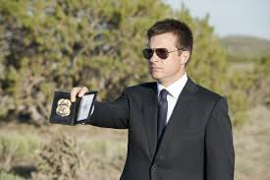
The role of the youth worker as social educator
The social educator can be defined as an agent of social change who coordinates social groups through educational strategies that help citizens to understand and participate in their social, political, economic and cultural surroundings, and to fully integrate in society.

Slide 16

Social Education
Socratic Dialogue
Question – Where is the social in Youth Work?

Slide 17
References
Bill 19, 45/4, 28th November 1973, Section 2 (2) (a); Bill 34, 47/1, 27th November 1974, Section 2 (2) (a).
Davies, B. and Gibson, A. (1967) The Social Education of the Adolescent, University of London Press.
Learning and Skills Improvement Service (2012) National Oiccupational Standards for Youth Work. LSIS.
Smith, M.K. (no date) From social education to social and life skills training: in whose interest? www.infed.org/archives/Bernard_davies (05.02.16)
Taylor, P. (1967) Society, Social Education and the Adolescent, National Association of Boys Clubs.

