Slide 1
Module Title: Professional Career Development within H&SC
Module Number: LCHS 4009 (LON)
Assignment No: Self-Awareness Presentation
Student Name: MD Ashraful Mokhlook Talukdar
Student ID: 2441949
Lecturer’s Name: Dr Tola Odugbesan

Slide 2
Acknowledge use of AI
No AI software has been used to complete this work.

Slide 3

Introduction
Communicating in health and social care (Sharkiya, 2023).
Describe the importance of communicating for quality care.
Understand the significance it has for my future role as a Care Assistant.
Notes:
Hello everyone. Hi, my name is Md Ashraful Talukdar, and today we will be looking at communication as a key working skill in health and social care. Communication is a key skill needed by health and social care workers as it helps them provide safe, effective and person-centred care (Sharkiya, 2023). In this presentation, I will be explaining what communication is, why it is important, how it is used in practice and how it will help me in my future career as a Care Assistant.

Slide 4

What is your chosen skill?
Communication is sharing of information and understanding (Fatimayin, 2023).
This is verbal, non-verbal and written communication.
The skill is developed through education, teamwork and practical experiences.
Notes:
My key professional skill is Communication. Communication is the exchange of information, ideas and feelings with clarity and effectiveness between people (Fatimayin, 2023). Health and social care professionals engage in communication via speech, listening, writing and body language. Trust and understanding is fostered through good communication. I have learnt this skill from studying it in school, participating in group activities and from being around people. This skill is very important to be able to use when working with patients and colleagues as a future Care Assistant.

Slide 5
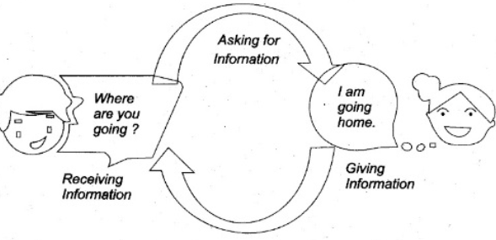
Importance of communication in professional practice
Facilitates safe, effective and person-centred care (Medline Plus, 2023).
Enhances interprofessional working.
Minimises mistakes and enhances patient care.
Notes:
Communication skills are vital in the workplace, as they impact on the care received by patients. Communication helps professionals to understand patient needs, explain treatments and cooperate with other professionals (Medline Plus, 2023). It also supports organisations to provide safe and efficient services. Communication problems could result in medication mistakes, patient dissatisfaction, and misunderstandings. So good communication plays a part in patient safety, improved health outcomes and increased rapport between the service user, staff and organisation.

Slide 6
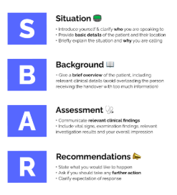
Model or framework linked to your chosen skill
SBAR is a way of communicating that is structured.
The acronym SBAR is used to describe the components of a situation: Situation, Background, Assessment and Recommendation (Fernández et al. 2022).
It enhances healthcare communication clarity and consistency.
Notes:
SBAR is a helpful way to communicate. SBAR is an acronym that represents Situation, Background, Assessment and Recommendation (Fernández et al. 2022). This model is used by healthcare professionals to communicate vital information in a timely and accurate manner. This framework helps to minimise miscommunication and prevent missing key information. In the case of a change in the resident's condition, a Care Assistant might report this using SBAR to a nurse. This is an organised method that helps ensure patient safety and effective collaboration among healthcare professionals.

Slide 7
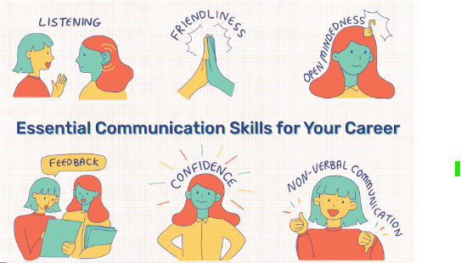
Applying this skill in practice
Professional role: Assistant to the Care Manager in a residential home for elderly people.
Problem: One of the elderly citizens gets sick.
Report observations to the nurse in a timely fashion.
Notes:
Communication is a skill that is in use on a daily basis in a residential care home as a Care Assistant. Suppose a senior citizen becomes sick. I would speak to the person who was living in the house in a calm way and see what changes took place and inform the nurse with correct details. With effective communication, healthcare professionals are able to respond rapidly and appropriately. This results in better patient safety, resident reassurance and quality care without unnecessary delay.

Slide 8

How does this skill support my future career?
Improves employability in health and social care.
Builds confidence when supporting patients (Reuter-Sandquist, Ernstmeyer and Christman, 2022).
Recognises a need for ongoing professional development.
Notes:
One of the most important things that I will learn in my future career is how to communicate. Healthcare professionals are expected to communicate professionally with patients, families and healthcare colleagues (Reuter-Sandquist, Ernstmeyer and Christman, 2022). I am also seeing myself as a good communicator but would like to build up my confidence in communicating in an unknown situation. This skill will be further developed through continued practice, training and experiences in real life settings. My personal development and career growth will be complemented by good communication skills.

Slide 9
Conclusion
Communication is an integral part of health and social work.
It promotes safe and effective team working with patients.
It will have a great impact in my future career.
Notes:
Overall communication is one of the key skills in health and social care. It promotes safe care practices, fosters collaboration and enhances patient satisfaction. Healthcare professionals need to communicate effectively every day to deliver high-quality services. This skill will enhance my employability and help prepare me for my future career as a Care Assistant. So, communication will continue to be a key aspect of my personal and professional growth.

Slide 10
References List
Fatimayin, F.F. (2023). What is Communication? [online] ResearchGate. Available at: https://www.researchgate.net/publication/337649561_What_is_Communication [Accessed 29 Jun. 2026].
Fernández, M.C.M., Martín, S.C., Presa, C.L., Martínez, E.F., Gomes, L. and Sanchez, P.M. (2022). SBAR method for improving well-being in the internal medicine unit: Quasi-Experimental research. International Journal of Environmental Research and Public Health, [online] 19(24), pp.1–13. Available at: https://www.mdpi.com/1660-4601/19/24/16813 [Accessed 29 Jun. 2026].
Medline Plus (2023). Communicating with Patients : MedlinePlus Medical Encyclopedia. [online] Medlineplus.gov. Available at: https://medlineplus.gov/ency/patientinstructions/000456.htm [Accessed 30 Jun. 2026].
Reuter-Sandquist, M., Ernstmeyer, K. and Christman, E. (2022). Chapter 1: Communicate Professionally Within a Health Care Setting. [online] www.ncbi.nlm.nih.gov. Available at: https://www.ncbi.nlm.nih.gov/books/NBK599382/ [Accessed 30 Jun. 2026].
Sharkiya, S.H. (2023). Quality communication can improve patient-centred health outcomes among older patients: A rapid review. BMC Health Services Research, [online] 23(1), pp.1–14. Available at: https://bmchealthservres.biomedcentral.com/articles/10.1186/s12913-023-09869-8 [Accessed 30 Jun. 2026].

