Slide 2
Understanding
Network Security
Network and Cybersecurity
Essentials (ACCA4024)
Applied Computing - WISA

Slide 3
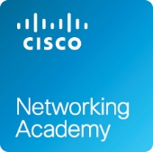
During our previous lectures, we discussed the concept of network, its entities (data, devices), metrics (bandwidth, throughput), roles (server, client/host) and components, the importance of documenting a network, the different types of network cables used in a home network, how network cables are very vital component which helps in establishing a successful network, the need of standard protocols in a network and the communication principles used with in the network.
After having a better understanding on the connecting components and the rules in establishing the communication, the session elaborated the Ethernet frame, the purpose of routing, the purpose of logical addressing (IP Address), How IP address are classified/ derived, how they are organized, how they are used etc, followed by the different methods of assigning IP addresses (static and dynamic), the concept of NAT. Finally, the features of IPv6. We also discussed TCP, UDP functions, Domain Name System and other services.
So far…
Network Types, Data Transmission, Bandwidth & Throughput
Clients and Servers, Network Components, Cables
Wireless Networks, Local Network Connections
Network Documentation
Communication Principles, Ethernet, Routing
IP ADDRESSING, DHCPv4, Network Address Translation
TCP, UDP Functions, Domain Name System
Other Services

Slide 4
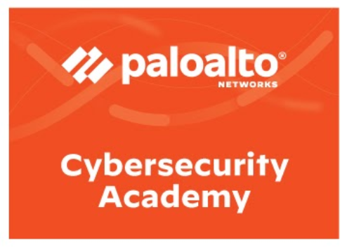
In our last session, we discussed the requirements to build a home network, the components and technologies that describes a home network, Where does the home network connects to? to understand the basic ISP connectivity options.
In addition to that, we also discussed the purpose and characteristics of network virtualization.
During our tutorial session last week, we configured DHCP.
Previous Class
Basics of home network
Home network technologies
Wireless Networks and its importance
Setting up home network
Beyond Home Networks
  ISP
  Virtualization
Tutorial session:
Design your own home network using packet tracer 8.0.
Configuring DHCP

Slide 5
Labs Checkpoint
Install Packet Tracer 8.0 and complete the Introduction to Packet Tracer Course via Cisco Networking Academy
Design and Connect a Simple Network and determine IP Address, Analyze MAC Address
Analyze Wired and Wireless Network Connection and Analyze Network Connectivity. (Address resolution protocol (ARP), PING (ICMP), TRACERT).
Understand, calculate and apply IPv4 address in a hybrid network (Wired and Wireless)
Observe URL to IP Address conversion
Design your own home network using packet tracer 8.0.
Working with Cisco Switches and Routers
Configure DHCP and Firewalls
So far Tutorial session:
Complete Introduction Packet Tracer.
https://www.netacad.com/courses/packet-tracer/introduction-packet-tracer
Complete Palo Alto – Network Fundamentals Course.
https://paloaltonetworksacademy.net/

Slide 6
So far after getting some clarity on home networks, its infrastructure, components, In this lecture, you will understand the different types of network security threats.
You will gain basic knowledge on common characteristics comprising cybersecurity world, cyber criminals and cybersecurity specialists.
In addition to that, we will also discuss the threats that affect individuals, and organizations.
Today’s Class
Security aspects of network
The Cybersecurity World
Cyber Criminals
Cyber Specialists
Cybersecurity Threats
Tutorial session:
Complete all the lab’s (Lab 1,2,3,4,5)
Complete the SBA Packet Tracer Activity
Complete NDG labs 3.1,4.1,4.2,5.2,5.3)

Slide 7




Network – Security Threats
Information theft: Breaking into a computer to obtain confidential information. Stolen information can be used or sold for various purposes such as when someone is stealing proprietary information of an organization, like research and development data.
Data loss and manipulation: Breaking into a computer to destroy or alter data records. An example of data loss is a threat actor sending a virus that reformats a computer hard drive. An example of data manipulation is breaking into a records system to change information, such as the price of an item.
When a threat actor gains access to the network, four types of threat may arise:
  Information theft,
  data loss and manipulation,
  identity theft, and
  disruption of service.
Identity theft is a form of information theft where personal information is stolen for the purpose of taking over the identity of someone. Using this information, a threat actor can obtain legal documents, apply for credit, and make unauthorized online purchases. Identify theft is a growing problem costing billions of dollars per year.
Disruption of service is preventing legitimate users from accessing services to which they are entitled. Examples include denial of service (DoS) attacks on servers, network devices, or network communications links.

Slide 8
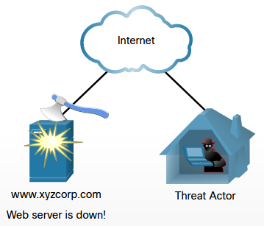
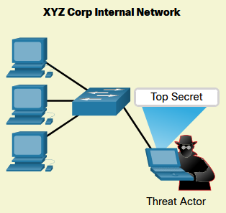
Network – Security Threats
These threats could be from network intruders can come from both internal and external sources.
External threats arise from individuals outside of an organization that do not have authorized access to the computer systems or network.
External attackers work their way into a network mainly from the internet through wireless links or dialup access servers.
Internal threats occur when someone has authorized access to the network through a user account or has physical access to the network equipment.
Internal attackers know the internal politics and people. They often know what information is both valuable and vulnerable, and how to get to it.

Slide 9
Network – Security Models
Perimeter-based network security Strategy
Considering Perimeter-based network security
Remote employees, mobile users, and cloud computing solutions blur the distinction between “internal” and “external”
Wireless technologies, the proliferation of partner connections, and the need to support guest users introduce countless additional pathways into the network branch offices that may be located in untrusted countries or regions
Insiders, whether intentionally malicious or just careless, may present a very real security threat
Perimeter-based model is unable to:
Definitively distinguish good applications from bad ones (which leads to overly permissive access control settings)
Adequately account for encrypted application traffic
Accurately identify and control users (regardless of where they’re located or which devices they’re using)
Filter allowed traffic not only for known application-borne threats but also for unknown ones

Slide 10
Network – Security Models
Zero Trust Security
Zero Trust Conceptual Architecture

Slide 11
Network – Security Technologies
Firewalls
Intrusion detection and intrusion prevention systems
Web content filters
Virtual private networks
Data loss prevention
Unified threat management
Secure Access Service Edge
Security information and event management
Security orchestration, automation, and response

Slide 12
Network – Security Technologies: Firewalls
Packet filtering (port-based)
  Operate up to Layer 4 (Transport layer) and inspect individual packet headers to determine source and destination IP address, protocol, and port number
  Match source and destination IP address, protocol, and port number information contained within each packet header to a corresponding rule on the firewall
  Inspect and handle each packet individually, with no information about context or session
Stateful packet inspection (dynamic packet filtering)
  Operate up to Layer 4 (Transport layer) and maintain state information about the communication sessions that have been established between hosts
  Inspect individual packet headers to determine source and destination IP address, protocol, and port number (during session establishment only) to determine if the session should be allowed, blocked, or dropped
  After a permitted connection is established between two hosts, the firewall creates and deletes firewall rules for individual connections

Slide 13
Network – Security Technologies: Firewalls
Application (Application layer gateway, proxy-based, reverse-proxy)
  Operate up to Layer 7 (Application layer) and control access to specific applications and services on the network
  Proxies network traffic rather than permitting direct communication between hosts
  Requests are sent from the originating host to a proxy server, which analyzes the contents of the data packets and, if permitted, sends a copy of the original data packets to the destination host
  Inspects Application layer traffic and can identify and block specified content, malware, exploits, websites, and applications or services using hiding techniques such as encryption and non-standard ports
  Can also be used to implement strong user authentication and web application filtering and to mask the internal network from untrusted networks
  Can have a significant negative impact on the overall performance of the network

Slide 14
Network – Security Technologies: IDS & IPS
Active and passive
  IPS (active) must be placed inline and can thus be directly attacked
  False positives can block authorized traffic
  IDS (passive) monitors and alerts
  Knowledge-based (signature) and behavior-based (statistical anomaly)
  Knowledge-based identifies known vulnerabilities and attack profiles (signatures)
  Behavior-based uses a baseline of “normal” activity to identify anomalies

Slide 15
Network – Security Technologies: Web Content Filters, VPNs
Allow or Block
  Gambling and online gaming
  Hacking
  Hate crimes and violence
  Pornography
  Social media
  Web-based email
VPNs
  Point-to-Point Tunneling Protocol (PPTP)
  Layer 2 Tunneling Protocol (L2TP)
  Secure Socket Tunneling Protocol (SSTP)
  Microsoft Point-to-Point Encryption (MPPE)
  OpenVPN
  Internet Protocol Security (IPsec)
  Secure Sockets Layer (SSL)

Slide 16
Network – Security Technologies: End Point
Endpoint Security Basics
  Personal firewalls
  Host-based intrusion prevention system (HIPS)
  Mobile device management (MDM)
  Mobile application management (MAM)
  Data loss prevention (DLP)
  Antivirus (AV) and anti-malware
Malware Protection
  Signature-based
  Container-based
  Application whitelisting
  Anomaly detection
Anti-spyware software, Personal firewalls, Host-based intrusion prevention systems, Mobile device management

Slide 17
Network – Securing the Enterprise
Next Generation Firewalls
  Essential Capabilities
  Application Identification

Slide 18
Network – Securing the Enterprise
Next Generation Firewalls
  Essential Capabilities
  User Identification

Slide 19
Network – Securing the Enterprise
Next Generation Firewalls
  Essential Capabilities
  Content Identification

Slide 20
Summary
Attacks to a network can be devastating and can result in a loss of time and money due to damage or theft of important information or assets.
Intruders can gain access to a network through software vulnerabilities, hardware attacks, or even through less high-tech methods, such as guessing usernames and passwords.
Security threats from network intruders can come from both internal and external sources.
Network Security Models: Perimeter-based network security strategy, Zero Trust security
Network Security Technologies: Firewalls, IDS, IPS, Web content Filters, VPNs, etc.
Firewalls: Packet Filtering, Stateful Packet Inspection, Application.
Endpoint Security, Malware Protection, Anti-spyware software, Host based intrusion prevention systems
Next Generation Firewalls: Application Identification, User Identification, Content Identification

