Slide 1
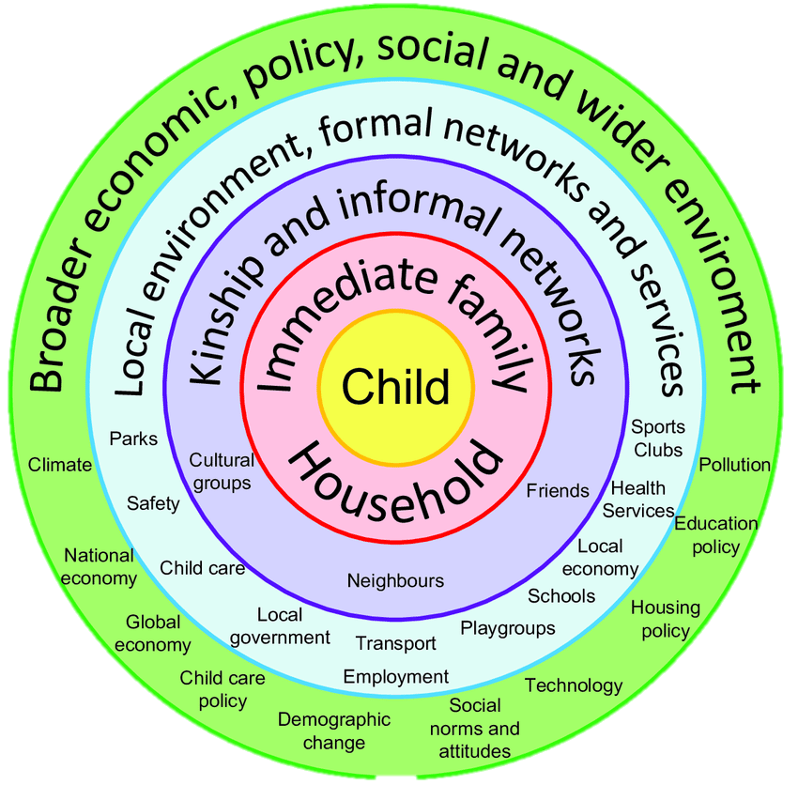

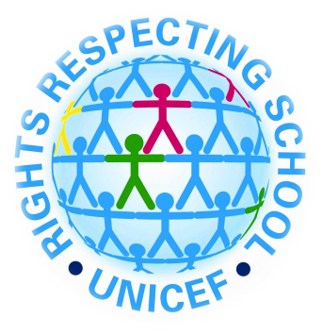

Start at my feet
For many children school is the centre of their life experience. The school which they attend is the key component that links the home, the local community and the wider community. Language, faith and social economy are all crucial to a child developing as a ‘capable individual’, Donaldson G. (2015).
Language
Language is something which is immensely important to a child’s holistic development. A good grounding and foundation with deep links to one’s heritage and community can help shape a person and their beliefs. In Wales language is a deep and protected language and for some it is the connection and link which takes them back through their family history and heritage. Nationality and language is a key part in a child’s identity and self image. Article 8 in the UNCRC Rights of The Child states that ‘every child has the right to their identity – including their nationality’. In my placement school nationality is key to the concepts of everyday school life, and being a rights respecting school nationality is buried deep into the ethos of the school. There are a few students who speak English as an additional language. In my class in particular I have one pupil who has very limited communication in English, as she has just moved from another country. However, she is encouraged to talk about her nationality and where she is from to others if she can. There are also two pupils in my class who speak other languages at home including Polish and Arabic.
Faith
Faith and religion is another key contributor to a child’s holistic development and growth. In my placement school the children share many different religious views, however, these views are all respected side by side. Although all children in my class sing prayers to God and express Christian beliefs in assembly there are also many other religions in the school. A main one being Islam. Muslim children within the school are offered the same opportunities as their friends, this is shown in the schools equality system and also in aspects of school life like school meals where a Halal option is available. There are also many displays within the school about religion and different children’s beliefs with facts about the Quran side by side with the story of Noah’s ark. The children in the foundation phase could arguably be regarded as the most impressionable, and therefore understanding others’ religion is fundamental from reception. Last week for example the foundation phase went on a trip into Swansea city to visit a Mosque. For many children in the school the Mosque is a very important aspect of normal life, but however there were also many children that had never been to one before. The exchange in religious knowledge at my placement school is highly commendable.
Social climate and economy and surrounding communities:
In my personal opinion many schools in Wales are highly involved and linked with the community in which they are situated in. My placement school and another bridging school I attended are both situated in rather deprived areas. My placement school is situated in a sub-urban area on the outskirts of Swansea, where many children come from disadvantaged backgrounds, this is shown by the fact that 38% of children are eligible for free school meals, which is well above the national average. According to Swansea City’s Council Social Inclusion Unit around 20% of children in the area come from workless households. I find this statistic fairly shocking, however the school is aware of the situation and has many systems in place to help disadvantaged families. This ranges from extra support for pupils in the classroom and outside of academia. There are also support systems in place for parents who may be struggling financially to support their children to go to school. An example of this is a ‘uniform shop’. Located within the school is a discounted uniform shop where donated items are sold to parents at discounted prices. The school is very much aware of the community in which it is situated and hold strong views on inclusivity. The school is located in a sub-urban area of Swansea and understands that some of it’s pupils may come from more disadvantaged backgrounds than others. The school understands that parents may struggle to provide the correct uniform for their child, especially if they have multiple children. The shop provides inclusivity for all pupils and parents, it shows that the school is aware of the economic and social climate in th surrounding community. A report written by the Social inclusion unit within Swansea council states that 20% of children in the area are living in workless households.
Amelia-Grace Hughes 1900314
Bronfenbrenner's Ecological Systems Theory (1979)
Bronfenbrenner's Ecological Systems Theory model shows the environment which the child grows up in. It consists of four sections known as systems; The Microsystem, The Mesosystem, The Exosystem, The Macrosystem, and The Chronosystem. Bronfenbrenner’s Theory shows how the environments a child interacts with can have an impact on their holistic development. The Microsystem involves settings where the child ‘directly interacts’, these can include school, family and the household. Although school is a part of The Microsystem it must also link with other parts of the system to fulfil it’s role. The aspects of a child’s life included within The Microsystem are arguably the most important factors to aid holistic development. If for example one section encounters a challenge such as problems with family life or the household, the child’s happiness and development are at risk. Being a part of The Microsystem the school is very often the link between the child and all other aspects of the Ecological Systems Theory. School should provide links between the home, links to the community, and awareness of the wider world.
Image taken from: https://www.moretonbay.qld.gov.au/libraries/Borrow-Discover/Community-Languages
School and The Mesosystem and Exosystem
School also provides connections to The Mesosystem and the immediate community. School is a place where the foundations are set for friendship bonds and also where relationships with local people and neighbours are formed, through events such as harvest and school fetes. School also provides access to the wider community and The Exosystem. For my placement school, this being Swansea City and Wales as a whole. An example of what I believe to be a good connection the local and wider community comes from my placement school. Located within the school corridor is a display which shows pupils working with local artist Frank Austin. The children worked with him to create artwork of their own depicting a lifeboat. The project stemmed from a visit to their local RNLI station, where they learned about the work of the volunteers there, the impact they have in the local community, and about the work of RNLI volunteers across Wales and the United Kingdom.
Logo taken from: : https://www.savethechildren.org.uk/what-we-do/childrens-rights/united-nations-convention-of-the-rights-of-the-child
Bronfenbrenner's ecological model. Diagram by Joel Gibbs based on Bronfenbrenner's (1979) ecological model.
Logo taken from: https://rnli.org/

Slide 2
Reference list:
Cadle Primary School, 2020. Cadle Primary School:Dream, believe, achieve. Available at:https://www.cadleprimaryschool.co.uk/(Accessed 22 January 2020)
City & County of Swansea Social Inclusion Unit, 2014. ‘Poverty Profile of Swansea’,pp1-10
Donaldson, G. (2015) ‘Successful Futures’, pp. 5-105
Peppler, K. (2017) The SAGE Encyclopaedia of Out-of-School Learning. Thousand Oaks, California, USA: SAGE Publications, Inc.
Riddall-Leech, S. (2013). How Children Learn 3, Tutor Resource Pack (3rd ed.) London, England: Practical Pre-School Books.
UNCRC. (1989). UN Convention on the rights of the child (UNCRC) An international agreement for child rights. Save the children: https://www.savethechildren.org.uk/what-we-do/childrens-rights/united-nations-convention-of-the-rights-of-the-child

