Slide 1

05.01.26

Slide 2

Gwnewch hyn nawr
Do this now
Beth oedd uchafbwynt eich tymor cyntaf?
What was your highlight of term one?

Slide 3
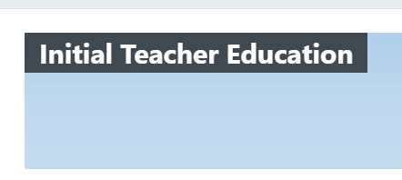
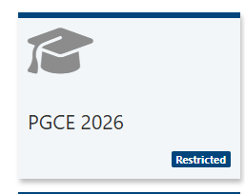

Materials for today

Slide 4
Heddiw
Today
Edrych nôl
Gwerthuso
Edrych ymlaen
Paratoi at gyfnewid cyfnod
Looking back
Evaluation
Looking ahead
Preparing for phase swap

Slide 5
Sesiwn 1
Session 1
Edrych nôl
Looking back

Slide 6
Yn y sesiwn hwn byddwn yn...
In this session we will…
Adfyfyrio’n bwrpasol ar eich profiad ar leoliad
Dod o hyd i'ch adroddiad diwedd lleoliad
Adnabod eich cryfderau a meysydd i’w datblygu
Trafod sut i weithredu ar y targed
Reflect purposefully on your placement experience
Find your end of placement report
Identify your strengths and areas for development
Discuss how to act on target

Slide 7
“Unless teachers develop the practice of critical reflection, they stay trapped in unexamined judgments, interpretations, assumptions, and expectations. Approaching teaching as a reflective practitioner involves fusing personal beliefs and values into a professional identity”
(Larrivee, 2000, p.293).
Notes:
Mae'r dyfyniad hwn yn tynnu sylw at rôl hanfodol adfyfyrio yn nhwf proffesiynol darpar athrawon. Er bod y term adfyfyrio yn aml yn cael ei ddefnyddio mewn modd llac neu fel arwyddair addysgol, mae ei wir werth mewn hunanwerthusiad pwrpasol, gonest a strwythuredig. Mae adfyfyrio go iawn yn galluogi darpar athrawon i ddadansoddi eu hymarfer, nodi cryfderau, mynd i'r afael â meysydd i'w datblygu, a gwneud newidiadau gwybodus i wella canlyniadau dysgu. Trwy ymgysylltu'n ddwfn ag ymarfer adfyfyriol, mae darpar athrawon yn symud y tu hwnt i wneud addysgu yn unig i'w ddeall yn wirioneddol - dod yn addysgwyr mwy hunanymwybodol, addasadwy ac effeithiol. Mae'r dyfyniad hwn yn dal yr arwyddocâd dyfnach hwnnw ac yn ein hatgoffa ni pam mae'n rhaid i adfyfyrio fod yn fwriadus, nid yn achlysurol.
This quote highlights the critical role of reflection in the professional growth of student-teachers. While the term reflection is often used loosely or as an educational buzzword, its real value lies in purposeful, honest, and structured self-evaluation. True reflection enables student-teachers to analyse their practice, identify strengths, address areas for development, and make informed changes to improve learning outcomes. By engaging deeply with reflective practice, student-teachers move beyond simply doing teaching to truly understanding it—becoming more self-aware, adaptable, and effective educators. This quote captures that deeper significance and reminds us why reflection must be intentional, not incidental.

Slide 8

Lefelau myfyrdod
Basic
Nodyn syml neu grynodeb o ddigwyddiadau. Nid oes trafodaeth y tu hwnt i'r disgrifiad.
Datblygol
Rhywfaint o dystiolaeth o fyfyrio, cysylltiad achlysurol â gwybodaeth flaenorol neu ddigwyddiad cyfredol. Defnyddio iaith ddisgrifiadol yn bennaf.
Proficient
Dangos 'camu'n ôl' o ddigwyddiadau. Mae myfyrdod cyson yn dangos gwahanol gysylltiadau ac ymwybyddiaeth o agweddau dysgu.
Exemplary
Yn ogystal, mae'n dangos myfyrdod beirniadol, ymwybyddiaeth y gellir gweld yr un gweithredoedd a digwyddiadau mewn gwahanol gyd-destunau gydag esboniadau gwahanol.
Notes:
Tasg 5 Munud
Trafod sut i ddod yn fwy myfyriol a pham mae hyn mor bwysig. Mae’r tabl yn rhoi rhai syniadau ar gyfer myfyrio’n ddyfnach a sut i wella eich ysgrifennu.
Gofynnwch i’r myfyrwyr-athrawon feddwl am eu defnydd o dyddlyfrau Dysgu – ble maen nhw ar hyn o bryd?
Ryan, M., (2011). Improving reflective writing in higher education: a social semiotic perspective. Teaching in Higher Education, 16(1), pp.99-111.

Slide 9
Levels of reflection
Basic
A simple recall or summary of events. There is no discussion beyond description.
Developing
Some evidence of reflection, occasional connection to prior knowledge or current event. Uses primarily descriptive language.
Proficient
Demonstrates a 'stepping back' from events. There is consistent reflection showing various connections and awareness of learning aspects.
Exemplary
In addition, demonstrates critical reflection, an awareness that the same actions and events may be seen in different contexts with different explanations.
Notes:
5 minutes - tasg
Discuss how to become more reflective and why this is so important. The table gives some ideas for deeper reflection and how to improve your writing. Ask student-teachers to think about their use of learning journals – where are they here?
Ryan, M., (2011). Improving reflective writing in higher education: a social semiotic perspective. Teaching in Higher Education, 16(1), pp.99-111.

Slide 10
Adfyfyrio ar PAP
Reflection on PTE
Beth aeth yn dda yn ystod eich lleoliad ysgol, a beth gyfrannodd at y llwyddiant hwnnw?
Pa heriau wnaethoch chi eu hwynebu, a sut wnaethoch chi ymateb iddynt?
Beth yw un peth allweddol y gwnaethoch chi ei ddysgu am addysgu neu amdanoch chi'ch hun fel athro?
What went well during your school placement, and what contributed to that success?
What challenges did you face, and how did you respond to them?
What is one key thing you learned about teaching or about yourself as a teacher?
Notes:
5-10 minutes - tasg
Gofynnwch i'r myfyrwyr gymryd amser i adfyfyrio'n ofalus ar eu hymatebion i'r cwestiynau hyn. Anogwch nhw i symud y tu hwnt i ddisgrifiadau anecdotaidd syml ac yn hytrach gymryd rhan mewn adfyfyrio dyfnach, mwy dadansoddol. Awgrymwch eu bod yn ailymweld â'r deunyddiau canlynol i gefnogi a chyfoethogi eu meddwl:
Eu dyddlyfr dysgu
Eu hadfyfyrdodau bob pythefnos
Eu ffurflen arsylwi
Eu hadroddiadau
Ask the students to take time to reflect carefully on their responses to these questions. Encourage them to move beyond simple anecdotal descriptions and instead engage in deeper, more analytical reflection. Suggest that they revisit the following materials to support and enrich their thinking:
Their learning journal
Their fortnightly reflections
Their observation form
Their reports

Slide 11

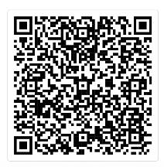
Beth yw eich barn am hyn?
A ydych chi wedi gweld unrhyw dystiolaeth o hyn ar PAP1?
Beth yw’r oblygiadau ar gyfer pobl sy’n ymuno â’r proffesiwn
What are your thoughts on this?
Have you seen any evidence of this on PTE1?
What are implications for people joining profession?
https://evidencebased.education/lethal-mutations-in-education-and-how-to-prevent-them/
Notes:
10 minutes - tasg
Cyflwynwch y darlleniad hwn i wneud y darpar athrawon yn gyfarwydd â'r cysyniad o lethal mutations. Anogwch nhw i ystyried a ydyn nhw wedi gweld enghreifftiau o hyn yn yr ysgol. Y nod yw eu helpu i ysgrifennu eu targedau a’u camau gweithredu eu hunain, yn ddiweddarach yn y ddarlith, sy'n benodol, ystyrlon, ac yn osgoi'r trafferthion cyffredin hyn.
Introduce this reading to familiarise the student teachers with the concept of lethal mutations. Encourage them to consider whether they have seen examples of this in school. The aim is to help them write their own targets and actions later in the lecture that are specific, meaningful, and avoid these common pitfalls.
LINK: https://evidencebased.education/lethal-mutations-in-education-and-how-to-prevent-them/

Slide 12
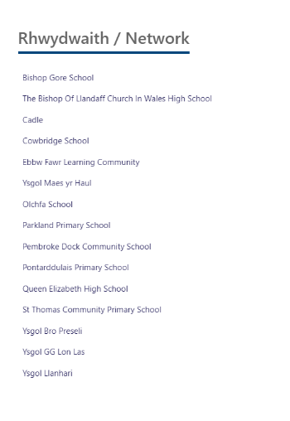
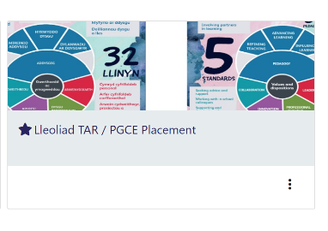
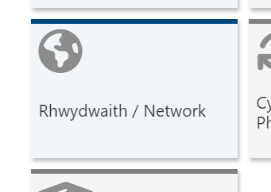
Dod o hyd i'ch adroddiad diwedd lleoliad
Find your end of placement report
Notes:
Gellir dod o hyd i adroddiadau ar Sharepoint.
Bydd llawer o fyfyrwyr eisoes wedi rhoi nod tudalen i Sharepoint, ond i unrhyw un sydd angen nodyn atgoffa, mae angen mynd i Moodle a chlicio ar enw eu rhwydwaith yn y tab 'Rhwydweithiau'. Maen nhw'n dod o hyd i'w ffolder, a dylai'r adroddiad fod yno.
Reports can be found on Sharepoint.
Many students will already have Sharepoint bookmarked, but for anyone who needs a reminder, they go to Moodle and click on the name of their network in the ‘Networks’ tab. They find their folder, and the report SHOULD be in there.
We know a handful of reports were not submitted at the end of last term – and are chasing these with the schools. Where student-teachers don't have a report, or there are parts missing they should use their mid-placement report, their fortnightly refelctions, and their learning journals to identify their targets.

Slide 13
Beth sydd yn fy adroddiad diwedd lleoliad?
What's in my end of placement report?
Cynnydd yn erbyn y SAFONAU PROFFESIYNOL
Cynnydd yn erbyn y LLINYNNAU CANOLOG
Targedau ar gyfer datblygu – tri tharged CAMPUS
Progress against the Professional Standards
Progress against the Central Strands
Targets for development – three SMART targets

Slide 14

Edrych ymlaen – Cynlluniau Gweithredu ar gyfer dechrau PAP 2
Looking Forward – Action Planning for Start of PTE2
Bydd cael cynllun gweithredu sy'n barod i’w drafod gyda'ch mentor ar ddechrau’r lleoliad yn eich helpu i ganolbwyntio ar dargedau
Having an action plan prepared to discuss with your mentor at the start of placement will help you to focus on specific targets
Notes:
Pam ydyn ni'n gwneud hyn?
Gwyddom fod amser yn werthfawr ar gwrs TAR. Mae cymryd saib i stopio ac adfyfyrio, i ffwrdd o brysurdeb dyddiol yr ystafell ddosbarth, yn eich galluogi i wneud cynnydd gwell yn y tymor hir.
Why do we do this?
We know that time is precious on a PGCE course. Taking a pause to stop and reflect away from the daily busy-ness of the classroom allows you to make better progress in the long term.

Slide 15
Adnabod cryfderau
Identifying strengths
Gan ddefnyddio'r ffynonellau tystiolaeth canlynol, o dan bob un o'r safonau, beth ydych chi'n teimlo yw eich cryfderau presennol? Beth yw eich sylfaen dystiolaeth?
Dyddlyfr dysgu
Myfyrdodau bob pythefnos
Adroddiad canol a diwedd lleoliad
  Os yw'n berthnasol, gallwch hefyd ddefnyddio
Arsylwi gwersi
Llyfryn STEER pontio
Cynllun ymyrraeth
  Byddwch yn barod i rannu rhain gyda'ch grŵp
Using the following sources of evidence, under each of the standards, what do you feel are your current strengths? What is your evidence base?
Learning journal
Fortnightly reflections
Mid and end of placement report
If relevant, you could also use:
Lesson observation
Bridging STEER booklet
Intervention plan
Be ready to share some of these with your group
Notes:
10 minutes - tasg
Cam un o'r broses hon yw ystyried beth yw eich meysydd cryfder.
Gall fod yn ddefnyddiol cysylltu'r rhain yn ôl â'r safonau addysgu - gan mai'r rhain yn y pen draw yw'r sail ar gyfer dyfarnu SAC.
Step one of this process to consider what your areas of strength are.
It can be helpful to link these back to the teaching standards- as these are ultimately the basis for the award of QTS.

Slide 16

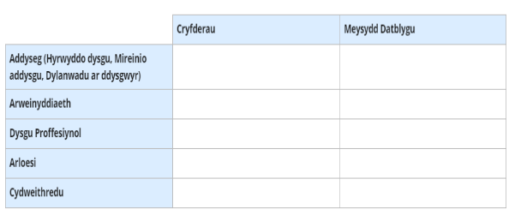
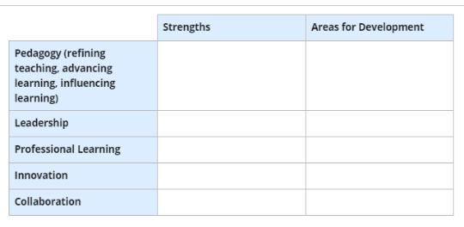
Tab 3: Cynnydd Proffesiynol Professional Progress
PDP
PLP (PebblePad)
Notes:
Gofynnwch i’r darpar athrawon fewngofnodi i’r PDP ac agor Tab 3 – Cynnydd Proffesiynol. Dylent gwblhau'r tabl gan ddefnyddio'r camau o'r sleidiau blaenorol, gan nodi eu cryfderau a'u meysydd ar gyfer datblygu, ynghyd â chamau penodol. Rhowch 20 munud ar gyfer y dasg hon.
Atgoffwch nhw am y cysyniad o lethal mutations - rhybuddiwch nhw rhag ychwanegu targedau sy'n amwys, yn generig, neu nad ydynt yn wirioneddol berthnasol. Anogwch nodau diriaethol, ystyrlon yn hytrach na datganiadau gwag.
Ask the student teachers to log in to PLP and open Tab 3 – Professional Progress. They should complete the table using the steps from the previous slides, identifying both their strengths and their areas for development, along with specific actions. Give 20 minutes for this task.
Remind them about the concept of lethal mutations - caution them against adding targets that are vague, generic, or not genuinely relevant. Encourage concrete, meaningful goals rather than empty statements.

Slide 17
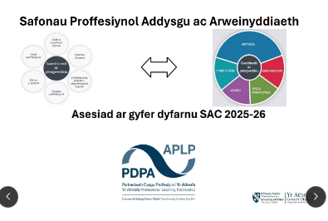

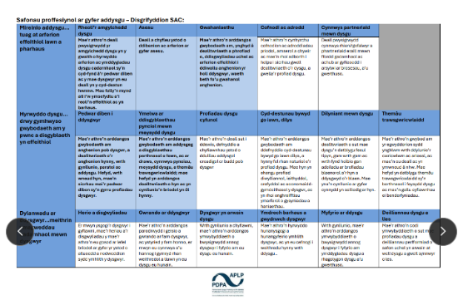
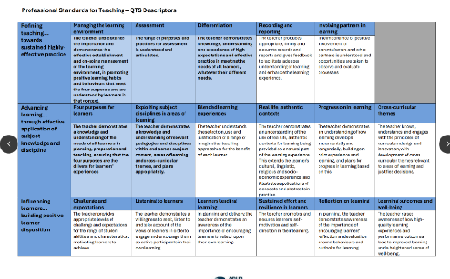
Notes:
Reminder -
Students have a copy of this document in their OneDrive, in the 'General Information' folder.
It gives an overview of all the strands in the teaching standards.

Slide 18
O darged i weithred
From a target to an action
Bydd eich adroddiadau canol lleoliad yn cynnwys sawl targed.
Ar gyfer pob un o'r targedau:
Pa linyn (au) sy'n ymwneud â nhw?
Sut olwg fyddai ar lwyddiant?
Pa gymorth / darllen pellach a allai helpu?
Sut allwch chi ddefnyddio eich amser yn y brifysgol i wneud cynnydd mewn perthynas â'r targed hwn?
Sut fyddwch chi'n datblygu'r ymarfer yn PAP2?
Your end of placement reports will contain several targets.
For each of the targets:
Which strand (s) does it relate to?
What would success look like?
What further reading / support might help?
How can you use your time in university to make progress in relation to this target?
How will you develop your practice in PTE2

Slide 19
Enghraifft – sut i ffurfio’ch Maes i’w Ddatblygu
Safon – Addysgeg (Mireinio) Meysydd i’w Datblygu
Rheoli’r amgylchedd dysgu Parhau i ddatblygu’r ffordd yr wyf yn rheoli’r amgylchedd dysgu, drwy ddatblygu fy strategaethau rheoli dosbarth, yn enwedig y rhai sy’n ymdrin ag ymddygiad heriol. I wneud hyn,
Byddaf yn ymchwilio i strategaethau rheoli ystafell ddosbarth, fel y rhai yn B Rogers, 'Classroom Behaviour: a Practical Guide to Effective Teaching, Behaviour management and Colleague Support ' (2015).
Unwaith y byddaf yn y lleoliad nesaf, gallaf edrych ar bolisi rheoli ymddygiad yr ysgol, rheolau'r ysgol a rheolau dosbarth, eu system wobrwyo a chanmol.
Gallaf siarad â Chydlynydd ADY, a’r uned ymddygiad am gymorth

Slide 20
Example – how to form your Area of Development
Standard – Pedagogy: Refining Areas for Development
Managing the learning environment To continue to develop the way in which I manage the learning environment, by developing my classroom management strategies, particularly those that deal with challenging behaviour. To do this,
I will both research classroom management strategies, such as those in B Rogers, 'Classroom Behaviour: a Practical Guide to Effective Teaching, Behaviour management and Colleague Support' (2015).
Once on placement, I can look at the school's behaviour management policy, school rules and class rules, their rewards and praise system.
The people I can speak with to help with this could be the ALNCO, and the behaviour unit.

Slide 21
O darged i weithred
From a target to an action
Cwblhewch y dasg
Cadwch y ddogfen ar OneDrive
Anfonwch y gwaith wedi’i gwblhau at eich Tiwtor Personol drwy e-bost
Os ydych ar gynllun ymyrraeth, anfonwch gopi hefyd at eich Rheolwr Rhaglen
Complete task
Save to OneDrive
Email to personal tutor
For those on intervention, send a copy to your Programme Manager as well.

Slide 22
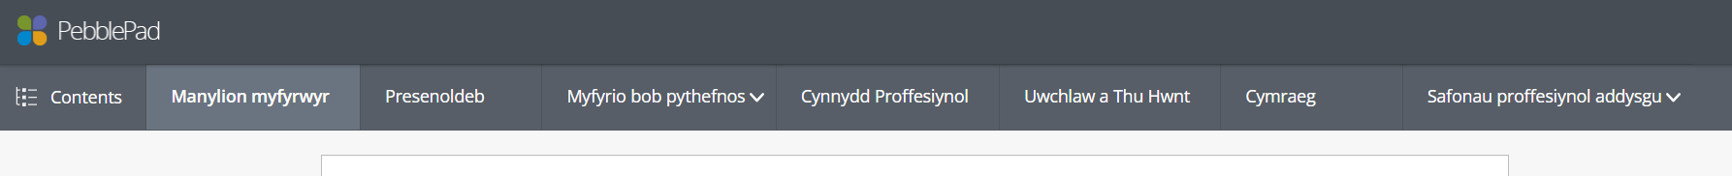
PDP - PLP
2
3
1

Slide 23

Amser ar gyfer cwestiynau
Time for questions

Slide 24
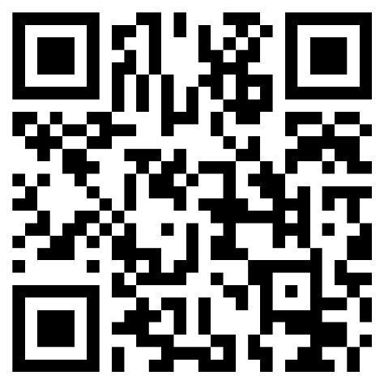
Gwerthusiad PAP / PTE Evaluation https://forms.office.com/e/kLxXr5jgWZ
Notes:
10 minutes
Sicrhewch fod POB darpar athro yn cwblhau’r gwerthusiad hwn yn y sesiwn cyn gadael.
Please ensure that ALL student-teachers complete this evaluation in the session, before leaving.

Slide 25
Sesiwn 2
Session 2
Edrych ymlaen
Looking ahead
Notes:
The aim of this session is make sure everyone is clear about the practicalities for the next term, as well as understanding how this second teaching block is designed to support the next stage of your professional development

Slide 26



Llwybr Cwricwlwm - TAR
Deall addysgeg, y cwricwlwm, a bod yn athro
Natur dysgu plant
.
1
Pontio
Tymor 1
Athro Dechreuol
Tiwtor Personol
Cymraeg mewn Ymarfer Proffesiynol.
Arwain y Dysgu
Pwy ydw i'n ei ddysgu?
Profiad Addysgu Proffesiynol 1
Datblygu sgiliau ymholi proffesiynol
Cysylltu Dysgwyr, Ysgolion a Chymunedau
2
Tymor 2
Cyfnod ymchwil
Athro Datblygol
Profiad Addysgu Proffesiynol 2
Ymchwilio i'r dysgu
AyD (parhad)
Ble dw i'n addysgu?
Profiad Dewisiadau
Lleoliad Amgen
Cyfnewid cyfnod
Cynhadledd ADY a lles
Cynhadledd Anelu at Ragoriaeth
Asesiadau
3
4
5
Tymor 3
Pontio
Statws Athro Cymwysedig
1
Pwy ydw i'n ei ddysgu?
Athro Proffesiynol
Profiad Addysgu Proffesiynol 2
2
Ble dw i'n addysgu?
3
Ymchwilio i'r dysgu
4
Cymraeg mewn Ymarfer Proffesiynol.
5
SAC
Notes:
Dangos le ar y llwybr mae’r myfyrwyr ar y pwynt hwn, a’u bod am edrych nol ar eu profiadau ers dechrau’r rhaglen yn ystod sesiwn gyntaf y diwrnod.

Slide 27
PGCE Curriculum Pathway
Understanding pedagogy, the curriculum, and being a teacher
The nature of children’s learning
.
1
Bridging
Term 1
Beginning to be a teacher
Personal Tutor.
Welsh in Professional Practice.
Leading the Learning
Who am I teaching?
Professional Teaching Experience 1
Developing the skills of professional enquiry
Connecting Learners, Schools, and Communities
2
Term 2
Research period
Developing as a teacher
Professional Teaching Experience 2
Researching the learning
LtL (cont)
Where am I teaching?
Electives
Alternative Placement
Phase Swap
ALN and Wellbeing Conference
Aiming for Excellence Conference
Assessments
3
4
5
Term 3
Bridging
Qualified Teacher Status
1
Who am I teaching?
Towards becoming a professional teacher
Professional Teaching Experience 2
2
Where am I teaching?
3
Researching the Learning
4
Welsh in Professional Practice
5
QTS
Notes:
Show where on the pathway students are and that they will be looking back at the experiences they’ve had on the programme to date during session 1.

Slide 28





Taith y darpar athro
Student-teacher journey
Deallusol
Dysgu am addysgu
Arfer Anuniongyrchol
Dysgu trwy weithgaredd ymarferol
Dysgu Integredig:
Dysgu trwy addysgu
Ymarferwyr Arbenigol
Dysgu gan fentoriaid a thiwtoriaid profiadol
Gwybodaeth Bersonol
Dysgu o'ch profiad personol
Intellectual
Learning about teaching
Indirect Practice
Learning through practical activity
Integrated Learning
Learning through
teaching
Expert Practitioners
Learning from experienced mentors & tutors
Personal Knowledge
Learning from your personal experience

Slide 29
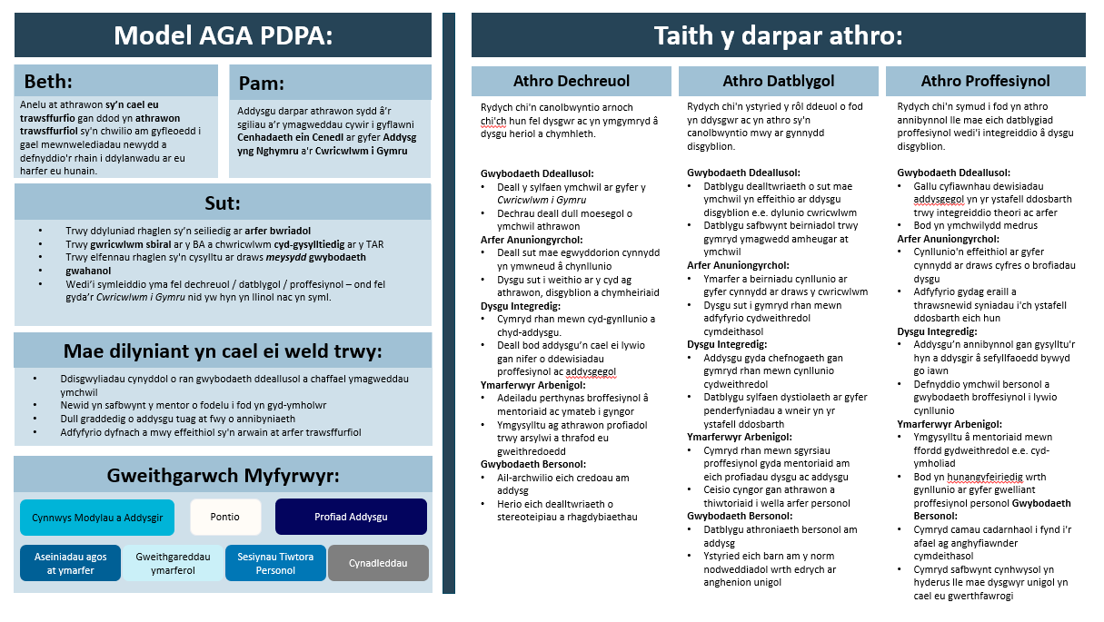

Slide 30
Athro Dechreuol
Rydych chi'n canolbwyntio arnoch chi'ch hun fel dysgwr ac yn ymgymryd â dysgu heriol a chymhleth.
Gwybodaeth Ddeallusol:
Deall y sylfaen ymchwil ar gyfer y Cwricwlwm i Gymru
Dechrau deall dull moesegol o ymchwil athrawon
Arfer Anuniongyrchol:
Deall sut mae egwyddorion cynnydd yn ymwneud â chynllunio
Dysgu sut i weithio ar y cyd ag athrawon, disgyblion a chymheiriaid
Dysgu Integredig:
Cymryd rhan mewn cyd-gynllunio a chyd-addysgu.
Deall bod addysgu’n cael ei lywio gan nifer o ddewisiadau proffesiynol ac addysgegol
Ymarferwyr Arbenigol:
Adeiladu perthynas broffesiynol â mentoriaid ac ymateb i gyngor
Ymgysylltu ag athrawon profiadol trwy arsylwi a thrafod eu gweithredoedd
Gwybodaeth Bersonol:
Ail-archwilio eich credoau am addysg
Herio eich dealltwriaeth o stereoteipiau a rhagdybiaethau
Athro Datblygol
Rydych chi'n ystyried y rôl ddeuol o fod yn ddysgwr ac yn athro sy'n canolbwyntio mwy ar gynnydd disgyblion.
Gwybodaeth Ddeallusol:
Datblygu dealltwriaeth o sut mae ymchwil yn effeithio ar ddysgu disgyblion e.e. dylunio cwricwlwm
Datblygu safbwynt beirniadol trwy gymryd ymagwedd amheugar at ymchwil
Arfer Anuniongyrchol:
Ymarfer a beirniadu cynllunio ar gyfer cynnydd ar draws y cwricwlwm
Dysgu sut i gymryd rhan mewn adfyfyrio cydweithredol cymdeithasol
Dysgu Integredig:
Addysgu gyda chefnogaeth gan gymryd rhan mewn cynllunio cydweithredol
Datblygu sylfaen dystiolaeth ar gyfer penderfyniadau a wneir yn yr ystafell ddosbarth
Ymarferwyr Arbenigol:
Cymryd rhan mewn sgyrsiau proffesiynol gyda mentoriaid am eich profiadau dysgu ac addysgu
Ceisio cyngor gan athrawon a thiwtoriaid i wella arfer personol
Gwybodaeth Bersonol:
Datblygu athroniaeth bersonol am addysg
Ystyried eich barn am y norm nodweddiadol wrth edrych ar anghenion unigol

Slide 31
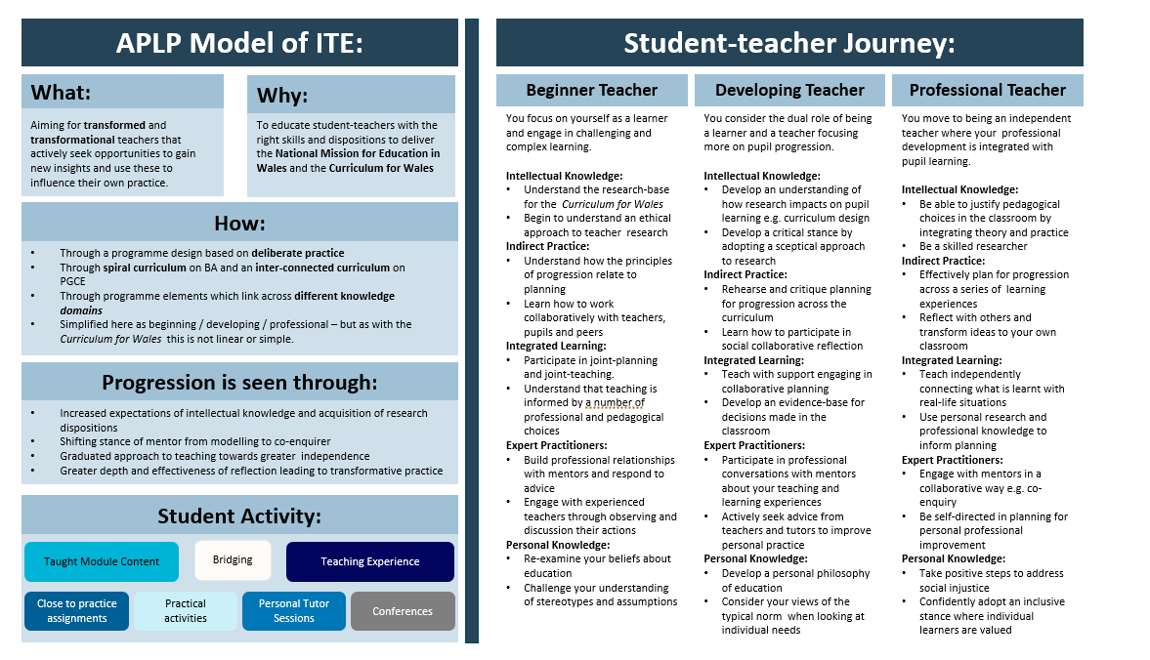

Slide 32
Beginner Teacher
You focus on yourself as a learner and engage in challenging and complex learning.
Intellectual Knowledge:
Understand the research-base for the Curriculum for Wales
Begin to understand an ethical approach to teacher research
Indirect Practice:
Understand how the principles of progression relate to planning
Learn how to work collaboratively with teachers, pupils and peers
Integrated Learning:
Participate in joint-planning and joint-teaching.
Understand that teaching is informed by a number of professional and pedagogical choices
Expert Practitioners:
Build professional relationships with mentors and respond to advice
Engage with experienced teachers through observing and discussion their actions
Personal Knowledge:
Re-examine your beliefs about education
Challenge your understanding of stereotypes and assumptions
Developing Teacher
You consider the dual role of being a learner and a teacher focusing more on pupil progression.
Intellectual Knowledge:
Develop an understanding of how research impacts on pupil learning e.g. curriculum design
Develop a critical stance by adopting a sceptical approach to research
Indirect Practice:
Rehearse and critique planning for progression across the curriculum
Learn how to participate in social collaborative reflection
Integrated Learning:
Teach with support engaging in collaborative planning
Develop an evidence-base for decisions made in the classroom
Expert Practitioners:
Participate in professional conversations with mentors about your teaching and learning experiences
Actively seek advice from teachers and tutors to improve personal practice
Personal Knowledge:
Develop a personal philosophy of education
Consider your views of the typical norm when looking at individual needs

Slide 33
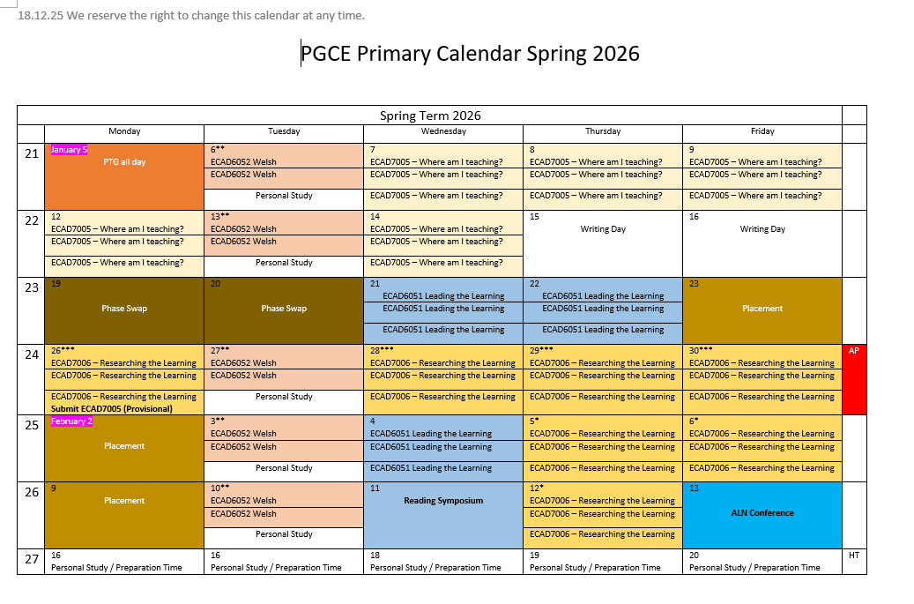
Amserlen - Cynradd
Timetable - Primary
Yr Athrofa | Teamup
Notes:
A copy of this is availble in today's folder in Moodle.
Students can also use Teamup - https://teamup.com/ksick4bzudn2xj771g

Slide 34

Amserlen - Uwchradd
Timetable - Secondary
Yr Athrofa | Teamup
Notes:
A copy of this is availble in today's folder in Moodle.
Students can also use Teamup - https://teamup.com/ksick4bzudn2xj771g

Slide 35
Dyddiadau Allweddol
Key Dates
Cyfnod Cynewid / Phase Swap | Cynradd / Primary – 19-20.01.26 Uwchradd / Secondary 21-22.01.26
Lleoliadau Amgen/Alternative Placements | A: 29-30.01.26 B: 26-28.01.26
Rhannu lleoliad PAP2 / PTE2 Placement shared | 12.01.26
Diwrnodau Paratoi PAP2 / Preparation days PTE2 | Cynradd / Primary – 23.01.26, 02.02.26 & 09.02.26 Uwchradd / Secondary – 23.01.26, 03.02.26 & 11.02.26
Symposiwm Darllen / Reading Symposium | 11.02.26
Cynhadledd ADY (ar-lein) / ALN Conference (online) | 13.02.26
Profiadau Dewisol / Electives | 25-27.03.26

Slide 36
Dyddiad cau aseiniadau
Assignment deadlines
Teitl y Modiwl Module Title | Cod y Modiwl Module Code | Arweinydd Modiwl Module Lead | Cyflwyno aseiniad Assignment submission
Ble ydw i'n addysgu? Where am I teaching? | ECAD7005/C | Jessica Roberts & Lilian Martin | 25.01.26
Ymchwilio i'r dysgu Researching the learning | ECAD7006/C | Elaine Sharpling & Rachel Bendall | 05.05.26
Cymraeg mewn arfer proffesiynol Welsh in professional practice | ECAD6052/C | Jeni Price | 13.05.26

Slide 37
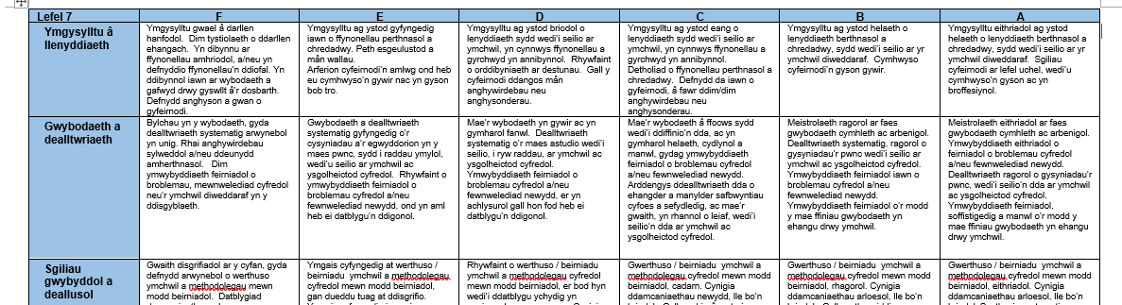
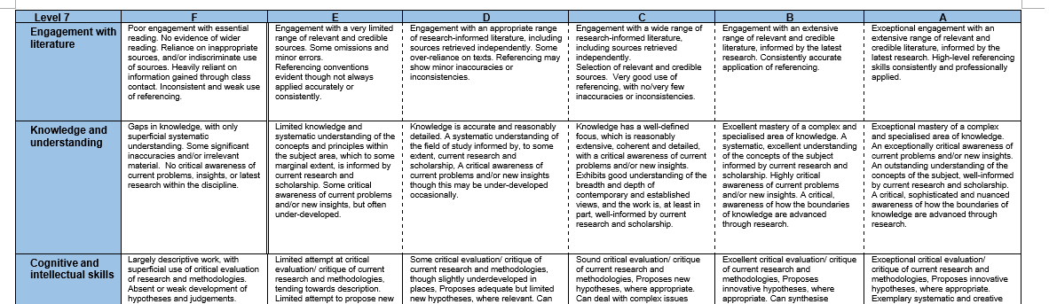

Slide 38
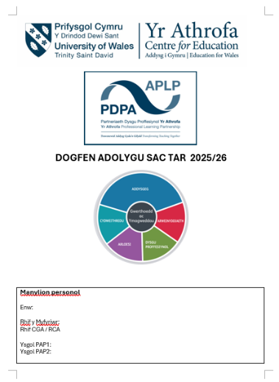

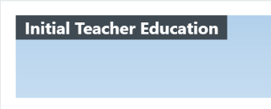
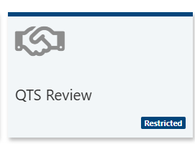

Slide 39
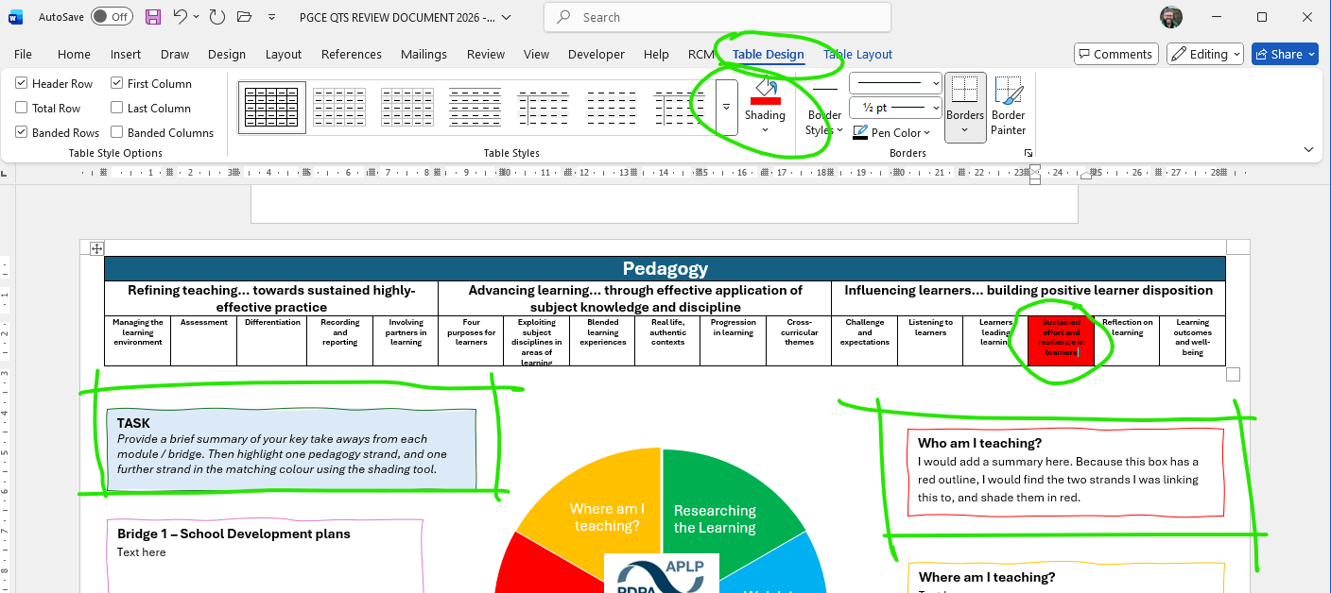

Slide 40
Sesiwn 3
Session 3
Paratoi at gyfnewid cyfnod
Preparing for Phase Swap
Notes:
This session introduces them to the materials they will need to engage with ahead of the Phase Swap experience. Please note the dates for the school element of Phase Swap will be different depending on phase. The allocation of students to schools will be shared shortly, and Network Schools will be contact with student-teachers directly.

Slide 41
Cynradd – Primary
Uwchradd - Secondary

Slide 42

Cyfnewid Cyfnod – TAR
Phase Swap – PGCE
Cynradd/Primary 19-20.01.26
Uwchradd/Secondary 21-22.01.26

Slide 43
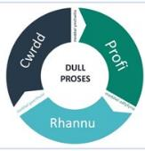
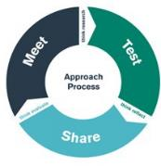
Amcanion / Aims
Profi addysgu a dysgu o fewn cyfnod oedran a chyd destun gwahanol i'r cyfnod oedran o'ch dewis.
Trawsnewid arfer bersonol drwy dri chyfnod o gymhwyso ymarfer: cwrdd, profi, rhannu.
Experience teaching and learning within a different age phase and context to your chosen age phase.
Transform personal practice through three phases of applied practice – meet, test, share.

Slide 44
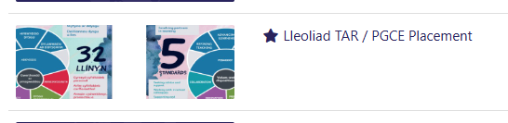
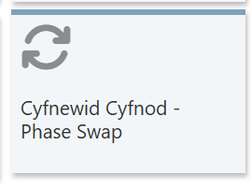
Dogfennaeth y Cyfnewid Cyfnod /
Phase Swap Documentation
Gallwch chi gael mynediad at y llyfryn Canllawiau Cyfnewid Cyfnod ar y teilsen Lleoliad TAR ar Moodle.
Access the Phase Swap Guidance booklet on the PGCE Placement tile on Moodle.
Course: Lleoliad TAR / PGCE Placement | Home

Slide 45

Trafodaeth
Discussion
Mathau o drosglwyddo
Types of transition
Ystyriaethau
Considerations
Trefniadau trosglwyddo effeithiol
Effective transitions
Tystiolaeth
Evidence

Slide 46
Trefniadau trosglwyddo a chynnydd
Mae rhannu’r cwricwlwm yn gyfnodau ar wahân, sy’n tueddu i gynnwys athroniaethau a dulliau gweithredu penodol, wedi arwain at greu pwyntiau trosglwyddo ychwanegol. Gwelir effeithiau negyddol yn y trosglwyddo rhwng y Cyfnod Sylfaen a Chyfnod Allweddol 2, rhwng Cyfnodau Allweddol 2 a 3, a rhwng Cyfnodau Allweddol 3 a 4. Ym mhob achos, mae’r newid yn yr athroniaeth neu’r dull gweithredu ar bwyntiau trosglwyddo yn gallu llesteirio cynnydd ac roedd tystiolaeth bod hyn yn gallu cyfrannu at ymddieithrio gan bobl ifanc wrth iddynt fynd drwy’r ysgol.
Donaldson 2015

Slide 47
Transitions and progression
Division into the separate stages, which tend to have distinctive philosophies and approaches, has had the effect of creating additional transition points. Negative effects are evident in the transitions between the Foundation Phase and Key Stage 2, Key Stages 2 and 3, and Key Stages 3 and 4. In each case, shifts in philosophy or approach at transition points can hinder progression and there was evidence that this could contribute to disengagement as young people progress through school.
Donaldson 2015

Slide 48
Beth yw cynnydd?
What is progression?

Slide 49
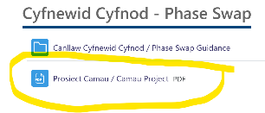
Prosiect Camau – Dysgu am gynnydd – llywio ein ffordd o feddwl am Gwricwlwm i Gymru.
Camau Project – Learning about progression – informing thinking about a Curriculum for Wales.
Darllenwch y cyflwyniad ar dudalennau 6-7 i gael dealltwriaeth o nodau a diben y prosiect.
Darllenwch dudalennau 21-22 ac ystyried a yw hyn yn cyd-fynd â’ch dealltwriaeth o gynnydd. Gwnewch gysylltiadau priodol i’ch amser ar PAP1.
Read the introduction on pages 6-7 to get an understanding of the aims and purpose of the project.
Read pages 21-22 and consider if this aligns with your understanding of progression. Make appropriate links to your time on PTE1.

Slide 50


Beth yw patrwm cynnydd?
What pattern does progression follow?

Slide 51
Gweithgaredd clip fideo
How transition arrangements support progression in the Jubilee Park Primary School cluster - YouTube
Ystyriwch y pwyntiau canlynol i’ch helpu i ofyn cwestiynau am y strategaethau trosglwyddo yn eich ysgol cyfnewid cyfnod:
Datblygu cyd-ddealltwriaeth o Gwricwlwm i Gymru
Datblygu cyd-ddealltwriaeth o ystyr dilyniant i bob plentyn – “Stori’r plentyn”; “profiad plentyn cyfannol”
Y strategaethau i gwrdd â’r her o gefnogi continwwm dysgu ar gyfer pob plentyn e.e. dysgu a datblygu athrawon ar y cyd ar draws clwstwr o ysgolion

Slide 52
Video clip activity
How transition arrangements support progression in the Jubilee Park Primary School cluster - YouTube
Consider the following points to help you to ask questions about the approach to transition strategies in your Phase Swap school:
The development of a shared understanding of Curriculum for Wales
The development of a shared understanding of the meaning of progression for each child – “The story of the child”; “the holistic child experience”
The strategies to meet the challenge of supporting the continuum of learning for each child e.g. joint learning and development of teachers across a cluster of schools

Slide 53
Beth nesaf?
What next?
Dilynwch ganllawiau’r ysgol ynghylch trefniadau ar gyfer 19/20/21/22 Ionawr.
Byddwch yn barod i drafod yr hyn yr ydych wedi’i ddysgu o’r sesiwn heddiw.
Ymgysylltwch yn llawn yn y profiad yn yr ysgol.
Cwblhewch adran adfyfyrio o’r llyfryn canllawiau Cyfnewid Cyfnod.
Follow school guidance regarding the arrangements for 19/20/21/22 January.
Be prepared to discuss your learnings from today’s session.
Engage fully in the experience in school.
Complete the reflection section of the Phase Swap guidance booklet

Slide 54
Tasg Adfyfyrio
Reflection Task
Ar ôl i chi gwblhau’r profiad Cyfnewid Cyfnod, bydd rhai i chi adfyfyrio’n bwrpasol ar sut y bydd yn effeithio ar eich ymarfer yn y dyfodol.
Rhaid cwblhau a lanlwytho’r ddogfen hon i’ch ffolder Sharepoint erbyn 30.01.26.
Once you have completed the Phase Swap experience, you will have to reflect purposefully on your practice will be impacted in the future.
This document must be completed and uploaded to your Sharepoint folder by 30.01.26.

Slide 55
Rhestr Gyfeiriadau/Reference List
Donaldson, G. (2015) Successful futures – independent review of curriculum and assessment arrangements in Wales
Jones, K. and Wiliam, D., (2022). Lethal mutations in education and how to prevent them. Evidence-Based Education, 13 October. Available at: https://evidencebased.education/resource/lethal-mutations-in-education-and-how-to-prevent-them/ [Accessed 12 December 2025]
Larrivee, B. (2000) ‘Transforming teaching practice: becoming the critically reflective teacher’, Reflective Practice, 1(3), pp 293-307
Ryan, M., (2011). Improving reflective writing in higher education: a social semiotic perspective. Teaching in Higher Education, 16(1), pp.99-111.
University of Glasgow and University of Wales, Trinity Saint David (2018). Learning about progression – informing thinking about a Curriculum for Wales.

Slide 56
Lleoliadau Amgen – TAR
Alternative Placements – PGCE
A: 28-29.01.26
B: 26/28.01.26
Neu eraill (gyda’r nos, penwythnosau, gwyliau)
Or other (evenings, weekends, holidays)

Slide 57
Amcanion / Aims
Profi addysgu a dysgu o fewn cyfnod oedran a chyd destun gwahanol i'r cyfnod oedran o'ch dewis.
Profi addysg sy’n digwydd o fewn lleoliad i ffwrdd o’r ystafell ddosbarth brif ffrwd.
Experience education happening within a setting away from the mainstream classroom.
Transform personal practice through three phases of applied practice – meet, test, share.

Slide 58
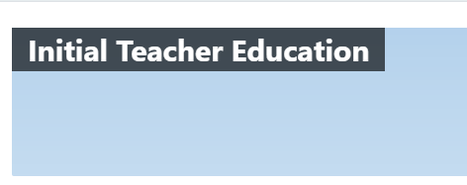
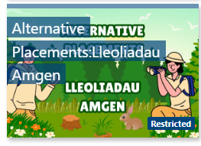
Dogfennaeth Lleoliad Amgen
Alternative Placement Documentation
Cewch fynediad at enghreifftiau’r Canllawiau Lleoliadau Amgen ar y deilsen Lleoliadau Amgen ar Moodle.
Access the Alternative Placement Guidance examples on the Alternative Placements tile on Moodle.
Notes:
Tile: Alternative Placements:Lleoliadau Amgen | Initial Teacher Education | Home

Slide 59
Tasg Adfyfyrio
Reflection Task
  Unwaith y byddwch wedi cwblhau’r profiad Lleoliad Amgen, bydd angen i chi ei gofnodi. Mae sawl dull gwahanol y gallwch eu defnyddio, fel y rhennir ar Moodle.
  Rhaid cwblhau hyn a’i lwytho i fyny i’ch ffolder SharePoint erbyn 13.04.26.
Once you have completed the Alternative Placement experience, you will have to document this. There are various methods you can use as shared on Moodle.
This must be completed and uploaded to your Sharepoint folder by 13.04.26.

