Slide 1

MSc Public Health and Social Care in Practice
Module Code: LCHS7003
Module: Community Care and Management of Longer-term Conditions
Assignment Title: Understanding, Managing, and Preventing Asthma in the UK
Lecturer:Brian Mashumba
Name | I.D.
Tarikul Islam | 2422390
Presentation Date: 10th December 2025

Slide 2


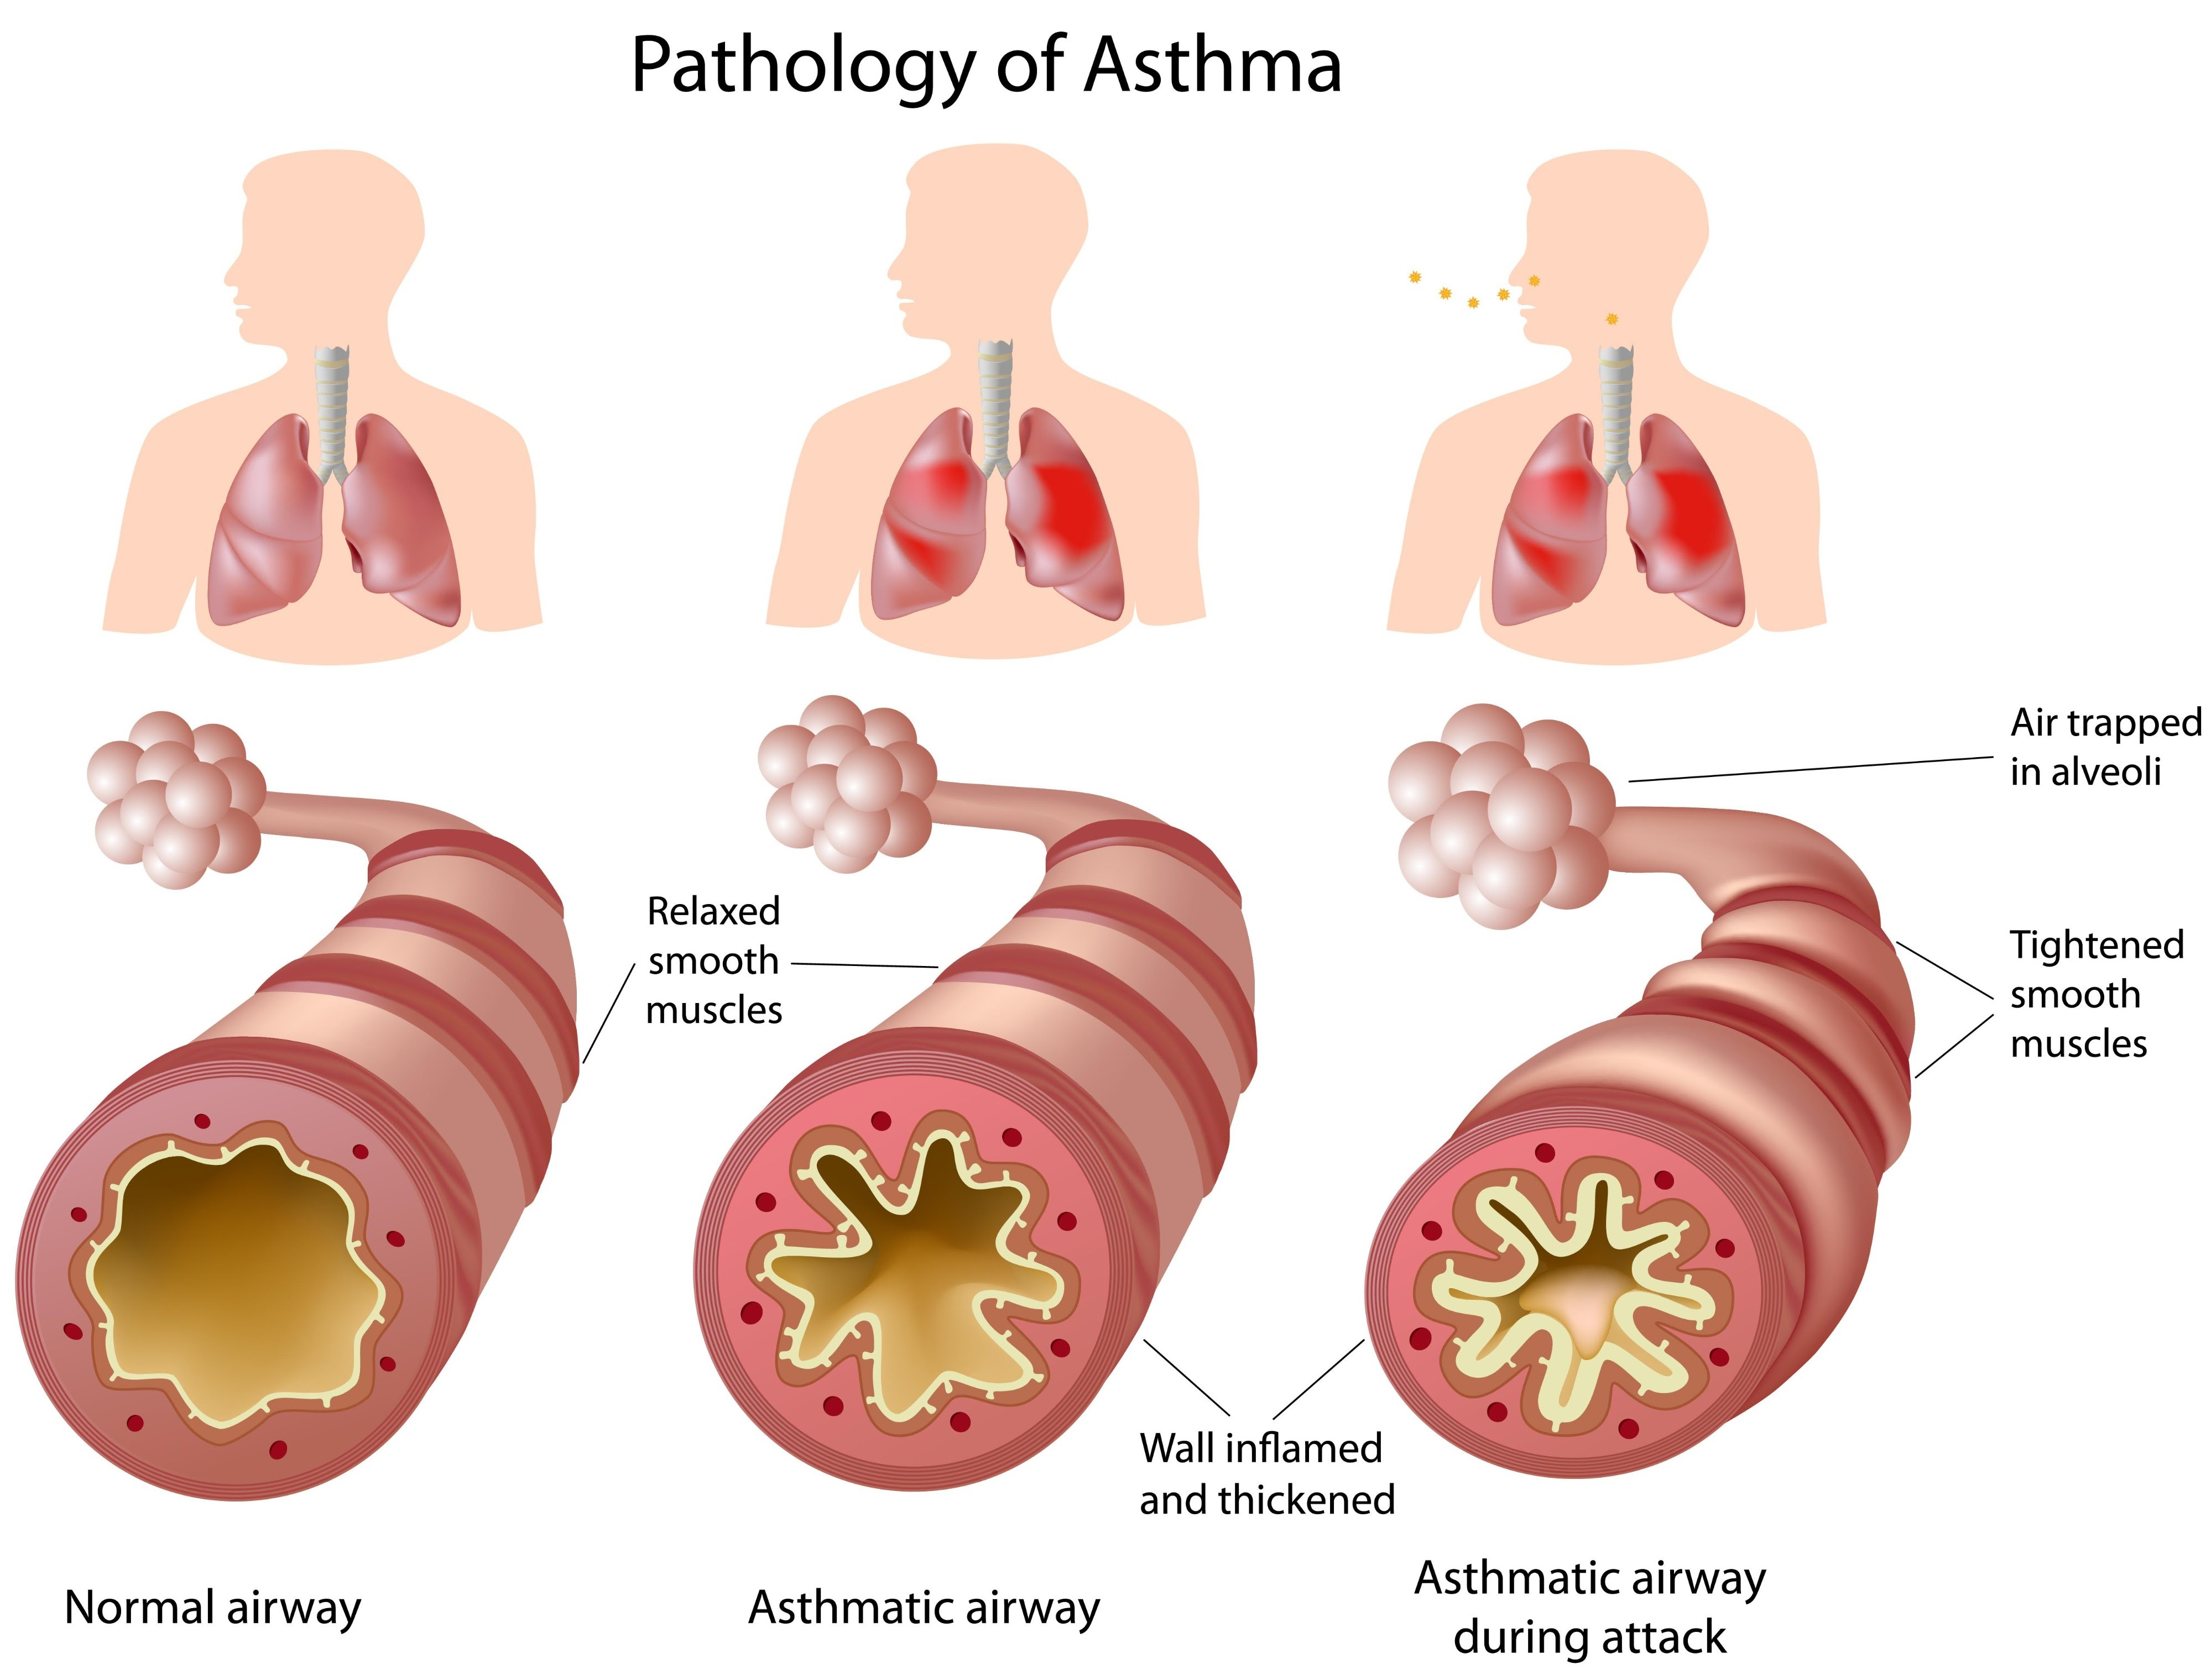

Overview of Asthma
Variable Airflow Obstruction & Bronchial Hyper-responsiveness:
Asthma is a prevalent and complex chronic inflammatory disorder of the airways that significantly impacts respiratory health globally. It is essential for Primary Care Nurses to understand its core characteristics for effective management.
Asthma is marked by recurring, variable symptoms and reversible airflow obstruction (NHLBI, 2007).
Bronchial hyper-responsiveness (BHR) causes exaggerated airway reactions to triggers like allergens, exercise, or cold air, leading to bronchoconstriction (Chaudhuri & MacNee, 2004; GINA, 2024).
Chronic Inflammatory Airway Disease:
Asthma is fundamentally characterized by chronic inflammation of the bronchial airways, involving various cells and cellular elements, such as mast cells, eosinophils, and T lymphocytes (National Heart, Lung, and Blood Institute, 2007).
Long-term Condition with Continuous Monitoring:
Asthma has no cure; management aims for symptom control and preventing exacerbations (GINA, 2024).
Continuous monitoring and patient self-management—correct inhaler use, symptom tracking, and an Asthma Action Plan—are essential (Chaudhuri & MacNee, 2004; GINA, 2024).

Slide 3







Symptoms of Asthma
The hallmark symptoms of asthma result from the underlying airway inflammation, which causes bronchoconstriction and excessive mucus production, leading to airflow limitation (Asthma + Lung UK, 2024).
Wheezing
Shortness of Breath (Dyspnoea)
Chest Tightness
This is a high-pitched, whistling sound, typically heard when the patient breathes out (exhales), caused by air being forced through narrowed airways.
A restrictive feeling in the chest, which may be described as a squeezing sensation or a band tightening around the chest. This is a direct consequence of the muscles around the airways contracting.
Patients often describe this as feeling breathless, unable to take a deep breath, or struggling to get air into or out of their lungs.

Slide 4

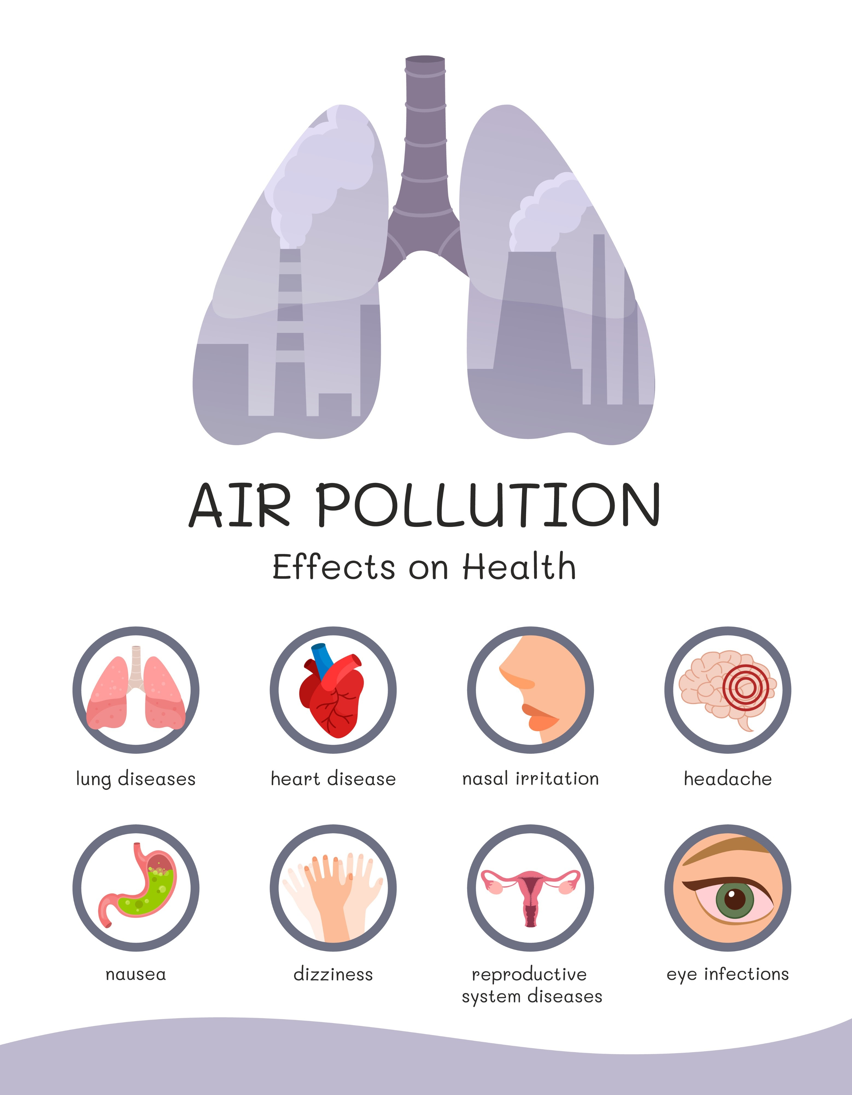
Aetiology
Environmental Triggers
The development of asthma is multifactorial, arising from a complex interplay between genetic predisposition and environmental exposures throughout life (Global Initiative for Asthma, 2024).
Early-life viral infections (RSV, rhinovirus) can damage airways and increase asthma risk (NHS, 2025).
Air pollution (indoor/outdoor, traffic-related) increases development and severity of asthma (Asthma + Lung UK, 2024).
Tobacco smoke exposure (maternal smoking, secondhand smoke) is a major risk factor (NHS, 2025).
Occupational irritants (wood dust, chemical fumes) can cause adult-onset asthma (American Lung Association, 2025).
Genetic Predisposition
Strong family history of asthma or atopic conditions (eczema, allergic rhinitis) increases risk (Asthma + Lung UK, 2024).
Atopic phenotype: tendency to produce IgE antibodies to common allergens (AAFA, 2022).
Lifestyle and Socioeconomic Factors
Obesity is linked to higher asthma risk and more severe symptoms (American Lung Association, 2025).
Poor housing and socioeconomic deprivation increase exposure to allergens, smoke, and pollution, raising exacerbation risk (RCPCH, 2019).

Slide 5



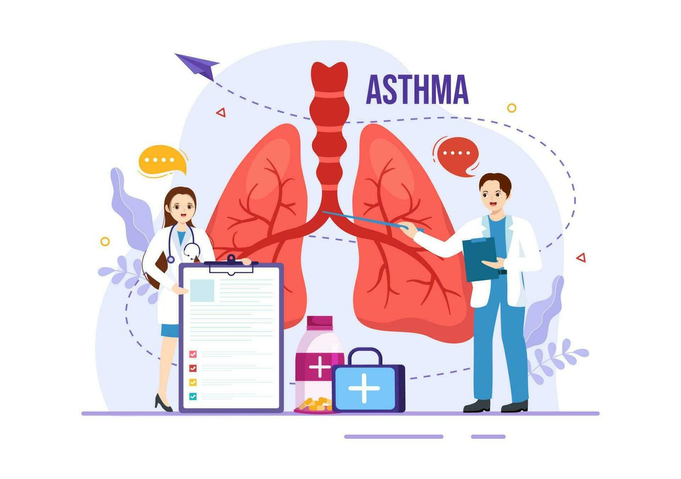





Prevalence (UK & Global)
Asthma represents a significant public health challenge, affecting millions worldwide.
UK Prevalence
Worldwide Burden
Global Trends
Approximately 5.4 million people in the UK are currently receiving treatment for asthma (Asthma + Lung UK, 2025). This equates to roughly 1 in 12 adults and 1 in 11 children affected, placing the UK among the countries with the highest rates of asthma prevalence in Europe (Asthma + Lung UK, 2025).
Globally, an estimated 300 to over 330 million people live with asthma (Global Initiative for Asthma, 2023; World Health Organization, cited in GINA, 2023).
While the overall prevalence of asthma symptoms remains higher in high-income countries (HICs), the disease burden, particularly severe asthma and mortality, is disproportionately high in low- and middle-income countries (LMICs) due to gaps in diagnosis and appropriate management (Global Asthma Network, 2018; Frontiers, 2023).

Slide 6
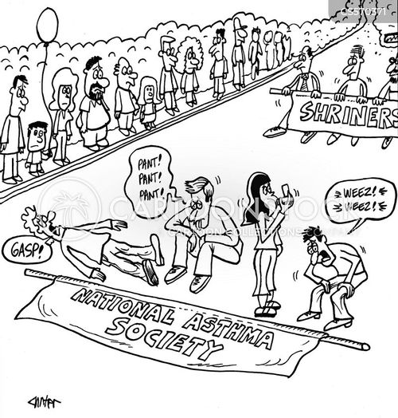

Economic & Social Burden
Patient Convenience
Patient Comfort
Financial Cost to the NHS: Asthma is estimated to cost the NHS approximately £3 billion annually (Asthma + Lung UK, 2019; Demos, 2021). This cost is primarily driven by high expenditure on medications (prescribing costs), emergency care, and GP/nurse consultations.
High Acute Care Utilisation: Poorly controlled asthma leads to over 60,000 emergency admissions per year in the UK, highlighting avoidable resource use and the severity of exacerbations (Asthma + Lung UK, 2019).
Patient Compliance
Patient Satisfaction
Wider Societal Impact: Asthma significantly impacts quality of life, often causing reduced quality of life, sleep disruption, and limitations on physical activity (Demos, 2021). The condition is also linked to millions of lost workdays and school days annually, incurring indirect costs to the wider economy (Demos, 2021).
Health Inequalities: Asthma disproportionately affects individuals in deprived communities, who experience higher rates of emergency admissions, greater disease severity, and are at increased risk of death due to greater exposure to environmental triggers and poorer access to quality routine care (Asthma + Lung UK, 2023).

Slide 7

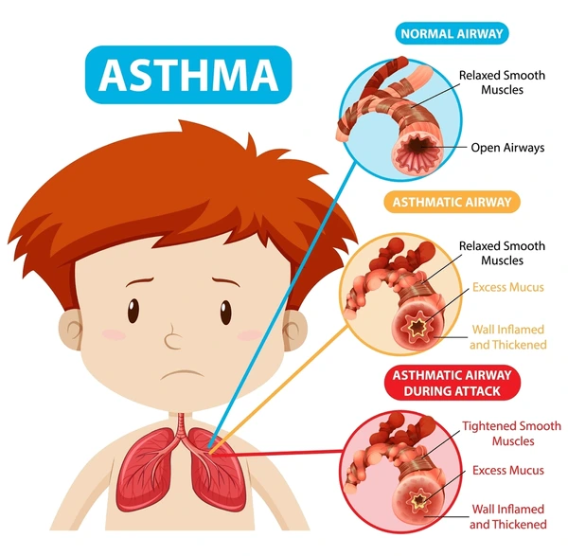
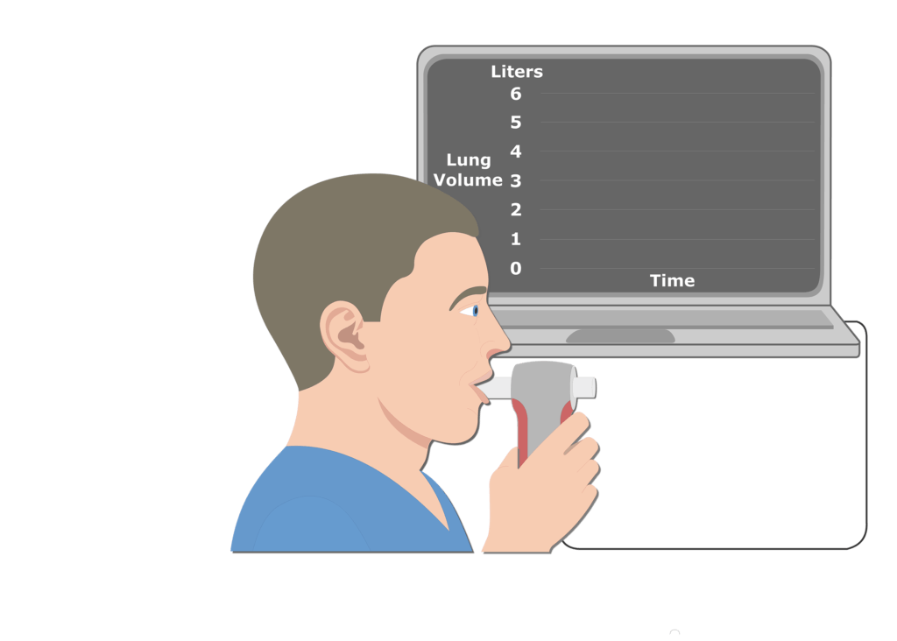
Diagnosis & Initial Assessment
Objective Diagnosis Tests
Asthma diagnosis in the UK follows NICE/BTS/SIGN guidelines (NG245, Nov 2024), combining clinical assessment with objective tests to reduce misdiagnosis (BTS/NICE/SIGN, 2024).
FeNO Testing: Measures exhaled nitric oxide as a marker of eosinophilic inflammation; positive if ≥50 ppb in adults, ≥35 ppb in children (BTS/NICE/SIGN, 2024).
Spirometry with Bronchodilator Reversibility (BDR): FEV1/FVC <70% indicates obstruction; BDR positive if FEV1 increases ≥12% and ≥200 mL in adults, or ≥12% in children (BTS/NICE/SIGN, 2024).
Initial Assessment
Symptom History: Detailed review of wheeze, cough, shortness of breath, chest tightness, noting timing (nocturnal/early morning) and triggers (BTS/NICE/SIGN, 2024).
Risk Factors: Identify exacerbation risks—overuse of SABA (>2 inhalers/year), non-adherence, previous hospital admissions (BTS/NICE/SIGN, 2024).
Allergy Testing: Consider skin prick or blood tests (total IgE, eosinophils) if allergy is suspected, especially when other tests are inconclusive (BTS/NICE/SIGN, 2024).

Slide 8


Management Frameworks & Models
Asthma management is structured by key national and international guidelines and service models, ensuring coordinated, patient-centered care.
NICE Guidance (NG245, 2024): The National Institute for Health and Care Excellence (NICE) provides evidence-based guidance for the diagnosis, monitoring, and chronic management of asthma in the UK (BTS/NICE/SIGN, 2024). This forms the core clinical standard for Primary Care Nurses.
GINA Global Strategy: The Global Initiative for Asthma (GINA) provides an annually updated, internationally recognized strategy focusing on cycles of assessment, adjustment, and review to optimize management (Global Initiative for Asthma, 2024).
NHS Long-Term Plan & Personalised Care: The NHS prioritizes personalised care and shared decision-making (House of Care Model), emphasizing patient empowerment and supporting self-management through the use of written Asthma Action Plans (NHS, 2019).
Chronic Care Model (CCM): The CCM supports coordinated, multidisciplinary care, integrating the community, self-management support, and clinical information systems to improve outcomes for long-term conditions like asthma (Wagner, 1998).

Slide 9
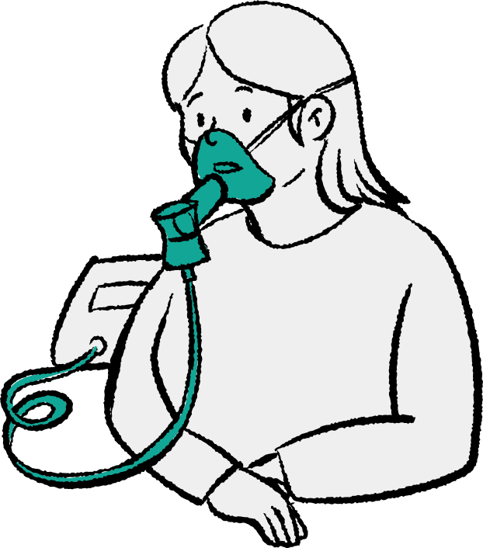
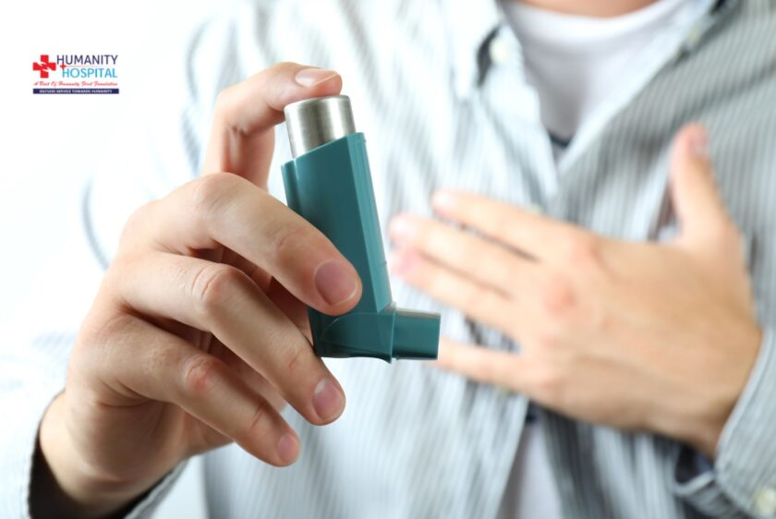
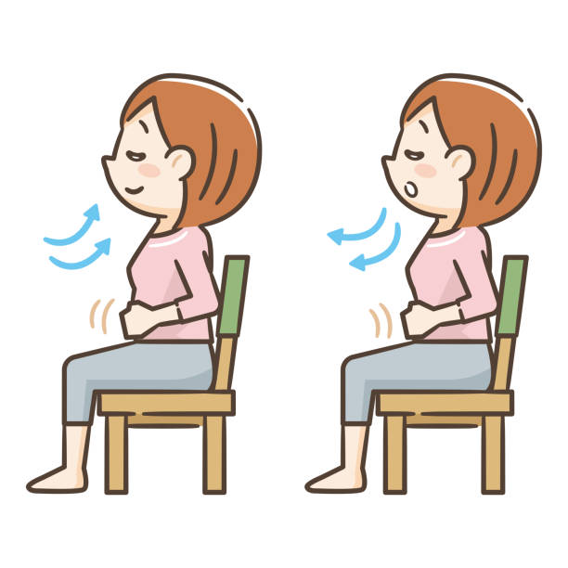
Treatment Options in the UK
Pharmacological Management
Non-Pharmacological Strategies
Anti-inflammatory Reliever Therapy (AIR) / ICS: ICS/Formoterol as needed is the preferred first-line reliever for adults/adolescents (12+); ICS is key for controlling inflammation (BTS/NICE/SIGN, 2024).
Short-acting bronchodilators (SABA): Should not be used alone; must be combined with ICS due to overuse risks (BTS/NICE/SIGN, 2024).
Long-acting beta-agonists (LABA): Combined with ICS (e.g., MART) for Step 2+ to maintain bronchodilation and reduce inflammation (BTS/NICE/SIGN, 2024).
Add-on Therapies: Leukotriene receptor antagonists (Montelukast) and LAMAs for uncontrolled asthma on moderate ICS/LABA (BTS/NICE/SIGN, 2024).
Biologic Therapies: Reserved for severe, refractory asthma under specialist care (e.g., Omalizumab) (NICE, 2024).
Trigger Avoidance & Smoking Cessation: Nurses provide guidance and support to reduce exposure and promote cessation (BTS/NICE/SIGN, 2024).
Breathing Exercises: Referral to physiotherapy for techniques like Buteyko may improve quality of life and reduce hyperventilation symptoms (BTS/NICE/SIGN, 2024).

Slide 10

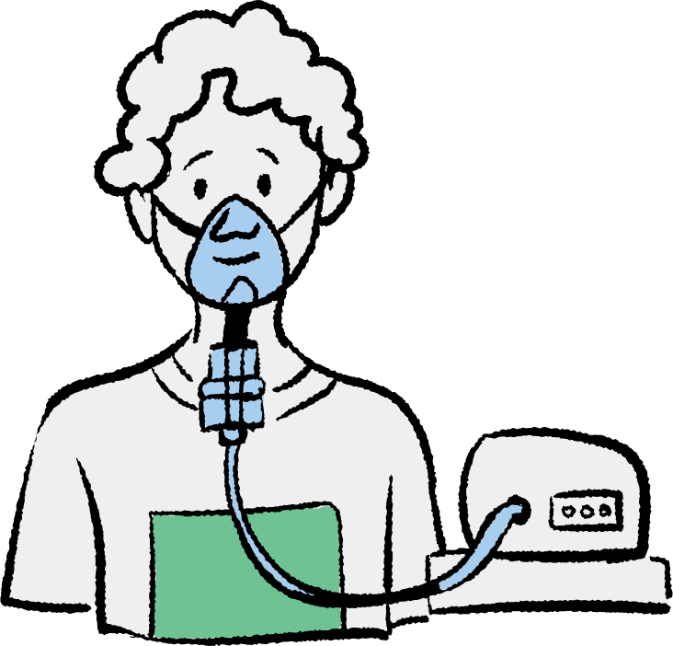

Common Comorbidities
Asthma frequently co-exists with other chronic conditions, which can significantly worsen asthma symptoms and make effective treatment more challenging (BTS/NICE/SIGN, 2024; GINA, 2024).
Allergic Rhinitis (Hay Fever) & Eczema/Atopic Dermatitis: These are common atopic diseases that often occur with asthma. Treating allergic rhinitis, for example, is essential as uncontrolled symptoms can directly impact asthma control (GINA, 2024).
Gastro-oesophageal Reflux Disease (GORD): Reflux of stomach acid can irritate the upper airway and trigger asthma symptoms, particularly nocturnal cough and wheezing (BTS/NICE/SIGN, 2024).
Obesity: Linked to both an increased risk of developing asthma and poorer control in those who already have it, often requiring higher levels of inhaled steroids (Global Initiative for Asthma, 2024).
Clinical Relevance: Primary Care Nurses must screen for and actively manage these comorbidities as part of a holistic asthma review to improve patient outcomes (BTS/NICE/SIGN, 2024).

Slide 11






Prevention Strategies
Effective prevention strategies, focusing on environmental control and risk reduction, are vital for minimizing asthma exacerbations and improving control (GINA, 2024).
Reducing Exposure to Known Triggers: Nurses must educate patients on identifying and mitigating exposure to specific personal allergens (e.g., dust mites, pet dander, mould) and irritants. This personalized approach reduces airway inflammation (Asthma + Lung UK, 2024).
Smoking and Vape Avoidance: Complete avoidance of all tobacco products and vaping (including second-hand smoke exposure) is crucial, as smoking causes inflammation and accelerates lung function decline (BTS/NICE/SIGN, 2024).
Vaccinations: Annual Influenza and up-to-date COVID-19 vaccinations are strongly recommended for people with asthma to prevent severe respiratory infections that commonly trigger life-threatening exacerbations (GINA, 2024).

Slide 12


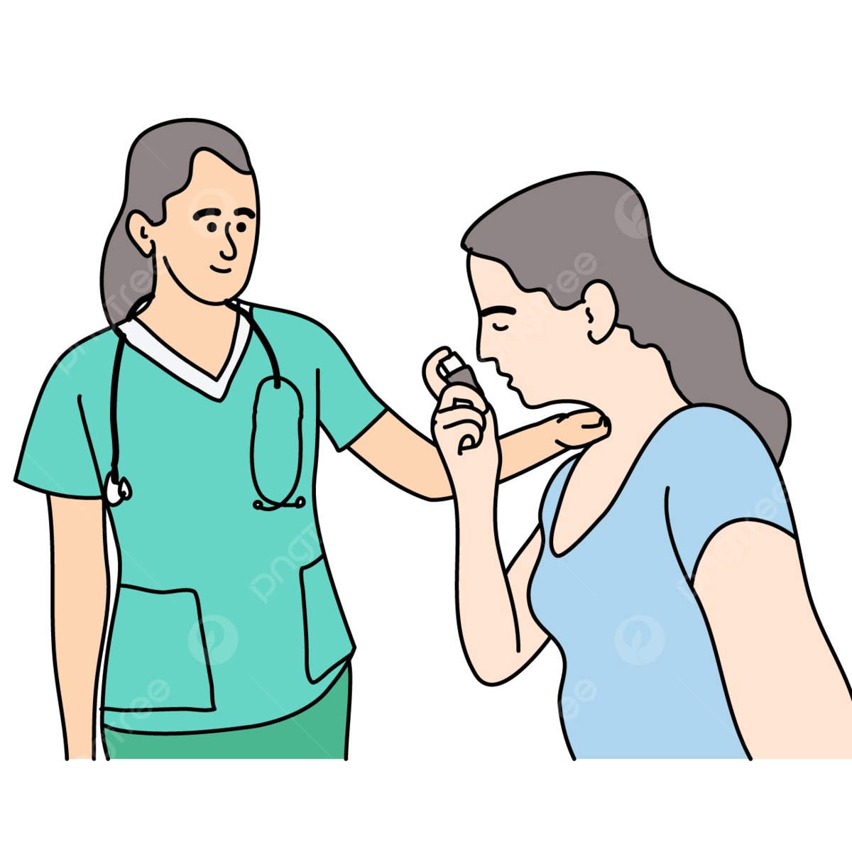


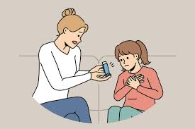
Skills, Values & Behaviours for Co-Productive Care
1. Active listening and empathy
2. Shared decision-making
3. Respect for cultural and personal beliefs
4. Motivational interviewing for adherence

Slide 13



Fauget
Using the Comprehensive Model of Personalised Care
Shared Decision-Making (SDM)
01
Personalised Care and Support Planning
02
Supported Self-Management (SSM)
03
Social Prescribing
04
Community-Based Support
05
Choice and Control
06

Slide 14




Recommendations
To significantly improve asthma outcomes and align with UK national strategy, Primary Care Nurses should prioritize the following actions:
  Implement Personalised Care and Self-Management
  Prioritize Inhaler Technique
  Adopt Anti-inflammatory Reliever Therapy (AIR)
  Screen for Comorbidities:

Slide 15
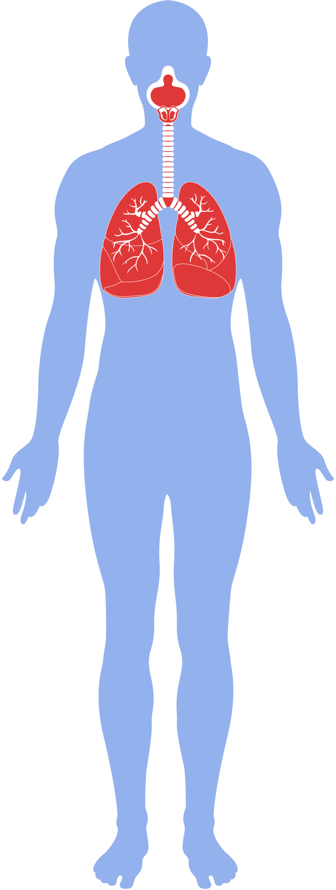
Conclusion
The primary role of the Primary Care Nurse is to drive personalised, co-productive care. This is best done by ensuring every patient has a thorough understanding of their condition, uses a written Asthma Action Plan, and demonstrates correct inhaler technique. Shifting to ICS-based reliever therapy and actively managing comorbidities are key clinical actions that will reduce exacerbations, lower the economic burden, and dramatically improve the quality of life for people living with asthma.

Slide 16
Reference:
Chaudhuri, R. & MacNee, W. (2004). Chronic inflammation and asthma. Indian Journal of Medical Research, 120(3), pp. 165–171. Available at: https://pmc.ncbi.nlm.nih.gov/articles/PMC2923754/ (Accessed 6 December 2025).
Global Initiative for Asthma (GINA). (2024). Global Strategy for Asthma Management and Prevention. Available at: https://ginasthma.org/2024-report/ (Accessed 6 December 2025).
National Heart, Lung, and Blood Institute. (2007). Section 2, Definition, Pathophysiology and Pathogenesis of Asthma, and Natural History of Asthma. National Institutes of Health. Available at: https://www.ncbi.nlm.nih.gov/books/NBK7223/ (Accessed 6 December 2025).
Asthma + Lung UK. (2024). Symptoms of asthma. Available at: https://www.asthmaandlung.org.uk/conditions/asthma/symptoms-asthma (Accessed 6 December 2025).
Asthma and Allergy Foundation of America (AAFA). (2022). What Are Asthma Symptoms?. Available at: https://aafa.org/asthma/asthma-symptoms/ (Accessed 6 December 2025).
Mayo Clinic. (2025). Asthma - Symptoms and causes. Available at: https://www.mayoclinic.org/diseases-conditions/asthma/symptoms-causes/syc-20369653 (Accessed 6 December 2025).
NHS inform. (2024). Asthma: Symptoms. Available at: https://www.nhsinform.scot/illnesses-and-conditions/lungs-and-airways/asthma/ (Accessed 6 December 2025).
American Lung Association. (2025). Asthma Causes & Risk Factors. Available at: https://www.lung.org/lung-health-diseases/lung-disease-lookup/asthma/learn-about-asthma/what-causes-asthma (Accessed 6 December 2025).
Asthma + Lung UK. (2024). What causes asthma?. Available at: https://www.asthmaandlung.org.uk/conditions/asthma/what-asthma (Accessed 6 December 2025).
Asthma and Allergy Foundation of America (AAFA). (2022). What Are Asthma Symptoms?. Available at: https://aafa.org/asthma/asthma-symptoms/ (Accessed 6 December 2025).
Global Initiative for Asthma (GINA). (2024). Global Strategy for Asthma Management and Prevention. Available at: https://ginasthma.org/2024-report/ (Accessed 6 December 2025).
NHS. (2025). Asthma - Causes. Available at: https://www.nhs.uk/conditions/asthma/ (Accessed 6 December 2025).
Royal College of Paediatrics and Child Health (RCPCH). (2019). Asthma. State of Child Health. Available at: https://stateofchildhealth.rcpch.ac.uk/evidence/long-term-conditions/asthma/ (Accessed 6 December 2025).
Asthma + Lung UK. (2025). Asthma Statistics Report 2025 - The Latest Facts. Available at: https://www.chemist-4-u.com/guides/research-insights/asthma-statistics/ (Accessed 7 December 2025).
Frontiers. (2023). Gaps in asthma diagnosis and treatment in low- and middle-income countries. Available at: https://www.frontiersin.org/journals/allergy/articles/10.3389/falgy.2023.1240259/full (Accessed 7 December 2025).
Global Asthma Network (GAN). (2018). Global Asthma Report. Available at: http://globalasthmareport.org/burden/burden.php (Accessed 7 December 2025).
Global Initiative for Asthma (GINA). (2023). GINA 2023 Full Report. Available at: https://ginasthma.org/wp-content/uploads/2023/05/GINA-2023-Full-Report-2023-WMS.pdf (Accessed 7 December 2025).
British Thoracic Society (BTS), National Institute for Health and Care Excellence (NICE) and Scottish Intercollegiate Guidelines Network (SIGN). (2024). Asthma: diagnosis, monitoring and chronic asthma management (NG245). Available at: https://www.nice.org.uk/guidance/ng245 (Accessed 7 December 2025).

