Slide 1

Effective Team-working and Communication
(BMSW4009)

Slide 2
Team member
Student name Florentina Barbulescu
Student ID 2324276
Lecter Melanie Square
Area covered Application of Communication skills in work place

Slide 3

Application of communication skills in workplace
  Presentation overview:
1. Introduction
2. How effective communication skills were applied to resolve conflicts, facilitate collaboration and achieve common goals in the workplace
3. Discuss the impact of clear and concise communication on team dynamics, project outcomes and overall organisational success
4. Highlight the importance of continuous improvement in communication skills, trough feedback, reflection, and practice

Slide 4
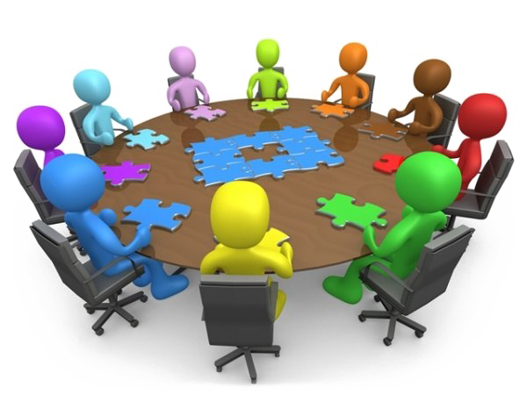
1.Introduction
It is this crucial to earmark continuous enhancement of the flow of communication with feedback supplement by self-awareness seasons and frequent training (Tuckman and Harper, 2012)
Clear and concise communication is essential for effective teamwork, successful project outcomes, and overall organizational success.
By integrating feedback, reflection, and practice into your communication development process, you can continuously enhance your communication skills, build stronger relationships, and achieve greater success in your personal and professional development.

Slide 5

2.How effective communication skills were applied to resolve conflicts, facilitate collaboration and achieve common goals in the workplace
Resolving conflicts
-Active listening
- Empathy
-Clarifying communication
Facilitating collaboration
-Clear and concise communication
-Regular updates
-Conflict resolution
Achieving common goals
-Vision
-Motivation
- Team building
There are often conflicts between two team members and it can occur during a project meeting when the two are making a stand one the direction of the project( Stadler,2019).
This Photo by Unknown Author is licensed under CC BY-NC-ND

Slide 6
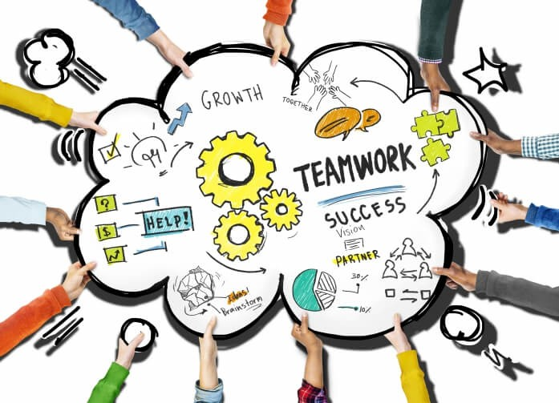
3.Discuss the impact of clear and concise communication on team dynamics, project outcomes, and overall organisational success
Team dynamics
-Improved understanding
-Enhanced collaboration
Project outcomes
-Reduced errors and rework
-Enhanced quality
Organisational success
-Increased productivity
-Improve customers satisfactions
(Mercader et al., 2021).

Slide 7

4.Highlight the importance of continuous improvement in communication skills trought feedback, reflection, and practice.
Feedback
- Identifying the blind spots
- Motivation for growth
Reflection
- Learn from experience
Goals settings
Practice
- Skill development
- Adaptability

Slide 8
Conclusion!
The presentation has highlighted an overview of the communication skills in the workplace.
Some essential communication skills have been analysed that become
relevant in a workplace environment.

Slide 9
References
Belbin, R. M., (2010) Team roles at work, (2nd edition). London: Routledge.
2. Mercader, V., Galván-Vela, E., Ravina-Ripoll, R. and Popescu, C.R.G., (2021). A focus on ethical value under the vision of leadership, teamwork, effective communication and productivity. Journal of Risk and Financial Management, 14(11), p.522.
3.Stadler, S., (2019). Conflict, Culture and Communication, Milton: Routledge.
4.Tuckman, B.W. and Harper, B.E. (2012) Conducting educational research. 6th edn. United
States: Rowman &amp;amp; Littlefield Publishers.

