Slide 1
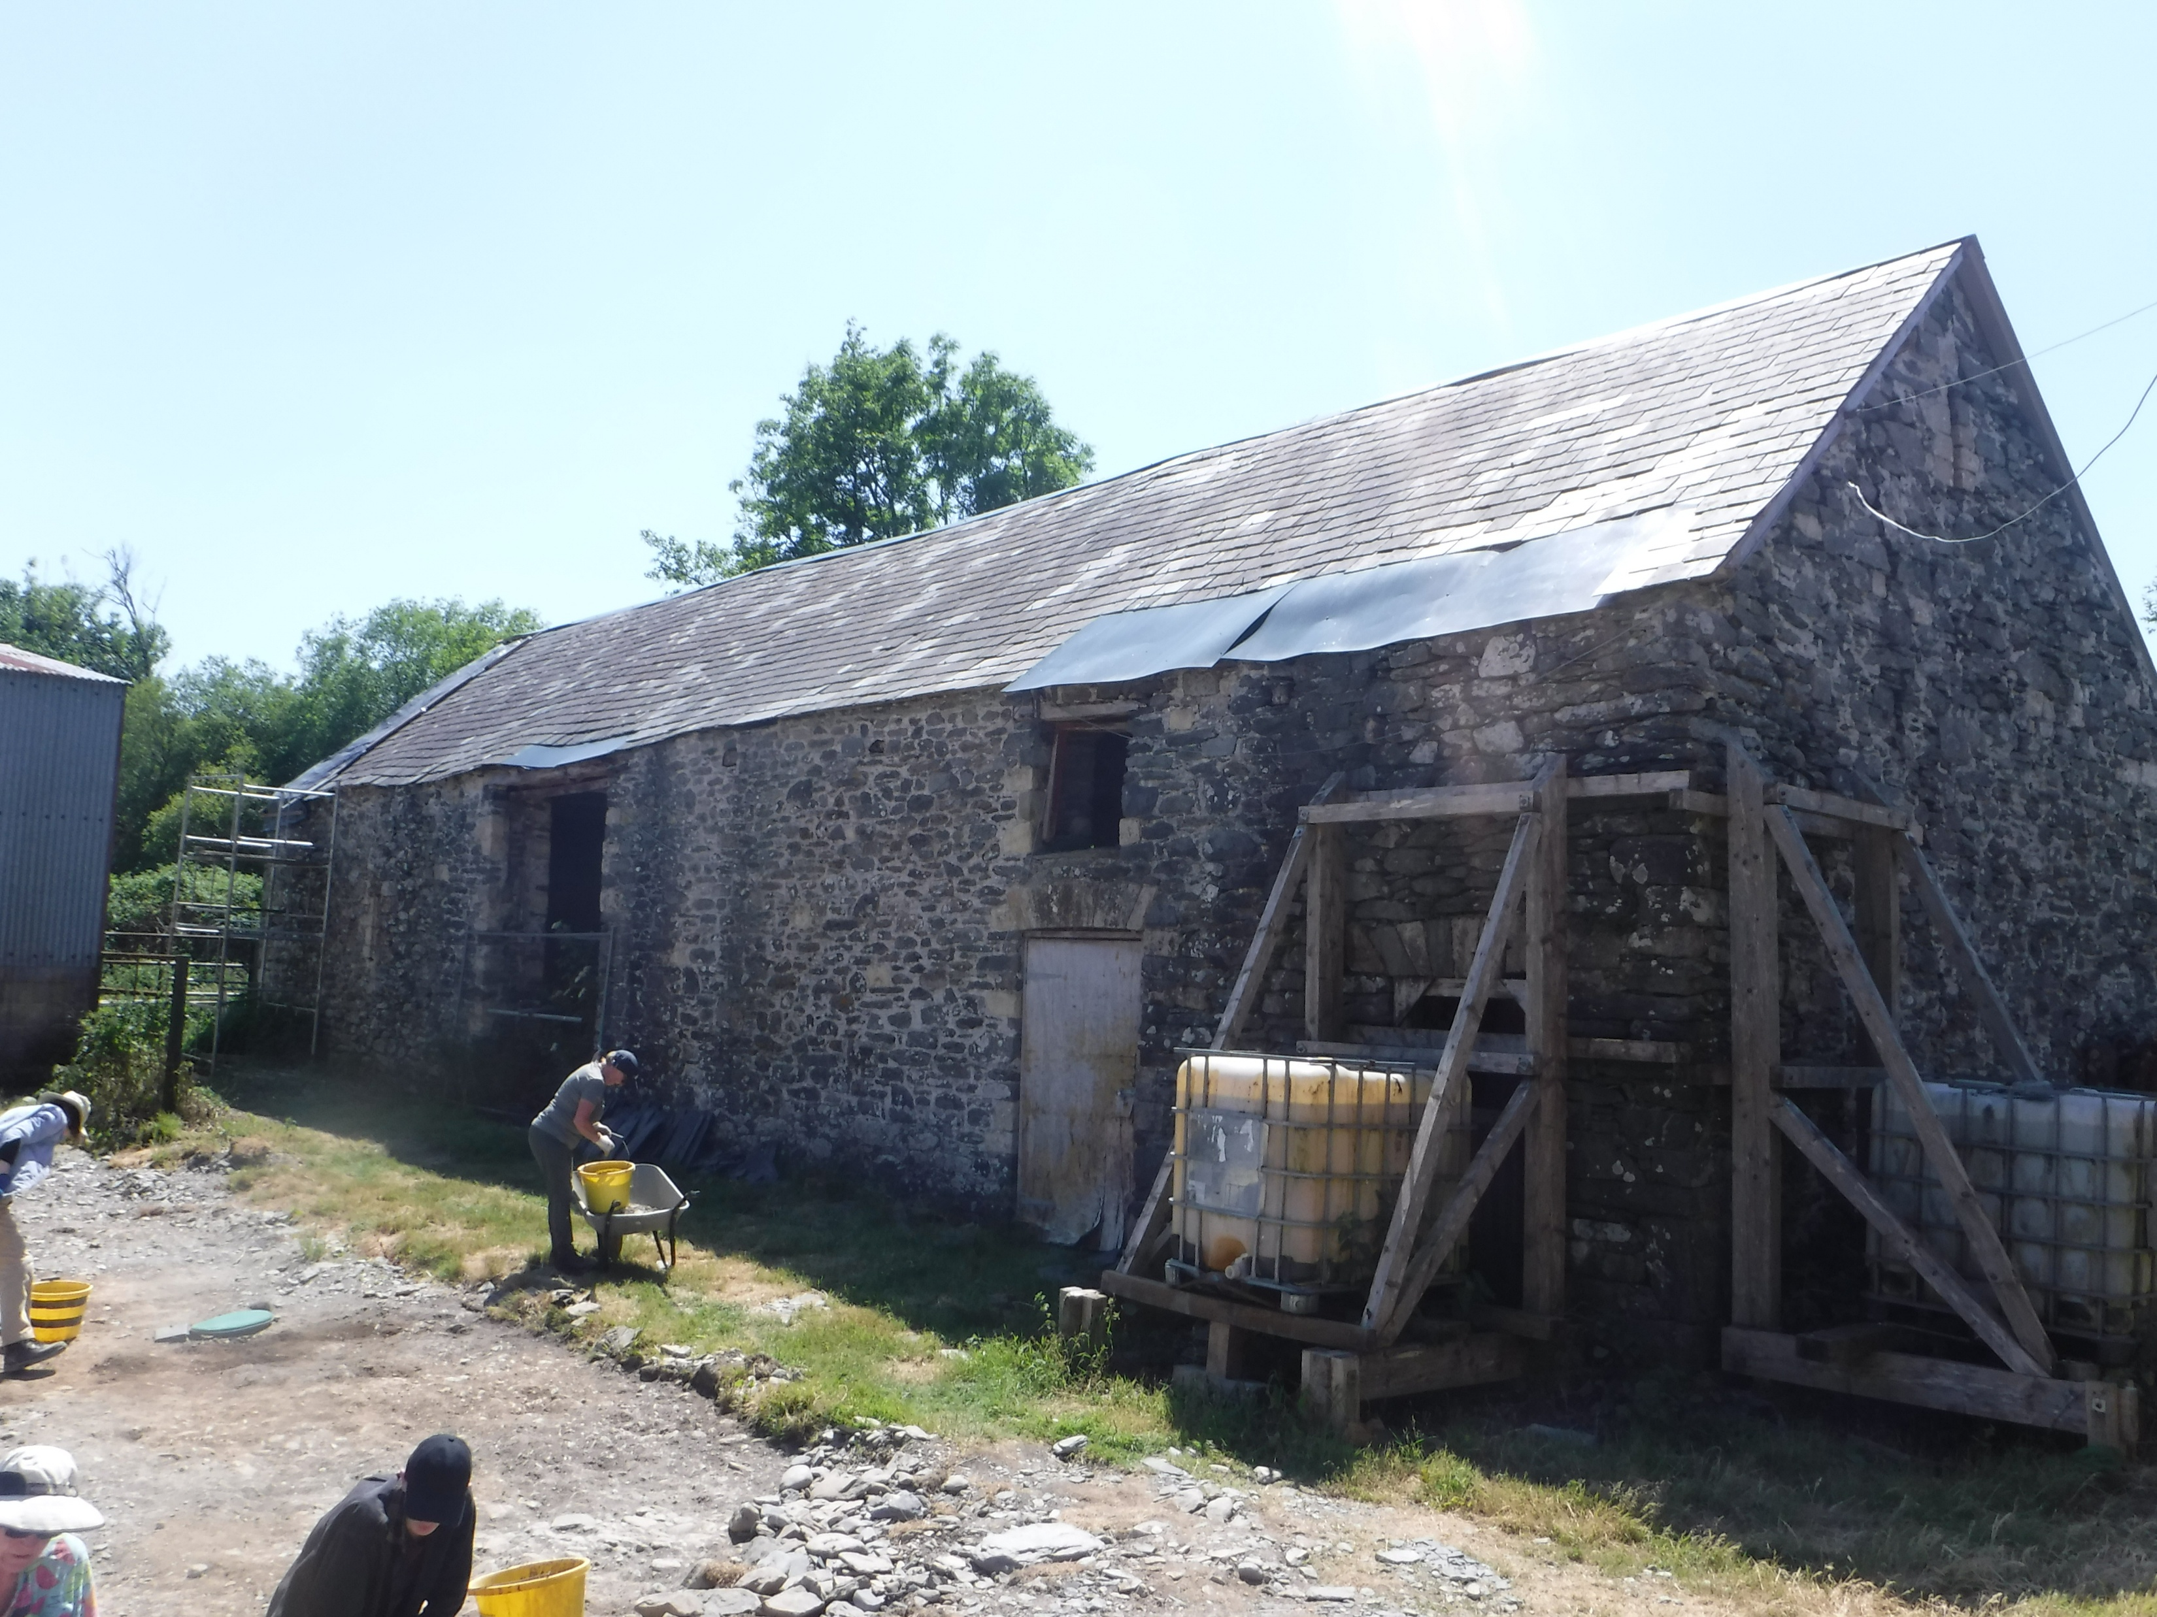
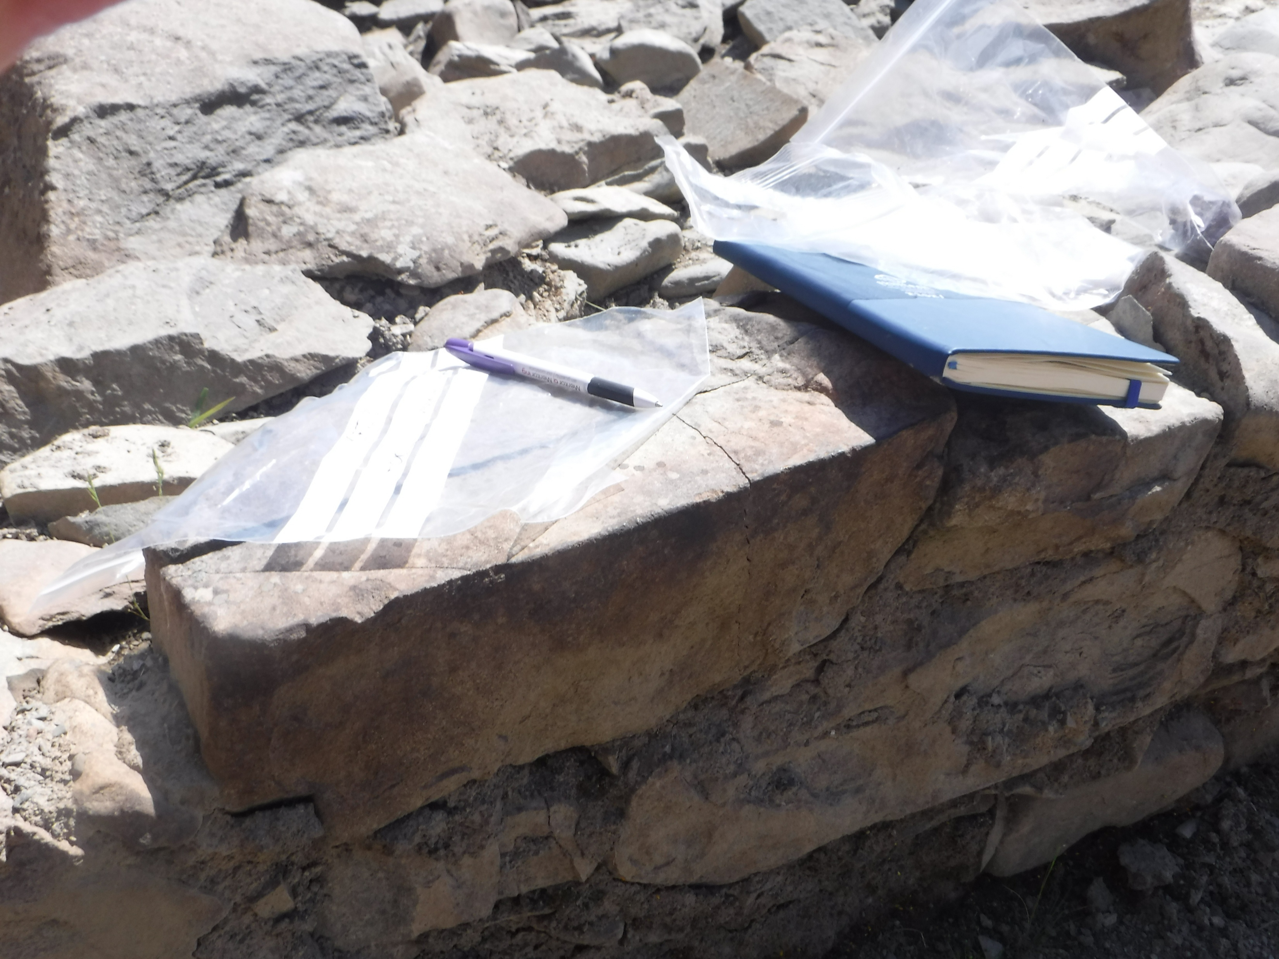
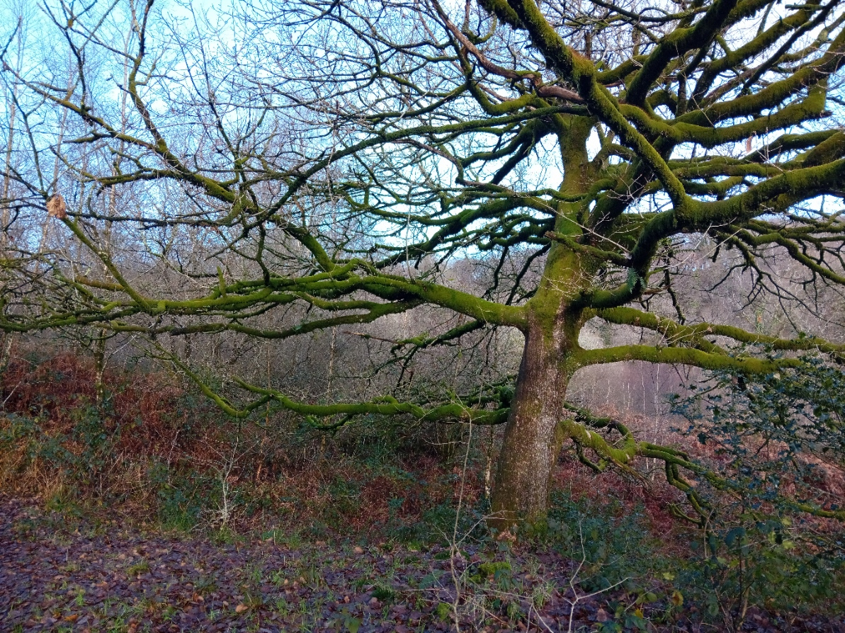
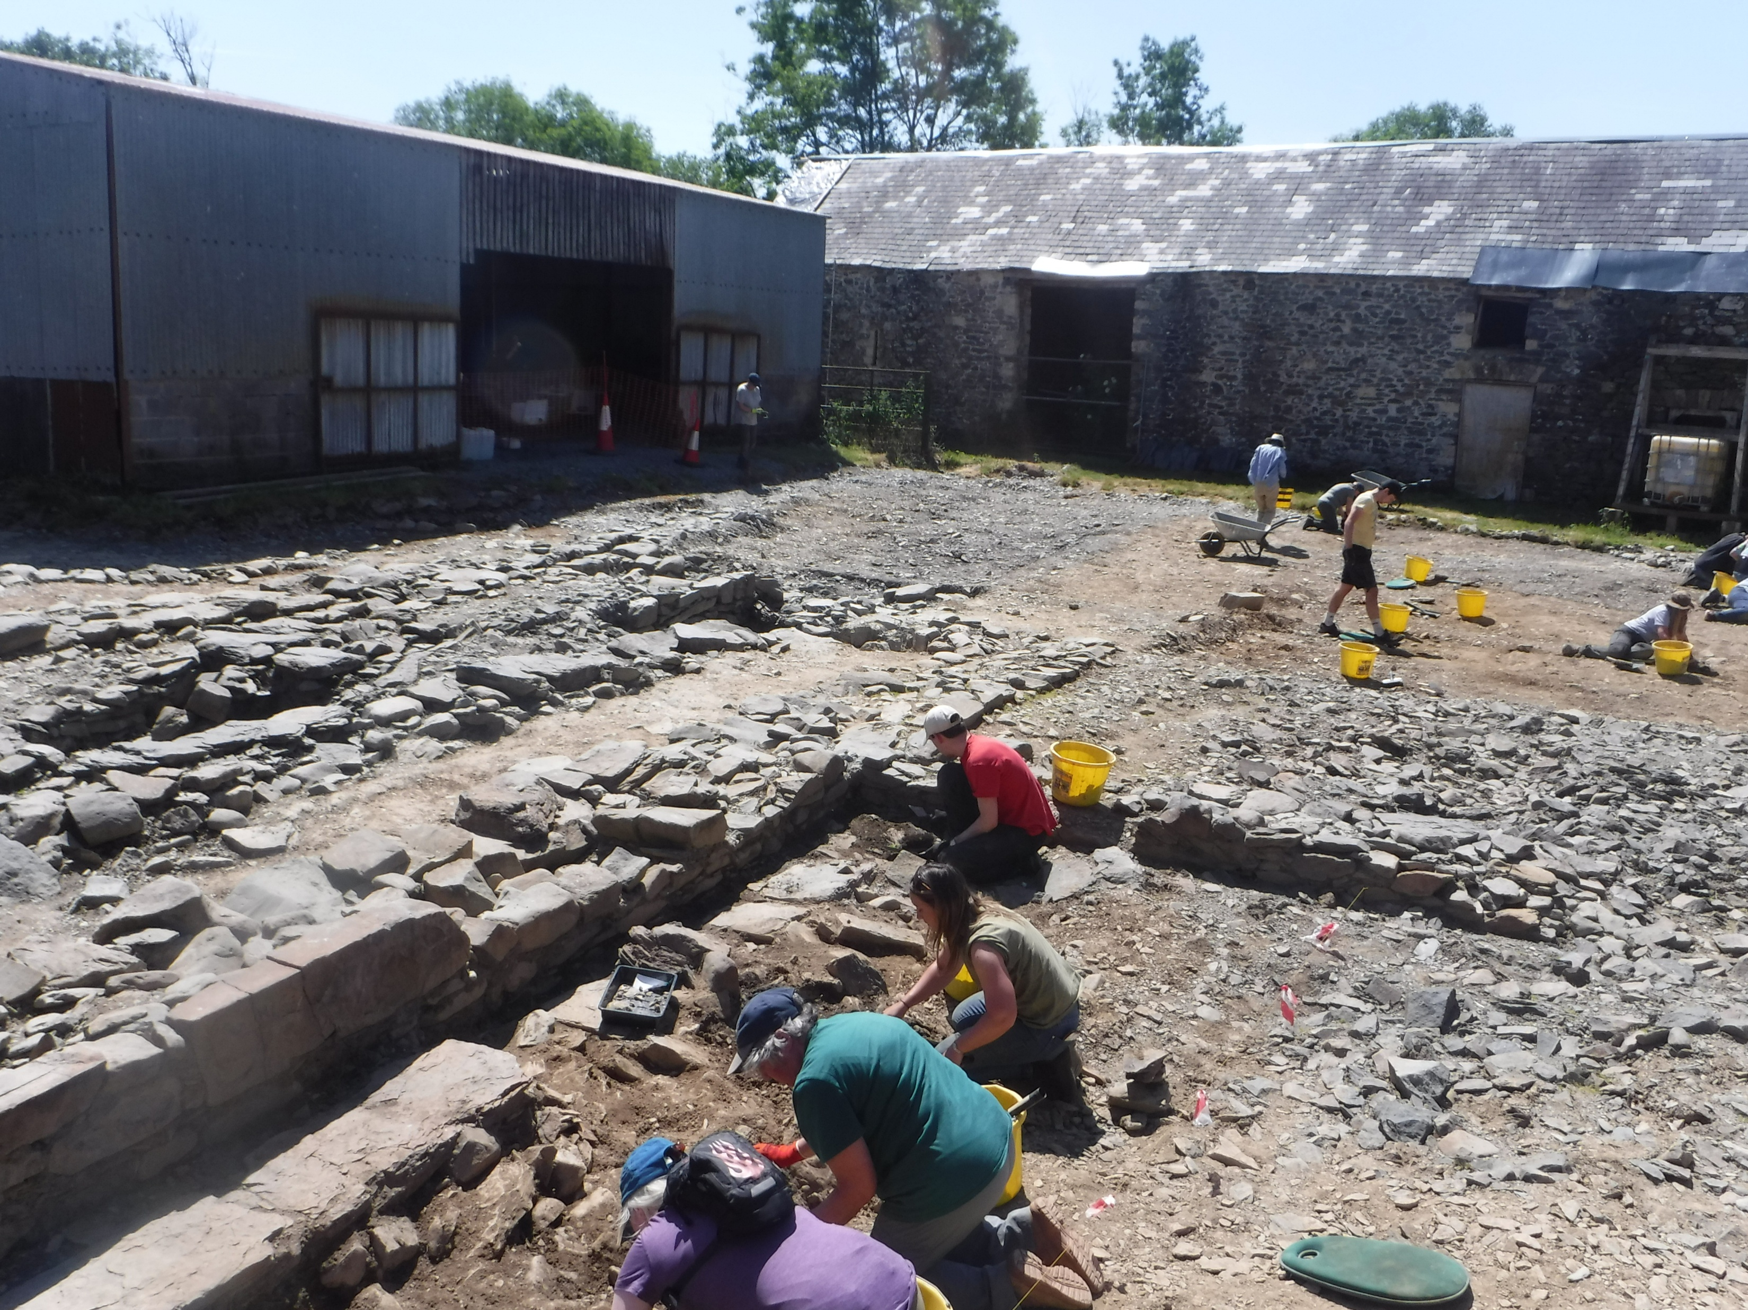
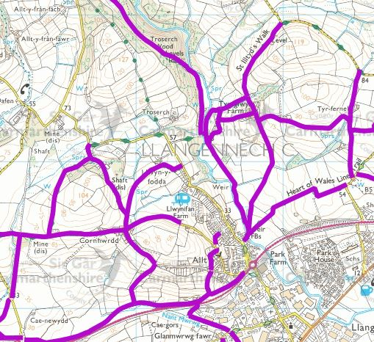
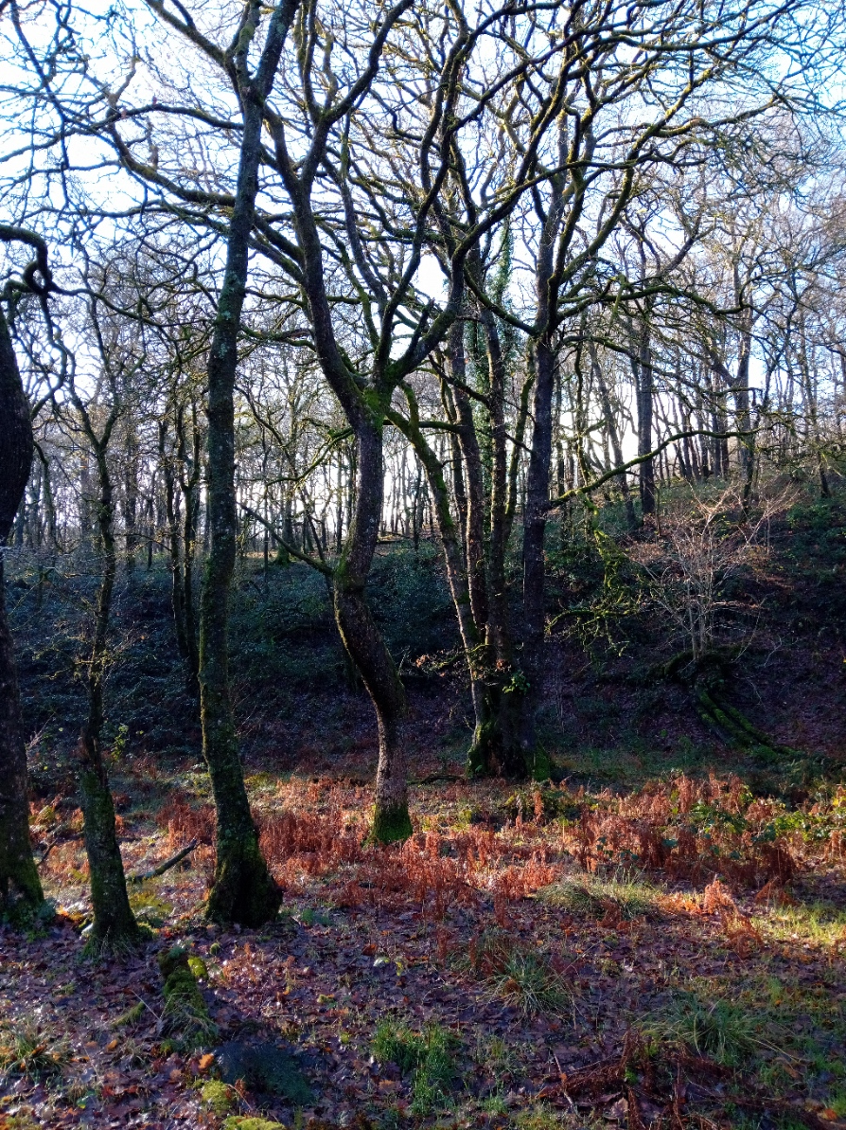
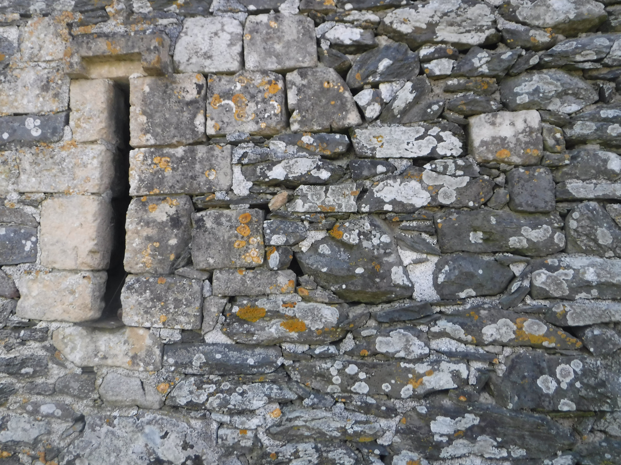
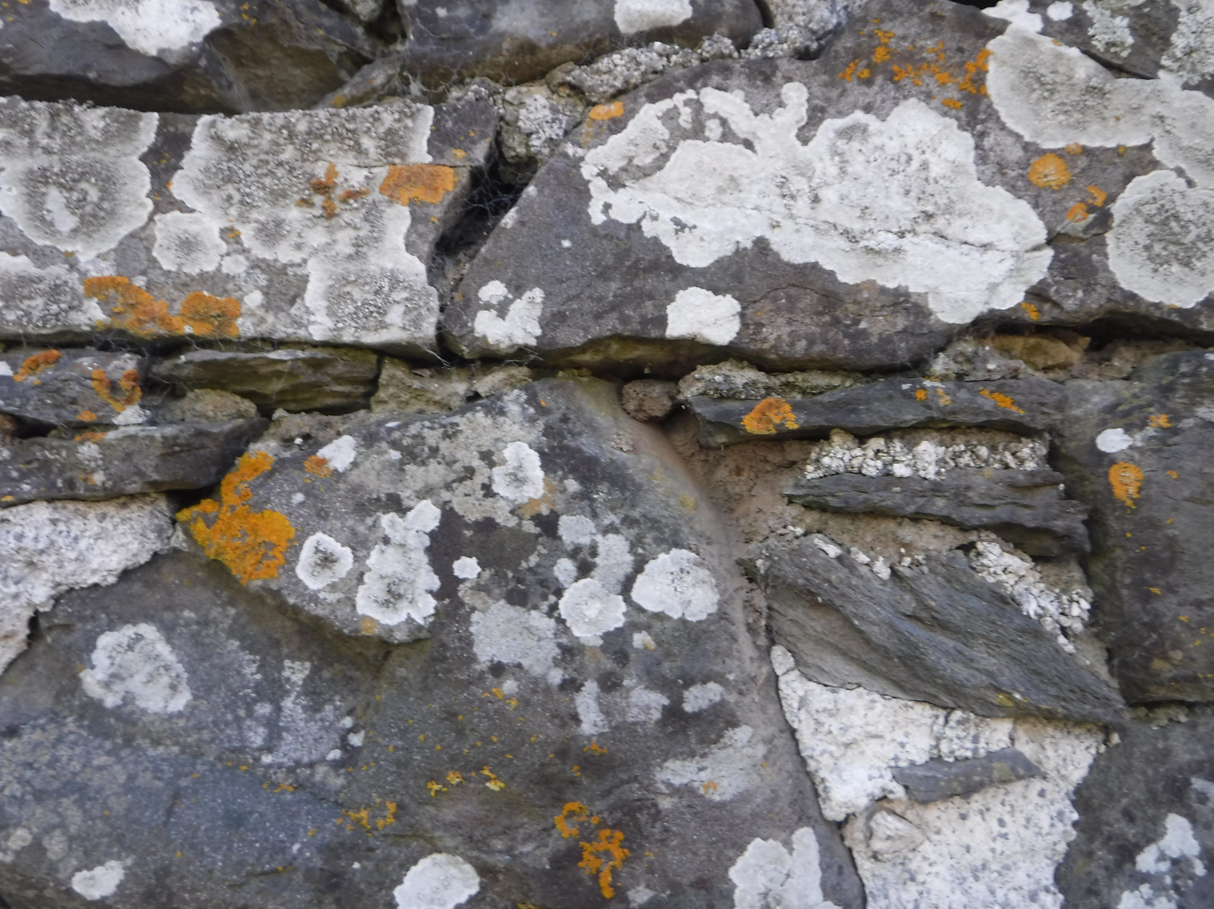
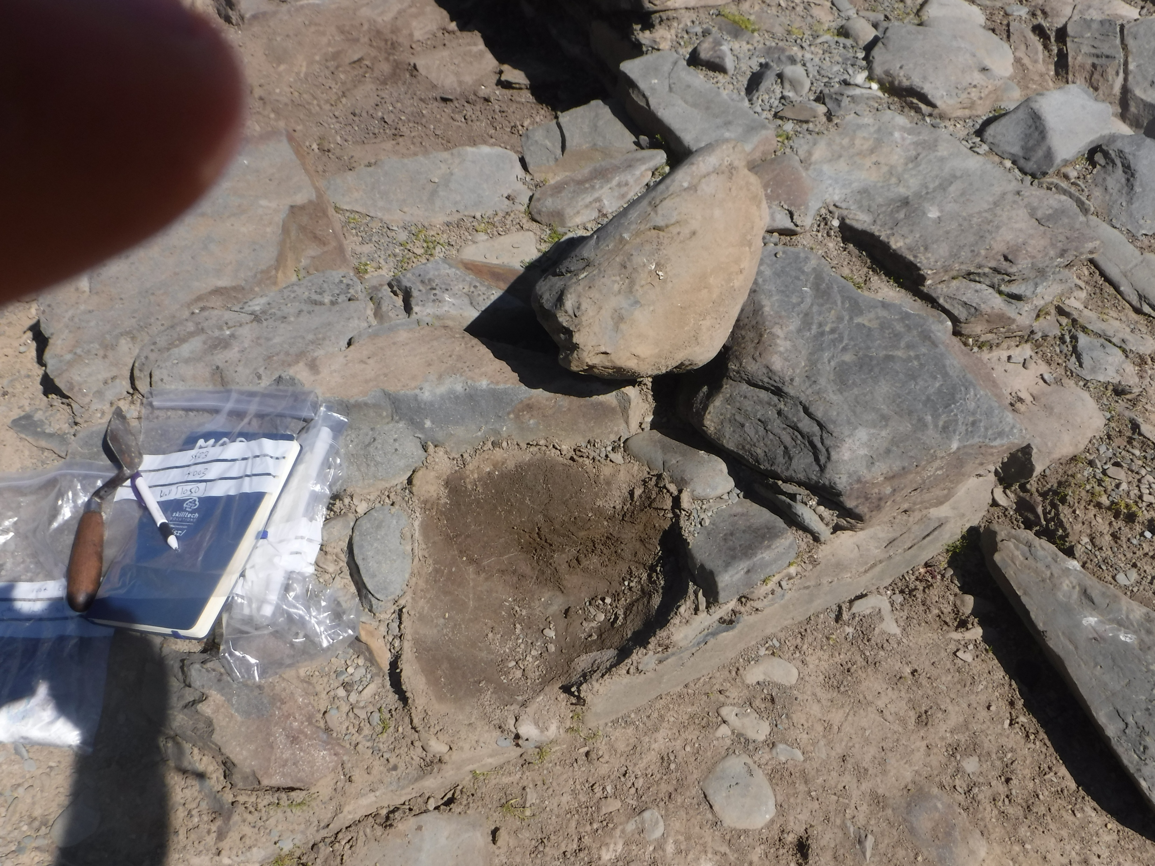
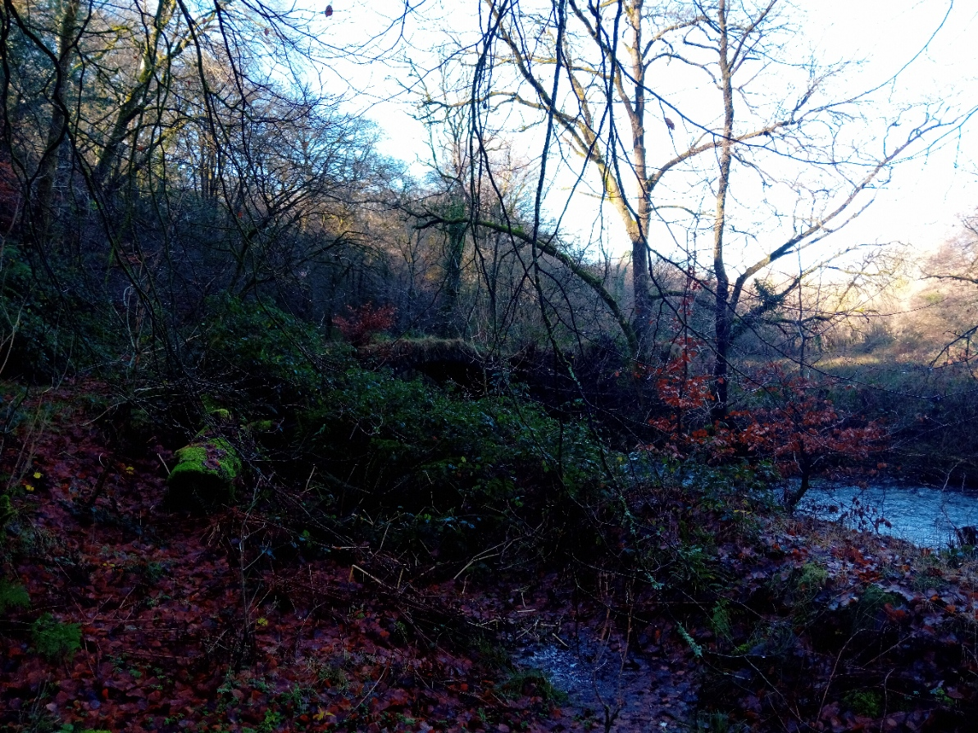
Excavations at Strata Florida 2023
Martin Locock 2342354
Caption saying what the pic is, what it tells you, and source
Caption saying what the pic is, what it tells you, and source
Caption saying what the pic is, what it tells you, and source
Caption saying what the pic is, what it tells you, and source
Caption saying what the pic is, what it tells you, and source
Caption saying what the pic is, what it tells you, and source
Caption saying what the pic is, what it tells you, and source
Caption saying what the pic is, what it tells you, and source
Caption saying what the pic is, what it tells you, and source
Caption saying what the pic is, what it tells you, and source

Slide 2
Reflection (200 words)
These images have been chosen………
Upload a single document onto Turnitin which includes the text and images your
Pinterest board and a brief description (200 words) help the marker contextualise your board. You should also include references (not in the word count) etc etc etc etc

Slide 3
References (not in word count)
Image 1: from Drew, Q 2023 Recent work at strata Florida www.sf.ac.uk/trench1.jpg.
Image 2: etc
etc

