Slide 1
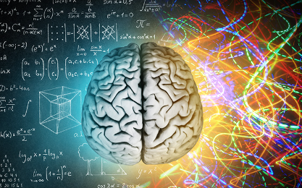
issues of Emotional Intelligence Emotional Intelligence(EI)
Touqir Hanif
Student ID : 2107037
Issues of Emotional Intelligence(EI)

Slide 2
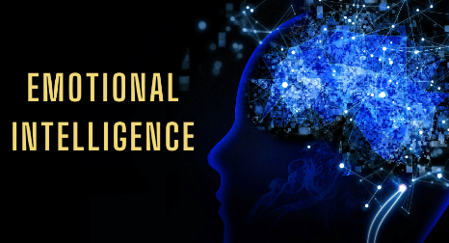
Introduction
Emotional Intelligence (EI)
The ability to recognize, understand, and manage own emotions as well as to respond effectively to the emotions of others.
To enhance communication, reduce stress, and build stronger relationships both personally and professionally.
To contribute to improved mental and physical health, better work performance, and deeper personal connections.
To control my feelings, handle stress, communicate better, and build stronger relationships by being more aware of how emotions affect me and those around me.
Notes:
Introduction
Emotional Intelligence (EI) is the ability to recognize, understand, and manage own emotions as well as to respond effectively to the emotions of others. It helps enhance communication, reduce stress, and build stronger relationships both personally and professionally (Emmadi, 2017). By being aware of emotions, I can make better decisions, foster empathy, and maintain a positive environment. This poster discovers the potential benefits of EI and EI skills such as self-awareness, empathy, and effective communication, which contribute to improved mental and physical health, better work performance, and deeper personal connections.
Emotional Intelligence (EI)
Emotional Intelligence (EI) is the ability to understand and manage own emotions as well as recognize and respond to the emotions of others (Emmadi, 2017). It helps me control my feelings, handle stress, communicate better, and build stronger relationships by being more aware of how emotions affect me and those around me.

Slide 3
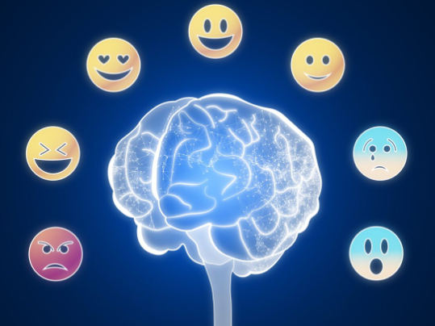
The Potential Benefits of Emotional Intelligence (EI)
To enhance communication, enabling clearer understanding and expression of emotions, and fostering better connections with others.
To better understand self and others for managing reactions and improving relationships.
To contribute positively to mental health by reducing stress and anxiety, while physical health benefits.
To enhance communication, reduce stress, and build stronger relationships both personally and professionally.
To control my feelings, handle stress, communicate better, and build stronger relationships by being more aware of how emotions affect me and those around me.
To make better decisions, foster empathy, and maintain a positive environment.
Notes:
The Potential Benefits of Emotional Intelligence (EI)
Emotional intelligence (EI) is vital for personal and professional success. It enhances communication, enabling clearer understanding and expression of emotions, and fostering better connections with others (Nguyen, et al., 2019). I with stronger EI can realize that being aware of my emotions allows me to better understand myself and others for managing reactions and improving relationships. EI also contributes positively to mental health by reducing stress and anxiety, while physical health benefits from reduced emotional strain and its impact on the body (Jiménez-Picón, et al., 2021).
I can overcome challenges by assessing my emotions, leading to better decision-making and communication. Relationship management becomes smoother as EI fosters empathy and understanding, allowing for constructive conversations and resolving conflicts (Kotsou, et al., 2019). Strong EI in the workplace can help me in relationship management with colleagues. By staying mindful of my emotions, I can manage stress effectively and keep a positive working environment even in challenging situations. Improved communication leads to clearer interactions and less conflict, which boosts work performance (Kotsou, et al., 2019). Additionally, self-management enables me to handle tasks with more focus and control, which enhances resilience during tight deadlines or setbacks.
Similarly, EI in personal relationships helps maintain deeper connections with family and friends, enhancing trust and mutual respect. Resilience is another key benefit, allowing individuals to cope with challenges more effectively, bounce back from adversity, and remain focused. Additionally, EI promotes self-management, empowering individuals to regulate their emotions, leading to greater self-control (Pool, and Qualter, 2018). Social intelligence improves due to increasing awareness of others’ emotions and behaviours, which helps navigate social situations smoothly. Ultimately, all these aspects together enhance work performance, as emotional regulation and clear thinking lead to better outcomes in professional settings.

Slide 4
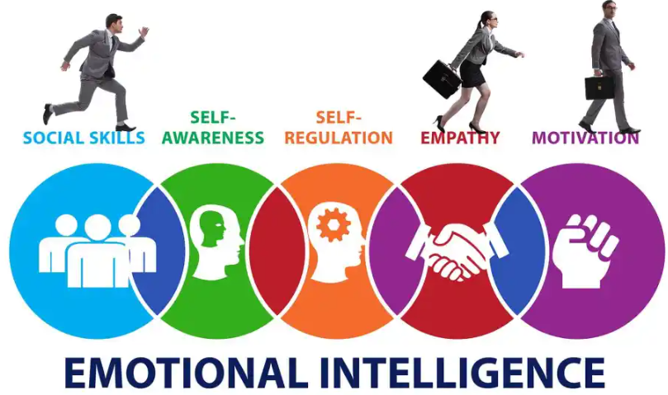
The Type of EI Skills
Key emotional intelligence skills are self-awareness, empathy, and effective communication.
To build better relationships and maintain personal and professional balance.
To provide constructive feedback with insights to encourage growth.
To promote connection and reduce conflict, and it encourages a more compassionate approach to personal, social and professional life.
Emotional awareness is a prerequisite for self-protection from manipulation.
To maintaining positive relationships in personal, social and professional life through forgiving and forgetting.
To understanding and considering other perspectives for inclusivity and problem-solving in competitive workplaces.
To be flexible and open to adjust to contemporary changes
Notes:
The Type of EI Skills
Key emotional intelligence skills involve self-awareness, empathy, and effective communication. Emotional Intelligence (EI) skills are essential for building better relationships and maintaining personal and professional balance (Pool, and Qualter, 2018). Acknowledging and giving constructive feedback allows me to share insights in a way that encourages growth. It helps foster trust and growth in any environment.
Being unafraid to apologize shows emotional maturity and strengthens trust. Having compassion for others deepens connections and helps me understand their emotions. Understanding and feeling what others are going through promotes connection and reduces conflict, as it encourages a more compassionate approach (Di Fabio, and Saklofske, 2021). Keeping my word and controlling my thoughts are crucial for building credibility and maintaining calmness. The ability to forgive and forget is essential for moving past conflicts and maintaining positive relationships in personal, social and professional life (Bru-Luna, et al., 2021). I am open to change, adjust my approach when necessary, and flexible in various situations.
I have strong emotional control to facilitate my thoughts and organize my emotions and ideas before reacting. Active listening to others helps build affinity and ensures others feel respected or valued. Active listening enhances communication and builds deeper understanding (Bușu, 2020). Protecting myself from manipulation is another valuable skill that requires emotional awareness. It involves recognizing when someone is trying to take advantage of emotions and setting healthy boundaries. Being able to understand and consider other perspectives fosters inclusivity and problem-solving (Bușu, 2020). It allows me for better collaboration and to perform effectively in competitive workplaces. Lastly, the ability to think before speaking or acting is a hallmark of emotional intelligence, which prevents spontaneous decisions and encourages thoughtful responses (Bușu, 2020).

Slide 5
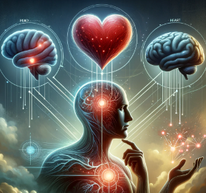
How I Could Improve My EI
To take responsibility for self-actions and their impact on others to builds self-awareness and trust.
To acknowledge the concurrent situation and be open to recognizing emotions to improve self-EI.
To have self-confidence to handle emotional challenges better by trusting myself to make clearer decisions and interact more positively with others.
To focus on physical activity to support emotional health by relieving stress and boosting mood.
To have compassion, certainty, and confidence to build stronger connections and navigate difficult situations
To demonstrate high EI in enhancing emotional skills for personal and professional growth.
To promote self-attention for self reflection and emotional regulation.
Notes:
How I Could Improve My EI
Improvement of Emotional Intelligence (EI) involves being more mindful of emotions and the way of interacting with others (Kaoun, 2019). Acknowledging situations means recognizing and accepting what’s happening around me, whether it is a challenge at work or a personal conflict. I must acknowledge the concurrent situation and be open to recognizing emotions to improve my EI. I am willing to take responsibility for my actions and their impact on others, which builds self-awareness and trust. It shows my maturity and strengthens to build stronger relationships with others as well as sets the foundation for personal growth.
Empathy plays an undeniable role in improving EI (Ioannidou, and Konstantikaki, 2008). I can build stronger connections and navigate difficult situations by understanding and compassion for others’ feelings. Practising empathy with others' feelings helps me deepen my emotional understanding and relationships. Certainty and confidence enable me to handle situations with more clarity. I can handle emotional challenges better by trusting myself. Confidence allows me to make clearer decisions and interact more positively with others. Focusing on physical activity supports emotional health by relieving stress and boosting mood (Pool, and Qualter, 2018).
Meeting new people can help expand my social skills and expose me to different perspectives. Paying attention to myself allows me to self-reflection and emotional regulation. Taking inspiration from others can demonstrate high EI in enhancing emotional skills with personal and professional growth (Goleman, 2021). Learning from their actions and applying those lessons can help me develop better emotional habits. Finally, writing things down helps clarify my thoughts and emotions with a better understanding of situations and how to manage them effectively.

Slide 6
Conclusion
To manage emotions of self and others for self-awareness, empathy, and communication.
To manage emotions effectively, reduce stress, and navigate social situations with greater ease.
To make better decision-making, conflict resolution, and resilience in the face of challenges.
To promote personal growth and a more positive and productive environment.
To enhance our overall well-being and success in all areas of life.
Notes:
Conclusion
Emotional Intelligence (EI) is a vital skill that enhances both personal and professional relationships. By improving self-awareness, empathy, and communication, EI allows us to manage emotions effectively, reduce stress, and navigate social situations with greater ease. It fosters better decision-making, conflict resolution, and resilience in the face of challenges. Developing EI leads to a deeper understanding of ourselves and others, promoting personal growth and a more positive and productive environment. We can improve our EI with consistent effort, which enhances our overall well-being and success in all areas of life.

Slide 7
References
Bru-Luna, L.M., Martí-Vilar, M., Merino-Soto, C. and Cervera-Santiago, J.L., 2021, December. Emotional intelligence measures: A systematic review. In Healthcare (Vol. 9, No. 12, p. 1696). MDPI.
Bușu, A.F., 2020. Emotional intelligence as a type of cognitive ability. Revista de Științe Politice. Revue des Sciences Politiques, (66), pp.204-215.
Di Fabio, A. and Saklofske, D.H., 2021. The relationship of compassion and self-compassion with personality and emotional intelligence. Personality and individual differences, 169, p.110109.
Emmadi, R., 2017. Emotional intelligence: a tool for success. International Journal Of Management, IT & Engineering, 7(11).
Goleman, D., 2021. Leadership: The power of emotional intelligence. More Than Sound LLC.
Ioannidou, F. and Konstantikaki, V., 2008. Empathy and emotional intelligence: What is it really about?. International Journal of caring sciences, 1(3), p.118.
Jiménez-Picón, N., Romero-Martín, M., Ponce-Blandón, J.A., Ramirez-Baena, L., Palomo-Lara, J.C. and Gómez-Salgado, J., 2021. The relationship between mindfulness and emotional intelligence as a protective factor for healthcare professionals: systematic review. International Journal of Environmental Research and Public Health, 18(10), p.5491.
Kaoun, T.M., 2019. Enhancing Leaders’ Emotional Intelligence: Why Mindfulness?. Journal of Leadership Education, 18(1), pp.200-212.
Kotsou, I., Mikolajczak, M., Heeren, A., Grégoire, J. and Leys, C., 2019. Improving emotional intelligence: A systematic review of existing work and future challenges. Emotion Review, 11(2), pp.151-165.
Nguyen, T., White, S., Hall, K. and Bell, R., 2019. Emotional intelligence and managerial communication. American Journal of Management, 19(2), pp.54-63.
Pool, L.D. and Qualter, P. eds., 2018. An introduction to emotional intelligence. John Wiley & Sons.

