Slide 1

LCLM4004
Problem Solving and Decision Making
Student Name: Zoran-George NACA
Student ID:2527910
Date:12/07/2026
LECTURER:CHARLES OBINWA

Slide 2
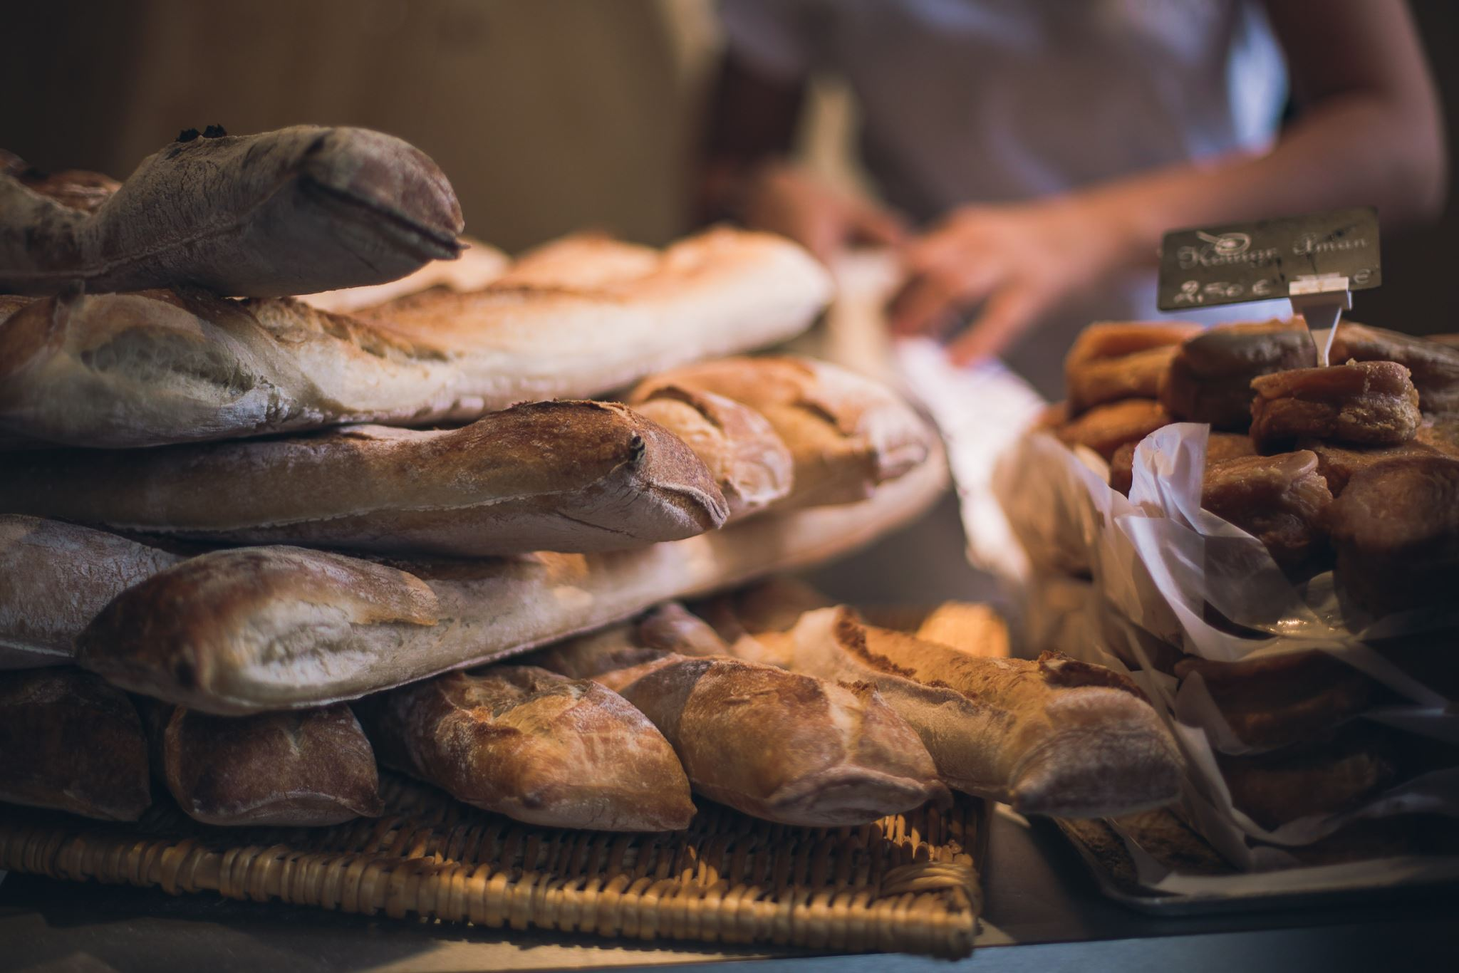
Introduction and Case Study Overview
Basil's Bakery, Coventry's premier independent artisan bakery since 2015.
Discuss the bakery's emphasis on fresh, organic cakes, breads and pastries.
Emphasise the loss of customers and sales since the outbreak of COVID-19.
Recognise the purpose of analysing factors that impact business performance.
Describe how these tools can be used to define business issues and facilitate decision making.
Notes:
Basil's Bakery is a local independent bakery, founded in Coventry in 2015. It has earned a strong reputation for producing artisan breads, pastries, and cakes made with high-quality organic ingredients. The company had good revenue growth before the COVID-19 pandemic and is still selling about 25% less than in 2019. This presentation intends to examine why this is and to discuss how business analysis tools can help to enable sound business decisions and increase future business success.

Slide 3

Evaluation of Analytical Tools
Benefits and Limitations
Benefits
This is the structured knowledge of business problems that 5W2H offers.
PESTEL is a list of external environmental factors that are significant.
Problem Tree outlines the root causes of a problem in sales performance (Bagwell, 2023).
Models enhance Strategic Planning and Decision Making.
Limitations
PESTEL is not used to assess the internal operations of the business.
A Fishbone Diagram is not suitable for setting priorities for the importance of individual causes.
5W2H relies on accurate and complete business information.
Notes:
There are various advantages to each business analysis tool. The 5W2H model is helpful to organise information and to clearly define the problem. PESTEL seeks out external opportunities and threats to a business's performance; the Fishbone Diagram is used to explore root causes. These models, however, have their drawbacks as well. PESTEL only looks at external factors, Fishbone does not have a cause-and-effect approach, and 5W2H relies on information. Combined usage of the models gives a more comprehensive picture of the business situation.

Slide 4
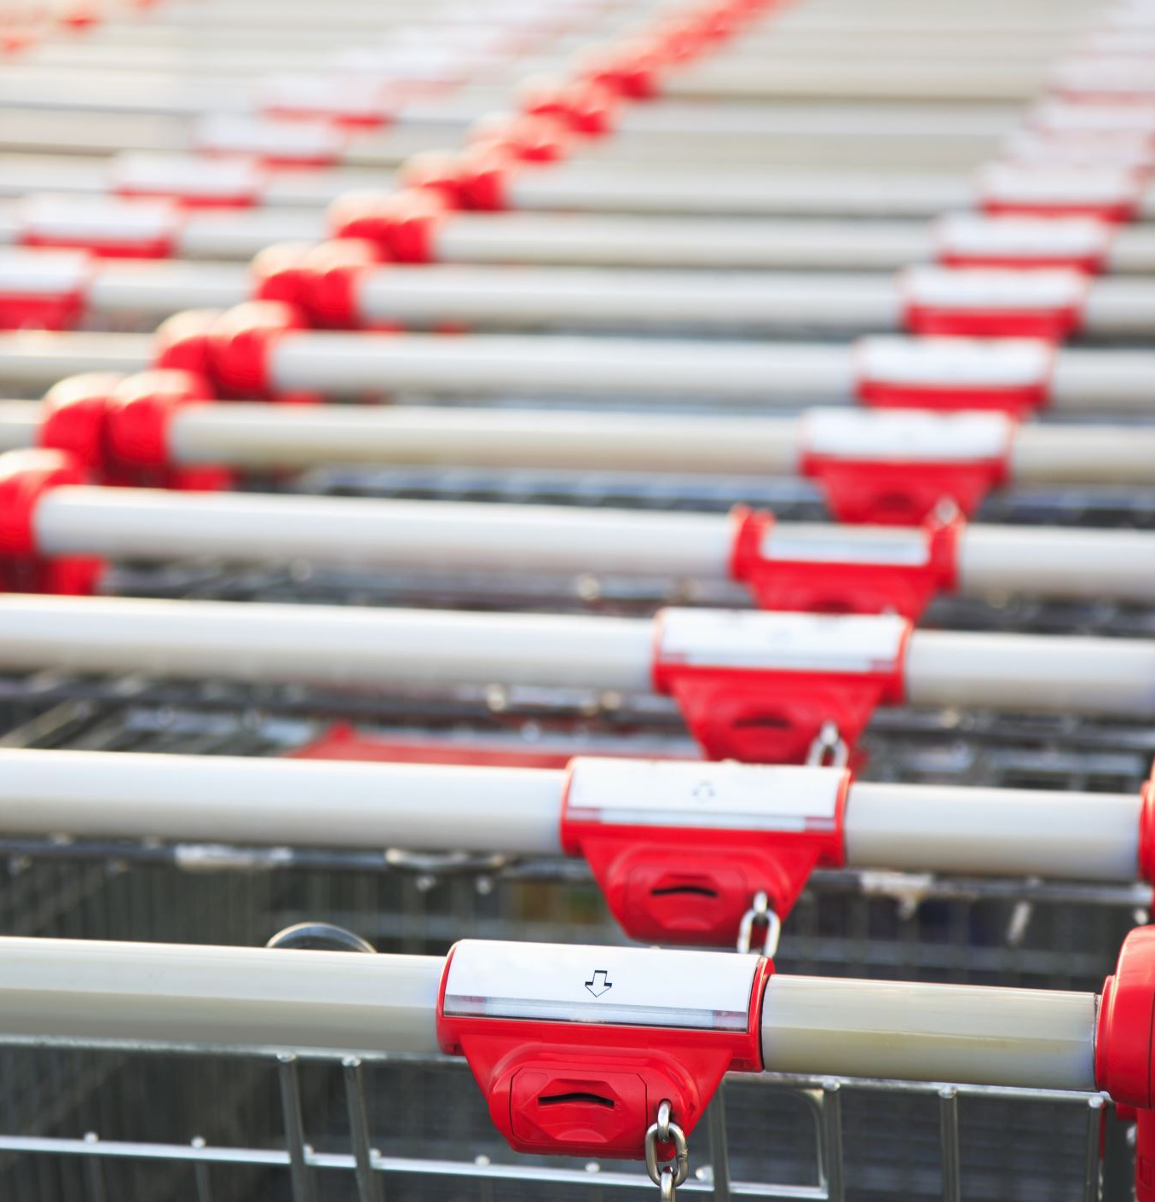
Nature and Scope of the Issues
Despite the economic recovery, sales are still about 25% off 2019 levels.
Decrease in customer visits as a result of fewer visitors to shopping centres.
Closure of nearby retail stores has decreased passing trade.
Customers place orders for delivery or pre-order merchandise that is not available (Abdullah, Halem and Ku Harmi, 2023).
The current business model is becoming less financially sustainable.
Notes:
The bakery's sales have been declining due to several internal and external factors. Fewer people are coming into the shopping centre, and many office workers continue to work from home, having reduced customer footfall. Nearby retail shops are also closed, which has also lessened the number of potential customers. Simultaneously, rents, utility expenses, insurance and the prices of organic produce are higher, making profits lower. All these challenges have a negative impact on the sustainability of the enterprise.

Slide 5

5W2H Analysis
Applying the 5W2H Model
What? Sales are not increasing as they did before the pandemic.
Why? Declining numbers of customers, limited digital services, and increasing business expenses.
Where? Basil's Bakery within Coventry retail park.
When? Sales were down from 2020 and were not much better until 2025.
Who? Business owners, employees of retail shops, employees of offices and customers (Mbogo and Waithaka, 2024).
How? Consumption behaviour and restrictions in operation hurt sales.
How Much? Approximately 25% reduction in sales compared with 2019.
Notes:
The 5W2H approach is a structured way of analysing a business problem. It knows the nature of the problem, its causes, location and timing, who is involved, how the problem arose and the extent to which it has impacted. In Basil's Bakery, all of these elements are clearly represented in the model as factors contributing to declining sales, and they are linked to the reductions in customer numbers, consumer behaviour, digital services, and operating costs.

Slide 6
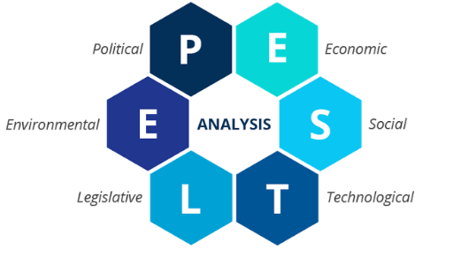
PESTEL Analysis
External Business Environment
Political: Business rates and employment laws are among politics' effects on operating costs.
Economic: Production costs are due to inflation and rising supplier prices.
Social: Fewer visits by customers as a result of remote working and altered shopping habits.
Technological: Absence of online ordering, delivery service or digital booking system (Nazry and Nawi, 2024).
Environmental: Organics can help sustainability but cost more.
Legal: Food Safety, hygiene and employment laws are adhered.
Notes:
PESTEL analysis looks at external factors that affect a business. Taxation, business rates and food safety regulations are examples of political and legal factors. The economic conditions, like inflation and rising ingredient costs, drive up the operating costs. The decline in visits is due to social changes such as remote work and altered purchasing patterns. Technological factors point out the lack of online ordering and delivery services

Slide 7
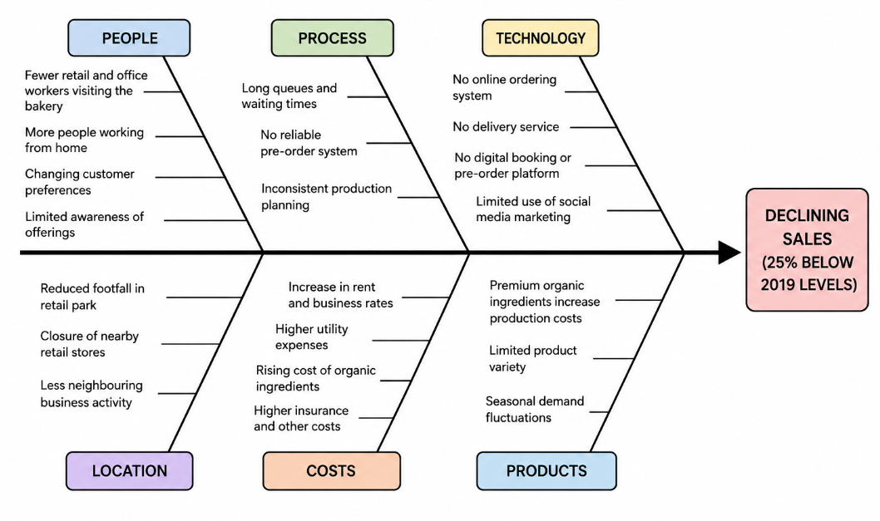
Fishbone (Cause-and-Effect) Analysis
.
Virginio et al., 2022).
Notes:
The Fishbone Diagram is used to classify the problems into various categories to determine the possible root causes of decreasing sales figures. Consumers reduce their visits to the bakery for retail and office jobs. Process problems include long wait times and a lack of a reliable pre-order system. Technology is restricted as there are no online ordering and delivery services. Financial pressures cause due to increase in operating expenditure, and environmental changes are due to a decrease in the shopping centre footfall. This analysis can be used to determine the priority areas for improvement.

Slide 8

Conclusion
The 5W2H model was able to clearly define the nature, causes and overall impact of the business problem.
The PESTEL analysis revealed that external factors like inflation, remote working and technological changes are having a significant impact on business performance.
The Fishbone Diagram identified root causes that were driving declining sales, such as low digital services, operational issues and higher costs.
An online ordering system, delivery, digital marketing and customer loyalty strategies can increase competitiveness and customer satisfaction.
Notes:
Basil's Bakery have a few big issues to contend with, including declining customers, changing consumer behaviour and increasing business costs. The 5W2H model and PESTEL analysis have been effective in determining the external and internal factors that impact the performance of the business, and the Fishbone Diagram is effective in determining the causes of the problem. The bakery can benefit from implementing digital services to boost sales performance and customer satisfaction, while also optimising operational efficiency and enhancing customer relationships.

Slide 9
References
Abdullah, F.N., Halem, F.N. and Ku Harmi, K.H., (2023). Pavlova cake bakery.
Bagwell, T.J., (2023). Marketing strategies to improve the sales of bakery products of small-medium enterprise (SMEs) in Malaysia. International Food Research Journal, 21(6), pp.2101-2107.
Jeba, R.H., Hemada, H.M., Shehata, A.N. and Mansour, M.E.S., (2025). Quality Evaluation, Nutrition Values, and Shelf-life Stability of Bakery Products Supplemented With Dried Olive Mill Wastewater. Egyptian Journal of Food Science, 53(1), pp.13-33.
Mbogo, D. and Waithaka, P., (2024). Market Penetration Strategy And Performance Of Bakeries In Nairobi City County. The Strategic Journal of Business & Change Management, 11(4), pp.1279-1295.
Nazry, N.A. and Nawi, N.M., (2024). ATC Bakery Online Booking System. Applied Information Technology And Computer Science, 5(2), pp.1420-1429.
Virginio, C.D., Garcia, C., Cruz, A., Galon, A., Hizon, J.S., Garcia-Vigonte, F. and Malang, B., (2022). Overcoming Challenges in the Quality Service and Production of a Bakery Business: A Literature Review. Available at SSRN 4031633.

