Slide 1
Crusading in the Middle Ages
The Death of Crusading

Slide 2
Plan of Action
Outline lecture on the decline of crusading in the middle ages
Group discussion about the legacy of the crusading movement
Discussion part 2: were the crusades a success?

Slide 3
Crusading in . . .
The Holy Land
The north
The south
Cyprus
Spain
Against the Ottomans
Reformation

Slide 4
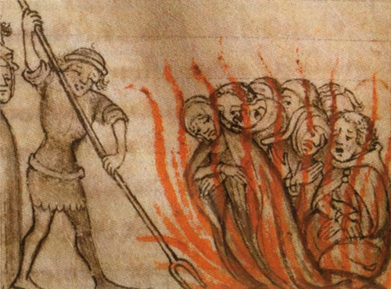

Slide 5
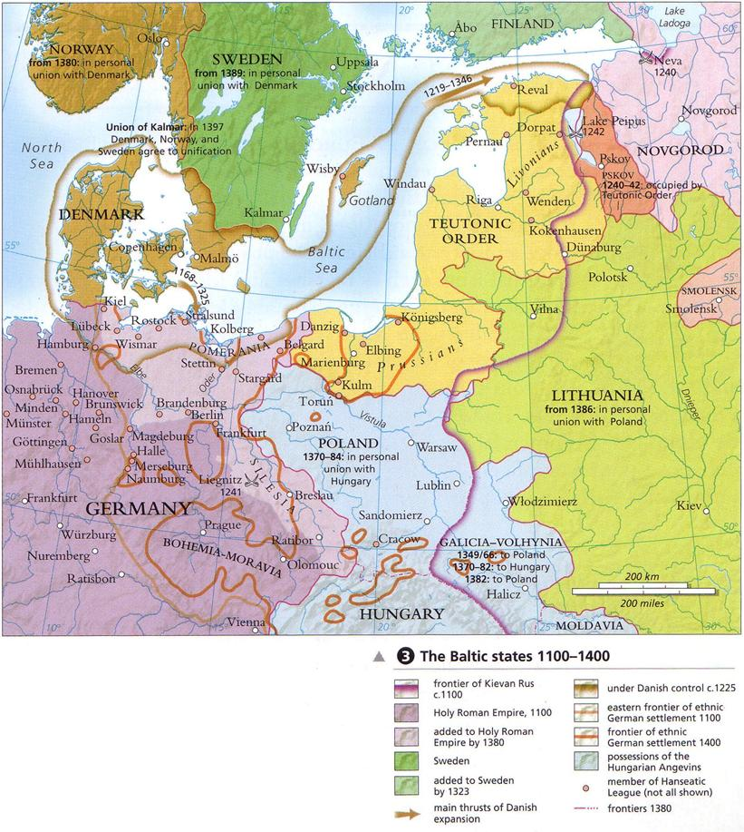

Slide 6
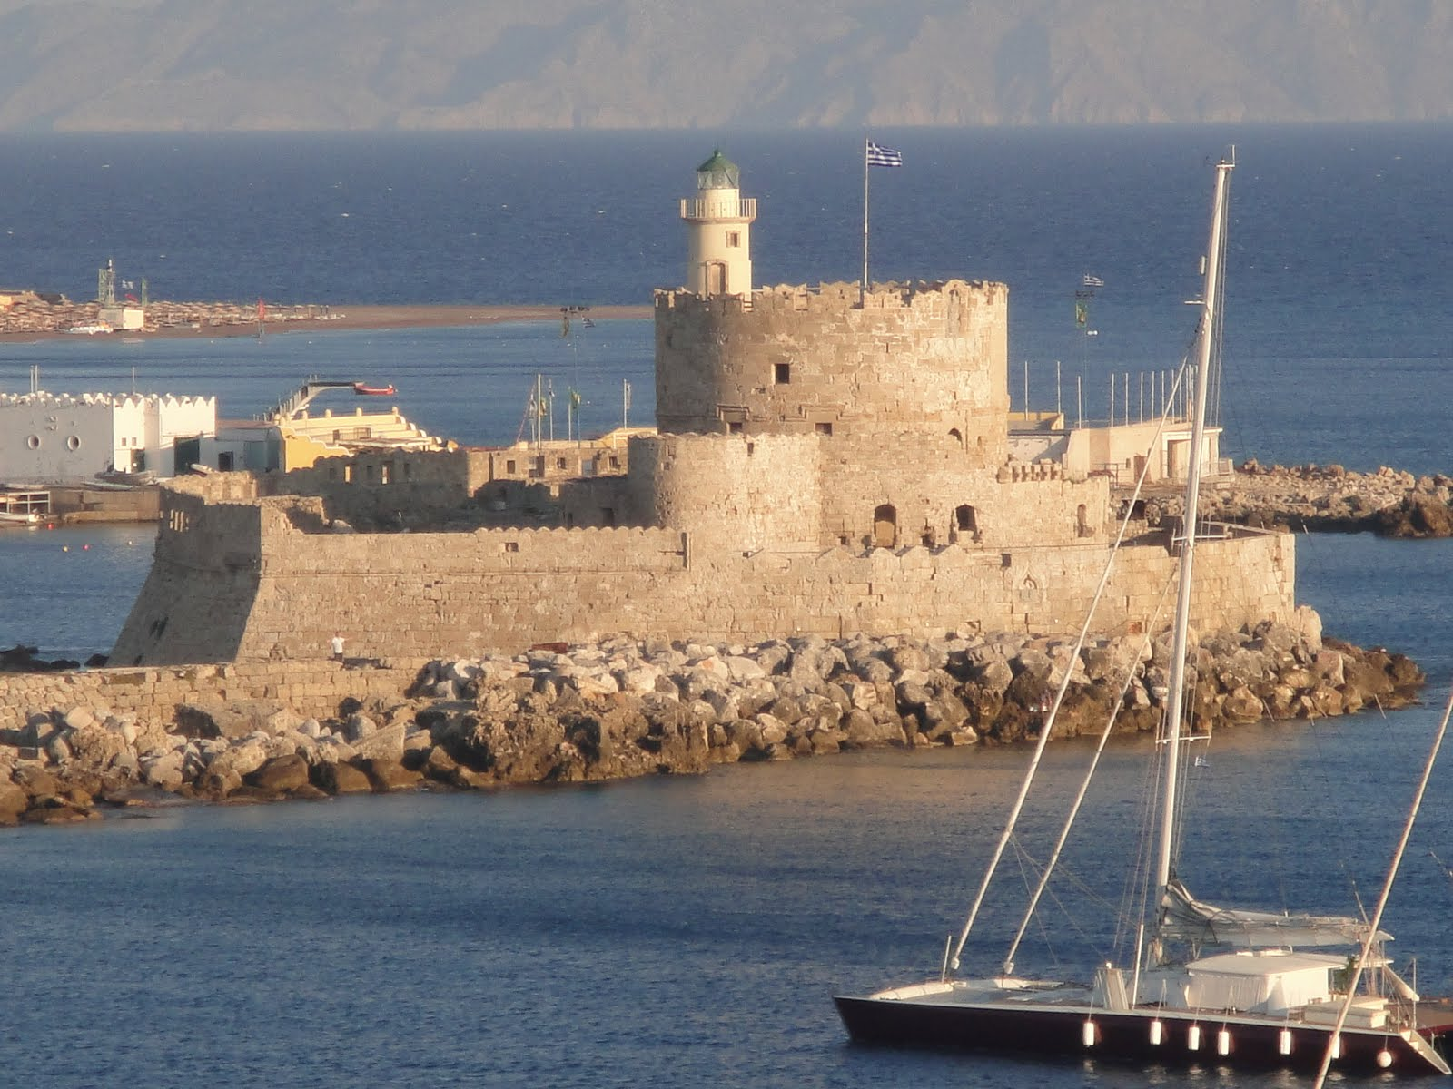

Slide 7
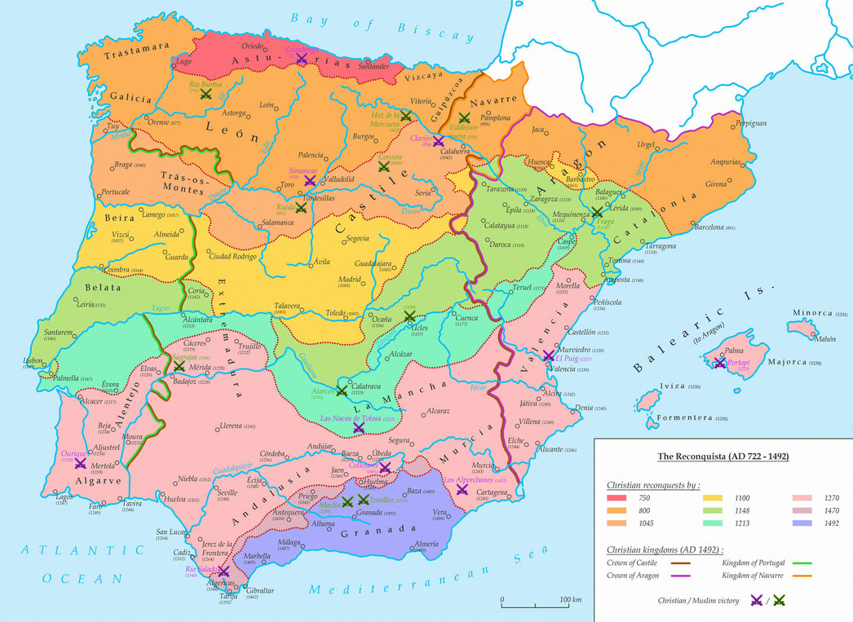

Slide 8


