Slide 1

Rheumatoid Arthritis
Student name: Krishna S. Goswami
Student number: 2436890
Module code and title: LCHS7003 and Community Care and Management of Longer-term Conditions
Lecture’s name: Dr Brian Mashumba

Slide 2
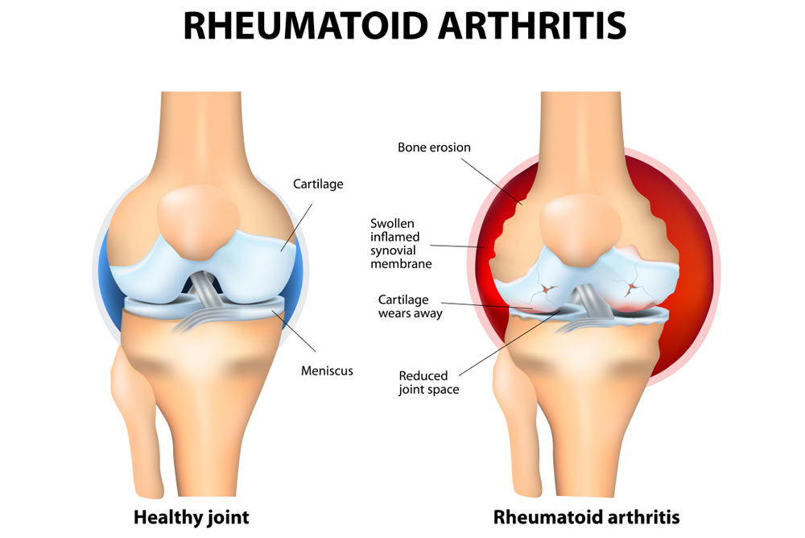
Introduction to Rheumatoid Arthritis
Rheumatoid arthritis (RA) is a chronic, systemic, autoimmune disease that mainly affects synovial joints, causing chronic inflammation, pain, and cumulative damage to joints (Padyukov, 2022, p.48).
RA is perpetuated by immune dysfunction and unlike osteoarthritis, it may extend to other organs as well as wear and tear (Weyand and Goronzy, 2021, p.11).
The illness usually starts slowly, yet can quickly escalate out of control unless treated.
Figure 1: Rheumatoid Arthritis
(Source: Bailey, 2020)

Slide 3
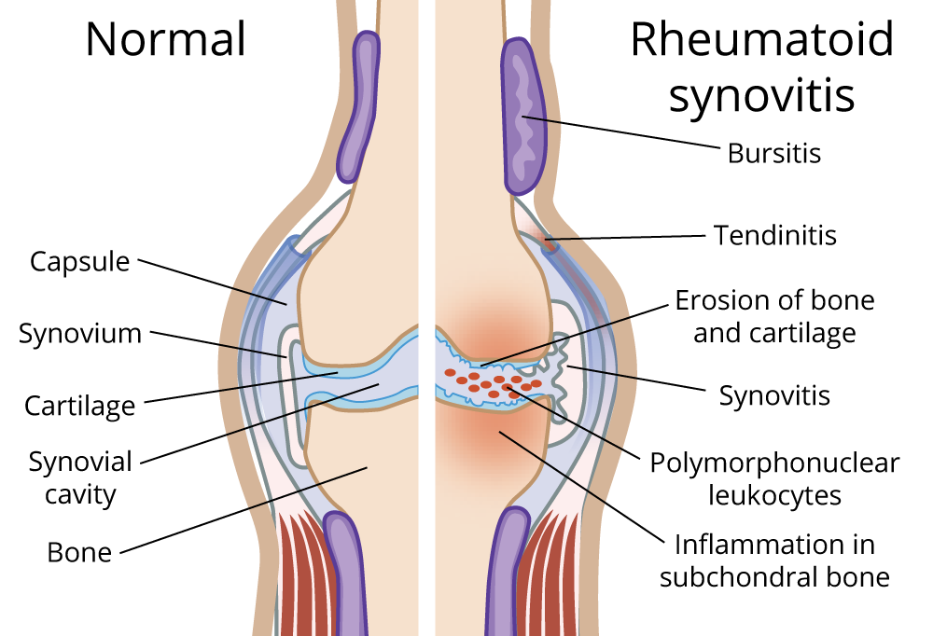
Symptoms of Rheumatoid Arthritis
The typical symptoms of rheumatoid arthritis consist of pain in the joints, swelling, and stiffening, primarily of the hands, wrists, and feet (Franjić, 2025, p.2).
The first characteristic is morning stiffness for over an hour (Mengi et al. 2024, p.3).
Systemic inflammation may also cause fatigue, low-grade fever and general malaise in the patient.
Figure 2: Knee Joints with Normal Compared to Rheumatoid Arthritis
(Source: Mennon, 2023)

Slide 4
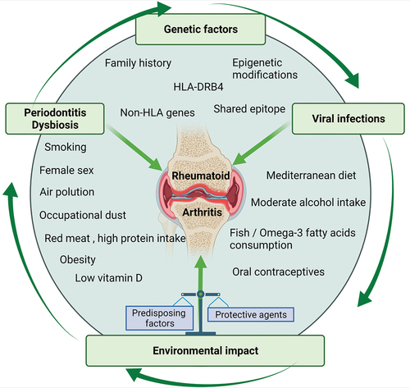
Aetiology of Rheumatoid Arthritis
The cause of rheumatoid arthritis has not been completely identified, but it is assumed to be a complex combination of genetic, environmental, and immunologic factors.
Some of the genes, especially the HLA-DR genes, predispose through their effects on the immune responses (Dong et al. 2025, p.189).
Autoimmune activation may be triggered by environmental triggers in the form of smoking, hormonal effects, infections and microbiome changes (Arleevskaya et al. 2022, p.2).
Figure 3: Aetiology of Rheumatoid Arthritis
(Source: Venetsanopoulou et al. 2022)

Slide 5
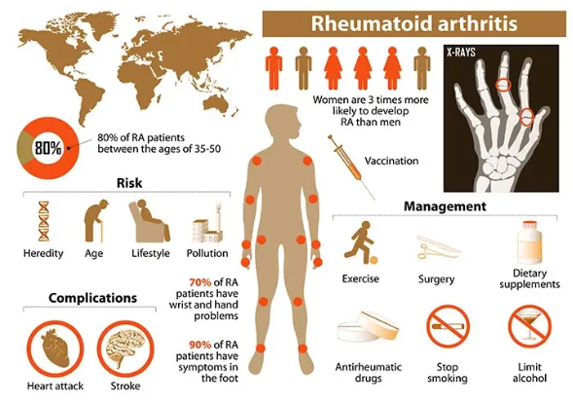
Worldwide prevalence of Rheumatoid Arthritis
Rheumatoid arthritis is a chronic autoimmune disease that mostly attacks joints, causing pain, swelling and disability.
In 2019, RA was estimated to affect at least 18 million people worldwide, of whom 70% and 55% corresponded to females and older adults, respectively (World Health Organisation, 2023).
There were about 13 million moderate to severe cases which need rehabilitation (Healthdata.org, 2023).
Figure 4: Rheumatoid Arthritis and Its Side Effects on the Body
(Source: Mya Care, 2024)

Slide 6
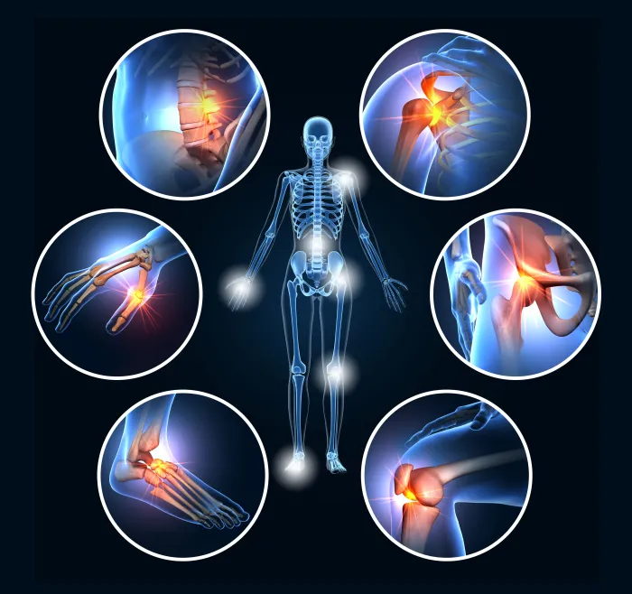
UK prevalence of Rheumatoid Arthritis
Women are three times more prone to developing RA in comparison to the male gender.
It is estimated that some 12,000 cases are diagnosed every year, most of which are found in persons between 40-70 years (Globalranetwork.org, 2021).
The disease is a major cause of disability, with approximately one-third of all patients being incapable of working within 10 years after diagnosis (Ampersand Health, 2022).
Figure 5: Rheumatoid Arthritis Effects
(Source: Resurgens Orthopaedics, 2025)

Slide 7
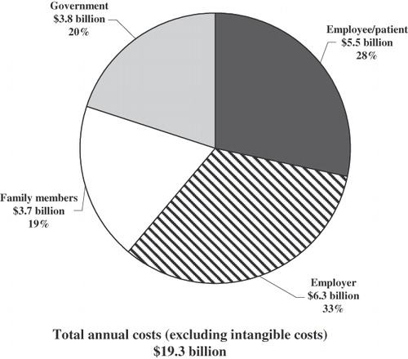
Economic Burden and Social Burden of Rheumatoid Arthritis
Rheumatoid arthritis has tremendous economic and social implications on people, health services and the community (Radu and Bungau, 2021, p.2857).
A 2009 National Audit Office (NAO) report reported that one in every three patients with RA ceases work within 2 years of developing the condition and one in five within 10 years.
The report gave an estimation of approximately £560 million in direct healthcare costs in the NHS per annum, with another £1.8 billion in indirect costs to the UK economy (Bowman and Guest, 2020, p.500).
Figure 6: Societal Cost Of Rheumatoid Arthritis
(Source: Birnbaum, 2020)

Slide 8
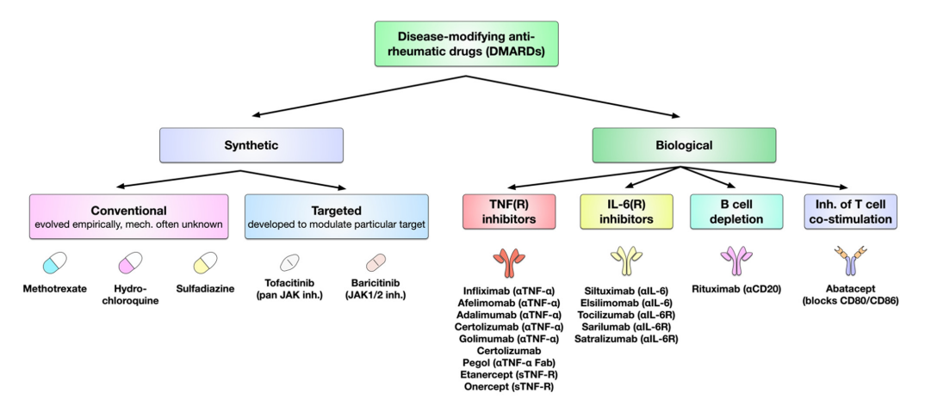
Management of the Disease (UK Guidelines)
Remission or low disease activity: Treat-to-target.
Early DMARDs, preferably methotrexate with short-term steroids.
Graduate to biologics in case of bad response.
Reassess after every 1-3 months (NICE, 2023; Oldroyd et al., 2022, p.1761).
Figure 8: Overview over the currently available DMARDs
(Source: Lin et al., 2020)

Slide 9
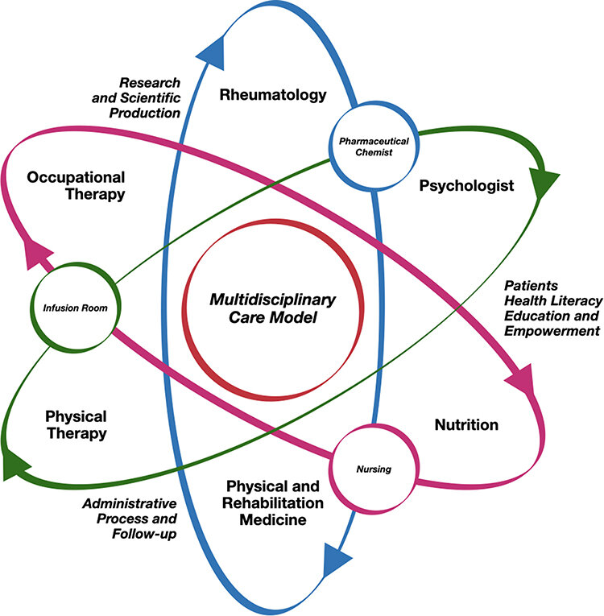
Models and Frameworks
The models of RA care are based on biopsychosocial, chronic care, and personalised care.
Focuses on self-management, coordinated MDT support, and continuity.
Integrated care models enhance better outcomes and less disability.
Facilitates the use of shared decision-making and proactive monitoring (Wade, 2020, p.75; Schaefer and Keyesser, 2022, p.6).
Figure 9: The rheumatoid arthritis multidisciplinary care model framework
(Source: Santos-Moreno et al., 2022)

Slide 10
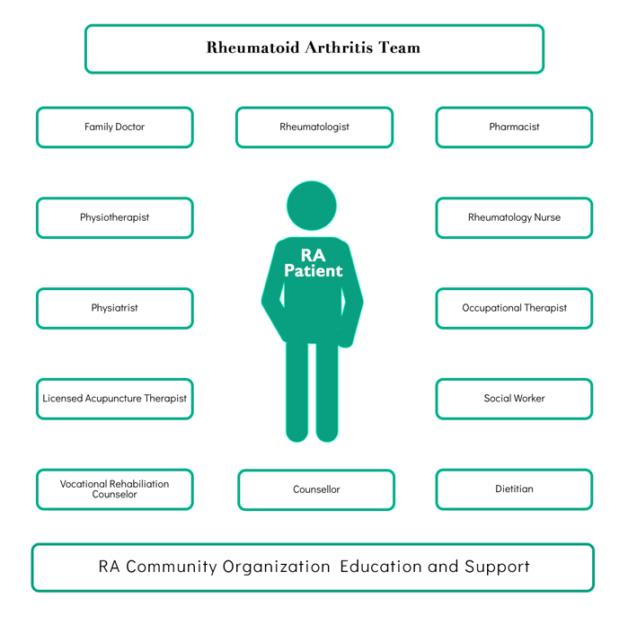
The House of Care Framework
Framework facilitates shared personalised care planning.
Four pillars: empowered patients, trained practitioners, organisational practices, and favourable commissioning.
Applied in LTC care, such as RA.
Results in enhancement of activation and self-efficacy (NHS ENGLAND, 2019).
Figure 10: The House of Care framework for RA
(Source: Globalranetwork.org, 2025)

Slide 11
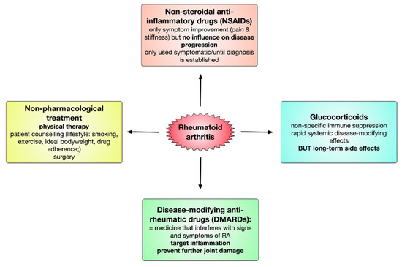
A Treatment Option for Rheumatoid Arthritis in the UK
The DMARD first-line treatment is methotrexate.
Lowers the inflammation and avoids joint destruction.
Orally administered or subcutaneously, folic acid.
Has to check liver functionality and blood counts (NICE, 2023; Fraenkel et al., 2021, p.12-13).
Figure 11: Treatment Option for Rheumatoid Arthritis
(Source : Lin et al., 2020)

Slide 12
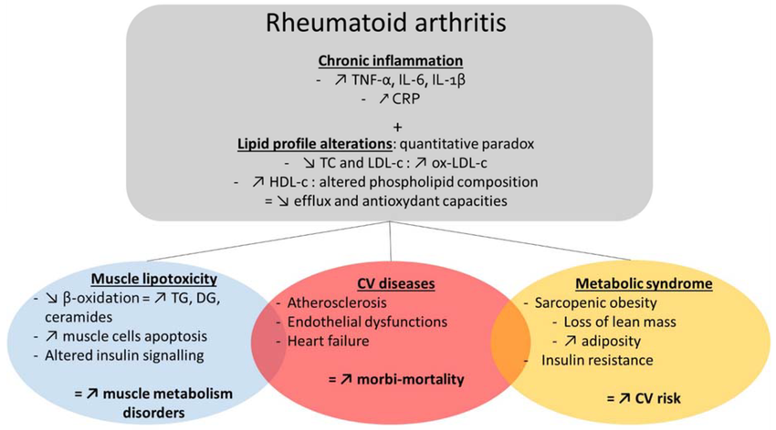
Comorbidities Associated with Rheumatoid Arthritis
Other comorbidities: risk of infection, osteoporosis, cardiovascular disease, and lung disease.
RA inflammation increases atherosclerosis.
Increased Interstitial lung disease.
Needs regular risk evaluation (Taylor et al., 2021, p.3-4).
Figure 12: Comorbidities in rheumatoid arthritis (RA)
(Source: Lanchais et al., 2020)

Slide 13
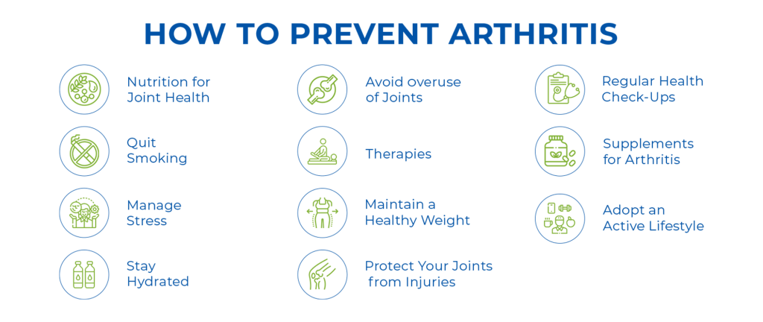
Prevention of the Disease
None, though there is a possibility of the reduction of risk.
Change or modify lifestyle: quit smoking, keep fit, and have good oral health.
At-risk people can be identified at an early stage in order to delay the onset.
There is an emergence of education and screening programmes (Ruscitti et al., 2024, p.10).
Figure 13: Prevention
(Source: SNS Rheumatology, 2023)

Slide 14
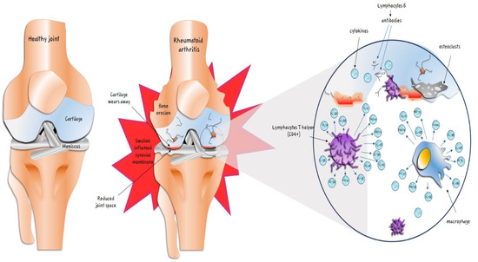
Behaviours, Skills, and Values
The development of the main skills: communication, shared decision-making, and motivational interviewing.
Values: cultural competence, empathy, respect.
Behaviours: joint care planning, comprehensive examinations, and advocacy.
Empowers patients and helps them maintain treatment compliance (MacIver et al., 2021; NHS ENGLAND, 2019).
Figure 14: Pathogenetic mechanisms of rheumatoid arthritis
(Source: Inchingolo et al., 2024)

Slide 15
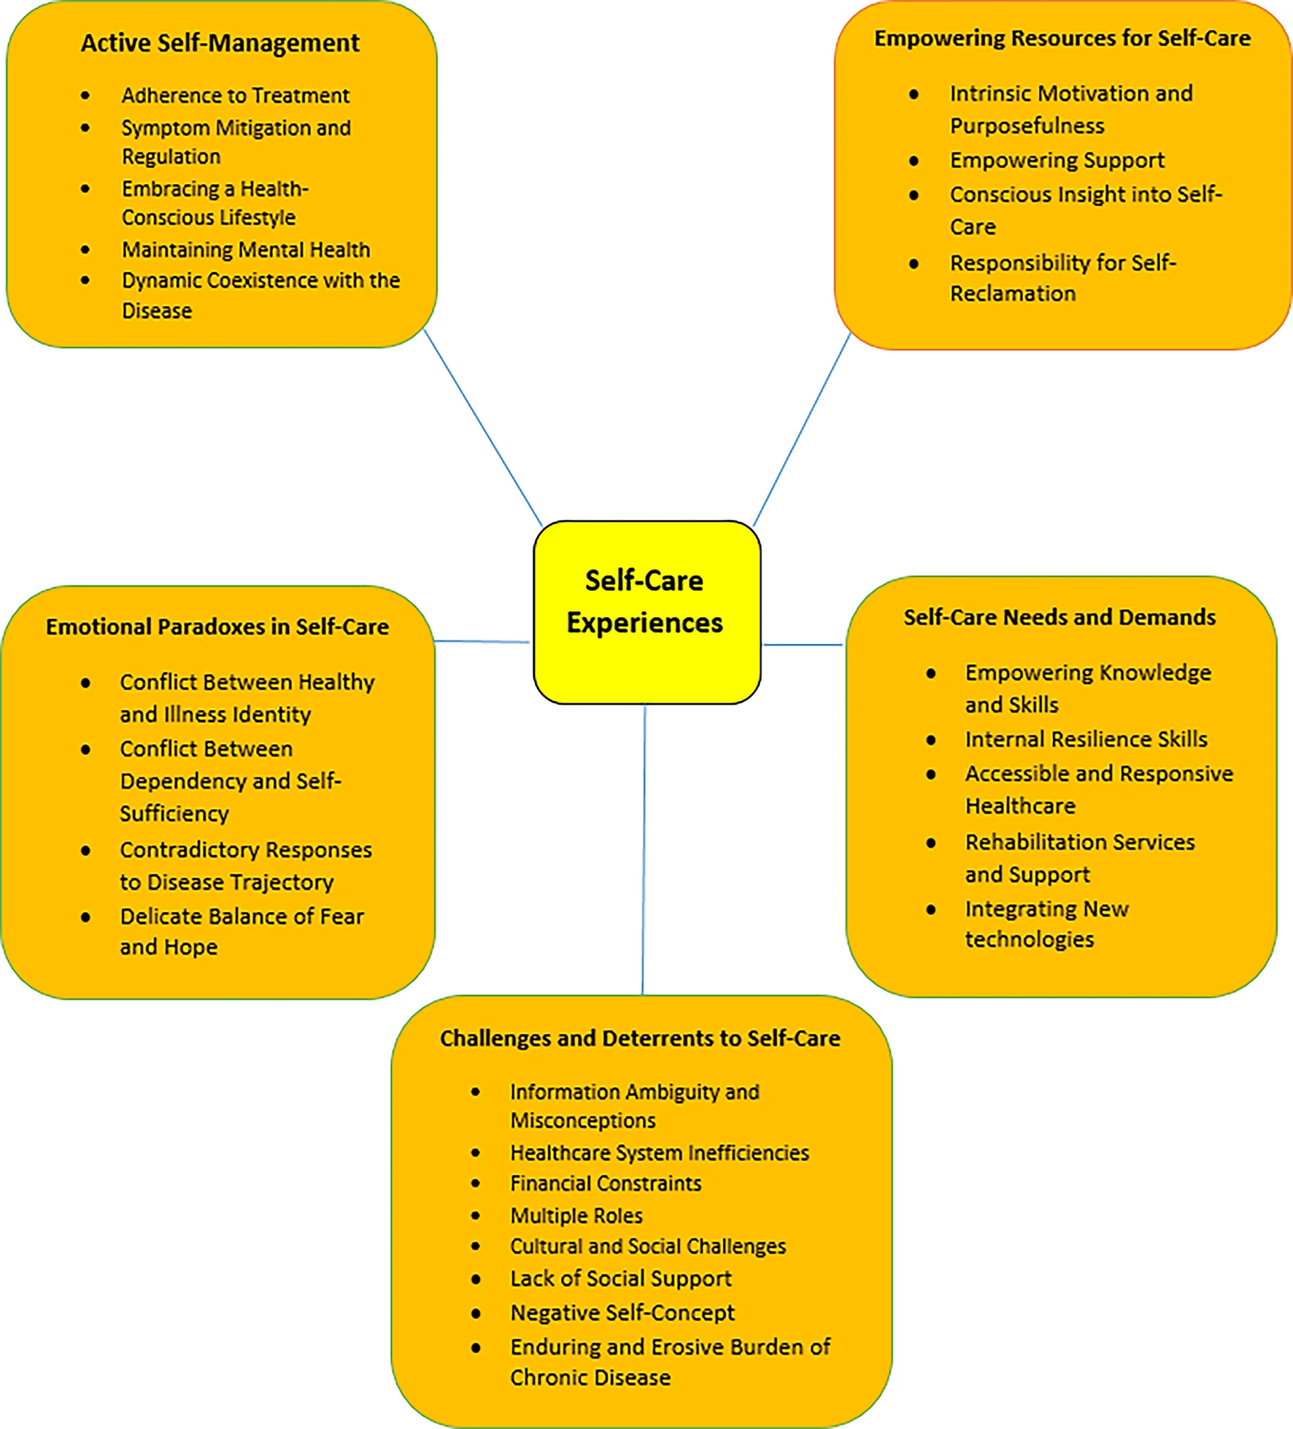
Comprehensive Personalised Care Model
It has six elements: shared decisions, personalised care planning, self-management support, social prescribing, choice in care, and personal health budgets.
Increases involvement and health outcomes in chronic disease.
Recommended by UK guidance to RA (NHS ENGLAND, 2019).
Figure 15: Self Care Experiences
(Source: Banafshi et al., 2025)

Slide 16
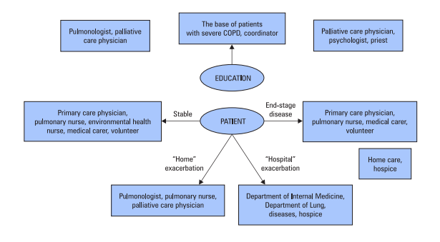
Self-management and personalised care in chronic obstructive pulmonary disease
Self-management allows patients to control the symptoms, prevent triggers and identify early signs of exacerbation
Personalised care builds treatments based on the severity of a disease, lifestyle, and preferences of a patient.
combined pulmonary care and self-management are better in reducing the exacerbation, improving the quality of life (Dębczyński et al. 2021).
Advanced tools and monitoring systems can improve treatment follow-up, track symptoms, and allow early intervention.
Figure 7: Integrated care for patients with advanced COPD
(Source: Dębczyński et al. 2021)

Slide 17
Recommendations for disease management
Initiate DMARD therapy early such as Methotrexate to slow joint damage process. (A et al. 2019)
Escalate to combine biologic DMARDs if disease activity spreads.
Include non-pharmacological strategies like physiotherapy, exercise, and patient education.

Slide 18
Conclusion
The project aims to keep RA under control and prevent joint damage.
Early and proper treatment improves movement and quality of life.
Collaborate with doctors, therapists, and family for long-term care.

Slide 19
Reference List
Ampersand Health. 2022. Rheumatoid Arthritis Facts & Statistics in the UK 2022. [online] Available at: https://ampersandhealth.co.uk/myarthritis/resources/rheumatoid-arthritis-facts-statistics-in-the-uk-2022/.
Arleevskaya, M., Takha, E., Petrov, S., Kazarian, G., Renaudineau, Y., Brooks, W., Larionova, R., Korovina, M., Valeeva, A., Shuralev, E. and Mukminov, M., 2022. Interplay of environmental, individual and genetic factors in rheumatoid arthritis provocation. International Journal of Molecular Sciences, 23(15), p.8140. https://doi.org/10.3390/ijms23158140
Bailey, C. 2020. A brief guide to rheumatoid arthritis and knees. [online] Chris Bailey Orthopaedics. Available at: https://www.chrisbaileyorthopaedics.com/blog/brief-guide-to-rheumatoid-arthritis-and-knees/
Banafshi, Z., Dehghan Nayeri, N., Moghimi, N. and Khatony, A., 2025. Exploring the self-care experiences of patients with rheumatoid arthritis through qualitative content analysis. Scientific Reports, [online] 15(1). https://doi.org/10.1038/s41598-025-15928-3.
Birnbaum, H., Pike, C., Kaufman, R., Marynchenko, M., Kidolezi, Y. and Cifaldi, M. 2020. Societal cost of rheumatoid arthritis patients in the US. Current Medical Research and Opinion, 26(1), pp.77–90. doi:https://doi.org/10.1185/03007990903422307.
Bowman, S.J. and Guest, L. 2020. The national clinical audit for rheumatoid and early inflammatory arthritis. Clinical Medicine, [online] 16(6), pp.500–501. doi:https://doi.org/10.7861/clinmedicine.16-6-500.
Dong, J., Yang, Y., Mo, M., Liu, S., Bai, R., Li, S., Zhao, R., Xu, X., Cheng, Y. and Xu, J., 2025. Association of HLA-B and HLA-DR gene polymorphisms with rheumatoid arthritis: A cross-sectional study in Yunnan Chinese Han population. Rheumatology and Immunology Research, 6(3), pp.188-194. https://www.degruyterbrill.com/document/doi/10.1515/rir-2025-0022/html
Fraenkel, L., Bathon, J.M., England, B.R., St.Clair, E.W., Arayssi, T., Carandang, K., Deane, K.D., Genovese, M., Huston, K.K., Kerr, G., Kremer, J., Nakamura, M.C., Russell, L.A., Singh, J.A., Smith, B.J., Sparks, J.A., Venkatachalam, S., Weinblatt, M.E., Al‐Gibbawi, M., Baker, J.F., Barbour, K.E., Barton, J.L., Cappelli, L., Chamseddine, F., George, M., Johnson, S.R., Kahale, L., Karam, B.S., Khamis, A.M., Navarro-Millán, I., Mirza, R., Schwab, P., Singh, N., Turgunbaev, M., Turner, A.S., Yaacoub, S. and Akl, E.A., 2021. 2021 American College of Rheumatology Guideline for the Treatment of Rheumatoid Arthritis. Arthritis Care &amp; Research, [online] 73(7), pp.924–939. https://doi.org/10.1002/acr.24596.
Franjić, S., 2025. Rheumatoid Arthritis Can Occur at Any Age. Clinical Images and Case Reports, 3(4), pp.1-6. https://www.visionpublisher.info/index.php/cicr/article/download/234/223
Globalranetwork.org., 2025. Global RA Network» RA Models of Care. [online] Available at: https://globalranetwork.org/project/ra-models-of-care/ [Accessed 8 Dec. 2025].
Globalranetwork.org. 2021. Global RA Network» Global RA Network Rheumatoid Arthritis Dashboard. [online] Available at: https://globalranetwork.org/ra-dashboard-uk-en/.
Healthdata.org. 2023. Global, regional, and national burden of rheumatoid arthritis, 1990–2020, and projections to 2050 | The Institute for Health Metrics and Evaluation. [online] Available at: https://www.healthdata.org/research-analysis/library/global-regional-and-national-burden-rheumatoid-arthritis-1990-2020-and.
Inchingolo, F., Inchingolo, A.M., Fatone, M.C., Avantario, P., Del Vecchio, G., Pezzolla, C., Mancini, A., Galante, F., Palermo, A., Inchingolo, A.D. and Dipalma, G., 2024. Management of Rheumatoid Arthritis in Primary Care: A Scoping Review. International Journal of Environmental Research and Public Health, [online] 21(6), p.662. https://doi.org/10.3390/ijerph21060662.
Lanchais, K., Capel, F. and Tournadre, A., 2020. Could Omega 3 Fatty Acids Preserve Muscle Health in Rheumatoid Arthritis? Nutrients, [online] 12(1), p.223. https://doi.org/10.3390/nu12010223.
Lin, Y.-J., Anzaghe, M. and Schülke, S., 2020. Update on the Pathomechanism, Diagnosis, and Treatment Options for Rheumatoid Arthritis. Cells, [online] 9(4), p.880. https://doi.org/10.3390/cells9040880.
MacIver, A., Hollinger, H. and Carolan, C., 2021. Tele-health interventions to support self-management in adults with rheumatoid arthritis: a systematic review. Rheumatology International, [online] 41(8), pp.1399–1418. https://doi.org/10.1007/s00296-021-04907-2.
Mengi, G., Aydoğmuş, H., Taşkıran, Ö.Ö., Göğüş, F. and Beyazova, M., 2024. Is it possible to objectively determine morning stiffness in rheumatoid arthritis?. Turkish journal of physical medicine and rehabilitation, 70(2), p.180. DOI: 10.5606/tftrd.2024.12219
Mennon, Y. 2023. Rheumatoid Arthritis - OrthoInfo - AAOS. [online] www.orthoinfo.org. Available at: https://orthoinfo.aaos.org/en/diseases--conditions/rheumatoid-arthritis/.
Mya Care. 2024. RHEUMATOID ARTHRITIS AND ITS SIDE EFFECTS ON THE BODY | Mya Care. [online] Available at: https://myacare.com/rheumatoid-arthritis-and-its-side-effects-on-the-body.

Slide 20
Reference List
Ampersand Health., 2022. Rheumatoid Arthritis Facts & Statistics in the UK 2022. [online] Available at: https://ampersandhealth.co.uk/myarthritis/resources/rheumatoid-arthritis-facts-statistics-in-the-uk-2022/.
NHS ENGLAND., 2019. NHS England» Universal Personalised Care: Implementing the Comprehensive Model. [online] www.england.nhs.uk. Available at: https://www.england.nhs.uk/personalisedcare/comprehensive-model/.
NICE., 2018. Rheumatoid arthritis in adults: management NICE guideline. [online] Available at: https://www.nice.org.uk/guidance/ng100/resources/rheumatoid-arthritis-in-adults-management-pdf-66141531233989.
Oldroyd, A.G.S., Lilleker, J.B., Amin, T., Aragon, O., Bechman, K., Cuthbert, V., Galloway, J., Gordon, P., Gregory, W.J., Gunawardena, H., Hanna, M.G., Isenberg, D., Jackman, J., Kiely, P.D.W., Livermore, P., Machado, P.M., Maillard, S., McHugh, N., Murphy, R., Pilkington, C., Prabu, A., Rushe, P., Spinty, S., Swan, J., Tahir, H., Tansley, S.L., Truepenny, P., Truepenny, Y., Warrier, K., Yates, M., Papadopoulou, C., Martin, N., McCann, L. and Chinoy, H., 2022. British Society for Rheumatology guideline on management of paediatric, adolescent and adult patients with idiopathic inflammatory myopathy. Rheumatology, [online] 61(5), pp.1760–1768. https://doi.org/10.1093/rheumatology/keac115.
Padyukov, L., 2022, January. Genetics of rheumatoid arthritis. In Seminars in immunopathology (Vol. 44, No. 1, pp. 47-62). Berlin/Heidelberg: Springer Berlin Heidelberg. https://doi.org/10.1007/s00281-022-00912-0
Radu, A.F. and Bungau, S.G., 2021. Management of rheumatoid arthritis: an overview. Cells, 10(11), p.2857. https://doi.org/10.3390/cells10112857
Resurgens Orthopaedics. 2025. Rheumatoid Arthritis: Types, Symptoms & Treatment. [online] Available at: https://www.resurgens.com/general-orthopedics/conditions/rheumatoid-arthritis.
Ruscitti, P., Nunziato, M., Caso, F., Scarpa, R., Di Maggio, F., Giacomelli, R. and Salvatore, F., 2024. Prevention of rheumatoid arthritis using a familial predictive medicine approach. Autoimmunity Reviews, [online] 23(12), p.103653. https://doi.org/10.1016/j.autrev.2024.103653.
Santos-Moreno, P., Rodríguez-Vargas, G.-S., Martínez, S., Ibatá, L., Villarreal-Peralta, L., Aza-Cañon, A., Rivero, M., Snr, Rodriguez, P. and Rojas-Villarraga, A., 2022. Better Clinical Results in Rheumatoid Arthritis Patients Treated Under a Multidisciplinary Care Model When Compared with a National Rheumatoid Arthritis Registry. Open Access Rheumatology: Research and Reviews, [online] Volume 14, pp.269–280. https://doi.org/10.2147/oarrr.s385423.
Schäfer, C. and Keyßer, G., 2022. Lifestyle Factors and Their Influence on Rheumatoid Arthritis: A Narrative Review. Journal of Clinical Medicine, [online] 11(23), p.7179. https://doi.org/10.3390/jcm11237179.
SNS Rheumatology., 2023. How to prevent arthritis: Top 11 prevention strategies. Retrieved December 8, 2025, from https://snsrheumatology.com/how-to-prevent-arthritis/
Taylor, P.C., Atzeni, F., Balsa, A., Gossec, L., Müller-Ladner, U. and Pope, J., 2021. The Key Comorbidities in Patients with Rheumatoid Arthritis: A Narrative Review. Journal of Clinical Medicine, [online] 10(3), p.509. https://doi.org/10.3390/jcm10030509.
Venetsanopoulou, A.I., Alamanos, Y., Voulgari, P.V. and Drosos, A.A. 2022. Epidemiology of rheumatoid arthritis: genetic and environmental influences. Expert Review of Clinical Immunology, 18(9), pp.923–931. doi:https://doi.org/10.1080/1744666X.2022.2106970.
Wade, D.T., 2020. What is rehabilitation? An empirical investigation leading to an evidence-based description. Clinical Rehabilitation, [online] 34(5), pp.571–583. https://doi.org/10.1177/0269215520905112.
Weyand, C.M. and Goronzy, J.J., 2021. The immunology of rheumatoid arthritis. Nature immunology, 22(1), pp.10-18. https://pmc.ncbi.nlm.nih.gov/articles/PMC8557973/pdf/nihms-1749342.pdf
World Health Organisation., 2023. Rheumatoid arthritis. [online] World Health Organization. Available at: https://www.who.int/news-room/fact-sheets/detail/rheumatoid-arthritis.
Dębczyński, M., Guziejko, K. and Mróz, R.M., 2021. Self-management and integrated pulmonary care as an essential part of treatment of patients with chronic obstructive pulmonary disease. Advances in Respiratory Medicine, 89(3), pp.291-298.https://www.academia.edu/download/98538865/pdf.pdf
A, M., F, I. and Dl, S., 2019. A Systematic Review of Guidelines for Managing Rheumatoid Arthritis. [online] BMC rheumatology. Available at: https://pubmed.ncbi.nlm.nih.gov/31660534/.

Slide 21


