Slide 1
OneDrive for Ashford Community Care Service
Student name: Fahema Akter ID: 2506897
Valentine C Okereke ID: 2605104
Aisha Hussain ID: 2534042
Module code:LcHs4007
Module name: OneDrive
ASSIGNMENT: COMPONENT 1
Lecturer name: Bianca Dodgen

Slide 2

Workplace Task
The selected workplace task is secure storage and sharing of service users' documents.
Staff manage and process sensitive care records, medication reminders, and wellbeing notes at Ashford Community Care Service in several locations, including in the service users’ homes and supported living environments.
There are inefficiencies today because of duplication of records, unclear updates, inconsistent documentation, etc., that limit the ability to deliver effective care.
Proper storage is critical to maintain data privacy and meet regulatory requirements.
To streamline access and updates, reduce duplication, and centralize files, a reliable digital solution is required (Alalwan et al., 2022).

Slide 3

Selected tool
The tool chosen from Microsoft 365 is OneDrive, an online storage service for securely storing and sharing files.
Access to sensitive care records is kept private and secure with encrypted storage, permission controls, and version history, ensuring that sensitive care records are kept confidential yet accessible to authorized staff.
It integrates seamlessly with other Microsoft 365 applications like Word and Excel, enabling employees to create, edit, and save documents to secure folders. This helps minimize duplication and keep records consistent.
Additionally, OneDrive offers mobile access, allowing care workers in the field to upload or download documents instantly, enhancing efficiency and communication (Microsoft, 2023).

Slide 4
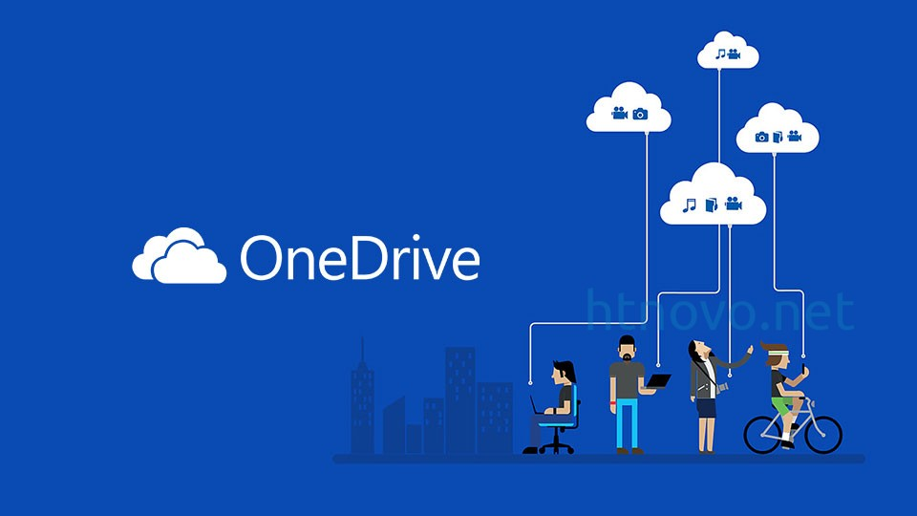
Why Microsoft OneDrive is suitable
A significant need for Ashford is to have a place to store the information securely and centrally, which is what OneDrive provides.
Currently, staff have difficulties with work being duplicated and updates not being transparent, as OneDrive helps solve this by having one shared place for all the work and updates.
It is also easy to use and includes encryption and compliance capabilities, which help to ensure that the sensitive care records are protected (Microsoft, 2023)
In addition, OneDrive can be used in conjunction with other Microsoft 365 apps and works with workflows in Word, Excel, and Teams.
Mobile accessibility ensures real-time record updating by staff, minimizing delays and errors. All the above characteristics improve efficiency, accountability, and collaboration (Alharthi et al., 2020)

Slide 5

How it improves efficiency and communication
OneDrive makes tasks more efficient by allowing for real-time collaboration between several employee roles(Shah & Tariq, 2021).
Support workers, nurses and coordinators are able to access the same document at once minimising duplication and consistency.
Version history helps eliminate errors because the staff can see when it is changed and if necessary, roll back to a previous version.
It integrates seamlessly with Word and Excel, helping to streamline workflows and enabling the creation and saving of Word documents into secure folders.
Mobile access ensures staff working in service users’ homes can instantly upload updates, enhancing communication between field staff and the office.
All these features contribute to improving teamwork and minimizing inefficiencies (Wani & Ali, 2021).

Slide 6
Advantages and its limitations of Microsoft OneDrive
Advantages
Limitations
Microsoft OneDrive is a secure and encrypted storage solution that adheres to data protection regulations (Microsoft, 2023).
It integrates seamlessly with other Microsoft 365 tools; it allows users to access it on mobile devices, and it offers version control, which minimises duplication and errors.
Staff can communicate in real-time, facilitating improved communication and efficiency (Alalwan et al., 2022).
OneDrive depends on connection of the internet, which may be difficult in some field settings.
Effective adoption and prevention of misuse depend on staff training.
Besides, the use of cloud storage may also pose a threat of data breaches when used improperly (Alharthi et al., 2020)

Slide 7
Recommendations on how Ashford can implement these changes
In order to effectively adopt OneDrive, Ashford needs to offer robust training for its staff on secure sharing, permission settings, and version control.
Avoid confusion by creating clear file-naming conventions and folder structures.
Mobile devices should be optimized to get updates to field staff instantly.
To ensure adherence to data protection requirements, management should track usage and implement measures to resolve connectivity issues but also consider options for offline access if applicable.
Using OneDrive in everyday work within Ashford will minimize duplication, improve communication, and enhance the quality of care delivery (Microsoft, 2023).

Slide 8
Conclusion
OneDrive offers a safe, secure and centralized repository for Ashford Community Care Service to store and share highly personal documents.
This minimizes duplication, provides version control and allows staff to access the information on their mobile devices, which allows them to provide more consistent and efficient care.
Collaboration and communication of roles is further improved with integration into Microsoft 365, leading to improved accountability and teamwork.
By implementing the right approach, including fostering a culture of best practices with proper training, structured file organization, and oversight, the adoption of OneDrive can enhance compliance, streamline workflows, and ultimately boost the quality of care delivery.

Slide 9
References
Alalwan, A.A., Dwivedi, Y.K., Rana, N.P. & Algharabat, R.S., 2022. Examining factors influencing adoption of cloud computing in healthcare: An empirical study. International Journal of Information Management, 62, pp.102433.
Alharthi, A., Alassafi, M.O., Walters, R.J. & Wills, G.B., 2020. An exploratory study for investigating the critical success factors for cloud migration in the healthcare sector. Procedia Computer Science, 164, pp.88–95.Microsoft, 2023.
Microsoft OneDrive documentation. [online] Available at: <https://learn.microsoft.com/en-us/onedrive/ > [Accessed 8 October 2026].
Shah, S. & Tariq, R., 2021. Cloud-based collaboration tools and their impact on organizational efficiency. Journal of Business and Technology, 15(2), pp.45–59.
Wani, T.A. & Ali, S., 2021. Cloud storage services and their role in enhancing communication and teamwork. International Journal of Cloud Computing and Services Science, 10(1), pp.12–20

