Slide 1
Module Code: SJSI4012
Student Number: 1804460
Student Name: Jennifer Davies
Assessment Number: 2
Assessment Title:
Discuss the concept of either
‘Welfare’ OR ‘Wellbeing’ OR ‘Poverty’
Referring to theory, policy and practice.

Slide 2


Slide 3
Welfare Definitions
Welfare' refers to 'well-being', or what is 'good' for people. Understood more narrowly, it can be taken to refer to the provision of social services - principally health care, housing, social security, education and social work (Spicker 2017)
Being concerned with implementing social policies, guaranteeing the cradle to grave wellbeing of the whole population, and particularly the elimination of poverty – i.e. – through a variety of welfare benefits via social security and tax systems.(Browne, 2016)

Slide 4
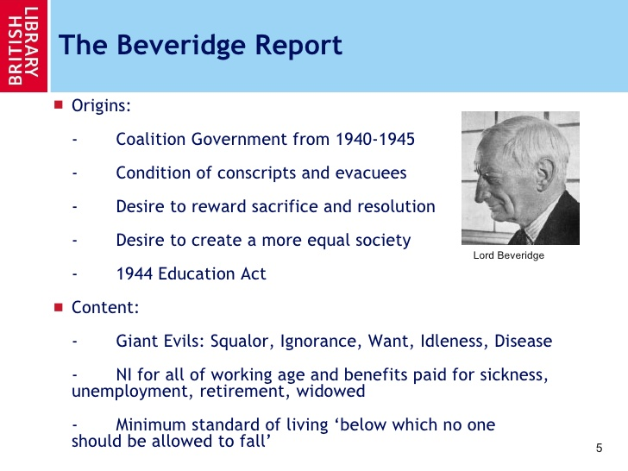

Slide 5
Welfare is often associated with needs, but it goes beyond what people need; to achieve well being, people must have choices and the scope to choose personal goals and ambitions
(Spicker,2017)

Slide 6
Need Vs Want
Bradshaw (1972) identifies four main categories of need:
Normative need is need which is identified according to a NORM
Comparative need concerns problems which emerge by comparison with others
Felt need is need which people feel - that is, need from the perspective of the people who have it.
Expressed need is the need which they say they have.

Slide 7
Third Way
A move back towards a more social democratic model of welfare provision, while still retaining some elements of the New Right approach.
A hand up not a hand out
A large number of policies were implemented to tackle poverty

Slide 8
Coalition Government 2015 - Present
Greater emphasis on individual responsibility and self help – The Big Society Policy
The re-emergence of the distinction between deserving and un-deserving poor
Cuts in the value of benefits, which hit the poorest hard

Slide 9
Experiencing Welfare (Patrick,2016)
Unemployment policy relies on welfare conditionality
‘The focus on conditionality can be criticized for its neglect of broader barriers to engagement in the paid labor market’
More research is needed to into how conditionality is experienced

Slide 10
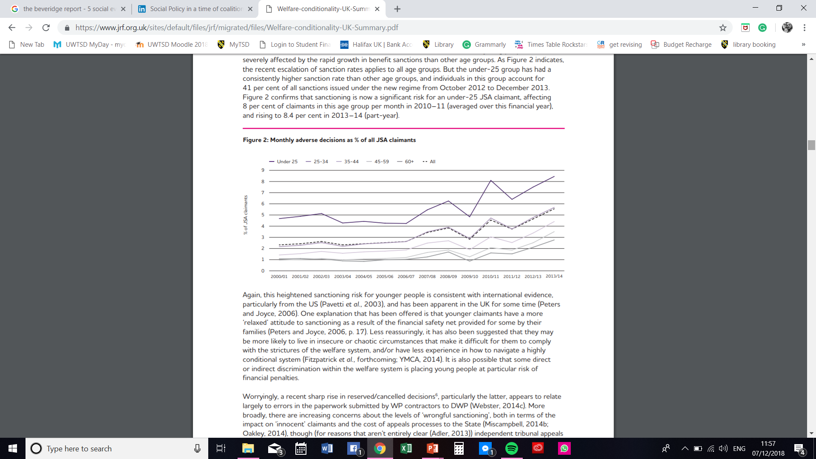
Conditionality (Joseph Rowntree Foundation 2014)

Slide 11
Experiencing Welfare
Welfare to Work (Patrick, 2016)
Much policy energy is focused on welfare to work
The main social security benefit for those experiencing unemployment is Job Seekers allowance
Eligility for Benefits has changed
In the UK, ‘Work First,’ approach is taken

Slide 12
The Big Society
The Big Society is about a huge culture change…
…where people, in their everyday lives, in their homes, in their neighborhoods, in their workplace…
…don’t always turn to officials, local authorities or central government for answers to the problems they face …
…but instead feel both free and powerful enough to help themselves and their own communities.
It’s about people setting up great new schools. Businesses helping people getting trained for work. Charities working to rehabilitate offenders.
(Cameron, 2010)

Slide 13
Why It Did Not Work
the Big Society has been launched at the wrong time: when public services are facing acute financial pressures. Indeed, ministers have been sending out mixed messages – proclaiming the need for a bigger role for community action, at the very time when government financial support for many charities and voluntary organisations is being cut.
The second front concerns the connection between the idea and the policies needed to bring that idea to life. In the 1980s, Margaret Thatcher’s big idea was the free market. She made this vivid with three powerful, emblematic policies: privatisation, council house sales and trade union reform. Everybody with a passing interest in politics had a reasonably clear sense of what ‘Thatcherism’ meant.
There is no such clarity today about Cameron’s big idea. Until there is, and until the Prime Minister manages to persuade voters that the Big Society is not a cover for public spending cuts, the Big Society is doomed to remain unloved.
(YouGov, 2011)

Slide 14
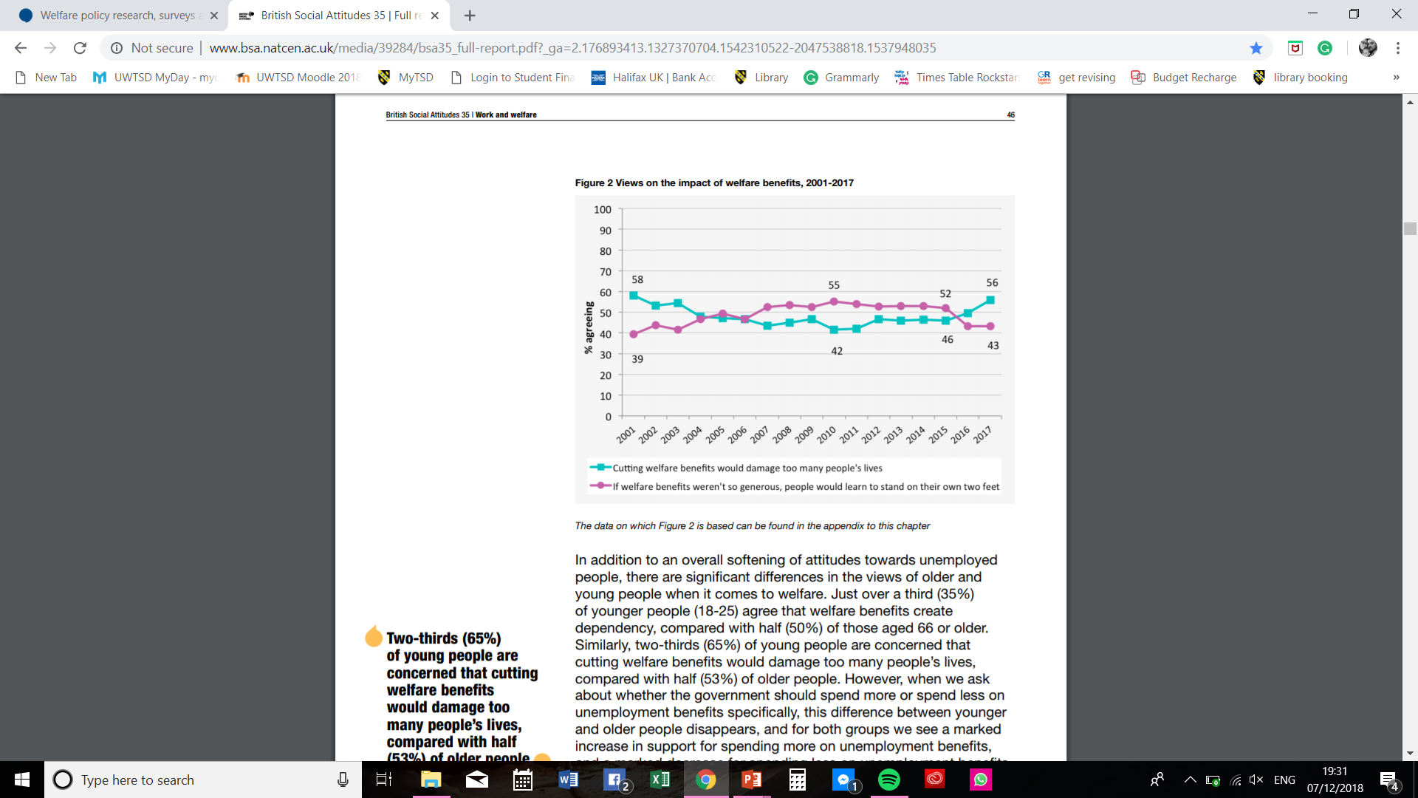
British Social Attitudes, 2018

Slide 15
The Effect of Conditionality
A client was sanctioned for missing an appointment with his Work Programme provider. The letter informing him of the appointment arrived at his home on 27th June 2014. It was dated 26th June 2014 and informed him of an appointment which he had to attend on 25th June 2014. Despite showing this letter to Job Centre Plus staff and being assured a sanction would not be applied, he was subsequently sanctioned.
One client was sanctioned for missing an appointment with Job Centre Plus. He had not been told about the sanction until he attended a subsequent appointment, where he asked to use a phone to apply for a hardship payment. He was told that Job Centre Plus phones were not for public use. After several visits to the Job Centre he was eventually provided with assistance to apply for a hardship payments but it was several weeks before he could access it. He was arrested for shoplifting food in the interim.
(Child Poverty Action Group)

Slide 16
The Work Capability Assessment Policy
Criticism of both the WCA and the conditionality process that its leads to have been particularly scathing from some disabled people organisations ,
research has found that many applicants find the assessment process a significant source of stress
Many new applicants view it as a threat, with the negativity around it demotivating people even before they attempt to access support
Combined with other aspects of the welfare system – including sanctions, for which evidence on effectiveness is limited and the all-to-common perception that many benefit claimants are ‘scroungers
A culture of mistrust in the welfare system has developed, which is particularly felt by those with long-term health conditions. Indeed, the stigma associated with being a welfare claimant prevents some people from claiming benefits to which they are entitled, and consequently also from accessing support
(The Work Foundation, 2016 )

Slide 17
CONCLUSION
CONCLUSION

Slide 18
References
Bradshaw, J. 'A taxonomy of social need', in G MacLachlan (ed.), Problems and progress in medical care (7th series), Oxford University Press; Oxford 1972.
Browne, K. 2017. Sociology for AQA Revision Guide 1: AS and 1st-Year A Level (AQA Revision Guides) Cambridge; Polity Press
Child Poverty Action Group in Scotland http://www.cpag.org.uk/sites/default/files/Sanctions%204.pdf (accessed 14/12/2018)
Cameron, D (2010) Big Society Speech Transcript of a speech by the Prime Minister on the Big Society, 19 July 2010. https://www.gov.uk/government/speeches/big-society-speech
Dudley, C . McEnhill, L. Steadman, K (2016) Is welfare to work, working well? Improving employment rates for people with disabilities and long-term conditions http://www.theworkfoundation.com/wp-content/uploads/2016/11/405_Work-Programmes.pdf (Accessed 14/12/2018)
Patrick, R. 2016. Experiences of Out of Work Benefit Receipt, in The Students Guide to Social Policy, Alcock, P et al. 5th Ed. Wiley and Sons ; Oxford
Spiker, P. (2017) Arguments for Welfare: The Welfare State and Social Policy. London. Rowman an Littlefield
YouGov (2011) Why The Big Society Isn’t Working https://yougov.co.uk/topics/politics/articles-reports/2011/05/24/why-big-society-isnt-working (accessed 14/12/2018)

Slide 19
References
Image 1 – TJS Accounting Company (Accessed 08/12/2018)
https://www.google.co.uk/search?q=welfare+state+ropaganda&tbm=isch&tbs=rimg:CVZwvV3lawS7IjiD69vRAJNjJ8XukhK5SvmSJ-PcdZV8UwejaY-gW4RjohanbFO4m4zSi-YcZkUsnELG8ainTDmwvCoSCYPr29EAk2MnEVO7SRtMb-3PKhIJxe6SErlK-ZIRfT9gda4Q0AwqEgkn49x1lXxTBxHS15UkpaDlKioSCaNpj6BbhGOiEc4ofhyZc1uCKhIJFqdsU7ibjNIRCgLrH9uJukEqEgmL5hxmRSycQhEDv2V4VkbF4SoSCcbxqKdMObC8Ea-5uuTnh51W&tbo=u&sa=X&ved=2ahUKEwj_7-iszZDfAhUKThoKHXesABAQ9C96BAgBEBs&biw=1536&bih=723&dpr=1.25#imgrc=xe6SErlK-ZIWJM:
Image 2 - https://www.slideshare.net/heatherdawson/england-4898990 ( Accessed 02/12/2018)
Image 3 - https://www.jrf.org.uk/sites/default/files/jrf/migrated/files/Welfare-conditionality-UK-Summary.pdf (Accessed 02/12/2018)
Image 4 - http://www.bsa.natcen.ac.uk/media/39284/bsa35_full-report.pdf?_ga=2.176893413.1327370704.1542310522-2047538818.1537948035 (Accessed: 02/12/18)

