Slide 1


Digital Transformation in the Health and Care Professions (BMHP6026)
Component 2 Assessment
Student name: Sarolta Beri
Student ID: 2314149
(Beautifulz Notebook, 2019)

Slide 2

Overview- Wysa app
Introduction
Impact on Workforce
Impact on service delivery
Impact on a patient
Impact on community
Innovation challenge
Recommendation
Conclusion
References

Slide 3
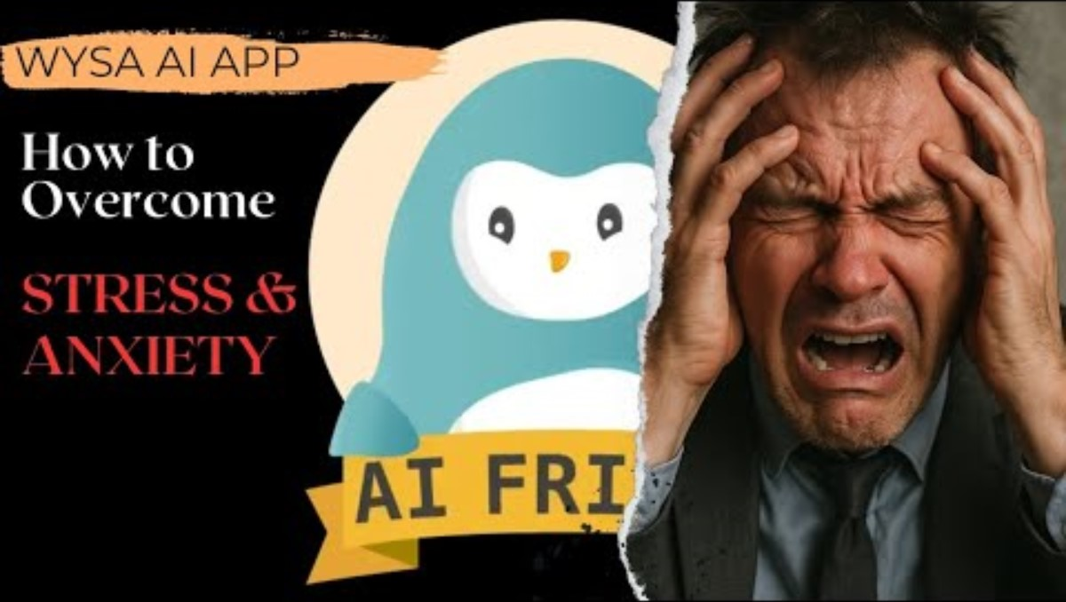
Introduction
https://youtu.be/EbYpQyhjFrk

Slide 4

Impact on Workforce
(Freepik, 2022).
Positive impacts:
24/7 access to mental wellbeing support (Wysa, 2024).
80.1% user engagement among healthcare workers during COVID-19 (Zhong, et al., 2022).
33% reduction in lost-time days (Wysa, 2024).
Anonymity reduces stigma (Tito et al., 2025).
Negative/critical aspects:
Cannot replace human nuance or complex case support (Inkster et al., 2018)
Engagement may decline over time (Sinha et al., 2022)
Premium features may add costs or limit access (Balaskas et al., 2023)
Risk of over-reliance on digital support (Inkster et al., 2018)

Slide 5
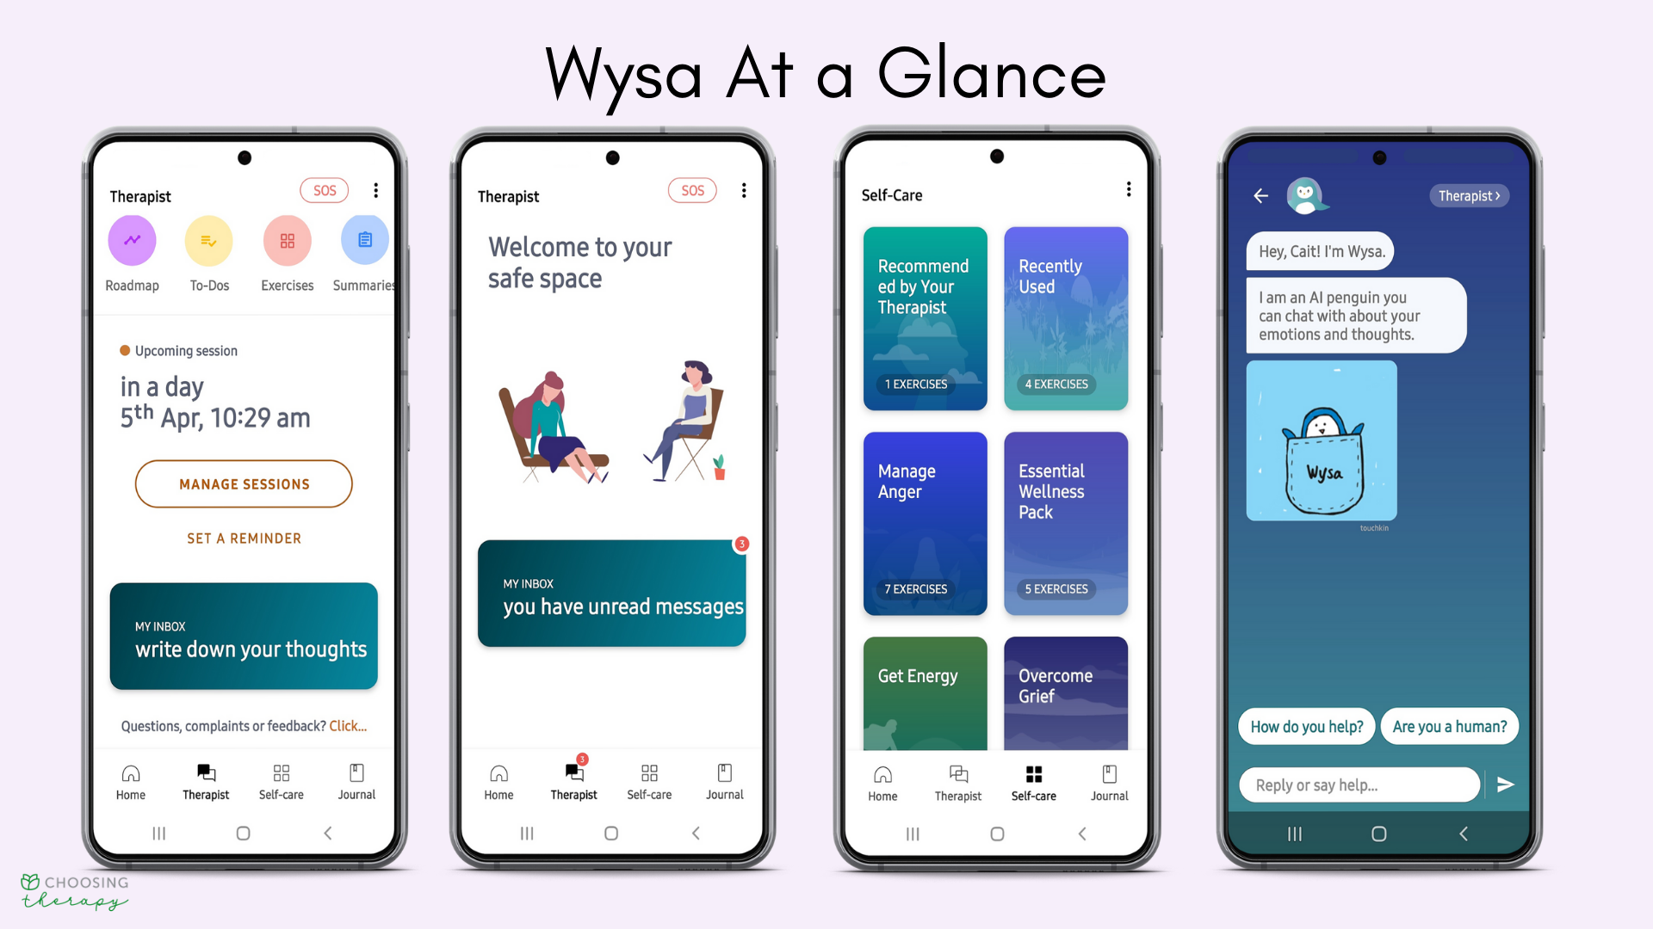
Impact on service delivery
Positive impacts:
Gateway” digital intake reduces paperwork and flags risk early (Wysa, 2025)
Supports earlier triage and engagement, reducing waiting times (NHS Innovation Accelerator, 2025)
Scalable across settings like schools, workplaces, and primary care (NHS, 2023)
Negative/critical aspects:
Bot-led tools may miss complex clinical cases (NHS, 2025)
Data security and privacy remain key concerns (Kretzschmar et al., 2019)
Over-reliance on apps may reduce face-to-face capacity and widen service gaps (Bucci et al., 2019)
May exclude individuals with low digital literacy or limited access (NHS, 2025)
(Bell, 2023)

Slide 6

Impact on patients
(Anan Sudsaithong , 2018)
Positive Impacts
Easier access to care (Malik et al., 2021)
More convenient and flexible (Haque, 2022)
Helps patients understand and manage their health (Malik et al., 2021)
Faster communication with health providers (Malik et al., 2021)
Can make patients feel more supported (Malik et a., 2021)
Negative/ critical aspects
Can feel less personal than face-to-face care (Giebel et al., 2023)
Technical problems can cause stress (Giebel et al., 2023)
Worries about privacy (Huckvale et al., 2019)
Some patients may struggle with using technology (Giebel et al., 2023)
May delay seeking real medical help (Giebel et al., 2023)

Slide 7
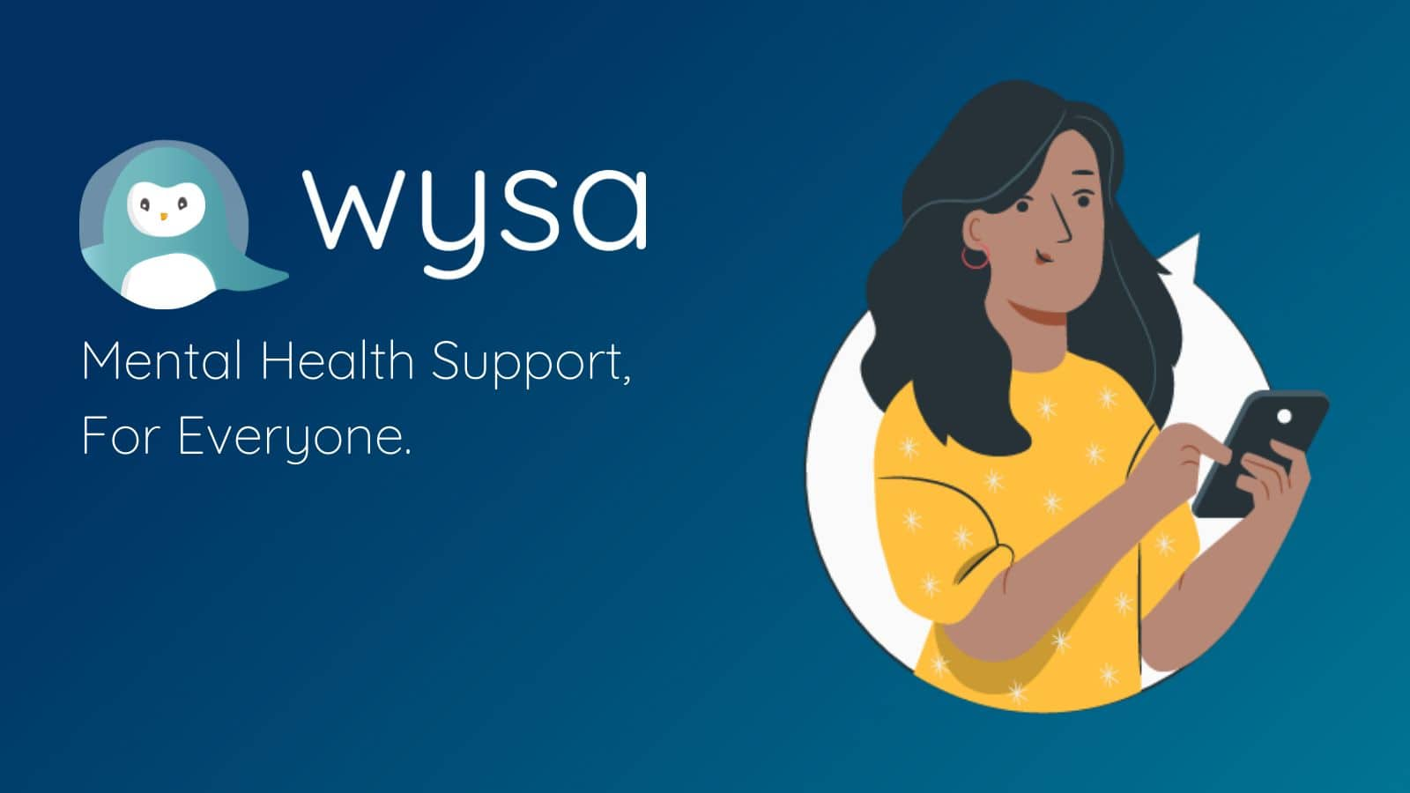
Impact on community
Positive impact
Improves access to mental-health services (WHO, 2022).
Reduces pressure on overstretched healthcare systems (OECD, 2024)
Supports early intervention (Powell, 2019)
Encourages community wellbeing (Public Health England, 2018)
Promotes public mental-health awareness (WHO, 2025)
Negative/ critical aspects
Reduces face-to-face community interaction (WHO, 2022)
Digital inequality (Raihan et al., 2024)
Privacy risks spread to the wider community (Iwaya et al., 2022)
Over-reliance on apps may delay professional help (Zenkan, 2025)
Misinformation or generic AI responses may lead to reduced trust (Bontridder, 2021)
(Garcia, 2023)

Slide 8

(MTU, 2024)
AI may give generic or limited answers, not fully understanding complex emotions
Repetitive chatbot responses can reduce user engagement
May not handle serious mental-health issues, leading to delays in getting professional help
Privacy and data-security concerns
Digital access barriers may exclude people without smartphones or internet access
(Beenish, 2023)

Slide 9

(Business R, 2023))
The Wysa app should be used as a supportive wellbeing tool, and UK users should check how it handles personal data under the Data Protection Act 2018 (NHS, 2024)
It is also important to ensure the app meets UK clinical-safety expectations such as the NHS DCB0129 standard for digital health tools (NHS, 2025)
Before using Wysa, users should read its privacy policy to understand how data is stored and protected (Wysa, 2022).
UK guidance also recommends that apps follow strong data-protection rules such as UK GDPR, overseen by the Information Commissioner’s Office (NHS, 2024).

Slide 10

Conclusion
(Oaks, 2022)
Wysa offers a valuable, accessible option for many people seeking mental‑health support — especially as a first aid or self‑help tool. Users report it as a safe, private, and convenient way to manage stress, anxiety or low mood through exercises, journaling, and AI‑guided conversations. However, Wysa — like any AI‑powered mental‑health app — has limitations: it lacks genuine empathy and deep understanding, and its responses can sometimes feel generic or repetitive. Importantly, Wysa should not be used as a substitute for professional therapy or crisis care; for serious mental‑health conditions or emergencies, human clinicians remain irreplaceable.

Slide 11


Slide 12
References
Anan Sudsaithong (2018). Medicine young Asian female doctor consulting patient in hospital office. Health care and medical concept. Available at: https://www.dreamstime.com/medicine-young-asian-female-doctor-consulting-patient-hospital-office-health-care-medical-concept-medicine-young-asian-image130731925 (Accessed 2 Dec. 2025).
Balaskas, A. et al. (2023) ‘Examining young adults daily perspectives on usage of anxiety apps: A user study’, PLOS digital health, 2(1), p. e0000185. Available at: https://doi.org/10.1371/journal.pdig.0000185. (Accessed: 9 November 2025)
Beautifulz Notebook (2019). Notebook. (Accessed: 10 November 2025)
Beenish Moalla Chaudhry and Happy Rani Debi (2023). User perceptions and experiences of an AI-driven conversational agent for mental health support. mHealth, Available at: doi:https://doi.org/10.21037/mhealth-23-55. (Accessed: 03 December 2025)
Bell, C. (2023). Wysa App Review 2022: Pros & Cons, Cost, & Who It’s Right For. [online] Choosing Therapy. Available at: https://www.choosingtherapy.com/wysa-app-review/ (Accessed: 9 November 2025)

Slide 13
Bontridder, N. and Poullet, Y. (2021). The Role of Artificial Intelligence in Disinformation. Data & Policy, Available at: doi:https://doi.org/10.1017/dap.2021.20. (Accessed: 03 December 2025)
Bucci, S., Berry, N., Morris, R., Berry, K., Haddock, G., Lewis, S., & Edge, D. (2019). “They Are Not Hard-to-Reach Clients. We Have Just Got Hard-to-Reach Services.” Staff Views of Digital Health Tools in Specialist Mental Health Services. Frontiers in Psychiatry, 10, 344. Available at: https://doi.org/10.3389/fpsyt.2019.00344 (Accessed:02 December 2025)
Business, R. (2023). like, best, good, quality, sign, hand, icon, symbol, up, recommend. Available at: https://www.istockphoto.com/photo/recommendation-wording-suggestions-recommended-rating-business-concept-gm1462020312-495721427 (Accessed 3 Dec. 2025).
Freepik. (2022). Front view nurse holding smartphone | at: https://www.freepik.com/free-photo/front-view-nurse-holding-smartphone_32486180.htm (Accessed 9 Nov. 2025).
Garcia, E. (2023). Wysa: la app que brinda apoyo emocional a través de la IA - Inteligencia Artificial. [online] Inteligencia Artificial. Available at: https://serinteligenciaartificial.com/wysa (Accessed 3 Dec. 2025).
Haque, R. and Rubya, S. (2022). An Overview of Chatbot Based Mobile Mental Health Applica-tions: Insights from App Description and User Reviews (Preprint). JMIR mHealth and uHealth, 11(11). Available at: doi:https://doi.org/10.2196/44838. (Accessed: 03 December 2025)

Slide 14
Huckvale, K., Torous, J. and Larsen, M.E. (2019). Assessment of the Data Sharing and Privacy Practices of Smartphone Apps for Depression and Smoking Cessation. JAMA Network Open, 2(4), p.e192542. Available at: doi:https://doi.org/10.1001/jamanetworkopen.2019.2542. (Accessed: 03 December 2025)
Inkster, B., Sarda, S. and Subramanian, V. (2018) ‘An Empathy-Driven, Conversational Artificial Intelligence Agent (Wysa) for Digital Mental Well-Being: Real-World Data Evaluation Mixed-Methods Study’, JMIR mHealth and uHealth, 6(11), p. e12106. Available at: https://doi.org/10.2196/12106. (Accessed: 9 November 2025)
Iwaya, L.H., Babar, M.A., Rashid, A. and Wijayarathna, C. (2022). On the privacy of mental health apps. Empirical Software Engineering, [online] 28(1). Available at: doi:https://doi.org/10.1007/s10664-022-10236-0. (Accessed:03 December 2025
Kretzschmar, K., Tyroll, H., Pavarini, G., Manzini, A., & Singh, I. (2019). Can Your Phone Be Your Therapist? Young People’s Ethical Perspectives on the Use of Fully Automated Conversational Agents (Chatbots) in Mental Health Support. Biomedical Informatics Insights, 11, 1178222619829083. Available at: https://doi.org/10.1177/1178222619829083 (Accessed: 02 December 2025)
Malik, T., Ambrose, A.J. and Sinha, C. (2021). User Feedback Analysis of an AI-Enabled CBT Mental Health Application (Wysa) (Preprint). JMIR Human Factors, 9(2). Available at: doi:https://doi.org/10.2196/35668. (Accessed: 03 December 2025)
MTU (2024). CIT Teaching & Learning Unit - The Innovation Challenge. Available at: https://tlu.cit.ie/the-innovation-challenge. (Accessed: 03 December 2025)

Slide 15
NHS (2025). Clinical risk management standards. Available at: https://digital.nhs.uk/services/clinical-safety/clinical-risk-management-standards (Accessed: 03 December 2025).
NHS England (2023). Inclusive digital healthcare: a framework for NHS action on digital inclusion. [online] NHS England. Available at: https://www.england.nhs.uk/long-read/inclusive-digital-healthcare-a-framework-for-nhs-action-on-digital-inclusion/. (Accessed: 02 December 2025)
NHS England (2024). Protecting Patient Data - NHS Digital. Available at: https://digital.nhs.uk/services/national-data-opt-out/understanding-the-national-data-opt-out/protecting-patient-data. (Accessed: 03 December 2025)
NHS England (2025). NHS England» Tackling digital exclusion and health literacy: How libraries can help bridge the gap. Available at: https://www.england.nhs.uk/blog/tackling-digital-exclusion-and-health-literacy-how-libraries-can-help-bridge-the-gap/. (Accessed: 02 Decemebr 2025)
NHS England (2025b). NHS England» Tackling digital exclusion and health literacy: How libraries can help bridge the gap. Available at: https://www.england.nhs.uk/blog/tackling-digital-exclusion-and-health-literacy-how-libraries-can-help-bridge-the-gap/. (Accessed: 02 December 2025)
NHS Innovation Accelerator. (2025). Smart Triage - AI-Powered Autonomous Appointment Booking for GP Practices - NHS Innovation Accelerator. Available at: https://nhsaccelerator.com/innovations/smart-triage/. (Accessed: 02 December 2025)

Slide 16
Oaks (2022). Wysa - Oaks Mental Health. - We grow knowledge of mental health. Available at: https://oaksmentalhealth.ca/resources/wysa/ (Accessed 3 Dec. 2025).
OECD. (2024). Digital health. Available at: https://www.oecd.org/en/topics/digital-health.html. (Accessed: 03 December 2025)
Powell, T., Gheera, M., Foster, D., Long, R. and Kennedy, S. (2019). Early intervention: policy and provision. [online] Parliament.uk. Available at: https://researchbriefings.files.parliament.uk/documents/CBP-7647/CBP-7647.pdf. (Accessed: 03 December 2025)
Public Health England (2018). Health matters: Community-centred approaches for health and wellbeing. Available at: https://www.gov.uk/government/publications/health-matters-health-and-wellbeing-community-centred-approaches/health-matters-community-centred-approaches-for-health-and-wellbeing. (Accessed: 03 December 2025)
Raihan, M.M.H., Subroto, S., Chowdhury, N., Koch, K., Ruttan, E. and Turin, T.C. (2024). Dimensions and barriers for digital (in)equity and digital divide: a systematic integrative review. Digital Transformation and Society, 4(2). Available at: doi:https://doi.org/10.1108/dts-04-2024-0054. (Accessed: 03 December 2025)
Sinha, C., Cheng, A.L. and Kadaba, M. (2022) ‘Adherence and Engagement With a Cognitive Behavioural Therapy–Based Conversational Agent (Wysa for Chronic Pain) Among Adults With Chronic Pain: Survival Analysis’, JMIR formative research, 6(5), p. e37302. Available at: https://doi.org/10.2196/37302. (Accessed: 9 November 2025)

Slide 17
Tito, S.A., Arefin, S. and Global Health Institute Research Team, (2025). Integrating AI Chatbots and Wearable Technology for Workplace Mental Health: Reducing Stigma and Preventing Burnout through Human-AI Collaboration. Central India Journal of Medical Research, 4(01), pp.60-68. (Accessed: 9 November 2025).
WHO (2025). WHO launches new guidance to promote mental health across all government sectors. Available at: https://www.who.int/news/item/24-11-2025-who-launches-new-guidance-to-promote-mental-health-across-all-government-sectors. (Accessed: 03 December 2025)
WHO, (2022). World mental health report: Transforming mental health for all. World Health Organization. Available at: World mental health report: transforming mental health for all - World Health Organization - Google Books (Accessed: 03 December 2025)
Wysa - Everyday Mental Health. (2024.). Wysa for Employers - Corporate Wellness Companies | Employee Wellness Programs. Available at: https://www.wysa.com/for-employers. (Accessed: 9 November 2025).

Slide 18
Wysa (2022). Wysa UK App Privacy Policy. Available at: https://legal.wysa.uk/privacy-policy. (Accessed: 03 December 2025)
Wysa.com. (2025). Wysa Gateway - Smart Digital Intake for Faster Access to Mental Health Care | Automate Clinical Screenings & Referral Pathways. Available at: https://www.wysa.com/gateway. (Accessed: 02 December 2025).
Zenkan (2025). Zenkan.app. Available at: https://zenkan.app/blog/20250205-productivity-apps-the-problem-of-overreliance (Accessed 3 Dec. 2025).
Zhong, S., Yang, X., Pan, Z., Fan, Y., Chen, Y., Yu, X. and Zhou, L. (2022). The usability, feasibility, acceptability, and efficacy of digital mental health services in COVID-19: a scoping review, systematic review, and meta-analysis (Preprint). JMIR Public Health and Surveillance. Available at: doi:https://doi.org/10.2196/43730. (Accessed: 9 November 2025).

