Slide 1
Menu Takeaway for Trinity Hotel
Student name: Ionut Birladeanu
Student number: 2121940
Food & Beverage Operations BMIH4002
Lecturer: Steve Jones

Slide 2





STARTERS
Szechuan Pepper Squid 14.00
Chilli, coriander& aioli
Garlic bread 3.59
Bacon & Cheese Bread 6.00
Cheese, bacon & sweet chilli sauce
TAKEAWAY MENU
To place an order call: 07586943678
You can also order online using :
SAUCES
Mushroom 1.49
Dianne 1.00
Gravy 0.79
Opening time :
Monday-Friday 9am-10 pm
Saturday-Sunday 10am-9pm
KIDS CORNER
Card , cash or online payment on site :
www.trinityhotel.takeaway.com
Fish & Chips 8.00
Chicken Nuggets & Chips 5.59
Spaghetti Carbonara 7.00
IF YOU HAVE A FOOD ALLERGY , PLEASE INFORM A MEMBER OF OUR STAFF BEFORE YOU PLACE YOUR ORDER

Slide 3
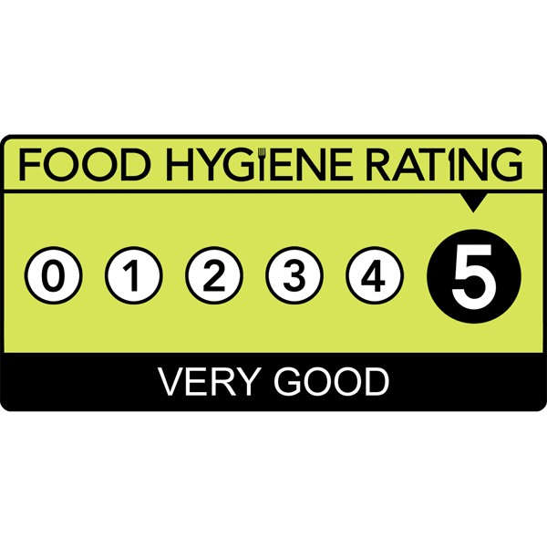
MAINS
PIZZERIA
280g BLACK ANGUS SCOTCH FILLET 29.59
Choice of sauce with chips & salad, or mashed potato
CHILLI NACHOS 15.00
Corn chips, chilli beans, cheese ,sour cream
FISH & CHIPS 18.00
Chips, salad, lemon
250g BLACH ANGUS RUMP 21.00
Salad, choice of sauce with chips
MARGHERITA 14.00
Fresh basil, mozzarella
GARLIC & CHEESE 12.00
HAWAIIAN 14.00
Ham, pineapple , mozzarella
BEVERAGES
FRUIT SHOOT 1.00
SMOOTHIE 1.00
DARK BLUE WINE MERLOT 750ml 5.10
COLD SAUVIGNON BLANC 750ml 4.00
SELECT CABERNET SAUVIGNONS 750ml 4.00
SALADS
CAESAR SALAD 14.59
Croutons, parmesan, boiled egg, crispy bacon
CLASIC GREEK SALAD 11.00
Baby cos, fetta , baby heirlooms
ADD GRILLED CHICKEN 5.00
ADD SZECHUAN PEPPER SQUID 5.00
Ewch i food.gov.uk/ratings i ganfod sgôr hylendid bwyd ein busnes neu gofynnwch inni beth yw ein sgôr hylendid bwyd wrth archebu / Go to food.gov.uk/ratings to find out the food hygiene rating of our business or ask us for our food hygiene rating when you order.

Slide 4
REFERENCE LIST:
Alby Gallum , THE TAKEAWAY, Chicago: Crain Communications, Incorporated, 2017-03-20, Vol.40(12), p.6.
Bret Thorn, Five Takeaway, New York: Lebhar-Friedman,Inc, 2018-08-01, Vol.52(11), p.28.
Debruge, Peter, A side-splitting menu, Los Angeles: Penske Business Media, LLC, 2009-09-21, Vol.416(6), p.42.
Jeremy Grant, Takeaway Kids, London: The Financial Times Limited, 2006-05-12, p.1.
Pearlman, Alison, Restaurant Menu Design, The SAGE ENCYCLOPEDIA of Food Issues, 2015, p.1206-1210.

