Slide 1
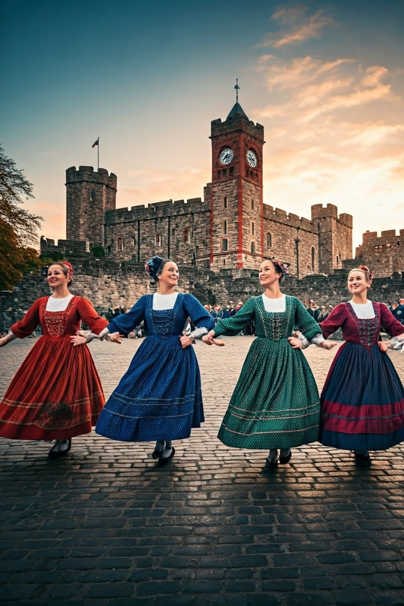
Croeso Cymru Festival: A Celebration of Welsh Heritage and Nature
Student Name: Rezwana Laboni
Student ID: 2242894
Module Code:BMIH6007
Lecturer: Kathryn Flynn
Submission Date: 23/05/25
IK

Slide 2
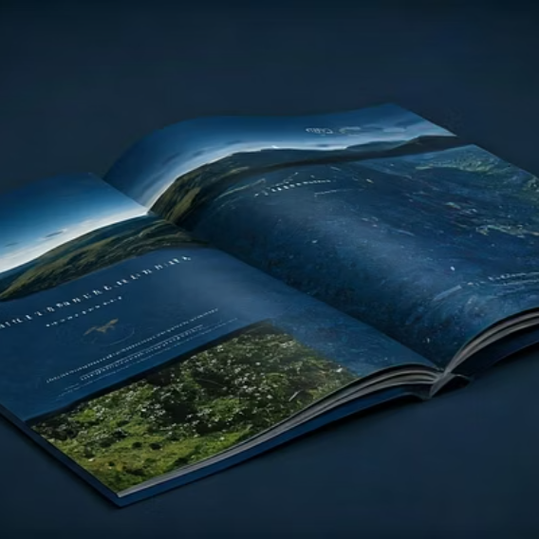
Presentation Contents
Introduction
Event Overview and Background
Event Content and Context
Market Factors
Operational Factors
Financial Factors: Breakdown of Cost
Financial Factors: Revenue Generation
Marketing and Promotion Strategy
Conclusion
Reference

Slide 3
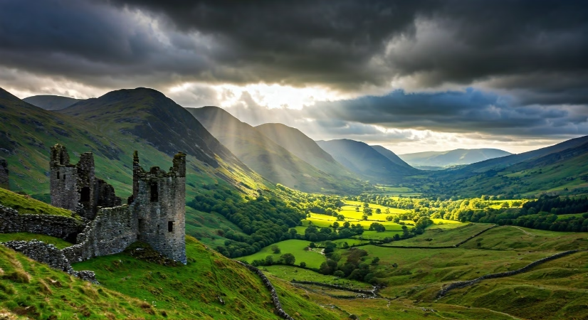
Introduction
Welcome to my presentation on the "Croeso Cymru Festival: A Celebration of Welsh Heritage and Nature."
This presentation will provide a comprehensive overview of the festival's concept, target market, operational feasibility, financial factors, and marketing strategies.
The festival aims to create immersive experiences that highlight Wales' unique offerings and establish it as a must-visit destination on the global tourism map.
Notes:
Introduction
Let’s welcome you to my presentation concerning the "Croeso Cymru Festival: A Celebration of Welsh Heritage and Nature”, an activity intended to make Wales a leading destination for world tours in the year of Croeso 2025. Concept for the event, target market, feasibility to run the operations and financial factors, as well as marketing strategies, are some of the topics that this presentation will touch on. I will describe the purpose of the event as one of introducing the Welsh culture, heritage, nature, and cuisine to international tourists with the use of a multi-day festival. We shall look at the potential of the festival in attracting visitors, how much it will cost and how much it will generate, as well as the logistics and operations that will make the festival come to fruition. At the end of the above presentation, I should be in a position to give a substantial overview regarding the feasibility of the event and how it contributes to Wales' tourism strategy.

Slide 4

Event Overview and Background
Festival Concept
Location
A four-day international cultural and outdoor festival celebrating Wales' rich history, breathtaking landscapes, and vibrant traditions under the Year of Croeso 2025 theme.
Primarily in Cardiff, with additional events in Snowdonia and the Brecon Beacons, showcasing urban and rural Welsh experiences (Visit Wales, 2025; Wales.com, 2025).
Core Elements
Promotion of Wales as an ideal destination for cultural tourism, adventure activities, and culinary experiences through immersive programming.
Notes:
Event Overview and Background
The Croeso Cymru Festival is a four-day international cultural and outdoor festival which is to celebrate Wales’ rich history, amazing natural beauties and lively traditions, according to the theme of Year of Croeso 2025. The festival will be hosted in Cardiff, while other events will be carried out in Snowdonia and the Brecon Beacons (Visit Wales, 2025; Wales.com, 2025). The festival will market Wales as the perfect destination for the practice of cultural tourism, adventure activities, and culinary activities. It will focus on essential elements of Welsh identity: from the Welsh folk dances, Welsh music, to the gorgeous countryside with its assortment of hiking and mountain biking. The activities of the festival are going to be interactive and will consist of the Welsh food festival, the classes of the local crafts, cultural exhibits, etc. They will all contribute to international visitors’ investigation of the wide range of options Wales has to offer (GOV.WALES, 2025). Bowdin et al., 2023).

Slide 5
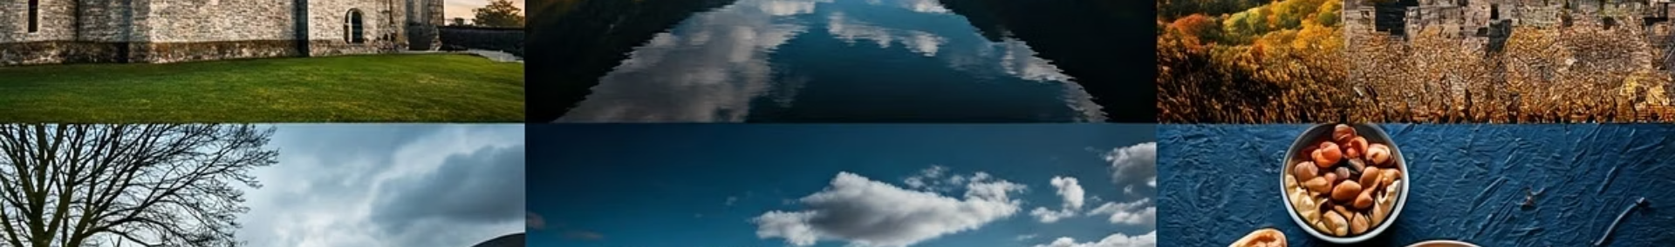




Event Content and Context
Day 1: Cultural and Heritage Exhibitions
Interactive displays, storytelling, and live Welsh performances at Cardiff Castle and Wales Millennium Centre, introducing visitors to Wales' history, language, and traditions.
Day 2: Outdoor Adventure Activities
Hiking, mountain biking, and wildlife photography workshops in Snowdonia and the Brecon Beacons, showcasing Wales' natural beauty (The Guardian, 2024).
Day 3: Welsh Cuisine Food Festival
Opportunity to sample local Welsh dishes such as Welsh rarebit, laverbread, and cawl at a dedicated food festival in Cardiff.
Day 4: Arts and Craft Workshops
Hands-on learning about traditional Welsh crafts including wool weaving, pottery, and knitting, with visitors taking home their creations as souvenirs.
Notes:
Event Content and Context
This Croeso Cymru Festival will take four days, each day with a different slant on the Welsh culture and tourism.
On day 1, there are going to be Cultural and Heritage Exhibitions around Cardiff Castle and the Wales Millennium Centre. By means of such exhibitions, the visitors will get acquainted with Wales’ history, language, and traditions presented by interactive displays, stories, and live performances in Welsh.
Day 2 will be taken up by the Outdoor Adventure Activities in Snowdonia and the Brecon Beacons, offering tourists the opportunity to take part in hiking, mountain-biking, and wildlife photography workshops.
Day 3 will present Welsh Cuisine with Food Festival in Cardiff, as visitors can taste Welsh cuisines – Welsh rarebit, laverbread, and cawl (The Guardian, 2024).
Day 4 will see Arts and Craft Workshops, where learners will learn about traditional crafts of Welsh people like weaving with wool, pottery, and knitting and carry their workmanship as a memento.
It is the goal to provide a completely immersive experience of cultural heritage, outdoor adventure, culinary excursion, and hands-on arts and crafts (Scottish Enterprise, 2024).

Slide 6








Market Factors
Adventure Seekers
Cultural Tourists
Outdoor enthusiasts who enjoy hiking, mountain biking, and nature experiences in beautiful landscapes (World Travel & Tourism Council, 2024).
Travellers eager to learn about Welsh heritage, traditions, and arts through immersive experiences.
Target Audience
International tourists from North America, Europe, and Asia interested in cultural travel, outdoor activities, and eco-tourism.
Food Enthusiasts
Culinary tourists keen to explore Welsh cuisine and local food traditions.
Notes:
Market Factors
The festival of Croeso Cymru will aim at the overseas tourists, mainly from North America, Europe and Asia, catering to tourists interested in the cultural, outdoor, and eco-tourist types of tourists. The event is meant for the general audience, which includes cultural tourists interested in Welsh heritage, traditions, and arts, adventure enthusiasts who like hiking, mountain biking, and other nature activities in Wales’ scenic areas, and foodies who would like to savour Welsh cuisine. With the Year of Croeso 2025, Wales will have a great scope of being able to bridge into the trending needs of the modern travellers, who wish to focus on experiential tourism, focusing on being immersed in the culture of the experience (World Travel & Tourism Council, 2024). In spite of such competition as the Edinburgh Festival and St. Patrick’s Day held in Ireland, Croeso Cymru Festival will be different from all these as it will be combining the culture, adventure, and cuisine of Wales into one, unlike event that has ever been seen before for the international visitors to enjoy.

Slide 7
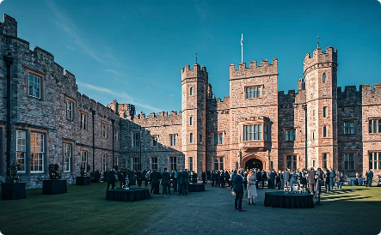
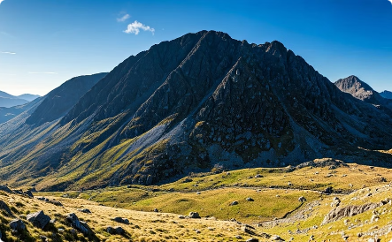

Operational Factors
Urban Venues
Cardiff, as the capital of Wales, offers excellent infrastructure and key venues like Cardiff Castle and Wales Millennium Centre for cultural exhibitions, performances, and food events.
Rural Locations
Snowdonia and the Brecon Beacons provide the perfect setting for outdoor activities such as hiking, mountain biking, and wildlife photography, appealing to adventure tourists (Aquilino, Harris and Wise, 2021; Morgan, 2025).
Logistical Requirements
The festival will require skilled event managers, security staff, local guides for outdoor activities, technical teams for performances, and transportation logistics between urban and rural locations.
Notes:
Operational Factors
The festival is mostly going to take place in Cardiff, with the events spreading to Snowdonia and the Brecon Beacons. Being the capital of Wales, Cardiff is a perfect venue due to its convenient access for foreign visitors, good infrastructure, and facilities such as Cardiff Castle and Wales Millennium Centre (Aquilino, Harris and Wise, 2021; Morgan, 2025). Cultural shows, exhibitions and food-based events will be held in these venues. The Snowdonia and the Brecon Beacons are a perfect location for such outdoor activities as hiking and mountain biking, as well as wildlife photography. Such areas are known for their natural beauty and are visited by adventure tourists (Mawarni et al., 2022; Bichler and Peters, 2021). Operationally, we shall require competent event managers, organisers, local guides for outdoor events, and a technical team for performances. We will also need to have transportation logistics to allow movement of the attendees from Cardiff to the rural locations. With the exception of meticulous planning and proper coordination of these logistical aspects, the success of the event would be impossible.

Slide 8
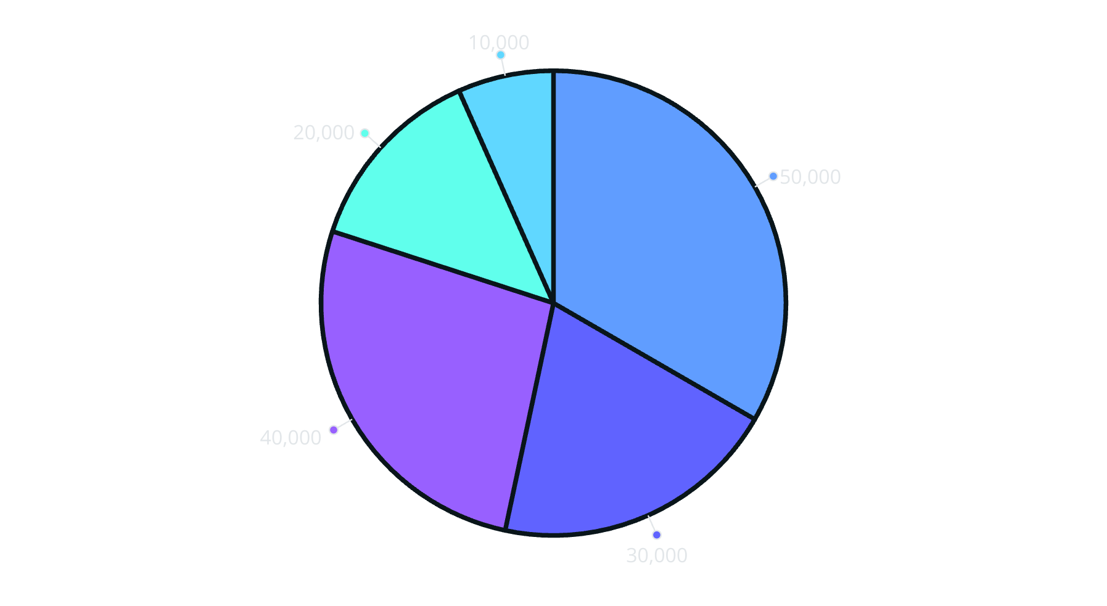
Financial Factors: Breakdown of Costs
Venue Rentals
Marketing
Outdoor Activities
Catering & Materials
Staffing & Logistics
The estimated total cost for the festival is £150,000. The largest portion of the budget (£50,000) will be allocated to venue rentals for locations like Cardiff Castle and Wales Millennium Centre. Marketing will receive £30,000 for promotional activities across digital channels to attract international tourists.
Outdoor activities will require £40,000 to cover equipment, staffing, and guides for excursions. Catering and event materials account for £20,000, while the remaining £10,000 will support staffing and logistics operations throughout the festival.
Notes:
Financial Factors: Breakdown of Costs
Totally, the cost for the festival is estimated at £ 150,000. The following shows the main costs of organising the event:
Cost Category
Amount (£)
Venue Rentals
50,000
Marketing and Promotion
30,000
Catering and Event Materials
20,000
Outdoor Activities
40,000
Logistics and Staffing
10,000
Total Estimated Cost
150,000
The biggest budget that is set to be £50,000 will be used in hiring venues to cater for such places as Cardiff Castle and Wales Millennium Centre. As we will target foreign tourists, we will have to rely heavily on marketing. Therefore, we will spend £30,000 on our promotional activities on the internet. The spending of £40,000 on the outdoor activities will include both the equipment, staffing, and guides for the excursions. Catering and event materials will represent £20,000, while the remaining £10,000 will be spent on staffing and logistics.

Slide 9
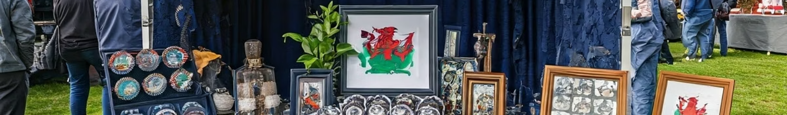
Financial Factors: Revenue Generation
£120,000
£50,000
Ticket Sales
Sponsorships
1,500 attendees purchasing £80 tickets for the four-day event
From local businesses, international brands, and tourism boards
£25,000
£5,000
Merchandise
Grants
5,000 items at average price of £5 per item
Local government and tourism board funding
Notes:
Financial Factors: Revenue Generation
Revenue Source
Estimated Quantity
Unit Price (£)
Total Revenue (£)
Ticket Sales
1,500
80
120,000
Sponsorships
-
-
50,000
Merchandise Sales
5,000 items
5
25,000
Local Government and Tourism Grants
-
-
5,000
Total Predicted Revenue
-
-
200,000
The Croeso Cymru Festival is expected to raise a total of 200,000 pounds in terms of revenue. The breakdown of the sources of revenue is as follows;
Ticket Sales: The estimated number of participants would be 1,500 people who would procure a ticket worth £ 80 for a four-day event, and we expect to earn £120,000 as a result of ticket sales.
Sponsorships: We expect to raise £50,000 from the sponsors and they will mostly be local businesses, international brands as well as tourism boards. Such partnerships will subsidise such parts of the event as outdoor activities, food festivals, and cultural performances among others.
Merchandise Sales: £25,000 in revenues is being projected from the sale of merchandise, sold at an average price of £5 per item at 5,000 Welsh-themed souvenirs, local food products and merchandises specific to the event.
Local Government and Tourism Grants: We also expect £5,000 from local government grants and tourism boards seeing that the event has potential to promote Wales on international grounds and through this, drive tourism.
The model of revenue involved in this is aimed at ensuring that the festival is able to return economically significant amount of money, which can cover up the costs and have a positive impact on tourism sector of Wales (Yen et al., 2023).

Slide 10





Marketing and Promotion Strategy
Digital Marketing
Social media campaigns on Instagram, Facebook, and TikTok to reach international audiences interested in adventure and cultural tourism
Influencer Partnerships
Collaborations with travel influencers and bloggers to increase awareness and generate excitement in key markets (Carlisle et al., 2021)
Paid Advertising
Google Ads and paid social media campaigns targeting specific demographic groups in key international markets
Public Relations
Partnerships with international media outlets, travel magazines, and news stations for broad media coverage (Clarke and Bowen, 2021; Scherf, 2021)
Notes:
Marketing and Promotion Strategy
We shall undertake an effective marketing and promotion strategy in order to make the Croeso Cymru Festival successful. This will include:
Digital Marketing: We will perform social media campaigns on the likes of Instagram, Facebook, and TikTok to target the international prospects (Carlisle et al., 2021). Such platforms will be efficient for the targeting of the expanding audience of adventure and cultural tourism.
Influencer Partnerships: We will work with travel influencers and bloggers to build awareness of the festival and create an interest in the destination in the key markets (GlobalData, 2023).
Paid Advertising: We will rely on Google Ads and paid social media campaigns to reach specific demographics groups in the key international markets as well, to gain maximum visibility (Price, 2021; Lonardi, 2022).
Public Relations: We will collaborate with the international media, travel magazines, and news stations to get wide media attention on the festival (Clarke and Bowen, 2021; Scherf, 2021).

Slide 11
Conclusion
The Croeso Cymru Festival presents a unique opportunity to showcase Wales' unparalleled combination of cultural richness, natural beauty, and world-class hospitality. The Year of Croeso 2025 is the perfect moment to introduce the world to Wales' many treasures, from breathtaking landscapes and adventurous activities to its vibrant food scene and centuries-old traditions.
Notes:
Conclusion
The Croeso Cymru Festival opens a unique way to display Wales’ inimitable mix of cultural opulence, beauty of nature, and world-class hospitality on the international arena. The Year of Croeso 2025 is a great opportunity to present the world with the many wonders of Wales, from the fabulous landscapes and adventurous outdoors to the colourful food culture and centuries-old traditions. This festival, combining heritage exhibitions with outdoor adventures, local cuisine, and hands-on workshops, will provide the visitors with an authentic and participatory experience (McHugh, 2021; Coles, 2021). In mixing cultural legacy with world appeal, we are not only winning over the international tourists but also creating long-lasting bonds that would continue to serve Wales well in future.

Slide 12
References
Aquilino, L., Harris, J. and Wise, N. (2021). A sense of rurality: Events, placemaking and community participation in a small Welsh town. Journal of Rural Studies, 83, pp.138-145.
Bichler, B.F. and Peters, M. (2021). Soft adventure motivation: An exploratory study of hiking tourism. Tourism Review, 76(2), pp.473-488.
Bowdin, G.A., Allen, J., Harris, R., Jago, L., O'toole, W. and McDonnell, I. (2023). Events management. Routledge.
Carlisle, S., Zaki, K., Ahmed, M., Dixey, L. and McLoughlin, E. (2021). The imperative to address sustainability skills gaps in tourism in Wales. Sustainability, 13(3), p.1161.
Clarke, J. and Bowen, D. (2021). Repeat tourists and familiar place formation: Conversion, inheritance and discovery. Journal of Destination Marketing & Management, 20, p.100605.
Coles, T. (2021). Tourism, Brexit and the climate crisis: on intersecting crises and their effects. Journal of Sustainable Tourism, 29(9), pp.1529-1546.
GlobalData (2023). Adventure Tourism: The Key Trends Shaping the Market. Available at: https://www.globaldata.com [Accessed 11 May 2025].
GOV.WALES (2025). Tourism in Wales - Annual Report. Available at: https://gov.wales/tourism [Accessed 9 May 2025].
Lonardi, S., (2022). Minority languages and tourism: a literature review. Journal of Heritage Tourism, 17(3), pp.342-356.
Mawarni, G., Moutinho, N., Fernandes, P.O. and Nunes, A. (2022). Factors affecting the adventure tourism development index: A worldwide analysis. In Advances in Tourism, Technology and Systems: Selected Papers from ICOTTS 2021, Volume 1 (pp. 371-383). Singapore: Springer Nature Singapore.
McHugh, K.A. (2021). Northern English travellers to Wales and Scotland 1790-1830: A study of manuscript travel accounts from Yorkshire and Lancashire.
Morgan, D. (2025). Adventure tourism. In Encyclopedia of tourism (pp. 12-13). Cham: Springer Nature Switzerland.
Price, W.R. (2021). Mining for tourists: an analysis of industrial tourism and government policy in Wales. Tourism Planning & Development, 18(4), pp.435-456.
Scherf, K. (2021). Creative tourism in smaller communities: Place, culture, and local representation (p. 328). University of Calgary Press.
Scottish Enterprise (2024). Global Trends in Tourism: How Destinations Are Evolving. Available at: https://www.scottishenterprise.com [Accessed 7 May 2025].
The Guardian (2024). Wales: The Best Places to Visit in 2025. Available at: https://www.theguardian.com/travel/wales [Accessed 11 May 2025].
Visit Wales (2025). Year of Croeso 2025 | Industry. Available at: https://industry.visitwales.com/get-involved/visit-wales-themed-year-campaigns/year-croeso [Accessed 10 May 2025].
Wales.com (2025). The Official Guide to Wales' Best Places and Events. Available at: https://www.wales.com [Accessed 13 May 2025].
World Travel & Tourism Council (2024). Travel & Tourism: Economic Impact 2024. Available at: https://wttc.org [Accessed 14 May 2025].
Yen, D., Jang, J., Wei, L., Morgan, N. and Pritchard, A. (2023). Leveraging folklore and fantasy to promote small destinations: the case of Visit Wales. Journal of policy research in tourism, leisure and events, pp.1-15.
Notes:
Reference
Aquilino, L., Harris, J. and Wise, N. (2021). A sense of rurality: Events, placemaking and community participation in a small Welsh town. Journal of Rural Studies, 83, pp.138-145.
Bichler, B.F. and Peters, M. (2021). Soft adventure motivation: An exploratory study of hiking tourism. Tourism Review, 76(2), pp.473-488.
Bowdin, G.A., Allen, J., Harris, R., Jago, L., O'toole, W. and McDonnell, I. (2023). Events management. Routledge.
Carlisle, S., Zaki, K., Ahmed, M., Dixey, L. and McLoughlin, E. (2021). The imperative to address sustainability skills gaps in tourism in Wales. Sustainability, 13(3), p.1161.
Clarke, J. and Bowen, D. (2021). Repeat tourists and familiar place formation: Conversion, inheritance and discovery. Journal of Destination Marketing & Management, 20, p.100605.
Coles, T. (2021). Tourism, Brexit and the climate crisis: on intersecting crises and their effects. Journal of Sustainable Tourism, 29(9), pp.1529-1546.
GlobalData (2023). Adventure Tourism: The Key Trends Shaping the Market. Available at: https://www.globaldata.com [Accessed 11 May 2025].
GOV.WALES (2025). Tourism in Wales - Annual Report. Available at: https://gov.wales/tourism [Accessed 9 May 2025].
Lonardi, S., (2022). Minority languages and tourism: a literature review. Journal of Heritage Tourism, 17(3), pp.342-356.
Mawarni, G., Moutinho, N., Fernandes, P.O. and Nunes, A. (2022). Factors affecting the adventure tourism development index: A worldwide analysis. In Advances in Tourism, Technology and Systems: Selected Papers from ICOTTS 2021, Volume 1 (pp. 371-383). Singapore: Springer Nature Singapore.
McHugh, K.A. (2021). Northern English travellers to Wales and Scotland 1790-1830: A study of manuscript travel accounts from Yorkshire and Lancashire.
Morgan, D. (2025). Adventure tourism. In Encyclopedia of tourism (pp. 12-13). Cham: Springer Nature Switzerland.
Price, W.R. (2021). Mining for tourists: an analysis of industrial tourism and government policy in Wales. Tourism Planning & Development, 18(4), pp.435-456.
Scherf, K. (2021). Creative tourism in smaller communities: Place, culture, and local representation (p. 328). University of Calgary Press.
Scottish Enterprise (2024). Global Trends in Tourism: How Destinations Are Evolving. Available at: https://www.scottishenterprise.com [Accessed 7 May 2025].
The Guardian (2024). Wales: The Best Places to Visit in 2025. Available at: https://www.theguardian.com/travel/wales [Accessed 11 May 2025].
Visit Wales (2025). Year of Croeso 2025 | Industry. Available at: https://industry.visitwales.com/get-involved/visit-wales-themed-year-campaigns/year-croeso [Accessed 10 May 2025].
Wales.com (2025). The Official Guide to Wales' Best Places and Events. Available at: https://www.wales.com [Accessed 13 May 2025].
World Travel & Tourism Council (2024). Travel & Tourism: Economic Impact 2024. Available at: https://wttc.org [Accessed 14 May 2025].
Yen, D., Jang, J., Wei, L., Morgan, N. and Pritchard, A. (2023). Leveraging folklore and fantasy to promote small destinations: the case of Visit Wales. Journal of policy research in tourism, leisure and events, pp.1-15.

