Slide 1
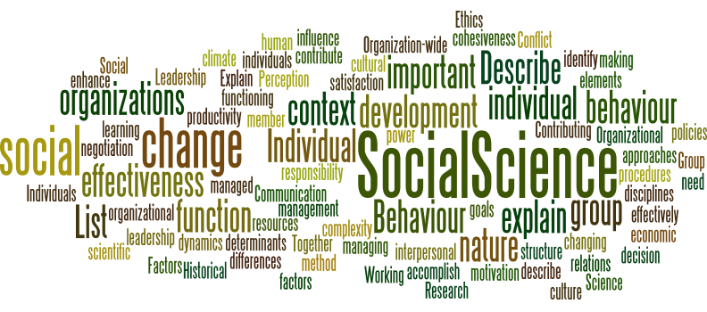
Hospitality Skill Requirements and Operational Issues

Slide 2

What is a skill?
A skill is the ability to perform an action with determined results often within a given amount of time, energy, or both.
Skills can often be divided into domain-general and domain-specific skills. For example, in the domain of work, some general skills would include time management, teamwork and leadership, self-motivation and others,
domain-specific skills would be used only for a certain job.
Skill usually requires certain environmental stimuli and situations to assess the level of skill being shown and used. Wikipedia

Slide 3
Customer service skills
Above all else, the one thing that can make or break you in hospitality is your ability
Simply serving drinks or running an entire hotel, job to ensure that the customers are having a great time and that they have nothing to worry about.
Essentially, customer service is about being both positive and proactive. Even when you are dealing with a difficult customer, it’s important to smile, be polite and remain professional; alternatively, on certain occasions, it can also be about going that extra mile for a guest or a patron.

Slide 4
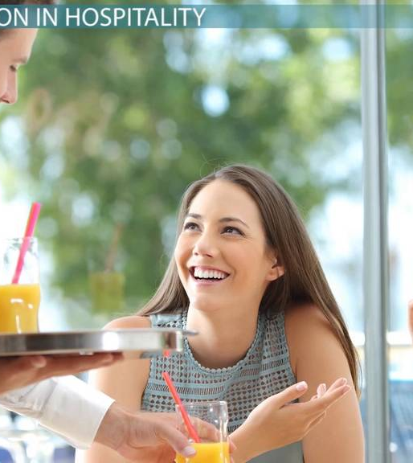
GUEST SERVICE
COMMUNICATION SKILLS
How much does it cost to smile?

Slide 5
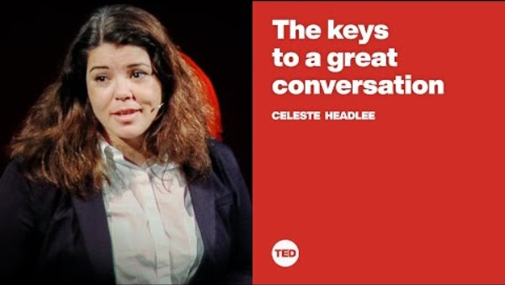
SIX COMMUNICATION SKILLS
APPEARANCE AND BODY LANGUAGE
SMILE, LAUGH AND EYE CONTACT
MEET AND GREET
READ AND ACT
ASK AND LISTEN
POSITIVE CAN DO ATTITUDE

Slide 6

The Six Stages of Service
Meet and greet the guests with a warm welcome
Read the guest – smile and laugh
Interaction – Share your culture
Ask about their Experiences
Listen with good communication skills
A Special Goodbye thanking them for choosing you

Slide 7
MEET AND GREET
Always meet and greet a guest when they arrive, or you see them
Make eye contact and acknowledge them
Give them a warm welcome
Always smile
Use appropriate words like “good morning”
If possible use their name

Slide 8
READ THE GUEST
Read the situation
Don’t let the guest struggle
Help them before they ask
Find out what they need
Act if needed
If a guest is sitting happily waiting for a friend smile and greet them BUT don’t go up and ask if you can help them

Slide 9
Interaction
Whenever possible talk to our guests
Think about your language
Tell them about the destination
Tell them about local heritage and attractions and help them plan their trips
Smile and laugh to create memories
Think about using the best communication skills, it’s not what you say it’s how you say it!

Slide 10
ASK
Ask the guest about their experiences
Feedback is essential
The guest can tell us all we need to know
The guest can tell us their needs and expectations if we just ask
Guest like talking about their experiences
React to what they tell you - action

Slide 11
LISTEN with good communication skills
Always listen to our guests
Your guests can tell us more about our service than anyone
Be attentative and see what they need
Be interested
Advise or act if needed
Communication is about your presentation and listening skills as well as what you say!

Slide 12
A Special Goodbye
All our guests deserve a special goodbye
Chose the right language
Make them feel special
Remember your guests have a choice and we want them to come back
We want them to recommend to their friends and family
Thank them for choosing you

Slide 13
THE SIX RULES
Whenever possible use the guest’s name
BUT Do not over use it!
Avoid being fake or overselling your service by being in the guest’s face
Read the guest – do they need help or are they happy waiting for a friend
Remember your guests have a choice
Upsell!

Slide 14

Cultural awareness
In hospitality, a large percentage of the customers you face and, people you work alongside will be from different backgrounds and from a variety of cultural backgrounds.
As a result, your ability to be culturally aware and adapt to attitudes and norms that are different from your own is crucial to building a successful career.
Your customers will not always share the same values, belief systems and perceptions, so it’s important to take this into account when trying to help them feel more comfortable.
As with all customers, the goal is to make them so happy that they’ll want to come back.

Slide 15

Discussion
Think of some cultural differences that you may have to be aware of for your
guests
Colleague
Managers
Think of some customer service skills that would be beneficial to your
guests
stakeholders

Slide 16

Communication skills
Strong communication skills are highly valued in every industry, but especially so in hospitality and tourism.
Dealing with people from a variety of backgrounds, ages, nationalities and temperaments, means that it is important that you can communicate in a way that is both clear and understandable, as well as representative of your employer’s brand.
To encourage a returning customer means having the ability to build and cultivate relationships can make a big difference.
It is also important to be able to communicate clearly with your fellow staff members, especially in busy, high-pressure environments like kitchens where effective teamwork is crucial.

Slide 17
Multitasking skills
One of the reasons why hospitality can be so difficult to work in is because very busy.
The ability to multitask and handle several tasks at once will serve you well.
This means learning how to prioritise and manage your time effectively, while you’ll also need to be able to handle pressure and remain calm when things get chaotic.
Think of what you did yesterday? Did in you multitask in order to get through your day? How effective were you?
Time management skills really play an important part in multitasking effectively.

Slide 18
Work ethic
If you’re going to work in hospitality, then regardless of your role, you’re going to have to work hard.
It’s likely that you will be on your feet for most of the time, working long shifts maintaining a cheerful and friendly persona in front of customers.
Being part of a team means not being late to work or not turning up for a shift.
Making sure the guests needs are met by going the ‘extra mile’ shows good work ethic.

Slide 19
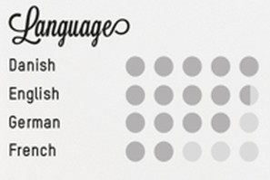
Language skills
language skills are a huge bonus in hotels and in hospitality because they allow you to communicate with a wider range of people.
They are particularly useful working in the tourism sector, where knowledge of languages is useful day-to-day.
Language skills can also benefit your career in the long term, too. If you speak French, for example, then there could be operations and/or management opportunities available to you on a more senior level, such as in a customer liaison or relationship management role or in a global business.

Slide 20
Professionalism
Most employers in the hospitality industry rely on their customer-facing staff to uphold the reputation of their brand; therefore, it’s important that, at all times, you remain highly professional.
Ensuring that you look tidy and well-groomed, are on time for your shifts and are not caught doing anything you shouldn’t be, such as smoking outside the main entrance or not washing your hands before handling food.
It also means keeping calm and not reacting negatively when dealing with an angry or irate customer, especially at the end of a long and tiring shift.

Slide 21

Specific Service Skills
Essential Skills for a Career in Hospitality:
High Level of Customer Service - Interpersonal Skills
Good Communication Skills.
Formal Training.
High Levels of Cultural Awareness.
Have the Ability to Multitask.
Work Well in a Team.- Teamwork:
Be Flexible.
Attention to Detail
Time Management
Problem-Solving

Slide 22
Teamwork skills
In hospitality, regardless of your role, you will always only ever be one cog in a much larger machine. Whether it’s within a particular hotel department, in a busy kitchen or as part of the bar staff, you need to be able to work well with others, especially during busy periods in a pressurised environment.
Given the high turnover rate within the industry, this can be challenging to adapt to new faces constantly and build relationships all over again.
But if you’re not working seamlessly in union, the whole operation can start to falter, which is bad for customers and the business.

Slide 23
Problem-solving skills
Again, this is a skill that is highly valued in any industry; in hospitality, though, the ability to think on your feet and solve problems quickly can save yourself a lot of potential hassle.
For instance, if a guest complains about their room, you could offer them complimentary drinks in the bar while you wait for another guest to check out. This keeps the customer happy, leaves a good impression of the hotel and saves you the trouble of a potential conflict.
Alternatively, if a customer has very specific dietary requirements, you could consult with the chef on their behalf to offer a tailored alternative solution.
Remember: the easiest way to keep customers happy is to provide solutions to their problems (within reason, of course), so if you are proactive and keen to get issues resolved, hospitality could be a good fit.

Slide 24
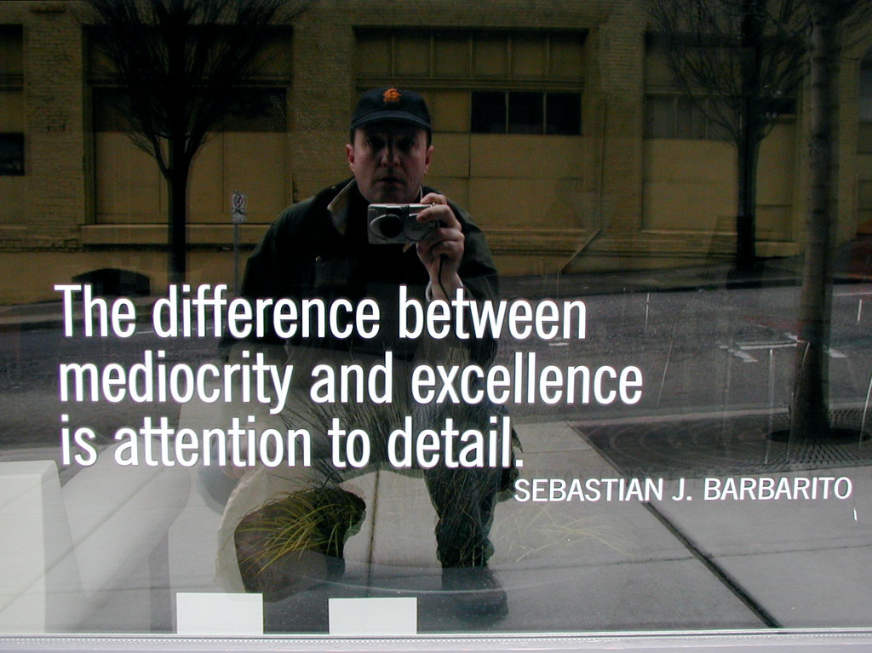
Attention to detail
Times when this can come in handy .e.g. spotting billing or administrative errors at reception or noticing that a particular ingredient is past its best in the kitchen, it’s the little things that can make a big difference.
It can also help to develop relationships with customers and provide a more positive experience overall.
For instance, suggesting a particular wine to accompany a dish, remembering how a certain customer prefers their drink to be made, or even noticing that somebody is struggling to carry their luggage and offering to help are all small details that can leave a big impression on customers.

Slide 25
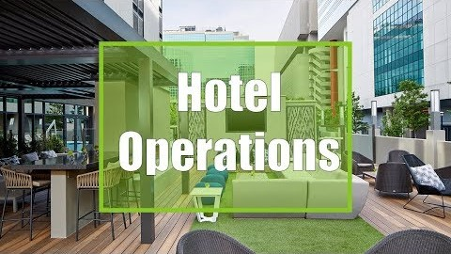
Opportunity and Challenges in Hotel Operations

Slide 26

Changing industry
Changing Guest Behaviour and
Expectations – what are they?
Technology Shaping the Guest Journey – what is this?
One Size Does Not Fit All Service Delivery – what do we mean?

Slide 27
What are the operational issues affecting the hospitality industry?
Some of the main operational issues which plague the hospitality industry are employee turnover, employee performance, labour costs associated with employee turnover and performance and evolving customer expectations.
High employee turnover rates and costs associated with the hiring, training and uniforms for new employees can cost a business almost 30% of a new hire’s annual salary.
The ability to anticipate and satisfy the ever evolving expectations of the customer is becoming increasingly difficult to achieve.
As more and more customers turn to the internet to research and select their options, creating unique experiences is challenging.
Marketing approaches need to be updated and adapted for effective results.

Slide 28

Consumer demands
The 21st-century customer has high expectations product or service they’re buying, for the experience they have while purchasing it.
Strong awareness of their own needs. They know what they want, when they want it and how they want it to be presented to them.
They want a certain quality and won’t settle for less. And they are not afraid to speak out about it.
The modern purchasers are busy. They do not have the time to search through a complicated-looking website, They value their time and try to use it as efficiently.
They are also almost always online. The product they want,
or at least its description, should be easy to find

Slide 29
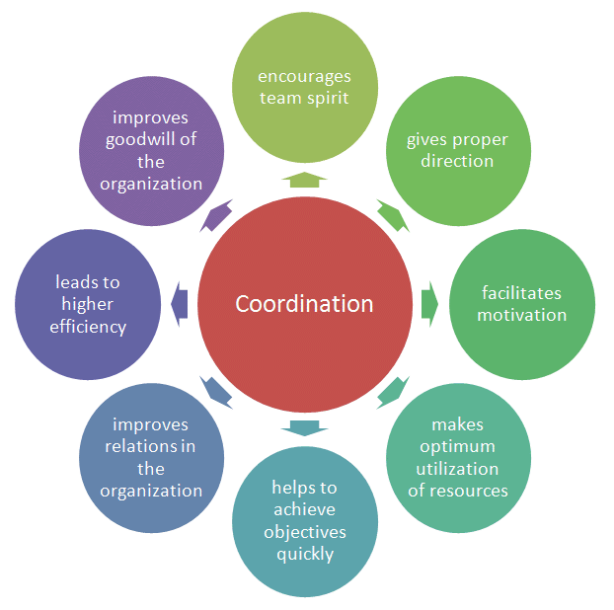
Resource co-ordination
Coordination helps to bring together the human and material resources of the organization.
It helps to make optimum utilization of resources.
These resources are used to achieve the objectives of the organization.
Coordination also minimizes the wastage of resources in the organization.

Slide 30
Operational systems for Food & Beverage
What is a food and beverage control system?
- computerising best practice. It gives managers a better idea of the flow of food through the restaurant, enabling them to plan cash flow and stock control more effectively.
It provides chefs with a more structured way of planning menus, taking into account nutritional and financial considerations.
Several key features:
Market lists - Creating a database of suppliers and ingredients will enable you to manage ingredient pricing more effectively.
Nutrition - ability to provide nutritional information on the food you serve can offer you a competitive edge.
Recipe management - manage your ingredients more effectively, while building in standard estimates for wastage. Price more accurately. undercut the competition still making a profit.
Stock control and purchasing - inventory food and create purchase orders maintain a minimum level of perishable stock and free up your capital
Reporting - best-performance, highest margin menu items,
Intelligent reporting can help you to forecast your requirements, which can be useful for seasonal items, for example, or for ingredients with volatile pricing
https://www.thecaterer.com/articles/300749/food-and-beverage-control-systems

Slide 31
Training initiatives Food Hygiene
Training and support for local businesses.
It is a legal requirement for the operator of a food business to ensure that all food handlers engaged in the food business are supervised and instructed and/or trained in food hygiene matters appropriate with their work activities.
Is it a legal requirement to have a food hygiene certificate?
A level 2 food hygiene certificate is required to satisfy a food handler's legal obligation for food safety training. However, if you are going to be responsible for other staff at your premises, you will need to ensure that you, or any supervisors are trained to level 3.

Slide 32
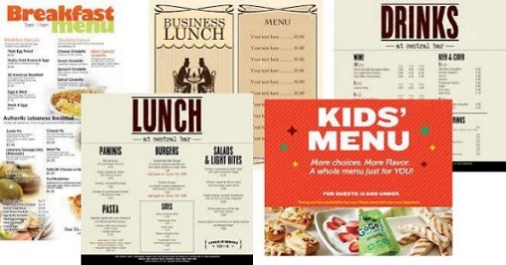
Menu planning
What is Menu?
It is a detailed list of food and beverage offerings with their respective prices. It is prepared by a food and beverage service business to keep the customers informed about the availability of various F&B items.
A good menu must −
Present clear, unambiguous information.
Adhere to food safety and nutrition policies of the business.
Meet or outstrip guests’ expectations.
Meet the quality standards of the business.
Be truthful in describing the taste and preparations.
Be strictly going with the production and service facilities of the business.

Slide 33
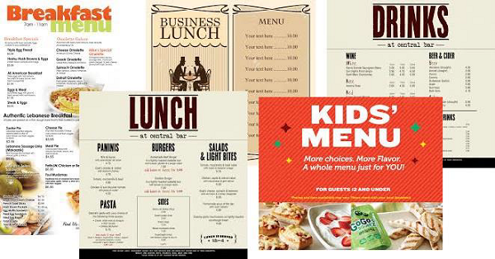
Restaurant Menu Preparation
The restaurant menu should be planned considering various aspects of the food outlet. Many menus available from breakfast, lunch, small bites, up to dinner.
The following information is gathered before planning food and beverage menu for a commercial kitchen:
What kind of food outlet is it? (Vintage, Contemporary, Modern, Theme, Bar, and more)
What is the name of the outlet?
What is the expanse of food items, their accompaniments, and beverages ?
Which information needs elaboration for food and beverages?
What tone of language is required? (formal/informal)
What types of names and category headings would best suit the food /beverage items?
What design, images, colours, and typeface would look best for the menu?
Are the graphic details relevant to the food outlet theme?
How large should the menu be on paper?

Slide 34
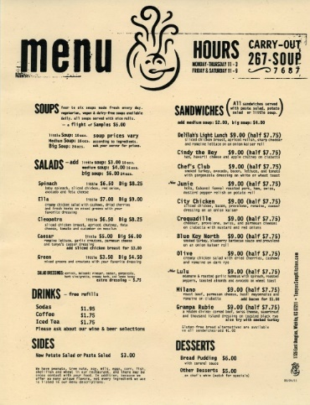
Menu Planning
Menu planning plays an important role in customer satisfaction.
Menu planning is beneficial in the following areas −
Purchasing of essential material in advance.
Pricing of the food.
Guiding the food preparation.
Evaluating the dietary needs.
Evaluating the food in terms of necessary improvements.
The menu must be planned such that it goes well with the theme of the F&B outlet and it must be a good bargain for food price and dietary value.

Slide 35

Legislation = Why is hospitality law important?
Keeping Customers Safe. Food safety laws play a
major role in the hospitality industry, and knowledge
about how to clean and store food can keep your customers safe and help your business avoid lawsuits and fines.
Hospitality law is a legal and social practice related to the treatment of a person's guests or those who patronize a place of business.
Hospitality laws are intended to protect both hosts and guests against injury, whether accidental or intentional.
Hospitality industry acts and regulations. Covered by many acts and regulations which relate both to employers and employees. The various acts and regulations are administered and monitored by appropriate government departments and independent agencies.

Slide 36

Cultural influences
Cultural diversity can have a significant influence on the hospitality business.
cultural diversity is highly important in hospitality business due to global customer-related industry. However, this phenomenal benefit has challenges as well, such as communication barriers between employees.
F& B – Cultural influences
Staff – employees
Guest Cultural differences e.g. language

Slide 37

Performance measures
KPI - Key Performance Indicators for hotels are select measurements that really matter for lasting success and we examine a few of the most important ones below.
Accommodation = RevPar / Average Daily Rate (ADR) /
Food & Beverage – number of customers / the average number of tables served by a waiter in a given period of time.
Occupancy % - The most critical and simplest measure of performance for hotels in the occupancy rate. Measured as the percentage of available rooms occupied over a specific period of time.

Slide 38
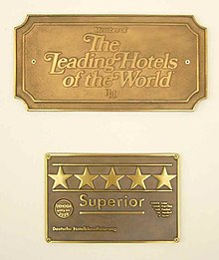
Verification and grading
Hotel ratings are often used to classify hotels according to their quality.
Initial purpose of informing travellers on basic facilities that can be expected, the objectives of hotel rating has expanded into a focus on the hotel experience as a whole
Today the terms 'grading', 'rating', and 'classification' are used to generally refer to the same concept, that is to categorize hotels.
There is a wide variety of rating schemes used by different organizations around the world. Many have a system involving Stars some Diamonds.

Slide 39
Social media influences (TripAdvisor) and digital management responses.
User-generated content - an input into the consumer purchase decision making process.
TripAdvisor - detailed rich data that can be used in travel planning it is a channel that combines hotel marketing and highly transparent customer service.
The way hoteliers engage with travellers on the web is critical and can be the difference between gaining or losing a new booking.
Consider these facts:
⅓ of consumers use Facebook to speak with a customer service representative.
47% of consumers think Facebook is the quickest social media channel to solve a customer service issue.
According to TripAdvisor, 68% of consumers say that if they were considering two comparable properties, the presence of a management response on one listing would sway them in its favour.
Successful messaging to today’s traveller is no longer about selling. It’s about
building a long-term relationship with your guests on a one-to-one level

Slide 40
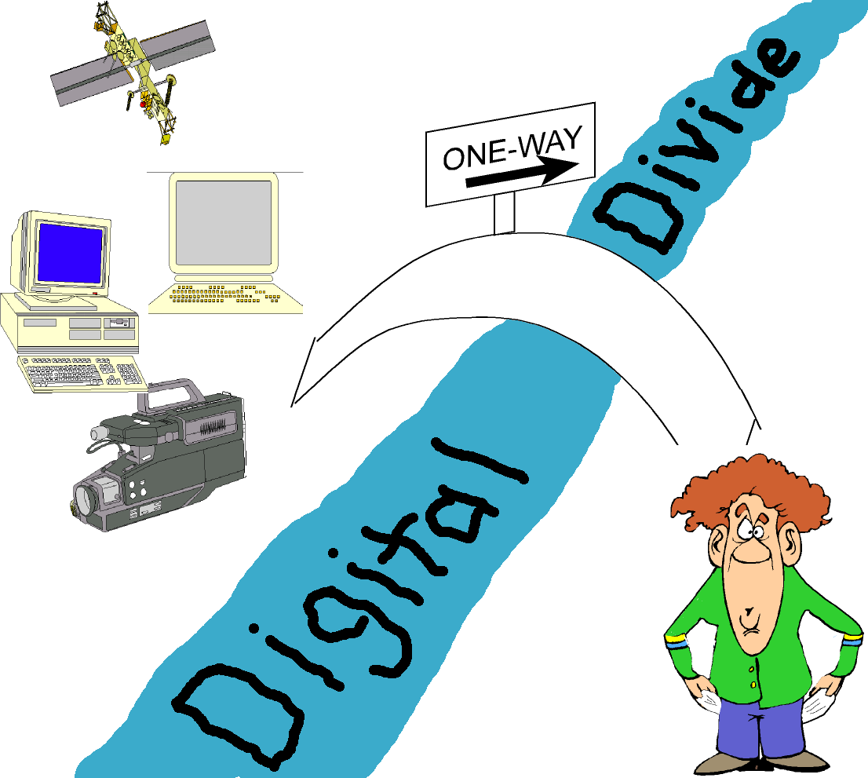
Social media influences (TripAdvisor) and digital management responses.
User-generated content - an input into the consumer purchase decision making process.
TripAdvisor - detailed rich data that can be used in travel planning it is a channel that combines hotel marketing and highly transparent customer service.
The way hoteliers engage with travellers on the web is critical and can be the difference between gaining or losing a new booking.
Consider these facts:
⅓ of consumers use Facebook to speak with a customer service representative.
47% of consumers think Facebook is the quickest social media channel to solve a customer service issue.
According to TripAdvisor, 68% of consumers say that if they were considering two comparable properties, the presence of a management response on one listing would sway them in its favour.
Successful messaging to today’s traveller is no longer about selling. It’s about
building a long-term relationship with your guests on a one-to-one level

