Slide 1
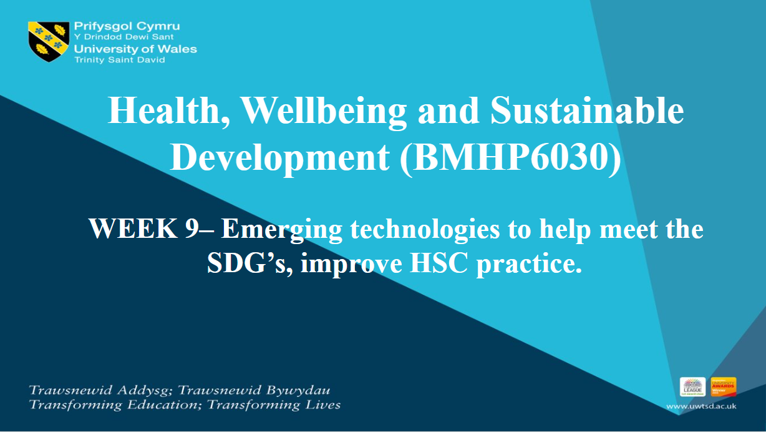

Slide 2

Learning Outcomes
Explore key emerging technologies transforming health and social care.
Understand the alignment between technologies and SDG targets.
Examine real-world examples and case studies.
Discuss ethical considerations, challenges, and the future outlook.

Slide 3

Recap
Why are SDGs important in health and social care?
Notes:
The Sustainable Development Goals (SDGs) are very important in health and social care because they guide efforts to improve health and reduce inequalities worldwide. Here are a few simple points to discuss:
Health for Everyone
SDG 3 focuses on ensuring healthy lives and promoting well-being for all, which is the core of health and social care.
Tackling Root Causes
Goals like ending poverty (SDG 1) and hunger (SDG 2) deal with the factors that often lead to poor health.
Reducing Inequalities
SDG 10 helps ensure equal access to health and social care services for everyone, especially vulnerable groups.
Working Together
The SDGs promote global partnerships to solve big challenges like pandemics and climate change, which impact health everywhere.
Sustainability Matters
Goals like SDG 13 (Climate Action) remind us that caring for the environment supports better health outcomes.

Slide 4
Technology's Role – How many are you aware of?
  Improve access to care
  Support equitable health outcomes
  Foster innovations that improve quality and efficiency
Technologies transforming HSC practice:
  Artificial Intelligence (AI) and Machine Learning.
  Telehealth and Telemedicine.
  Wearable Devices and IoT (Internet of Things).
  Robotics and Automation.
  Big Data and Health Informatics.
  Virtual Reality (VR) and Augmented Reality (AR).
  Blockchain for Health Data Security.

Slide 5


Slide 6
Replacement, Redesign, Optimisation
Using the ideas shared in the video, can you think of an example of replacement, redesign and optimisation within UK health and social care that help to meet a SDG of choice.
Notes:
1. Replacement
Replacing Traditional Processes with Innovative Solutions:
Telemedicine for Healthcare Access (SDG 3): Replacing in-person consultations with virtual appointments, especially in remote or underserved areas.
Renewable Energy in Healthcare Facilities (SDG 7): Transitioning from fossil fuels to solar or wind energy in hospitals and clinics to ensure energy sustainability.
Digital Health Records (SDG 16): Replacing paper-based systems with electronic health records for more efficient and secure data management.
2. Optimisation
Improving Existing Systems to Enhance Efficiency:
AI-Powered Diagnostics (SDG 3): Leveraging AI to optimise disease detection accuracy, such as Google's DeepMind for breast cancer diagnosis.
3. Redesigning
Creating New Systems or Processes for Better Outcomes:
Redesigning Community Care Models (SDG 3, SDG 11): Shifting focus from hospital-based care to community-led initiatives that prioritise mental health and chronic disease management.
Accessible Health Technologies (SDG 10): Developing low-cost, user-friendly medical devices to reduce health inequalities.
Integration of Health and Social Services (SDG 1, SDG 3): Redesigning services to provide holistic care, combining healthcare with social support systems to address the social determinants of health.

Slide 7
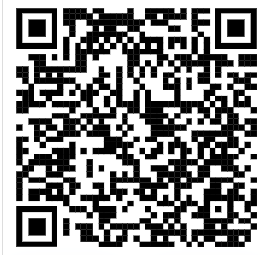
Artificial Intelligence
Use of algorithms and machine learning to process data, recognize patterns, and make decisions.
Applications in HSC
  AI diagnostics (e.g., detecting cancer in radiology).
  Predictive analytics for disease outbreaks.
  Virtual health assistants.
Supporting SDGs:
  SDG 3 (Early diagnosis).
  SDG 10 (Reducing health inequalities).
  Read the following journal article – how many ways can you note down that AI Is helping to achieve the SDG's
ssrn_id4698970_code6202721.pdf

Slide 8
Virtual Reality Technology (VR)
Use of simulated environments for training, therapy, and patient care.
Applications in HSC
  VR therapy for mental health conditions (e.g., PTSD, anxiety).
  Training tools for surgeons and HSC students.
SDGs Supported
  SDG 3 (Improved well-being and mental health).

Slide 9


Slide 10
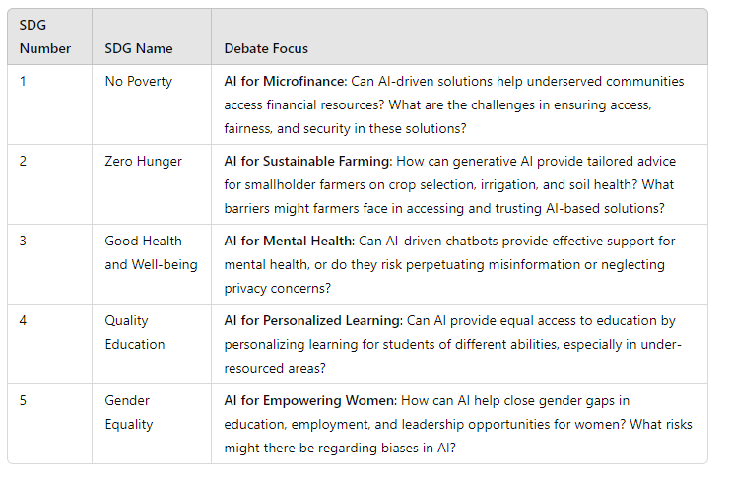
Group Activity
Choose one of the following SDG's.
As a group discuss the debate topic – you must all have a point to make regarding the question, and use research (report, credible web page, journal article, book) to justify your claim

Slide 11
Challenges in Implementation
Technology has immense potential to address the Sustainable Development Goals (SDGs), but its implementation in health and social care comes with challenges
Digital divide and health inequalities
Data privacy and security
  Bias in AI algorithms
High costs of implementation
Resistance to change among professionals
The challenges highlighted must be addressed through collaborative efforts between governments, organisations, and technology developers.
Balancing innovation with ethical considerations is crucial to ensuring the equitable and effective use of technology in achieving the SDGs.
(United Nations Inter-Agency Task Team on Science, Technology and Innovation for the SDGs and UNIDO, 2022)

Slide 12
Ethical Concerns
  The integration of technology in health and social care to achieve the Sustainable Development Goals (SDGs) raises critical ethical concerns. Addressing these issues is essential to ensure that the benefits of technology are distributed equitably, responsibly, and sustainably.
  Patient confidentiality.
  Informed consent for data use.
  Digital exclusion among vulnerable populations.
Example:
Health apps and wearables that collect data on physical activity or mental health might share this information with third parties without users’ consent.
Ethical Approaches:
Ensure informed consent for data collection and usage.
Use data encryption and follow data protection laws like GDPR.
Limit access to sensitive data and ensure transparency about how it is used.
(National Institute for Health and Care Excellence, 2024)

Slide 13
Assignment Focus
In this 2000-word (+/-10%) report you will critically examine current health, wellbeing and sustainability policies and initiatives that impact citizens on a global, national and local level.
Within this report you will be conducting the following:
Analysis of how Sustainable Development (SDG) Goal 3 ‘Good Health and Wellbeing’ and another SDG of your choice impacts the health and wellbeing of citizens.
Evaluate the effectiveness of national and local health, wellbeing and sustainable development initiatives and present recommendations for improvements.

Slide 14
Assignment Focus
Evaluation Criteria
Effectiveness:
  Impact on Health: Evaluate how these initiatives improve health outcomes. Do they lead to increased access to healthcare, better disease management, or reduced healthcare costs?
  Sustainability: How are these initiatives supporting sustainability? For example, are digital health systems helping reduce waste in healthcare settings? Is the adoption of renewable energy in health services lowering carbon footprints?
Accessibility:
  Are the initiatives reaching all populations? Consider marginalized or underserved groups, such as rural communities or low-income individuals.
  Evaluate whether the technologies are accessible to everyone (e.g., affordability, digital literacy, internet access).
Challenges:
  Identify barriers to success, such as technical challenges (e.g., data integration issues), lack of resources (e.g., financial constraints), or resistance to change from healthcare professionals.
  Consider any negative impacts, such as the digital divide or health inequalities, and whether these initiatives are unintentionally exacerbating disparities.

Slide 15
Assignment Focus
Making Recommendations Actionable
Ensure that your recommendations are practical and specific. For example:
  “Increase funding for telemedicine services in rural areas to ensure all citizens have access to healthcare consultations.”
  “Develop training programs for healthcare professionals on how to use new health technologies effectively.”
  “Introduce subsidies for low-income households to access health-monitoring wearables to manage chronic diseases.”
  Tips for Evaluation and Recommendations:
  Use Evidence: Support your evaluation with evidence from studies, reports, or real-world data to show how initiatives have worked or not worked.
Balance Positives and Challenges: Acknowledge both the successes and the challenges faced by these initiatives to present a balanced evaluation.
Be Specific and Practical: Make your recommendations as specific and actionable as possible. Avoid vague suggestions like "improve healthcare access." Instead, focus on tangible steps like "expand telemedicine services to cover underserved areas, as as digital health interventions have shown promise in improving healthcare access and outcomes across various healthcare areas, including chronic disease management, mental health, prenatal care, and preventive care (Maita et al., 2024)"

Slide 16

Writing Retreat
Work on writing the Evaluation of an initiative and Recommendations
The evaluation of the chosen initiative (effectiveness, accessibility, challenges).
The recommendations for improving the initiative (two actionable and evidence-based suggestions).
Be sure to use Harvard referencing for any sources you reference.

Slide 17
Bibliography
Maita, K.C., Maniaci, M.J., Haider, C.R., Avila, F.R., Torres-Guzman, R.A., Sahar Borna, Lunde, J.J., Coffey, J.D., Demaerschalk, B.M. and Antonio Jorge Forte (2024). The impact of digital health solutions on bridging the health care gap in rural areas: A scoping review. The Permanente Journal, [online] 28(3), pp.1–14. doi:https://doi.org/10.7812/tpp/23.134.
National Institute for Health and Care Excellence (2024). Use of AI in evidence generation: NICE position statement | Our research work | What we do | About | NICE. [online] NICE. Available at: https://www.nice.org.uk/about/what-we-do/our-research-work/use-of-ai-in-evidence-generation--nice-position-statement (Accessed: 19 December 2024).
Nitin Liladhar Rane (2023). Roles and Challenges of ChatGPT and Similar Generative Artificial Intelligence for Achieving the Sustainable Development Goals (SDGs). Social Science Research Network. [online] doi:https://doi.org/10.2139/ssrn.4603244.
United Nations Inter-Agency Task Team on Science, Technology and Innovation for the SDGs and UNIDO (2022). Science, Technology and Innovation for Achieving the SDGs: Guidelines for Policy Formulation Innovation for the SDGs and UNIDO WORK STREAM 6: UN capacity-building programme on technology facilitation for SDGs In partnership with the Republic of Korea. [online] Available at: https://sdgs.un.org/sites/default/files/2022-06/ONLINE_STI_SGDs_GUIDELINES_EN_v3_0.pdf (Accessed: 19 December 2024).

