Slide 1
MODULE NAME : Problem Solving and Decision Making
MODULE CODE : LCLM4004
STUDENT NAME : Cherelle Whitbread
STUDENT ID : 2513414
LECTURER : Anita
Assignment 1: Presentation

Slide 2
OVERVIEW
Introduction
Company background
Problem: Nature and Scope
Pestle Analysis: Green Haven Florists
Cause and effect analysis: Fishbone diagram
Conclusion
References

Slide 3
INTRODUCTION
DROP IN SALES- "decrease in the amount sold or revenue generated between two periods" ( Calculator Ultra, 2025)

Slide 4
COMPANY BACKGROUND
Green Haven Florists
Founded in 2016
Owners: Liam and Priya Patel
Sells flowers
Strong community ties
Eco-friendly packaging
Personal touch and sustainable ethos
Catering for walk-ins to corporate clients and weddings

Slide 5
PROBLEM: Nature and Scope
Who: Liam and Priya Patel
What: Problem in significant decline in profitability & sales
Where: Green Haven Florist
When: Ongoing
Why: Not able to compete against new modern business

Slide 6
PESTLE ANALYSIS: Green Haven Florists
POLITICAL
Regulations - Local laws regarding business operations, labor laws, and environmental regulations can affect how Green Haven Florists operates.
Trade Policies - Import tariffs on flowers and plants can influence costs and pricing strategies.
ECONOMIC
Economic Conditions - Economic downturns can reduce consumer spending on non-essential items like flowers.
Seasonality - Demand for flowers often peaks during holidays and special occasions, impacting revenue.
SOCIAL
Consumer Trends - Increasing interest in sustainable and locally sourced products can affect purchasing decisions.
Cultural Events - Different cultures have specific floral traditions, which can influence product offerings.

Slide 7
PESTLE ANALYSIS: Green Haven Florists
TECHNOLOGICAL
E-commerce – there is a rise on online shopping so it’s necessary to have the equipment to cater for this service.
Supply chains Technology – can improve inventory management and delivery efficiency. This helps maintaining fresh floral products.
LEGAL
Health regulations – applying to the health and safety regulations to sell flowers is crucial.
Intellectual property – it is important to protect unique floral design or brands.
ENVIRONMENTAL
Sustainability concerns - demand for eco-friendly products and practices.
Climate change - demand for flowers peak during holidays and special occasions.

Slide 8
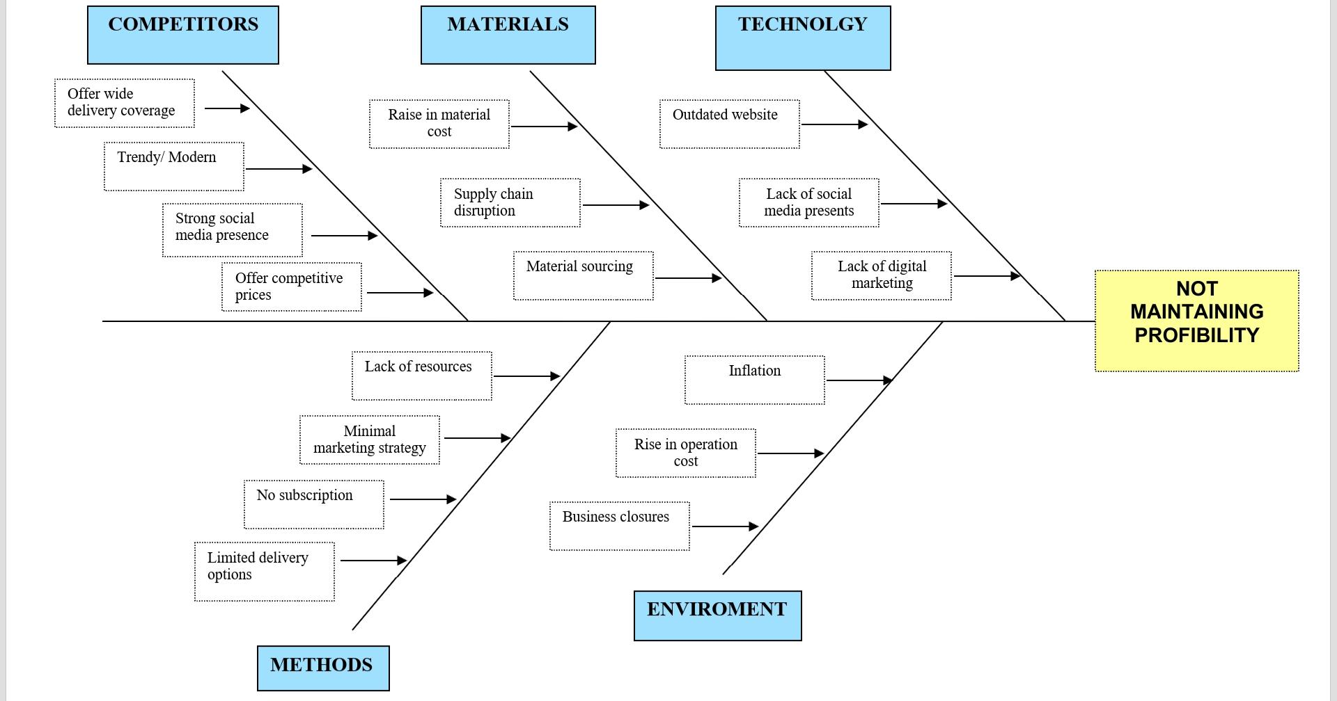
Cause and effect analysis: Fishbone Diagram

Slide 9
CONCLUSION
YES
Should Green Haven stay open?
I believe with a few adjustments and updating their business methods
Green Haven Florist has a fighting chance of increasing sales and
becoming more compatible with other business.
BOOST ONLINE
PRESENCE =
Updating their online presents will help attract new customers
and increase sales.
ENGAGE WITH
CUSTOMERS =
Engaging with customers through social media will create a stronger relationship with new and existing customers.
Simplifying supply chain processes will reduce cost and improve efficiency, ensuring timely delivery of high-quality floral arrangements.
IMPROVE SUPPLY
EFFICIENCY =

Slide 10
REFERENCES
Calculator Ultra (2025) Find More Calculator Available at: Drop in Sales Calculator & Formula Online Calculator Ultra (Accessed: 6 October 2025).
MSI Staff Writers (2024) Understanding PESTLE Analysis: A Comprehensive Guide Available at: PESTLE Analysis (Accessed: 12 March 2026)
CIPD (2025) PESTLE ANALYSIS Available at:PESTLE analysis | CIPD (Accessed: 8 March 2026)
BGMC (2024) Exploring the Fishbone Diagram: Types, Advantages, Drawbacks, and Revealing the Six M’s of Change. Available at: https://bgmcgroup.com/exploring-the-fishbone-diagram-types-advantages-drawbacks-and-revealing-the-six-ms-of-change/ (Accessed 8 March 2026)

Slide 11

Questions

