Slide 1
To love, honour and obey?
An introduction to behaviour studies (HPAN4014)
Andy Coard UWTSD

Slide 2
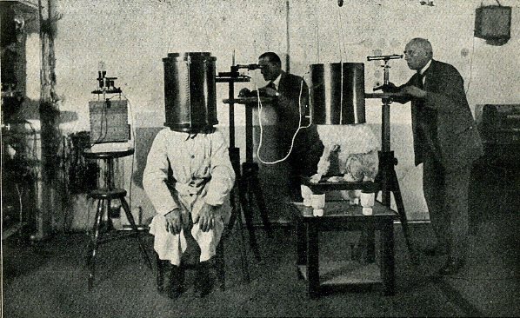
Experimental Methods & Behavioural Research
http://www.weirdexperiments.com/Experiment_1_farb.jpg
Notes:
Karl Krall (far right) researching telepathy between man and dog

Slide 3

Do we need scientific psychology?
(Scientific Psychology vs. Folk Psychology)
It can be argued that we’re all psychologists with insightful knowledge of human behaviour developed through ‘real world’ experience
https://encrypted-tbn2.gstatic.com/images?q=tbn:ANd9GcQa-ue0QzmZ0eFQ0r8jPMGYPTYJVBP7KPN1F06RPRYw3tL_TWIL

Slide 4
Scientific & Folk Psychology
(Pros and Cons)
Scientific Psychology
Folk/Informal Psychology
Takes place in controlled conditions, often in a laboratory, may lead to distortions of behaviour
Uses empirical methods to promote the gradual accumulation of knowledge
Takes place in real world settings, providing natural examples of behaviour
Can lead to contradictory findings, preventing a progression of accumulated knowledge

Slide 5
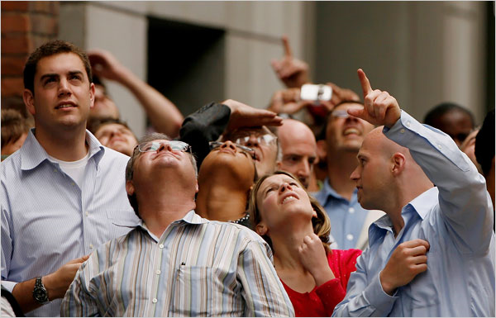
Why choose the Scientific Method for the study of human behaviour?
Notes:
http://www.bing.com/images/search?view=detailV2&ccid=WbAYTwZU&id=15527764167D6088798817E3C10D1D8B428CD0C1&q=looking+up+milgram&simid=608017441762316113&selectedIndex=1&ajaxhist=0

Slide 6
Creating a Scientific Study of Human Behaviour
Allport (1947) argued that the study of behaviour can satisfy the criteria of a science since it provides “understanding, prediction and control above the levels achieved by unaided common sense”
Although we cannot predict the behaviour of every individual, all of the time, research provides the ability to predict the likely outcomes of people’s behaviour in general

Slide 7
Some Issues to Consider when Applying the Scientific Approach to Human Behaviour
Social Control
Ratomorphism & Generalising from Animal Studies
Mechanistic/Reductionist View of Behaviour
Cross Cultural Differences
Freewill vs. Determinism
Paradigm Shifts in Thinking

Slide 8


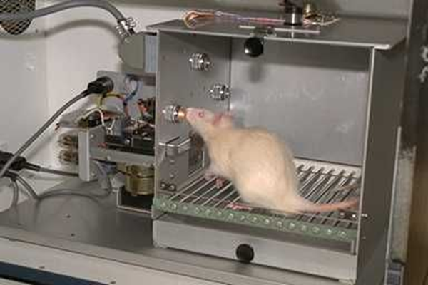
The Science of Behaviour
(Issues to be aware of)
Social Control
Ratomorphism
http://oslovet.norecopa.no/bilder/xl/32.jpg
https://encrypted-tbn2.gstatic.com/images?q=tbn:ANd9GcTZ2ox1snNP3uQOlK4737E2sJyCgG69vn6jKG9WeADloBD_yDfK
http://www.hackettpublishing.com/media/catalog/product/cache/1/image/308x/9df78eab33525d08d6e5fb8d27136e95/s/k/skinner_waldentwo_165x260_1.png
Notes:
Social Control: consider Turing and issues raised in Huxley’s Brave New World

Slide 9
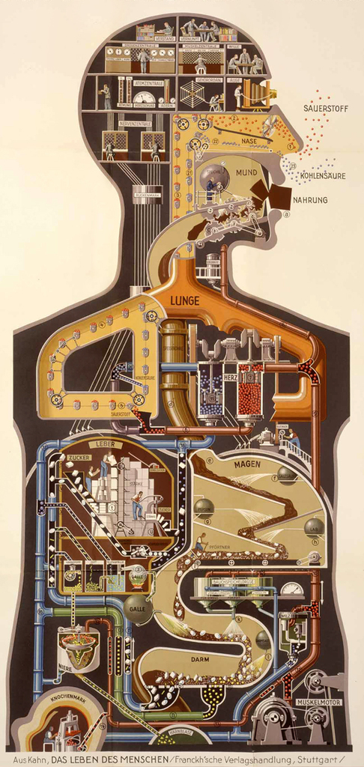
Mechanistic View of Behaviour
Can the scientific method of physical science (with its mechanistic and reductionist approach) capture the essence of human experience?
http://4.bp.blogspot.com/_lDqTalWaT7s/TOwhwd6hBxI/AAAAAAAAAEw/H_YA1JVsKkA/s1600/humanmachine.jpg
Notes:
Descartes (1662) considered the mechanistic view of human nature (De homine figuris), initially supressing his work due to fear of it being considered heretical fearhttp://www.historyofinformation.com/expanded.php?id=2282

Slide 10
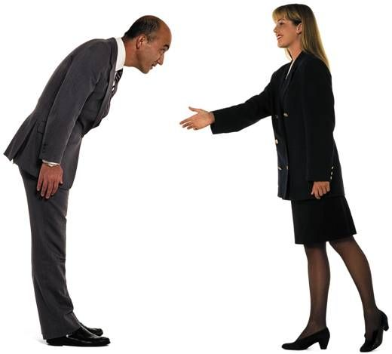
Many behavioural research findings do not generalise well to other cultures
https://s-media-cache-ak0.pinimg.com/736x/dc/cf/ab/dccfab2574a16370fa169e7ffc0e0cb2.jpg

Slide 11
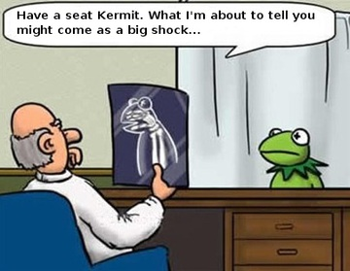
Freewill vs. Determinism
https://gradesaver.s3.amazonaws.com/uploads/section/7447ee35-80b9-4317-a138-faba65bca004/image/1433492047.jpeg

Slide 12
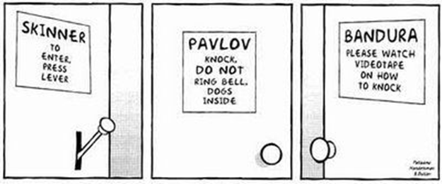
Research perspectives often progress through paradigm shifts which influence viewpoints, methodology and future direction of research
https://sallyky.files.wordpress.com/2014/03/146a33dcc885b9d2f1b5a40d1f80cd43.jpg
(This has both advantages and disadvantages)
Notes:
Skinnerian view took an individual perspective, Bandura acknowledged the importance of the social situation (very relevant to social influence and this module)

Slide 13

Kuhn (1962)
Kuhn believes science does not progress in orderly logical steps - instead it progresses in paradigm shifts based, in part, on scientific promise
https://upload.wikimedia.org/wikipedia/en/thumb/d/d8/Structure-of-scientific-revolutions-1st-ed-pb.png/220px-Structure-of-scientific-revolutions-1st-ed-pb.png

Slide 14


Establishing a Theory
A good theory allows many testable hypotheses
The Asymmetry of Truth
A good theory will be falsifiable, allowing many testable hypotheses
It will be internally consistent and supported by data allowing for both prediction and explanations of relevant data
“In so far as a scientific statement speaks about reality, it must be falsifiable: and in so far as it is not falsifiable, it does not speak about reality.” (Popper 1952: 314)
Notes:
Popper, K. R. 1952. The Logic of Scientific Discovery. London: Hutchinson.

Slide 15
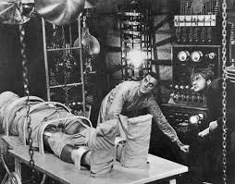
How the Scientific Method Works
(The underlying rationale)
http://dimanagul.files.wordpress.com/2012/10/movfrankenstein.jpg

Slide 16



Requirements of a Good Experiment
Needs to be replicable (and so falsifiable)
Needs to have validity
Ability to generalise the findings
(sampling technique will be important)
(What is the difference between reliability & validity?)

Slide 17
Summary
We cannot predict the behaviour of every individual, all of the time, but the Scientific Method provides an ability to predict likely outcomes of people’s behaviour in general. However, this also raises important issues:
Issues of Social Control; Ethical implications re direction and implementation of research (Who decides what is and what is not acceptable?)
Mechanistic/Reductionist views of human behaviour
Freewill versus Determinism

Slide 18

(Part Two Coming Soon)
http://www.buckleygrayyeoman.com/publications/to-be-continued/

