Slide 1
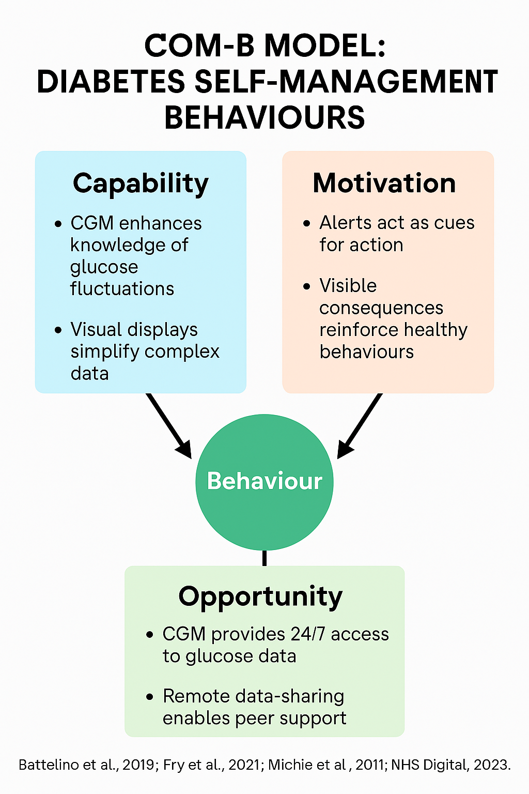
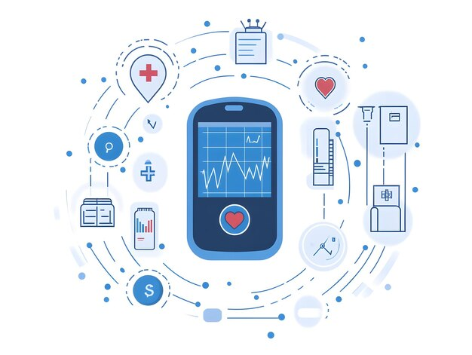
Continuous Glucose Monitoring (CGM) for Diabetes Management
NAME: Arpita chaudhary STUDENT ID: 2432245
MODULE: Population Health and Digital Health Promotion PROGRAM: MSc in Public Health and Social Care
ii
INTRODUCTION
Health Promotion Principles and Values
BEHAVIOUR CHANGE THEORY – COM-B
Diabetes mellitus is a major and growing global public health challenge. Current estimates suggest that 537 million adults worldwide live with diabetes, a figure expected to rise to 643 million by 2030 and 783 million by 2045 (WHO, 2023). These escalating numbers reflect demographic ageing, rising obesity and lifestyle changes that contribute to increasing rates of Type 2 diabetes. Both Type 1 and Type 2 diabetes require continuous, lifelong glucose monitoring to avoid acute complications such as hypoglycaemia and hyperglycaemia, as well as long-term complications including cardiovascular disease, neuropathy, retinopathy and renal failure (ADA, 2023). Effective glucose monitoring therefore plays a central role in preventing long-term health loss and healthcare system burden.
Traditional finger-prick monitoring remains widely used but has well-recognised limitations. It provides only intermittent “snapshot” data, failing to capture the full picture of glucose fluctuations that occur throughout the day (Heinemann, 2020). Many individuals find finger-prick testing painful, inconvenient or disruptive, contributing to inconsistent monitoring patterns and behavioural disengagement. Such barriers can negatively influence decision-making around diet, physical activity, stress management and medication adherence.
Digital technologies have significantly transformed chronic disease management in recent years. Among these, Continuous Glucose Monitoring (CGM) has emerged as a groundbreaking innovation capable of supporting more precise, proactive and personalised diabetes management. CGM systems involve a wearable sensor that measures interstitial glucose levels every few minutes, transmitting this information to a smartphone or dedicated reader. As a result, users benefit from real-time glucose values, trend arrows, and predictive alerts that signal hypoglycaemia or hyperglycaemia before dangerous events occur (Battelino et al., 2019).
This assignment critically explores the role of CGM in diabetes management, examining its relevance to public health, its alignment with health promotion values, and its theoretical foundations through the COM-B model. It also evaluates expected outcomes and implications for future research, education and policy, with particular attention to digital equity and access.
---
Health promotion emphasises empowerment, participation, equality, partnership, and a holistic approach to wellbeing (Green & Tones, 2018). CGM supports these core principles in multiple ways.
Empowerment
CGM provides individuals with immediate, personalised insights into their physiological responses. Seeing “what happens inside the body” after meals, medication or activity strengthens self-awareness and enables informed decision-making (Battelino et al., 2019). Empowerment is further enhanced by trend arrows and visual graphs that make glucose patterns easy to interpret, even for those without medical expertise.
Participation and Shared Decision-Making
CGM data can be shared remotely with healthcare providers. This supports patient–clinician partnerships by enabling collaborative reviews of glucose trends, encouraging individuals to take an active role in their care plans (NICE, 2022). Such collaboration aligns with the Ottawa Charter’s emphasis on shared responsibility for health decision-making.
Equity and Reducing Barriers
CGM may promote equity by offering more accessible glucose monitoring for people who struggle with finger-prick testing due to dexterity issues, neuropathy, low vision or learning disabilities (ONS, 2023). However, digital inequality remains a serious concern. Lower-income individuals, older adults and marginalised groups are less likely to access or afford CGM (Holt, 2022). Digital literacy challenges may also prevent effective use.
Thus, while CGM has the potential to reduce health disparities, it can also unintentionally widen them if equitable implementation is not prioritised.
Holism
CGM supports a holistic approach to health by linking behavioural, psychological and physiological factors. The ability to observe real-time glucose responses can motivate dietary changes, encourage physical activity and promote stress management (Greenwood et al., 2022). These holistic benefits extend beyond glucose control, contributing to overall wellbeing.
Autonomy
Unlike traditional monitoring, CGM reduces dependence on healthcare services by enabling individuals to self-manage effectively at home. This autonomy is especially beneficial for working-age adults, students and people with complex lifestyles.
Overall, CGM embodies the principles of modern health promotion, provided that access barriers are systematically addressed.
The COM-B model (Capability, Opportunity, Motivation – Behaviour) provides a strong theoretical foundation for understanding how CGM influences diabetes self-management behaviours (Michie et al., 2011).
Capability
CGM enhances psychological capability by improving knowledge and understanding of glucose fluctuations. Real-time feedback allows individuals to learn from their behaviour, reinforcing positive habits and discouraging harmful patterns (Battelino et al., 2019). Visual displays make complex physiological changes easier to interpret, reducing cognitive load. CGM also enhances physical capability by eliminating the manual coordination required for SMBG, which can be difficult for older adults or those with neuropathy.
Opportunity
CGM increases physical opportunity by providing round-the-clock access to data without the need for clinic visits. Individuals can independently track patterns and make immediate adjustments. Remote data-sharing creates social opportunity by enhancing communication with healthcare professionals and enabling community support networks among people living with diabetes (NHS Digital, 2023).
Motivation
CGM strongly enhances both automatic and reflective motivation:
Automatic motivation: Alerts act as cues for action, prompting immediate behavioural adjustments such as having a snack or administering insulin.
Reflective motivation: The visible consequences of behaviours foster understanding and accountability (Fry et al., 2021). Positive reinforcement occurs when individuals see improvements in their glucose patterns following healthier choices.
CGM also supports habit formation, as consistent engagement with real-time data helps to integrate diabetes self-care behaviours into daily routines. The COM-B model therefore demonstrates that CGM is not only a monitoring tool but also a powerful behaviour-change intervention.
BACKGROUND
Diabetes imposes a significant burden on individuals, communities and healthcare systems. In the UK, diabetes accounts for approximately 10% of the annual NHS budget, amounting to nearly £10 billion per year, with 80% of this cost linked to preventable complications such as amputations, stroke and kidney disease (NICE, 2022). Poor glycaemic control is one of the most important drivers of these complications, highlighting the necessity for accurate and consistent glucose monitoring.
The primary drawback of traditional self-monitoring of blood glucose (SMBG) is its inability to provide continuous insight into glucose patterns. SMBG typically requires 3–8 finger-prick tests per day, leaving long periods without data (ADA, 2023). These gaps prevent users from identifying the full impact of meals, exercise or stress. As glucose variability is an independent predictor of complications—including cardiovascular events—this limitation poses a serious barrier to optimal diabetes management (Battelino et al., 2019).
CGM addresses these issues by generating a stream of glucose data every 1–5 minutes, providing up to 288 readings per day (Beck et al., 2019). This high-resolution dataset enables users and clinicians to identify previously unknown patterns, such as nocturnal hypoglycaemia or post-meal glucose spikes. CGM also provides predictive alerts, enabling users to respond proactively rather than reactively.
Furthermore, CGM aligns with public health priorities by improving safety and reducing unplanned care. Severe hypoglycaemic events are a major cause of hospital admissions and accidental injury, particularly among insulin users. CGM significantly reduces time spent in dangerous glucose ranges, thereby preventing complications and reducing healthcare utilisation (Fry et al., 2021).
Digital integration is an additional advantage. CGM systems often sync with mobile health apps that include food logging, activity tracking and insulin calculators. These tools form part of a broader digital ecosystem that empowers individuals to take control over their condition (Greenwood et al., 2022). CGM can therefore be considered both a monitoring technology and a digital behaviour-change intervention.
EXPECTED OUTCOMES
CGM has been shown to improve a wide range of clinical, behavioural and psychological outcomes.
Clinical Outcomes
CGM consistently improves HbA1c, reduces glucose variability and decreases episodes of hypoglycaemia (Beck et al., 2019). Lower HbA1c reduces the risk of long-term complications such as stroke, kidney disease and nerve damage (ADA, 2023). Studies also indicate reduced time spent in hypoglycaemic ranges, which is particularly beneficial for individuals taking insulin.
Behavioural Outcomes
CGM supports healthier dietary choices, increased physical activity and improved medication adherence (Greenwood et al., 2022). The visibility of glucose responses reinforces behaviour–outcome relationships, strengthening long-term adherence (Michie et al., 2011). CGM users are more likely to adjust behaviours proactively and avoid risk-taking activities that may destabilise glucose.
Psychosocial Outcomes
Real-time alerts and continuous data reduce anxiety, fear of hypoglycaemia and uncertainty (Fry et al., 2021). Increased confidence promotes greater independence and empowerment.
Healthcare System Outcomes
CGM enables clinicians to make more accurate treatment adjustments based on dense glucose datasets (NHS Digital, 2023). It can also reduce emergency admissions and long-term treatment costs by preventing complications.
CONCLUSION
CGM is a transformative digital health technology that has the potential to revolutionise diabetes care. It aligns with modern health promotion principles, enhances behaviour change, and improves clinical and psychosocial outcomes. However, barriers related to cost, digital literacy and unequal access pose challenges that must be addressed.
Policymakers should prioritise funding strategies, digital inclusion initiatives and equitable distribution policies (ONS, 2023). Healthcare professionals require training in digital interpretation, shared decision-making and behaviour change counselling to support CGM users (PHE, 2020). Future research should investigate long-term outcomes, cost-effectiveness, user experiences and accessibility, particularly for vulnerable or digitally excluded populations.
CGM represents a major step toward proactive, personalised, and data-driven diabetes management. When implemented equitably, it can significantly reduce complications, improve quality of life and ease healthcare burden.
REFERENCE
American Diabetes Association (ADA) (2023) Standards of care in diabetes—2023. Diabetes Care, 46(Suppl. 1), pp. S1–S350.https://doi.org/10.2337/dc23-Sint
Battelino, T. et al. (2019) Clinical targets for continuous glucose monitoring data interpretation: recommendations from the international consensus. Diabetes Care, 42(8), pp. 1593–1603.https://doi.org/10.2337/dci19-0028
Beck, R.W. et al. (2019) Effect of continuous glucose monitoring on glycaemic control in adults with type 1 diabetes using insulin injections. JAMA, 317(4), pp. 371–378.https://doi.org/10.1001/jama.2016.19975
Fry, E. et al. (2021) Exploring the lived experiences of continuous glucose monitoring in adults with type 1 diabetes. BMC Endocrine Disorders, 21(1), pp. 1–11.https://doi.org/10.1186/s12902-021-00730-w
Green, J. and Tones, K. (2018) Health Promotion: Planning and Strategies. 3rd edn. London: SAGE Publications.
Greenwood, D.A. et al. (2022) A systematic review of digital health interventions for diabetes self-management. Journal of Diabetes Science and Technology, 16(1), pp. 163–172.https://doi.org/10.1177/19322968211011959
Heinemann, L. (2020) Finger pricking and pain: A never-ending story? Journal of Diabetes Science and Technology, 14(5), pp. 953–955.https://doi.org/10.1177/1932296820914987
Holt, R.I.G. (2022) The socioeconomic impact of access to diabetes technologies. The Lancet Diabetes & Endocrinology, 10(2), pp. 89–91.https://doi.org/10.1016/S2213-8587(21)00362-0
Michie, S., van Stralen, M.M. and West, R. (2011) The behaviour change wheel: A new method for characterising and designing behaviour change interventions. Implementation Science, 6(42), pp. 1–12.https://doi.org/10.1186/1748-5908-6-42
NHS Digital (2023) National Diabetes Audit Report 2022–2023. London: NHS Digital.
NICE (2022) Type 1 diabetes in adults: Diagnosis and management (NG17). London: National Institute for Health and Care Excellence.
Office for National Statistics (ONS) (2023) Digital exclusion in the UK: 2023 report. London: ONS.
Public Health England (PHE) (2020) Health matters: Preventing Type 2 diabetes. London: PHE.
World Health Organization (WHO) (2023) Global report on diabetes. Geneva: World Health Organization.
Ziegler, R. and Neu, A. (2018) Diabetes in childhood and adolescence. Deutsches Ärzteblatt International, 115(9), pp. 146–156.https://doi.org/10.3238/arztebl.2018.0146

