Slide 1










In association with &
The
DATING POOL
Join our celebs as they make a splash in the real world
COMING SOON
W E D N E S D A Y S · 9 : 00 P M
facebook.com/thedatingpool
@thedatingpool
@thedatingpool
@thedatingpool

Slide 2


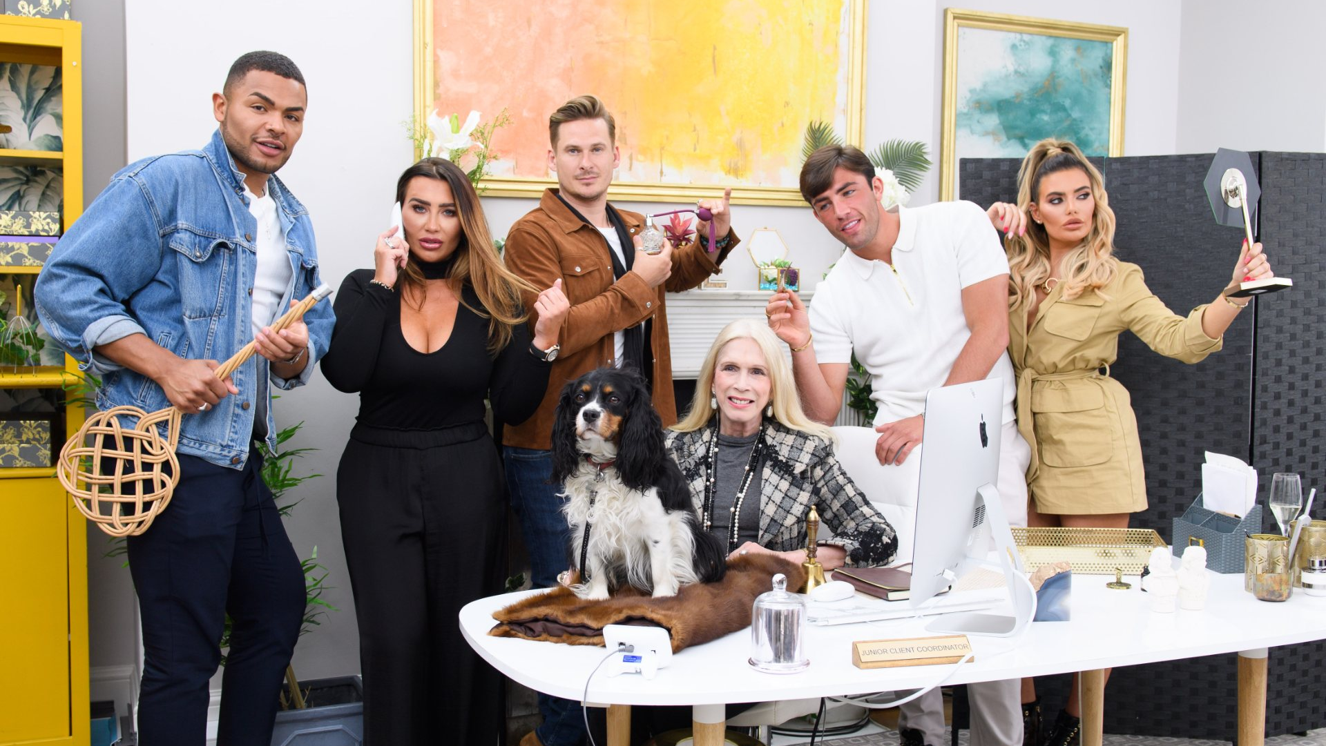
The
CONCEPT
A dating show which sees celebrities meet non-celebs via popular dating apps Tinder and Taimi.
The show will follow the celebs in their experiences and interactions. Dates, drama, and maybe even true love!
An accompanying app will create an interactive platform for viewers to vote on happenings in the show.
Fun, positive, feelgood vibes!
Mixing the popularity of celebrity culture and dating shows with technology and throwing them into the real world, for an all new insight into the world of modern dating.
Photos:
https://www.limepictures.com/news/programme-news/166-celebs-go-dating-season-7-singletons-announced
https://tveveryday.com/first-dates-19-march-2020-1932020-march-19-thursday-channel-4/

Slide 3
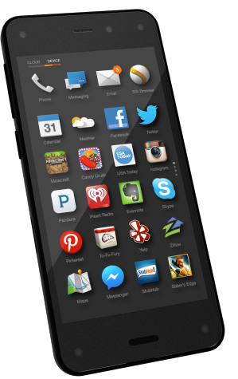
The
APP
Viewers can vote on different scenarios and decisions in each show, like:
Date locations / activities
Food / drink choices
Topics of conversation / challenges
and more!
Free to download and free to vote
Premium area with extra perks, pay-to-play competitions and adverts will generate revenue
VOTE NOW!
Option to donate to selected charities when you vote or enter
competitions

Slide 4






The
TIMELINE
Social media launch campaign
App launch two weeks before show airs
Commence filming one week before show airs
Show launch. Introduce first two celebrities
Roll out new celebrities through the first half of season
Second half of season devoted to developing relationships
REUNION EPISODE
12 weeks of dating, plus a 13th live reunion episode

Slide 5

Who’s
WATCHING?
Dating shows are popular among a younger audience.
Celebrities are already familiar faces.
The type of celebrities cast will influence the type of audience.
Inclusion of older / longer established celebrities would help to engage an older audience.

Slide 6

The
ETHICS
TV is a major influencer in shaping ethics and cultural perceptions.
Diversity
“Sex sells”
Language
Consent
Age
Ethics Team
The British Psychological Society

Slide 7
SUPPORT MESSAGE
ALL participants are given professional help and support throughout filming and for as long as required once filming has ended.
ALL participants retain the right to withdraw from the show at ANY time, and informed consent is gained continuously.
#BeKind
If you have been affected by any of the issues within this show help and support can be found below:
Samaritans (Open 24 hours): 116 123 (free phone line) or jo@samaritans.org
Switchboard (LGBTQ+): 0300 330 0630 (10AM-10PM) or chris@switchboard.lgbt
For an extensive list of helplines please visit: https://helplines.org/helplines/

Slide 8

An
OPPORTUNITY FOR ACTIVISM
Highlighting bullying and abuse on dating apps
Diverse hosts and production crew
Promoting online safety
Highlighting and talking about a different social issue on each episode, for example:
Diversity without tokenism
Women’s issues
Racial discrimination
A pledge
LGBTQ+ discrimination
At least 15% of the show’s workforce will be made up of “vulnerable” people – e.g. homeless or disabled people

Slide 9

The
PSYCHOLOGY BIT
COLOUR
PSYCHOLOGY
Yellow = Positivity
Blue = Trust
Pink = Playfulness, romance
Branded
AFFECT
Truth
Reality
MEDIA
“REALITY”

Slide 10
REFERENCES
BBC (2019) Love Island attracts six million viewers to break ratings record. Available at: https://www.bbc.co.uk/news/entertainment
-arts-48991692 (Accessed 16th April 2020).
BPS Media Ethics Advisory Group. (2019) Psychology and Media Productions: Guidance for Commissioners and Producers, Leicester: The British Psychological Society
Giles, D. (2010) Psychology of the Media. Basingstoke: Palgrave Macmillan
Grindstaff, L. and Murray, S. (2015) ‘Reality Celebrity: Branded Affect and the Emotion Economy’. Public Culture 17(175), pp. 109-135. DOI: 10.1215/08992363-2798367
Hawkins, G. (2001) ‘The Ethics of Television’ International Journal of Culture Studies 4(4), pp. 412-426. Thousand Oaks: SAGE
Helplines Partnership. (2020) Find a Helpline. Available at: https://helplines.org/helplines/ (Accessed 15th April 2020)
Mind. (2018) Crisis Services and Planning for a Crisis. Available at: https://www.mind.org.uk/information-support/guides-to-support-and-services/crisis-services/helplines-listening-services/ (Accessed 15th April 2020)
Schmitz, A. (2012) Ethical Issues in Mass Media. (Online)
Available at: https://saylordotorg.github.io/text_understanding-media-and-culture-an-introduction-to-mass-communication/s17-01-ethical-issues-in-mass-media.html
(Accessed 15 April 2020)
Singh, N. and Srivastava, S. K. (2011) ‘Impact of colors on The Psychology of Marketing – A Comprehensive Overview’ Management and Labor Studies 36(2), pp. 199-209. Thousand Oaks: SAGE.
Taylor, J. (2011) ‘Popular Culture: Reality TV is NOT Reality’ Psychology Today. Available at: https://www.psychologytoday.com/us/blog/the-power-prime/201101/popular-culture-reality-tv-is-not-reality (Accessed 6th April 2020).
Tsay-Vogel, M. and Krakowiak, K. M. (2015) ‘Exploring Viewers’ Responses to Nine Reality TV Subgenres’ Psychology of Popular Media Culture. DOI: 10.1037/ppm000010

