Slide 1

Collaboration: Reflective Practice

Slide 2
Activity
Research
Research different tools that could be used for collaboration – 15 mins
Consider
Consider an activity that would normally not use tech for collaboration – 15 mins
Plan
Plan for the inclusion of your chosen piece of technology and develop the activity - 40 mins
Deliver
Deliver that activity to the group – 15 mins

Slide 3
Models of Collaboration
Remote | Role-Based | Shared Screen
Individual devices, connected to a shared document or LMS (learning management system), are used. Students communicate via chat or comment feature. | Students work on smaller, individual tasks based on their role within the group. Continuous communication is needed to construct shared final product. | Students work side-by-side, discussing and taking turns to complete an activity using one device.
Notes:
RB = Multiple machines

Slide 4
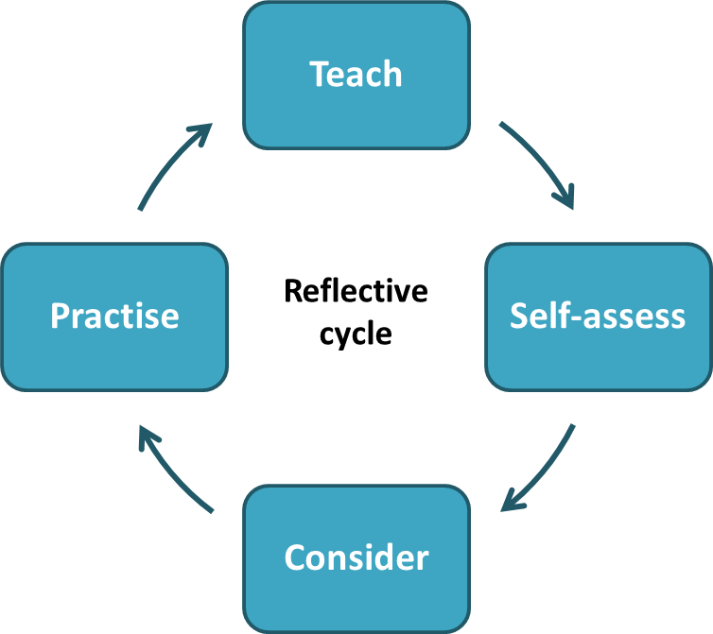
Reflecting
The process of reflection is a cycle which needs to be repeated.
  Teach
  Self-assess the effect your teaching has had on learning
  Consider new ways of teaching which can improve the quality of learning
  Try these ideas in practice
  Repeat the process
Reflective practice is ‘learning through and from experience towards gaining new insights of self and practice’ (Finlay, 2008)

Slide 5
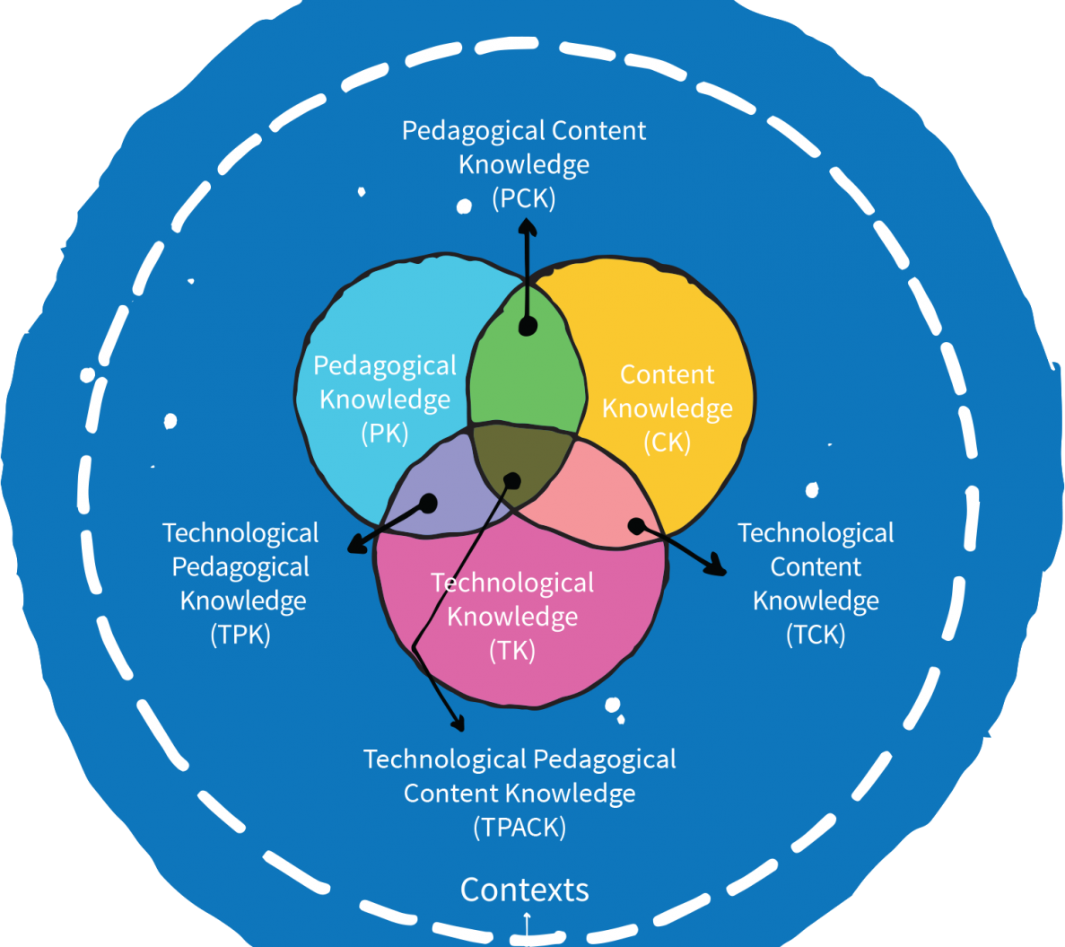
Reflecting on Tech Implementation
Use the models you use to consider implementation
TPACK, SAMR, TIM
What did you plan – did it work?
Were there gaps?
Did it change the lesson as you intended?
Did it help achieve the LO’s?

Slide 6
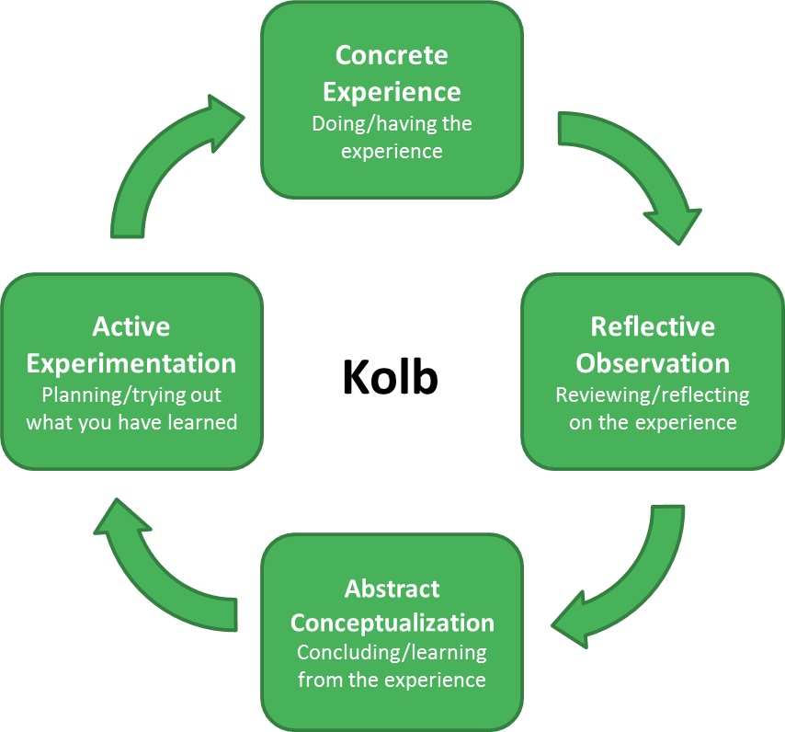
Kolb Reflective Model
Kolb (1984)
Concrete Experience
  experiencing something new for the first time in the classroom
Reflective Observation
  strengths of the experience and areas of development
  what helped students’ learning and what hindered it.

Slide 7
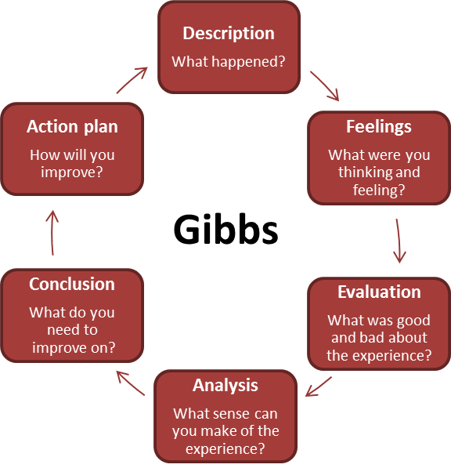
Gibbs Reflective Cycle (1998)
Description
  outline the experience
  factual account of what happened in the classroom
Feelings
  explore any thoughts or feelings had at the time of the event
  be honest with how you feel, even if these feelings might be negative
Evaluation
  opportunity to discuss what went well and analyse practice
  consider areas needed for development and things that did not work out as initially planned
  should consider both the practitioner’s learning and the students’ learning.

Slide 8
Gibbs Cont…
Analysis
  makes sense of the experience
  consider what might have helped the learning or hindered it
Conclusion
  draws all the ideas together
  should now understand what they need to improve on and have some ideas on how to do this based on their wider research.
Action plan
  sums up all previous elements of this cycle
  create a step-by-step plan for the new learning experience
  identifies what they will keep, what they will develop and what they will do differently
  might also outline the next steps needed to overcome any barriers, for example enrolling on a course or observing another colleague.

Slide 9
Activity
Pick a reflective model from the examples provided.
Reflect on your experience of delivering your tech collaboration activity.
What does good tech collaboration look like?
What does bad tech collaboration look like?
How can we keep the scales on the side of good tech collaboration?
Consider how the model explored helps you reflect further.
Share your reflections with the group, do your findings match with their feedback?

