Slide 1


Children, Young People, and Families
Case study A-
Referred by: anti-social behavior team. The focus of referral: A primary school-age boy who was viewed to be behaving disruptively. Also considered are issues around domestic violence, non-payment of rent, potential parental alcohol problems, and parenting issues Five. family members were identified. These were the mother and the father, a teenage daughter, a primary school-age daughter and the young son already mentioned
Kim Merson: 2127725
Lisa Ellam: 2014962
Kabir:
Module: BMHP5004_BIRM
Lecturer: Colin
Submission date: 23/06/2023
2.
1.

Slide 2

Contents
1. Title slide
2. contents.
3. Introduction
4. Presentation case study
5. Risk factors
6.Safeguarding
7. Abuse and neglect
8. Parents mental health/possible disorders
9. Drugs and alcohol misuse
10. Main child (primary boy aged 5)
11. Mother
12. Father
3.

Slide 3
Contents
13. Teenage sister
14. Primary age sister
15. Analysis of whole family
16. Current policy
17. Teams and Services
18. Plan A
19. Plan B
20. Next Steps
21. Conclusion
22. References
23. Image References.

Slide 4
Introduction
This presentation is based on a case study regarding a primary aged boy who has been reported to be behaving disruptively and the whole family unit who include, a mother, father, primary aged sister and a teenaged sister. The children's mother and father have suspected drug and alcohol addiction and are at high risk of eviction.(Chaulagain, Kunwar, Watts, Guerrero and Skokauskas, 2019) a risk factor and side effect of homelessness in childhood can cause disruptive behaviour, 28.6% of individuals who are at risk or become homeless are diagnosed with mental behaviour disorders. However, the children within this case study are potentional victims and are at high risk of child neglect and physical abuse. (Eldeson, 1999) children who witness domestic violence between adults become victims of domestic violence themselves. This presentation will include an individual analysis of each family member involved in the case study and a plan of action to promote the wellbeing, and to safeguard and protect the children while supporting the family as a whole unit. This presentation will also include professional health teams and services who are fundamental in promoting the children's and families welfare in this case study. This presentation will include risk factors, Laws and policies in the UK, next steps and a plan B.

Slide 5

Presentation case study
Referred by: anti-social behaviour team. Focus of referral: primary school age boy who was viewed to be behaving disruptively. Also considered issues around domestic violence, non-payment of rent, potential parental alcohol problems and parenting issues Five. family members were identified. These were the mother and the father, a teenage daughter, a primary school-age daughter and the young son already mentioned.
4.

Slide 6

Case study- family a
Risk Factors
Safeguarding
Abuse and Neglect
Parental mental health issues
Drug and alcohol misuse.
Housing (high risk of eviction)

Slide 7

Safeguarding
Guidance and Boundaries
Family History
Stability
Housing
Assessment framework focusing on the needs and views of the child.
Every organisation that interacts with children or works with them should have safeguarding policies in place to guard against injury, abuse, and mistreatment. NSPCC(2018)
Emotional
Employment
Parenting Capacity
Family and Environmental Factors
Assessment Framework
Safety
Income
Family’s Social Integration-
Basic Care
Childs Developmental Needs
Community resources-
Health
Working Together to Safeguard Children 2018 (publishing.service.gov.uk)
Keeping children safe in education: information for all school and college staff (publishing.service.gov.uk)
Safeguarding adults | SCIE
Family and social relationships
Education
Emotional and Behavioural
Self care

Slide 8
Abuse and neglect
(May-Chahal, 2005) Child neglect is the persistent failure of a parent or carer, who fail to meet a child's basic, physical or psychological needs. E.g, (food, water, healthcare, shelter, emotion, supervision) and is one of the most common forms of child abuse.
(Featherstone, Morris, Daniel, Bywaters, Brady, Bunting, Mason, and Mirza, 2019.) child abuse is any action inflicted by another individual, e.g, an adult or child, that causes or places a child at significant risk of physical, emotional or sexual harm. However, child abuse could also be through neglect. Such as the lack of care, support, love and attention.
(Levendosky, Huth-bocks, Semel and Shapiro, 2002) children who are victimised to child abuse, neglect and domestic violence showcase signs of aggression and behaviour changes. Referring to the case study, the main boy may be showcasing aggression due to neglect, lack of attention, witnessing domestic violence between parents at home or potentional victim of physical child abuse. Due to the mother and fathers alcohol abuse, parents are possibly using finances to provide addiction, children are possibly not eating or may be without gas, electric, hot water etc.

Slide 9


Parents mental health/ possible disorders
5.
6.
(Cocoza and Skowyra, 2000) a mental health disorder is a mental illness that affects an individual's ability to interact with others, behave, think and feel. There are over 200 such as depression, anxiety, bipolar, schizophrenia, PTSD, eating disorders etc. (Chutitami, Cheong, Salihu, Bell, Ndwiga, Maharaj, Naidoo, Kolo, Jacob, Chhina and Ku, 2022) an estimated of 45.8 million- 1 in every 6 adults have a mental health disorder in the UK. However global statistics show that over 970 million people have a mental health disorder worldwide.
Mother
Father
Potentional alcohol abuse/addiction.
Potentional depression, anxiety, bipolar,.
Vulnerable.
Potentional anger issues, (domestic violence) ADHD, genetic.
Potentional alcohol abuse/addiction.
Depression, anxiety, narcissism disorder.
Anger issues, E.g, ADHD. Childhood trauma?
Controlling.
Violence/aggression disorder.

Slide 10


Alcohol and substance Misuse
Parental substance misuse. This includes parents and carers that consume large amounts of alcohol, are dependant on alcohol, use drugs regularly or are dependant on drugs.
This also includes parents who aren’t able to take care or supervise their children appropriately because of the dependence on alcohol or drugs. (NSPCC, 2018).
This can lead to not meeting their children’s needs and may lead to their children being at risk of harm.(Cleaver, Unell, Aldgate, 2011)
Alcohol Misuse-Related problems
Depression
Loss of job/ unreliable
Illness
Domestic abuse, emotional abuse and physical abuse
Criminal activities
Neglect

Slide 11
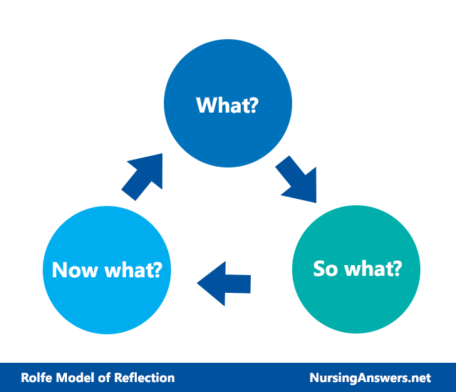
The Rolfe at al model of critical reflection theory
(Rolfe, 1993) Rolfe's model of reflection is a framework that is aimed to support practitioners to critically reflect on experiences, feelings and actions. The model consists of three stages, What? So what? And What next.

Slide 12

Individuals involved
Main child- primary school-age boy
Referred by: Anti-Social Behaviour Team.
Behaving disruptively
Neglect and vulnerability
School
Activities
Protentional victim of domestic violence
Protentional abuse
School attendance
Poverty?
Lonely
Safeguarding

Slide 13
What? | So What? | What Next?
Behaving disruptively. Referred by Anti-social behaviour team. | School work affected, bullying. Ongoing for a while, referral made by Anti-social team. | Contact school … arrange for child to attend activities such as afterschool football club, basketball, arts and crafts or activity protects organised by local charities. Occasional breaks for child to be arranged when overwhelmed in school. Organise family meeting. Arrange for child to see school support worker/councillor .
Neglect and vulnerability | Physical, social, emotional and psychological health affected. Child is vulnerable | Inform management, contact social services.
Housing support | Risk of eviction and becoming homeless due to parents failing to pay rent. | Contact council for descrimanry payment depending on parents employment status. Support from local charities.
Finacial support | Parents have potential finance issues, child may not be receiving food at home. | Contact school for free breakfast and lunch.
What?
So what?
What next?

Slide 14

Individuals involved - Mother
Analysis of Mother:
Children – Teenage daughter, school-age daughter, and young son.
Potentional domestic violence
Alcohol issues
Financial problems, eg. non-payment of rent
Parenting issues
Employment?
Mental health issues?
Poverty?

Slide 15
What? | So What? | What Next?
Domestic violence | (Wolfe, Crooks, Lee, McIntyre-Smith, and Jaffe, 2003) Physical, mental, and emotional. Lead to Depression Effects children Could lead to injury or in worst cases Death. | Social worker Support Encourage them to talk to someone
Alcohol misuse | (Barnes, Reifman, Farrell, and Dintcheff, 2000) leads to depression, anger issues, mistrust, mental health disorders, Could cause loss of job. Unreliable At risk of chromic/ long term illness Domestic abuse, emotional abuse and physical abuse Criminal activities Neglect | Social worker Support Alcohol Anonymous sessions
Parenting issues | Neglect Possible abuse No guidance Depression | Parenting Classes Advise school Social worker
Financial issues | Non payment of rent Not employed? No food | Contact council for descrimanry payment depending employment status. Support from local charities. Advise food bank Seek help from universal credit or citizens advice.
What??
So what?
What next??

Slide 16

Individuals involved
Analysis of Father
Children – Teenage daughter, school-age daughter, and young son.
Potential domestic abuse
Employment?
Alcohol issues.
Financial crisis, eg. non-payment of rent
Parenting issues
Mental health issues?
Poverty?

Slide 17
What? | So What? | What Next?
Domestic violence | Physical, mental, and emotional. Lead to Depression Effects children Could lead to injury or in worst cases Death. | Social worker Support Encourage them to talk to someone
Alcohol misuse | Depression Loss of job/ unreliable Illness Domestic abuse, emotional abuse and physical abuse Criminal activities Neglect | Social worker Support Alcohol Anonymous sessions Speak to GP
Parenting issues | Neglect Possible abuse No guidance Depression | Parenting Classes Advise school Social worker
Financial issues | Non payment of rent Not employed? No food | Contact council for descrimanry payment depending employment status. Support from local charities. Advise food bank Seek help from universal credit or citizens advice.
What??
So what?
What next?

Slide 18
Individuals involved
Analysis of teenage daughter:
Potential neglect
Potential carer
School/ college?
Potential victim of domestic violence
Potential drug and alcohol misuse.
Social life
Mental health issues?
Poverty?
Lonely
Safeguarding
Finance?

Slide 19
What?
So what?
What next?
What? | So What? | What Next?
Potential domestic violence victim | College or work affected, may be the main carer of the family. May be victim of violence | Contact school Social worker involvement.
Neglect and vulnerability | Physical, social, emotional and psychological health affected. Vulnerable, stressed with housing and protential abuse. Possible carer for siblings. | Inform management, family meeting, contact social services/support worker.
Financial support | Can not afford social life, travel or basic needs such as food, clothing or sanitary products, | Access to financial support if unemployed, e.g, universal credit. College bursaries if attending college.
Housing support | At risk of becoming homeless due to parents failing to pay rent. Physical and mental health affected, no family or friends to live with. Eviction will lead to teenager becoming vulnerable. | Decrimanry rent payments from the council to help parents if unemployed. Potential supported accommodation to house teenagers such as St Basils or foster care placement.

Slide 20

Individuals involved- Primary age sister
Analysis of primary school age daughter
Potential special educational needs.
Potential victim of domestic violence.
Potential neglect and abuse
School attendance
Hygiene eg. School uniform
Vulnerability
Poverty?
Lonely
Safeguarding

Slide 21
What? | So What? | What Next?
Educational support | School work affected. Possible bullying. | Contact school … arrange for child to attend activities such as afterschool. Extra help with curricular work. School councillor.
Neglect and vulnerability | Physical, social, emotional and psychological health affected. Child is vulnerable | Inform management. Inform School. contact social services.
Housing support | Risk of eviction and becoming homeless due to parents failing to pay rent. | Contact council for descrimanry payment depending on parents employment status. Support from local charities.
Hygiene issues | No guidance at home Bullying No clean uniform | Inform school. Get help with Uniform.
What?
So what?
What next?
What?
What next?
So what?

Slide 22

Current policy
Although we support these goals, the system has occasionally fallen short and, regrettably, resulted in a child's death as a result of inadequate professional cooperation.
(Aldgate and Stratham, 2001) The Childrens Act 1989 and 2004 protects and ensures the adequate wellbeing and welfare of a child by ensuring local authorities take appropriate action to safeguard and provide systems and services for children and young people in need in the area and living in the UK. The Children's Act 1989 key principles include, the concept of parental reasonability and understanding that all children are best looked after by family members unless intervention between the family is essential. The act is fundamental for systems, professionals and services to be provided to vulnerable children to ensure a great level of protection, safety and welfare for children living in the UK.
(BOSHIER, 2005) Childrens Act 2004 places all local authorities in the UK ar duty to collaborate with other inter-professionals, local agencies, and key partners such as, the police, NHS Clinical Commissioning Groups, doctors and social services to safeguard and promote the overall wellbeing of children living within the authorities local area.
The Children's Act 1989 and 2004 policies are important to use in this case study because the key principles ensure vulnerable children living in the UK are receiving the correct and equal support from local authorities, services and systems to ensure all children that are in need, remain safeguarded. It showcases the importance of collaboration with other interprofessional.
(UNCRC) lead an international children's right agreement which states that all children, regardless of culture, age, race, disability, gender or religion are entitled to the right of protection, education and survival such as emotional, psychological and basic needs E.g food and water, security, love and affection, housing or protection from abuse and neglect at home.

Slide 23
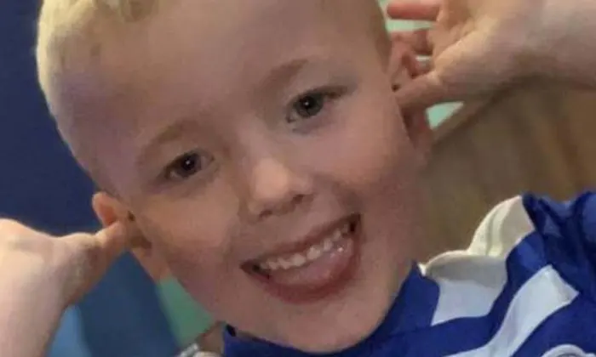
Teams and Services
Arthur Labinjo-Hughes, whose parents murdered him in 2020. The authorities failed to help him.
research revealed that social workers had visited the home in the months before Arthur's murder and had found no reason for worry and “no safeguarding concerns”. This shed light on the circumstances surrounding his death.
(Murray,2021)
Parenting classes for parents in local area. (GOV, local council)
Social services
School- councilor / support worker.
Therapist for mother, father and teenage daughter.
Alcohol and drug abuse/addiction support for parents. E.g, NHS, charities, support groups.
Housing advisor, for whole family and teenage daughter.
Benefit advisor/ financial support.
Children activities coordinator.
Local charities.
Foodbank
Family support worker for whole unit.
Domestic violence charity/ advocacy
10

Slide 24
Plan A- how to make our plan work
Talk to school to gain insight on main boys and primary school girls behaviour and to see If the school have any concerns regarding neglect.
Speak to management regarding the feedback from school and act upon the safeguarding concerns immediately.
organise a meeting with the whole family. And (a separate meeting without the domestic violence perpetrator present.)
If concerns of domestic violence, neglect and child abuse are present, inform management and contact social services.
If parents are unemployed, help parents access eligible benefits such as universal credits, housing benefit, child benefit, employment.
Contact primary school and request free breakfast and lunch for children. Request main boy, and primary aged sister, have access to after school activities such as football, dance and singing club.
Organise access to child activities for main boy, primary aged girl and teenage sister through local charities.
Contact secondary school or college of the teenage girl and request free lunch and financial bursary support.
Help teenage daughter access eligible benefits such as income support.
If teenage daughter is victim of domestic violence, find foster care placement or supported accommodation.
If family live in social housing, contact council and request financial crisis support to cover rent payments. (if family are living in private accommodation, register family to local social housing as rent charges will be lower)
Organise parenting classes for parents.
Organise engagement sessions for parents in alcohol abuse/addiction.
Revisit family and review case within 3 weeks to see progress.

Slide 25
Plan B- a Backup plan if plan a does not work?
If plan A fails to safeguard and protect main school boy and other children in the household due to mother and father continuously abusing alcohol or if domestic violence is present around the children or inflicted on children then social services should be contacted to arrange for children to be removed out of parents care and temporary homed with a safe, trusted family member or into a foster care placement until the domestic violence and alcohol abuse is no longer inflicted by parents. However () under the Childrens Human Rights act, all children have the right to development and to have their basic, emotional, physical and medical needs met. The parent's will not have the capacity to be responsible, safeguard and promote the children's wellbeing if under the influence and intoxicated with alcohol. It is affecting the children's mental health and rights to development.

Slide 26

Next steps
Revvist family and review case within 3 weeks.
Regular visits/ check ups.
Termly school meetings
Involve social services
Access to Parenting classes.
Access to Alcohol addiction/abuse support sessions.
Access to Housing support. E.g, rent payments, social housing or supported accommodation for teenage daughter.
Access Benefit/employment support for parents and teenage daughter.
Access to activities for children and free school breakfast and lunch.
Access to sessions with school support worker/ councillor to all children.
If abuse is present, take immediate action and remove children from parents care and temporary rehome all children with a safe. trusted family member such as a grandmother or auntie, or into a foster care placement.

Slide 27

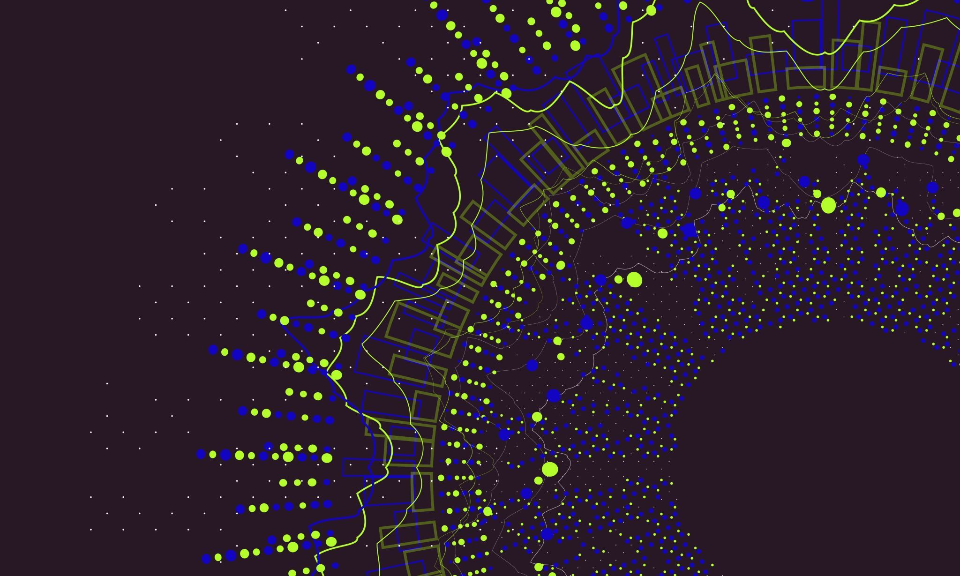
Conclusion
C
In conclusion to this presentation (Radford, Susana, Bradley, and Fisher, 2013) every child living in the UK have over 40 policies, acts and laws for child rights which all promote and include the three P'S. Provision, participation and protection, however this also includes prevention and safeguarding. An estimate of over 825,000 children in the UK live in homes with domestic violence and an estimate of 100,000 children live in homes with alcohol or drug abuse. However, over 275 million children are living in domestic violence homes globally. (WHO) over 1 billion children between the ages of two to seventeen years old are victims of physical, emotional sexual, domestic violence or child neglect worldwide annually. it is important for immediate action to be taken as soon as allegations of child abuse are enclosed.
(Stiles, 2002) although children may not be physically abused or harmed during domestic violence episodes, the child is a victim from being present and witnessing as this mentally harms a child. Local authorises have a duty to protect all children in need within the local area. Free parenting classes are available to parents who are struggling to parent their children in the UK, when working with children, it is fundamental for professionals to communicate with other inter-professionals and local authorises to ensure the best interest of a child
If a child is behaving disruptively in school, home life may include domestic violence, child abuse or neglect. However, support is available to prevent children. Referring to the case study, a plan of action has been created which involves communicating with school, family meetings, organise parenting classes and alcohol abuse sessions for mother and father, this will benefit the whole family by allowing the parents to become reliable. for the main boy and other children in the case study, physical and creative activities such as football, painting, or preforming arts will help release anger and tension in children. Social services should be contacted due to allegations of child neglect and domestic violence.

Slide 28

References
C
Aldgate, J. and Stratham, J., (2001) The Children Act now: messages from research. Stationery Office.
Barnes, G.M., Reifman, A.S., Farrell, M.P. and Dintcheff, B.A., (2000) The effects of parenting on the development of adolescent alcohol misuse: a Six‐Wave latent growth model. Journal of Marriage and Family, 62(1), pp.175-186.
Boshier, P. (2005) The Care of Children Act 2004: Does It Enhance Children's Participation and Protection Rights?. Childrenz Issues: Journal of the Children's Issues Centre, 9(2).
Chaulagain, A., Kunwar, A., Watts, S., Guerrero, A.P. and Skokauskas, N., (2019) Child and adolescent mental health problems in Nepal: a scoping review. International journal of mental health systems, 13, pp.1-8.
Chutiyami, M., Cheong, A.M., Salihu, D., Bello, U.M., Ndwiga, D., Maharaj, R., Naidoo, K., Kolo, M.A., Jacob, P., Chhina, N. and Ku, T.K., (2022) COVID-19 pandemic and overall mental health of healthcare professionals globally: a meta-review of systematic reviews. Frontiers in psychiatry, 12, p.2600.
Cocozza, J.J. and Skowyra, K.R., (2000) Youth with mental health disorders: Issues and emerging responses. Juv. Just., 7, p.3.
Edleson, J.L., (1999) Children's witnessing of adult domestic violence. Journal of interpersonal Violence, 14(8), pp.839-870.
Featherstone, B., Morris, K., Daniel, B., Bywaters, P., Brady, G., Bunting, L., Mason, W. and Mirza, N., (2019) Poverty, inequality, child abuse and neglect: Changing the conversation across the UK in child protection?. Children and Youth Services Review, 97, pp.127-133.
Levendosky, A.A., Huth-Bocks, A.C., Semel, M.A. and Shapiro, D.L., (2002) Trauma symptoms in preschool-age children exposed to domestic violence. Journal of interpersonal Violence, 17(2), pp.150-164.

Slide 29
References
C
MAY-CHAHAL, C. AND CAWSON, P., (2005) MEASURING CHILD MALTREATMENT IN THE UNITED KINGDOM: A STUDY OF THE PREVALENCE OF CHILD ABUSE AND NEGLECT. CHILD ABUSE & NEGLECT, 29(9), PP.969-984.​
MURRAY J., (2021).’ Arthur Labinjo-Hughes: timeline of events that ended in his murder’ The Guardian, 3rd December. Available at: Arthur Labinjo-Hughes: timeline of events that ended in his murder | Child protection | The Guardian (Accessed:20 June 2023)
PARKES, A., (2013) CHILDREN AND INTERNATIONAL HUMAN RIGHTS LAW: THE RIGHT OF THE CHILD TO BE HEARD. ROUTLEDGE.​
CLEAVER, H. AND UNELL, L. AND ALDGATE, J. (2011) CHILDREN’S NEEDS: PARENTING CAPACITY: CHILD ABUSE: PARENTAL MENTAL ILLNESS, LEARNING DISABILITY, SUBSTANCE MISUSE, AND DOMESTIC VIOLENCE(PDF). LONDON STATIONERY OFFICE(TSO). ​
NSPCC (2018). CHILDREN LIVING IN FAMILIES FACING ADVERSITY: NSPCC HELPLINES REPORT. LONDON: NSPCC.​
Radford, Lorraine, Susana Corral, Christine Bradley, and Helen L. Fisher. "The prevalence and impact of child maltreatment and other types of victimization in the UK: Findings from a population survey of caregivers, children and young people and young adults." Child abuse & neglect 37, no. 10 (2013): 801-813.
Rolfe, G., (1993.) Closing the theory—practice gap: a model of nursing praxis. Journal of clinical nursing, 2(3), pp.173-177.
Stiles, M., (2002) Witnessing domestic violence: The effect on children. American Family Physician, 66(11), p.2052.
WOLFE, D.A., CROOKS, C.V., LEE, V., MCINTYRE-SMITH, A. AND JAFFE, P.G., (2003) THE EFFECTS OF CHILDREN'S EXPOSURE TO DOMESTIC VIOLENCE: A META-ANALYSIS AND CRITIQUE. CLINICAL CHILD AND FAMILY PSYCHOLOGY REVIEW, 6, PP.171-187.​
Wolrd Health Organisation,Violence against children.
PARKES, A., (2013.)CHILDREN AND INTERNATIONAL HUMAN RIGHTS LAW: THE RIGHT OF THE CHILD TO BE HEARD. ROUTLEDGE.​
​

Slide 30
Image references
C
1.Hi Children Cartoon Free PNG Image｜Illustoon
2.3,986 Naughty Boy Cartoon Images, Stock Photos & Vectors | Shutterstock
3. Pencil Cartoon png download - 753*1024 - Free Transparent Crayon png Download. - CleanPNG / KissPNG
4. Confidential Folder Illustrations, Royalty-Free Vector Graphics & Clip Art - iStock (istockphoto.com)
5. Пин на доске png. (pinterest.co.uk)
6. 1,300+ Handsome Father Illustrations, Royalty-Free Vector Graphics & Clip Art - iStock (istockphoto.com)
7. kids sports clipart - Clip Art Library (clipart-library.com)
8. Pupil kids at classroom. Primary school children pupils, smiling boys and girls study in schools class cartoon vector illustration Stock Vector Image & Art - Alamy
a moment... (joelnathanmd.com)
9. Rolfe's Reflective Model (nursinganswers.net)
10. Arthur Labinjo-Hughes (guardian.com)

