Slide 1

Key Skills Presentation
Module name: Professional Development within Health and Social Care
Presented by:

Slide 2
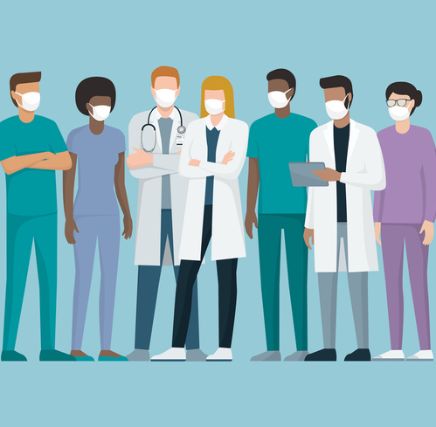
Introduction
Working in teams refers to the ability to collaborate with other individuals towards a common goal. It involves communication, cooperation, and the ability to work interdependently towards shared objectives.
According to Naylor, M.D., Coburn, “Team-based health care is the provision of health services to individuals, families, and/or their communities by at least two health providers who work collaboratively with patients and their caregivers—to the extent preferred by each patient – to accomplish shared goals within and across settings to achieve coordinated, high-quality care.”

Slide 3

Essential Skills for Working in Teams in Health and Social Care
Communication skills
Problem-solving and decision-making skills
Flexibility and adaptability
Active listening
Empathy and compassion
Respect for diversity and cultural differences

Slide 4
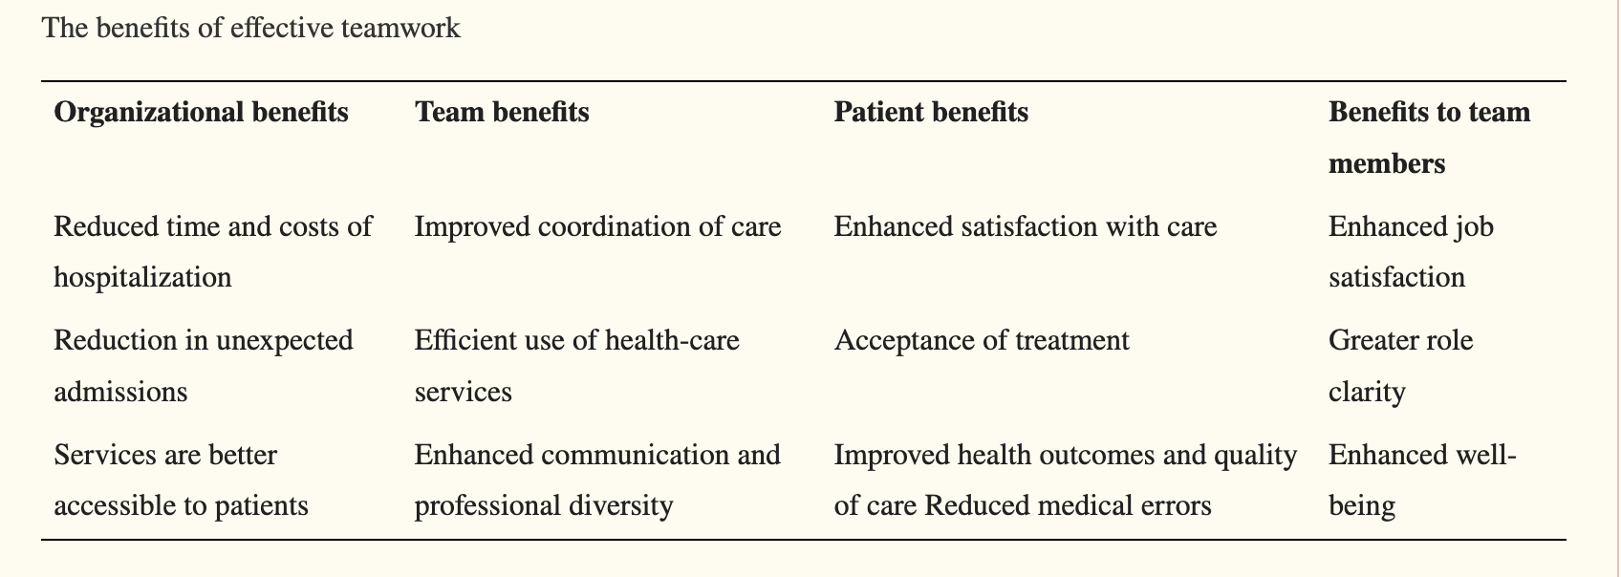
Advantages of Working in Teams in Health and Social Care

Slide 5
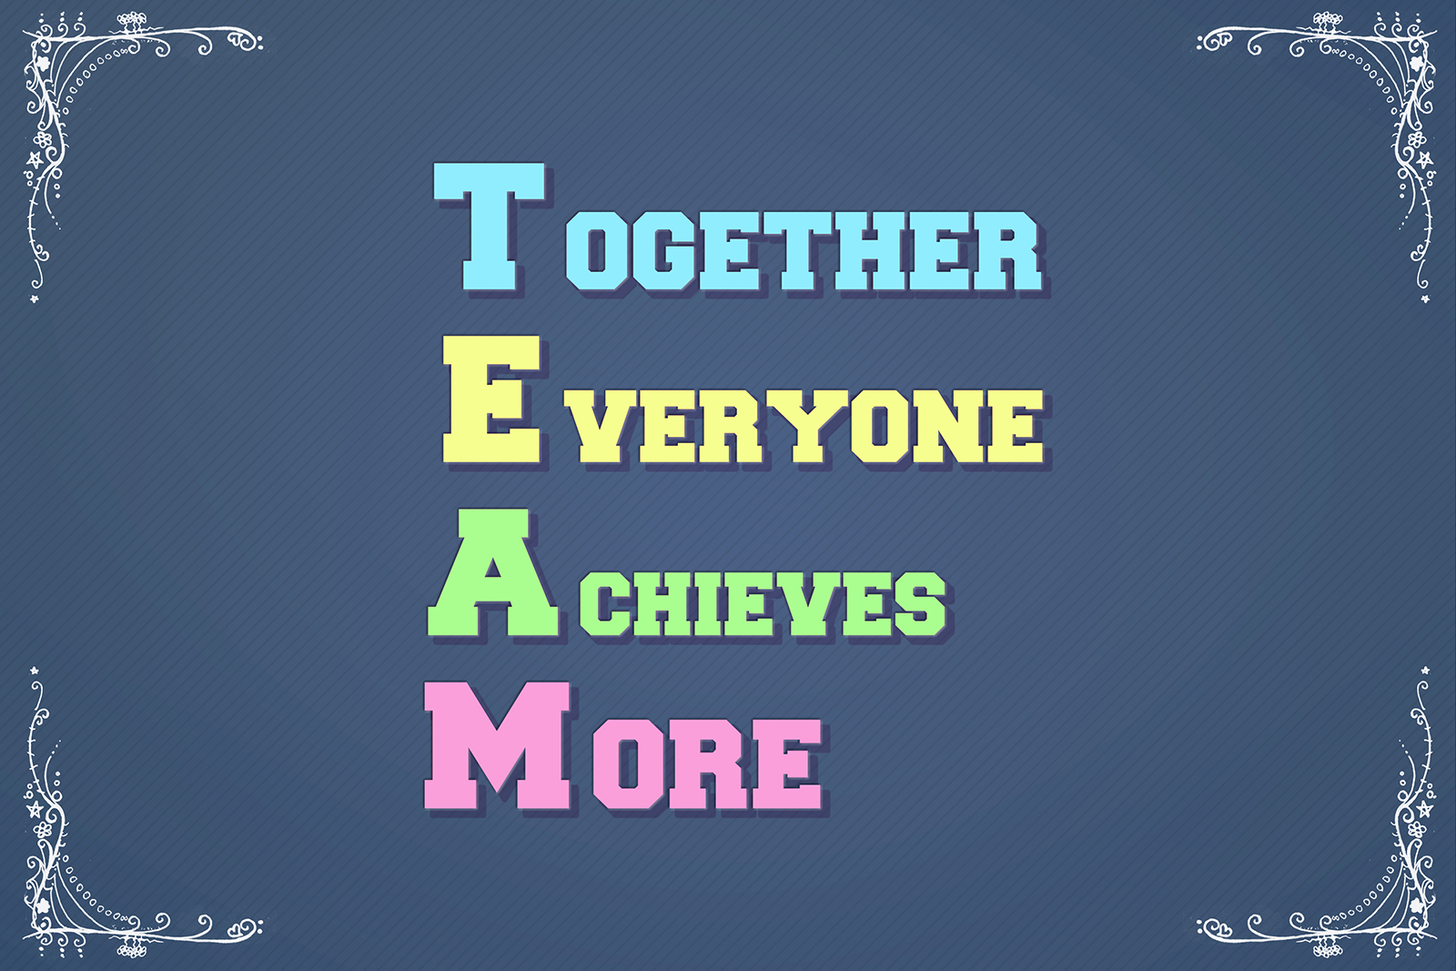

Challenges to Effective Teamwork
Communication barriers
Role conflicts and ambiguity
Lack of trust
Resistance to change
Cultural differences and diversity
Limited resources and time constraints
Inadequate leadership and management support
Burnout and staff turnover.

Slide 6
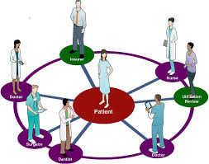
Practical Example of Working in Teams in Health and Social Care:
Interprofessional Team in Stroke Rehabilitation-
An example of working in teams in health and social care is an interprofessional team in stroke rehabilitation. This team consists of healthcare professionals from different backgrounds, including physiotherapists, occupational therapists, speech and language therapists, nurses, and social workers, who work together to support stroke patients in their recovery journey.

Slide 7
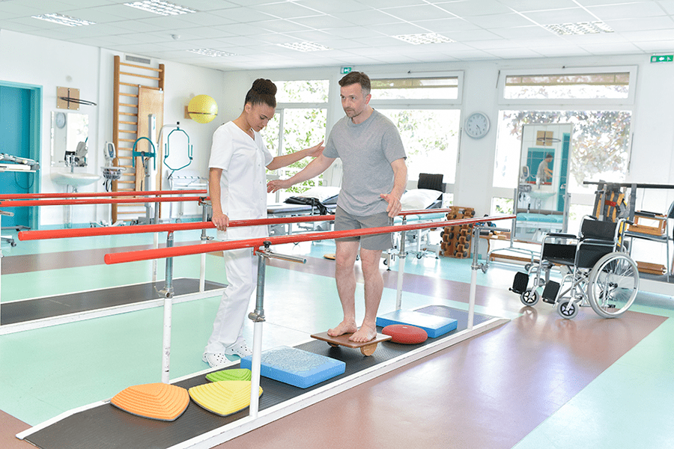
Role of the Interprofessional Team in Stroke Rehabilitation
Conducting comprehensive assessments of patients' physical and cognitive abilities
Developing individualized rehabilitation plans based on patients' needs and goals
Providing interventions to improve patients' mobility, function, and communication
Offering emotional and psychological support to patients and their families
Coordinating care and services with other healthcare providers and community resources

Slide 8
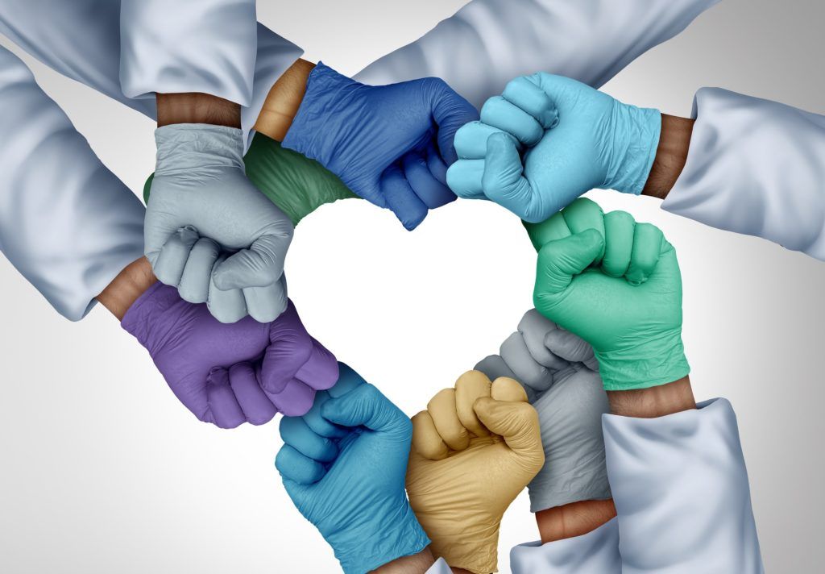
Conclusion
In conclusion, working in teams is a crucial skill in health and social care that helps to ensure the delivery of high-quality, patient centered care. By collaborating with other healthcare professionals, individuals can provide comprehensive care that addresses the physical, cognitive, and psychosocial needs of stroke patients and their families.

Slide 9
References
Markle-Reid, M., Orridge, C., Weir, R., Browne, G., Gafni, A., Lewis, M., Walsh, M., Levy, C., Daub, S., Brien, H. and Roberts, J., (2011) ‘Interprofessional stroke rehabilitation for stroke survivors using home care’, Canadian Journal of Neurological Sciences, 38(2), p.317-334.
Naylor, M.D., Coburn, K.D., Kurtzman, E.T., Prvu Bettger, J.A., Buck, H., Van Cleave, J. and Cott, C.A., (2010) ‘Inter-professional team-based primary care for chronically ill adults: State of the science’, Unpublished white paper presented at the ABIM Foundation meeting to Advance Team-Based Care for the Chronically Ill in Ambulatory Settings. Philadelphia: p.24-25.
World Health Organization, Being an effective team player. Available at: URL: http://www.who.int/patientsafety/education/curriculum/who_mc_topic-4.pdf (Accessed on 10th March 2023)

Slide 10


