Slide 1
Student Name: Rosena Lucy
Student ID: 2210256
Student Name: Nadeie seaied
Student ID: 2212621
Student Name: Mohammad Ilyas
Student ID: 2029045
Module Code: LCHS7000
Lecturer: Dr Hamdi Hussain
Component 1 – Group Presentation
Module: Social Epidemiology and Public Health Development
Programme: MSc Public Health and Social Care in Practice
Campaign Title
🗣️ Let’s Talk: Empowering Young People for Safer Sexual Health
Target Group
👥 Young people aged 14–25 in Birmingham

Slide 2
“Good morning, everyone. My name is Lucy, and I’ll be presenting the first part of our group project — Task 1 — which focuses on a practice-based public health intervention aimed at improving sexual health outcomes for young people aged 14 to 25.
My colleagues Nadia and Illiyas will be delivering Task 2 and Task 3 respectively, each exploring different dimensions of our shared public health theme (Sexual Health). Together, our work reflects a comprehensive approach to tackling health inequalities through evidence-based practice, policy alignment, and critical evaluation.

Slide 3

Campaign Title:
🗣️ Empowering Young People for Safer Sexual Health
Target Group:
👥 Young people aged 14–25 in Birmingham
(Unsplash, 2025)

Slide 4
🧠 Sexual Health:
8-Week Empowerment Journey
Young people (14–25) will join 8 weekly sessions covering:
🔍 Myth-Busting
🎯 Condom Confidence
🏳️‍🌈 LGBTQ+ Inclusive Health
🤝 Peer-Led Q&A
💬 Consent & Communication
🏥 Clinic Visit
📊 Evaluation & Celebration
📱 Digital Safety & Sexting

Slide 5
Rationale
This campaign tackles sexual health inequalities affecting young people in Birmingham, especially those aged 14–25.
Local data shows rising STI rates and poor access to youth-friendly services (Public Health England, 2023).
Many young people lack knowledge, face peer pressure, and struggle to get care. However, they are active online, so visual and interactive tools work well (WHO, 2022).
The campaign is co-designed with young people, inclusive, and based on NICE guidelines. It aims to be easy to access and backed by evidence.
It supports Birmingham’s Public Health Strategy and national goals to reduce health inequalities in young communities.

Slide 6
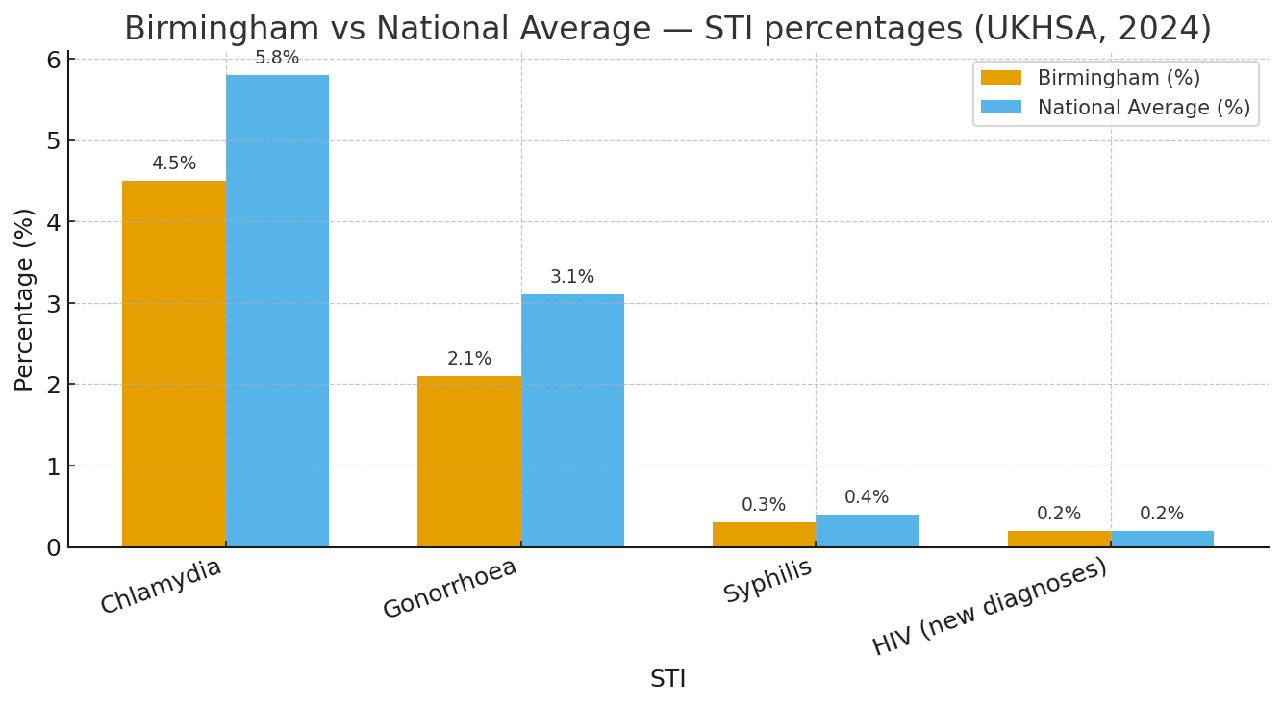
(UKHSA, 2024).

Slide 7




8 Weeks sexual Health Empowerment Sessions/Activities, Inclusive Learning for 14-25 Year Olds.
Weekly Session Breakdown.
Week | Image | Session Theme | Focus
1 |  | Icebreaker & Myth-Busting | Challenge stigma and misinformation
2 |  | STI Facts & Testing Increase awareness and reduce fear Demo
3 |  | Condom Confidence | Hands-on demo and access kits
4 |  | Consent & Communication | Promote respectful relationships
(Adobe Stock, 2025).
(Adobe Stock, 2025).
(Adobe Stock, 2025).
(Adobe Stock, 2025).

Slide 8




Slide 4 continued
Week | Picture | Session Theme | Focus
5 |  | LGBTQ+ Inclusive Health | Address diverse needs and identities
6 |  | Peer-Led Q&A | Safe space for anonymous questions
7 |  | Local Clinic Visit | Build trust with health services
(Adobe Stock, 2025).
(Adobe Stock, 2025).
(Adobe Stock, 2025).
8 |  | Evaluation and celebrations | Reflect, reward, and reinforce learning
Unsplash, 2025).

Slide 9
SMART Aims for Sexual Health Promotion(14-25 years)
Aim | SMART Objective | Benefit | Measurement | Citation
🧪 Aim 1 | Increase STI screening uptake by 20% among 14–24-year-olds in Birmingham | Early detection and reduced transmission of STIs | Clinic attendance data and pre/post campaign surveys | (UKHSA, 2024)
🧤 Aim 2 | Boost condom confidence and access for 14–25s by increasing confidence 25%, distributing 2,000 condoms, and securing 500+ engagements. | Empowered decision-making and safer sex practices | Distribution logs and workshop feedback forms | (Pound et al, 2022)
📚 Aim 3 | Deliver 6 sexual health interactive sessions to 300+ young people, achieving 80% positive feedback on learning outcomes. | Informed choices and reduced stigma | Attendance records and pre/post knowledge quizzes | (BASHH, 2023)

Slide 10
🚨 Consequences of Poor Sexual Health Habits
Impacts on Young People (Ages 15–25): Short-Term & Long-Term
🔹 Short-Term Effects (Daily Life) | 🔸 Long-Term Effects (Future Health & Wellbeing)
🦠 Higher risk of STIs (e.g. chlamydia, gonorrhoea) | 🧬 Infertility from untreated infections (e.g. pelvic inflammatory disease)
😟 Anxiety, embarrassment, and social isolation | 🚺 Chronic pelvic pain and lifelong complications
🎓 Unplanned pregnancies disrupting education or career plans | 🎗️ Greater vulnerability to HIV and other lifelong infections
💔 Relationship breakdowns due to poor communication or mistrust | 😔 Persistent emotional distress and reduced self-esteem
🏥 Avoidance of health services due to stigma or fear of judgement | 🏛️ Increased strain on NHS and social services
(Brook, 2023) (Marmot, 2020)

Slide 11
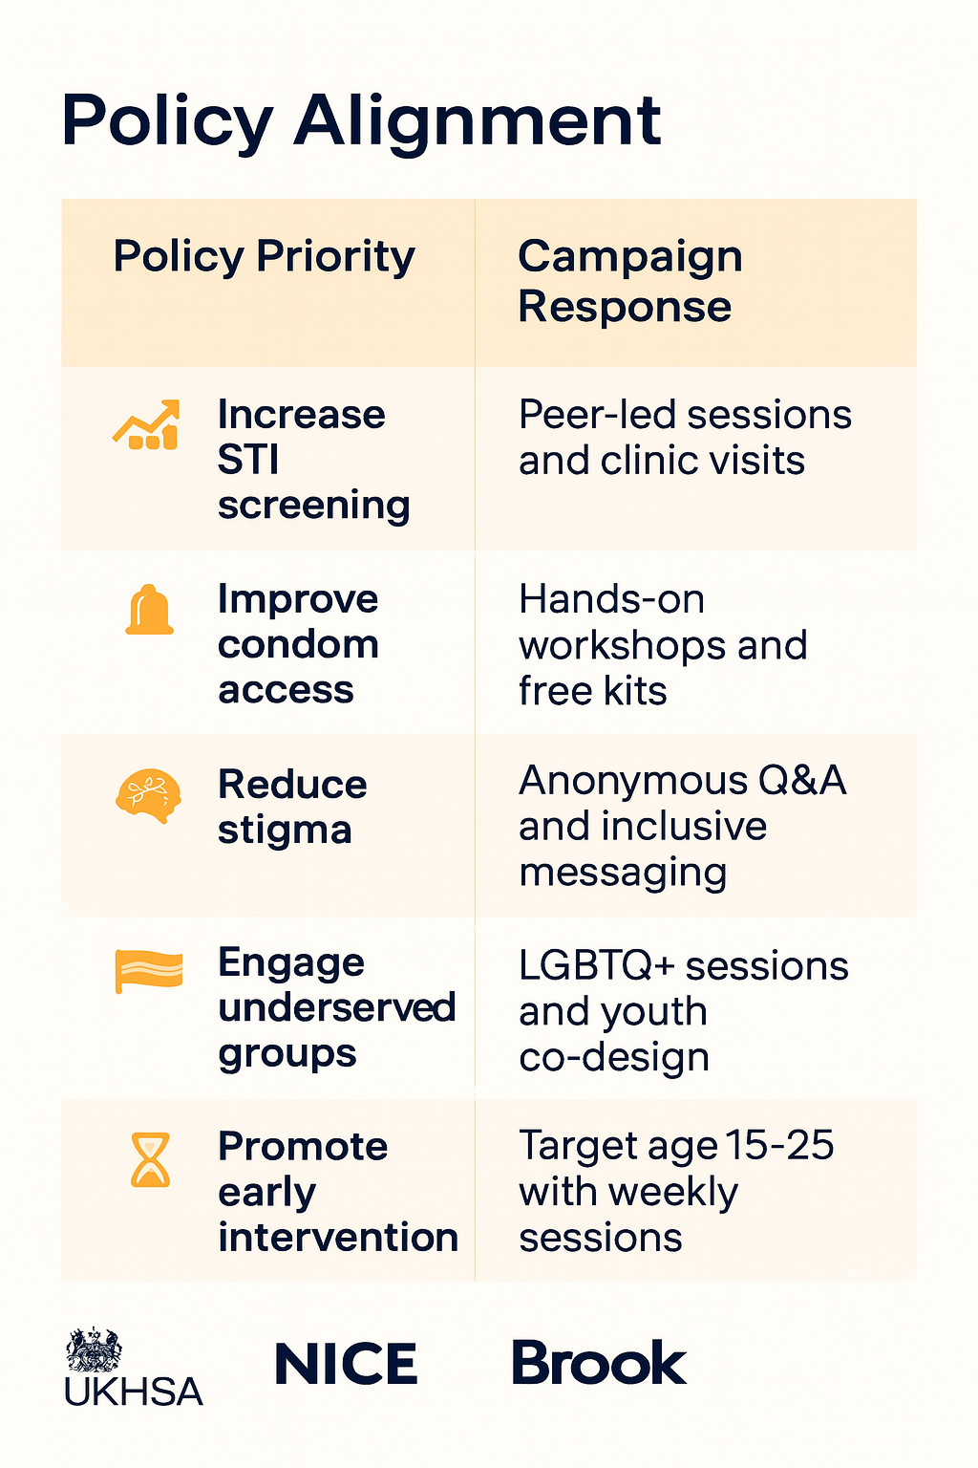
(NICE, 2014)

Slide 12
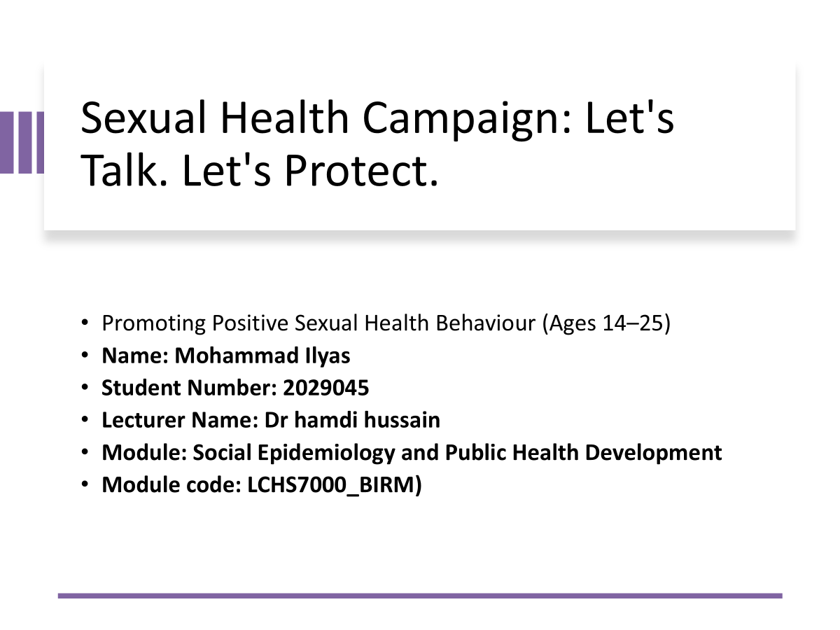

Slide 13
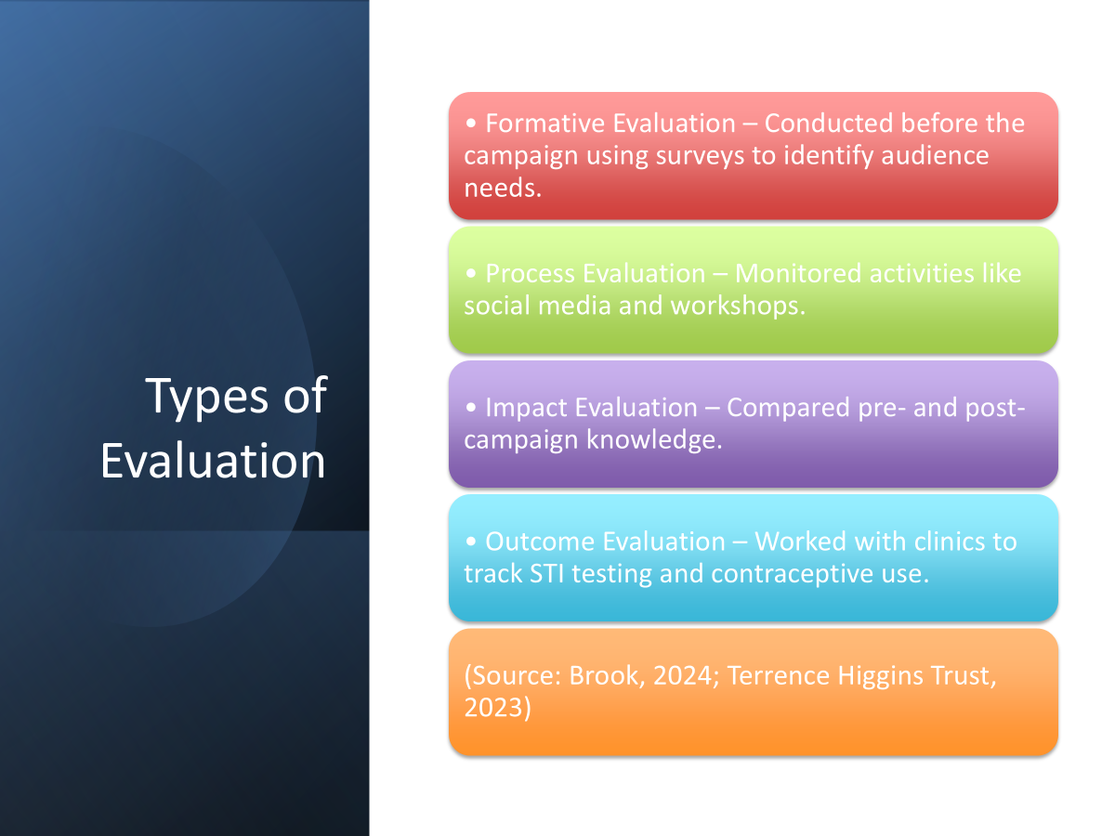

Slide 14
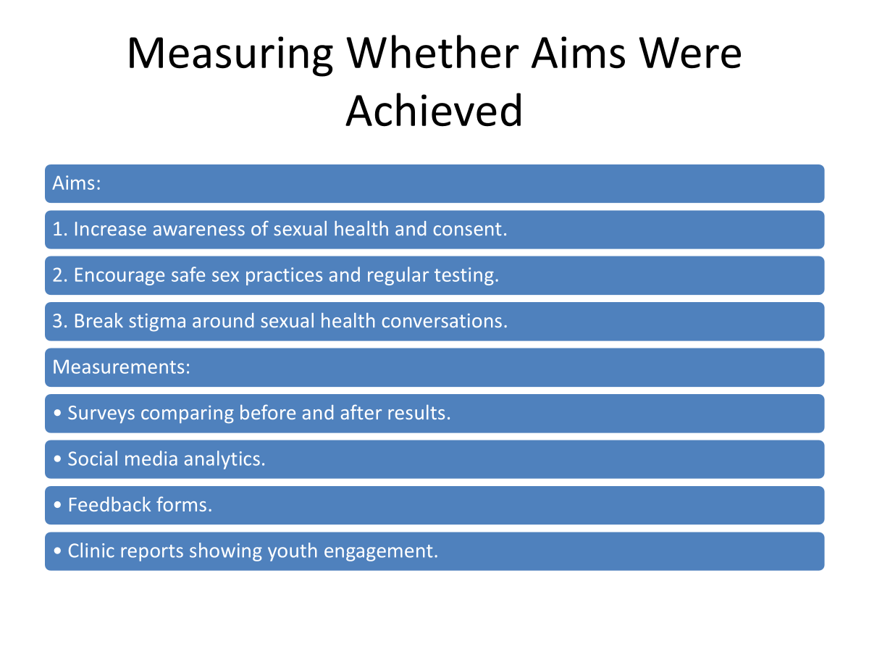

Slide 15
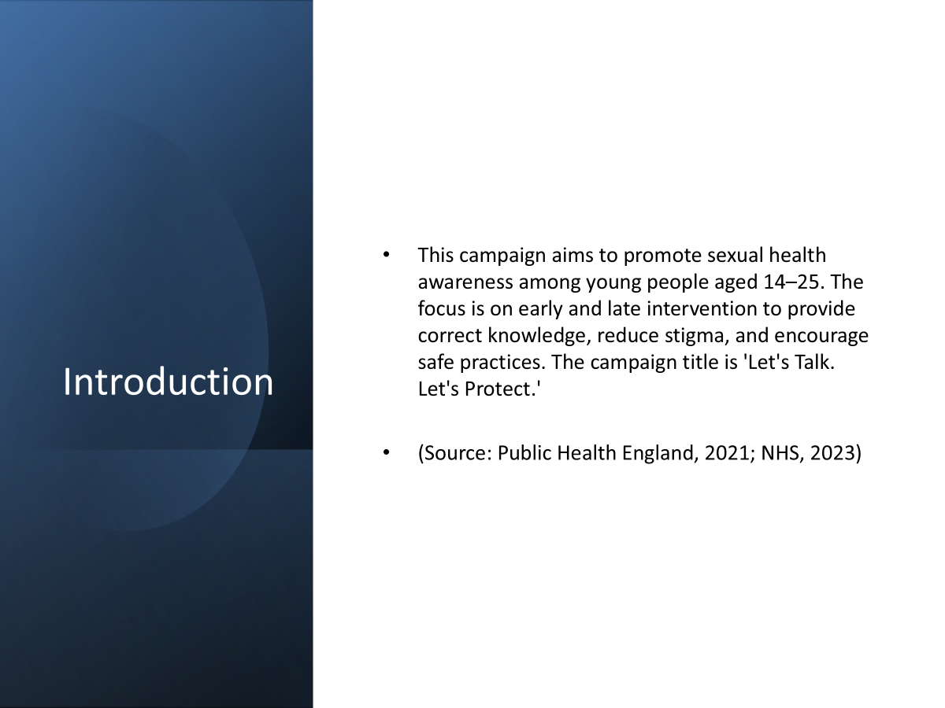

Slide 16
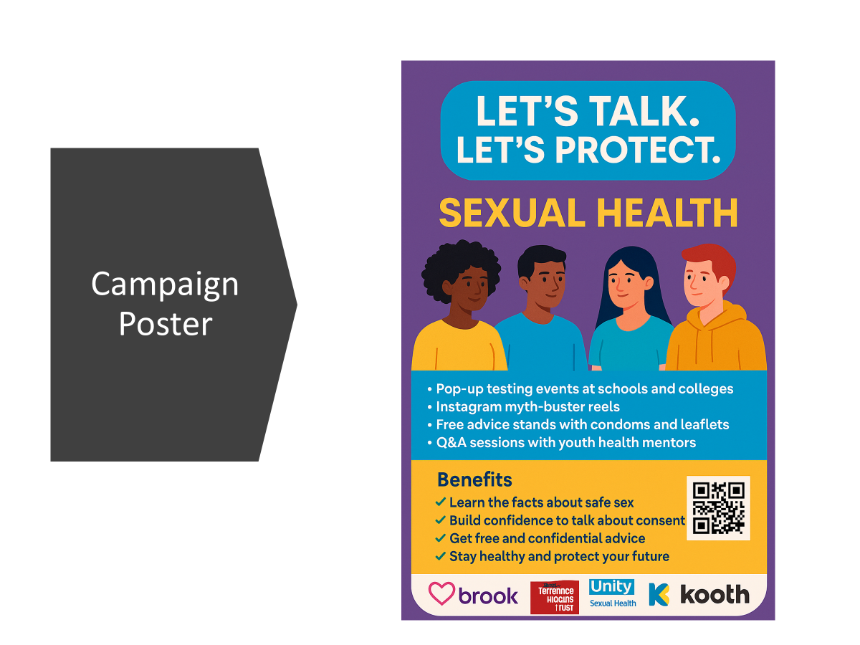

Slide 17
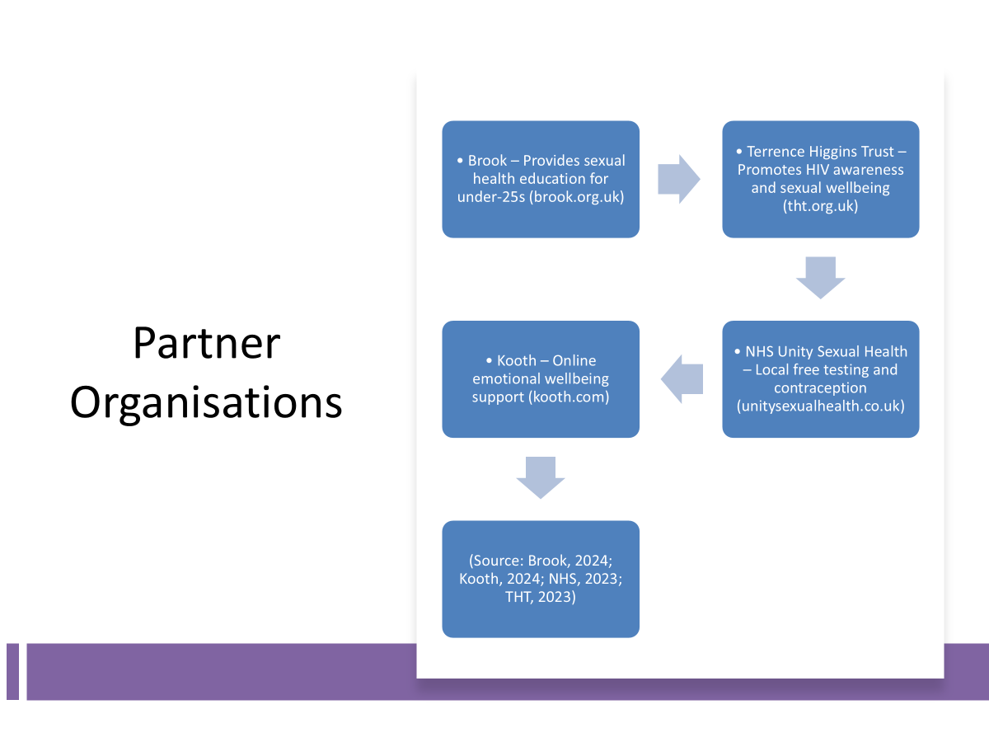

Slide 18
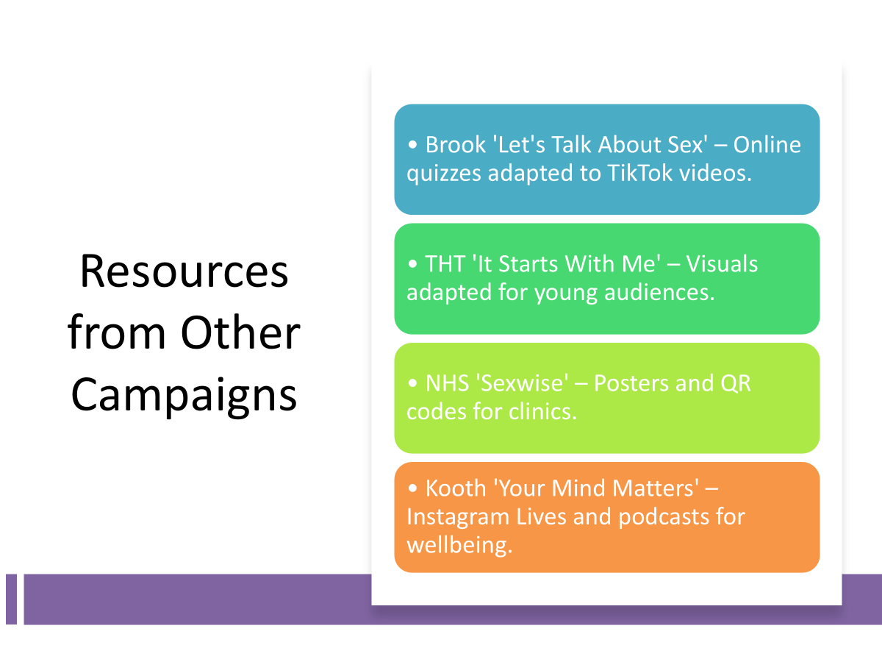

Slide 19
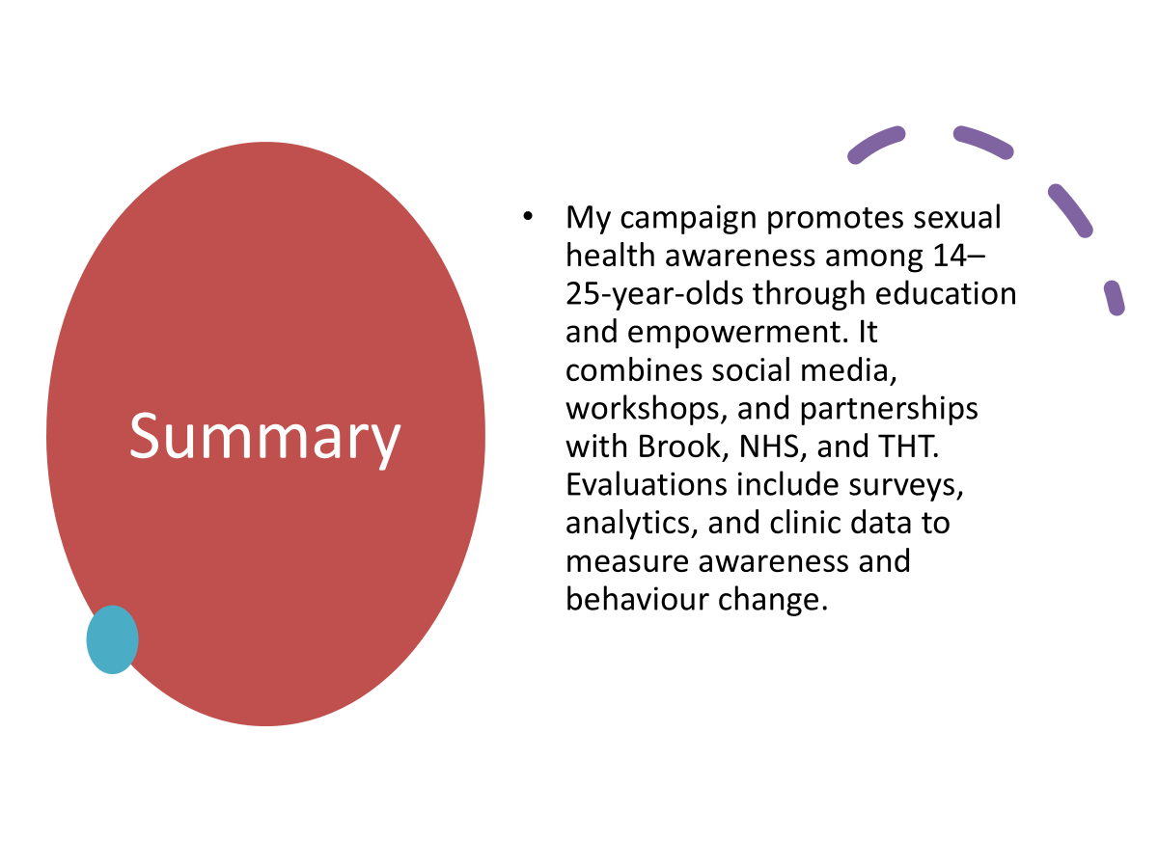

Slide 20
MSc public Health and Social Care in practice
Student name : Nadeie Seaied
Student ID: 2212621
Module: Social Epidemiology and public Health Development
Module code:LCHS7000
Lecturer name :Dr Hamdi Hussain
Assignment Title: Component 1 Group presentation .

Slide 21

Physiological Benefits
• Avoids sexually transmitted infections, including chlamydia, HIV, and HPV (Douglas et al., 2013).
• Promotes reproductive health and lowers unwanted pregnancies (CDC, 2024).
• Promotes regular screening to discover problems early (Health.state.mn.us, n.d.).
• Enhances heart health, lowers stress, and boosts immunity (WebMD, 2024; OHSU, n.d.).
(Faster capital,2025)

Slide 22
Sociological Benefits
• Encourages cordial, mutually beneficial partnerships (WHO, 2022).
• Normalises conversations and lessens stigma (CDC, 2024).
Young people and women are empowered (Darabi et al., 2017).
• According to Douglas et al. (2013), prevention lowers long-term healthcare expenses.

Slide 23
Psychological Benefits
Enhances confidence and self-worth (Encompass Wellness, n.d.; OHSU, n.d.).
Lessens pregnancy and STI worry (Lin et al., 2021).
Enhances wellbeing by fostering secure connections (Douglas et al., 2013).
It strengthens resistance to peer pressure (Setiowati, 2019).

Slide 24
Health Behaviour Theories
According to the health belief model, behaviour is driven by perceived risk (Douglas et al., 2013).
The Theory of Planned Behaviour: control, norms, and attitudes (Darabi et al., 2017; Godin & Kok, 1996).
The stages of transition in the transtheoretical model (Wang et al., 2017)

Slide 25
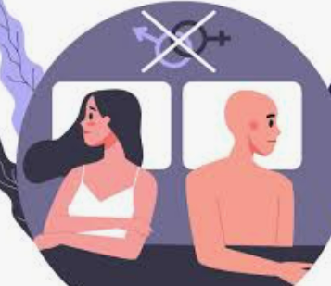
Challenges in Behaviour Change
vulnerability to danger (Perceived 2012; Protogerou)
• Stigma related to culture and religion (Lin & Lin, 2017)
• Unsafe behaviour is encouraged by peer norms (Lin et al., 2021).
• A lack of adaptability (Godin & Kok, 1996).

Slide 26
Campaign Solutions
• Role models and peer educators lessen stigma (Jeihooni et al., 2022).
• Confidential, youth-friendly assistance (CDC, 2024)
• Age-appropriate, creative workshops (Setiowati, 2019)
• Mobile health apps and digital

Slide 27
Conclusion
There are definite physiological, social, and psychological advantages to promoting sexual health.
Stigma, peer pressure, and change readiness are among the difficulties; behavior models clarify obstacles and direct interventions; and our campaign offers focused, empirically supported alternatives.

Slide 28
Douglas Jr, J.M. and Fenton, K.A., 2013. Understanding sexual health and its role in more effective prevention programs. Public Health Reports, 128(2_suppl1), pp.1-4.
Darabi, Fatemeh, Mohammad Hossein Kaveh, Farideh Khalajabadi Farahani, Mehdi Yaseri, Fereshteh Majlessi, and Davoud Shojaeizadeh. "The effect of a theory of planned behavior-based educational intervention on sexual and reproductive health in Iranian adolescent girls: a randomized controlled trial." Journal of research in health sciences 17, no. 4 (2017): 400.
Jeihooni, A.K., Moradi, A., Yari, A., Kiyani, A. and Hasirini, P.A., 2022. The effect of educational intervention based on theory of planned behavior on mothers’ skills in sexual care of children. BMC public health, 22(1), p.1759.
Godin, G. and Kok, G., 1996. The theory of planned behavior: a review of its applications to health-related behaviors. American journal of health promotion, 11(2), pp.87-98.
Protogerou, C., Flisher, A.J., Aarø, L.E. and Mathews, C., 2012. The theory of planned behaviour as a framework for predicting sexual risk behaviour in sub-Saharan African youth: A critical review. Journal of Child & Adolescent Mental Health, 24(1), pp.15-35.
Jalambadani, Z., Garmaroodi, G., Yaseri, M., Tavousi, M. and Jafarian, K., 2017. Education based on theory of planned behavior over sexual function of menopausal women in Iran. Journal of Mid-life Health, 8(3), pp.124-129.
Lin, C.L., Ye, Y., Lin, P., Lai, X.L., Jin, Y.Q., Wang, X. and Su, Y.S., 2021. Safe sexual behavior intentions among college students: the construction of an extended theory of planned behavior. International Journal of Environmental Research and Public Health, 18(12), p.6349.
UNITED WE CARE (2024), Sex and Health: 7 Important Benefits of Healthy Sex Life on Health, Available at: https://www.unitedwecare.com/sex-and-health-7-important-benefits-of-healthy-sex-life-on-health/ (Accessed on 25th Sep 2025).

Slide 29
Setiowati, T.A., Pamungkasari, E.P. and Prasetya, H., 2019. Application of theory of planned behavior on sexual behavior in female adolescents. Journal of Health Promotion and Behavior, 4(2), pp.126-136.
Word health organisation (2022), Celebrating sexual health for benefits throughout life. Available at: https://www.who.int/news/item/31-08-2022-celebrating-sexual-health-for-benefits-throughout-life#:~:text=The%20theme%20of%20this%20year's,in%20designing%20sexual%20health%20programmes.( Accessed on 25th Sep 2025).
CDC (2024), Sexual Health Education. Available at: https://www.cdc.gov/healthy-youth/what-works-in-schools/sexual-health-education.html ( Accessed on 25th Sep 2025).
Department of health (2019). Sexual Health Promotion. Available at:https://www.health.state.mn.us/people/sexualhealth/sexualityedfs.pdf ( Accessed on 25th Sep 2025).
WEBMD, (2024). 9 Surprising Health Benefits of Sex. Available at: https://www.webmd.com/sex-relationships/sex-and-health .( Accessed on 25th Sep 2025).
OHSU (n.d.) ‘The Benefits of a Healthy Sex Life’, OHSU Women’s Health. Available at: https://www.ohsu.edu/womens-health/benefits-healthy-sex-life (Accessed on 25th Sep 2025).
Encompass Wellness (n.d.) ‘The Importance of Sexual Wellness for Overall Health’, Encompass Wellness. Available at: https://encompass-wellness.com/the-importance-of-sexual-wellness-for-overall-health/ (Accessed on: 25th Sep 2025).
Lin, C.Y., Oveisi, S., Burri, A. and Pakpour, A.H., 2017. Theory of Planned Behavior including self-stigma and perceived barriers explain help-seeking behavior for sexual problems in Iranian women suffering from epilepsy. Epilepsy & Behavior, 68, pp.123-128.
Wang, Y., Fadhil, A., Lange, J.P. and Reiterer, H., 2017. Towards a holistic approach to designing theory-based mobile health interventions. arXiv preprint arXiv:1712.02548.
Integrating Mental and Sexual Health (2025)Available at: Integrating Mental and Sexual Health. (Accessed: 25 September 2025).

Slide 30
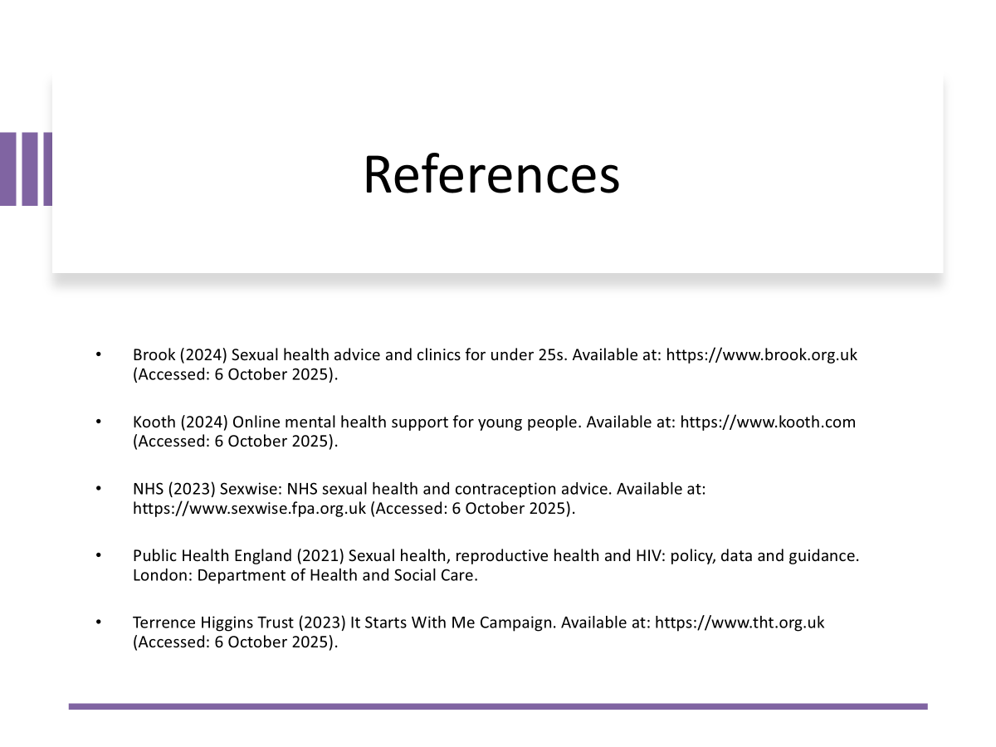

Slide 31
References
Adobe Stoke (2025) ‘Holding Condom’. Available at: "Holding Condom" Images – Browse 30 Stock Photos, Vectors, and Video | Adobe Stock. (Accessed: 28 September 2025).
British Association for Sexual Health and HIV (BASHH) (2023) ‘SH:24 at BASHH Conference 2023.’ Fettle by SH:24. Available at: https://fettle.health/help-centre/bashh-2023. (Accessed: 3 October 2025).
Brook (2003) ‘Sexual Health Education and Support for Young People.’ London: Brook Advisory Centre. Available at: https://www.brook.org.uk. (Accessed: 29 September 2025).
Department of Health and Social Care (DHSC) (2023) Sexual Health Strategy. London: DHSC. Available at: https://doi.org/10.1007/978-3-031-08728-8_7.
Marmot, M. (2020) ‘Health Equity in England:’ The Marmot Review 10 Years On. London: Institute of Health Equity. Available at: https://www.instituteofhealthequity.org/resources-reports/marmot-review-10-years-on (Accessed: 29 September 2025).
McLeroy, K.R., Bibeau, D., Steckler, A. and Glanz, K (1988) ‘An ecological perspective on health promotion programs. Health education quarterly,’ 15(4), pp.351-377. Available at: https://doi.org/10.1177/109019818801500401.
NICE (2014) ‘PH51: Contraceptive Services with a Focus on Young People. London:’ National Institute for Health and Care Excellence. Available at: Sexual health promotion and contraceptive services in local authorities: A systematic review of economic evaluations 2010-2015. (Accessed: 29 September 2025).
Nutbeam. D (2000) Health ‘ literacy as a public health goal: a challenge for contemporary health education and communication strategies into the 21st century.’ Health Promotion International, 15(3), pp.259-267. Available at: https://doi.org/10.1093/heapro/15.3.259.
Nutbeam. D (2000) Health ‘ literacy as a public health goal: a challenge for contemporary health education and communication strategies into the 21st century.’ Health Promotion International, 15(3), pp.259-267. Available at: https://doi.org/10.1093/heapro/15.3.259.
Pound, P., Langford, R. and Campbell, R. (2022) ‘What do young people think about their school-based sex and relationship education? A qualitative synthesis of young people’s views and experiences’, BMJ Open, 6(9), e011329. Available at: https://bmjopen.bmj.com/content/6/9/e011329. (Accessed: 3 October 2025).
UK Health Security Agency (2023) ‘Sexual and reproductive health profiles.’ Available at: https://fingertips.phe.org.uk/profile/sexualhealth. (Accessed: 3 October 2025).

Slide 32
Reference continued..
UK Health Security Agency (UKHSA), (2024) ‘UKHSA annual report and accounts: 2023 to 2024’. Available at: https://www.gov.uk/government/publications/ukhsa-annual-report-and-accounts-2023-to-2024. (Accessed 29 September 2025).
UKHSA (2024) ‘Sexually Transmitted Infections Annual Data. Available at: https://www.gov.uk/government/statistics. (Accessed: 29 September 2025).
Unsplash (2025) ‘Youth Group Discussion.’ Available at: https://unsplash.com. (Accessed: 28 September 2025).
WHO (2023) ‘Global Health Observatory:’ Adolescent Sexual Health. Available at: https://www.who.int/data/gho (Accessed: 28 September 2025).

