Slide 1
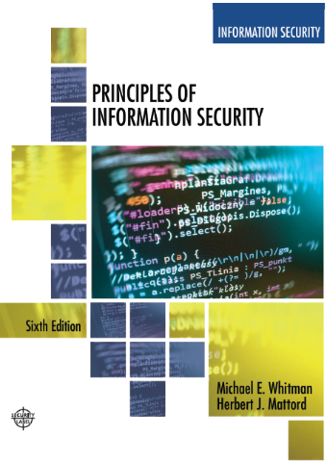
Identity, Access Control & Zero Trust Security
Week 2
Adapted Text
Lecturer: Assoc. Prof. Carlene Campbell
Email: carlene.campbell@uwtsd.ac.uk
Website: https://www.knowledgewithprofit.com/
Notes:
This week should help students understand:
“Identity is now the new security perimeter.”
Traditionally organisations focused on:
firewalls
network protection
perimeter security
Modern organisations now rely heavily on:
cloud computing
remote working
mobile access
SaaS applications
digital identities
Meaning:
protecting identities has become critical.

Slide 2
Learning Objectives
Understand modern access control principles
Recognise why identity is now the new security perimeter
Understand Zero Trust concepts
Critically evaluate MFA, VPNs, and firewall strategies
Understand modern access risks in cloud/hybrid environments
Apply governance thinking to identity and access management (IAM)
Notes:
modern cybersecurity increasingly focuses on:
controlling access.
Organisations must now secure:
users
devices
remote connections
cloud access
identities
because attackers often target access mechanisms first.

Slide 3
PROPOSED SESSION FLOW
Time | Activity Type
11:00–11:20 | Strategic opening discussion
11:20–11:50 | Condensed modern lecture
11:50–12:20 | Interactive breach case study
12:20–12:30 | Comfort break
12:30–1:00 | Assignment integration workshop
2:00–2:30 | Security architecture discussion
2:30–3:15 | Group governance exercise
3:15–3:25 | Comfort break
3:25–4:15 | Modern Zero Trust workshop
4:15–4:45 | Professional debate
4:45–5:00 | Reflection + short video

Slide 4
Identity & Access Security
Identity and access security controls:
who can access systems
what users can access
how access is verified
Core Components
  Authentication
  Authorisation
  Access control
  Identity management
  User accountability
Authentication | Authorisation
Verifies identification | Grant permissions
Username/password | File access
Biometrics | System privileges
MFA | Database permissions
Why are attackers increasingly targeting identities?
Notes:
Identity security focuses on protecting digital identities and controlling access to systems and resources.
Authentication verifies user identity using methods such as:
passwords
biometrics
tokens
Authorisation determines:
permissions
access rights
allowed activities
Effective identity security reduces:
unauthorised access
insider threats
credential misuse
Why This Matters
Modern organisations increasingly rely on:
remote access
cloud systems
mobile users
making identity protection critical.

Slide 5
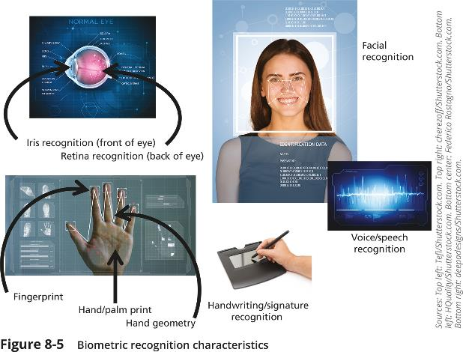
Why Identity Became the New Perimeter?
Modern organisations use:
cloud services
hybrid working
mobile devices
remote access
SaaS platforms
Traditional perimeter security is weakening.
Can organisations still trust internal users automatically?
Notes:
Very important discussion point:
Organisations no longer fully control:
devices
locations
networks
Therefore:
identity becomes critical.
Can organisations still trust internal users automatically
NO
insider threats
compromised accounts
phishing
remote working
credential theft
SOME MAY SAY YES
“What if an employee account is compromised?”

Slide 6
Access Control Fundamentals
Access Control Fundamentals
Identification: I am a user of the system.
Authentication: I can prove I’m a user of the system.
Authorization: Here’s what I can do with the system.
Accountability: You can track and monitor my use of the system.

Slide 7
Access Control Models
Discretionary Access Control (DAC)
  Owners manage permissions.
Mandatory Access Control (MAC)
  Central authority controls permissions.
Role-Based Access Control (RBAC)
  Permissions based on job roles.
Attribute-Based Access Control (ABAC)
  Permissions based on context and attributes.
Where are these use today?
Model | Charateristics | Example
DAC | User-controlled permissions | File sharing
MAC | Strict classification | Miltary systems
RBAC | Role-based access | HR systems
ABAC | Context-aware access | Cloud access
Notes:
Which access model works best in healthcare or banking?
Access control models determine how permissions are assigned and managed.
RBAC is widely used because it simplifies permission management in organisations.
ABAC is increasingly important for:
cloud computing
Zero Trust
remote access environments
because access decisions may consider:
location
device
user behaviour
risk level
Where are these used today?
SAMPLE ANSWERS:
Healthcare
RBAC
least privilege
separation of duties
Banking
strong centralised controls
strict monitoring
multi-layer authorisation
here are these used today?

Slide 8
Multi-Factor Authentication (MFA) – Solution or New Problem?
MFA uses multiple authentication methods:
password
mobile code
fingerprint
smart card
Benefits
stronger security
reduced credential theft
improved remote access protection
supports Zero Trust
https://learn.microsoft.com/en-us/entra/identity/authentication/concept-mfa-howitworks
Should organisations trust MFA alone or force MFA for every employee ?
https://www.youtube.com/watch?v=hGRii5f_uSc
Notes:
MFA improves security BUT:
attackers now target MFA directly
Examples:
MFA bombing
AiTM phishing
session hijacking
Traditional passwords are vulnerable to:
phishing
brute force attacks
credential stuffing
MFA strengthens security by requiring attackers to compromise multiple authentication factors.
Why This Matters
Credential theft is one of the most common causes of:
ransomware attacks
cloud breaches
account compromise
Should organisations trust MFA alone?
NO:
MFA fatigue attacks
social engineering
compromised devices
YES:
still stronger than passwords alone
Force MFA for every employee
Generally yes, especially for:
remote workers
administrators
cloud users
privileged accounts
MFA
push fatigue attacks
SIM swapping
phishing bypass kits
token theft

Slide 9
Comfort Break (12:10 - 12:20)

Slide 10
Firewalls
A firewall monitors and controls network traffic based on predefined security rules.
Packet filtering firewall
Stateful inspection firewall
Proxy firewall
Next-Generation
Firewall Type | Main Function
Packet Filtering | Filters packets using rules
Stateful Inspection | Tracks connection states
Proxy firewall | Acts as intermediary
NGFW | Advanced traffic inspection
Can firewalls alone stop modern cyber attacks?
Notes:
Firewalls act as barriers between trusted and untrusted networks.
They analyse incoming and outgoing traffic and determine whether traffic should be:
allowed
blocked
monitored
Modern NGFWs include:
intrusion prevention
application awareness
deep packet inspection
malware detection
Can firewalls alone stop modern cyber attacks?
No.
Modern attacks increasingly bypass traditional perimeter defences through:
phishing
credential theft
insider threats
cloud attacks
Types of Firewalls (Brief Explanations)
🔷 Packet Filtering Firewall
A packet filtering firewall examines individual data packets and decides whether to allow or block them based on predefined rules such as:
IP address
Port number
Protocol type
Example:
Allow web traffic on port 80 and 443 but block all other incoming traffic.
Advantage:
Fast
Simple
Low resource usage
Limitation:
Does not inspect packet contents
Cannot detect sophisticated attacks
🔷 Stateful Inspection Firewall
A stateful firewall monitors active network connections and keeps track of the "state" of communication sessions.
Instead of examining packets individually, it determines whether packets belong to an established, legitimate connection.
Example:
If a user requests a webpage, the firewall allows the returning traffic because it recognises it as part of an existing session.
Advantage:
More secure than packet filtering
Better at detecting suspicious connections
Limitation:
Uses more resources than packet filtering firewalls
🔷 Proxy Firewall
A proxy firewall acts as an intermediary between users and external systems.
Instead of connecting directly to a website or service, users connect to the proxy, which then communicates with the destination on their behalf.
Example:
An employee requests access to a website:
User → Proxy Firewall → Website
Advantage:
Hides internal network addresses
Filters content
Provides additional security controls
Limitation:
Can introduce latency
More complex to manage
🔷 Next-Generation Firewall (NGFW)
A Next-Generation Firewall combines traditional firewall functions with advanced security capabilities.
Features:
Deep Packet Inspection (DPI)
Intrusion Prevention System (IPS)
Application awareness
Malware detection
User identity integration
SSL/TLS inspection
Example:
An NGFW can identify and block malicious traffic hidden within legitimate web applications.
Advantage:
Detects advanced threats
Greater visibility into network traffic
Supports modern cybersecurity requirements
Limitation:
More expensive
Requires skilled administration
🟦 Quick Comparison Table
Firewall TypeMain Function Security Level
Packet Filtering Filters packets using rules Basic
Stateful Inspection Tracks active connections Moderate
Proxy Firewall Acts as intermediary High
Next-Generation Firewall (NGFW) Advanced inspection and threat detection Very High
Simple Memory Aid for Students
Packet Filtering = Looks at the packet.
Stateful Inspection = Looks at the packet and the connection.
Proxy Firewall = Stands in the middle and speaks on your behalf.
NGFW = Traditional firewall + advanced threat detection and application awareness.

Slide 11
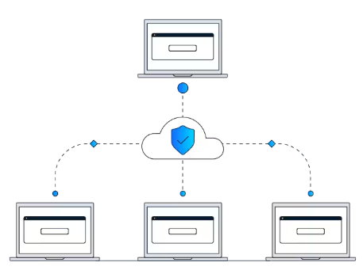
Virtual Private Networks (VPNs)
VPNs create secure encrypted connections over public networks.
VPN Benefits
protects remote access
encrypts data transmission
secures public Wi-Fi usage
supports remote working
VPN Advantage | Description
Encryption | Protects transmitted data
Remote Access | Supports remote workers
Privacy | Masks user traffic
Security | Reduces interception risk
https://www.youtube.com/watch?v=_wQTRMBAvzg
Are VPNs still enough for modern remote security?
Notes:
VPNs use encryption tunnels to protect data transmitted between users and organisational systems.
Remote access
Site-to-site
Remote workers increasingly rely on VPNs to securely access:
corporate networks
cloud services
internal applications
However, stolen VPN credentials remain a major security risk.
Are VPNs still enough for modern remote security?
VPNs remain important but modern organisations increasingly combine VPNs with:
MFA
Zero Trust
endpoint security
identity verification

Slide 12
Zero Trust Security
Zero Trust is a security strategy. It isn't a product or a service, but an approach in designing and implementing the following set of security principles.
Zero Trust Principle: “Never trust, always verify.”
Core Principles
continuous verification
least privilege access
assume breach mentality
identity-centric security
Traditional Security | Zero Trust
Trust internal users | Verify continuously
Perimeter-focused | Identity-focused
VPN-based trust | Context-aware access
Static permissions | Dynamic verification
Is Zero Trust realistic for small organizations?
Notes:
Traditional security trusted users once they entered the network perimeter.
Zero Trust continuously verifies:
users
devices
locations
behaviours
access requests
before granting access.
Why This Matters
Cloud computing and remote work weakened traditional perimeter security models.
Identity is increasingly becoming:
the new security perimeter.

Slide 13
Modern Access Threats
Modern access-related threats include:
phishing
credential stuffing
password spraying
session hijacking
MFA fatigue attacks
Why do phishing attacks continue to succeed?
Threat | Description
Phishing | Trick users into revealing credentials
Credential stuffing | Reuse stolen passwords
Password Spraying | Attempt common passwords
Session Hijacking | Steal active sessions
MFA Fatigue | Repeated MFA requests
Notes:
Modern attackers increasingly target:
identities and access mechanisms
rather than directly attacking systems.
Attackers exploit:
weak passwords
human error
stolen credentials
poor access governance
Why This Matters
Access compromise frequently leads to:
ransomware
data breaches
cloud compromise
financial fraud
MFA Fatigue (also called Push Notification Fatigue or MFA Bombing) is a cyberattack technique where an attacker repeatedly sends Multi-Factor Authentication (MFA) requests to a user's device until the user becomes frustrated, confused, or accidentally approves the request.
MFA Fatigue is a social engineering attack where attackers repeatedly send authentication requests to a user's device until the user accidentally or deliberately approves access.

Slide 14
Lunch Break (1-2)

Slide 15
Assignment Linkage
This week strongly supports:
Zero Trust topic
cloud governance
AI governance
risk management
access governance
policy recommendations
Start:
collecting references
identifying case studies
comparing organisational approaches
Notes:
Strong Sources:
NIST Zero Trust Architecture
Microsoft Zero Trust Guidance
CISA Identity & Access Security
ENISA Zero Trust publications
UK NCSC guidance on MFA and remote working

Slide 16
Interactive Case Study
“The Compromised Employee Account”
Scenario
An employee:
clicks phishing email
attacker steals credentials
VPN account compromised
attacker accesses cloud systems
sensitive data downloaded
Discussion Questions
What failed first?
Was MFA enough?
Should VPN access have been restricted?
How could Zero Trust reduce impact?
What governance weaknesses exist?
What should happen immediately after detection?
Notes:
SAMPLE ANSWERS
Q1 – What failed first?
Possible answers:
user awareness
email filtering
authentication controls
monitoring
Q2 – Was MFA enough?
NO:
attackers bypass MFA
session hijacking
fatigue attacks
Q3 – VPN restrictions?
Students may suggest:
device compliance checks
geo-location restrictions
behavioural monitoring
limited privileged access
Q4 – How would Zero Trust help?
Expected answers:
continuous verification
device trust validation
segmentation
reduced lateral movement
Q5 – Governance weaknesses?
inadequate training
weak identity governance
excessive permissions
poor monitoring

Slide 17
Group Workshop Activity
“You Are the Security Governance Team”
Scenario
A company:
supports hybrid working
uses VPNs
has BYOD devices
expanding cloud adoption
BUT:
increasing phishing attacks
weak identity governance
poor access reviews
Task
Develop:
Top identity/access risks
Governance improvements
Technical improvements
Staff awareness recommendations
Notes:
“Would this scale?”
“Who pays for this?”
“Would users resist?”
“What would leadership say?”

Slide 18
Comfort Break (3:15 – 3:25)

Slide 19
Debate
If time permits
Split class into two to research and choose 3 persons from each side to:
Agree – Password will become obsolete in the future
Refute – Password will not become obsolete in the future
Justify your argument with relevant sources

Slide 20
Future of Access Security
passwordless authentication
biometrics
AI-driven access monitoring
behavioural analytics
adaptive authentication
quantum implications
Discussion
“Will passwords disappear completely in the future?”

Slide 21
Reflection
What is the greatest weakness in modern identity and access security?
Which one relates more to your organization?
modern cybersecurity increasingly focuses on:
securing access and identities.
Identity compromise remains one of the biggest cybersecurity risks globally.
Notes:
open discussion
workplace examples
differing opinions

Slide 22
Reference Links
NIST Cybersecurity Framework
NIST Cybersecurity Framework
NIST Zero Trust Architecture
NIST SP 800-207 Zero Trust
Microsoft Zero Trust Overview
Microsoft Zero Trust Overview
Cisco Firewall Overview
Cisco Firewall Overview
Cisco VPN Overview
Cisco VPN Overview
OWASP Credential Stuffing
OWASP Credential Stuffing
IBM Cost of a Data Breach Report
IBM Cost of a Data Breach Report

