Slide 1


Slide 2

Business skills for International Hotel Industry
(Anon, 2019)

Slide 3
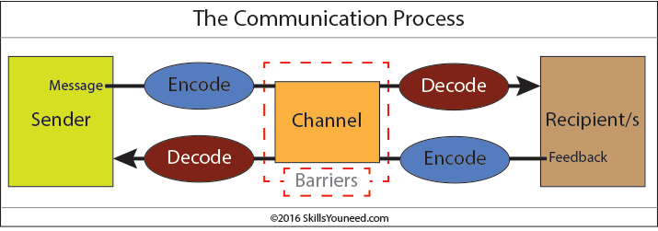
Every moment we communicate :
(Anon, 2019)

Slide 4

(Anon, 2019)

Slide 5
  ? ?
  ? ?

Slide 6


What is interview?
Interview is between one to one interaction.
Individual question are about the company and of skills required for the job.
(Anon, 2019)

Slide 7

Questions:
What can you tell me about yourself? ...
Can you list your strengths? ...
What weaknesses do you have? ...
Why should I consider hiring you? ...
Where do you see yourself five years from now? ...
Why do you want to work here
(Anon, 2019)

Slide 8
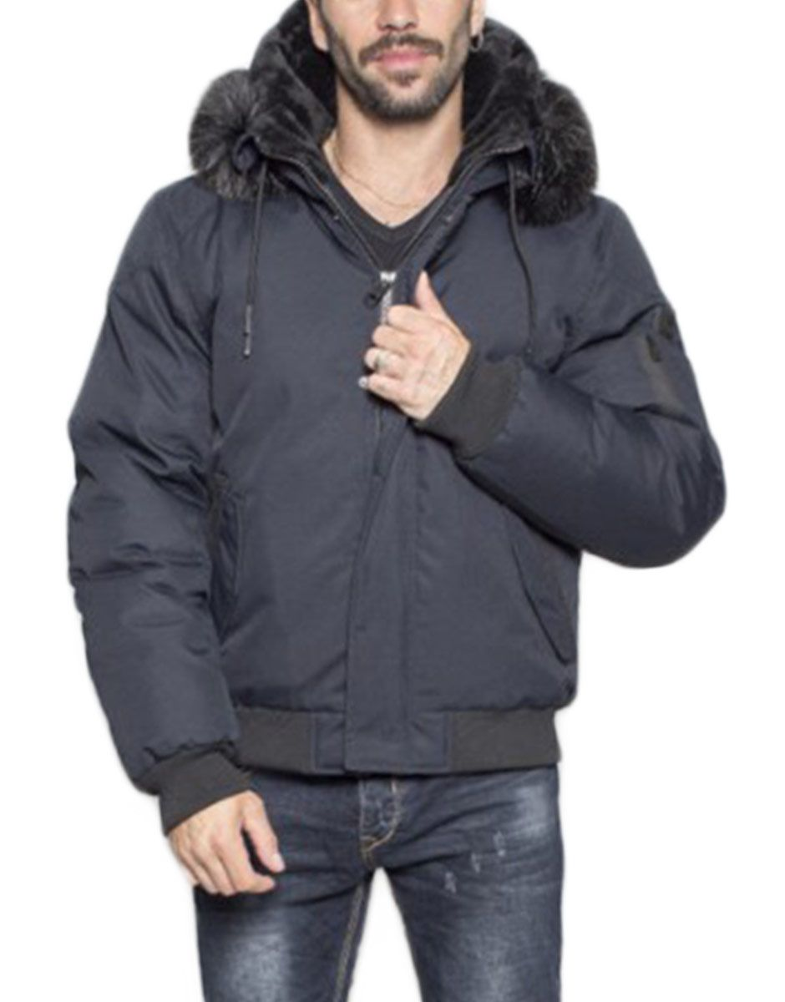
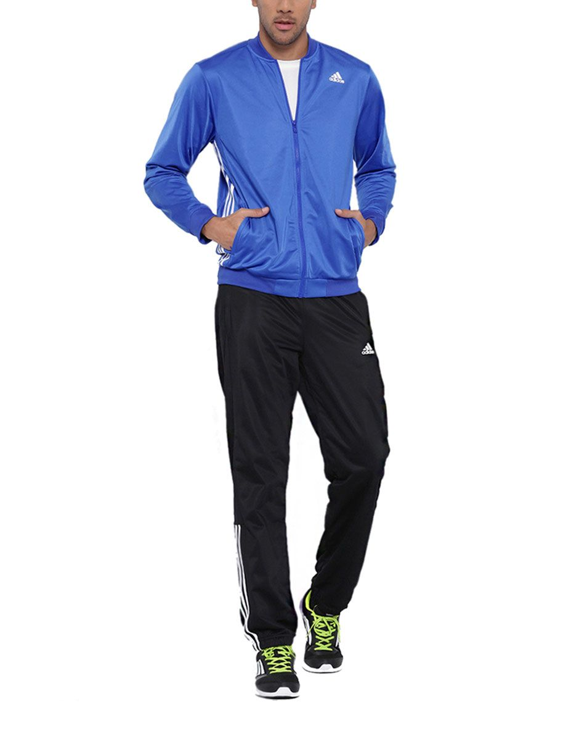
Look
(Anon, 2019)
(Anon, 2019)

Slide 9
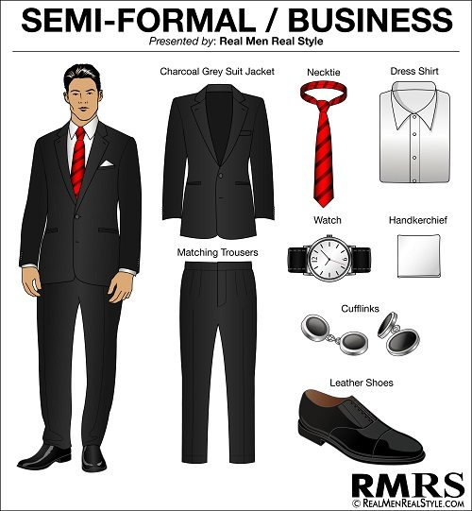
MAN
Charcoal dark colors suit jacket
Matching trousers
Dress shirt
Necktie
Leather shoes
Watch
(Anon, 2019)

Slide 10
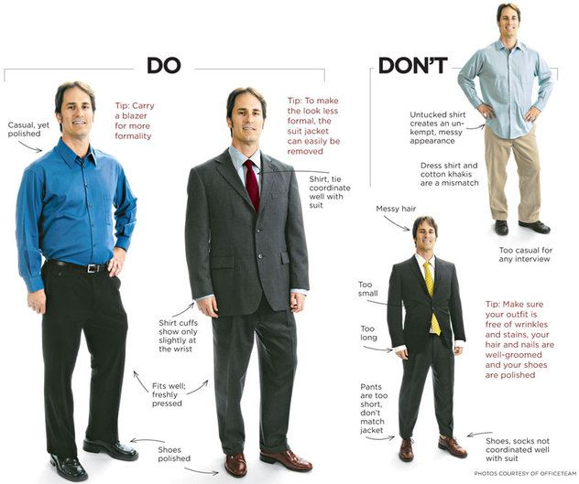
(Anon, 2019)

Slide 11



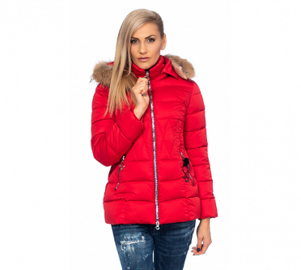
WOMEN
(Anon, 2019)

Slide 12
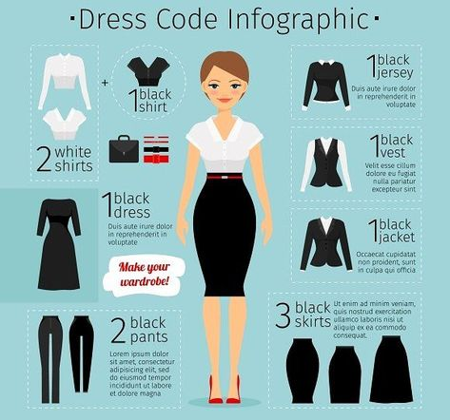
(Anon, 2019)

Slide 13
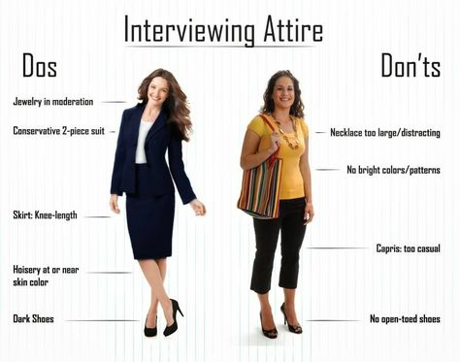
(Anon, 2019)

Slide 14

Manners and behavior
(Anon, 2019)

Slide 15
Here we will explain to you the non-verbal
communication
(Anon, 2019)

Slide 16

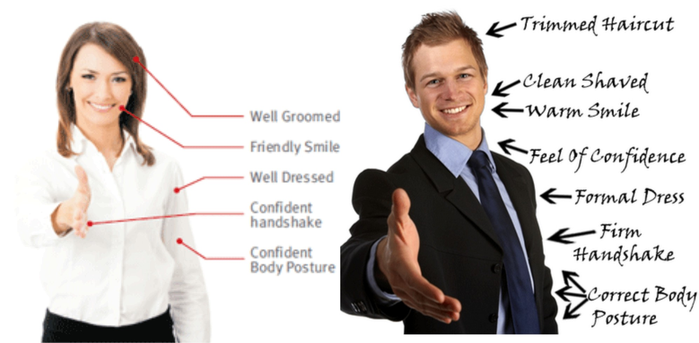

(Anon, 2019)

Slide 17

Communication and attention
Eye contact
Speech
Posture
Listening
(Anon, 2019)

Slide 18

(Anon, 2019)

Slide 19
Be prepared
Research the information about the company or organisation
Mirror reflection

Slide 20

Knowledge
Research on the company
Customer satisfaction
Employees experience
History of the company
Knowledge on how their system operates
(Anon, 2019)

Slide 21
Give a thanks

Slide 22
REFERENCES:
Anon, (2019). [image] Available at: https://www.google.com/search?sa=G&hl=en-GB&q=elite+associates&tbm=isch&tbs=simg:CAQSlQEJfY66vlUvAZ4aiQELEKjU2AQaAggVDAsQsIynCBpiCmAIAxIo4BuBB4MHzhvHEMEQlQXGEIIH7hudO547kTfQPu4vmjfYL8s-gDCUNBowKBMHUM4E5CbW2C04Tx6GVh1DjQfoeWqo7bN9NTCTfowg 9Qo6ptPzOppvRkx09Z0IAQMCxCOrv4IGgoKCAgBEgRkRbSQDA&ved=0ahUKEwjs0LfDs-vgAhVfRhUIHe-pDiUQwg4IMCgA&biw=1920&bih=937#imgrc=JFvHOH6MpDI43M: [Accessed 5 Mar. 2019].
Anon, (2019). [image] Available at: https://www.google.com/search?sa=G&hl=en-GB&q=communication+process+chart&tbm=isch&tbs=simg:CAQSlQEJ3b8izEe8q2IaiQELEKjU2AQaAggVDAsQsIynCBpiCmAIAxIomxT0E-MI4QioFIwKtwOfFN0dshPwM5U3kjeePe4_15DPtP509xD6fPRowYlMNzgnsEHM-eIVUbnGxIATWol-limmm-vkFh1fWXFWpbkRzncm744RUUu7qm_1ElIAQMCxCOrv4IGgoKCAgBEgSo23mwDA&ved=0ahUKEwipwsy0tOvgAhUOShUIHd33BHYQwg4IMCgA&biw=1920&bih=937#imgrc=82LQ5i8qc_9-UM: [Accessed 5 Mar. 2019].
ANON2019

Slide 23
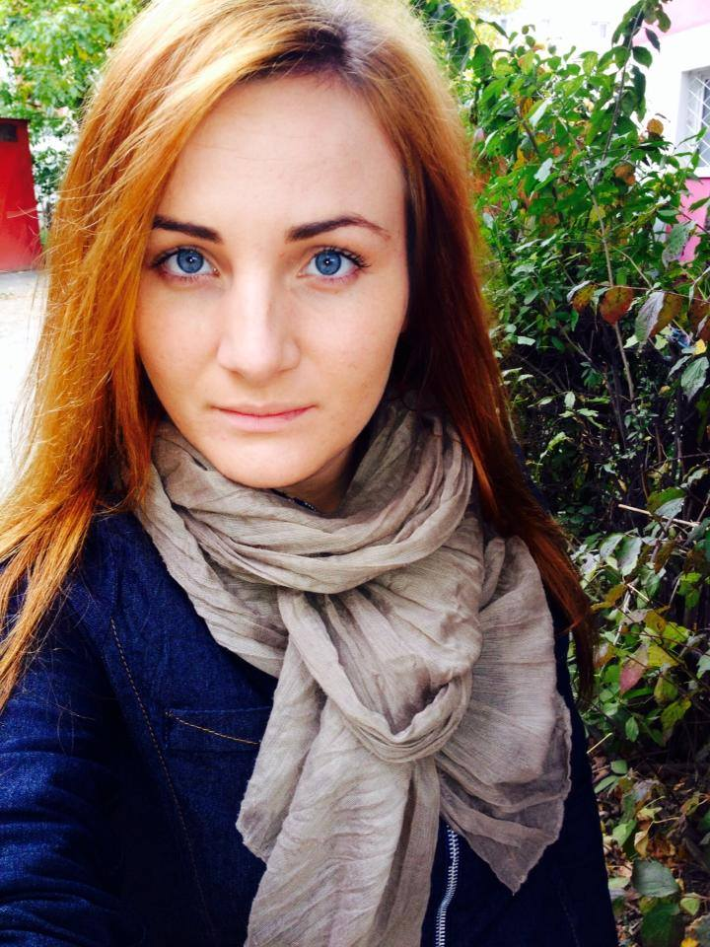
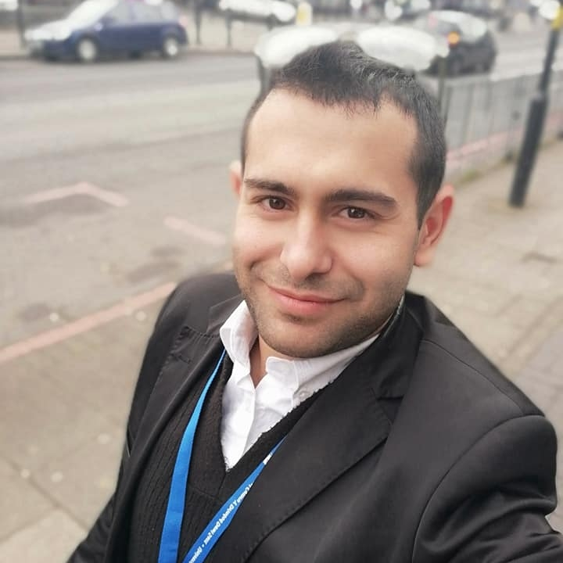

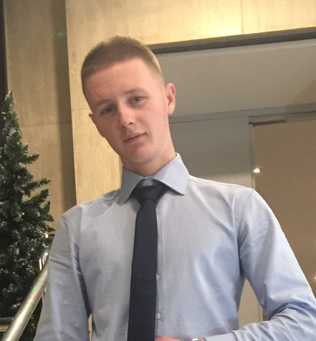
Thank you to everyone for the attention :)
Iuliana Andronic
Rumen Pavlov
Celia Mcclelland
Manos Areza

