Slide 1
Researching the history of an institution

Slide 2
Where to start even before we ask about archives and records?
What kind of institution
Was it independent (autonomous)
Was it linked to any other institution?
Was it part of a larger organization?

Slide 3
How does this affect how we begin research into its history?
The archive that the institution generates
The archive generated by the institutions or organization with which it is linked

Slide 4
Researching the history of an institution
Strata Florida Abbey

Slide 5
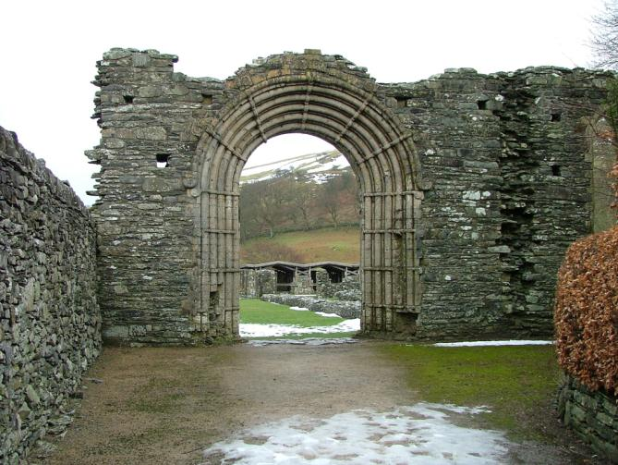
Strata Florida

Slide 6
What? When? Why?
What was Strata Florida?
It is now a ruin, but at what period was it active?
As an institution, what did it do?
What was its role locally? Regionally? Further afield?

Slide 7
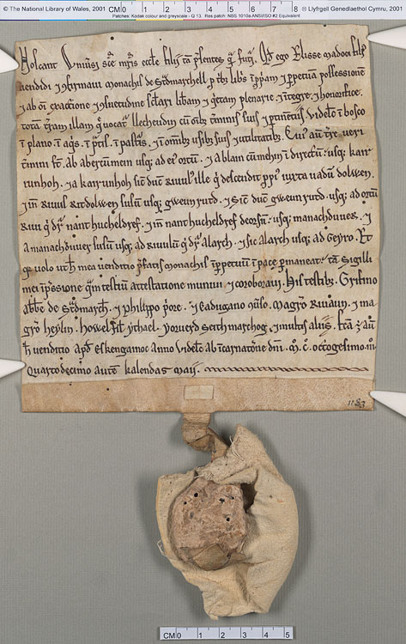
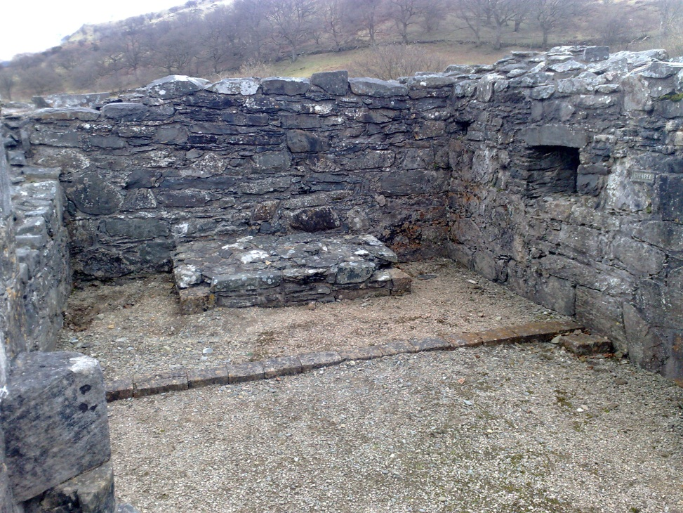
Sources
Documentary
Physical

Slide 8
Documentary Sources
Records
  A term often used more generically to denote written or documentary evidence
Archives
  records created by an institution in the course of its everyday business

Slide 9
Physical sources
Buildings: surviving and below ground
Landscape: the abbey in its wider environment

Slide 10
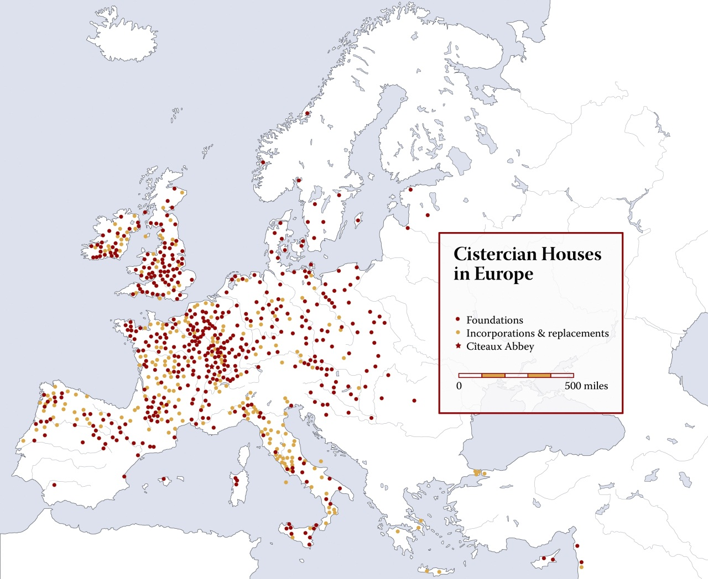
Strata Florida
A Cistercian monastery
The Cistercian Order
A European phenomenon

Slide 11
The foundation of Strata Florida
Narrative histories
The Brut y Tywysogion
  1164: ‘In that year through the will of God … a community of monks came to the place called Strata Florida’

Slide 12
What questions do we ask?
Who? What? When? Where? Why?

Slide 13
The Brut y Tywysogion
  What is the Brut?
  The chronicle of the Princes, which, for a while, was maintained at Strata Florida.
  Gives prominence to the house of Deheubarth BUT does not mention the Lord Rhys in connection with the foundation
  Is this an part of the archive? Or a record?

Slide 14
Types of records often found in monastic archives
Charters
Cartularies
    i.e. records associated with the acquisition of lands
Estate records
  Rentals
  Leases
  Manorial records
    i.e. records associated with the administration of lands

Slide 15
Charter of the Lord Rhys, 1184
Notification that he began to build the monastery called Ystrad Fflur (Strata Florida) since it has been constructed he has cherished it, and has endowed it with lands, pastures, agricultural land, and mountains pasture. These grants he now reaffirms, and they have been confirmed by this three sons. The lands are named, and detailed boundaries given.

Slide 16
What can this tell us?
That Lord Rhys saw himself as the main founder and patron of Strata Florida
That he associated his sons with his grant
Where the lands of Strata Florida lay
What kind of lands they were
Why the boundaries?

Slide 17
Where would you look for archives?
The descent of monastic records after the Dissolution: some possibilities
  Get lost
  Pass to new owners – and get lost
  Pass to new owners and down the generations until they end up in an archive repository, perhaps a local record office, as deposited records
  Pass to the crown and end up at TNA

Slide 18
What about records?
That is, records generated by other institutions?
  They may be preserved among the archives of the creating institution
  Rhys’s 1184 charter survives in six copies dating between the late thirteenth and the early sixteenth century
  These are copies of later confirmations by the king and are kept among the records of government

Slide 19
Records generated
Records received
The archive of an institution
Local institutions come into the orbit of government
Where are these records likely to be?

Slide 20
Searching the National Archives
www.nationalarchives.gov.uk

Slide 21
Conflict and Authority
http://discovery.nationalarchives.gov.uk/SearchUI/Details?uri=C9209112

Slide 22
Click here to download your order item

Slide 23
Where else to look
National Library of Wales?
Local record offices?

Slide 24
Try ‘Access to Archives’
http://www.nationalarchives.gov.uk/a2a/

Slide 25
Strata Florida as part of the Cistercian Order
How did the order operate?
  Remember: understand the administration and you can understand the records
  Visitation and the General Chapter

Slide 26
International? Or local / regional?
Strata Florida as a member of the Order, which placed certain expectations on it
But did the monks think of themselves as Cistercian? Or part of Pura Wallia?

Slide 27
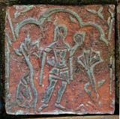
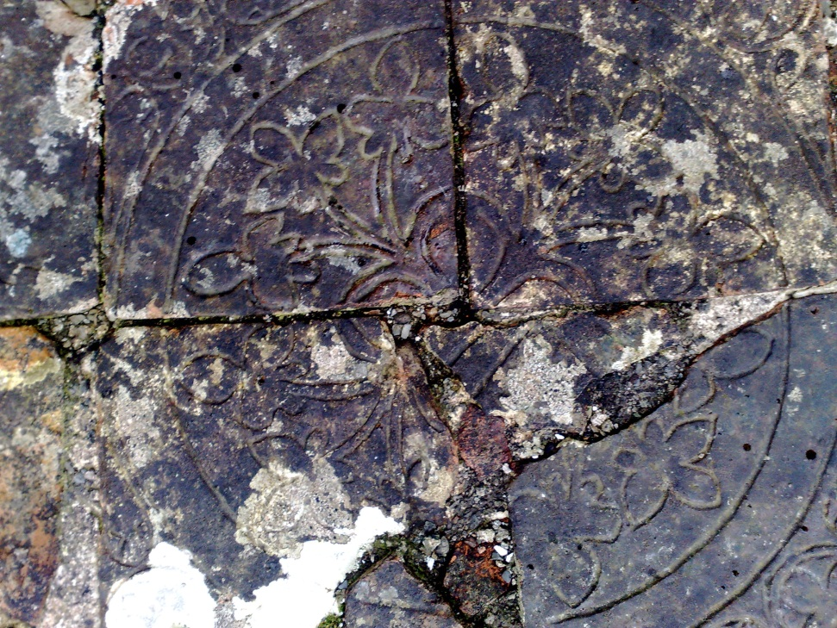
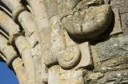
We need to look beyond the documents

Slide 28
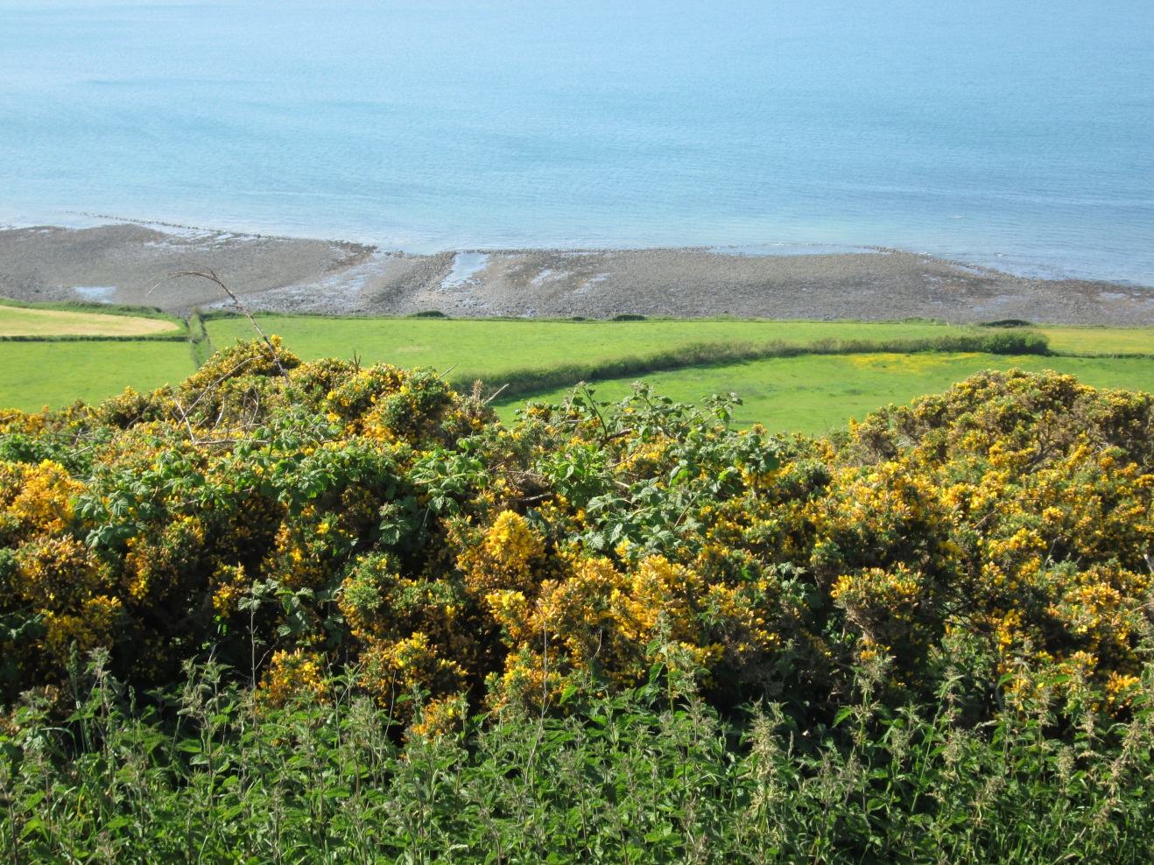
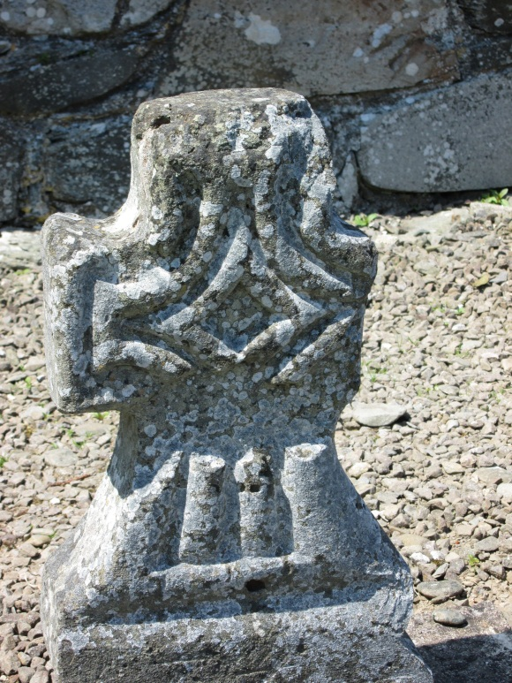
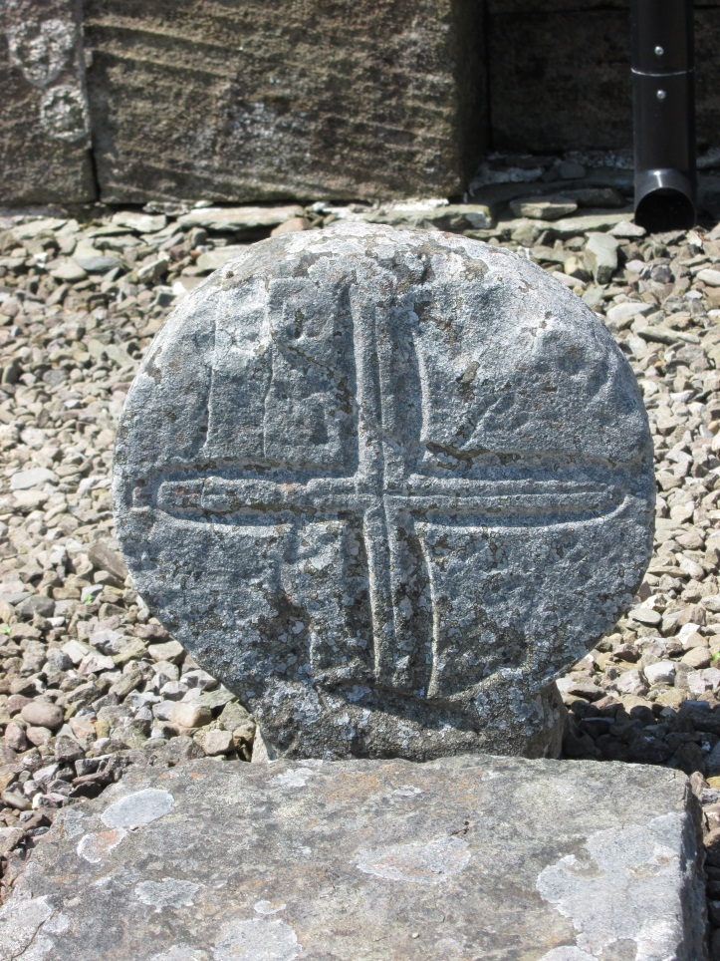
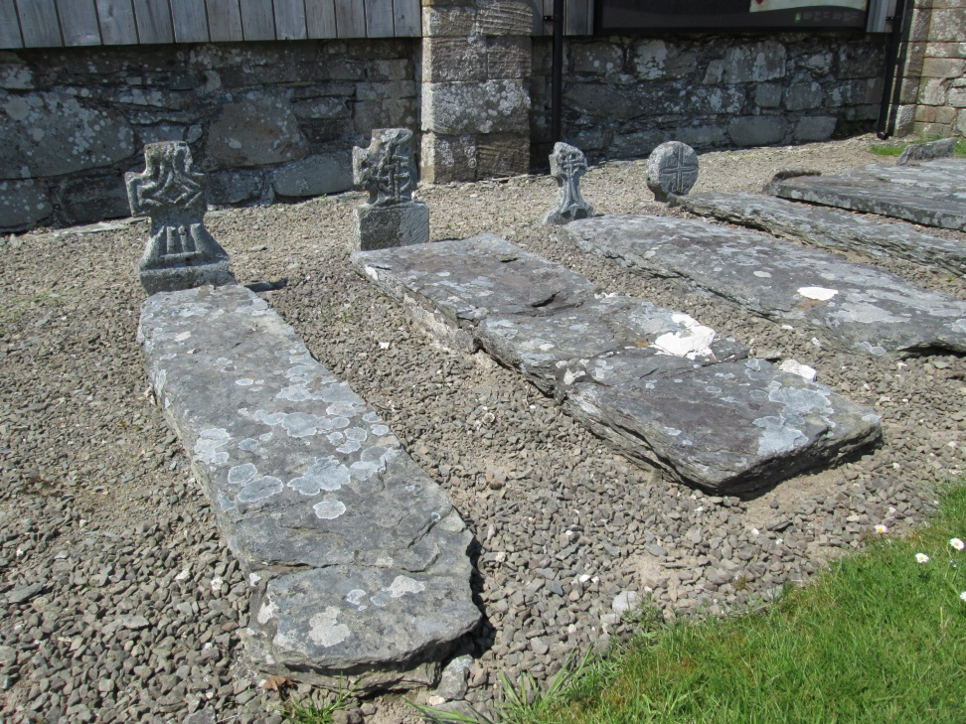

Slide 29
Archaeology at Strata Florida
‘The Strata Florida Project’ umbrella term
  Multidisciplinary (as part of Medieval research cluster)
Archaeology, History, Welsh language and culture, Geography and Earth Sciences, Religious Studies, Art and Architectural History, Anthropology, Creative Arts and Design
  Started in 2004
  ‘trained’ hundreds of students
  Flagship sustainability and heritage project for TSD
  Partnerships with RCAHMW, Cadw, DAT and CAWCS
  http://www.tsd.ac.uk/en/strataflorida/

Slide 30
Archaeology at Strata Florida
What do we already know?
    Historic Environment Record
    National Monument Record

Slide 31
National Monuments Record

Slide 32
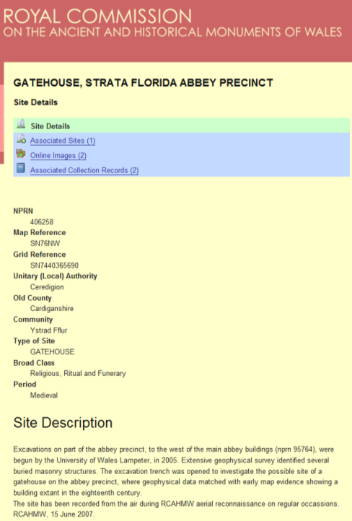
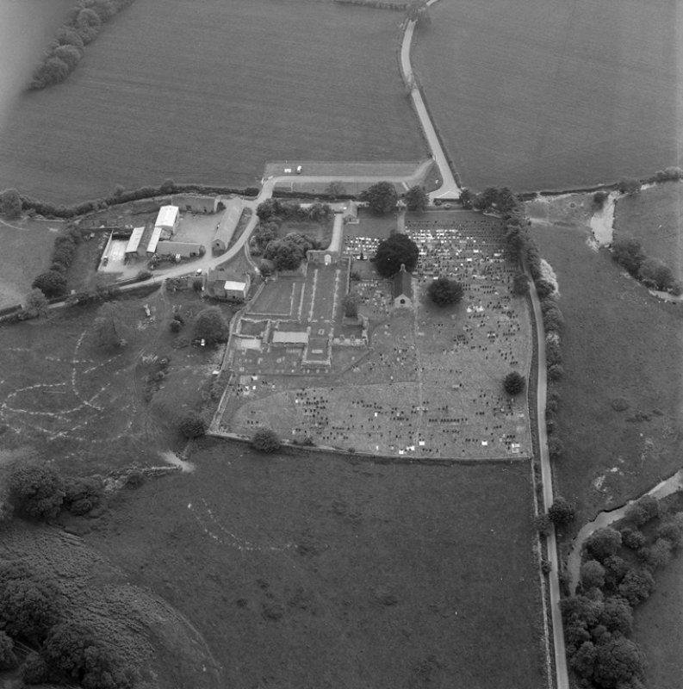

Slide 33
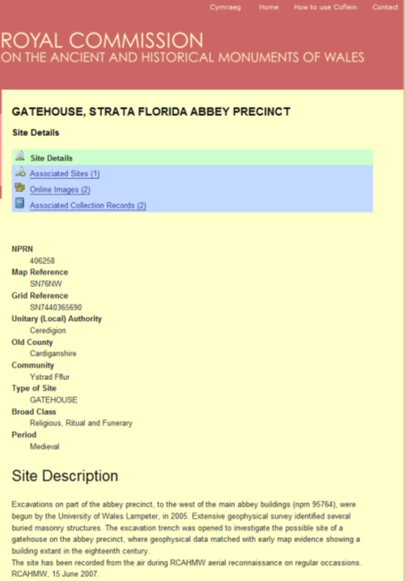
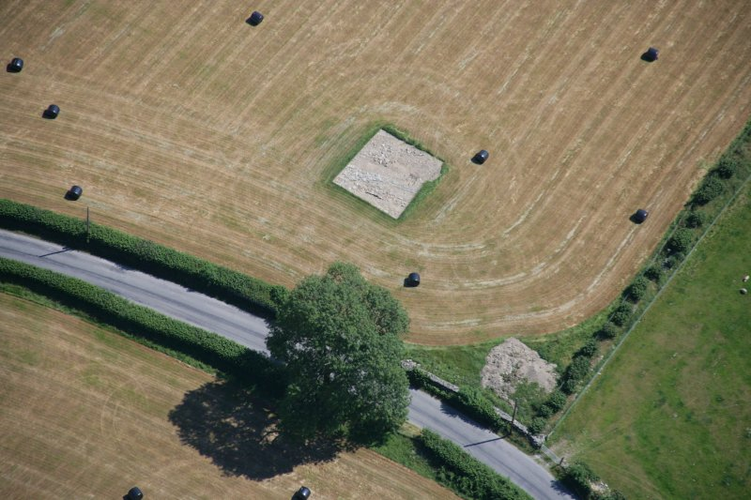

Slide 34
Precinct: The Layout?

Slide 35
Later history
The abbey passed into secular hands at its dissolution under Henry VIII, and only the ruins of the church and part of the cloister remain.
We are learning much from archaeological excavation

Slide 36
The abbey estates
also passed from monastic into secular hands
We can investigation later ownership, and how much difference change of ownership made through estate records
We can look at what Strata Florida means today

Slide 37
Sources
http://www.wac6.org/livesite/posters/poster_files/WAC_008_Bezant.pdf
www.monasticwales.org
  http://www.tsd.ac.uk/en/strataflorida/

