Slide 1

Session 6 - Leadership in uncertain times
BMSW6101 Emergent Leadership Skills

Slide 2
THE IMPORTANCE OF LEADERSHIP IN THE MODERN ORGANIZATION
Leadership is key to organizational success as a result of:
With flatter organizations, as traditional systems of hierarchical authority are inappropriate.
Organizations facing rapid and constant change need vision, creativity and leadership.
Effective control is best achieved through strong values embodied in leadership.
Employees are more demanding and require strong leadership.

Slide 3
Strategic leadership roles – top management
Leadership is the process of influencing an organisation (or group within an organisation) in its efforts towards achieving an aim or goal.
Three key roles of top management in leading strategic change:
  Envisioning future strategy
  Aligning the organisation to deliver that strategy.
  Embodying change.

Slide 4
Strategic leadership roles – middle management
Middle managers do not just implement strategy but have key roles in leading change:
  Advisers – on requirements for change and the likely blockages to change.
  Sense making – interpreting the intended strategy for their specific part of the organisation.
  Reinterpretation and adjustment – of strategic responses and relationships as events unfold.
  Local leadership of change – aligning and embodying change at the local level.

Slide 5
THEORIES OF LEADERSHIP
Theories based on traits and skills
Theories based on the leader’s behaviour and style
Situational and contingency models
Transactional-transformational leadership
Leadership as a function of the organization

Slide 6

CLASSROOM DEBATE
Are Leaders born or made?

Slide 7
How are Leaders Made? evolution of Leadership Theories
Great Man Theory (1840s)
  Assumed that leadership was intrinsic
  Leaders are born…not made
  Based on the belief that leaders are exceptional people, born with innate qualities, destined to lead. The use of the term 'man' was intentional since until the latter part of the twentieth century leadership was thought of as a concept which is primarily male, military and Western.
Trait Leadership Theory (1930’s-1940’s)
  People are made with certain qualities that will make them excel in leadership roles
  Which qualities and in what combination?
  Early start to behavioral theories

Slide 8
Leadership Theories (continued)
Behavioral Theories (1940’s-1950’s)
  A leader’s behavior is the best predictor of his leadership influence and success
  2 groups of leaders: people oriented and task oriented
  Leadership can be taught
Contingency Theories (1960’s)
  There is no single way of leading: leadership style should be based on the situation.

Slide 9
Leadership Theories (continued)
Transactional Leadership Theories (1970’s)
  Leadership is formed through a series of mutually beneficial exchanges: if you do this for me, I will do this for you
  Emphasises ‘hard’ levers of change e.g. designing systems, targets, financial incentives, project management and careful monitoring.
  Followers will choose a leader that maximizes their pleasurable experiences and minimizes negatives
Notes:
Transactional leadership is based on legitimate authority within the bureaucratic structure of the organisation.
The emphasis is on the clarification of goals and objectives, work task and outcomes, and organisational rewards and punishments.
Transactional leadership appeals to the self-interest of followers. It is based on a relationship of mutual dependence and an exchange process of ‘I will give you this, if you do that.’

Slide 10
Leadership Theories (continued)
Transformational Leadership Theories (1970’s)
  Leader’s transform their followers through their inspirational nature and charismatic personalities such that followers identify with the leader and its purpose
  Emphasises building a vision for their organisations; an organisational identity built on collective values and beliefs and energising people to achieve the vision.
  Rules and regulations are guided by group norms
Notes:
Transformational (or creative) leadership, by contrast, is a process of engendering higher levels of motivation and commitment among followers.
The emphasis is on generating a vision for the organisation and the leader’s ability to appeal to higher ideals and values of followers, and creating a feeling of justice, loyalty and trust.
In the organisational sense, transformational leadership is about transforming the performance or fortunes of a business.

Slide 11
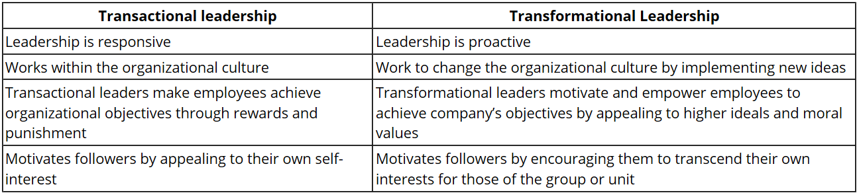
Transactional versus Transformational Leaders

Slide 12
TRANSFORMATIONAL LEADERSHIP
In transformational leadership the leader transforms and motivates followers by:
Generating greater awareness of the importance of the purpose of the organisation and task outcomes.
Inducing them to transcend their own self-interests for the sake of the organisation or team.
Activating their higher-level needs.
Notes:
Creating high-performance workforce has become increasingly important and to do so business leaders must be able to inspire organizational members to go beyond their task requirements.
As a result, new concepts of leadership have emerged - transformational leadership being one of them.
Transformational leadership may be found at all levels of the organization: teams, departments, divisions, and organization as a whole.
Such leaders are visionary, inspiring, daring, risk-takers, and thoughtful thinkers. They have a charismatic appeal. But charisma alone is insufficient for changing the way an organization operates.

Slide 13
TRANSFORMATIONAL LEADERSHIP CHARACTERISTICS
A transformational leader is someone who:
Encourages the motivation and positive development of followers
Exemplifies moral standards within the organization and encourages the same of others
Fosters an ethical work environment with clear values, priorities and standards.
Builds company culture by encouraging employees to move from an attitude of self-interest to a mindset where they are working for the common good
Holds an emphasis on authenticity, cooperation and open communication
Provides coaching and mentoring but allowing employees to make decisions and take ownership of tasks

Slide 14
THE PROCESS OF TRANSFORMATIONAL LEADERSHIP
Leaders have the skill to recognize the need for change.
The leader uses charisma to appeal to employees’ ideals, values and emotions.
Employees are inspired and stimulated to think differently about their job and their contribution to the organization.
Employees are encouraged to seek new ways of solving work problems.
The leader addresses and meet employees’ emotional needs.
This creates high performance employees and groups and enhances organization effectiveness and its ability to cope with change.

Slide 15
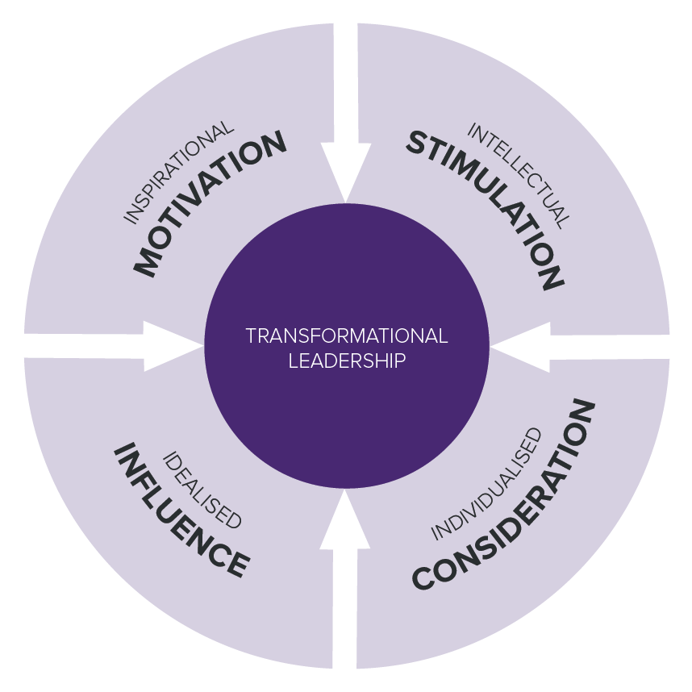
COMPONENTS OF TRANSFORMATIONAL LEADERSHIP
Transformational leadership comprises four basic components:
Idealised influence – the charisma of the leader, and the respect and admiration of the followers;
Inspirational motivation – the behaviour of the leader, which provides meaning and challenge to the work of the followers;
Intellectual stimulation – leaders who solicit new and novel approaches for the performance of work and creative problem solutions from followers; and
Individualised consideration – leaders who listen and give special concern to the growth and developmental needs of the followers.
Notes:
Idealized Influence: They believe in the philosophy that a leader can influence followers only when he practices what he preaches. The leaders act as role models that followers seek to emulate. Such leaders always win the trust and respect of their followers through their action. They typically place their followers needs over their own, sacrifice their personal gains for them, ad demonstrate high standards of ethical conduct. The use of power by such leaders is aimed at influencing them to strive for the common goals of the organization.
Inspirational Motivation: The foundation of transformational leadership is the promotion of consistent vision, mission, and a set of values to the members. Their vision is so compelling that they know what they want from every interaction. Transformational leaders guide followers by providing them with a sense of meaning and challenge. They work enthusiastically and optimistically to foster the spirit of teamwork and commitment.
Intellectual Stimulation: Such leaders encourage their followers to be innovative and creative. They encourage new ideas from their followers and never criticize them publicly for the mistakes committed by them. The leaders focus on the “what” in problems and do not focus on the blaming part of it. They have no hesitation in discarding an old practice set by them if it is found ineffective.
Individualized Consideration: Leaders act as mentors to their followers and reward them for creativity and innovation. The followers are treated differently according to their talents and knowledge. They are empowered to make decisions and are always provided with the needed support to implement their decisions.

Slide 16

20 MINUTES

Slide 17
General theories of leadership: A summary
Source: Institute for Sustainability Leadership (2017). Global definitions of leadership and theories of leadership development: Literature review. Cambridge: University of Cambridge.

Slide 18
LEADERSHIP AS A FUNCTION OF THE ORGANIZATION
A number of factors shape or inhibit a leader’s action and effectiveness:
Age and history of the organization
Size of the organization
Structure of the organization
Stability or crisis situation
The nature of leadership varies in different cultures
Employee reaction to leader initiatives

Slide 19
WHAT IS AN IDEAL LEADERSHIP TRAIT/STYLE IN A CHANGING WORLD/BUSINESS ENVIRONMENT?
ACIVITY - DISCUSSION

Slide 20
Traits, styles, and skills of global leaders
Source: Institute for Sustainability Leadership (2017). Global definitions of leadership and theories of leadership development: Literature review. Cambridge: University of Cambridge.

Slide 21
Declining confidence in the global economy calls for agility and resilience
How does a leader lead in an unfavourable business environment?
Source: https://assets.kpmg/content/dam/kpmg/xx/pdf/2019/05/kpmg-global-ceo-outlook-2019.pdf

Slide 22
Leadership challenges, skills, and barriers
Source: https://www.london.edu/-/media/files/faculty-and-research/research-centres/lbs-leadership-institute-leadership-survey-2017.pdf?la=en

Slide 23
Leading in uncertain times: the practitioners perspective
Complexities and uncertainties in the global economy highlights the need for an agile organization, as well as agile leadership.
The social, economic and technological headwinds we have seen emerge in recent years are no longer short term. While leaders continue to see exciting growth opportunities, they are set against a complex, volatile and increasingly uncertain environment. To be resilient, organizations need to be comfortable disrupting their business models if they want to continue to grow.
One of the most compelling findings in this year’s Global CEO Outlook survey by KPMG is that over two-thirds of chief executive officers believe that agility is the new currency of business. If they fail to adapt to a constantly changing world, their business will become irrelevant.
Source : https://assets.kpmg/content/dam/kpmg/xx/pdf/2019/05/kpmg-global-ceo-outlook-2019.pdf

Slide 24
Agile organizations excel at both stability and dynamism
Dynamic practices enable companies to respond nimbly and quickly to new challenges and
opportunities, while stable practices cultivate reliability and efficiency by establishing a backbone of elements that don’t need to change frequently
How to create an agile organization? – Refer to page 14 in source 1 below.
Source 1: https://www.mckinsey.com/~/media/McKinsey/Business%20Functions/Organization/Our%20Insights/How%20to%20create%20an%20agile%20organization/How-to-create-an-agile-organization.ashx
Source 2: https://assets.kpmg/content/dam/kpmg/xx/pdf/2019/05/kpmg-global-ceo-outlook-2019.pdf

Slide 25
Leading transformational change and employee engagement
Source: https://www.mckinsey.com/~/media/McKinsey/Business%20Functions/Organization/Our%20Insights/The%20people%20power%20of%20transformations/The-people-power-of-transformations.ashx

Slide 26

10 MINUTES

Slide 27
Activity:
Read this Abstract and summarise your views in three sentences.
https://www.emerald.com/insight/content/doi/10.1108/978-1-80043-380-920201011/full/html

Slide 28
Which leadership style is best for you?
The importance of ‘context’ – e.g. sector, industry, function, department, type of organization → leadership style may vary depending on the context.
The role of organizational culture in influencing leadership styles
Influences from national or regional culture impact leadership
Leadership is a social construct - Leadership ‘knowledge’ is constructed in the context of human interactions – leadership is, after all, about ‘leading people.’ Human beings are not static or isolated, but rather they can be seen as social actors, entrenched in a dynamic and interwoven social reality within which they base their perceptions, actions, interactions, and sense of meaning.
No ‘one size fits all’ leadership style – develop your own style based on experience and feedback.

Slide 29
“If your actions inspire others to dream more, learn more, do more and become more, you are a leader”
John Quincy Adams
(Sixth president of the United States)

Slide 30
References
CEML. (2002). Managers and Leaders: Raising our Game. London: Council for Excellence in Management and Leadership.
Institute for Sustainability Leadership (2017). Global definitions of leadership and theories of leadership development: Literature review. Cambridge: University of Cambridge.
KPMG (2019). Agile or irrelevant – redefining resilience: 2019 Global CEO Outlook. London: KPMG International
Leadership Institute (2017). Navigating uncertainty: Global leadership challenges. London: London Business School
McKinsey (2017). How to create an agile organization. New York: McKinsey and Company.
McKinsey (2017). The people power of transformations. New York: McKinsey and Company
Needle, D. and Burns, J. (2019). Business in Context: An Introduction to Business and its Environment, London: Cengage Learning.
Stogdill, R.M. (1974). Handbook of Leadership: A Survey of the Literature. New York: Free Press
Yukl, G. (2013). Leadership in Organizations, 8th ed., Harlow: Pearson Education.

Slide 31
Assignment Brief Review

