Slide 1
STEEL in Construction
Faculty of Architecture, Computing and Engineering
School of The Built and Natural Environments
Allan Nantel
November 2018

Slide 2
Classification of Metals
Metals
Ferrous
Non Ferrous
Cast Iron
Wrought Iron
Steel
Alloys
Pure metals
Ferrous metals are those which contain iron;
Non ferrous metals do not contain iron.
Alloys are a mixture of 2 or more metals.
In Construction…. Steel, Aluminium, Copper, Lead and Zinc predominate.

Slide 3
Classification of Metals
Non ferrous metals
Copper – soft, malleable, ductile, good conductor of heat. Used for water pipes, boilers, wiring etc
Lead – malleable & easily rolled into sheets. Used for roofs and flashings
Zinc – soft, brittle. Used for galvanising iron, for cowls & roof flashings.
Aluminium – light, strong, hard wearing. Used for light structural work, hinges, doors, windows etc
Chromium – hard wearing metal. Used for coating iron & steel.

Slide 4
Classification of Metals
Non ferrous alloys
Brass
  Copper-zinc alloy. Used for joints, handles, door furnituire etc
Bronze
  Copper – tin alloy. Used for bearings, electrical connectors and springs.
Phosphored bronze
  Phosphorus – 1% tin alloy. Harder & more easily cast. Used for high compressive loads and for bearings.
Solder
  Lead- tin alloy. Low melting point & used for electrical & pipe joints

Slide 5
Ferrous Metals
Cast Iron – in excess 2% Carbon
Hard & brittle
High carbon content
High compressive strength
Was used for guttering; drain pipes and water tanks
Wrought iron – only 0.02% Carbon
Highly malleable at low temperature
Fibrous in character
Used for decorative gates and staircases

Slide 6

Steel
An alloy of Iron and Carbon.
Iron Carbide (cemenite) exists in sheets in it’s microstructure. This is very hard and brittle.
These sheets are interwoven with iron to form a compound called pearlite.
It is pearlite that gives steel its characteristic strength.
Higher the pearlite content...the stronger the steel.
Presence of pearlite is also dependent upon the Carbon content.
Steels are classified by their Carbon content.

Slide 7
Types of Steel:
(According to varying Carbon Content)
Low Carbon Steel (Less than 0.15 % Carbon )
Mild Steel (0.15 – 0.25 % Carbon)
Medium Carbon Steel (0.25 -0.50 % Carbon)
High Carbon Steel (0.5 -0.9 % Carbon)
BS EN 10365:2017

Slide 8
Effects of Carbon Content on Steels
Low Carbon Steel 0.05 to 0.15%
Mild Steel 0.15 to 0.25%
Medium Carbon Steel 0.25 to 0.5%
High Carbon Steel 0.5 to 0.9%
Increasing Ductility
Increasing Ease of Welding
Increasing Tensile Strength
Increasing Quenched Hardness (Martensite)
Increasing Ease of Casting
0.5
1.0
1.5
Carbon Content by Weight (%)

Slide 9
THE STEEL PRODUCTION PROCESS
http://youtu.be/-ZCaFE97hkM

Slide 10
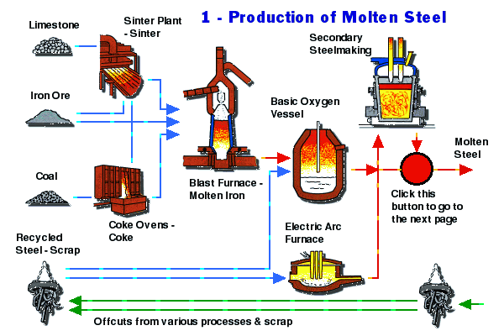
Steel production
Coke converted in the blast furnace to Carbon Monoxide which in turn reduces the iron Oxide to Iron. Iron collects in bottom of the furnace, Limestone forms a liquid slag which floats on top. Impurities from the iron are absorbed by the slag.
Iron is drawn into ladles and taken to the Oxygen Vessel.
Manufacture of Bulk Quantities of graded steel.
Molten Iron added to scrap steel (1/4 of the charge). High pressure oxygen is blown into the mix with a lance, forming molten steel.
Coke is a high carbon content fuel derived from the baking of low ash coal.
Low quantity …Stainless steel.

Slide 11
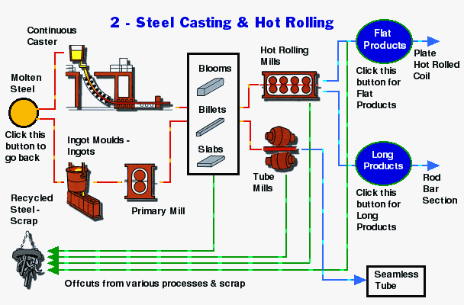
Steel production
Red hot slabs reduced to size. (1250 degree C)
NEW
METHOD
Saves on re-heating
OLD
METHOD
Billets need re-heating to shape form

Slide 12
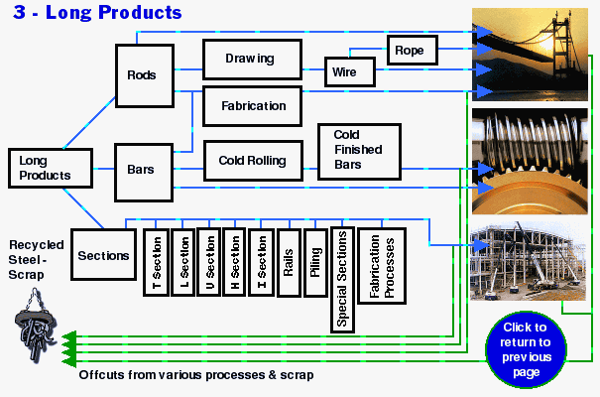
Steel production

Slide 13
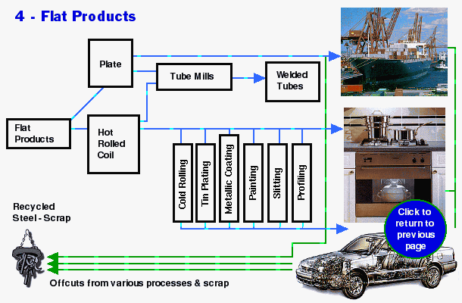
Steel production
http://youtu.be/-ZCaFE97hkM

Slide 14
Annealing
Is a heat process whereby a metal is heated to a specific temperature and colour and then allowed to cool slowly.
This softens the metal which means it can be cut and shaped more easily.
Mild steel is heated to a red heat and allowed to cool slowly.
Tempering
Is a heat treatment technique applied to ferrous alloys, such as steel or cast
iron, to decrease the hardness of the alloy.
The reduction in hardness is usually accompanied by an increase in ductility,
thereby decreasing the brittleness of the metal.
Tempering is usually achieved after quenching which is rapid cooling of the
metal to put it in its hardest state.

Slide 15
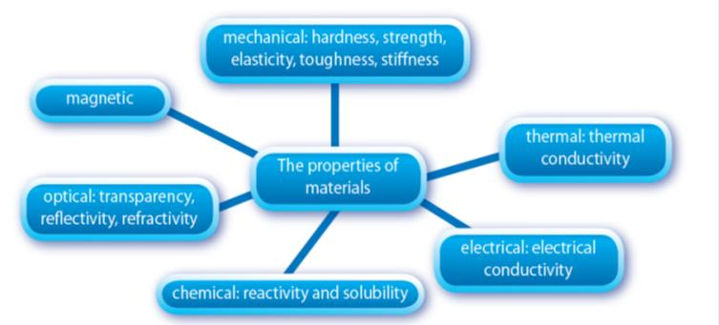
The Properties of Materials

Slide 16
Stress Strain relationship
DUCTILE MALLEABLE ELASTIC PLASTIC BRITTLE
The measurement of the strength of a metal.
Questions :
  What is Stress?
  What is Strain?

Slide 17
BASIC DEFINITIONS

Slide 18
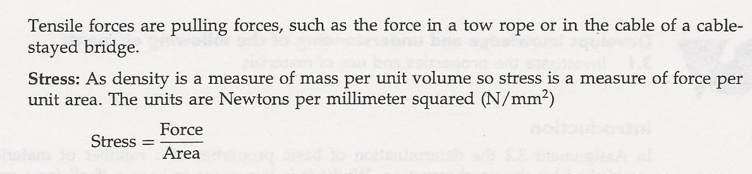
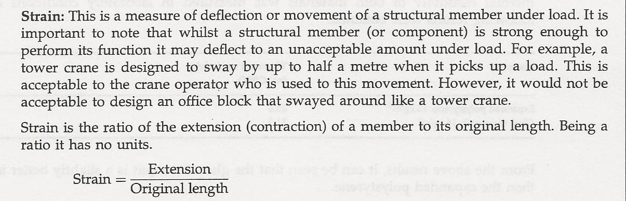
Stress Strain relationship
YOUNG’s MODULUS = STRESS
STRAIN
This ratio is specific to the particular substance under consideration.

Slide 19
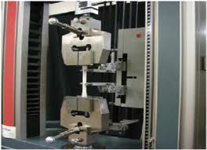
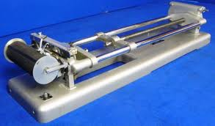
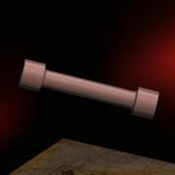
Tensile Testing
Hounsfield Tensometer
Gauge Length
Test Samples
DARTEC - 30 tonne Tensile / Compression test machine.

Slide 20
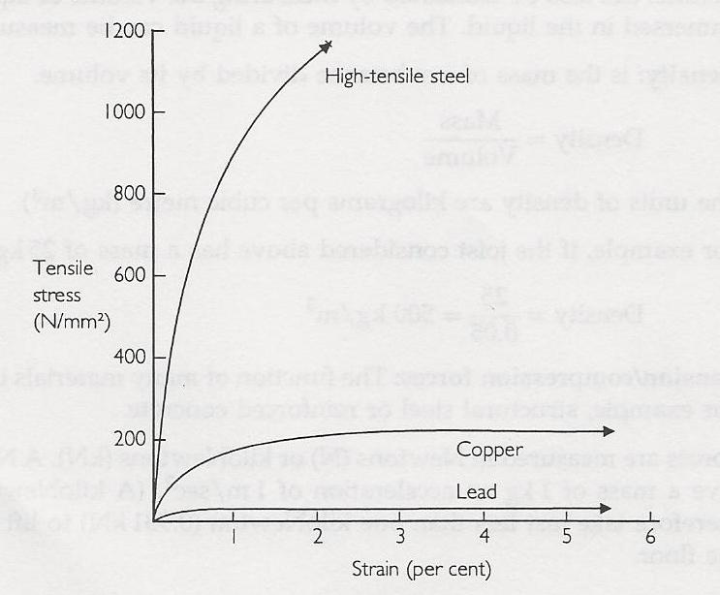
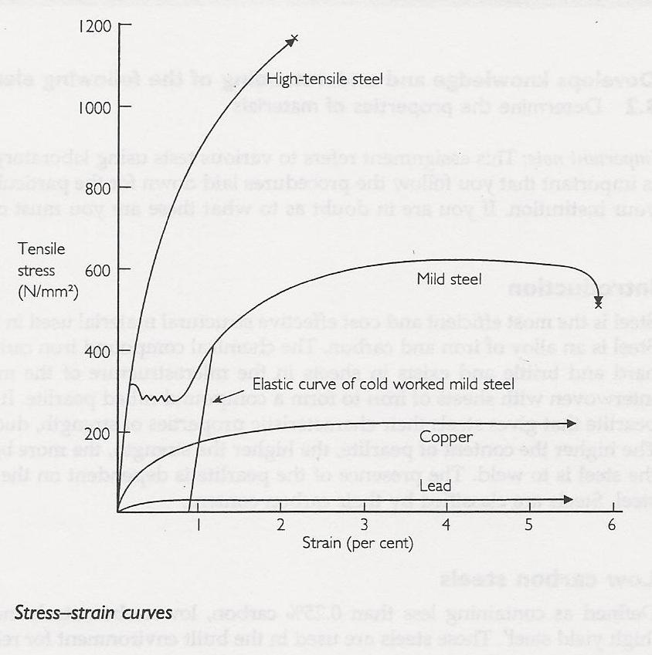
Stress Strain relationship
Young’s Modulus – ‘The Elastic Modulus’ – measures the stiffness of a metal.
It is measured within the Elastic Range of Stress
Yield Point – the initial yield stress
Factor of 2 required in manufacture.
Plastic range of stress
Break Point Measure of Ductility
Elastic range of stress
A material with a long elastic range is considered to be ELASTIC (DUCTILE).
A material with a short elastic range is considered to be BRITTLE.
Mild steel has a unique stress/strain property.
In the elastic range, deformation is recoverable
In the plastic range, deformation is non recoverable

Slide 21
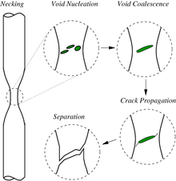
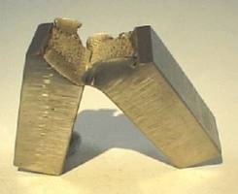
DUCTILE FRACTURE
BRITTLE FRACTURE
High Yield (high Carbon content) Steel
Mild Steel
What would be Aluminium’s reaction to tensile stress?
What would be Brass’s reaction to tensile stress?

Slide 22
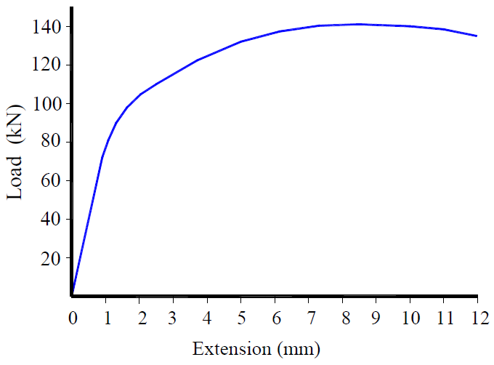
Exercise:
The following data was obtained from a tensile test on a specimen of
8mm diameter and gauge length 50mm.
Using the graph paper supplied, plot the load-extension diagram

Slide 23
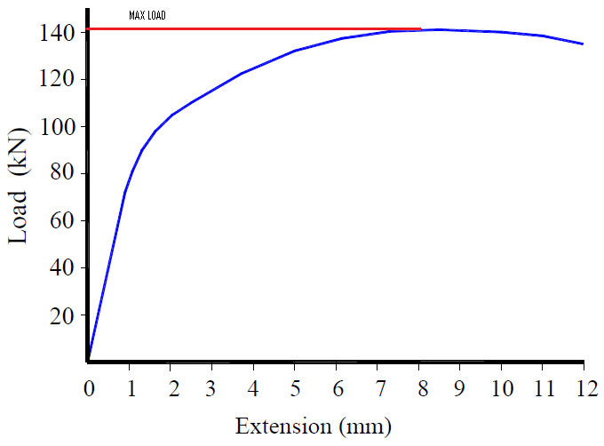
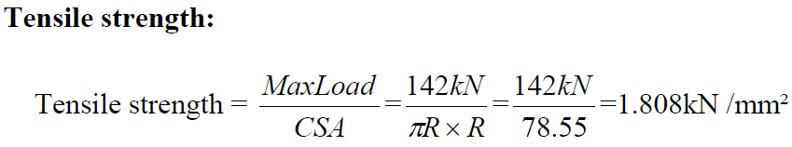
(1) Find the Tensile Strength
a specimen of 8mm diameter and gauge length 50mm.
How will we calculate the metal’s Tensile strength?
2.82
50.27
CSA = Cross sectional Area

Slide 24
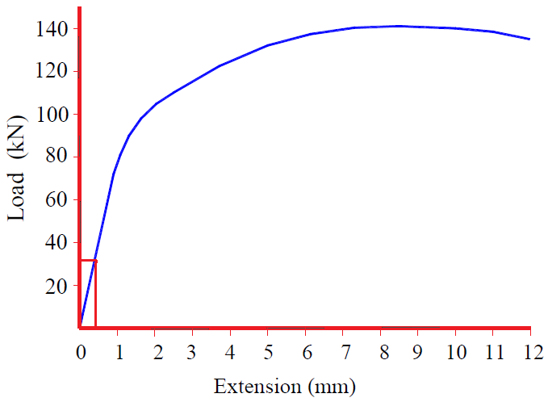
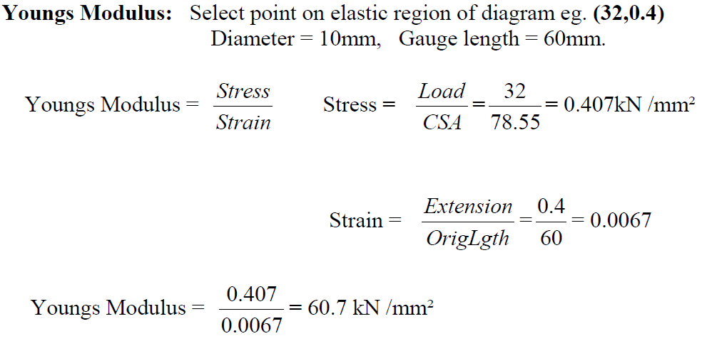
(2) Find Young's Modulus
Select a point on the elastic region of diagram e.g. 32,0.4
Diameter = 8mm Gauge length = 50mm
0.64
50.27
The higher the Modulus, the more load the material requires for deformation of shape (within the Elastic Range)
0.008
50
0.64
80.00
0.008

Slide 25
Stress, s = LOAD
AREA
Strain, e = EXTENSION
TENSILE TESTING EXERCISE
ORIGINAL LENGTH
Yield Point = Load at which plastic deformation begins.
Ultimate tensile Load (UTL) = The maximum load attained
Young’s Modulus = STRESS
STRAIN
MATERIAL | YIELD POINT (Newtons) | U.T.L. (Newtons) | ORIGINAL LENGTH OF SPECIMEN | CROSS SECTIONAL AREA (mm²) | ELONGATION At FRACTURE (mm) | LOAD AT FRACTURE (Newtons)
STEEL |  |  | 26.94mm
BRASS |  |  | 26.69mm
ALUMINIUM |  |  | 26.71mm

Slide 26
The central diameter of the specimens (dumbbell shaped) were measured and found to be 5.02mm.
From this, calculate the cross sectional area of the specimen.
1). Mark the Elastic Range, Plastic Range, Yield Point, UItimate Tensile
Load and Load at Fracture on each of the graphs.
2). From the three graphs supplied, complete the table.
3). Use the completed data table above, and the equations described to
calculate Stress and Strain for each metal tested.
4). Calculate Young's Modulus within the elastic range of stress for each
metal tested.
Mark your reference points for this calculation on your graphs.

Slide 27
GRAPH HANDOUTS

Slide 28
Stress, s = LOAD
AREA
Strain, e = EXTENSION
TENSILE TESTING EXERCISE
ORIGINAL LENGTH
Yield Point = Load at which plastic deformation begins.
Ultimate tensile Load (UTL) = The maximum load attained
Young’s Modulus = STRESS
STRAIN
MATERIAL | YIELD POINT (Newtons) | U.T.L. (Newtons) | ORIGINAL LENGTH OF SPECIMEN | CROSS SECTIONAL AREA (mm²) | ELONGATION At FRACTURE (mm) | LOAD AT FRACTURE (Newtons)
STEEL | 12500 | 16500 | 26.94mm | 19.79 | 5.1 | 14000
BRASS | 6900 | 7800 | 26.69mm | 19.79 | 6.2 | 5500
ALUMINIUM | 5000 | 5800 | 26.71mm | 19.79 | 4.5 | 4150
Any material you would re-test here?

Slide 29
INDICATIVE CALCULATION ON THE ALUMINIUM SPECIMEN
STRESS = Load
Area
= 4000
19.79
= 202.12 N/mm²
STRAIN = Extension
Original Length
= 0.75
26.71
= .028
Young’s Modulus = STRESS
STRAIN
= 202.12
.028
= 7218.57 N / mm²

Slide 30
Mild Steel as a material
Ductile & malleable
Tough and elastic
More prone to rusting - Corrodes quickly
Easily forged, welded
Withstands shocks & impacts well
Equally strong in tension,
compression and in shear

Slide 31
Mild Steel : Uses ?
Used as rolled structural sections like I-section; T-section; Channel Section; Angle, Plates, round and square rods for structural frame.
Used as reinforcement (Links, Stirrups, Mesh)
Hot Rolled High Yield for ribbed reinforcement
Plain and Corrugated M.S. Sheets are used in roofing and floor deck.

Slide 32
High Carbon Steel as a material
Increased tensile strength
Resists corrosion better
Tougher than mild steel
More brittle and less ductile than mild steel.

Slide 33
High Carbon Steel : Uses ?
In reinforcing:
In pre-stressed and post tensioned
concrete structures.
Tool bits – drills / blades / digger scoops

Slide 34
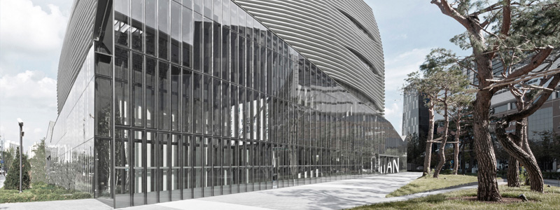
Advantages of Steel Frame Construction: ??
STEEL
Lighter weight and strong (much lighter and stronger than concrete when strength to weight ratio is compared )
Prefabricated - frames assemble quickly
Precise and predictable (excellent quality control)
Architectural shaping possible
Can build very tall and wide

Slide 35
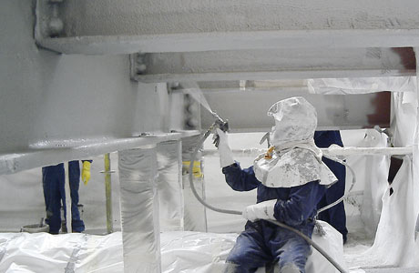
STEEL
Disadvantages of Steel Frame Construction: ??
Steel is an expensive material
(much more expensive than masonry or concrete)
Frames are more ‘unstable’ (more liable to deformation and torsion)
Needs fire protection
Needs separate "skin"
(walls and floors)

Slide 36
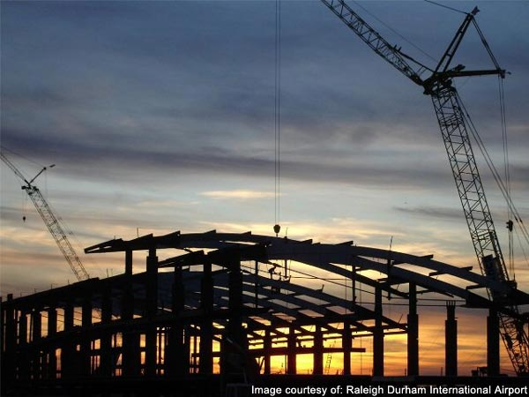
Properties of a structural steel frame:
Advantages lie in three areas:
IN DESIGN
IN CONSTRUCTION
IN USE
10 minutes

Slide 37
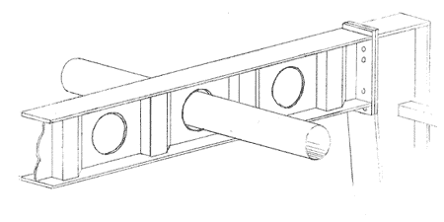
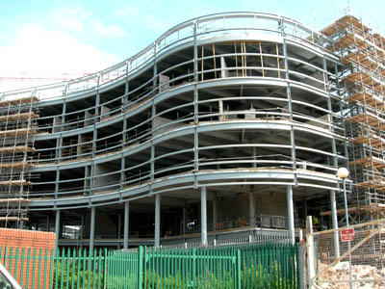
Properties of a structural steel frame
1. In Design:
Large spans with columns of small sections
Greater building heights and high load bearing capacity
Structural systems in which openings can be easily provided
Installation of services is simplified
Architectural diversity

Slide 38
Properties of a structural steel frame
2. In Construction:
Prefabrication and ease of erection of components
Shorter construction time
Close dimensional tolerances
Ease in fixing and cladding
Erection independent of weather conditions
Modest demand on space on the site
Dry construction

Slide 39
Properties of a structural steel frame
3. In life cycle and use:
Greater flexibility
Limited number of internal supports
Adaptability of frame work to change of use therefore…
Increasing effective life of building
Ease in dismantling or demolition
Recycleable

Slide 40
COMPARE THIS WITH A
CONCRETE FRAME ?

Slide 41
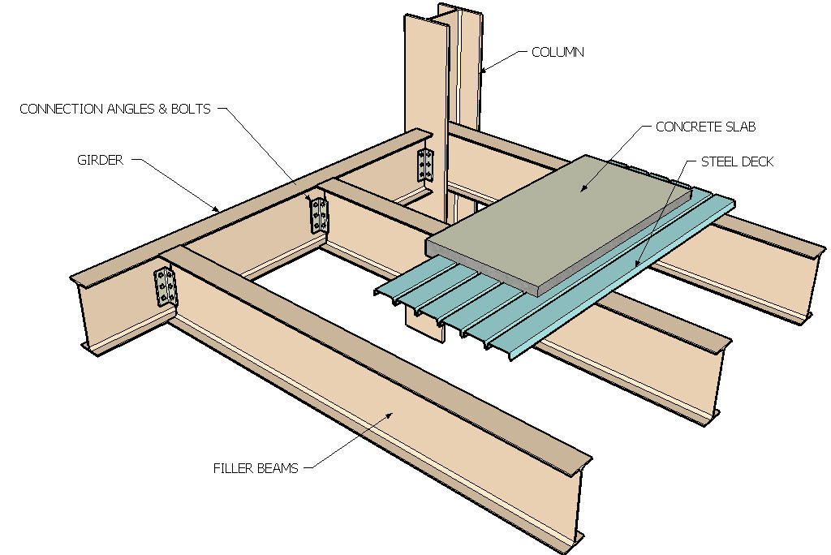
Basic System - Post & Beam (skeleton frame)

Slide 42
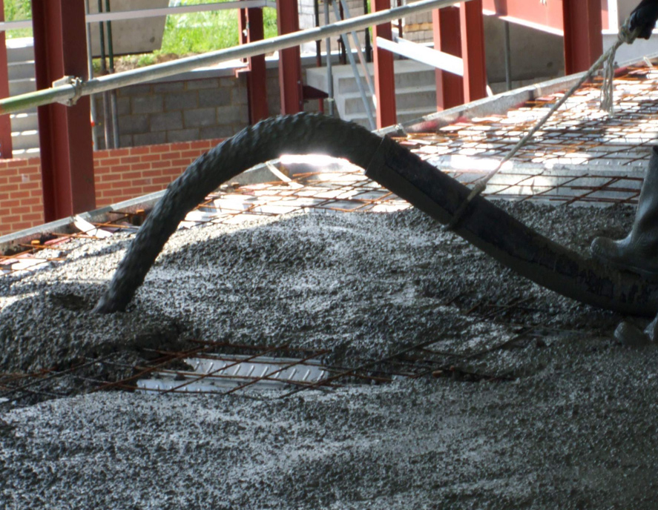

Slide 43
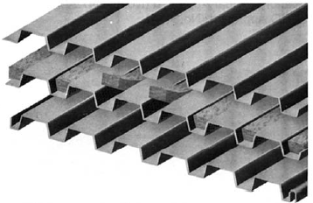
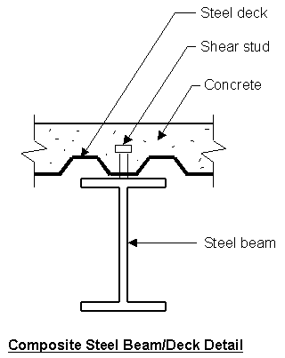
Steel Decking:
  Floor Deck
  This deck acts as part of a structural system
  with steel beams.
  The deck is placed on top of the steel beam and steel
  "shear studs" are welded through the deck and onto
  the top flange of the beam.
  After the concrete is placed and cured, it grips the shear
  studs and acts compositely with the steel beam
  and greatly increases the load-carrying capacity
  of the steel beam alone.
All deck is cold-rolled and is sold in gauge thicknesses.

Slide 44
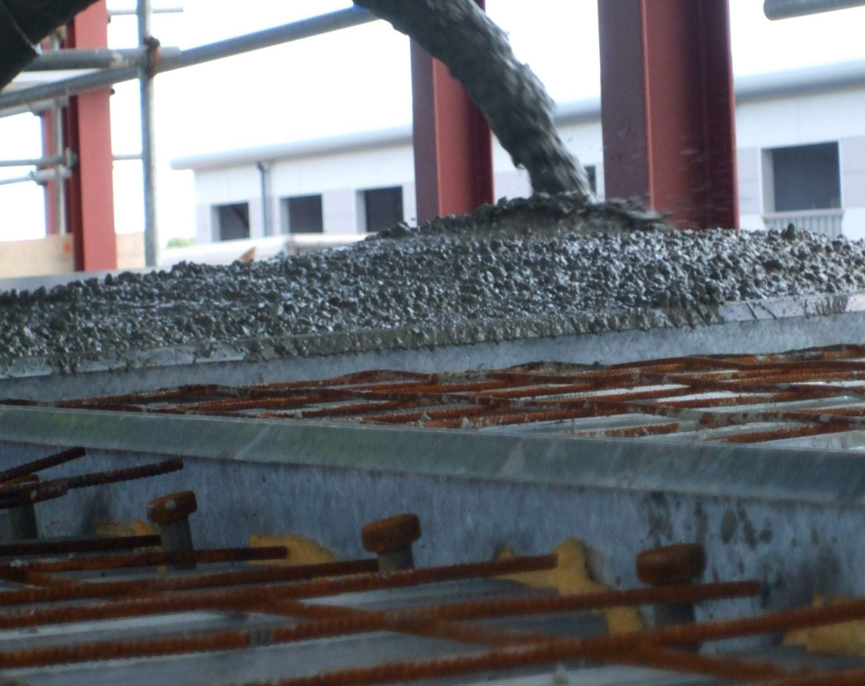

Slide 45
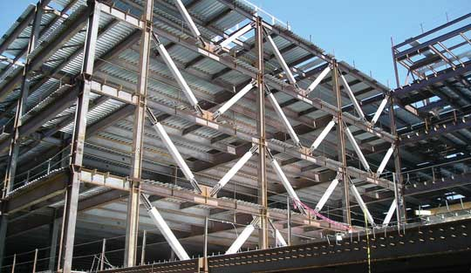
STEEL frames are unstable
Methods to stabilise Steel Frames
  Usually accomplished by interior masonry (or concrete) stair towers and elevator shafts that creates a vertical rigid core that resists deformation and torsion of the building due to external lateral forces.
Rigidity of Core -
  Rigidity of the Exterior –
  The addition of diagonal "X"
  or "K" bracing that resists
  lateral loads.
  Problems – may interfere
  with exterior windows.

Slide 46
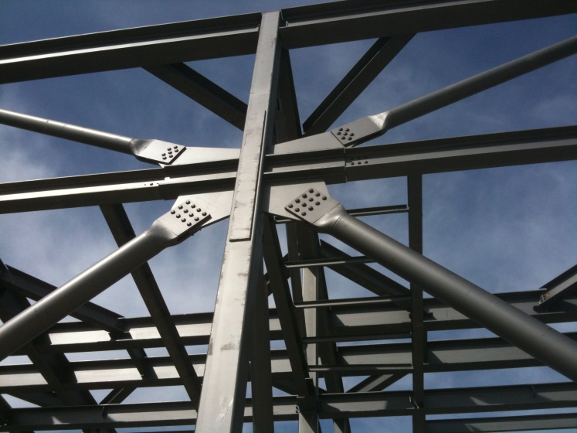
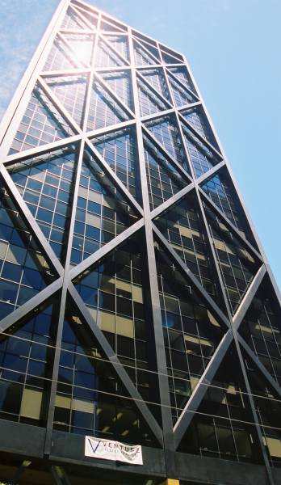
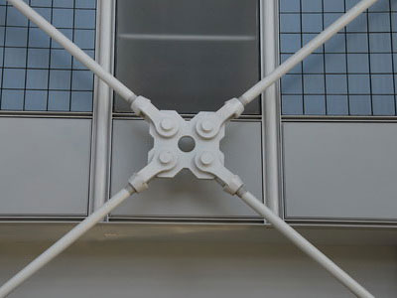
  Diagonal Bracing

Slide 47
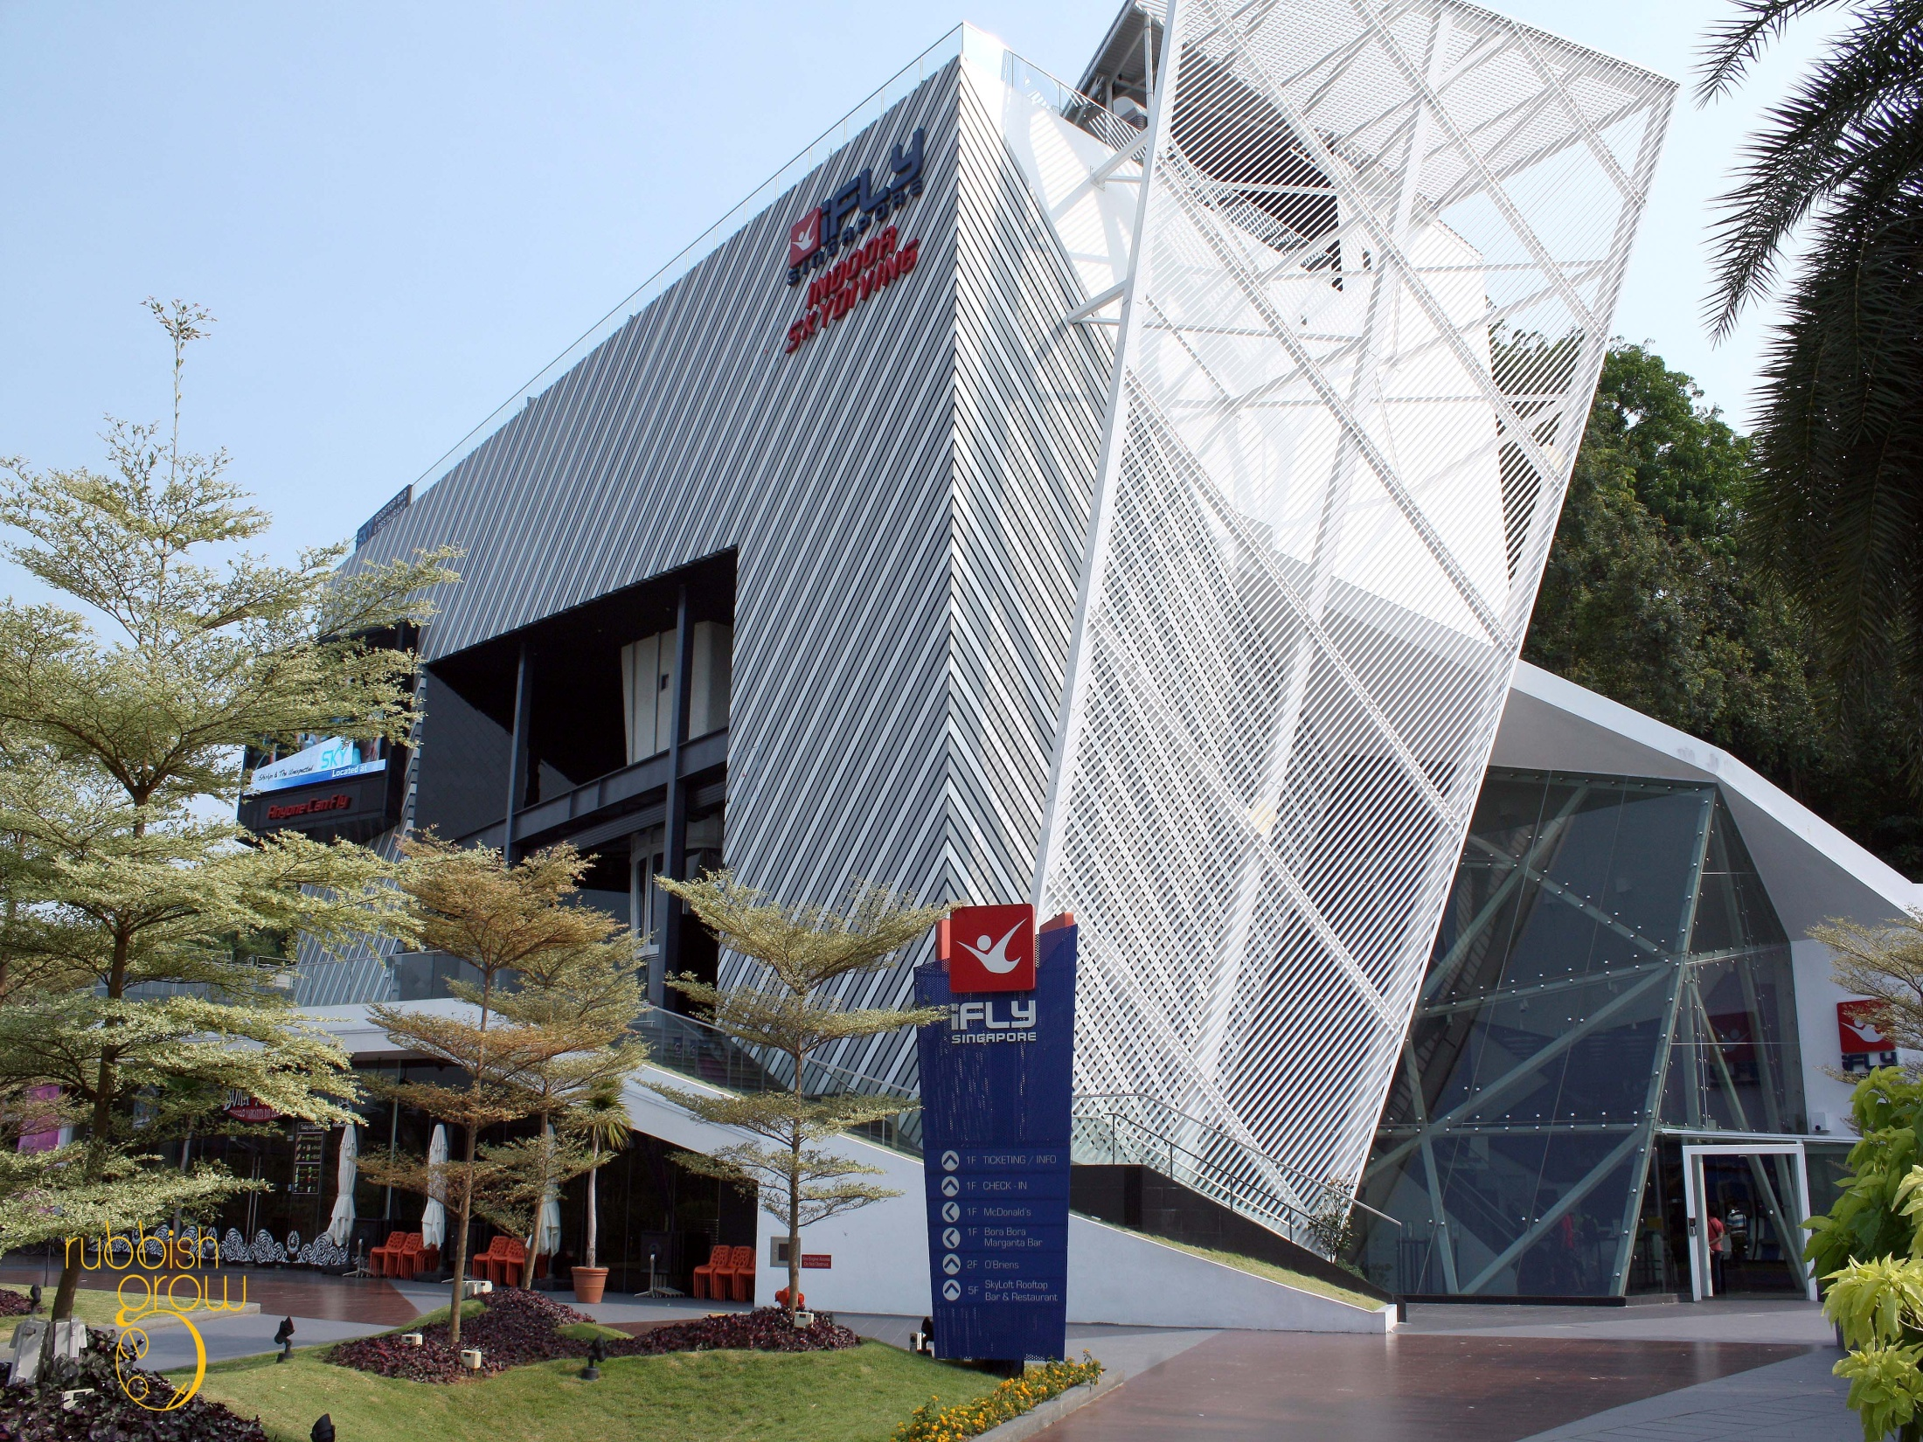

Slide 48
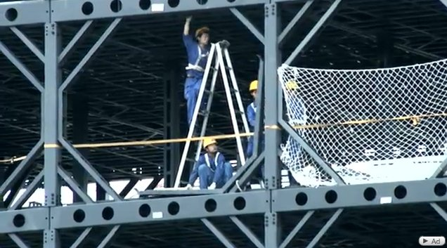
STEEL
Methods of Stabilising Steel Frames
  Typically accomplished by fabricating extra connection angles, welds and bolts that greatly increase the rigidity of the connection.
  Problems - extremely
  labour intensive and
  expensive.
  Moment-Resisting Beam-to-Column Connections –

Slide 49
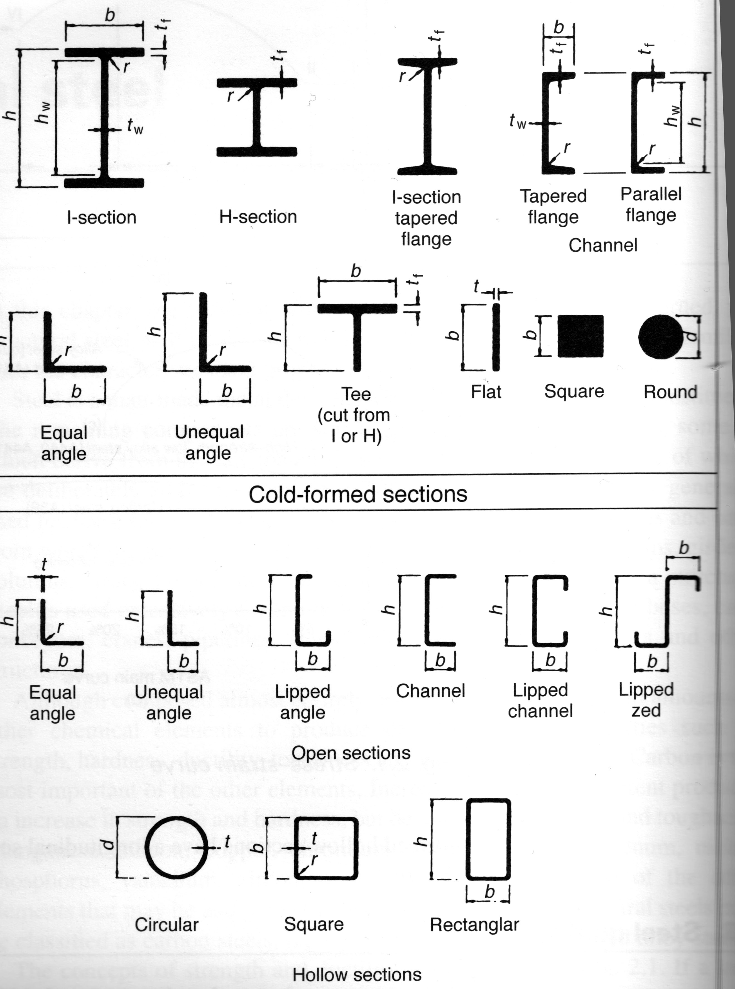
Structural steel sections
Hot rolled sections

Slide 50
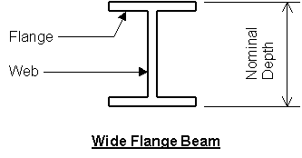
Basic Structural Steel Shapes (Hot-rolled):
  1.Wide Flange - The typical "I Beam" used in construction.
  Example - W18x35, where "W" = Wide flange,
  18 = nominal depth of member in inches
  35 = linear weight in lbs of beam /foot
  Used for beams, columns, piles, bracing and other heavy applications.

Slide 51
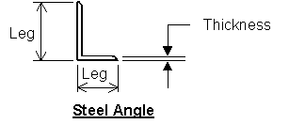
Basic Structural Steel Shapes (Hot-rolled):
  2. Angles - Either equal legs or unequal legs. Example - L4x3x1/4 where 4 and 3 are the actual leg dimensions in inches
  1/4 = angle thickness in inches.
  Used for lintels, bracing, built-up beams and
  columns, secondary framing and other light-
  duty applications.

Slide 52
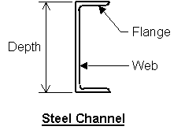
Basic Structural Steel Shapes (Hot-rolled):
  3. "C" shaped members are used for beams, built-up columns, bracing, secondary framing and other light to medium-duty applications.
  An example of a channel is C10x30 where "C" indicates channel, 10 is the actual height of the channel in inches,
  30 = linear weight in lbs / foot

Slide 53
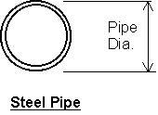
Basic Structural Steel Shapes (Hot-rolled):
  4. Steel Pipe - Circular pipe is used most often for columns. Comes in three categories based upon diameter and wall thickness, and are "standard weight", "extra strong" and "double extra strong, depending on wall thickness.

Slide 54
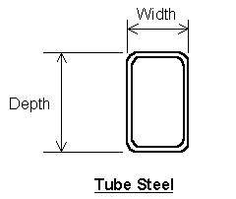
Basic Structural Steel Shapes (Hot-rolled):
  5. Tube Steel - These square or rectangular sections are used most often as columns, but may also be used as beams, bracing or other applications.
  A typical example is TS6x4x1/4 where TS = Tube Steel, 6 and 4 are the actual width and depth in inches, and 1/4 is the wall thickness in inches.

Slide 55
Basic Structural Steel Shapes (Hot-rolled):
  6. Plates - Flat pieces of steel cut to size. Generally in the range of 1/8" thick up to 6" thick.
  Used as column base plates, built-up beams and columns (i.e., plate girders),
  Connection pieces (I.e., gusset plates, weld plates, etc.), and any other application where specific sized pieces are required.
  Example - PL 6x4x3/8 where 6 and 4 are length and width of the plate in inches and 3/8 is the plate thickness in inches.

Slide 56
Connections

Slide 57
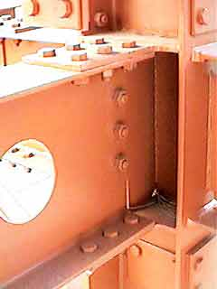
Connecting the Frame
1. Bolts –
Carbon steel and High-strength.
The carbon steel bolts obtain their strength through shear and tension along the shaft of the bolt only.
High-strength bolts obtain their strength
not only through the shear and tension
along the shaft, but also from the friction
forces that are generated from tensioning
the nut to prescribed levels.
(Torque wrenching).

Slide 58
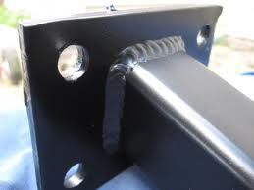
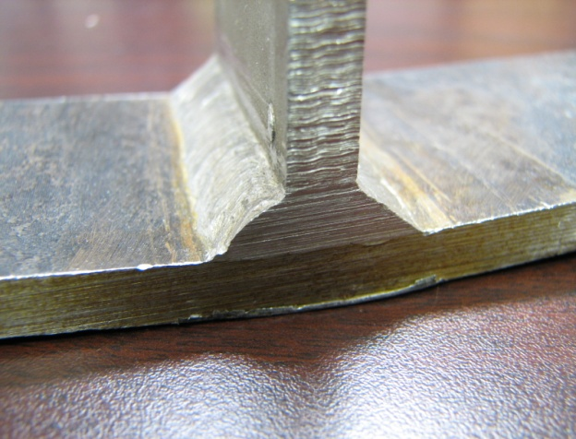
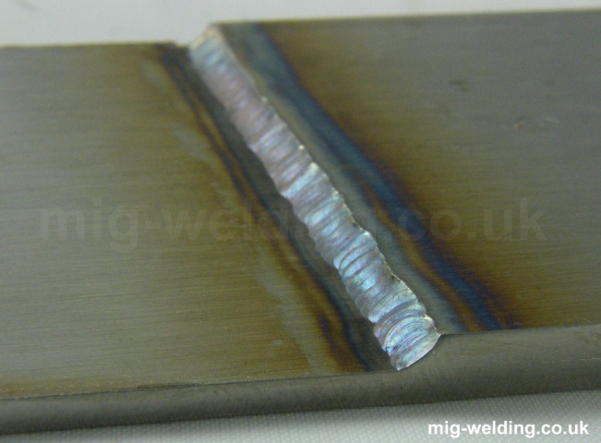
2. Welding
There are 3 main type of welds:
Butt weld
Fillet weld
Lap weld

Slide 59
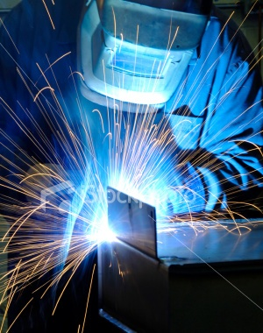
Connections:
  Welding –
  Welding consists of heating the two pieces to be
  joined until they melt enough to fuse.
  The heat comes from an electric arc that is formed
  between a welding rod and the two pieces to be welded.
  A portable electric generator is connected to the structural
  steel and to the welding rod. A current is passed through the
  rod and the structure when the rod touches the steel members.
  The tip of the rod and some depth of the base metal are melted. The arc produces a temperature of about 1500ºC at the tip. This heat melts both the base metal and the electrode. The two metals combine and harden upon cooling.
  Arc-eye, or welder's flash, is an inflammation of the cornea, caused by ultraviolet radiation from the arc during welding.

Slide 60
Fire Protection:
Although it takes a very substantial amount of heat to actually melt steel, it will lose most of its strength at temperatures above 700⁰ F.
There are generally two major categories of fire proofing –
Thermal and Absorptive.
  Thermal Fire Protection - Slows the heat passage through the steel. Methods used include providing insulation and intumescent paint.
  Absorptive Fire Protection - Absorbs heat. Methods used include covering steel members with concrete, vermiculite (spray-on), and elaborate methods such as gel-filled chambers (generally wrapped around columns).

Slide 61
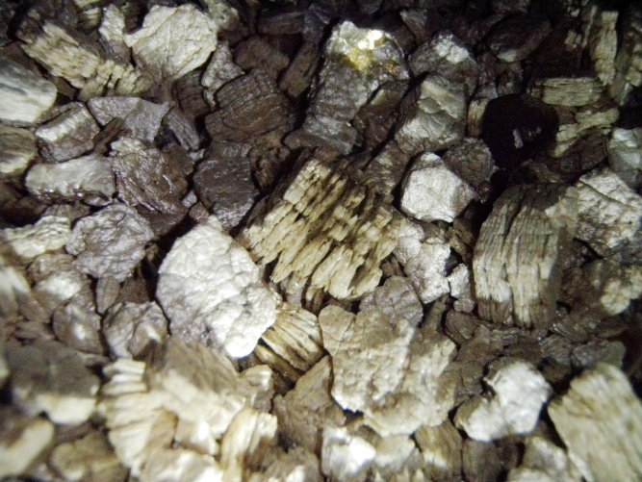
COATINGS USED TO PROTECT THE STEEL
1. Intumescent Coatings:
Heat in a fire triggers a catalytic reaction causing expansion of an insulating char layer up to 50 times the paint film thickness. This keeps the steel below its critical temperature thus maintaining the structural stability of the building. (Produced from Sodium Silicates and Graphite)
2. Sprayed Coatings:
Vermiculite cement (calcium silicate or gypsum
binder) or mineral fibres.
3. Boarded Systems:
Vermiculite cement or mineral fibre in
cement, calcium silicate or gypsum binder.
Screwed directly to steel or onto light steel fixing angles.
4. Concrete Fill / Masonry:
Fully encased or hollow tubes filled.

Slide 62
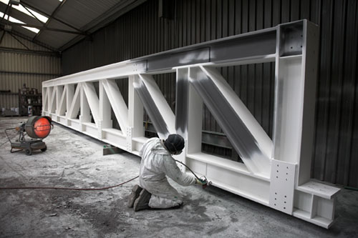
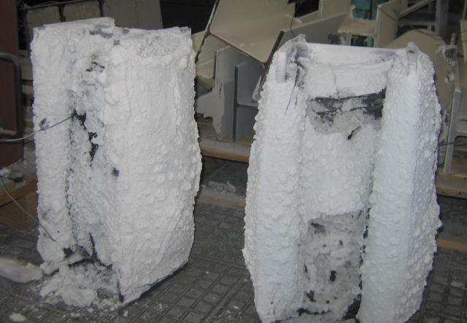
Intumescent Coating
Intumescent Coating under heating

Slide 63
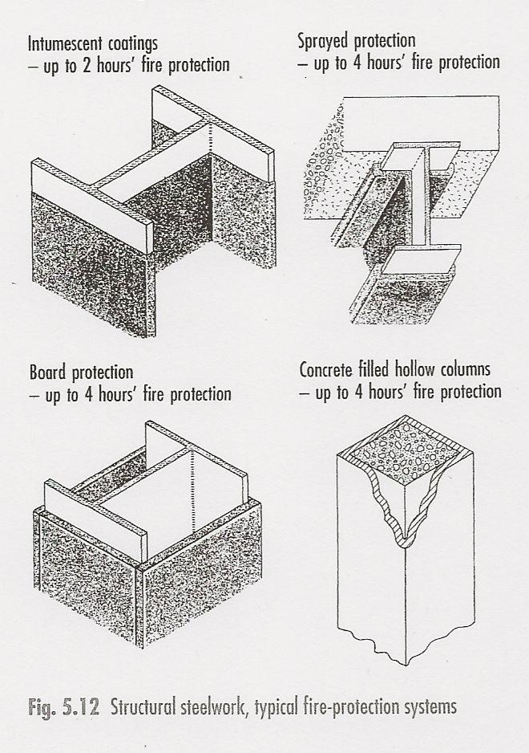
Structural Steelwork – Typical Fire protection systems

Slide 64
Questions:
State the difference between ferrous and non-ferrous metals.
2. State the basic materials in the production of Steel.
List four metals that can be described as non-ferrous, and give uses for
each of them in construction.
List five positive aspects of the use of steel as a construction framing
material
5. Sketch a simple ‘post and beam’ skeletal steel frame, showing column, beam, decking and slab positions.
6. What are the four main ways of protecting a steel column from fire?
IRON CONTENT
IRON ORE, LIMESTONE, COKE, RECYCLED STEEL
COPPER, ZINC, BRASS, ALUMINIUM, LEAD, BRONZE
ADAPTABILITY, RECYCLING, EASE OF BUILD, EASE OF DEMOLITION, OPEN SPACE
INTUMESCENT PAINT, SPRAY COAT, BOARDING, FILLING
10 minutes

