Slide 1
Electromagnetic
Radiation
(ACDC5009)
Lecture - 6

Slide 2
Content
Scalar and Vector Quantities
Representation of a vector
Unit vector
Vector algebra
  Scaling
  Addition
  Subtraction
Cartesian or Rectangular co-ordinate system

Slide 3
Learning Outcome
The student upon completion of the lecture will be able to:
Define a Scalar and vector quantities
Describe vector algebra.
Demonstrate the ability to apply vector algebra in rectangular coordinates system.

Slide 4
Vectors and Scalars
The quantities involved in the study of engineering electromagnetics can be classified as
Scalars
Vectors

Slide 5
Vectors and Scalars
Scalars
Scalar quantities may be represented by a real number, which may be positive or negative. The direction is not required.
It is characterised by its magnitude.
E.g: temperature, mass, volume, density, speed, electric charge etc
Vectors
A quantity which has both, magnitude and a specific direction in space is called a vector.
In Electromagnetism vectors defined in two or three dimensions are required but vectors can be defined in n-dimensional space.
Vector is a quantity which is characterized by both a magnitude and a direction.
E.g. Force, velocity, displacement, electric field, intensity, magnetic field intensity, acceleration.

Slide 6
Vectors and Scalars
Scalar field
A field is a region in which a particular physical function has a value at each and every point in that region. The distribution of a scalar quantity with a definite position in a space is called scalar field.
Eg: temperature of atmosphere, height of surface of sea, linght intensity in a room, sound intensity in a room, atmospheric pressure.
Vector Field
A quantity which is specified in a region to define a field is a vector, then the corresponding field is called a vector field.
E.g, Gravitational force on a mass in a space is a vector field., velocity of a particle in a moving fluid, wind velocity of atmosphere, magnetic field existiance from north to south field etc.
Notes:
This force has a value at various points in a space and always has a specific direction.

Slide 7
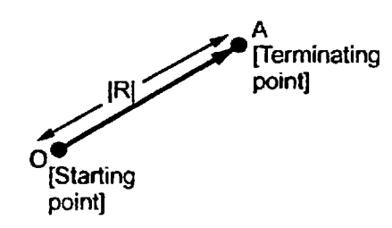
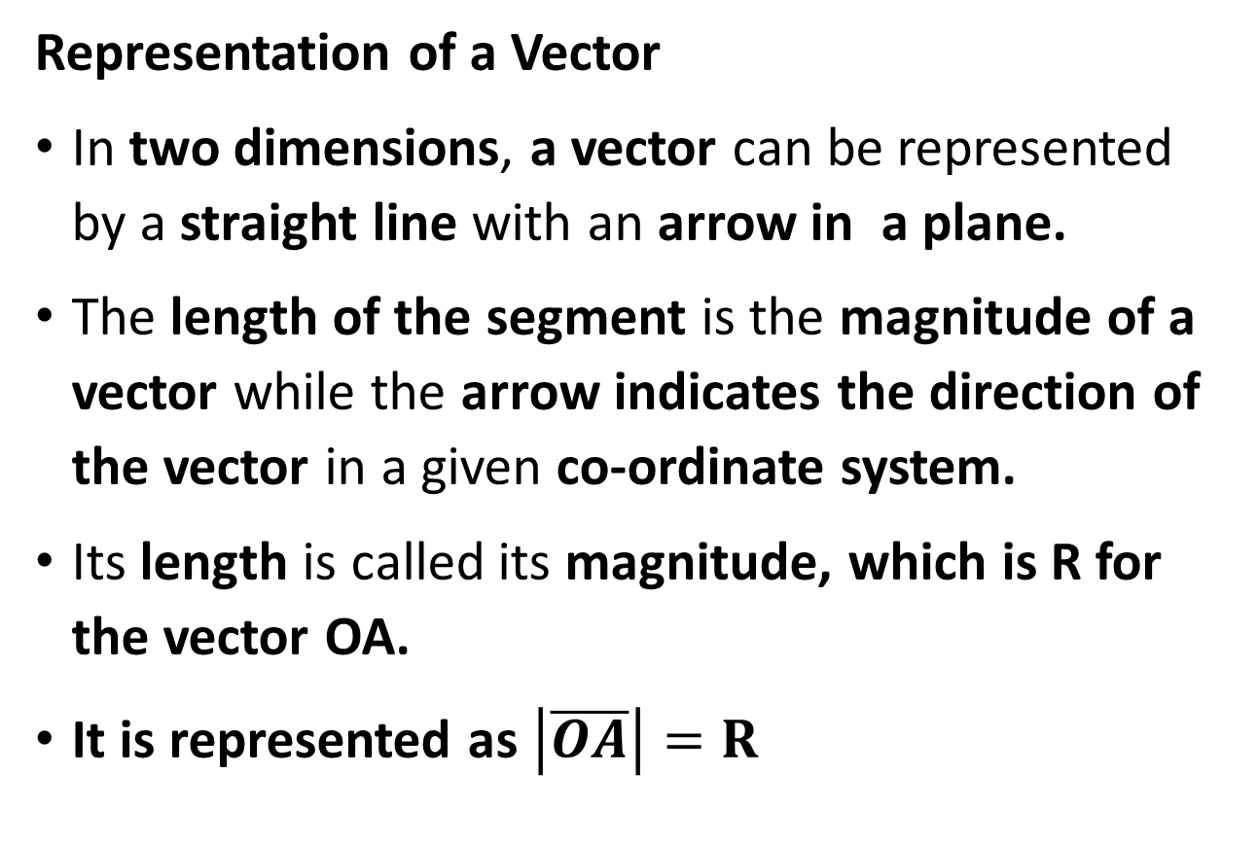
Vectors and Scalars
Representation of a Vector
In two dimensions, a vector can be represented by a straight line with an arrow in a plane.
The length of the segment is the magnitude of a vector while the arrow indicates the direction of the vector in a given co-ordinate system.
Its length is called its magnitude, which is R for the vector OA.
It is represented as $\left|\overline{OA}\right|=R$
Notes:
$\left|\overline{OA}\right|$ - distance between the starting point and terminating point of the vector

Slide 8
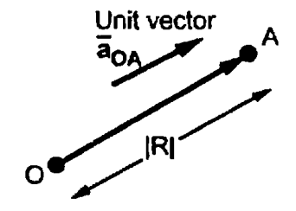
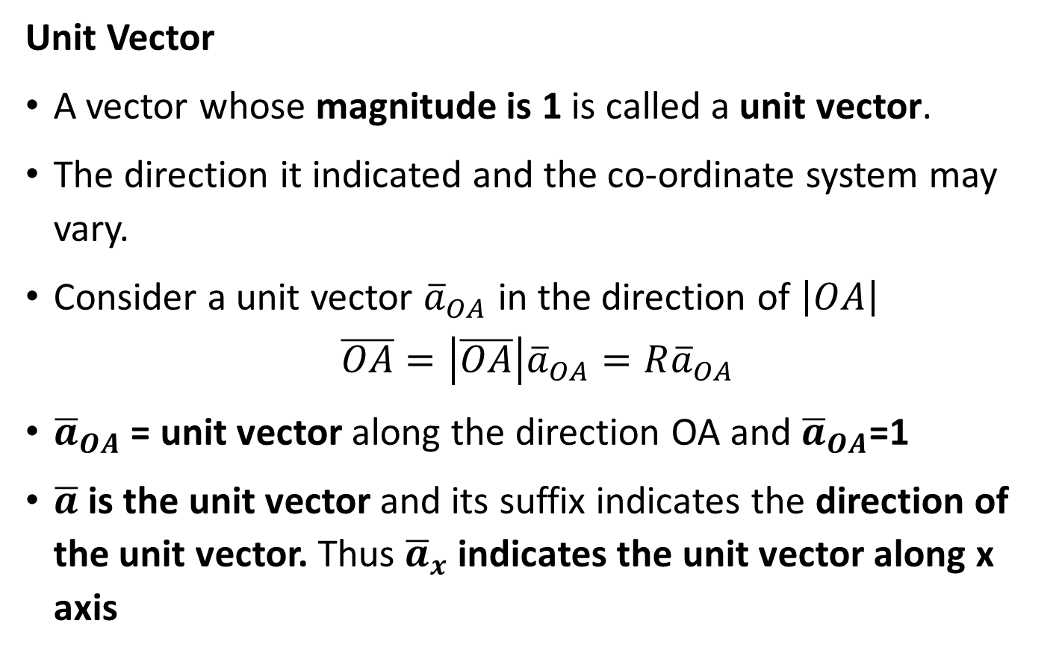
Vectors and Scalars
Unit Vector
A vector whose magnitude is 1 is called a unit vector.
The direction it indicated and the co-ordinate system may vary.
Consider a unit vector ${\overline{a}}_{OA}$ in the direction of $\left|OA\right|$
$$\overline{OA}=\left|\overline{OA}\right|{\overline{a}}_{OA}=R{\overline{a}}_{OA}$$
${\overline{a}}_{OA}$ = unit vector along the direction OA and ${\overline{a}}_{OA}$=1
$\overline{a}$ is the unit vector and its suffix indicates the direction of the unit vector. Thus ${\overline{a}}_{x}$ indicates the unit vector along x axis

Slide 9
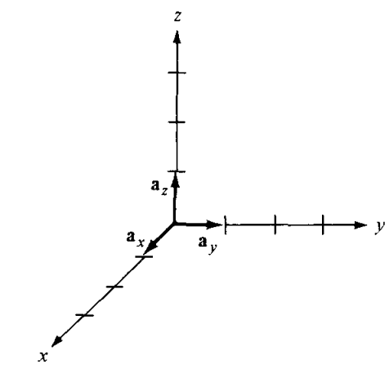
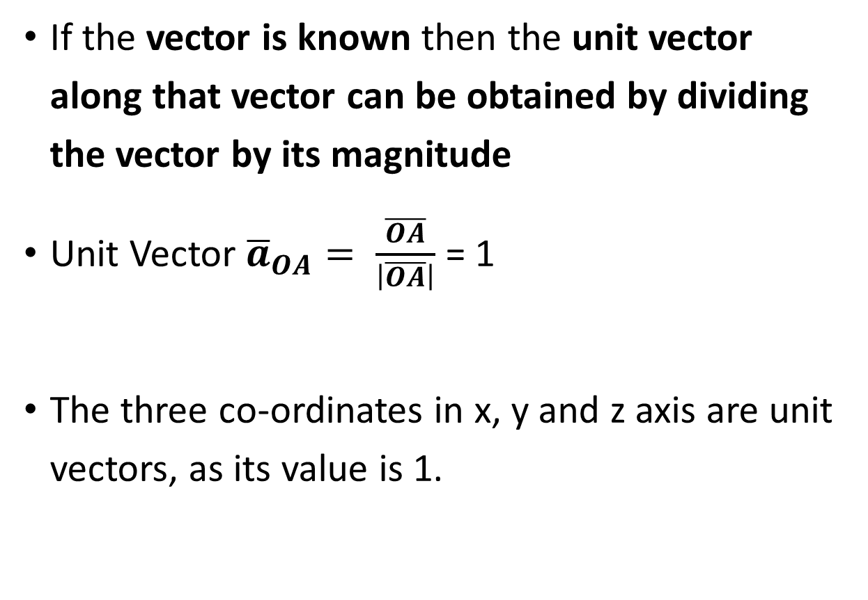
Vectors and Scalars
If the vector is known then the unit vector along that vector can be obtained by dividing the vector by its magnitude
Unit Vector ${\overline{a}}_{OA}= \frac{\overline{OA}}{\left|\overline{OA}\right|}$ = 1
The three co-ordinates in x, y and z axis are unit vectors, as its value is 1.
Notes:
$\frac{1}{\sqrt{1^{2}}}$=

Slide 10
Vectors and Scalars
Vector Algebra
The various mathematical operations such as Addition, subtraction, multiplication etc can be performed with the vector.
Scaling
Adding
Subtraction

Slide 11
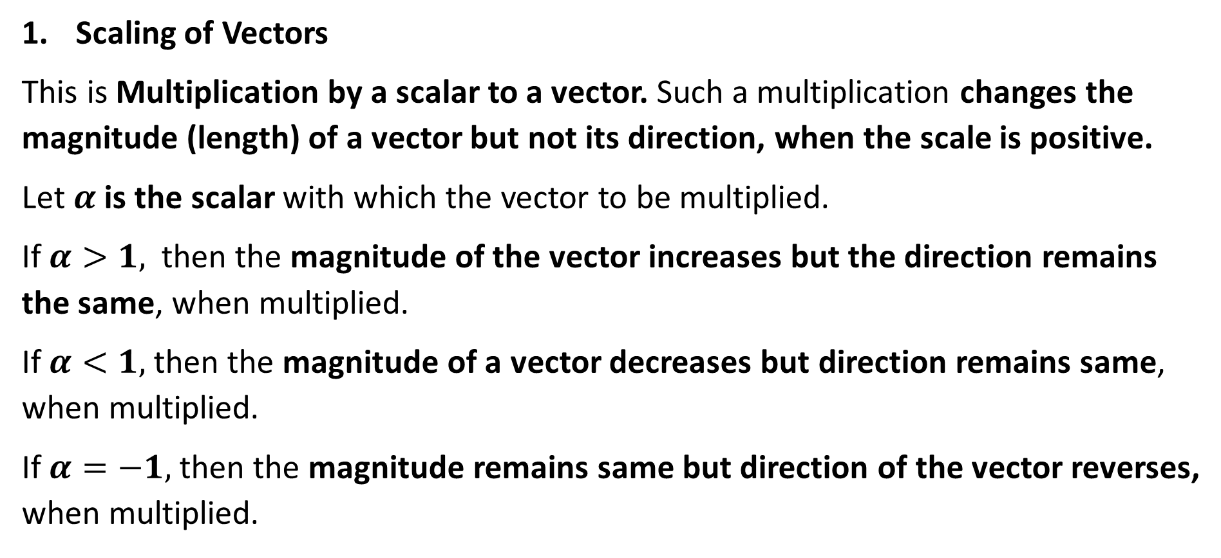
Vectors and Scalars
Scaling of Vectors
This is Multiplication by a scalar to a vector. Such a multiplication changes the magnitude (length) of a vector but not its direction, when the scale is positive.
Let $α$ is the scalar with which the vector to be multiplied.
If $α>1,$ then the magnitude of the vector increases but the direction remains the same, when multiplied.
If $α<1,$ then the magnitude of a vector decreases but direction remains same, when multiplied.
If $α=−1,$ then the magnitude remains same but direction of the vector reverses, when multiplied.

Slide 12
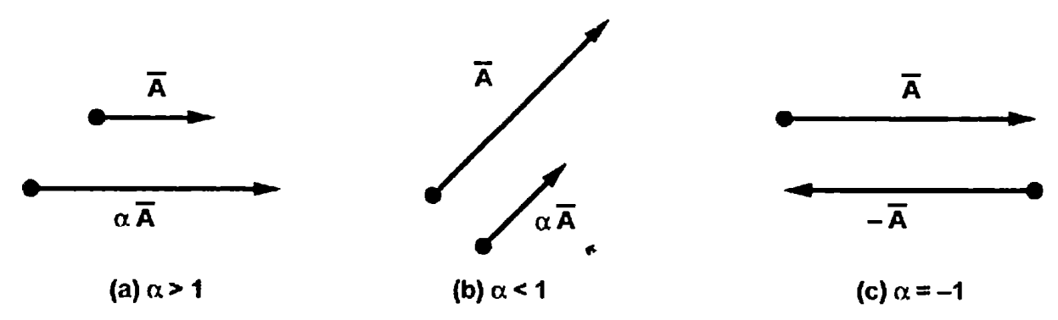
Vectors and Scalars

Slide 13
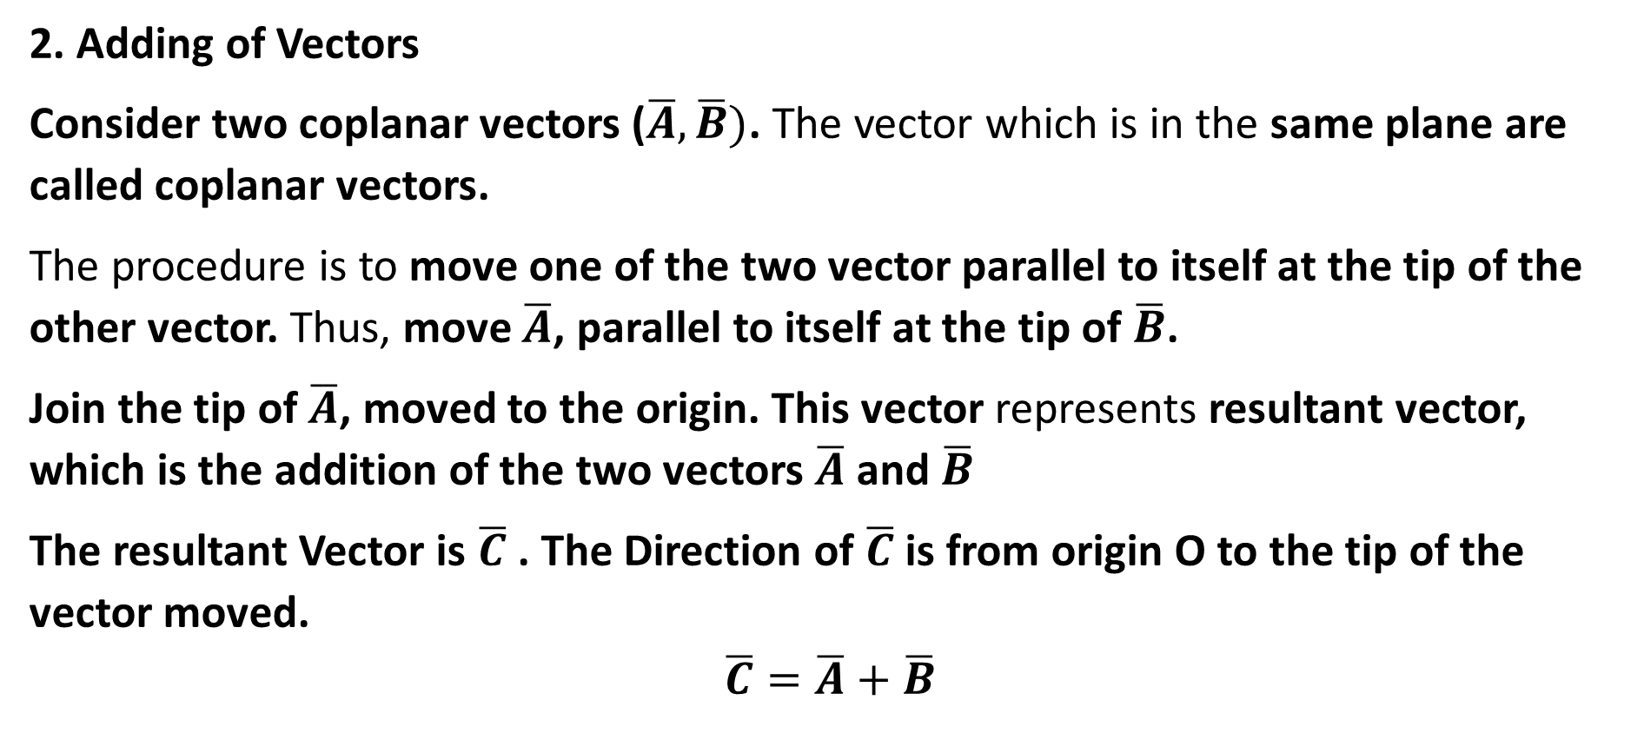
Vectors and Scalars
2. Adding of Vectors
Consider two coplanar vectors ($\overline{A},\overline{B})$. The vector which is in the same plane are called coplanar vectors.
The procedure is to move one of the two vector parallel to itself at the tip of the other vector. Thus, move $\overline{A}$, parallel to itself at the tip of $\overline{B}$.
Join the tip of $\overline{A}$, moved to the origin. This vector represents resultant vector, which is the addition of the two vectors $\overline{A}$ and $\overline{B}$
The resultant Vector is $\overline{C}$ . The Direction of $\overline{C}$ is from origin O to the tip of the vector moved.
$$\overline{C}=\overline{A}+\overline{B}$$

Slide 14
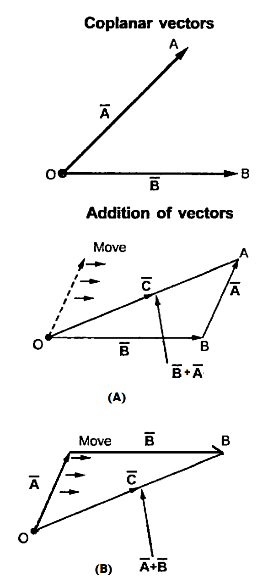
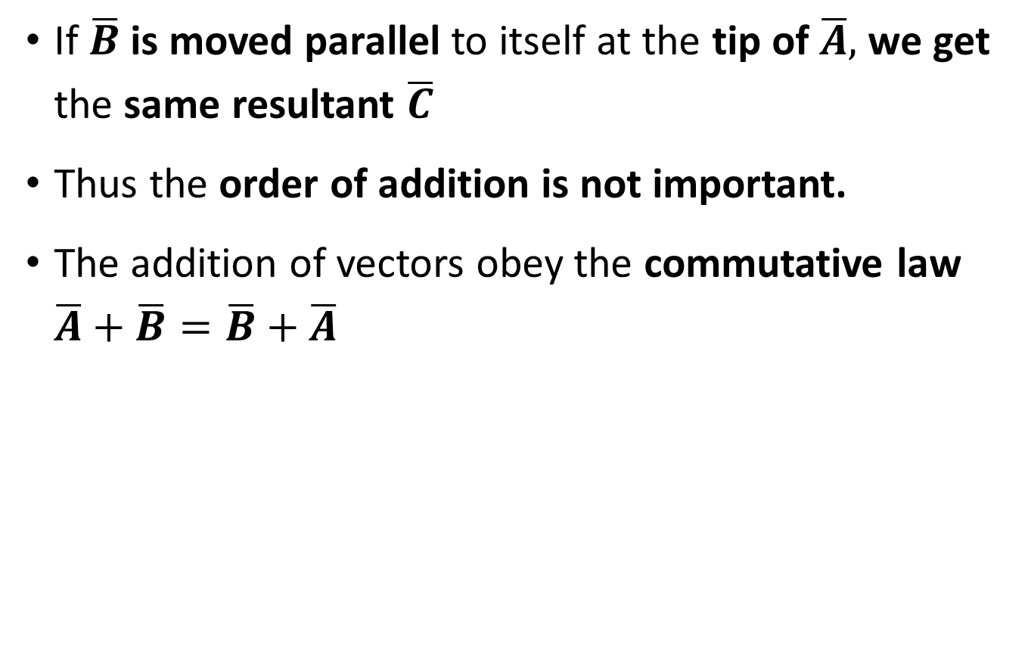
Vectors and Scalars
If $\overline{B}$ is moved parallel to itself at the tip of $\overline{A},$ we get the same resultant $\overline{C}$
Thus the order of addition is not important.
The addition of vectors obey the commutative law $\overline{A}+\overline{B}=\overline{B}+\overline{A}$

Slide 15
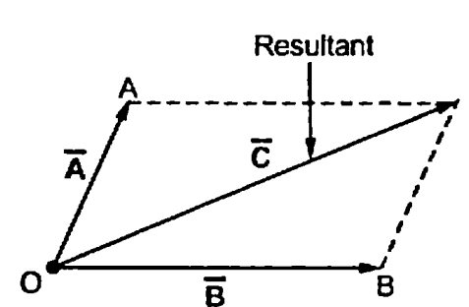
Vectors and Scalars
Another method of performing the addition of vectors is the parallelogram rule.
The diagonal of the parallelogram represents the addition of two vectors.
By using any of these two methods not only two but any number of vectors can be added to obtain the resultant.

Slide 16
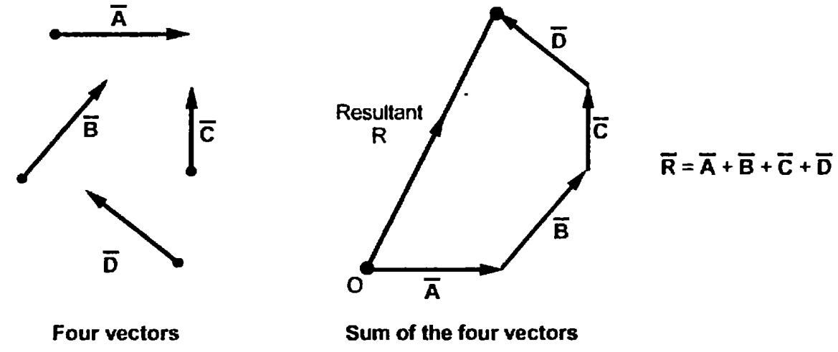
Vectors and Scalars
Consider 4 vectors, these can be added by shifting these vectors one by one to the tip of other vectors to complete the polygon.
The vector joining origin O to the tip of the last shifted vector represents the sum.
This method is called head to tail rule of addition of vectors.

Slide 17
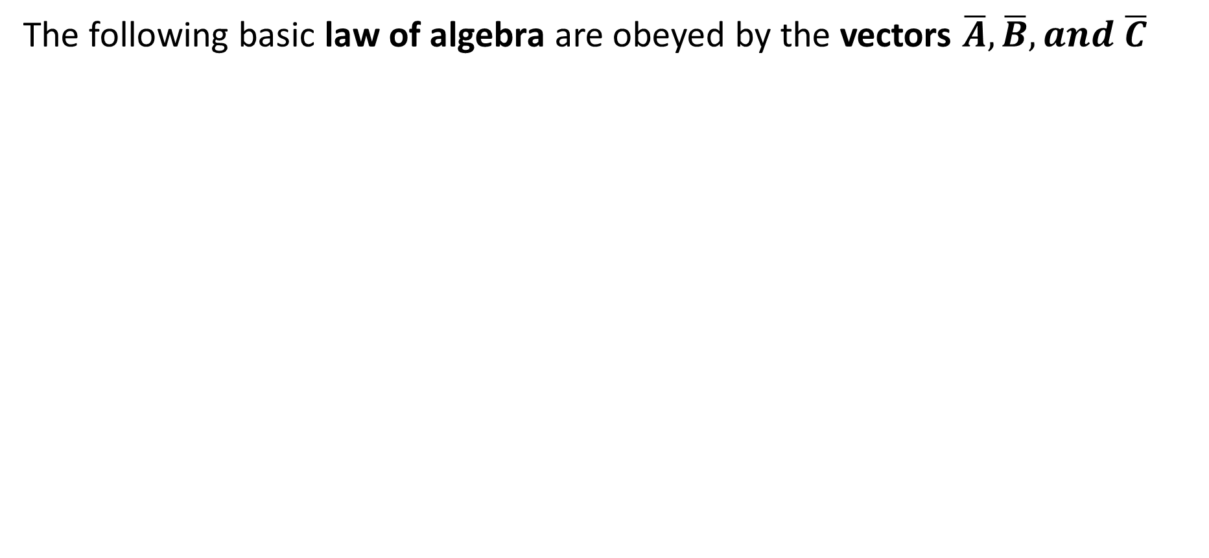
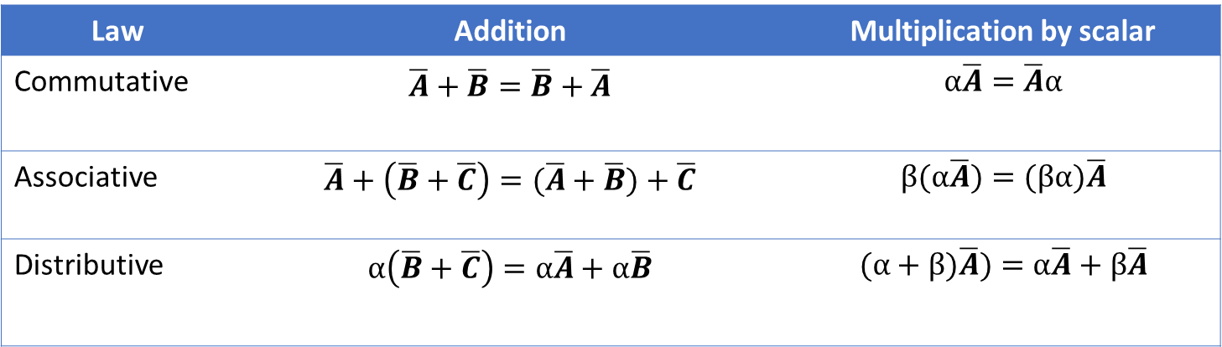
Vectors and Scalars
The following basic law of algebra are obeyed by the vectors $\overline{A}, \overline{B}, and \overline{C}$
Law | Addition | Multiplication by scalar
Commutative | $$\overline{A}+\overline{B}=\overline{B}+\overline{A}$$ | $$α\overline{A}=\overline{A}α$$
Associative | $$\overline{A}+\left(\overline{B}+\overline{C}\right)=(\overline{A}+\overline{B})+\overline{C}$$ | $$β(α\overline{A})=(βα)\overline{A}$$
Distributive | $$α\left(\overline{B}+\overline{C}\right)=α\overline{A}+α\overline{B}$$ | $$(α+β)\overline{A})=α\overline{A}+β\overline{A}$$

Slide 18
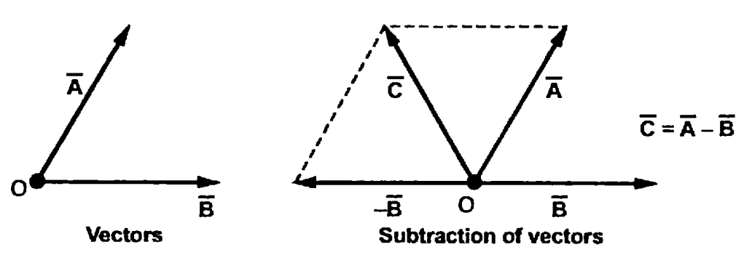
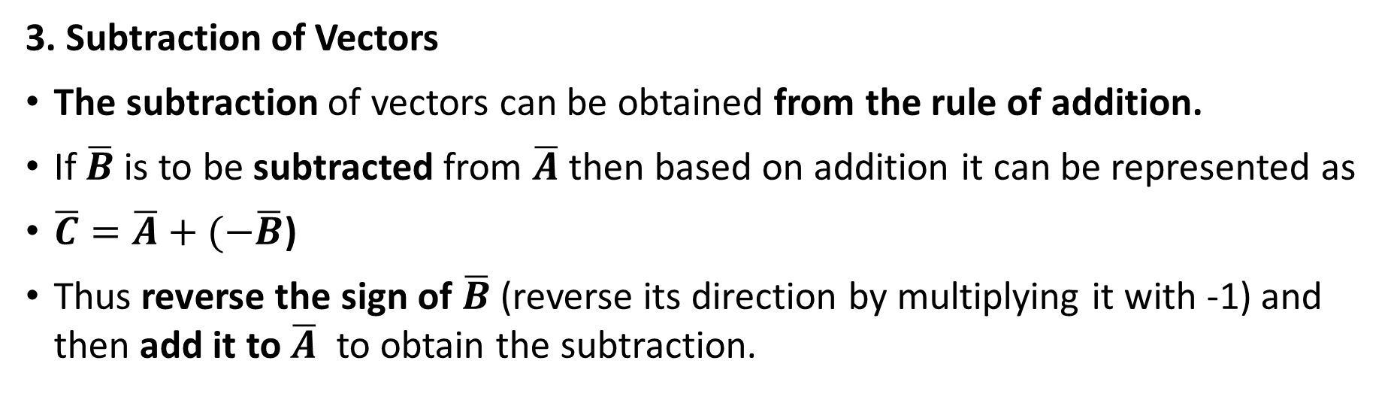
Vectors and Scalars
3. Subtraction of Vectors
The subtraction of vectors can be obtained from the rule of addition.
If $\overline{B}$ is to be subtracted from $\overline{A}$ then based on addition it can be represented as
$\overline{C}=\overline{A}+(−\overline{B}$)
Thus reverse the sign of $\overline{B}$ (reverse its direction by multiplying it with -1) and then add it to $\overline{A}$ to obtain the subtraction.

Slide 19
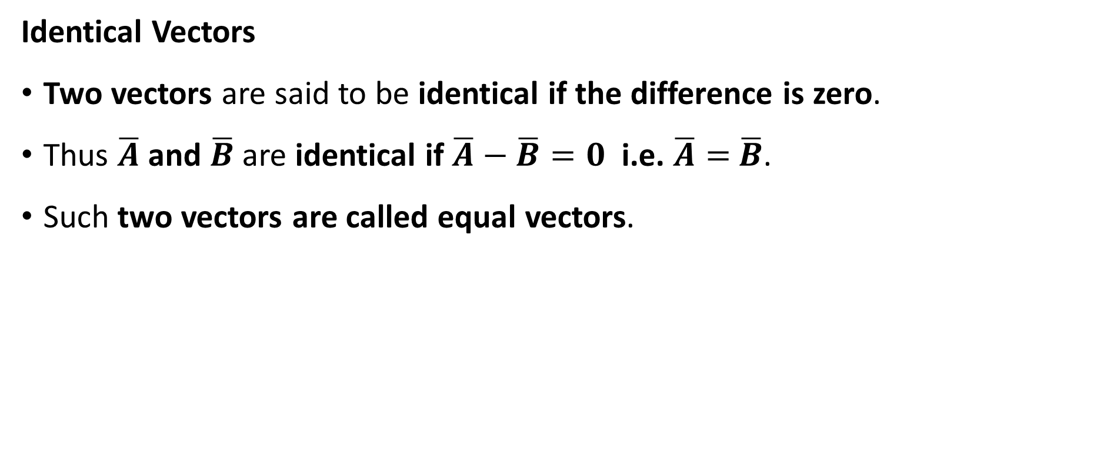
Vectors and Scalars
Identical Vectors
Two vectors are said to be identical if the difference is zero.
Thus $\overline{A}$ and $\overline{B}$ are identical if $\overline{A}−$ $\overline{B}=0$ i.e. $\overline{A}=$ $\overline{B}$.
Such two vectors are called equal vectors.

Slide 20
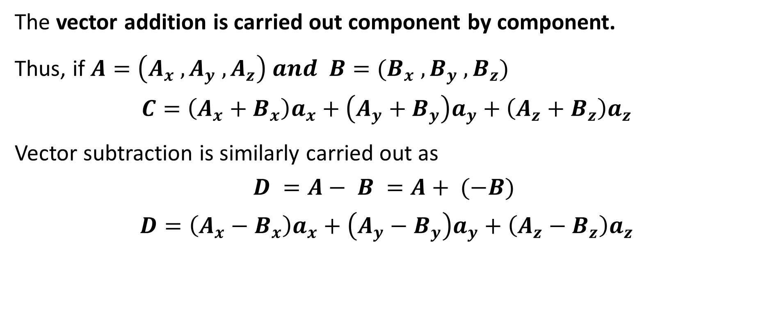
Vectors and Scalars
The vector addition is carried out component by component.
Thus, if $A=\left(A_{x} ,A_{y} ,A_{z}\right) and B=(B_{x} ,B_{y} ,B_{z})$
$$C=\left(A_{x}+B_{x}\right)a_{x}+\left(A_{y}+B_{y}\right)a_{y}+\left(A_{z}+B_{z}\right)a_{z}$$
Vector subtraction is similarly carried out as
$$D =A− B =A+ (−B)$$
$$D=\left(A_{x}−B_{x}\right)a_{x}+\left(A_{y}−B_{y}\right)a_{y}+\left(A_{z}−B_{z}\right)a_{z}$$

Slide 21
Vectors and Scalars
The Co-ordinates system
To describe vector accurately and to express a vector in terms of its components, it is necessary to have some reference directions. Such directions are represented in terms of various coordinate system.
Cartesian or Rectangular co-ordinate system
Cylindrical co-ordinate system
Spherical co-ordinate system

Slide 22
Vectors and Scalars
Cartesian or Rectangular co-ordinate system
This is also called rectangular co-ordinate system.
This system has three co-ordinate axes, represent x, y, z which are mutually at right to each other.
These three axes intersect at a common point called origin of the system.
Two types of systems are
Right handed system
Left handed system

Slide 23
Vectors and Scalars
Right handed system
If x- axis is rotated towards y-axis through a smaller angle, then this rotation causes the upward movement of right handed screw in the z axis direction.
Thumb -x axis, forefinger – y axis, middle finger – z axis
2. Left handed system
The x and y are inter changed. The rotation of x-axis into y-axis through smaller angle causes the downward movement of right handed screw in the z-axis direction.
In Cartesian coordinate system, x = 0 plane indicates two dimensional y-z plane, y=0 plane indicate two dimensional x-z plane and z=0 plane indicates two dimensional x-y plane

Slide 24
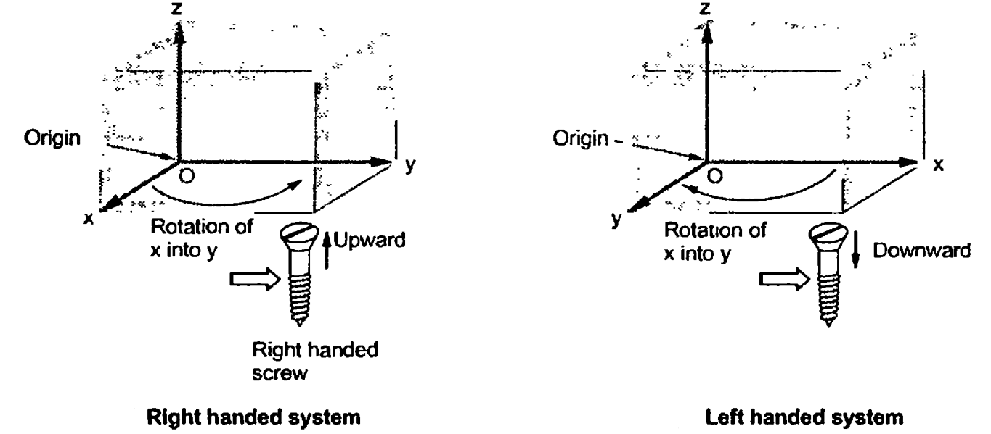
Vectors and Scalars

Slide 25
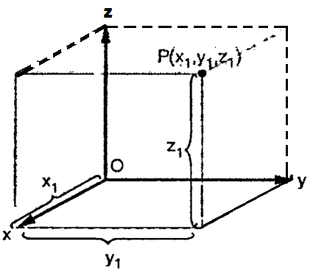
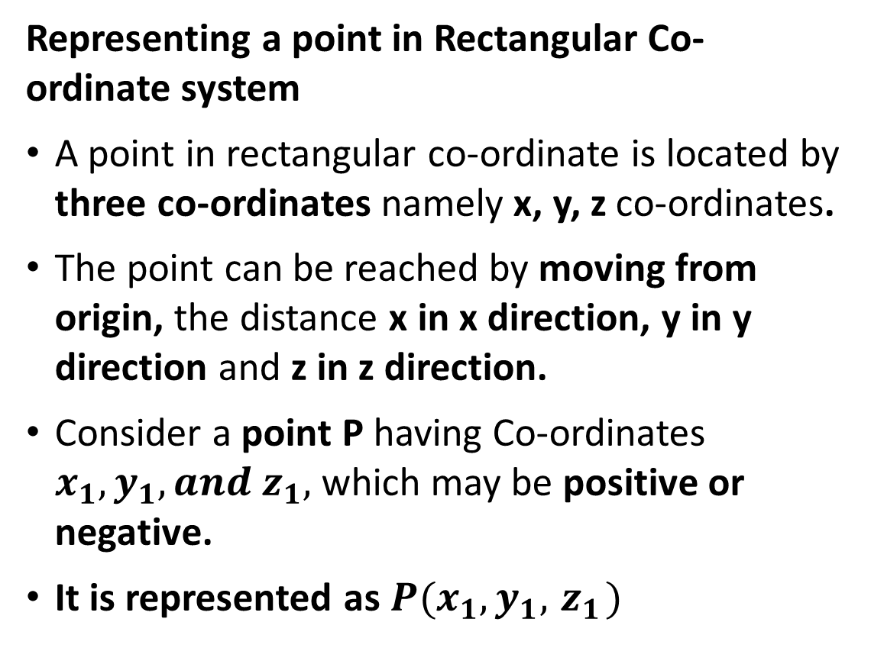
Vectors and Scalars
Representing a point in Rectangular Co-ordinate system
A point in rectangular co-ordinate is located by three co-ordinates namely x, y, z co-ordinates.
The point can be reached by moving from origin, the distance x in x direction, y in y direction and z in z direction.
Consider a point P having Co-ordinates $x_{1},y_{1}, and{ z}_{1},$ which may be positive or negative.
It is represented as ${P(x}_{1},y_{1}, { z}_{1})$

Slide 26
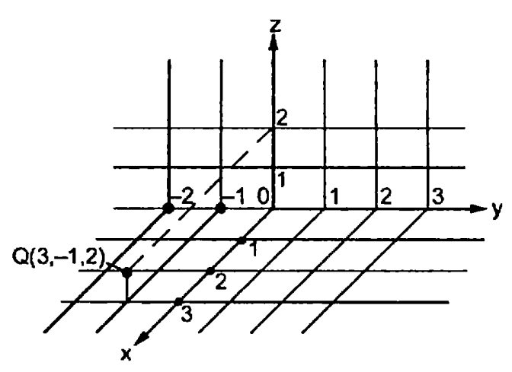
Vectors and Scalars
The Point Q(3,-1,2) can be shown in this system as

Slide 27
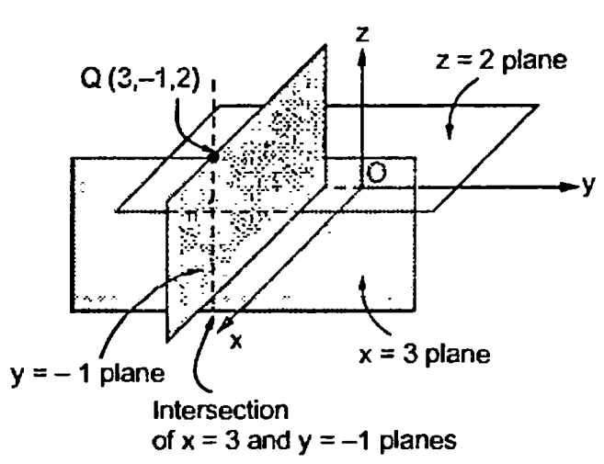
Vectors and Scalars
Another method to define a point is to consider three surfaces namely x=constant, y=constant and z=constant planes.
The common intersection point of these three surface is the point to be defined and the constants indicate the coordinats of that point.
Consider Point Q, which is intersection of three planes namely x=3 plane, y=-1 plane and z=2 plane.

Slide 28
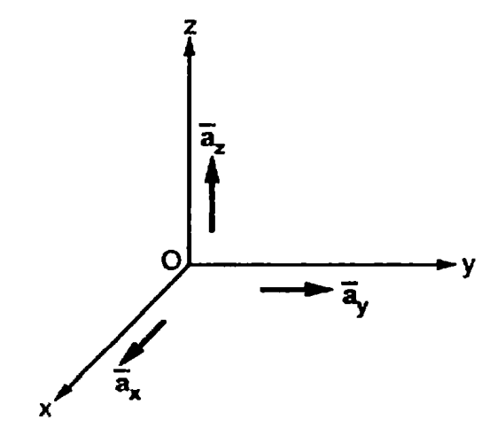
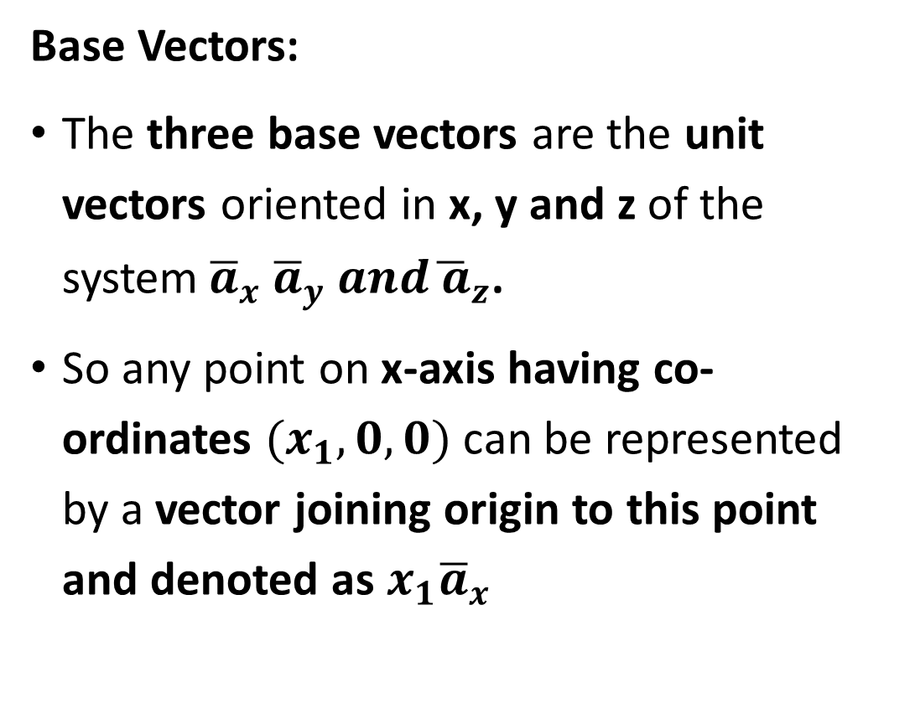
Vectors and Scalars
Base Vectors:
The three base vectors are the unit vectors oriented in x, y and z of the system${\overline{a}}_{x}{ \overline{a}}_{y} and{\overline{ a}}_{z}$.
So any point on x-axis having co-ordinates $(x_{1}, 0, 0)$ can be represented by a vector joining origin to this point and denoted as $x_{1}{\overline{a}}_{x}$

Slide 29
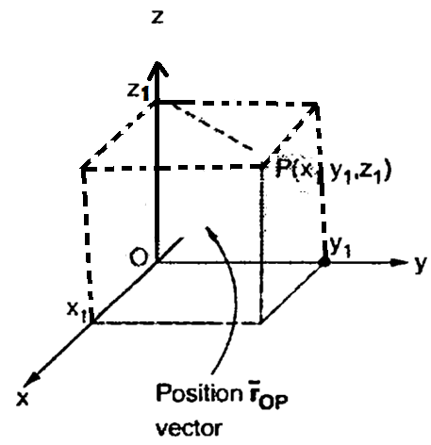
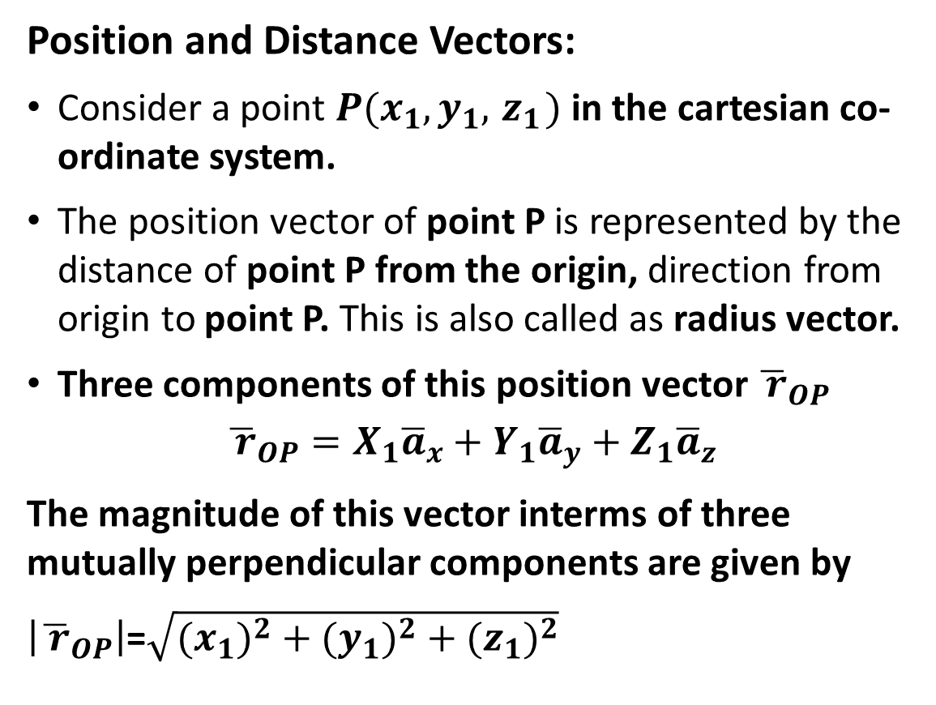
Vectors and Scalars
Position and Distance Vectors:
Consider a point ${P(x}_{1},y_{1}, { z}_{1})$ in the cartesian co-ordinate system.
The position vector of point P is represented by the distance of point P from the origin, direction from origin to point P. This is also called as radius vector.
Three components of this position vector ${\overline{ r}}_{OP}$
$${\overline{ r}}_{OP}=X_{1}{\overline{a}}_{x}+Y_{1}{\overline{a}}_{y}+Z_{1}{\overline{a}}_{z}$$
The magnitude of this vector interms of three mutually perpendicular components are given by
$\left|{\overline{ r}}_{OP}\right|$=$\sqrt{{{(x}_{1})}^{2}+{{(y}_{1})}^{2}+{{(z}_{1})}^{2}}$

Slide 30
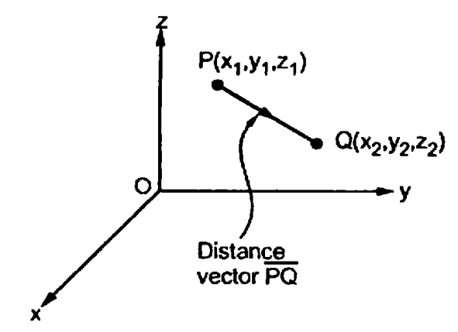
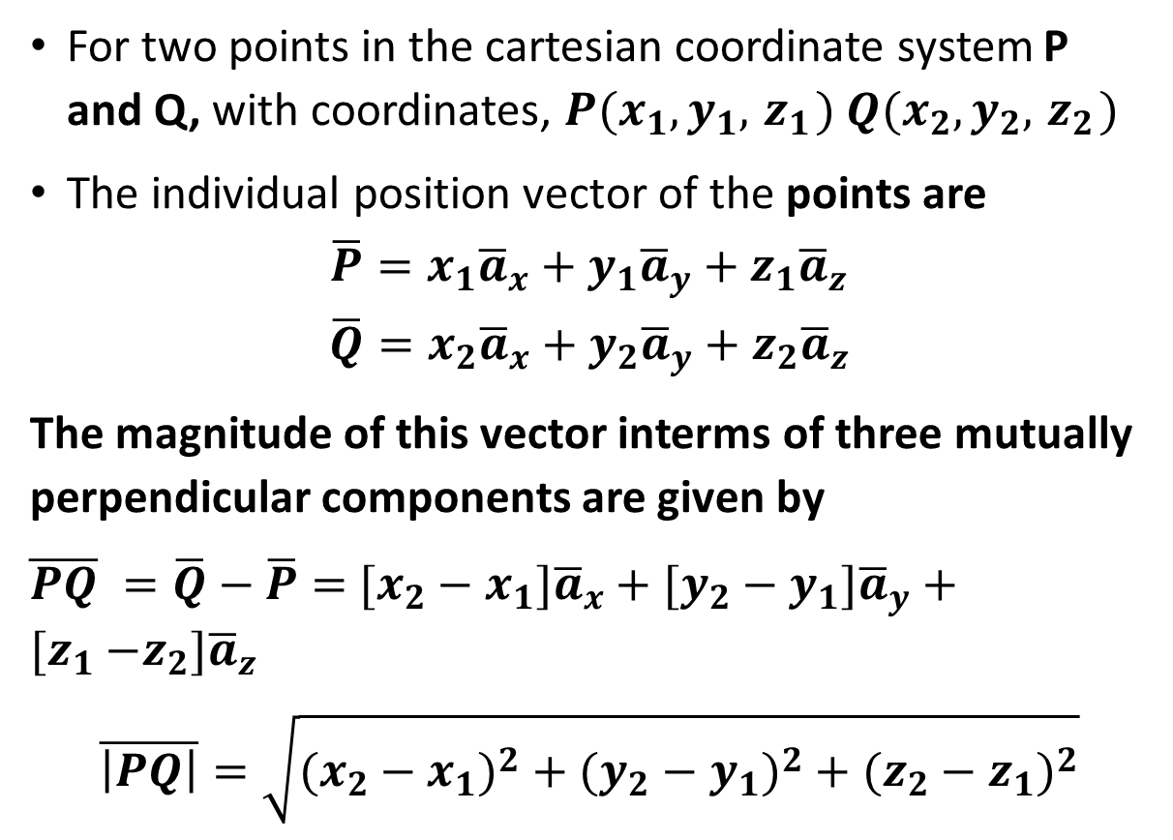
Vectors and Scalars
For two points in the cartesian coordinate system P and Q, with coordinates, ${P(x}_{1},y_{1}, { z}_{1})$ ${Q(x}_{2},y_{2}, { z}_{2})$
The individual position vector of the points are
$$\overline{P}=x_{1}{\overline{a}}_{x}+y_{1}{\overline{a}}_{y}+z_{1}{\overline{a}}_{z}$$
$$\overline{Q}=x_{2}{\overline{a}}_{x}+y_{2}{\overline{a}}_{y}+z_{2}{\overline{a}}_{z}$$
The magnitude of this vector interms of three mutually perpendicular components are given by
$\overline{PQ} =\overline{Q}−\overline{P}=$ ${[x_{2}−x}_{1}]{\overline{a}}_{x}+{[y_{2}−y}_{1}]{\overline{a}}_{y}+[z_{1}{−z_{2}]\overline{a}}_{z}$
$$\overline{\left|PQ\right|}=\sqrt{{{(x_{2}−x}_{1})}^{2}+{{(y_{2}−y}_{1})}^{2}+{{(z_{2}−z}_{1})}^{2}}$$

Slide 31
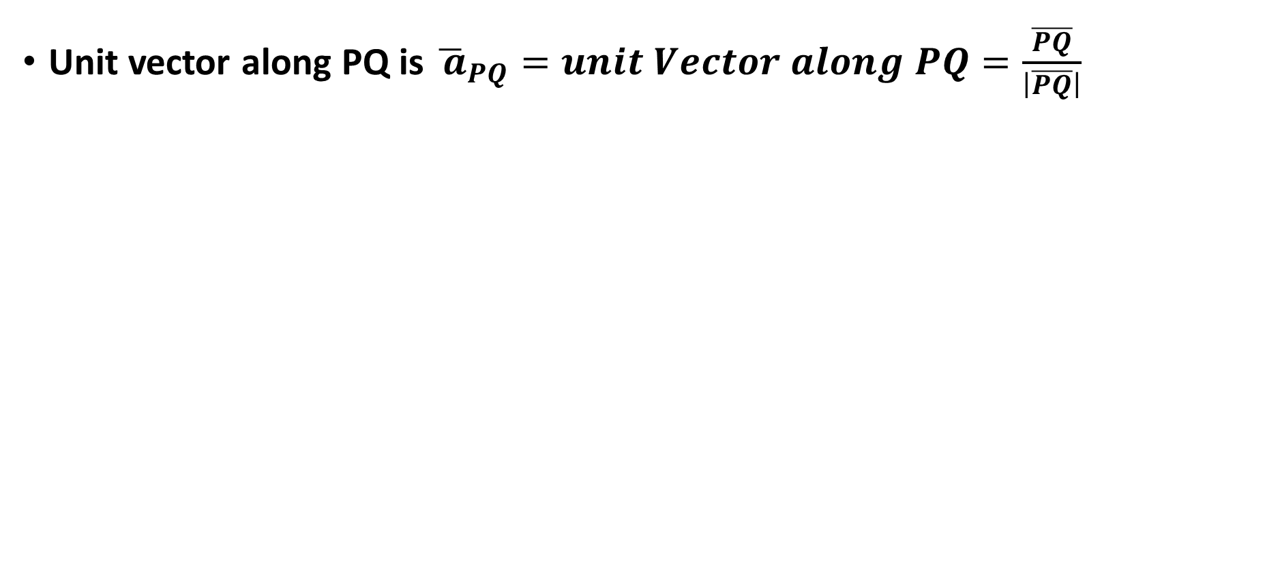
Vectors and Scalars
Unit vector along PQ is ${\overline{ a}}_{PQ}=unit Vector along PQ=\frac{\overline{PQ}}{\left|\overline{PQ}\right|}$

Slide 32
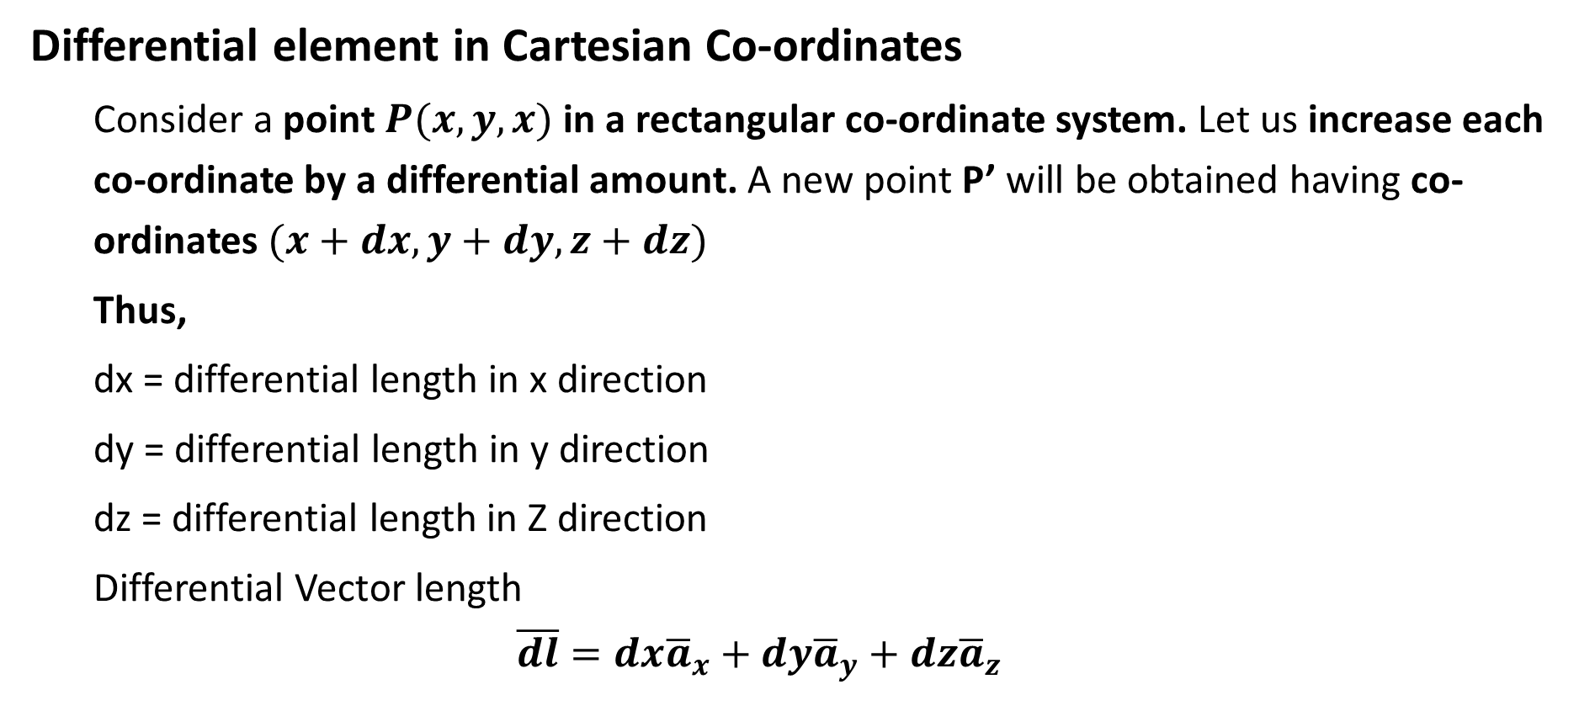
Vectors and Scalars
Differential element in Cartesian Co-ordinates
  Consider a point $P(x,y,x)$in a rectangular co-ordinate system. Let us increase each co-ordinate by a differential amount. A new point P’ will be obtained having co-ordinates $(x+dx, y+dy, z+dz)$
  Thus,
  dx = differential length in x direction
  dy = differential length in y direction
  dz = differential length in Z direction
  Differential Vector length
  $$\overline{dl}=dx{\overline{a}}_{x}+dy{\overline{a}}_{y}+dz{\overline{a}}_{z}$$

Slide 33
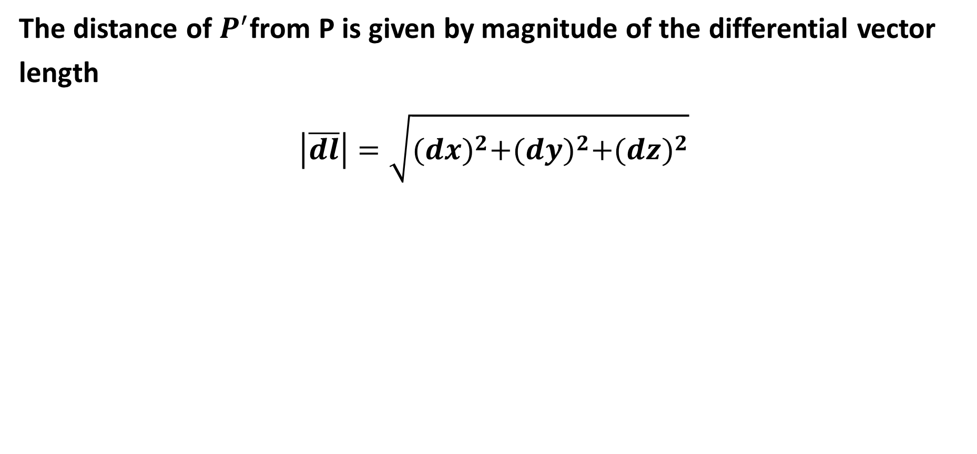
Vectors and Scalars
The distance of $P^{′}$from P is given by magnitude of the differential vector length
$$\left|\overline{dl}\right|=\sqrt{{(dx)}^{2}+{(dy)}^{2}+{(dz)}^{2}}$$

Slide 34
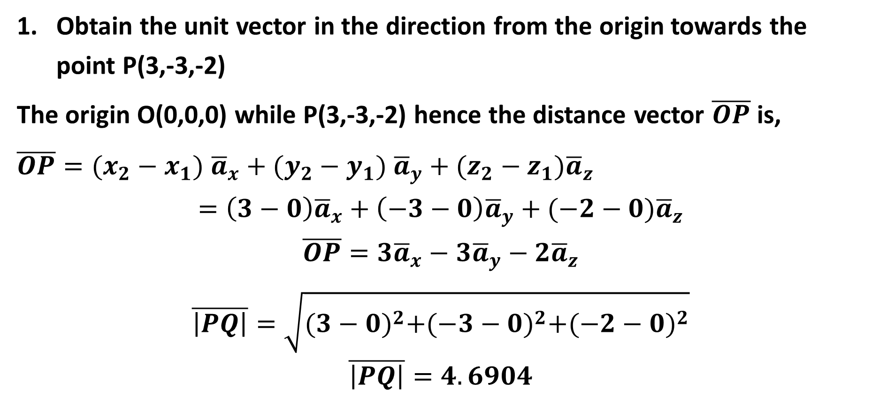
Vectors and Scalars
Obtain the unit vector in the direction from the origin towards the point P(3,-3,-2)
The origin O(0,0,0) while P(3,-3,-2) hence the distance vector $\overline{OP}$ is,
$\overline{OP}=(x_{2}−x_{1})$ ${\overline{a}}_{x}+(y_{2}−y_{1}) {\overline{a}}_{y}+(z_{2}−z_{1}){\overline{a}}_{z}$
$$=\left(3−0\right){\overline{a}}_{x}+\left(−3−0\right){\overline{a}}_{y}+(−2−0){\overline{a}}_{z}$$
$$\overline{OP}=3{\overline{a}}_{x}−3{\overline{a}}_{y}−2{\overline{a}}_{z}$$
$$\overline{\left|PQ\right|}=\sqrt{{(3−0)}^{2}+{(−3−0)}^{2}+{(−2−0)}^{2}}$$
$$\overline{\left|PQ\right|}=4.6904$$

Slide 35
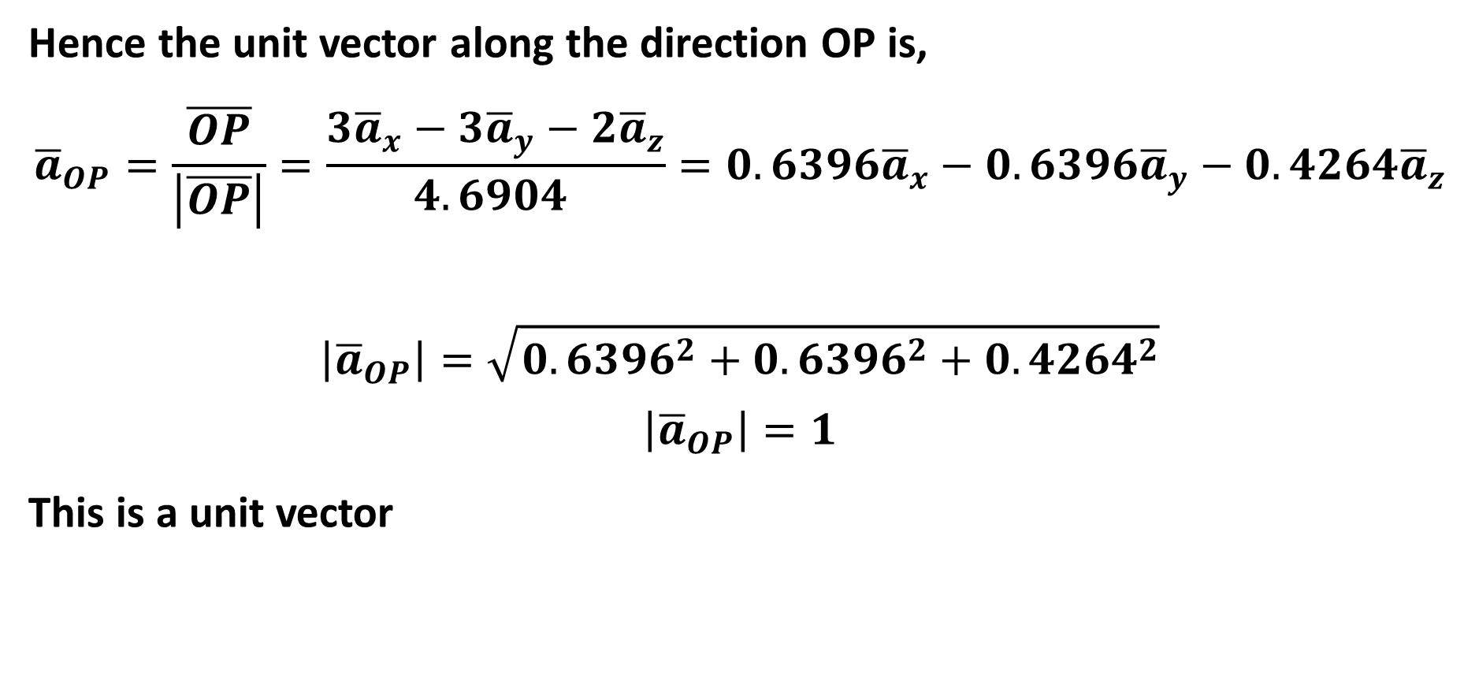
Vectors and Scalars
Hence the unit vector along the direction OP is,
$${\overline{a}}_{OP}=\frac{\overline{OP}}{\left|\overline{OP}\right|}=\frac{3{\overline{a}}_{x}−3{\overline{a}}_{y}−2{\overline{a}}_{z}}{4.6904 }=0.6396{\overline{a}}_{x}−0.6396{\overline{a}}_{y}−0.4264{\overline{a}}_{z}$$
$$\left|{\overline{a}}_{OP}\right|=\sqrt{{0.6396}^{2}+{0.6396}^{2}+{0.4264}^{2}}$$
$$\left|{\overline{a}}_{OP}\right|=1$$
This is a unit vector

Slide 36
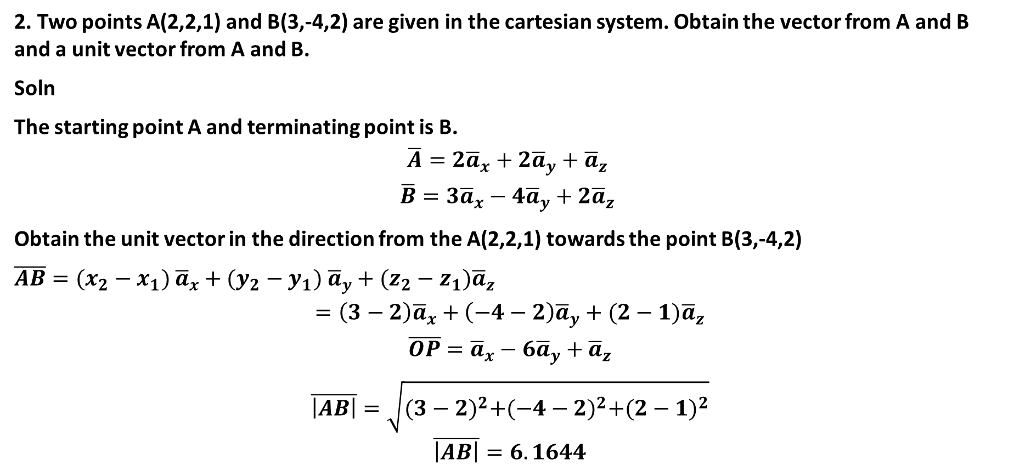
Vectors and Scalars
2. Two points A(2,2,1) and B(3,-4,2) are given in the cartesian system. Obtain the vector from A and B and a unit vector from A and B.
Soln
The starting point A and terminating point is B.
$$\overline{A}=2{\overline{a}}_{x}+2{\overline{a}}_{y}+{\overline{a}}_{z}$$
$$\overline{B}=3{\overline{a}}_{x}−4{\overline{a}}_{y}+2{\overline{a}}_{z}$$
Obtain the unit vector in the direction from the A(2,2,1) towards the point B(3,-4,2)
$\overline{AB}=(x_{2}−x_{1})$ ${\overline{a}}_{x}+(y_{2}−y_{1}) {\overline{a}}_{y}+(z_{2}−z_{1}){\overline{a}}_{z}$
$$=\left(3−2\right){\overline{a}}_{x}+\left(−4−2\right){\overline{a}}_{y}+(2−1){\overline{a}}_{z}$$
$$\overline{OP}={\overline{a}}_{x}−6{\overline{a}}_{y}+{\overline{a}}_{z}$$
$$\overline{\left|AB\right|}=\sqrt{{(3−2)}^{2}+{(−4−2)}^{2}+{(2−1)}^{2}}$$
$$\overline{\left|AB\right|}=6.1644$$

Slide 37
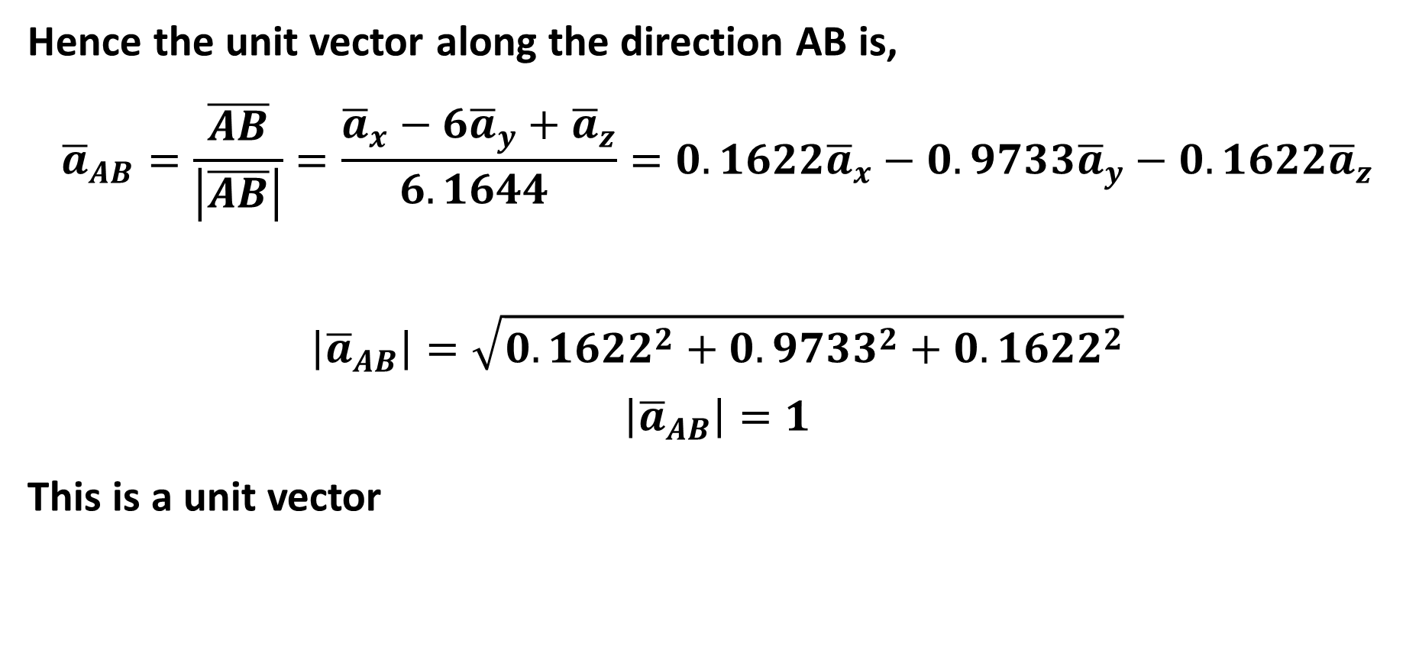
Vectors and Scalars
Hence the unit vector along the direction AB is,
$${\overline{a}}_{AB}=\frac{\overline{AB}}{\left|\overline{AB}\right|}=\frac{{\overline{a}}_{x}−6{\overline{a}}_{y}+{\overline{a}}_{z}}{6.1644 }=0.1622{\overline{a}}_{x}−0.9733{\overline{a}}_{y}−0.1622{\overline{a}}_{z}$$
$$\left|{\overline{a}}_{AB}\right|=\sqrt{{0.1622}^{2}+{0.9733}^{2}+{0.1622}^{2}}$$
$$\left|{\overline{a}}_{AB}\right|=1$$
This is a unit vector

Slide 38

Thank You
Module Descriptor

