Slide 1
Recruiting a Graduate AI Strategist at UWTSD
Student: ID: 2416334

Slide 2
The Recruitment Case
Purpose: Enhance AI learning and graduate readiness.
UK Survey: 95% used AI in some form; 94% used it to support assessed work.
Local Baseline: Sector self-reports do not establish UWTSD outcomes.
HR Approach: Recruit capability, support development and review performance.
Notes:
I recommend appointing a Graduate AI Strategist to strengthen students’ responsible use of AI and support their careers. According to Stephenson and Armstrong (2026), AI is widely used among UK undergraduates, but that does not mean UWTSD students have the same needs. Start local and work outwards. As Raisch and Krakowski (2021) note, AI can automate and augment work. Our recruitment strategy thus involves ability, motivation and opportunity.

Slide 3
Job Description and Employment Terms
Job Details | Proposed Employment Terms
Job Title | Graduate AI Strategist
Contract Duration | 12 month development appointment
Working Hours | 37 hours per week
Annual Salary | £30,000 gross
Work Location | Quay Place Campus, 92-93 Edward St, Birmingham B1 2RA
Work Arrangement | Hybrid: 3 campus days + 2 remote days
Reporting Line | Senior Academic Sponsor
Management Responsibility | No line management
Approval Status | Subject to HR approval and job evaluation
Notes:
I would like to propose a 12 month position, to be based at the UWTSD, Quay Place Campus, 92-93 Edward St, Birmingham B1 2RA. This will include 37 hours a week, a salary of up to £30,000 a year and 3 days on campus and 2 days remotely. These are assumptions which need formal HR approval. The graduate would report to a senior academic sponsor, coordinate projects, and be supervised, without responsibility for university wide policy or procurement.

Slide 4

Duties and Decision Boundaries
Key Responsibilities
Student needs assessment
Accessible learning design
AI pilot coordination
Risk register management
Learning outcome evaluation
Decision Boundaries
Data privacy escalation
Procurement decision escalation
Academic policy compliance
Authorised team approval
(ICO, 2023).
Notes:
The strategist would evaluate student needs, develop accessible resources, and plan and monitor approved AI pilots and their results. While applications of AI in higher education are documented by Crompton and Burke (2023), this does not necessarily mean that a new tool will enhance learning. Thus, local testing is required. Responsible data governance is maintained, with authorised teams retaining technical, privacy, and purchasing decisions (ICO, 2023).

Slide 5

Essential Person Specification
Experience with projects and demonstrable learning for the relevant degree or equivalent.
Critical AI literacy and easy explanation to laypeople.
Design for inclusive learning and ethical judgements.
Planning, working together, responsibility and learning from mistakes.
Evidence can be based on study, placements, work or volunteer.
(Ng et al., 2021)
Notes:
Education or equivalent experience, critical AI literacy and inclusive communication and teaching skills are required. According to Ng et al. (2021), AI literacy is not confined to operating AI software but includes understanding and evaluation. Candidates are expected to show good judgement regarding potentially unreliable outputs, student access and ethical issues. Coursework, placements, work or volunteering will be accepted to provide fair opportunities for graduate applicants.

Slide 6
Desirable Criteria and Fair Selection
Desirable Qualities: Peer teaching, data analysis, Welsh capability and documented AI projects.
Shortlisting: Two assessors shortlist using essential criteria and evidence.
Interview Process: Six common questions, neutral probes and independent scoring.
Selection Threshold: Proposed threshold is 65/100 with minimum Q3 score 3/4 with all essentials met.
Fair Treatment: Reasonable adjustments and protected interview records can help towards fair treatment.
(Sackett et al., 2022; ACAS, 2026).
Notes:
Peer teaching, data analysis, Welsh language ability and recorded AI projects are all desirables. Two assessors would shortlist using essential criteria. Using structured questions and consistent scoring minimises impression bias (Sackett et al., 2022). Applicants would be made reasonable adjustments, following ACAS (2026). I propose a minimum score of 65 out of 100 and at least three out of four for ethics.

Slide 7
Student AI Literacy Programme
Learning Unit | Training Activities | Duration
Understand AI | Make a comparison between a plausible answer and a reliable source. | 45 minutes
Use responsibly | Fill out a sanctioned formative activity and describe choices. | 60 minutes
Assess Outputs | Spot and correct mistakes and fix a fake reference. | 60 minutes
Ethics and Careers | Provide a rationale for a safe workflow in the workplace. | 45 minutes
Inclusive Learning | All units are accompanied by accessible alternatives and independent learning checks. | Throughout
Total Duration | Four training units and inclusive learning support | 3.5
(Ng et al., 2021)
Notes:
Propose 4 Units of 3.5 hours. The students would be taught to understand Artificial Intelligence, responsibly use approved tools and recognise and evaluate ethical scenarios in the workplace and identify fabricated sources. This corresponds with Ng et al. (2021)'s AI literacy dimensions. Learning would be demonstrated through short independent tasks rather than attendance. For students without paid access to a tool, alternatives would be provided.

Slide 8
Institutional Readiness
Responsible Stakeholders | Key Responsibilities
Academics | Rules and subject examples specific to assessment.
Management and HR | Sponsor, budget, protected time and supervision.
Digital Services and Data Protection | Tool review and approval conditions.
Library and Learner Developers | Verification, study support and accessibility.
Careers Services | Workplace judgement
International delivery | local review of language and data rules.
(Marin-Garcia and Martinez Tomas, 2016; ICO, 2023).
Notes:
Implementation requires collaboration. Academic staff need to clarify assessment rules, HR and management need to fund and supervise the initiative and Digital Services need to approve technical safeguards. Library and learning support teams can provide instruction on Verification and Accessibility and careers staff can provide instruction on Employability. Opportunity in HRM emphasizes the factor of ‘time offered by staff ', which points to the time available for staff (Marin-Garcia and Martinez Tomas, 2016). Specialists are needed to review data use (ICO, 2023).

Slide 9
90 Days Implementation Plan and Evaluation
Key Areas | Implementation and Evaluation Plan
Implementation Timeline | Days 1-30 - baseline and scope. Day 31-60: Two day pilot in two modules. Days 61-90: review.
Estimated Budget | Planning subtotal £36,000: £30,000 salary + £6,000 support. Employment on-costs excluded.
Performance Targets | completion rate 80% and 80% of the completion rate achieve competence.
Evaluation Measures | Retention, access differences and staff workload in relation to learning.
Decision Making | Be sure to extend only on the basis of evidence and approval. Stop activities, which have high risks that have not been resolved.
Notes:
The graduate would begin the baseline during days one through thirty. Days 31-60 would be piloting resources in 2 modules, with review at day 90. The budget is given as an illustration only and is £36,000 excluding on-costs. Proposed targets: 80% completion and 80% competence of the completers. We would also look at accessibility, workload and retention. Expansion should be based on evidence and not attendance alone and should be approved or risk-assessed.

Slide 10
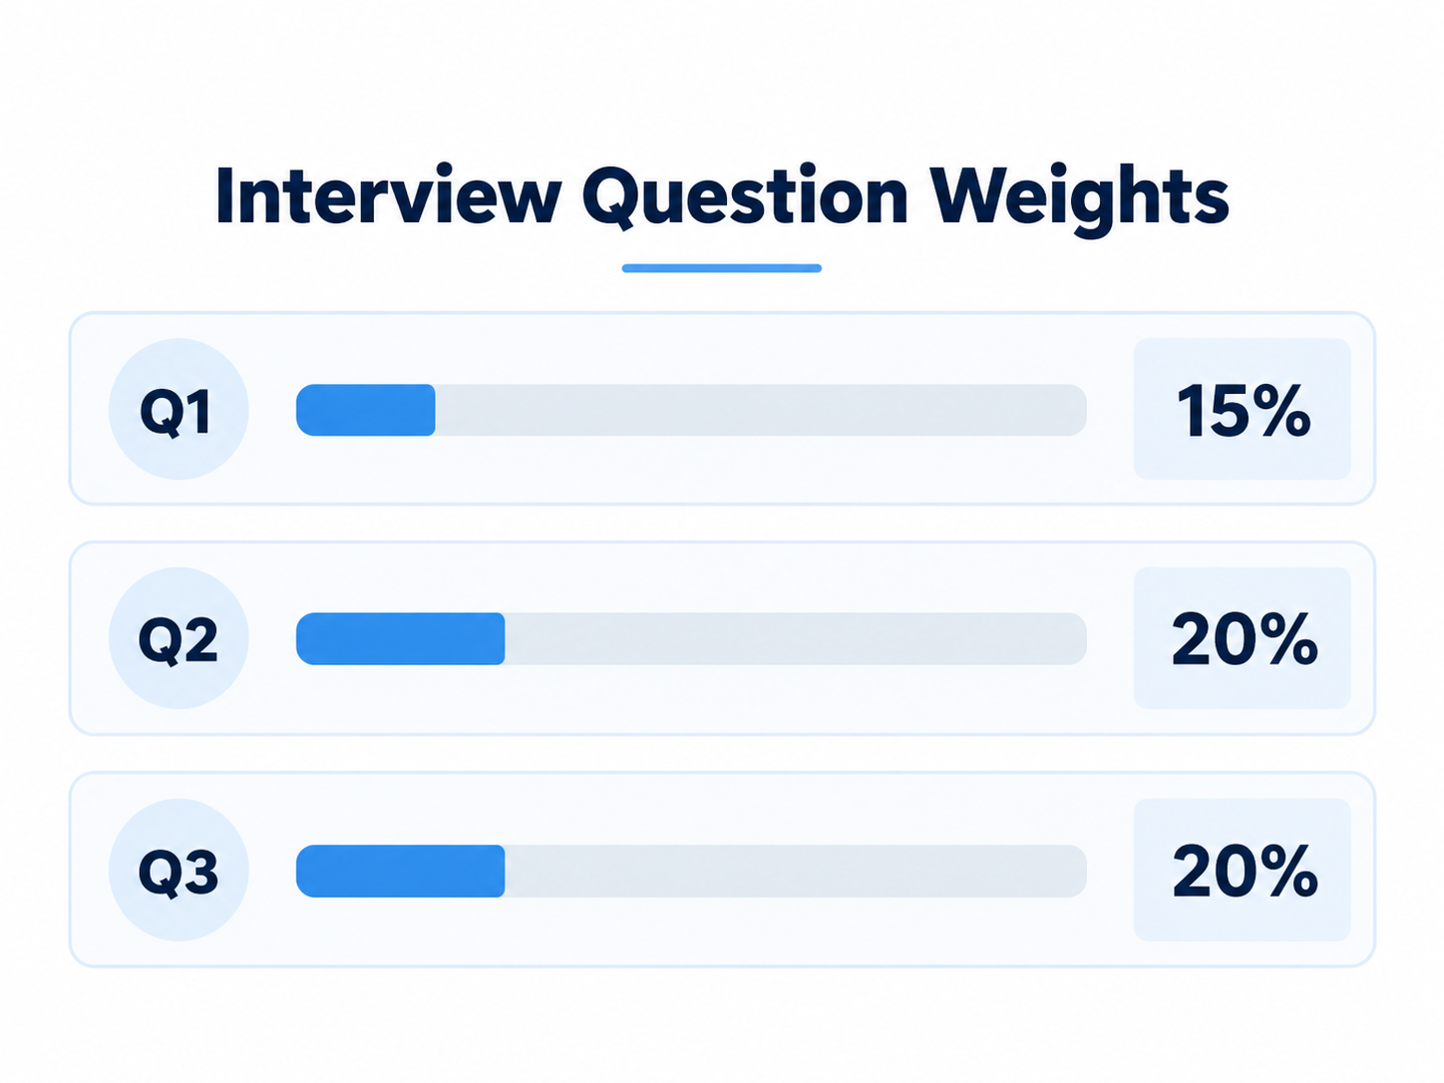
Interview Questions on Strategy and Learning
Question 1: Strategic Judgement
What SME tasks would you want to automate and what would you like to teach students?
Question 2: Inclusive AI Learning
What would you design an AI workshop for students of various skill levels and access to tools?
Question 3: Ethical AI and Data Protection
How would you act in the situation prior to operating an assistant seeking student records and providing biased advice?
(Raisch and Krakowski, 2021; Ng et al.;2021; ICO, 2023).
Notes:
As the Hiring Manager, I created 6 structured interview questions to assess the Graduate AI Strategist against the person specification. All candidates would be given the same questions, follow-up prompts and be given the opportunity to request reasonable adjustments. This helps create a more equitable comparison, but remember that interview results cannot predict how a person will perform in the workplace (Sackett et al., 2022).
The first question is: “How would you decide which SME tasks to automate and what students should learn?” I would ask what evidence would affect the candidate's recommendation. The concept of automation and augmentation is explained by Raisch and Krakowski (2021). So, I would expect candidates to consider task quality, costs, employment implications and opportunities for graduate development. A good response would suggest a small-scale trial under human control and avoid assuming it will be beneficial. This question carries 15%.
My second question is: “How would you design an AI workshop for students with different skills and tool access?” I would inquire about the candidate's measurement of learning and not attendance. Ng et al. (2021) define AI literacy as understanding, application, evaluation and ethics. The best candidates would suggest clear aims, clear resources and an activity that should enable students to check the answer that the AI had produced. They should provide alternatives for students that do not have a subscription and make clear how learning will be assessed. This question carries 20%.
My third question is: “Proposed AI study assistant demands student records which are easy to identify and provides biased advice.” What would happen if you didn't get a green light from a pilot? I would ask: Who would have to authorise any further action? I would have hoped the candidate would not have continued to use identifiable data, would have sought appropriate data protection and technical advice and would have explored the possibility of using synthetic data. They should understand that no matter how many biased outputs are corrected, that does not equal fairness throughout the system. For this question, 20% and at least 3 out of 4 marks will be available.
These scenarios are not testing memorised technical terminology, but rather judgement. Crompton and Burke (2023) introduce a wide range of uses of AI in Higher Education; however, their review is not able to prove the success of our proposed project. So, I would give good marks to candidates who are able to differentiate between an idea and an established outcome and who recognise uncertainty. The indicators would be agreed by assessors and evidence recorded independently and not for confidence only. The questions aim to provide insight into applicants' ability to think, explain choices and understand the boundaries of a graduate position.

Slide 11
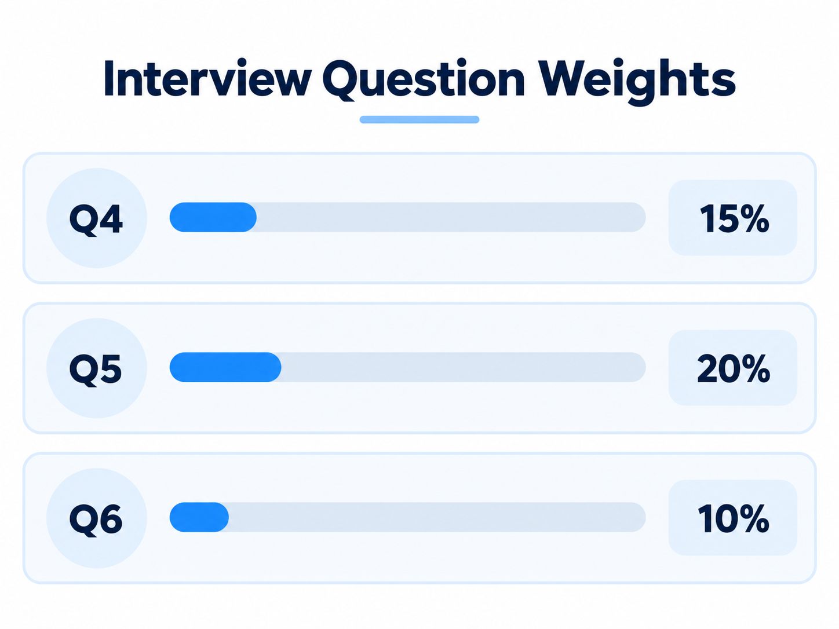
Interview Questions on Delivery and Evidence
Question 4: Collaboration and Conflict Resolution
What would you do in case of a clash between a conservative teacher and the careers staff who want to get students out the door quickly?
Question 5: Evaluation and Improvement
What would you do differently if you had high attendance and yet the students were taking fake notes?
Question 6: Reflective Learning
What would a project in which you learned a tool have to do with your first 90 days here?
Selection and Scoring
Score 0-4 independently.
Compare evidence and document decision
Proposed threshold: 65/100.
In Q3 you need to get at least 3/4.
All essential criteria have to be met.
(Sackett et al., 2022; ACAS, 2026).
Notes:
My fourth question is: “A lecturer who does not want to use AI training due to fears of academic misconduct and career risks and the careers staff who want as soon as possible.” “What would you do to find a solution to the problem?” Then I would ask the candidate: If this doesn't change, what would you do? Anticipate listening, awareness of competing priorities and a plan for a controlled formative trial. Academic authority cannot be circumvented. The ability, motivation and opportunity framework emphasise institutional support (Marin-Garcia and Martinez Tomas, 2016). This question has a weighting of 15% and tests on collaboration, accountability and escalation.
My 5th question is “Students still take fabricated AI reference although workshop attendance is high. What would you do to investigate the problem and to improve the programme?” I would question them to explain how they would prevent themselves from saying that training would improve outcomes, but there's no proof of that. A good answer would distinguish between attendance and demonstrated competence, analyse students' mistakes and accessibility issues and redesign activities with regard to source verification. The applicant may suggest similar evaluations and a follow-up evaluation be postponed. But even improved scores might be the result of practice or differences in participants. The educational value must be shown by the strategist; this question is worth 20%.
My sixth question is: “Write about a project, placement or voluntary work that you were involved in and learnt a new tool and involved others to coordinate. How would that experience relate to your first 90 days here?” My follow-up would have been to talk about things learned and how you changed in cross-cultural or language situations. I would look for personal contribution, obstacles, feedback and realistic improvement. The lesson or volunteering should count! Reflective learning, delivery and professional potential will be assessed with this question, which is weighted at 10%.
Two assessors would independently rate each score on a 0-4 point scale, based on agreed behavioural indicators. Each mark would be divided by 4 and multiplied by the percentage that it is allotted. Decisions should be based on the recorded evidence and not personal impression, following structured selection principles (Sackett et al., 2022). Reasonable adjustments and a clear feedback process would be in place, in line with ACAS (2026). My proposed appointment threshold is that they score at or above 65 out of 100, of which at least 3 out of 4 on the ethics question and score all essential criteria. I would recommend not appointing if no one meets the following:
Lastly, I would check the graduate's progress over the 90 days and then set up to resolve any training deficiencies in a timely manner. This can help reveal the support required or areas of weakness in the selection process, but no one appointment alone is sufficient to statistically validate the interview. My recommendations connect fair recruitment, supervision, responsible innovation and measurable student learning.

Slide 12
References
ACAS (2026) Interviewing job applicants. Available at: https://www.acas.org.uk/recruitment/interviewing-job-applicants (Accessed: 16 October 2026).
Crompton, H. and Burke, D. (2023) ‘Artificial intelligence in higher education: the state of the field’, International Journal of Educational Technology in Higher Education, 20, article 22. Available at: https://doi.org/10.1186/s41239-023-00392-8. (Accessed: 16 October 2026).
Information Commissioner’s Office (ICO) (2023) Guidance on AI and data protection. Available at: https://ico.org.uk/for-organisations/uk-gdpr-guidance-and-resources/artificial-intelligence/guidance-on-ai-and-data-protection/ (Accessed: 16 October 2026).
Marin-Garcia, J.A. and Martinez Tomas, J. (2016) ‘Deconstructing AMO framework: a systematic review’, Intangible Capital, 12(4), pp. 1040–1087. Available at: https://doi.org/10.3926/ic.838. (Accessed: 16 October 2026).
Ng, D.T.K., Leung, J.K.L., Chu, S.K.W. and Qiao, M.S. (2021) ‘Conceptualizing AI literacy: An exploratory review’, Computers and Education: Artificial Intelligence, 2, article 100041. Available at: https://doi.org/10.1016/j.caeai.2021.100041. (Accessed: 16 October 2026).
Raisch, S. and Krakowski, S. (2021) ‘Artificial intelligence and management: The automation–augmentation paradox’, Academy of Management Review, 46(1), pp. 192–210. Available at: https://doi.org/10.5465/amr.2018.0072. (Accessed: 16 October 2026).
Sackett, P.R., Zhang, C., Berry, C.M. and Lievens, F. (2022) ‘Revisiting meta-analytic estimates of validity in personnel selection: Addressing systematic overcorrection for restriction of range’, Journal of Applied Psychology, 107(11), pp. 2040–2068. Available at: https://doi.org/10.1037/apl0000994. (Accessed: 16 October 2026).
Stephenson, R. and Armstrong, C. (2026) Student generative artificial intelligence survey 2026. HEPI Report 199. Oxford: Higher Education Policy Institute. Available at: https://www.hepi.ac.uk/reports/student-generative-ai-survey-2026/ (Accessed: 16 October 2026).

