Slide 1
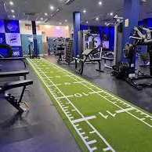
Cleo’s Gym Business Plan
By Ionela Filip-Datcu, id 1922490
Lecturer name: Vasilios Tavlaridis

Slide 2
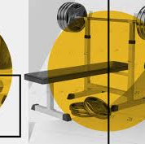
About us
Welcome
This a family run gym. It started with an idea during lockdown when my daughter and I had to improvise a lot at home to keep fit. We did a lot of exercise and then thought about opening a gym.

Slide 3

Business overview
Cleo’s Gym is an exclusive fitness club that expects to provide an improvement to the lifestyle of all its members .
Cleo’s Gym mission is to educate members about the art and discipline for a healthy & sustainable lifestyle regime.

Slide 4
Our Product and services
Service program | Overview
Crash Loss Program | -reducing the body fat percentage of clients
Crash Gain Program | -to build muscle with correct exercise and nutrition
Weight Gain Program | -to gain weight with the correct knowledge of nutrition
Diet plans& Charts | -offers a diet plans for beginners
Kangoo Jumps exercise | -jumping along with music to stay fit and loose weight
Yoga Training Program | -provide yoga and meditation to clients
Wellness Course | -provide the correct knowledge about the fitness industry.
Notes:
Cleo’s Gym create for her members a personalised and customised programmes according to their goals. The list of fitness programs will be in accordance with the goals of its clients and will compromise :

Slide 5
Market research
Marketing strategies to reach the Target Market
Traditional Marketing
Word of the Mouth Strategy
Social Media Marketing
Digital Marketing
Influencer Marketing
Membership Marketing
Notes:
Traditional marketing – marketing strategies such as flyers, business cards , print advertising & banner advertisrments
Word of the Mouth Strategy- existing members to bring in , new admissions that help maximize revenue.
Social Media Marketing – Instagram , YouTube, Facebook.
To attract customers Cleo’s Gym has focus on consumer behavior and looking to anticipate their needs.

Slide 6
Target Market
The most important segment will be women between 18 years and 32 years old.
The target segment is expected to be women who are active, involved in sport, wishing to maintain a healthy lifestyle ,women looking to cut down on body fat and tone their bodies

Slide 7
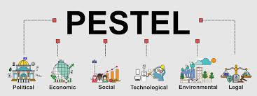
Pestel Analyses
Pest Analysis is another strategic management tool that helps in identifying and analysing the external influences or the macro-environmental influences which may have an impact on the business.
Political - Covid 19 pandemic has impacted the industry, but the Government supporting the recovery.
Economic -The lockdowns in January 2020 for gyms and fitness facilities in the UK have caused a combined decrease in £90m worth of revenue each week. The level of activity and results is a long road to recovery and will potentially result in a long-lasting structural change in the industry.
Social-during the pandemic, people in Uk prioritizing in being more active, have online fitness classes from home
Technological – new equipment and periodic upgrade of machines.

Slide 8
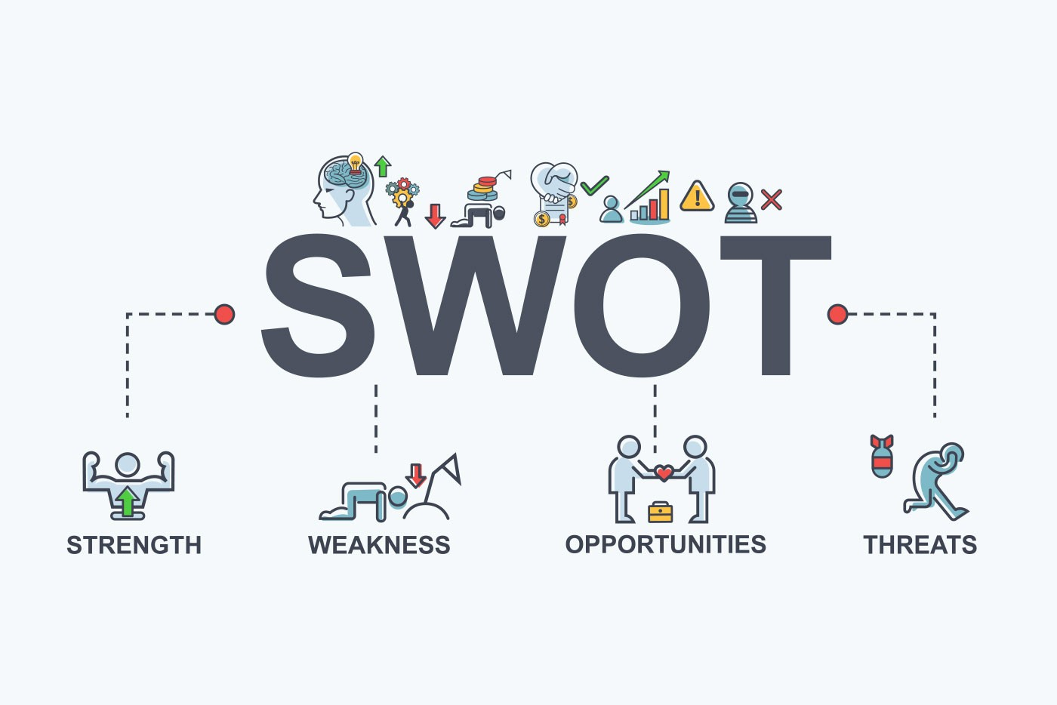
Strength | Weakness | Opportunities | Threats
-the passion for fitness -location -competitive price -latest equipment | -lack operational experience -selected target market | -expand the location -set up a mini -store based on nutritional supplements | -competitive threat - market saturated

Slide 9
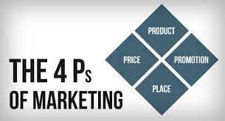

Cleo’s Gym 4 Ps of marketing
For the fitness world the pricing plan is correlate with the classes and services offers and to promote and attract a large variety of customers.
Cleo’s Gym has a range of products, is located in Erdington , a great position that will certainly help attract more possibilities through the door. Cleo’s Gym must promote the best services in terms of their value, promotion is a crucial aspect of marketing.

Slide 10

Management Team and operations
Director :Lucian Filip-Datcu- coordinates the activity of the organization
Marketing Lead : Ionela Filip-Datcu- coordinating the sales activity and provide marketing strategies
Fitness coach: Paul Stanley
Yoga coach: Emma Walker
Reception :Doreen Jordan – offer warm welcome

Slide 11

Financial Plan
Start-up Cost: £80,000.00
Total Income:£25,321.00
Total Expenses:£21,570.83
Gross Profit: £450.00
Net Profit: £85.00

Slide 12
References
Economics Observatory, 2021. What does coronavirus mean for the future of sport and fitness clubs? - Economics Observatory. [online] Economics Observatory. Available at: <https://www.economicsobservatory.com/what-does-coronavirus-mean-future-sport-and-fitness-clubs> [Accessed 21 October 2021].
Erdingtonlocal.com, 2021. NEWS: Erdington named one of the ‘best places to live’ in Birmingham by property industry experts -. [online] Erdingtonlocal.com. Available at: <http://www.erdingtonlocal.com/news-erdington-named-one-of-the-best-places-to-live-in-birmingham-by-property-industry-experts/> [Accessed 21 October 2021].
GOV.UK, 2021. Government announces allocation of £100 million to support recovery of leisure centres. [online] GOV.UK. Available at: <https://www.gov.uk/government/news/government-announces-allocation-of-100-million-to-support-recovery-of-leisure-centres> [Accessed 21 October 2021].
Guardian, 2021. Leisure facilities face £90m a week loss under UK winter Covid-19 lockdown. [online] the Guardian. Available at: <https://www.theguardian.com/sport/2021/jan/07/leisure-facilities-face-90m-a-week-loss-under-uk-winter-covid-19-lockdown> [Accessed 21 October 2021].
Hunger, J.D., 2020. Essentials of strategic management.

Slide 13
References
Lasserre, P., 2017. Global strategic management. Macmillan International Higher Education.
Leisureopportunities.co.uk, 2021. UK gym industry calls for sector-specific government financial support | Leisure Opportunities news. [online] Leisureopportunities.co.uk. Available at: <https://www.leisureopportunities.co.uk/news/Physical-activity-sector-calls-for-a-National-Physical-Activity-Plan-and-financial-protection-as-government-announces-lockdown-3-VAT-reductions-rent-protection-business-rate-relief/346919> [Accessed 21 October 2021].
Men's Health, 2021. New Studies Highlight Covid-19's Impact on Changing Fitness Habits. [online] Men's Health. Available at: <https://www.menshealth.com/uk/health/a35360124/covid-19s-impact-changing-fitness-habits/> [Accessed 21 October 2021].
Startups.co.uk, 2021. How to Start a Gym Business 2021 | Guide by Startups.co.uk. [online] Startups.co.uk. Available at: <https://startups.co.uk/guides/how-to-start-a-gym-business/#:~:text=Starting%20a%20gym%20business%20is,smaller%2C%20like%20a%20fitness%20studio.> [Accessed 21 October 2021].
Wholesale.rdxsports.com, 2021. 10 Marketing Strategies for Gyms and Fitness Clubs. [online] Wholesale.rdxsports.com. Available at: <https://wholesale.rdxsports.com/blog/10-marketing-strategies-for-gyms-and-fitness-clubs> [Accessed 21 October 2021].
https://marketingmix.co.uk/4ps-marketing/[Accessed 30 October 2021]

