Slide 1


ORGANISATIONAL CHANGE CASE STUDY
Jade Emery
Notes:
Hello
My name is Jade Emery
I am the change agent for the Park Veterinary group.
I will be taking you thorough my initial analyse that I have undertaken to work towards a major and vital change within the organisation.

Slide 2

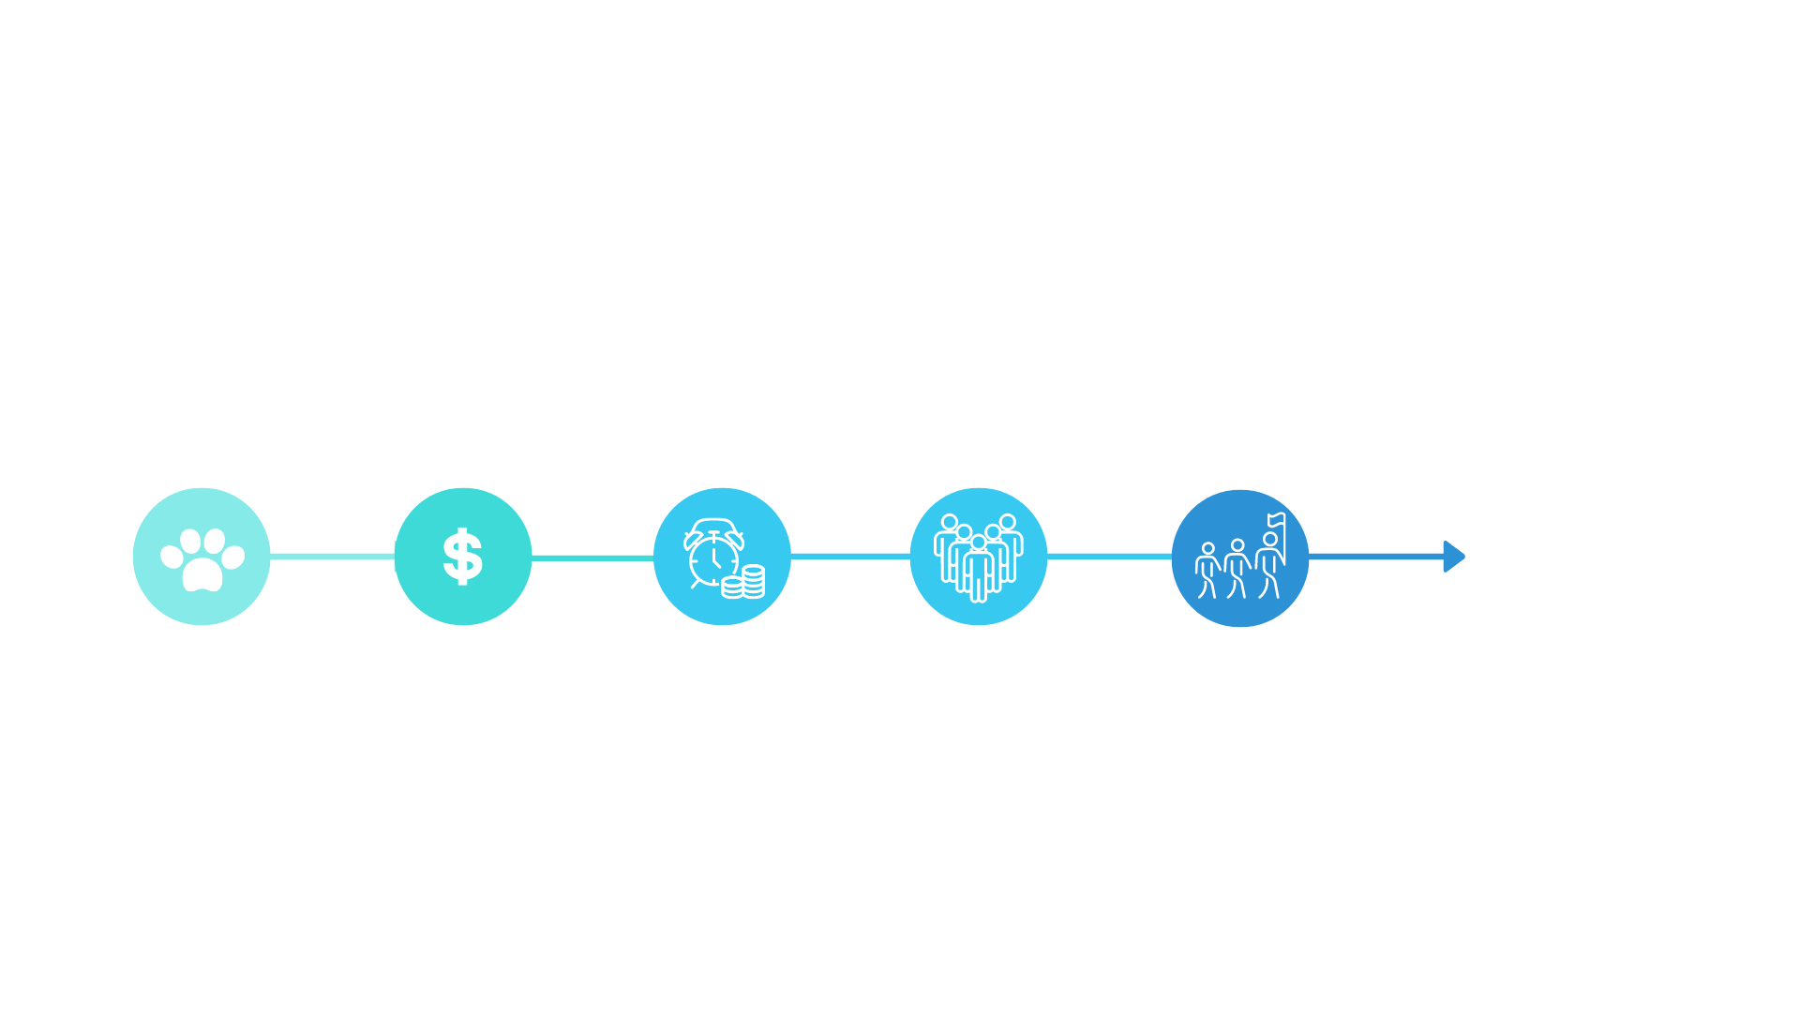
Notes:
The Park Veterinary Group is a long standing veterinary practice with three branches operating in South Wales.
Four years ago the practice was bought by a corporate company named VetPartners. Despite this acquisition the practice remains very independent run by a team of directors.
Two years ago, all the original directors retired. Shortly following their retirements we also experienced the sudden resignation or our two out of three remaining managers. This change has had the most detrimental effect on the whole team. And since then the practice has experienced a high turnover of employees, a loss of trust in leadership, lack of customer focus and the innovation to sustain success.
The main objective is to analyse how change was managed previously, then to learn from it and to move forward using efficient planned change models.
Due to the disruption the change in leadership caused the team, the goal for change will be organisation culture
“Organisational culture is outlined at the highest level of an organisation and then communicated, supported, and enforced throughout every level.” (SHRM, u.d)
The new leadership team must take a proactive approach to build a positive culture.

Slide 3

Change management
Current Approach
Emergent
Approach
Work towards
Planned
Approach
Unfreeze
Transition
Refreeze
Kurt Lewin (1947)
Notes:
Through analysis of the major and sudden changes that occurred within the organisation, the current approach can be described as "Emergent."
The emergent approach to change is based on the assumption that change is not a linear process or a one-off isolated event, but a continuous, open-ended, cumulative and unpredictable process of aligning and re-aligning an organization to its changing environment (Falconer, 2002).
The emergent approach reflects Park Vets working environment, which became in the last few years unpredictable, turbulent, and difficult to predict. The emergent approach regards change 'as a process that unfolds through the interplay of multiple variables such as context, political processes and consultation within an organisation’ (Bamford, 2003).
The effects of an emergent approach have caused unpredictability. With this analyse, a logical decision would be to move to a planned approach to improve group effectiveness which will help to achieve a better culture in an environment that is currently more stable.
Once the approach has been established, creating successful change is achieved by either strengthening the driving forces or weakening the restraining forces.
The force field analysis integrates with Lewins three stage theory of change as you work towards unfreezing the existing equilibrium, moving towards the desired change, and then freezing the change at the new level so that a new equilibrium exists that resists further change (Connelly, 2020)

Slide 4
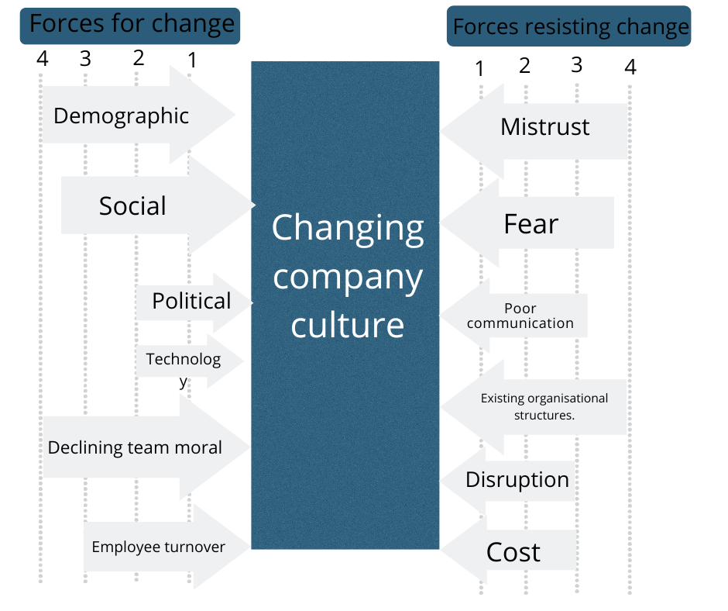
Forcefield analysis
Notes:
So before change the force field is in equilibrium between forces favourable to change and those resisting it. Lewin spoke about the existence of a quasi-stationary social equilibrium.
For change to happen the equilibrium must be upset – either by adding conditions favourable to the change or by reducing resisting forces.
What Kurt Lewin proposes is that whenever driving forces are stronger than restraining forces, the status quo or equilibrium will change (Kaminski, 2011)
The forcefield analysis for Park Vets begins with the proposed change in company culture at the centre.
From here we can identify the forces for change and the forces resisting change
Scoring each force will determine whether to move forward with the change. Alternatively, we can use this analysis to think about how to strengthen the forces that support the change and weaken the forces opposing it, so that the change is more successful (MindTools, 2022)
From this analysis actioning the change will weaken many of the resistances.
The resistant forces mistrust, fear, poor communication and disruption will be reduced greatly with the success of a positive company culture.
The forces for change are strong and impact every area of the organisation. Therefore, this is a viable change to make within Park Vets.
The forces resisting change need to be looked at in more depth and the report following will explore the emotional aspects that the team experiences with resistance. Looking at models that focus on emotional reactions such as the Kubler-ross change curve or bridges transition model.

Slide 5
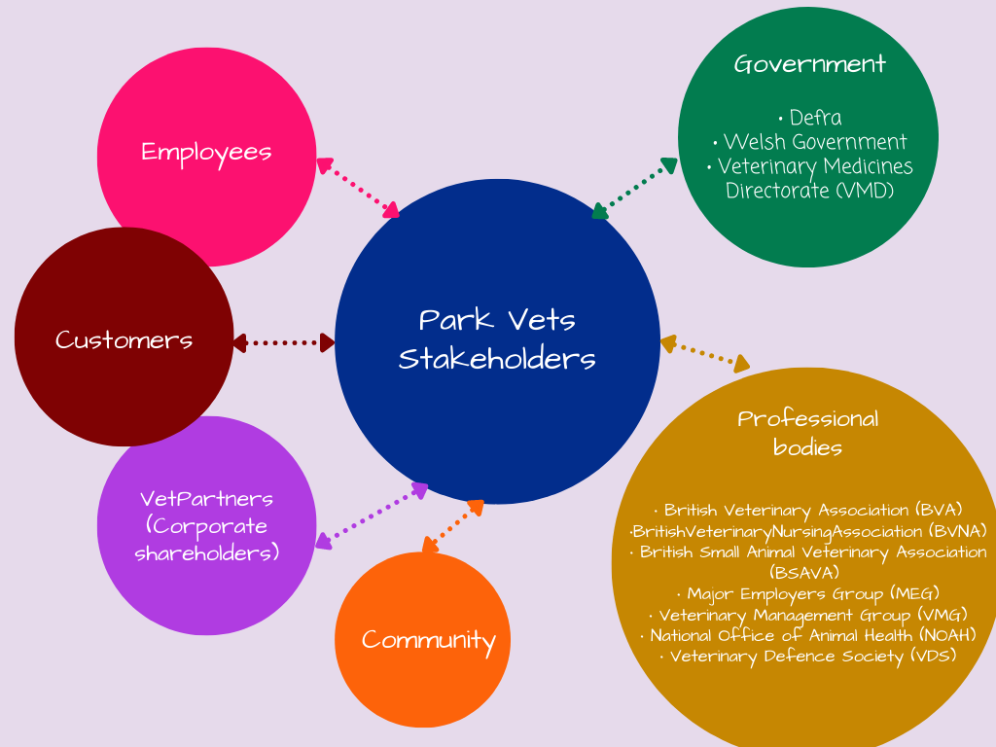
Stakeholder analysis
Identifying the key stakeholders
  Employees
  VetPartners
  Customers
Notes:
As it is a relatively small company the main stakeholders for this organisation would be customers, employees, owners/ shareholders.
The stakeholder map identifies stakeholder expectations, power and helps to understand priorities. There are several benefits of stakeholder mapping such as finding out who has the most influence, understanding who benefits the most, seeing what resources are most available and having a plan to establish who is going to be satisfied with the decisions that are made (Savina, 2022)
It is vital to be aware of the project supporters and opponents, recognizing their specific needs and levels of influence, and adapting the project as necessary can make the difference between success and failure (Smith, 2000)
After trying to understand the stakeholders, it is important to reassess their level of participation and informational requirements. Key stakeholder roles will be made clear in a well-designed project, and who participates when will be as clearly defined as feasible. Not every stakeholder needs to be involved in every component of the project during every phase of the lifecycle. We have identified prospective stakeholder groups using analysis (Miller, 2015).
There are a number of different models that can be used to classify and analyse stakeholders. For example:

Slide 6
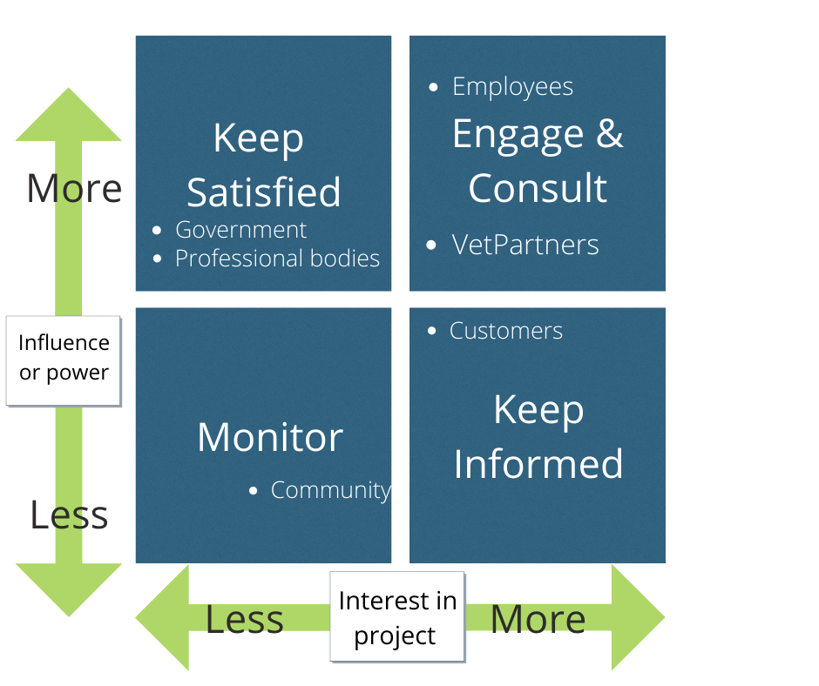
Stakeholder PI Grid
Engage and consult:
  Employees
  VetPartners
Notes:
The stakeholder PI grid categorises stakeholders in a way that provides the ability to develop strategies to manage all stakeholders effectively. We can use this categorisation to create a stakeholder communication plan (Bdaiwi, 2017).
Identifying the stakeholders with high power and high interest which are the employees and Vetparters is crucial as we will want to engage with them regularly, whereas stakeholders with low power and low interest do not require regular and detailed communication.
We can move on to building appropriate stakeholder management methods after using the power-interest grid.
In order to describe each stakeholder's engagement in the project and to manage it efficiently, it is also beneficial to use additional models, such as the RASCI (Responsible, Accountable, Support, Consult and Inform).

Slide 7

“Changing Company Culture Requires a Movement, Not a Mandate”
(Walker, 2017)
Notes:
In conclusion, just as people and employee groups are complicated, change is too.
It has been observed that Park Vets would need to conduct substantial research, planning and development to construct a change management project to attain a better organisational culture.
The investigation of Kotters' eight-step model and the change curve will follow. Kotter argues that 70% of change initiatives fail and attributes this to the fact that most organisations do not put in the necessary preparation or see the project through correctly. Following these steps ensure your change initiative is more likely to be a long-term success. (Kotter, 1996) In Kotter's approach and other successful change models, which will be discussed, the need to embed the intended transformation into corporate culture through routine and repeated encouragement, feedback, reinforcement, and success acknowledgment is addressed (Auguste, 2013).
Resistance is also an area of great importance; the report will investigate the challenges that may be faced by changing company culture—exploring the cognitive and psychological factors.
Understanding individuals, their histories, beliefs, and mindset can help us better understand and prepare for change. There'll probably be a lot of opposition. In addition, timely information, engagement, fairness, and respect are essential for effective change management. The report will look at the team's emotional reaction to change, the emotional reaction to change resistance, and how the business can overcome this challenge.
The current research will primarily focus on leadership and power.
Leaders are pivotal in renewing, refreshing and motivating their team and inspiring new beginnings (Brower, 2021)

Slide 8
References
Auguste, J., 2013. Applying Kotters 8-Step Process for Leading Change to the Digital Transformation of an Orthopedic Surgical Practice Group in Toronto, Canada. Journal of Health &amp; Medical Informatics, 04(03).
Bamford, D. and Forrester, P., 2003. Managing planned and emergent change within an operations management environment. International Journal of Operations &amp; Production Management, 23(5), pp.546-564.
Bdaiwi, Y., 2017. Stakeholder Analysis using the Power Interest Grid. [online] https://www.projectmanagement.com/contentPages/wiki.cfm?ID=368897&thisPageURL=/wikis/368897/Stakeholder-Analysis--using-the-Power-Interest-Grid. Available at: <https://www.projectmanagement.com/contentPages/wiki.cfm?ID=368897&thisPageURL=/wikis/368897/Stakeholder-Analysis--using-the-Power-Interest-Grid>
Brower, T., 2021. Leading Change: 10 Ways Great Leaders Make Change Happen. [online] Forbes. Available at: https://www.forbes.com/sites/tracybrower/2021/01/17/leading-change-10-ways-great-leaders-make-change-happen/?sh=142fe2ce4864
Burnes, B. (2019). The Origins of Lewin’s Three-Step Model of Change. The Journal of Applied Behavioral Science, [online] 56(1), pp.32–59. doi:10.1177/0021886319892685.

Slide 9
Coghlan, D. (2020). Edgar Schein on Change: Insights Into the Creation of a Model. The Journal of Applied Behavioral Science, p.002188632092402. doi:10.1177/0021886320924029.
Connelly, M., 2020. Force Field Analysis - Kurt Lewin. [online] Change-management-coach.com. Available at: <https://www.change-management-coach.com/force-field-analysis.html>
Falconer, J., 2002. Emergence Happens! Misguided Paradigms Regarding Organizational Change and the Role of Complexity and Patterns in the Change Landscape. Emergence, 4(1), pp.117-130.
Hussain, S T, (2018) Kurt Lewin's change model: A critical review of the role of leadership and employee involvement in organizational change, Journal of Innovation & Knowledge (JIK), ISSN 2444-569X, Elsevier, Amsterdam, Vol. 3, Issue. 3, pp. 123-127, https://doi.org/10.1016/j.jik.2016.07.002
Kaminski, J. (Winter, 2011). Theory applied to informatics – Lewin’s Change Theory. CJNI: Canadian Journal of Nursing Informatics, 6 (1), Editorial. https://cjni.net/journal/?p=1210
Kotter, John P. (1996). Leading Change. Boston, Mass.: Harvard Business School Press, 1996. Print
MindTools, 2022. Force Field Analysis: Analyzing the Pressures For and Against Change. [online] Mindtools.com. Available at: <https://www.mindtools.com/pages/article/newTED_06.htm>.

Slide 10
SHRM, n.d. Understanding and Developing Organizational Culture. [online] SHRM. Available at: <https://www.shrm.org/resourcesandtools/tools-and-samples/toolkits/pages/understandinganddevelopingorganizationalculture.aspx>
Savina, A., 2022. Complete Stakeholder Mapping Guide. [online] Miro. Available at: <https://miro.com/blog/stakeholder-mapping/> [Accessed 1 July 2022].
Miller, D. & Oliver, M. (2015). Engaging Stakeholders for Project Success. PMI White Paper
Smith, L. W. (2000). Stakeholder analysis: a pivotal practice of successful projects. Paper presented at Project Management Institute Annual Seminars & Symposium, Houston, TX. Newtown Square, PA: Project Management Institute.
Walker, B., 2017. Changing Company Culture Requires a Movement, Not a Mandate. [online] Harvard Business Review. Available at: <https://hbr.org/2017/06/changing-company-culture-requires-a-movement-not-a-mandate>

