Slide 1



Public Finances

Slide 2
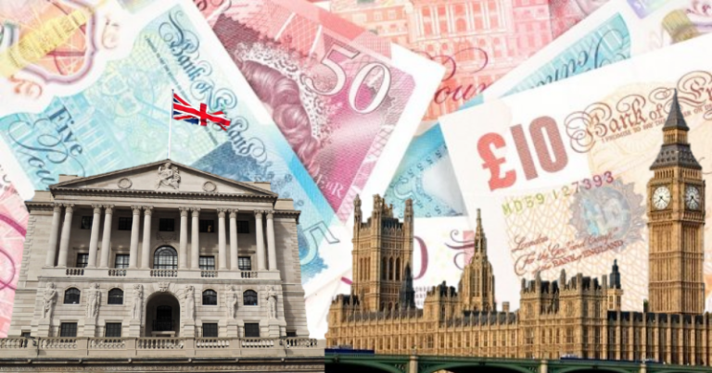
Content
The point of public money
Personal v. Public Money
Political Decisions
Resources
Political choices and public priorities
Borrowing and debt
Council and police illustrations

Slide 3
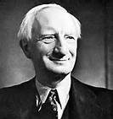
Sir William Beveridge (1879-1963)
Beveridge was a British economist and social reformer, closely associated with the development of the welfare state
Trained as a lawyer but came to prominence during the Liberal government of 1906 - 1914 when he was asked to advise David Lloyd George on old age pensions and national insurance
When, in 1941, the government commissioned a report into the ways that Britain should be rebuilt after World War Two, Beveridge was an obvious choice to take charge

Slide 4
Dynamic Government Action
Free education
NHS
Employment
Housing
National insurance
Ignorance
Disease
Idleness
Squalor
Want
Free education up to age 15 (16 later)
A National Health Service (NHS) free at the point of use
State commitment to securing full employment
Public housing for all
National insurance benefits for all in need

Slide 5
Two Key Drivers
‘The object of government in peace and in war is not the glory of rulers or races, but the happiness of the common man.’
- William Beveridge
Beveridge argued that it was in everyone’s interest to remove these evils from British society
It was the duty of the state, as the representative body of all citizens, to do this

Slide 6

Resources?
Money
People
Skills
Knowledge
The buildings we need as a base for staff and the services we provide
The equipment they need to do their job

Slide 7
Personal Finances
The basic three-step financial equation
A. Money in – Income
B. Money out – Expenditure
C. The bottom line – Profit or (Loss)
We say we are in the black – money in the bank, or in the red – we are spending more than we earn
Public Finances
The basic three-step financial equation also applies
Think!
If you overspend, where does the deficit come from?
What about governments?
Should you borrow? Should countries?

Slide 8
A personal example
Dave earns £50 – what is the impact on him if…
He spends £49
He spends £50
He spends £51
Dave’s priorities
Dave’s future plans
He has £1 spare
He’s ok
Where did that come from?
Tea-total, or big spender
Mortgage, rent, tree house, parents
The money has to come from somewhere
Without the money there is no activity

Slide 9

There is no money tree for personal finance
But we will see there is for government finance

Slide 10
Government Finances
Tax collection and redistribution
Public borrowing

Slide 11
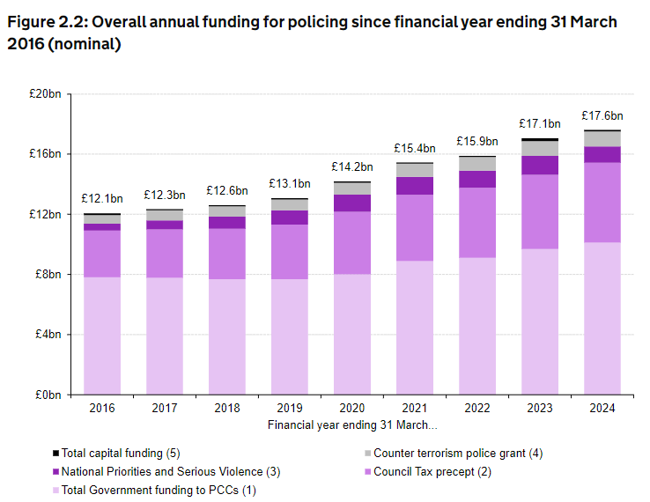

Slide 12
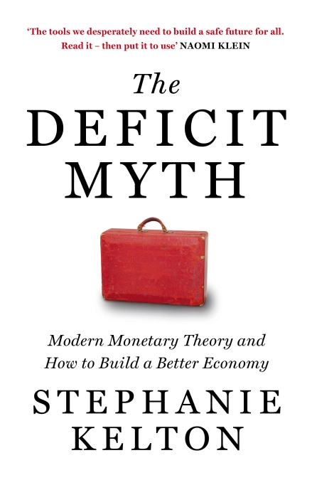
Modern Monetary Theory
Do not believe the myths that some people, somewhere know best and have all the right answers
They do not. We need to question how things work the way they do
People are important
Prosperity needs to be shared especially with those who have the least money, and are most vulnerable

Slide 13

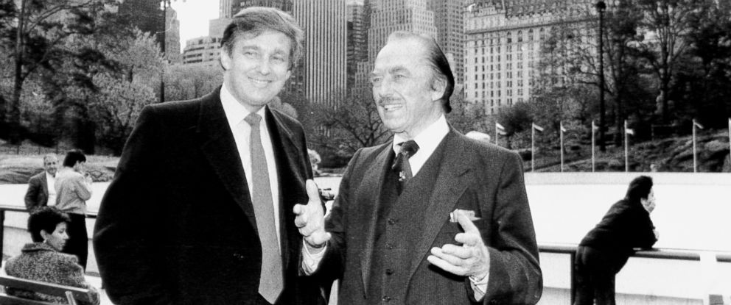
Kelton is all about fairness
The wealthy become wealthier; many have accrued enormous wealth during lockdown
How much money does one person need?
Is it true that if Bill Gate drop $100 it would cost him more money to bend and pick it up than just to leave it there?
Many wealthy people are content to pay a fair tax contribution
Some are certainly not!
Ed Sheeran

Slide 14
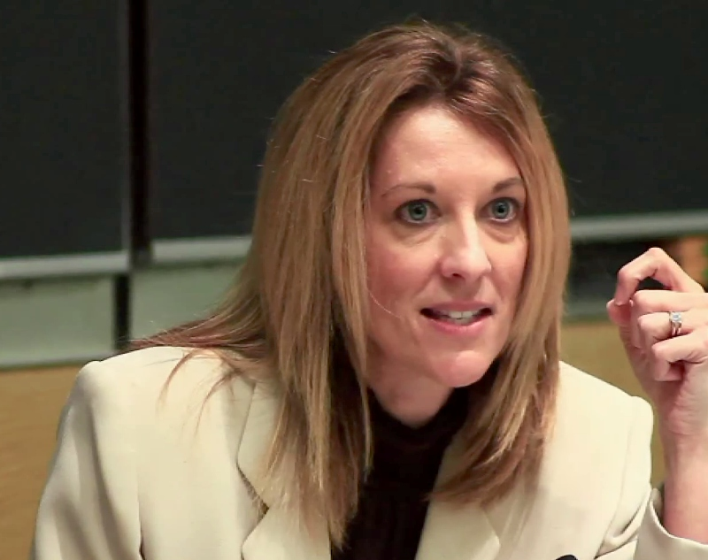
MMT
Functional finance from central government
Taxes and borrowing to support the people
Deficits did not stop the funding of wars, FD Roosevelt’s New Deal programme, JFK’s space programme and going to the moon!
These are political decisions
Politicians have the power

Slide 15
2008 Financial Crash
$779 billion USA deficit
800,000 Americans lost their jobs
2007-2009 8.7m jobs lost
US borrowed $780 billion
Should have been $1 trillion
Stimulate the economy, create jobs!
This is how Keynesian economics rebuilt countries after WW2

Slide 16
MMT Myths
Government budgets are not like household budgets
Deficits do not prove over-spending: spend $100 and collect $90 in taxes. The difference is matched by borrowing
Deficits do not burden the next generation. We saw great debt after WW2 and a period of great prosperity
Deficits are not harmful. They do not crowd out private investment. They stimulate business
Deficits do not make us dependent on foreign economies

Slide 17
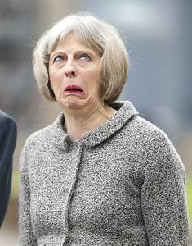
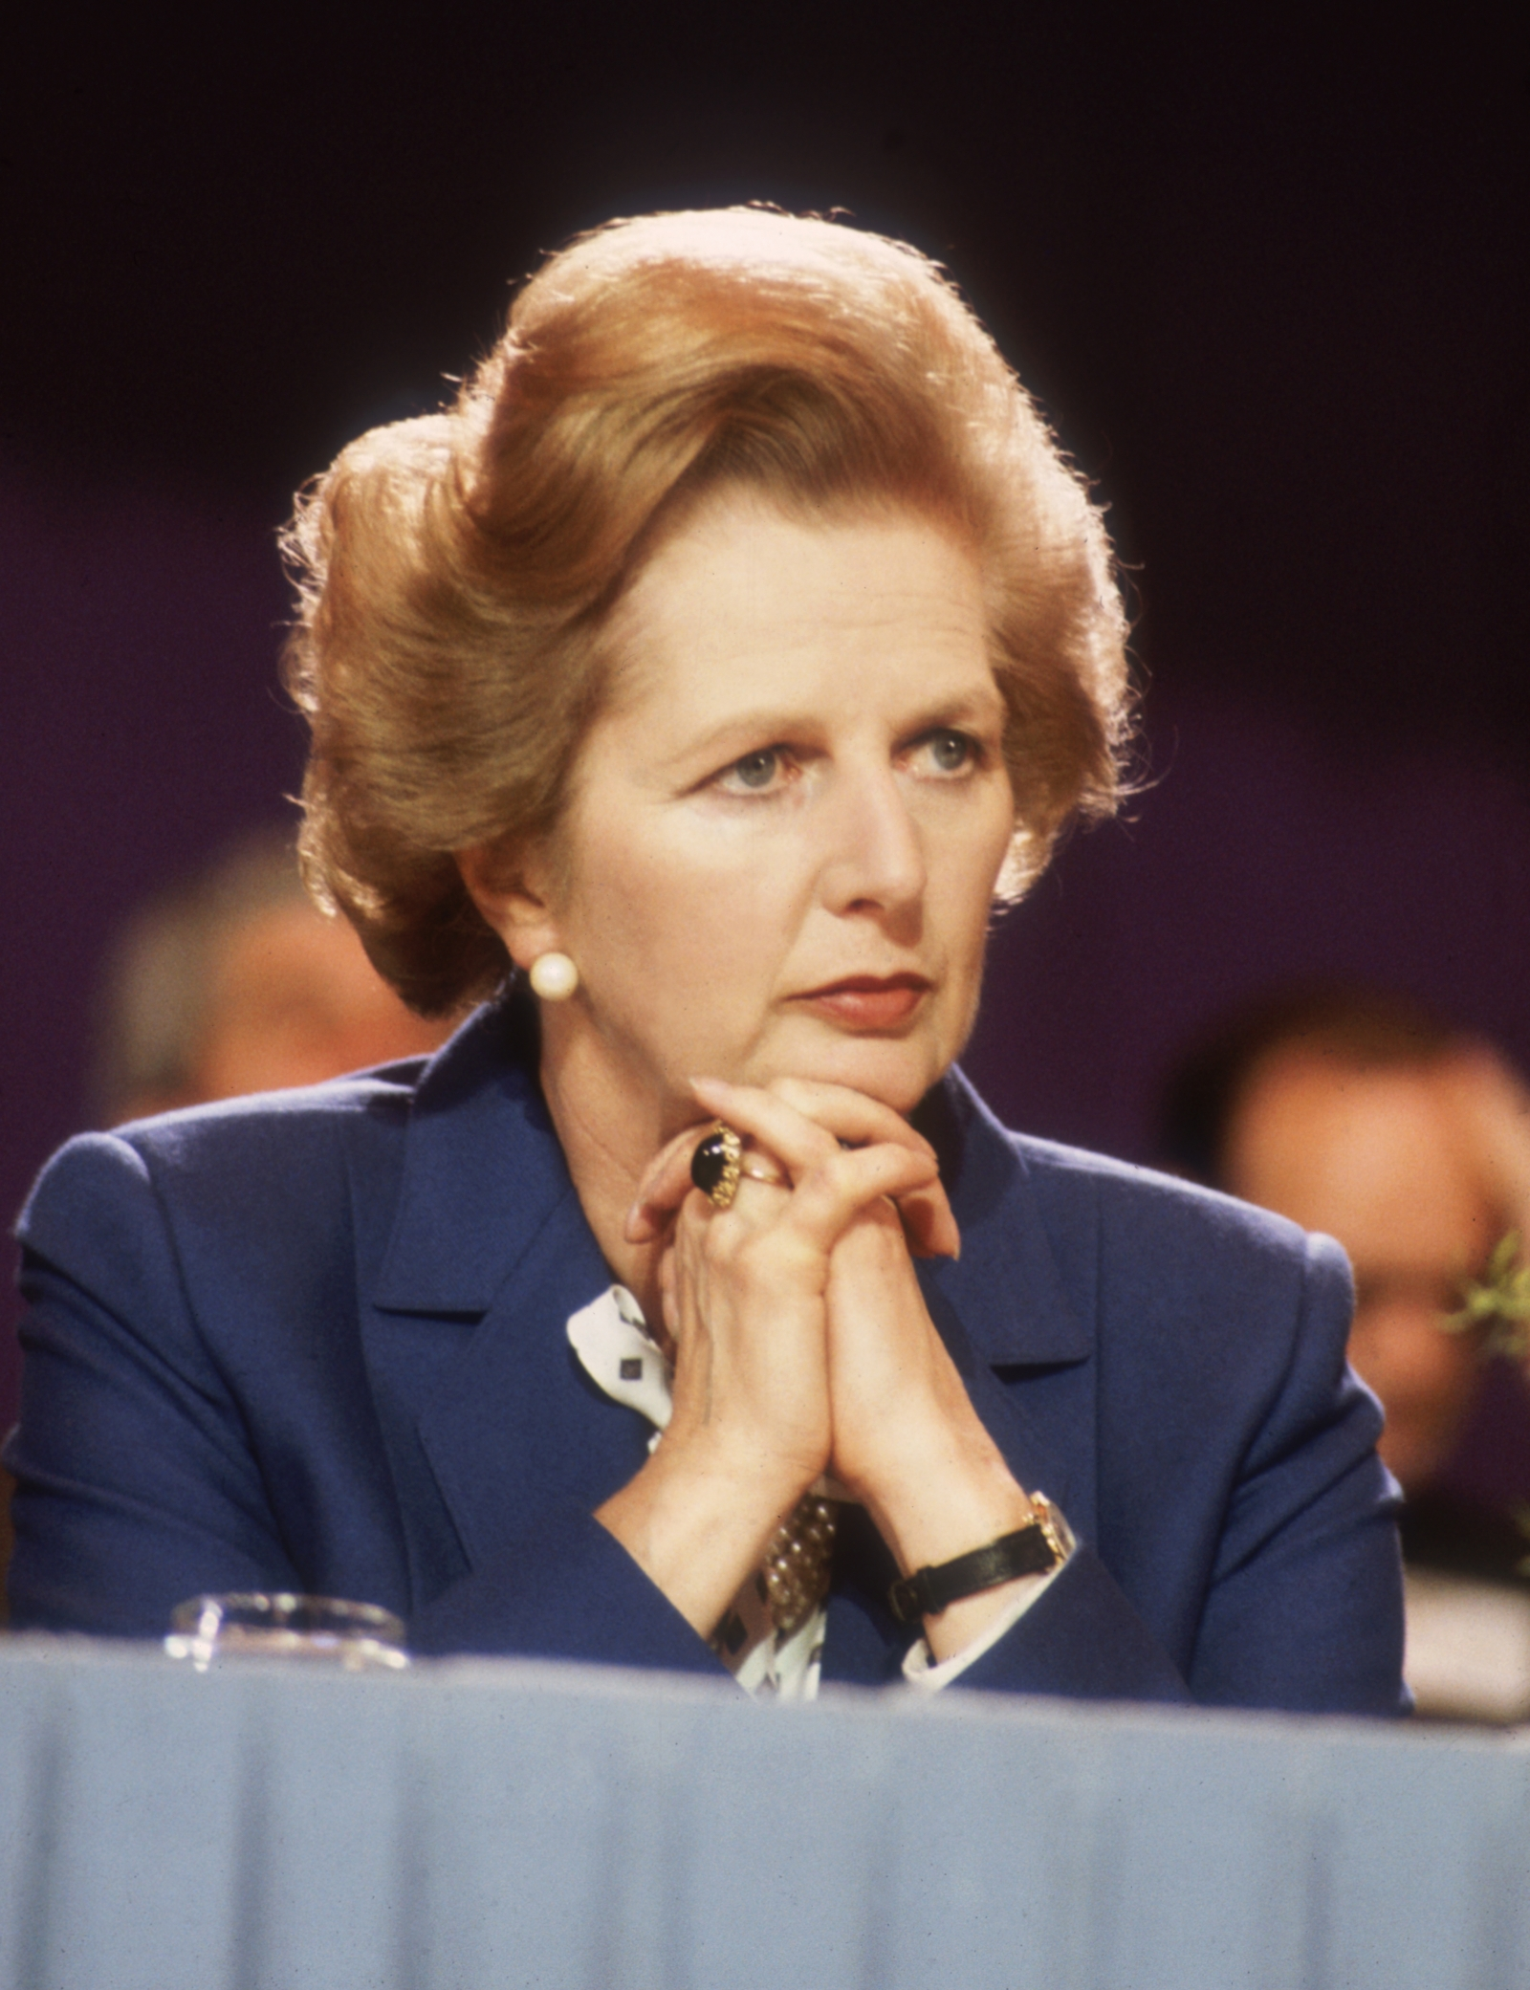
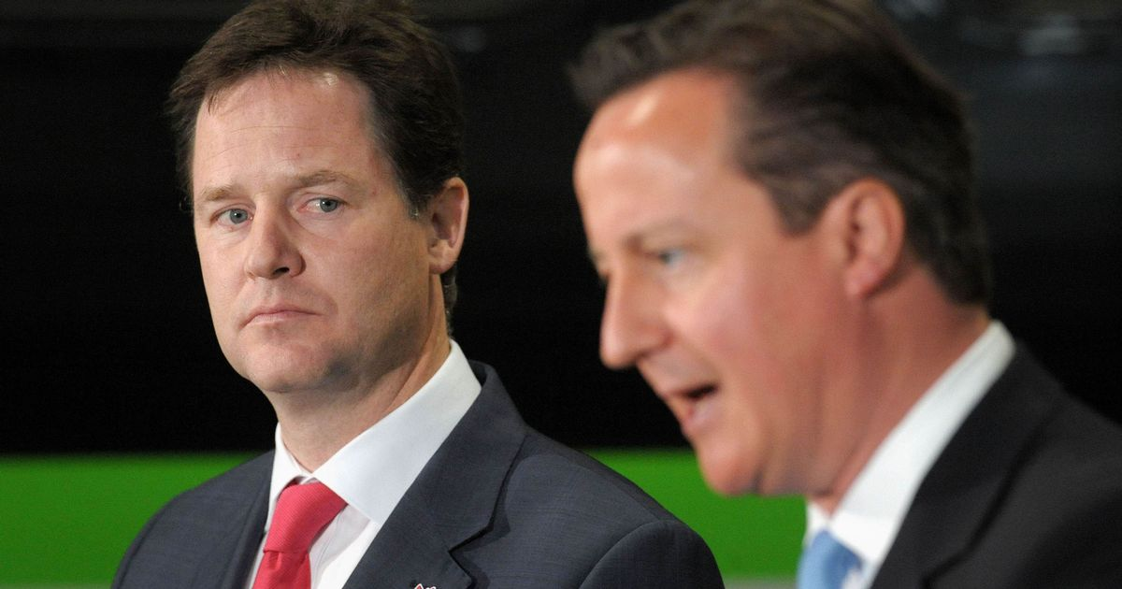
Political point-scoring or economic ignorance?
Thatcher: government has no source of income other than from the people
Coalition Government: Labour has overspent and left us in a hole
Teresa May – no magic money tree
All completely wrong.

Slide 18
Deficit and Debt
Public sector net debt (PSND) represents the amount of money the public sector owes
Public sector net debt is often referred to by commentators as “national debt”
If governments spend more than they receive each month they have a deficit, and this deficit grows over time and represents the total debt
While borrowing (or the deficit) represents the difference between total spending and receipts over a period of time, debt represents the total amount of money owed at a point in time.

Slide 19
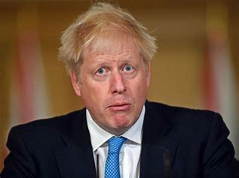
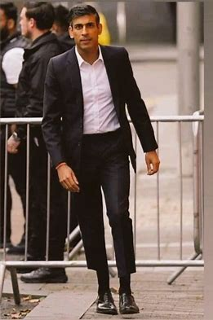
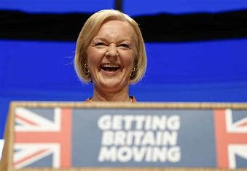
Power to Decide
Priorities are set by the politicians who win elections
… and secure control over the government of the day
Prime Minister, First Minister and Council Leaders
Cabinet Members
Scrutiny by non- executive members

Slide 20
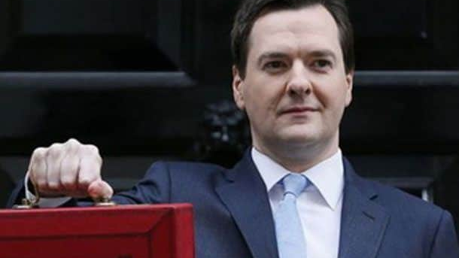
Austerity
The intentional decision by politicians to slash public budgets
Sold to the public on the household analogy: “You would not run your household finances recklessly and we will not do this with public money.”
Great tactic, but they cannot be compared

Slide 21
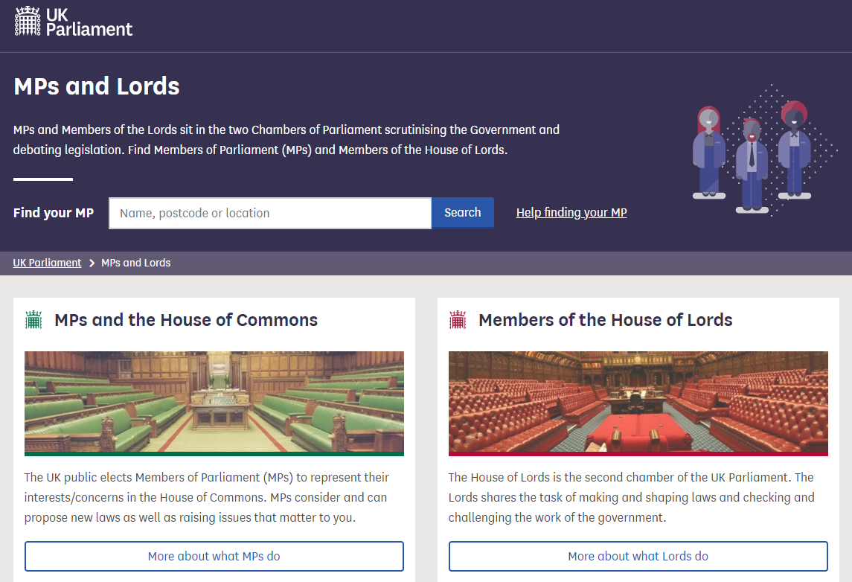
650 MPs
All change on 12th Dec 2019

Slide 22
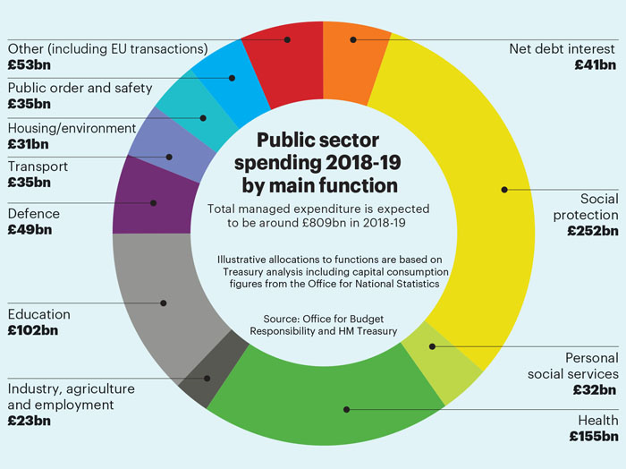
What is ‘public spending’?
Public spending is expenditure incurred by the "public sector" in the course of its activities
http://www.politics.co.uk/reference/public-spending

Slide 23
How do we measure public spending?
UK Total Managed Expenditure
£1.1 trillion
Government's preferred measure is Total Managed Expenditure (TME), which describes all forms of expenditure made by central government, local authorities and public enterprises.
http://www.politics.co.uk/reference/public-spending

Slide 24
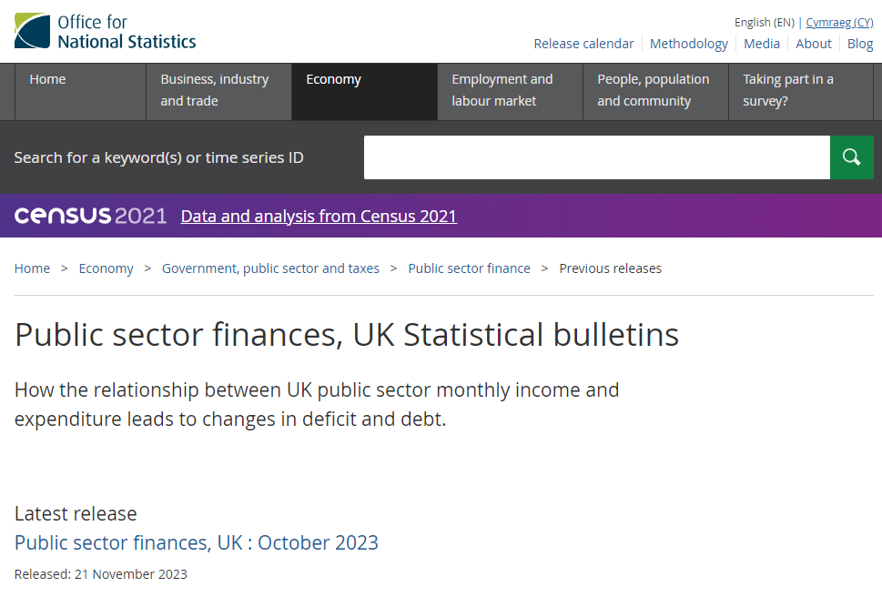

Slide 25
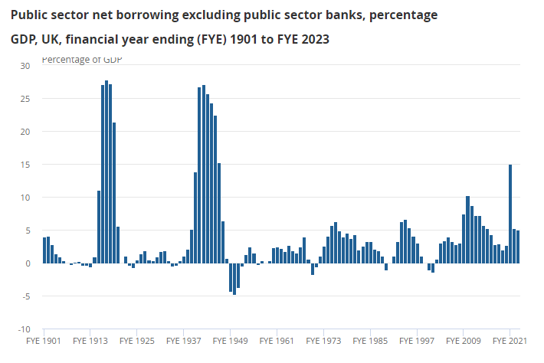

Slide 26
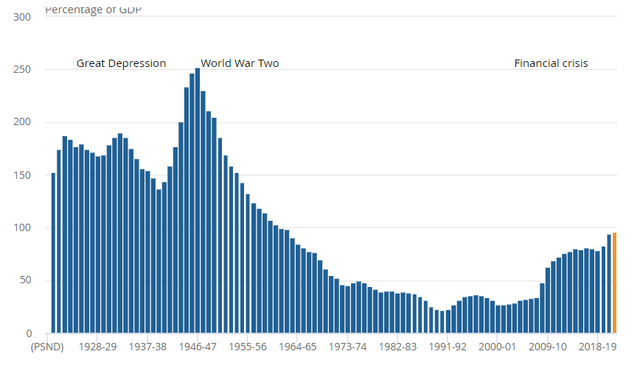
Public sector debt as a proportion of GDP
Below 50% 1972 - 2009

Slide 27
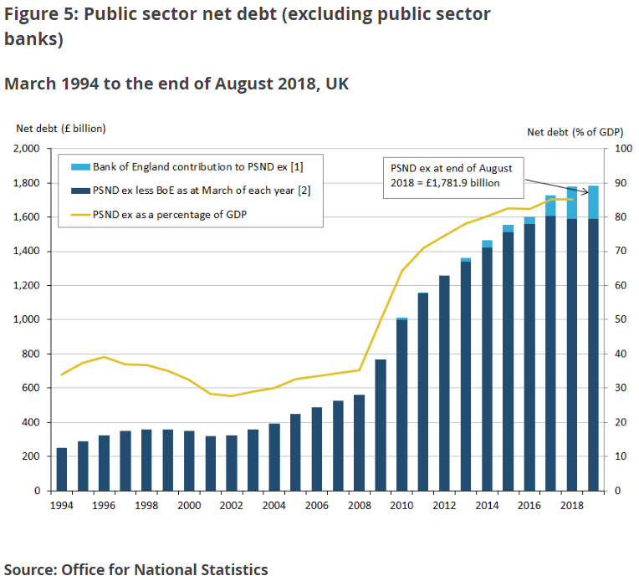
October 2023
Total debt was £2,643.7 billion [£2.6 trillion]
97.8% of the UK's annual gross domestic product (GDP)
2.3 percentage points higher than in October 2022
Remains at levels last seen in the early 1960s.

Slide 28
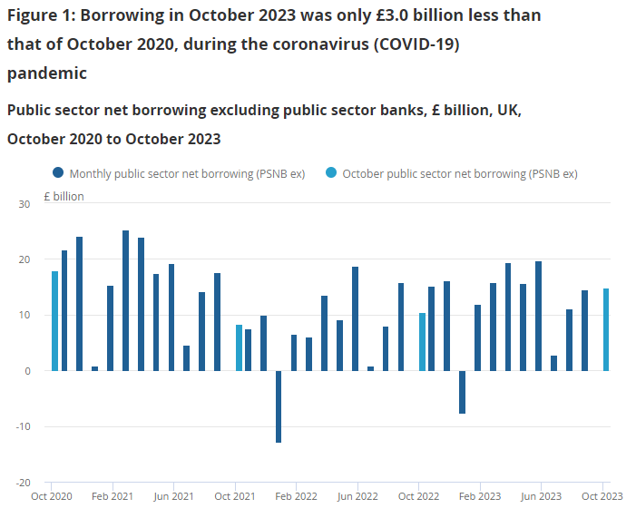

Slide 29
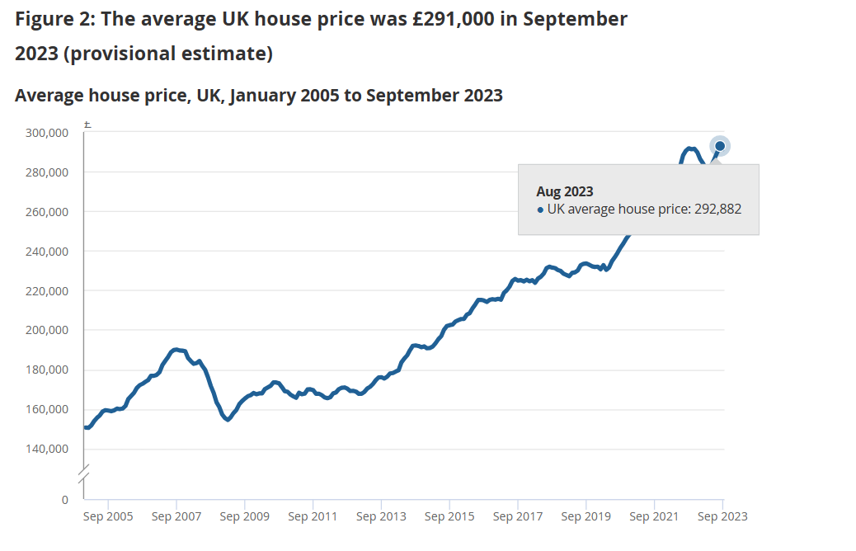
What is the average house price in the UK?
Debt is huge business
Is enough public money reinvested in the life of the people?

Slide 30
Good Governance and Strategic Management are a fundamental aspect of Public Finance

Slide 31
Thompson& Strickland (2001; p7)
5 Tasks of Strategic Management
Develop strategic vision
Set Objectives
Create a Strategy to Achieve Objectives
Implement and Execute
Evaluate. Monitor and Amend

Slide 32
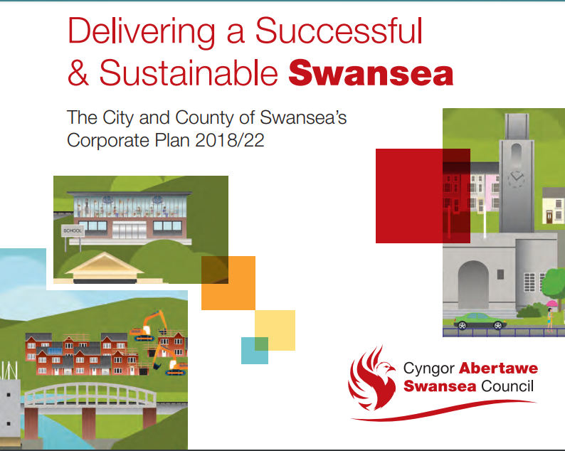



Slide 33
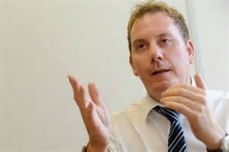
Democratically elected members – the Council
Paid service – officers of the C&C Swansea
Authority is delegated to the staff led by CEO
75 Councillors
1 CEO
Directors
10,000 staff
Leader & Cabinet

Slide 34
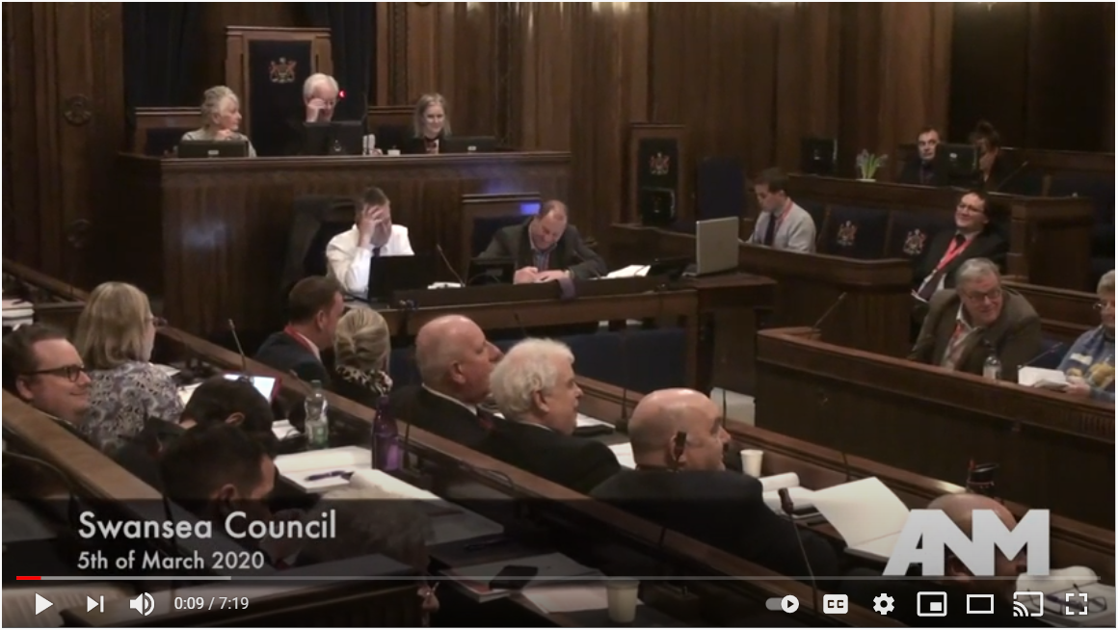
Presiding Officer
Head of Legal
CFO s.151 Officer
CEO
Leader

Slide 35
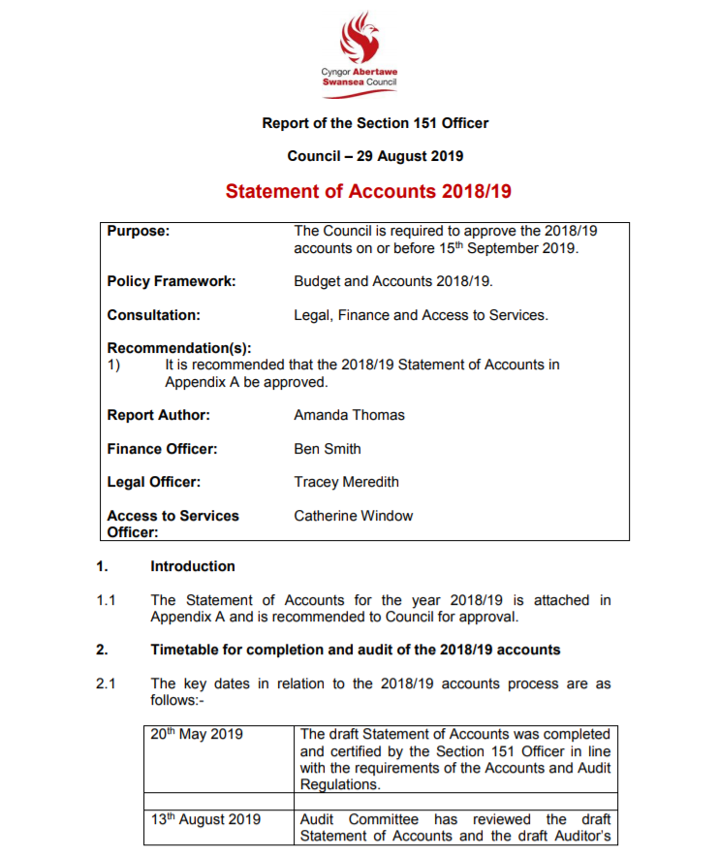
Where the money comes from and where it goes
To explain the purpose of the Annual Governance Statement

Slide 36
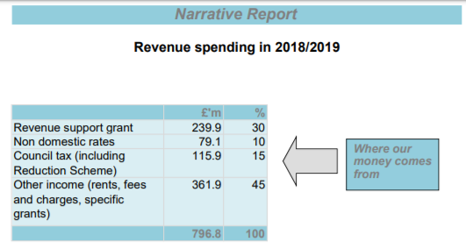
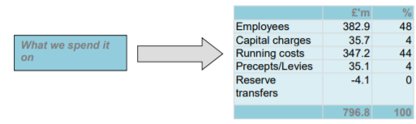
Overview

Slide 37
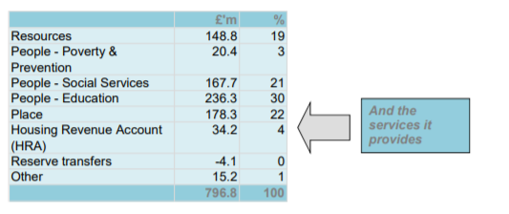
£796 million received from a variety of sources and spent on services for the people of Swansea
Figures show 100% monies received and 100% spent
Your personal bank statements show the same thing though the numbers are probably a bit different
Think in terms of money in and out; income and expenditure
Planning ahead is extremely important (budgeting)
If we do not have the money we cannot spend it

Slide 38
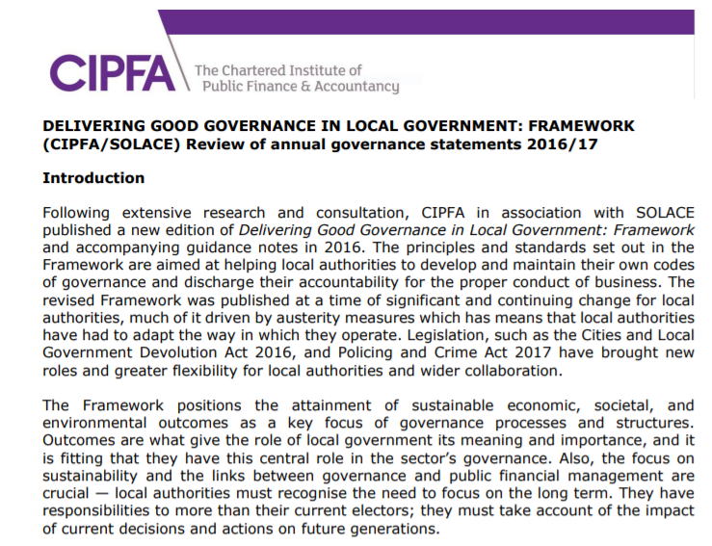
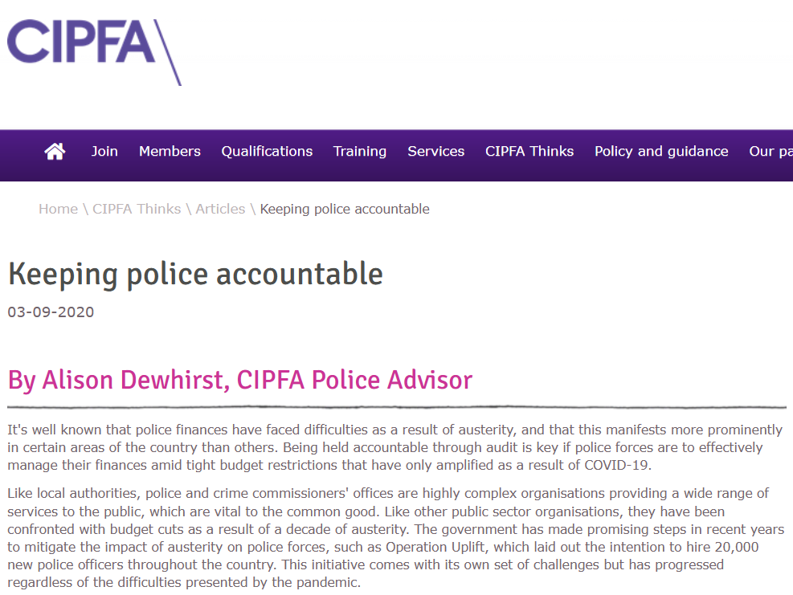
Annual Governance Statement
In accordance with the law and proper standards
Public money is safeguarded and properly accounted for
Duty under the Local Government (Wales) Measure 2009 to secure continuous improvement in the way functions are exercised

Slide 39
Purpose of the Governance Framework
Systems and processes, culture and values, by which the Authority is directed and controlled
Activities through which it accounts to, engages with and leads the community
Monitor the achievement of its strategic objectives and to consider whether those objectives have led to the delivery of appropriate services and value for money
Internal control system is extremely important

Slide 40
The Governance Framework
Behaving with integrity, demonstrating strong commitment to ethical values, and respecting the rule of law.
Ensuring openness and comprehensive stakeholder engagement.
Defining outcomes in terms of sustainable economic, social and environmental benefits.
Determining the interventions necessary to optimise the achievement of the intended outcomes.
Developing the entity’s capacity, including the capability of its leadership and the individuals within it.
Managing risks and performance through robust internal control and strong public financial management.
Implementing good practices in transparency, reporting and audit to deliver effective accountability.

Slide 41
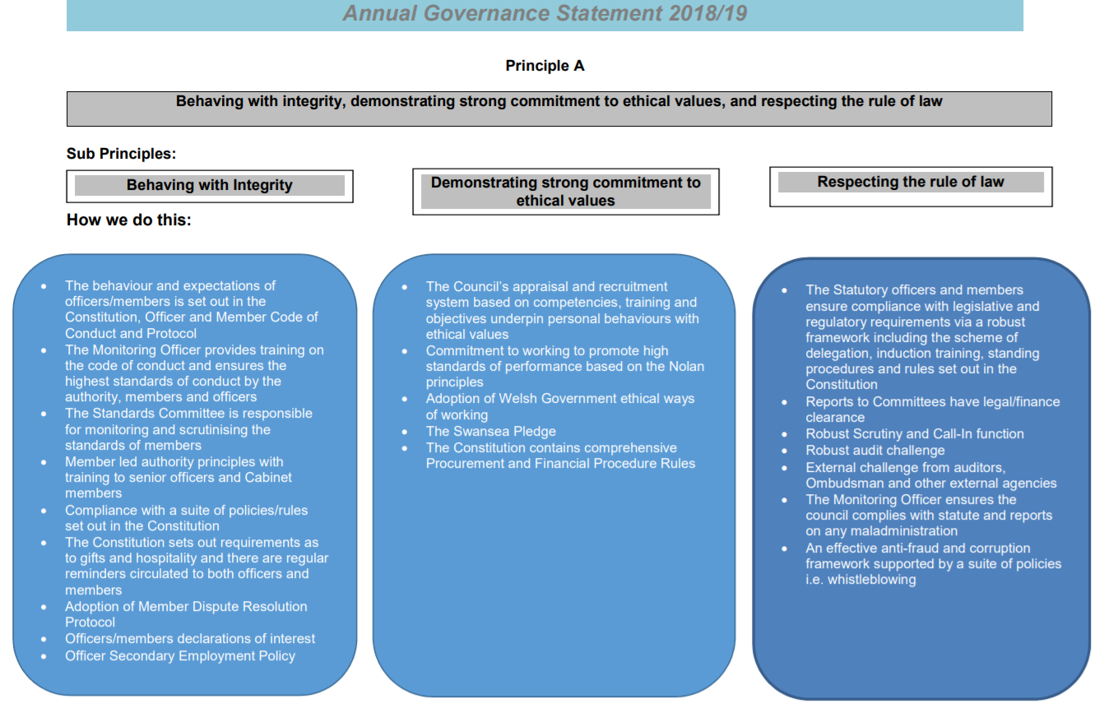
There are six other principles broken down in the same way to show how the organisation acts in accordance with high-level ethical requirements

Slide 42
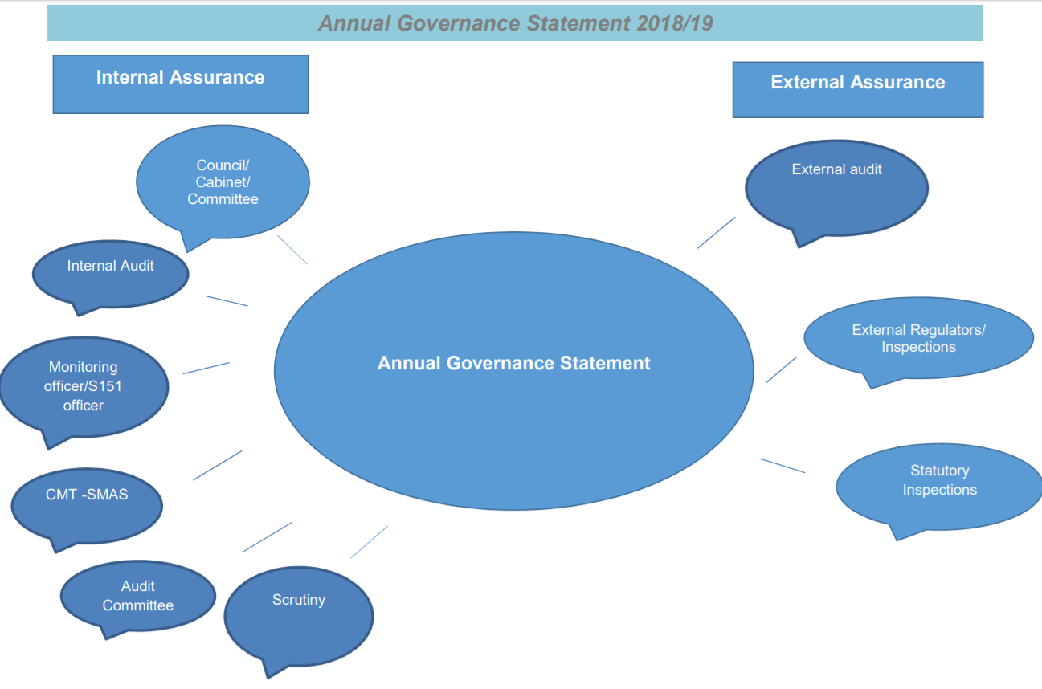
A thumbs up, professional approval, from the Wales Audit Office is of fundamental importance
The auditor attends and reports to full Council

Slide 43
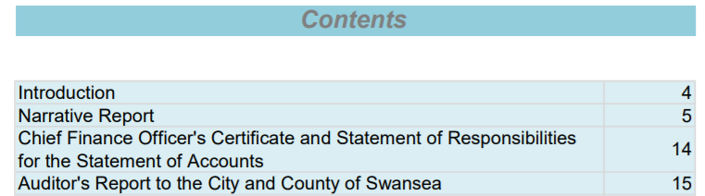
Looking for key assurances
Reading through accounts for non-financial managers can be an arduous and challenging task
Consider summary information and look for highlights
Look for internal assurances from the organisation lead finance officer
What does the external auditor say
Do they agree that a true and fair view is provided?

Slide 44
1962 Royal Commission on Policing
Tripartite Governance Structure
Home Secretary
Chief Constables
Police Authorities
Police Authorities
9 Councillors
5 Independents
3 Magistrates
Too distant
Not known/ invisible
Lacked police challenge
Street-level
Be known/ high visibility
Challenge and support
Barber 2022: 152
Way forward?

Slide 45
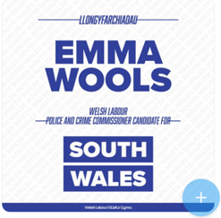
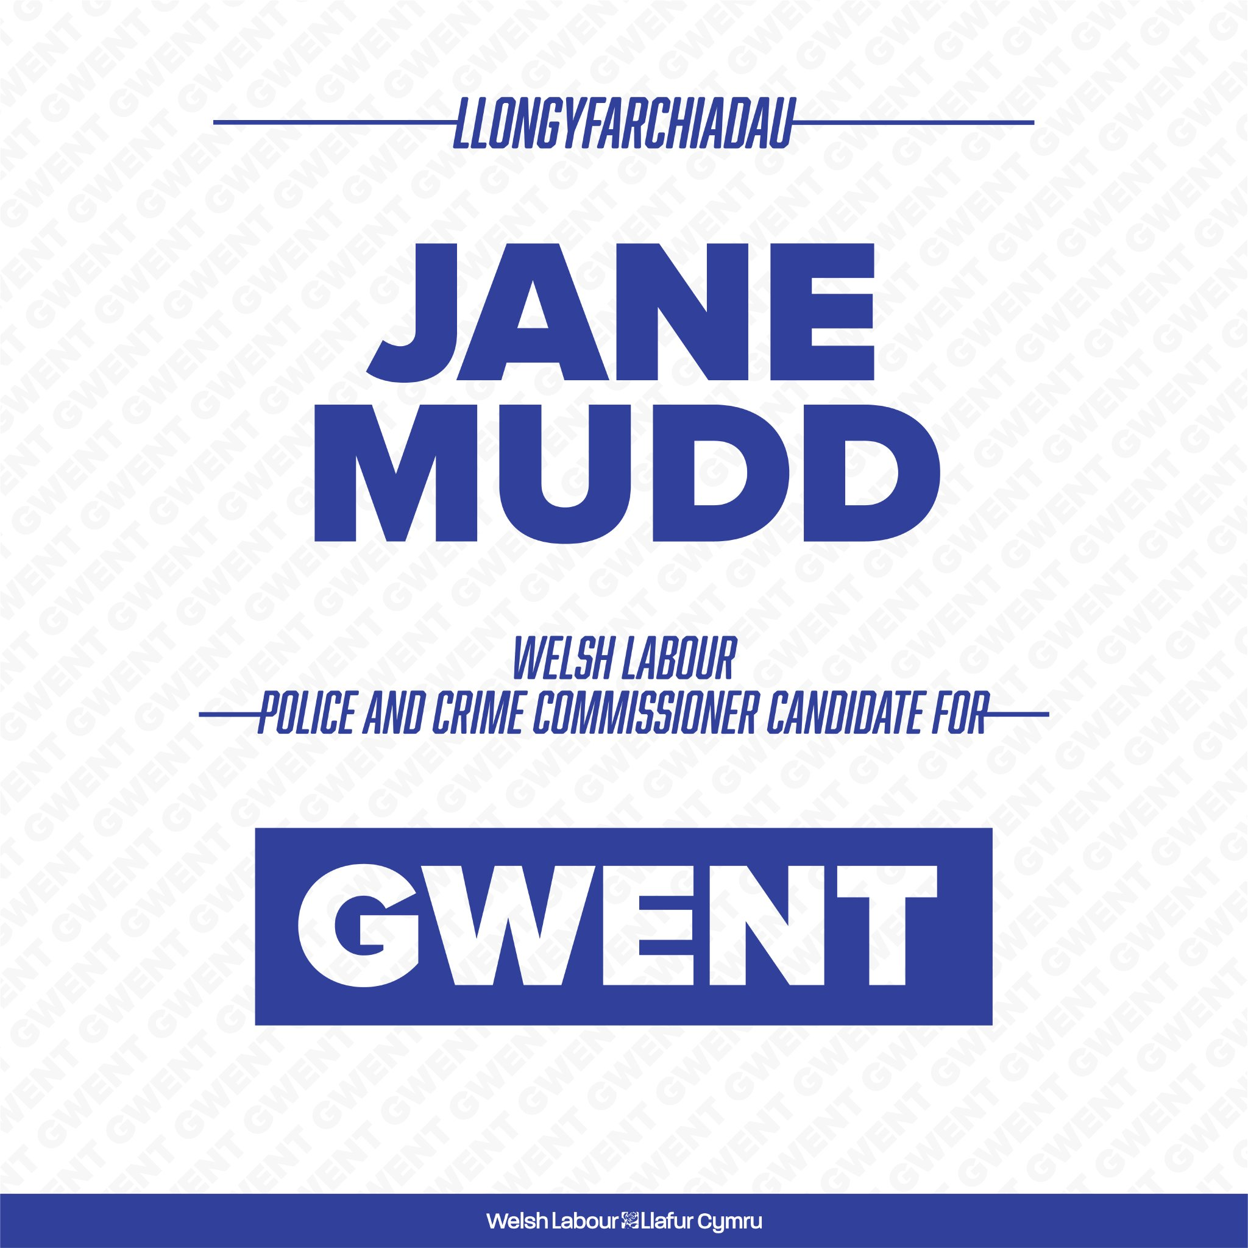
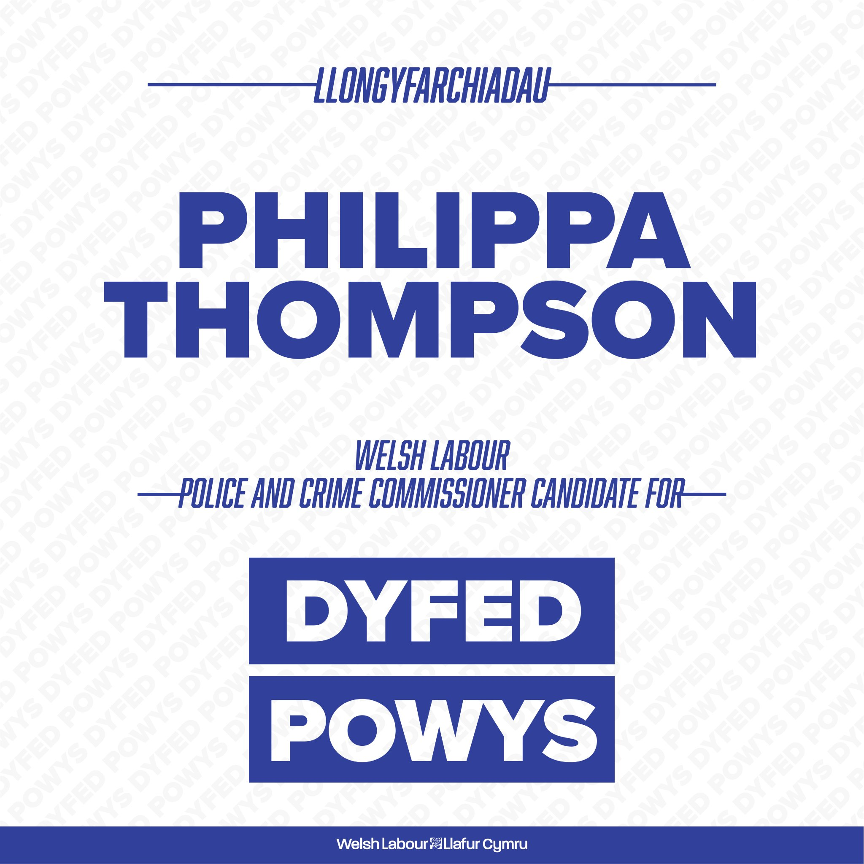
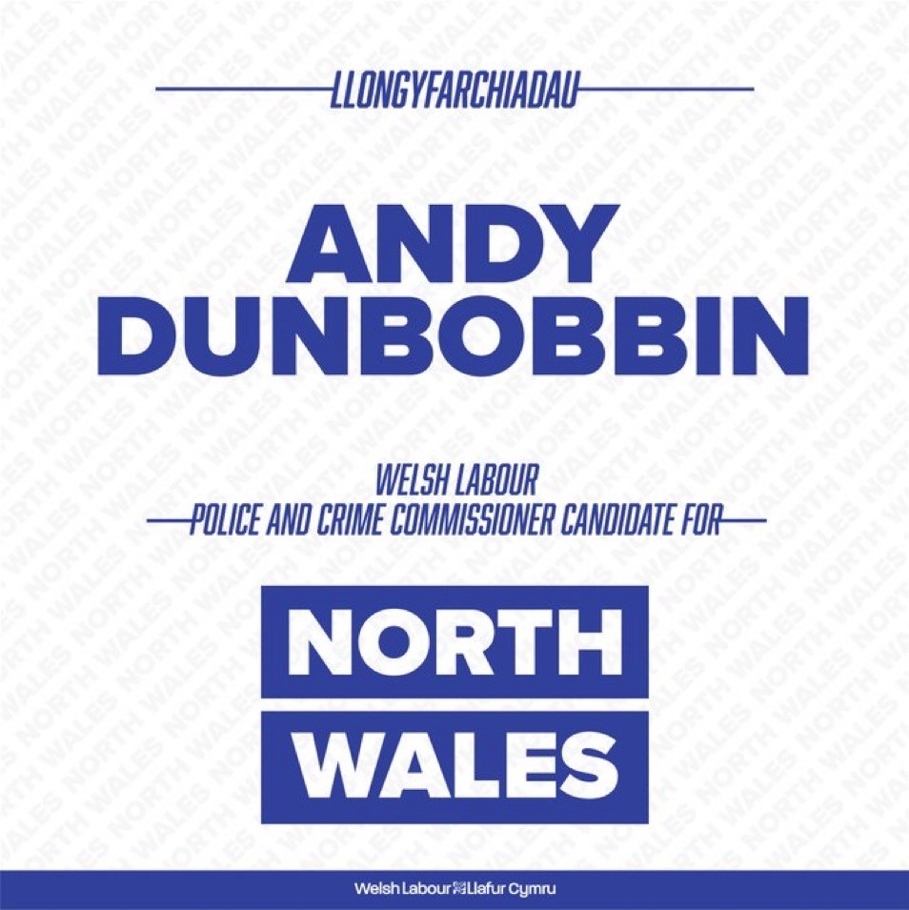
Police Reform and Social Responsibility Act 2011
Police and Crime Commissioners replaced Police Authorities
Totality of policing
Holding Chief Constables to account for operational policing
Including in relation to the Strategic Policing Requirement published by the Home Secretary
Barber 2022: 153

Slide 46
Police Reform and Social Responsibility Act 2011
Chief Constable Responsibilities
Lead the force in a way that is consistent with the attestation made by all Constables and to ensure the force acts impartially.
Appoint officers and staff.
Assist the PCC with planning the budget.
Support the PCC in delivering the Police and Crime Plan.
Have regard to the Strategic Policing Requirement.
Explain to the public operational actions.
Enter into collaboration agreements with other Chief Constables where this will improve the effectiveness and efficiency of policing.
Politically independent of their PCCs.
Manage complaints against the force.
Day to day control of the financial management of the force.
PCC Responsibilities
Strategic direction through Police and Crime Plan
Hold Chief to account
Set force budget and council tax precept
Chief appointment
Chief removal
Collaboration with other PCCs
Complaint monitoring
Barber 2022: 153

Slide 47
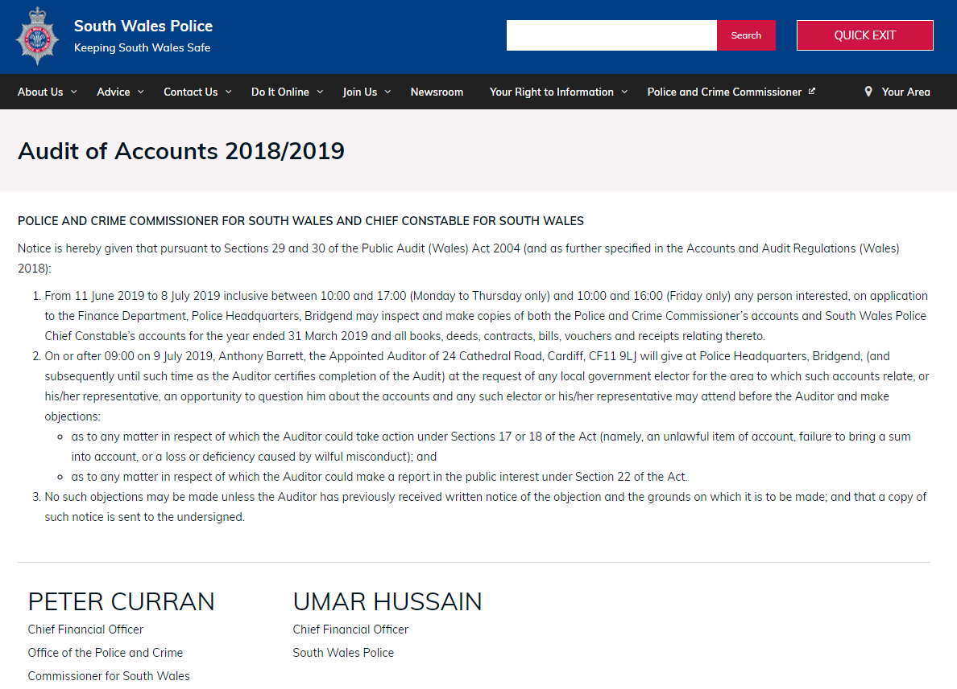
Financially qualified professionals and their teams are your friends
Follow the pound
Expect close scrutiny

Slide 48
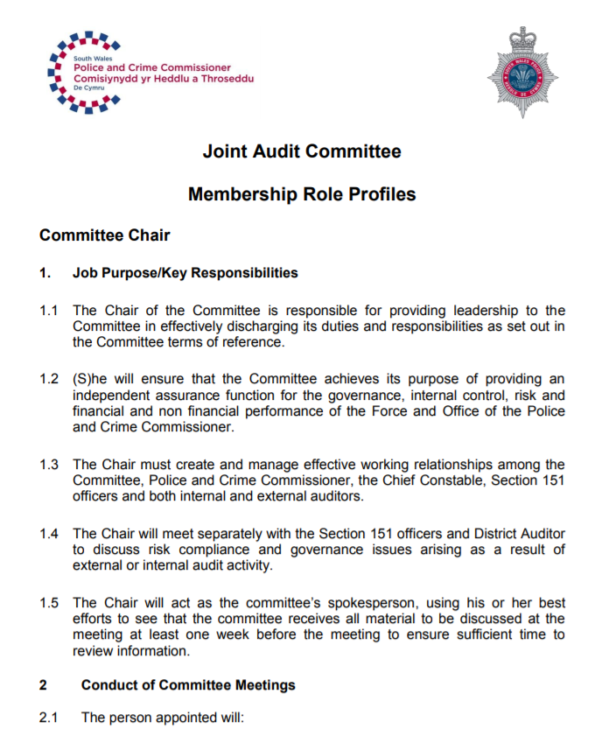
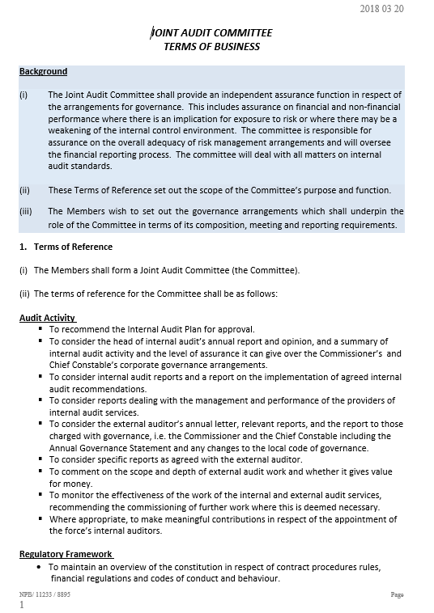
There are two statutory roles which in addition to the Police and Crime Commissioner – a CEO [Chief Executive Officer] and a CFO [Chief Finance Officer]

Slide 49
References
Home Office (2023) Police funding for England and Wales 2015 to 2024 available at Police funding for England and Wales 2015 to 2024 - GOV.UK (www.gov.uk) accessed on 23rd November 2023.
Home Office (2023a) Police Grant (England and Wales) Police Grant Report (England and Wales) 2023-24 available at Police Grant Report (England and Wales) 2023-24 – HC 1066 (publishing.service.gov.uk) accessed on 23rd November 2023.

