Slide 1
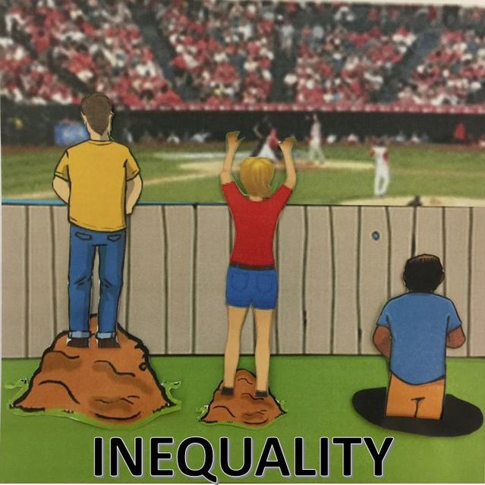
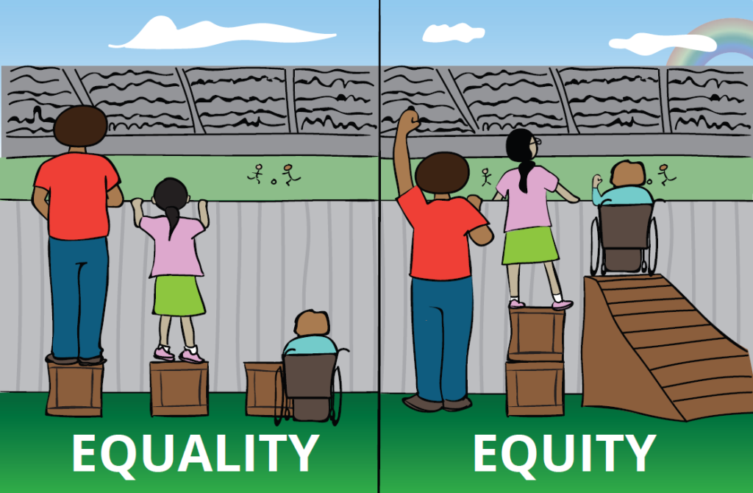
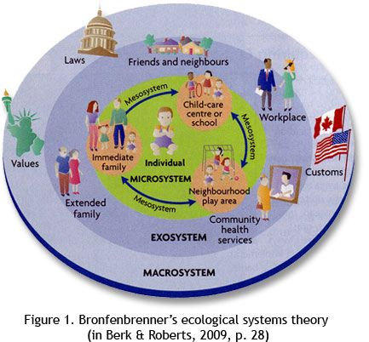
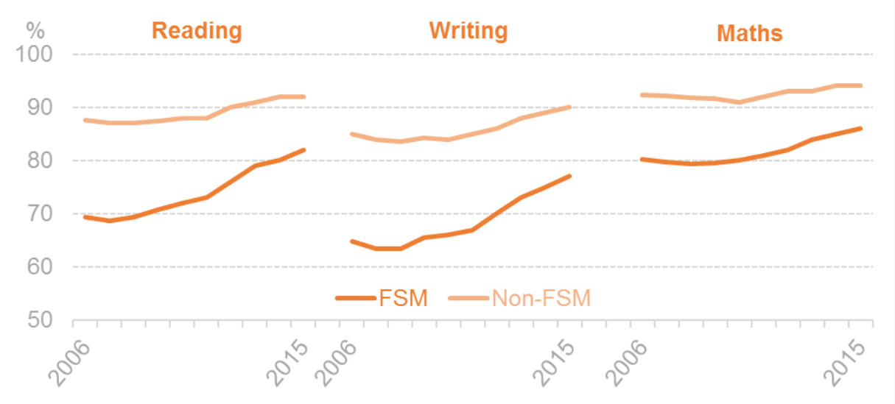
INTENDED FOR:
Reduce disadvantage experiences
Access opportunities
Improve level of attainment
Remove barriers to learning
PUPIL DEVELOPMENT GRANT
Additional funding for children who receive free school meals
Headteacher (2019-2020)
Pupil Development Grant (Cwmtawe Community School 2020)
What's the difference between equity and equality?(Online Public health 2018)
Helping children blow the basic line
Be inclusive, every child should get a free school meal and the same level of teaching
Self- esteem approaches
Practical skills approaches
Emotional resilience approaches
Headteacher (2019-202)
RED
GOOD POINTS:
Receive benefits
Children receive a healthy hot meal
Uniform grants
BAD POINTS
Harsh way of measuring deprivation
Reinforcing inequality
MUD
Redistribute the wealth
Should be universal
S
I
D
(Levitas, cited in Pierson, 2010)
SUPPORT FOR:
Interventions – language and communication
- numeracy
- behaviour/emotional
Staff - well- being officer
- teaching assistants
- early years
Skills week - outdoor learning and developing
Family engagement – working alongside school
Sharing good practices – staff training
(Levitas, cited in Pierson, 2010)
(Levitas, cited in Pierson, 2010)
Perentage of childen achieving level 2 in key stage 1
Bronfrenbrenner
"Helps teachers understand the importance of fostering positive relationships with children and their families to support the child's development"
Headteacher(2019-2020)
Maslow
"An individual's respone to learning is dominated at any given moment, whichever need is priority"
A child's rights and development
Mobbs, C. H. (204) In Challenges and difficulties, Epact Kids, Repatriaion, Well-being ad health.
Britian's Social Mobility Crsis in ten graphs. (Channel 4 television cooperation 2020)
(Bates, B. 2019, p. 194)
(Bates, B. 2019, p. 66)

Slide 2
Reference List
Bates, B. (2019 Learninhg Theories Simplified. 2nd Ed. London: SAGE Publications
Channel Four television cooperation (2020) Britian's Social Mobilty Crisis In Ten Graphs. Available at: https://www.channel4.com/news/factcheck/britains-social-mobility-crisis-in-ten-graphs [Accessed:21 August 2020]
Dauncey, M. (2018) Next steps for the Pupil Development Grant. Available: https://senddresearch.blog/2018/04/11/next-steps-for-the-pupildecelopment-grant [Accessed: 17 August 2020]
Headteacher (2019-2020) School Annual Spnd Plan. City and County of Swansea Pupil Dvelopmnt Grant
Mobbs, C.H. (2014) In Challenges and difficulties, Expat Kids, Repatriation, Well-being and health. Available: https:/www./expactchild.com/expact-child-many-layers-influence/ [Accessed: 17 August 2020
Levitas, R. (2005) The inclusive society? Social exclusion and new labour, Basingstoke: Palgrave Macmillian
Pierson, J. (2010) Tackling Social Exclusion. London: Routledge
Pupil Development Grant (2020) Available: https://www.Cwntawe.org/about-us/pupil-development-grant/ [Accessed: 7 August 2020]
School guide UK Ltd (2013-2020) Setting A. Available at: https://www.schoolguide.co.u/schools/-swansea [Accessed: 16 August2020
Online Public Health (2018) What's the difference between equity and equality?Available at: https://onlinepublichealth.gwu.edu/resources/equity-vs-equality/
[Accessed: 16 August 2020]

