Slide 1

Team work
Effective Team working

Slide 2

This Photo by Unknown Author is licensed under CC BY-SA

Slide 3


Objectives
What is a team?
What works as a team?
The effectiveness of a team?
How is a team formed?
This Photo by Unknown Author is licensed under CC BY-NC

Slide 4
What is the definition of a team?
A team is a group of individuals (human or non-human) working together to achieve their goal....Teams normally have members with complementary and several skills and generate synergy through a coordinated effort which allows each member to maximize their strengths and minimize their weaknesses.

Slide 5
Pros of working in a team.
TEACHES CONFLICT RESOLUTION SKILLS
BUILDS TRUST
GOOD COMMUNICATION
CLEAR OBJECTIVES
APPROPRIATE LEADERSHIP
BALANCED ROLES

Slide 6
Cons of working in a team.
DISAGREEMENTS
MISSED DEADLINES
CONFLICT MANAGEMENT
MULTPLE PEOPLE TRYING TO TAKE CHARGE
CERTAIN GROUP MEMBERS MIGHT NOT TAKE OTHER SUGGESTIONS IN TO ACCOUNT

Slide 7
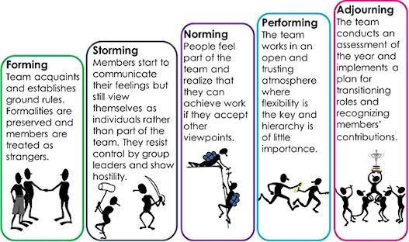
Understanding Stages of team forming
This Photo by Unknown Author is licensed under CC BY

