Slide 1

Effective team working and communication
BMSW4002_BIRM
Strategies for effective communication in a business setting.
Dami Pokubo
Stephanie Whelan (2029726)

Slide 2

Introduction
To improve communication within the project team and Amazon we will outline some strategies that can be applied.
"All organisations regard effective communication as essential for survival. Without communication a business would not exist" (Fielding, 2006).
Notes:
The purpose of this presentation is to improve communication within the project team and Amazon, we will do this by applying some strategies outlined in the presentation.

Slide 3

Benefits of communication
Teamwork is facilitated by effective communication. Having a better understanding of how their work works together with the work of others and how it contributes to the business goals of the team will make your team members feel empowered and ready to act.
Increased revenue
Reduced operation costs
Improved company image
Increased customer loyalty and retention
Improved internal/external communication
Improved customer relationship
Promotes trust
Resolves issues
Enhances team member engagement
Notes:
Benefits of communication
Teamwork is facilitated by effective communication. Having a better understanding of how their work works together with the work of others and how it contributes to the business goals of the team will make your team members feel empowered and ready to act.
How could Tom, the project team and Amazon all benefit from effective communication?
Increased revenue
Reduced operation costs
Improved company image
Increased customer loyalty and retention
Improved internal/external communication
Improved customer relationship
Promotes trust
Resolves issues
Enhances team member engagement

Slide 4
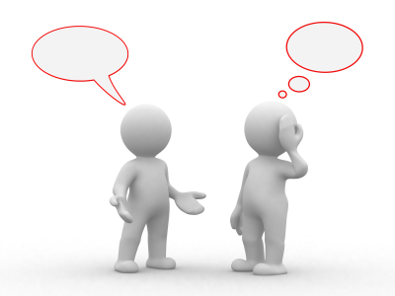
Model of communication
A theory of communication was developed by David Berlo in 1960. Due to its four components; source, message, channel and receiver it is also known as the SMCR model.
A key feature of Berlo's model is the treatment of the message and the channel or medium of distribution, as Rayudu (2009) mentions in his e-book.

Slide 5
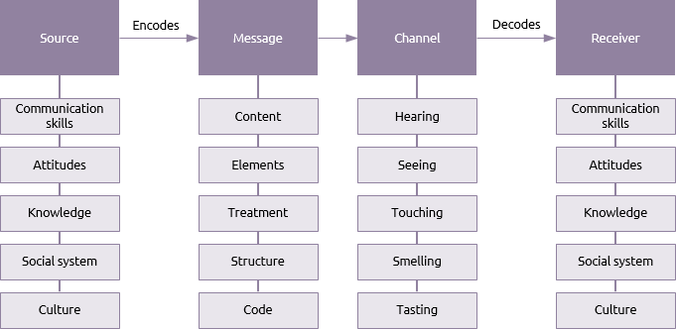
Berlo's Model of communication
Notes:
Message- what is sent by sender that could be a voice, audio, text, video or other media. A message contains
Content -which is the whole message
Elements – nonverbal elements such as gestures and signs
Treatment – the way message is conveyed
Structure - the way it has been structured or arranged
Code- form in which the message is sent.
Channel - medium used to send the message. In interpersonal communication our five senses are important in how we communicate effectively
Hearing – Face to face, phone call, video calls, through sources
Seeing – Face to face, video calls, email, letters
Touching – Holding hands,
Smelling
Tasting
Receiver is the person who gets the message and a receiver must have very good listening skills as well as the following;
Communication skills – ability to speak, write, read and listen.
Attitudes should fit into situation
Knowledge – about the subject
Social Systems – values, beliefs and culture
Culture - Cultural differences make messages different

Slide 6

Communication barriers
When people join forces to accomplish the same goals, they often encounter barriers. It can be a frustrating process to get to know someone when differences are identified and dealt with because individuals differ in terms of their backgrounds, experiences, moods, and expectations (Quill 1995).

Slide 7
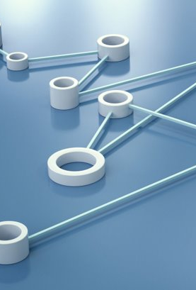
There are specific items that can prevent effective communication within an organisation such as:
National Culture
Language
Defensiveness
Filtering
Emotions
Information Overload

Slide 8
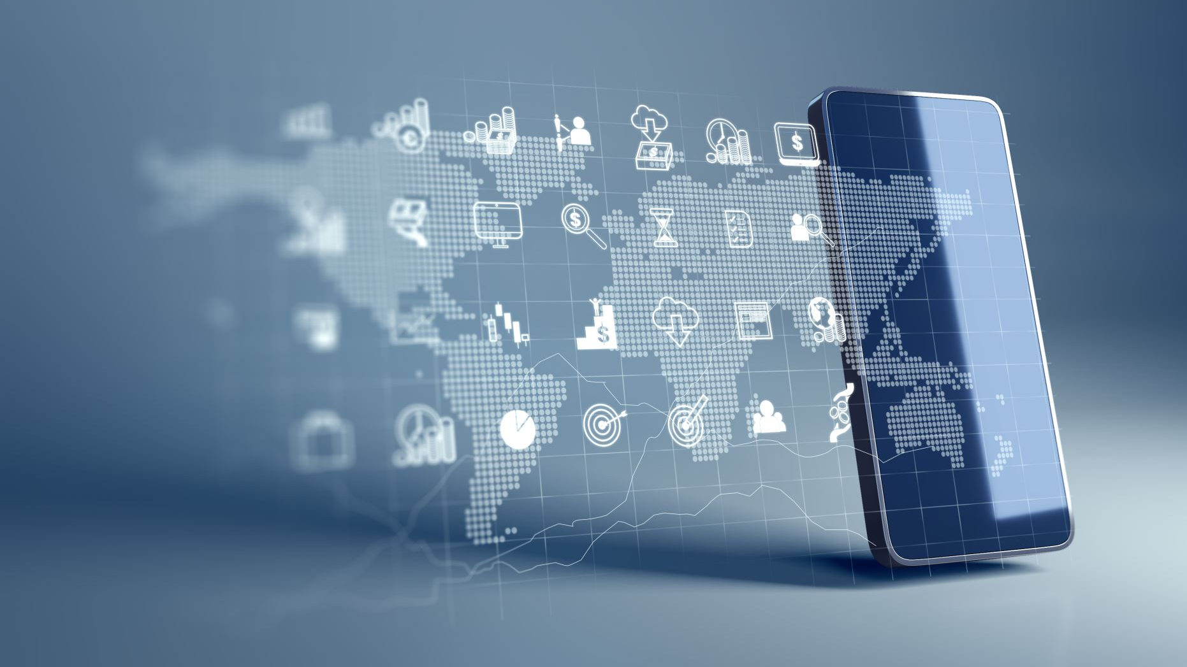
Channels of Communication
Communication channels refer to the "pipe" along which a message is delivered, and there are many types of channels available, from face-to-face conversations to telecommunications such as telephones and e-mails as well as computational channels (Coiera, 2006).
Essentially, communication channels are media through which a message is conveyed to its intended audience. All forms of communication, including phone calls, text messages, emails, video, radio, and social media, are communication channels.
It is possible for a channel to be a low-richness channel or a high-richness channel, based on its capacity to convey information.
Notes:
Communication channel means the medium or media through which the message
passes

Slide 9
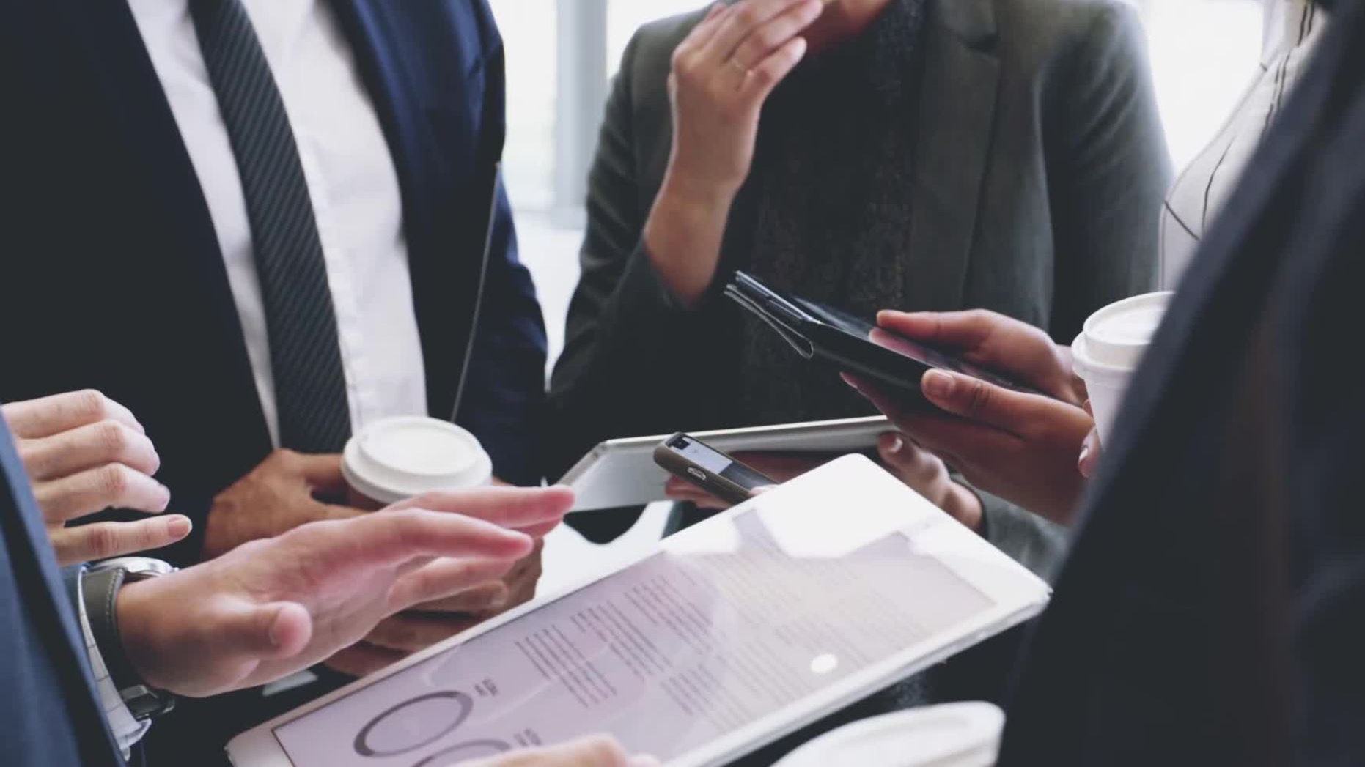
Channels of communication can then be improved by:
Prioritising face-to-face communication and video conferences
Encouraging Mobile, webinar and email for Effective Communication Between the project team.
Introduce online discussion groups.
following for simple steps to improve listening performance: observe, focus, knowledge, respect.
Help your employees understand the business strategy.

Slide 10
Teamwork Evaluation
Teamwork Evaluation ​ | Team responses. ​
Who was in your team? ​ | Stephanie Whelan​
What were the key strengths of your team? ​ | Writing skills​ Organisational skills​ Internet research skills​
What were the challenges that you overcame as a team?​ | Communicating effectively through different methods​ Work allocation​ collaborating​
What would you do differently if you worked as a team again?​ | Ensure every member is willing to work as a team​ Establish a team leader and all agree upon it​ Share workload more evenly​
How would you rate your team working? Out of 10? ​ | 10

Slide 11
References
Aritzeta, A et al (2007) 'Belbin's Team Role Model: Development, Validity and Applications for Team Building', Journal of Management Studies, 44, pp. 96-118. https://doi.org/10.1111/j.1467-6486.2007.00666.x (Accessed 1 December 2022).
Coiera, E. (2006) 'Communication systems in healthcare', Clinical Biochemist Reviews, 27(2), p.89.
Fielding, M. (2006) Effective communication in organisations. Juta and Company Ltd.
Rayudu, C., (2009) 'Communication', Global Media, Mumbai. Available at: ProQuest Ebook Central. (Accessed: 1 December 2022).
Quill, T. (1995) 'Barriers to effective communication', In The medical interview, pp. 110-121 Springer, New York, NY.

