Slide 1


Recruitment and Selection During Organisational Transformation
River Island: Supporting Business Transformation Through Effective Recruitment
Student Name: Kiran Rehman
Student Number:2437752
Module Code and Title Developing and Managing Individuals and Teams
Lecturer Name: Samson Oladejo

Slide 2

Contents page:
River Island Transformation Overview
PESTLE Analysis
Recruitment Process Overview
Job Analysis
Job Description & Person Specification
Advertising and Attraction Methods
Structured Interview
Competency-Based Interview
Assessment Centre
Questioning Techniques
Face-to-Face vs Virtual Interviews
Recommendations
Conclusion
References

Slide 3
Introduction: River Island Transformation
The UK fashion retailer was established in 1948
Operates stores across the UK and internationally
Competes within a highly digital and fast-changing retail market
Current Transformation
Increased digitalisation of retail operations
Expansion of e-commerce capabilities
Investment in data-driven decision making
improved customer experience strategies
Supply chain and operational improvements
Key Roles Required
(Armstrong and Taylor, 2023)
About River Island
Role | Purpose
Project Manager | Deliver transformation projects
Change Manager | Manage employee transition
Digital Specialist | Support digital innovation
Operations Manager | Improve efficiency
Financial Analyst | Monitor project performance

Slide 4

Factor | Impact on River Island
Political | Employment legislation and minimum wage changes
Economic | Inflation and cost-of-living pressures affecting labour market
Social | Demand for flexible and hybrid working
Technological | Growth of AI, automation and digital retailing
Legal | Equality Act 2010 and GDPR compliance
Environmental | Sustainability expectations from customers and employees
PESTLE Analysis
External Factors Affecting Recruitment During Transformation
Implication
Recruitment strategies must attract candidates with digital skills while ensuring legal compliance and organisational sustainability.
(Johnson et al., 2020)

Slide 5

Recruitment Process Overview
Recruiting the Right Candidate
Workforce planning
Job analysis
Job description
Person specification
Advertising vacancies
Shortlisting
Interviewing
Selection decision
Onboarding
Why It Matters
Reduces recruitment risk
Improves quality of hire
Supports transformation objectives
(Bratton et al., 2021)

Slide 6

Job Analysis
Change Manager
Benefits
Clarifies role expectations
Supports fair selection
Identifies required competencies
(CIPD, 2024)
Area | Requirements
Duties | Lead organisational change initiatives
Skills | Communication, leadership, stakeholder management
Knowledge | Change management frameworks
Experience | Previous transformation projects

Slide 7
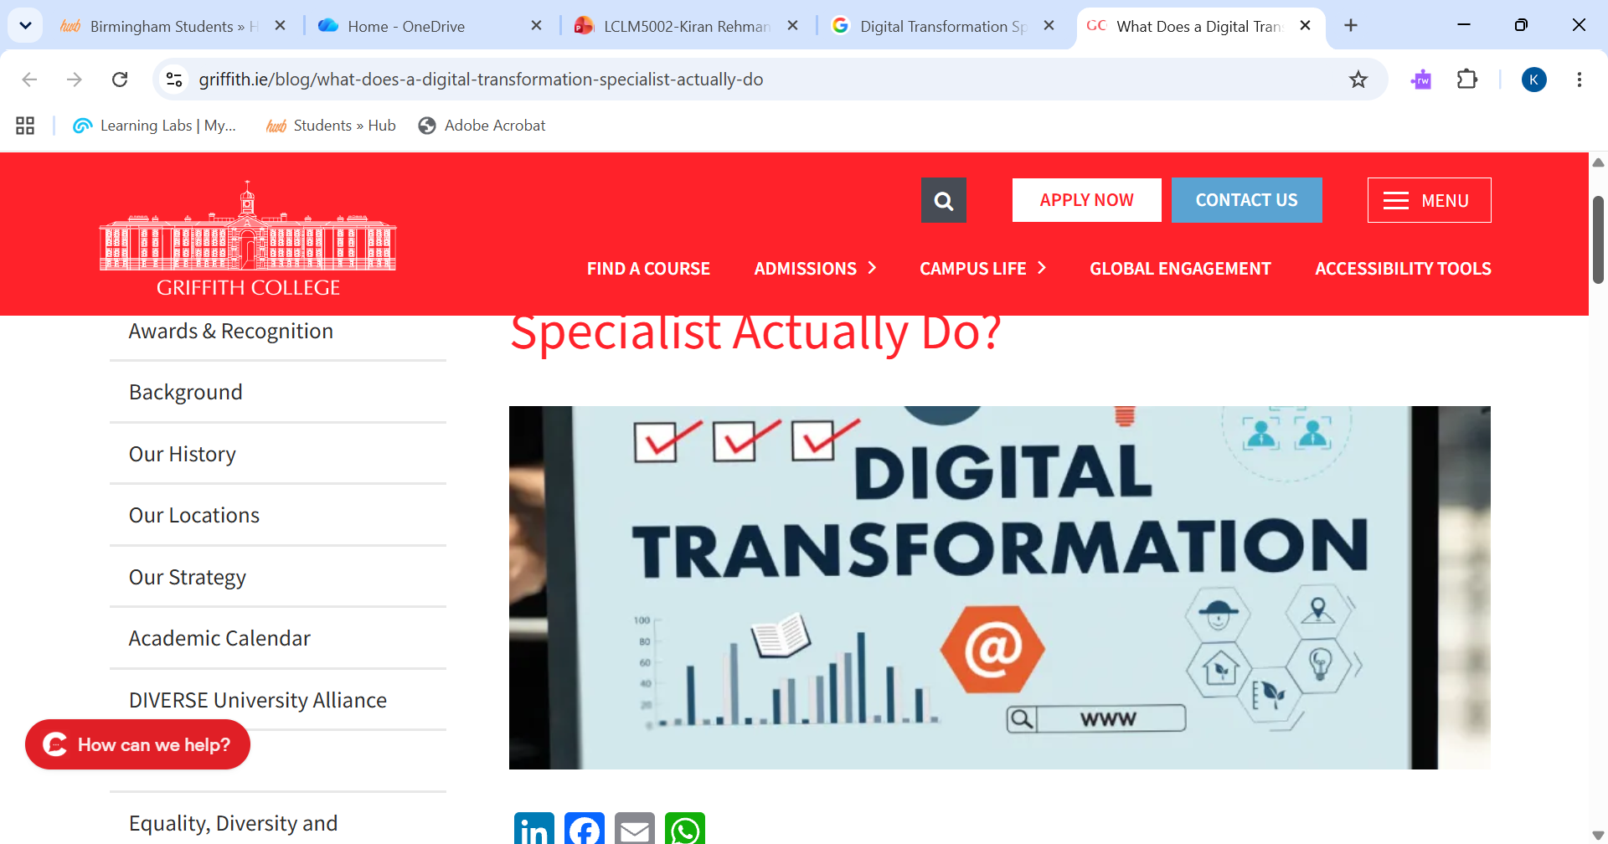

Job Description and Person Specification
Job Description
Position: Digital Transformation Specialist
Key Responsibilities
Implement digital solutions
Support technology adoption
Train employees on new systems
Person Specification
(Torrington et al., 20
Essential | Desirable
Degree in IT/Business | Retail experience
Digital transformation experience | Agile certification Release small improvements every few weeks, gather feedback and adjusts accordingly.
Communication skills | Project management knowledge

Slide 8
Interview Type 1: Structured Interview
What Is It?
All applicants are asked the same questions in the same order.
Advantages
Fair and consistent
Easier comparison of candidates
Reduces bias
Suitable Roles
Financial Analyst
Operations Manager
Limitation
Less flexibility to explore responses
(Dessler, 2020)

Slide 9

Interview Type 2: Competency-Based Interview
What Is It?
Evaluates behaviours demonstrated in previous situations.
Example Question
"Describe a time you successfully managed resistance to change."
Advantages
Strong predictor of future performance
Assesses key competencies
Suitable Roles
Change Manager
Project Manager
STAR Technique
Situation → Task → Action → Result
(Armstrong and Taylor, 2023)

Slide 10
Interview Type 3: Assessment Centre
Components
Group exercises
Presentations
Case studies
Interviews
Advantages
Suitable Roles
Senior Managers
Digital Transformation Specialists
(Wood and Payne, 2017)
Benefit | Explanation
Realistic assessment | Simulates workplace challenges
Multiple assessors | Improves objectivity
Comprehensive evaluation | Assesses various competencies

Slide 11

Advertising and Attraction Methods
Recruitment Channels
Recommendation
Use a multi-channel strategy to attract diverse talent during transformation.
(CIPD, 2024)
Method | Advantages
LinkedIn | Access to professional candidates
Company Website | Strengthens employer brand
Reed.co.uk | Large UK talent pool
Indeed | High visibility
Recruitment Agencies | Specialist expertise

Slide 12

Technique | Example
Behavioural | "Tell me about a time you led change."> this will show us how capable the individual is and how they lead a task.
Situational | "How would you respond to employee resistance?" > this will show us how effectively they respond to situations.
Competency-Based | "Describe your stakeholder management experience."> this will help highlight the skills they have and show how well suited they are for the role.
Probing | "Can you explain your specific contribution?". This will help gather precise evidence of skills, understand their thought process and action.
Questioning Techniques:
Recommended Techniques:
Justification
These techniques help identify:
Leadership capability
Adaptability
Problem-solving skills
Change management competence
(Marchington et al., 2021)

Slide 13

Face-to-Face vs Virtual Interviews
Recommendation
A hybrid recruitment approach should be adopted.
Virtual: Initial screening
Face-to-Face: Final-stage assessment
(CIPD, 2024)
Criteria | Face-to-Face | Virtual
Cost | Higher | Lower
Candidate Reach | Local | Wider talent pool
Flexibility | Lower | Higher
Relationship Building | Stronger | Moderate
Non-Verbal Communication | Easier to assess | More limited

Slide 14

Recommendations and Conclusion
Key Recommendations
✓ Conduct thorough job analysis
✓ Use competency-based recruitment
✓ Combine structured interviews and assessment centres
✓ Apply behavioural and situational questioning
✓ Adopt a hybrid interview strategy

Slide 15

Conclusion:
River Island's transformation success depends on attracting and selecting employees who possess the technical expertise, adaptability and leadership skills needed to support organisational change. A structured and fair recruitment process will improve workforce capability and contribute to long-term business performance.

Slide 16

Reference List
Armstrong, M. and Taylor, S. (2023) Armstrong's Handbook of Human Resource Management Practice. 16th ed. London: Kogan Page.
Bratton, J., Gold, J., Watson, S. and Pattie, M. (2021) Human Resource Management. 7th ed. London: Palgrave Macmillan.
Chartered Institute of Personnel and Development (CIPD) (2024) Recruitment Factsheet. London: CIPD.
Chartered Institute of Personnel and Development (CIPD) (2024) Selection Methods Factsheet. London: CIPD.
Dessler, G. (2020) Human Resource Management. 16th ed. Harlow: Pearson.
Foot, M. and Hook, C. (2022) Introducing Human Resource Management. 9th ed. Harlow: Pearson.
Johnson, G., Whittington, R., Scholes, K., Angwin, D. and Regnér, P. (2020) Exploring Strategy. 12th ed. Harlow: Pearson.
Marchington, M., Wilkinson, A., Donnelly, R. and Kynighou, A. (2021) Human Resource Management at Work. 7th ed. London: CIPD.
Mullins, L.J. and Christy, G. (2022) Management and Organisational Behaviour. 13th ed. Harlow: Pearson.
Pilbeam, S. and Corbridge, M. (2019) People Resourcing and Talent Planning. 7th ed. Harlow: Pearson.
River Island (2024) Annual Report and Corporate Information.
Taylor, S. (2021) Resourcing and Talent Management. 8th ed. London: CIPD.
Torrington, D., Hall, L., Taylor, S. and Atkinson, C. (2023) Human Resource Management. 12th ed. Harlow: Pearson.
Wood, R. and Payne, T. (2017) Competency-Based Recruitment and Selection. Chichester: Wiley.
Beardwell, J. and Thompson, A. (2023) Human Resource Management. 10th ed. Harlow: Pearson.
Storey, J. (2019) Human Resource Management: A Critical Text. 5th ed. London: Routledge.

