Slide 1
Module Introduction to Physiology
Module code: BMHP5003_BIRM
Lecturer: Mumtaz Goolam
Assignment Title: Individual Academic Poster (Respiratory System)
KOLAWOLE OSASUYI OSASUYI STUDENT ID 1815461

Slide 2
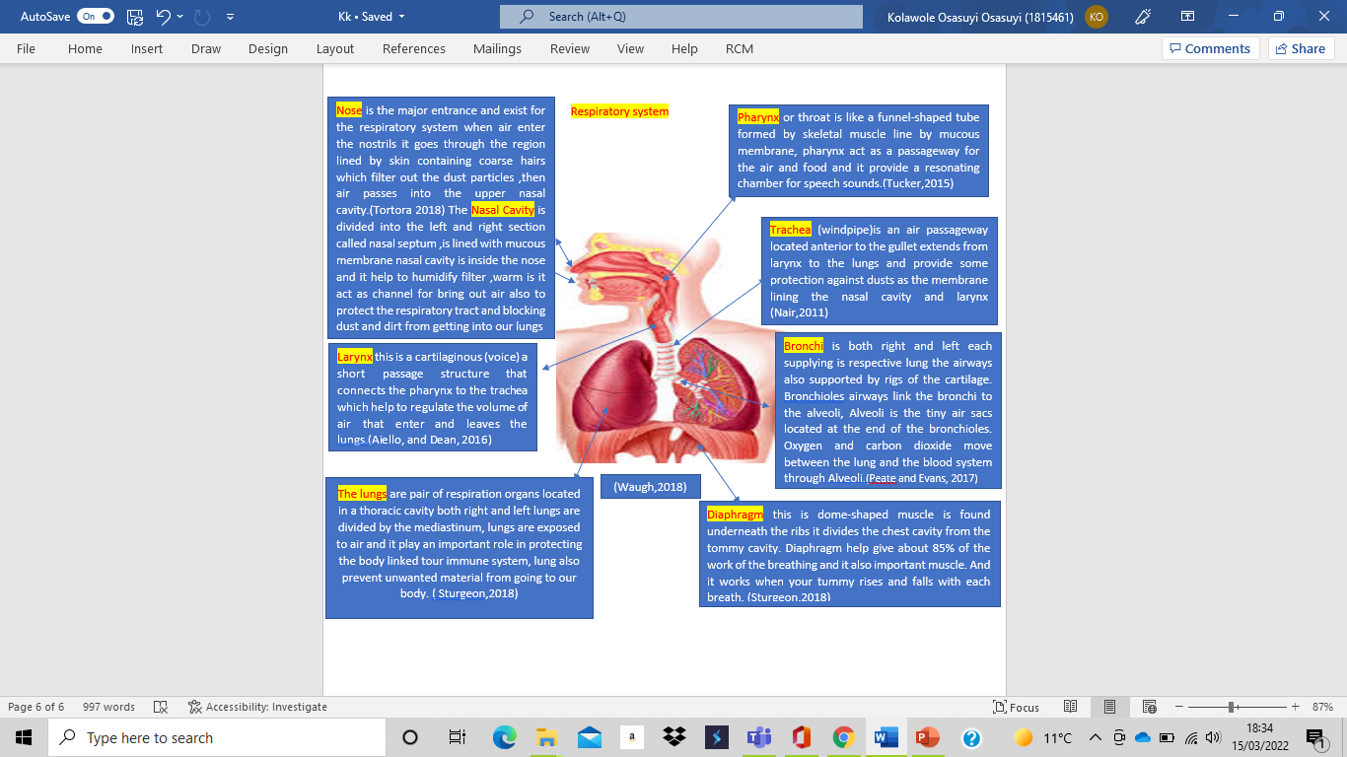

Slide 3
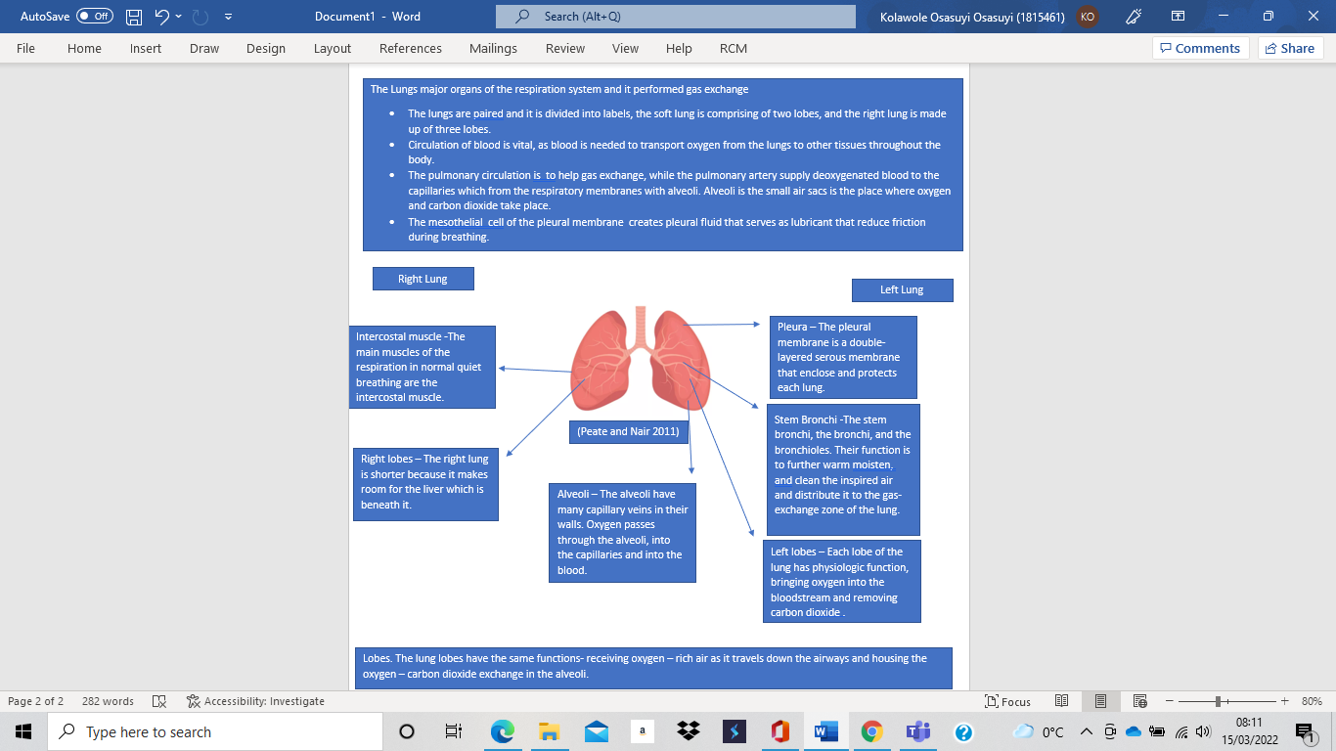

Slide 4
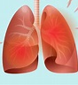
Lungs Major risk factors include:
tobacco smoke
second-hand tobacco smoke
indoor air pollutants
outdoor air pollutants
allergens occupational agents
bacteria, viruses (Taylor Butler.2008)
Lungs Disease
Asthma is lung obstructive disease that inflames and narrow the airway, air move freely through the trachea or windpipe then through the large tubes bronchi and the small tubes called bronchioles and finally into the tiny sacs called alveoli. Bronchioles will expand as the air is temperate, not dry and free of irritants and allergy causing substances called allergens when air is cold or dry or contains irritants or allergens the bronchioles contract. If person have asthma the Airways are frequently inflamed and swollen certain substances can cause the inflamed Airways to overreact which lead to asthma attack. Everyone is Triggers by asthma attacks in a different ways f but mostly this include irritants' outdoor and pollen allergens such as smoke, pollution, and cold weather indoor irritants and allergens also respiratory infections stress strong emotions and exercise. The symptoms of an asthma attack include coughing wheezing shortness of breath and tightness in your chest. During an asthma attack also known as a bronchospasm the muscles around the airways tighten, and the airway wall become more swallow then then airways will also produce mucus that narrow them even more making it difficult to breath. (Waugh, 2018)
Recommendation
Preventing individuals from making the first move to smoke tobacco and persuade smokers to quit or reduce smoking Prevention of respiratory disease entails strengthening healthcare systems, using well institute guidelines for promoting health and disease prevention, medical personnel, training and educating the populace
Proper dietetics and physical activities are vital for health. Both obesity and malnutrition contribute to respiratory diseases.
Asthma medication need to be taking regularly as prescribed the doctors
Action plan for asthma patients most be strictly followed
To the demand for the public health the government and other professional organization must be well prepared to meet the of people.
COMMON SYMPTOM OF ASTHAM
Coughing : continue cough
Chest tightness: or like stabling pain in the chest
Wheezing sound of whistling when breathing
Breathlessness: difficult in take deep breath
Treatment of Asthma
Inhaled corticosteroids, is one of the best to keep asthma attack under control
Quick relief inhaler, like albuterol are this is used for quick use to open the airway for easy breathing (Taussing et al, 2018)

Slide 5
Aiello, L. & Dean, C. (2016) An introduction to human evolutionary anatomy. 3rd Ed. London: Academic Press.
Sturgeon, D. (2018) Introduction to Anatomy and Physiology for Healthcare Students. Taylor & Francis Group.
Tucker, L. (2015) An introductory guide to anatomy & physiology. 5th Ed. London, [England] : EMS Publishing.
Taylor-Butler, C. (2008) The Respiratory System. New York : Children’s Press
Tortora, G. & Derrickson, B. (2014) Introduction to the human body. 3rd Ed. New York: harper Collins.
Taussig. L, Landau. L, and Le Souef , P. (2008). Paediatric Respiratory Medicine. Philadelphia: Mosby Elsevier
Nair, M. (2011) Fundamentals of anatomy and physiology for student nurses. 5th Ed. Chichester, West Sussex, U.K.: Wiley-Blackwell.
Peate, I. & Evans, S. (2017) Fundamentals of Anatomy and Physiology for Nursing and Healthcare Students. 3rd Ed. London: Wiley Blackwell.
Waugh, A. (2018) Ross and Wilson Anatomy and Physiology in Health and Illness. 13th Ed. Amsterdam: Elsevier - Health Science.
Reference

