Slide 1
Presentation
Student ID: 2439738
Name: Bernice Gyedu
Lecturer: Kennedy Obohwemu
Module: Psychology in Health and Social care
Module code: Lch4001

Slide 2
Vygotskys Theory
Vygotsky developed the Sociocultural Theory of development, which highlights the importance of social interaction, culture, and language in children's learning and development. Vygotsky believed that children do not learn independently, instead, they develop knowledge and skills through interactions with parents, caregivers, teachers, and peers. According to the theory, learning occurs first through social experiences and is then embraced by the child.

Slide 3
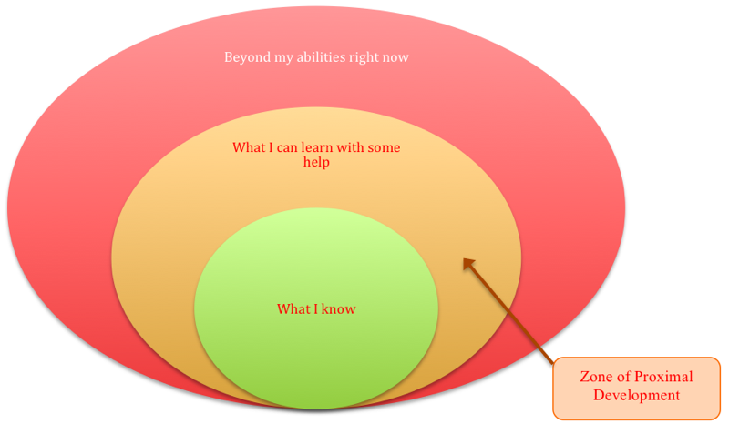
Key concept
According to Lev Vygotsky (1978), children's cognitive development is strongly influenced by social interaction and cultural experiences, with learning occurring through engagement with parents, carers, teachers, and peers who support the development of knowledge and skills; a key concept of his theory is the Zone of Proximal Development (ZPD), which refers to the difference between what a child can achieve independently and what they can achieve with guidance from a more knowledgeable person; another important concept is scaffolding, where temporary support is provided to help a child complete tasks and gradually withdrawn as his ability to do it independently increases; Vygotsky also identified the More Knowledgeable Other (MKO), such as a parent, teacher, or skilled peer, who facilitates learning by modelling behaviors and providing guidance; additionally, he emphasized that language plays a central role in cognitive development because it enables communication, problem-solving, and the adaption of knowledge; therefore, Vygotsky argued that children's learning and development are socially constructed through interaction, collaboration, and participation within their cultural environment, highlighting the importance of relationships and communication in early childhood development (Vygotsky, 1978).

Slide 4
Developmental assumptions
According to Lev Vygotsky (1978), cognitive development is fundamentally a social process in which children actively construct knowledge through interactions with more educated individuals within their cultural environment, and he assumed that learning does not occur in isolation but is shaped by social relationships, communication, and shared experiences; Vygotsky believed that children acquire new skills and understanding through guided participation with adults and peers, with learning often preceding development rather than simply resulting from it, meaning that appropriate support can help children achieve higher levels of thinking than they could independently; he also assumed that language is the primary tool for intellectual growth because it enables children to communicate, solve problems, organise their thoughts, and gradually internalise cultural knowledge and values; furthermore, he argued that development is influenced by the specific cultural context in which a child is raised, as different societies provide different experiences, expectations, and learning opportunities; therefore, children's cognitive abilities are not viewed as developing solely through biological maturation but through meaningful social interaction, collaboration, and support from others, making relationships, culture, and communication essential factors in promoting learning, development, and the acquisition of increasingly complex cognitive skills (Vygotsky, 1978)

Slide 5

Relevance to early childhood
Lev Vygotsky's Sociocultural Theory is highly relevant to early childhood because it emphasizes that young children develop cognitive, language, social, and emotional skills through interactions with parents, carers, practitioners, teachers, and peers, making relationships and communication central to learning and development; the theory suggests that children learn most effectively when they are supported by more knowledgeable individuals who provide guidance, encouragement, and scaffolding, enabling them to achieve tasks that would be difficult to complete independently; this is particularly significant during the early years, as children are rapidly developing essential skills such as language acquisition, problem-solving, self-regulation, and social competence through play and collaborative experiences; furthermore, Vygotsky highlighted the importance of cultural influences and language-rich environments in shaping children's understanding of the world, which aligns closely with early years practice that promotes exploration, communication, and active participation in learning; by identifying the value of guided learning within the Zone of Proximal Development. The theory provides practitioners with practical strategies for supporting children's individual needs and promoting positive developmental outcomes; therefore, Vygotsky's theory stays highly influential in early childhood education because it explains how social interaction and supportive relationships contribute to children's learning and overall development (Berk and Winsler, 1995).

Slide 6
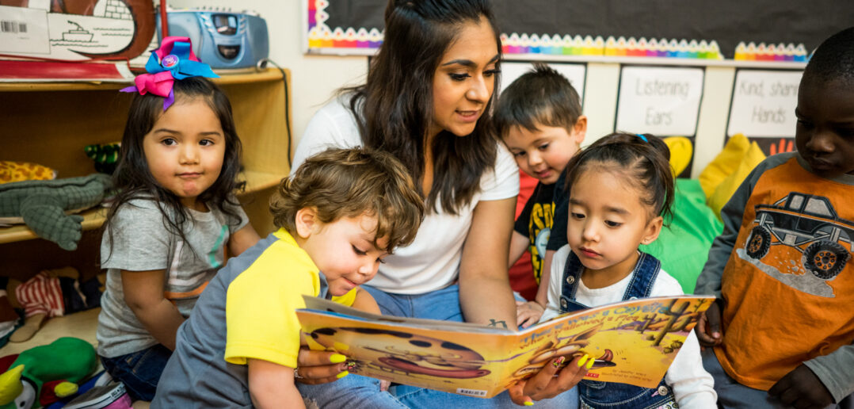
Why is this theory relevant to Isaac's situation
Lev Vygotsky's Sociocultural Theory is particularly relevant to Isaac's situation because it highlights how children's development is shaped by social interactions, relationships, and opportunities for guided learning, all of which appear to have been affected by the challenges Isaac has experienced, including disrupted childcare arrangements, a recent move to a new area, and his mother's post-natal depression and limited social support network; these circumstances may have reduced his opportunities to engage consistently with adults and peers who could support his language, social, and emotional development, which may help explain why he is quiet and withdrawn during free play, struggles to participate in group activities, experiences distress when separated from his mother, and demonstrates delays in language development; Vygotsky argued that children learn best when supported by more knowledgeable others who provide guidance and scaffolding within the Zone of Proximal Development, enabling them to develop skills that they cannot yet achieve independently, and Isaac's difficulties suggest that he may benefit from additional structured support and positive interactions to strengthen his communication skills, confidence, and social engagement; therefore, the theory provides a useful framework for understanding how environmental and relational factors may have influenced Isaac's development and how targeted interventions from practitioners and caregivers can help him achieve positive developmental outcomes (Wood, Bruner and Ross, 1976).

Slide 7
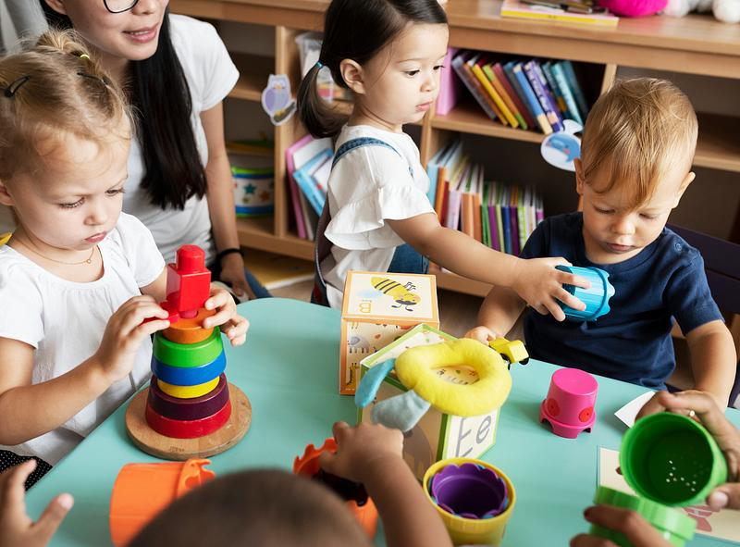
Applying Vygotsky's Sociocultural Theory to Isaac's Experiences
Applying Lev Vygotsky's Sociocultural Theory to Isaac's experiences helps explain how his social, emotional, and language difficulties may have been influenced by the environment and relationships around him, as Vygotsky argued that children's development occurs through meaningful interactions with parents, carers, teachers, and peers who support learning through communication, guidance, and shared activities; Isaac's disrupted childcare arrangements, recent move to London, and his mother's post-natal depression may have limited the consistency of these interactions, reducing opportunities for him to develop language skills, confidence, and social competence through collaborative experiences; his quiet and withdrawn behaviour during free play, reluctance to join group activities, and distress when separated from his mother suggest that he may have had fewer opportunities to engage with more knowledgeable others who could provide the scaffolding needed to support his development; additionally, his language delay may be linked to reduced social communication experiences, as Vygotsky believed that language develops through interaction and is fundamental to cognitive growth; from this perspective, Isaac may benefit from supportive relationships with early years practitioners who can act as more knowledgeable others by modelling language, encouraging participation in play, and providing structured support within his Zone of Proximal Development, enabling him to gradually develop greater independence, communication skills, emotional security, and confidence in social situations (Daniels, 2016).

Slide 8
Considers nurture and nature
Isaac's development can be understood through the interaction of both nature and nurture factors. From a nature perspective, biological influences such as temperament and early brain development may contribute to his behavior and emotional responses. Some children are naturally more cautious, sensitive, or anxious in unfamiliar situations, which may partly explain Isaac's withdrawn attitude, separation distress, and reluctance to engage in group activities. In addition, early brain development plays a significant role in language acquisition, emotional regulation, and social competence, meaning that individual differences in developmental pace may contribute to his language delay and difficulties with independent play (Miller, 2016).
From a nurture perspective, environmental influences appear highly significant in Isaac's situation. His mother's post-natal depression may have affected the consistency and quality of early interactions, reducing opportunities for communication, emotional reassurance, and responsive caregiving. Furthermore, disrupted childcare arrangements and the family's recent move to London may have limited his opportunities to develop stable relationships with caregivers and peers, which are important for social, emotional, and language development. According to Lev Vygotsky, children learn through social interaction and guidance from others, suggesting that reduced opportunities for these experiences may have contributed to Isaac's developmental difficulties (Daniels, 2016). Therefore, Isaac's development is influenced by an interaction between his biological characteristics and the environmental experiences that have shaped his learning, wellbeing, and social development.

Slide 9
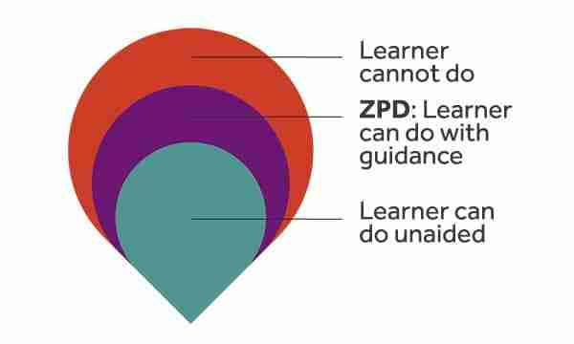
Proposed practical, theory-informed strategies
Drawing on Lev Vygotsky's Sociocultural Theory, several practical strategies can be implemented to support Isaac's development by increasing opportunities for guided learning, social interaction, and communication; a key worker should be assigned to build a consistent and trusting relationship with Isaac, providing emotional security and acting as a More Knowledgeable Other who can model language and social skills; practitioners can use scaffolding techniques by breaking tasks into manageable steps, offering prompts and encouragement, and gradually reducing support as Isaac's confidence grows; small-group play activities should be introduced to help him develop friendships and practise communication in a less overwhelming environment before participating in larger group sessions; language-rich experiences such as storytelling, singing, role play, and shared book reading should be incorporated into daily routines to promote vocabulary development and communication skills; visual timetables and predictable routines may help reduce anxiety and support successful separation from his mother; practitioners should also work closely with Isaac's mother by sharing strategies that encourage play, conversation, and independence at home, creating consistency between home and the early years setting; where necessary, referrals to specialist services such as Speech and Language Therapy can provide additional support, ensuring that interventions are tailored to Isaac's developmental needs and delivered within his Zone of Proximal Development to maximise learning and progress (Berk and Winsler, 1995).

Slide 10
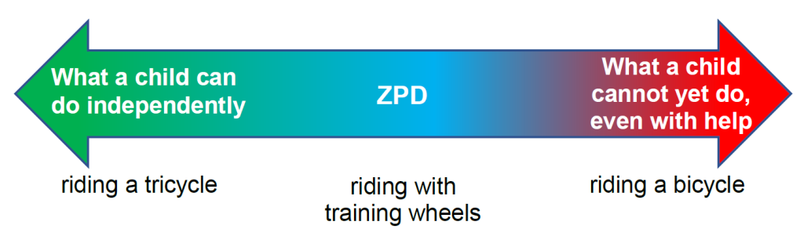
Critically evaluate the theory
Lev Vygotsky's Sociocultural Theory is highly valuable in early years practice because it emphasises the importance of social interaction, language, and guided learning in supporting children's development, providing practical approaches such as scaffolding and the Zone of Proximal Development that practitioners can use to promote learning and inclusion (Daniels, 2016). The theory is particularly relevant in London's diverse communities because it recognises that culture, language, family values, and social experiences influence children's development, encouraging practitioners to adopt culturally responsive approaches that respect children's backgrounds and experiences (Moll, 2014). However, the theory has limitations, as it focuses heavily on environmental and social influences while giving less attention to biological factors such as genetics, temperament, and maturation that may also affect development (Miller, 2016). Additionally, Vygotsky did not provide clear developmental stages, making it difficult to predict age-related changes. Despite these criticisms, the theory stays highly relevant for understanding children's diverse developmental needs and promoting inclusive early years practice.

Slide 11
Reference list
Vygotsky, L.S. (1978) Mind in Society: The Development of Higher Psychological Processes. Cambridge, MA: Harvard University Press.
Wood, D., Bruner, J.S. and Ross, G. (1976) ‘The role of tutoring in problem solving’, Journal of Child Psychology and Psychiatry, 17(2), pp. 89–100.
Berk, L.E. and Winsler, A. (1995) Scaffolding Children's Learning: Vygotsky and Early Childhood Education. Washington, DC: National Association for the Education of Young Children.
Daniels, H. (2016) Vygotsky and Pedagogy. 2nd edn. London: Routledge.
Miller, P.H. (2016) Theories of Developmental Psychology. 6th edn. New York: Worth Publishers.
Moll, L.C. (2014) L.S. Vygotsky and Education. London: Routle

